Slide 1
CAMCA
DMV Training

Slide 2
DMV COURT WEBSITE
FOR COURT USE ONLY
Colorado.gov/revenue/courts
  Log-In: Courts (case sensitive)
  PW: Law&Order (case sensitive)

Slide 3
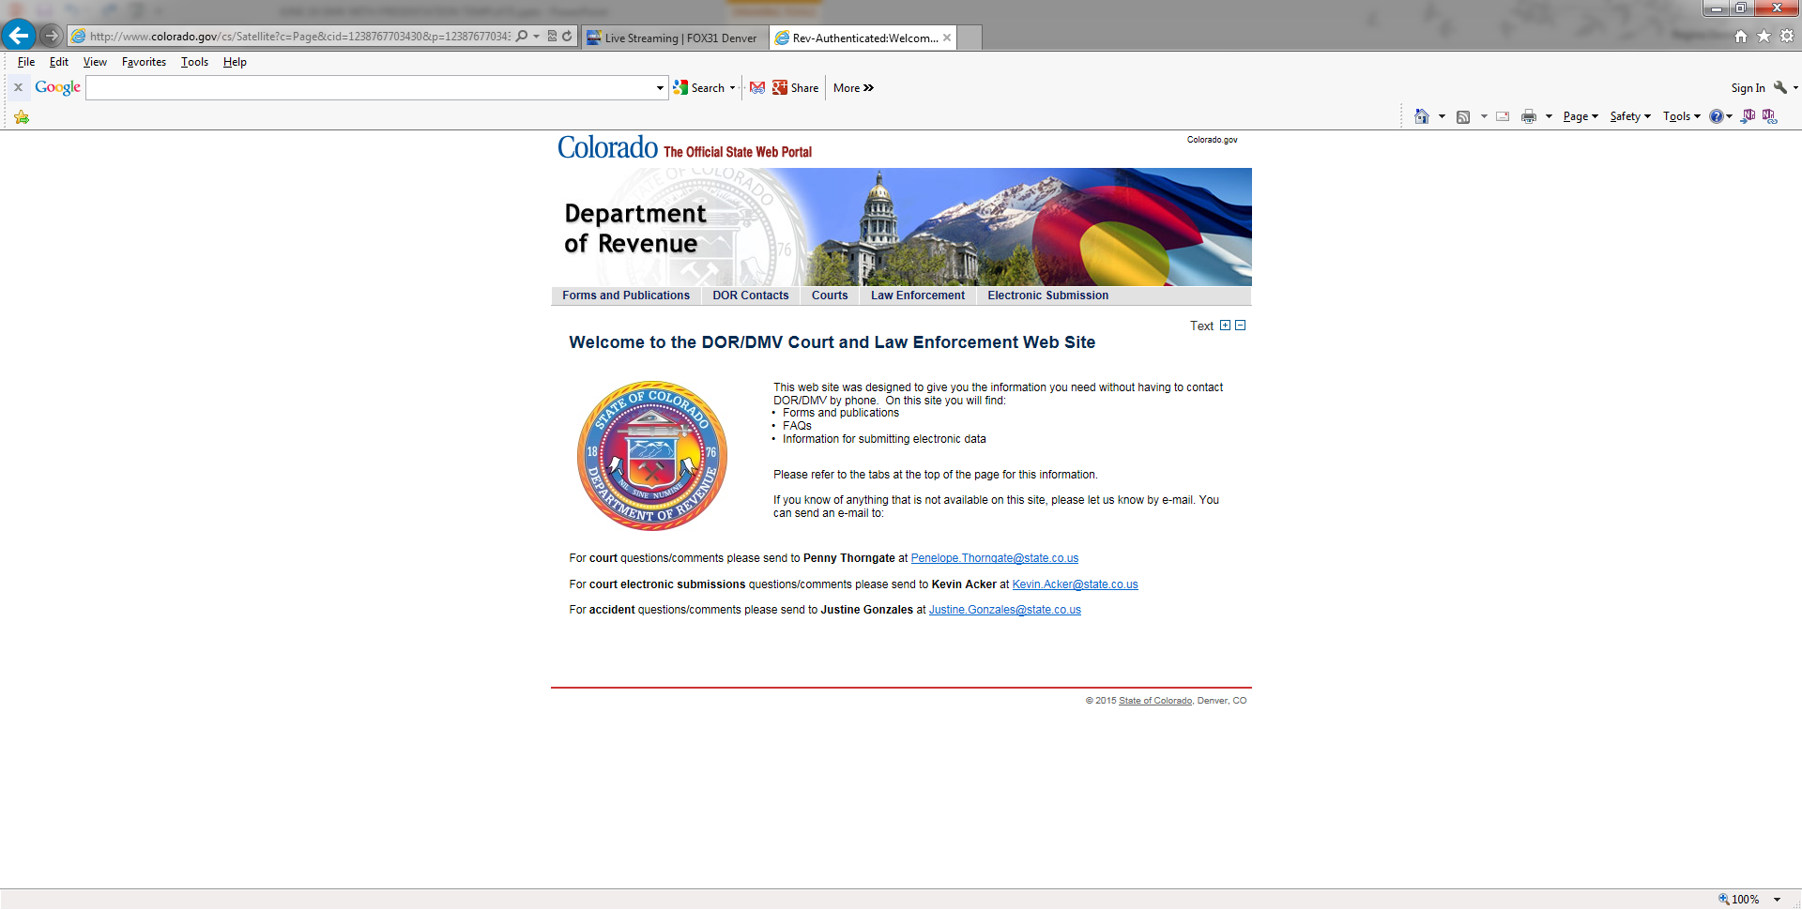

Slide 4
DMV PUBLIC WEBSITE
Colorado.gov/DMV
  Driver’s License Information
  Vehicle Registration Information
  Handicapped Placard Regulations
Lots of good information you can give to defendants

Slide 5
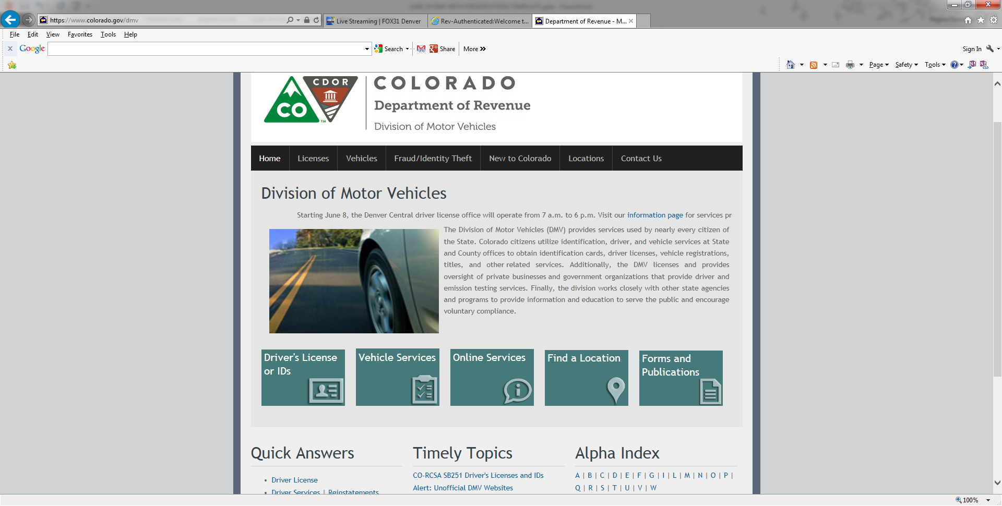

Slide 6
WHAT YOU NEED TO KNOW
BEFORE WE BEGIN
Are some or all of your traffic violations decriminalized?
  If not decriminalized, your court cannot issue default judgments
What title in CRS regulates traffic law, including OJ/W’s and defaults?
Get to know Title _____?
You can find all the statutes regarding OJ/W’s, defaults, points that will be assessed – everything you ever wanted to know about dmv!

Slide 7

WHAT IS AN OJ/W AND WHAT IS A DEFAULT JUDGMENT?
Courtney Clerk

Slide 8
OUTSTANDING JUDGMENT/WARRANT
A/K/A OJ/W

Slide 9
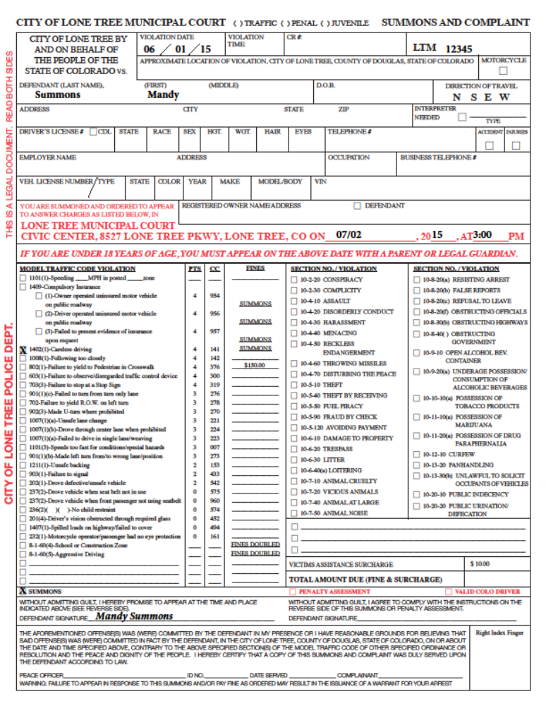
This handout is in your folder

Slide 10
OUTSTANDING JUDGMENT – NO WARRANT ISSUED
DEFENDANT FAILED TO
Ticket Issued
Result
Appear in Court
Filed until can clear OJ/W
Judgment is entered
Pay fine
Complete other sentencing conditions/Court order
OJ/W is issued
$30.00 fee assessed
OJ/W forwarded to DMV
Summons/Mandatory Appearance

Slide 11
OUTSTANDING JUDGMENT
AND WARRANT ISSUED
DEFENDANT FAILED TO
Ticket Issued
Result
Appear in Court
Filed until can clear OJ/W
Bench Warrant is issued
Pay fine
Complete other sentencing conditions/Court order
OJ/W is issued
$30.00 fee assessed
OJ/W forwarded to DMV
Summons/Mandatory Appearance
OJ/WFees are separate from bench warrant & bonding fees

Slide 12
OUTSTANDING JUDGMENT and WARRANT
TRAFFIC AND JUVENILE VIOLATIONS
  Defendant failed to appear in court
  Defendant failed to pay stay on fine and/or did not comply with other court orders; OJ/W and bench warrant are issued
  After defendant appears in court, warrant is cancelled, conviction is reported to DMV
    If defendant previously appeared in court and BW was issued, conviction should have already been reported to DMV
  Clearance is sent to DMV when all fines/costs and other conditions have been met
    However, the Judge can waive costs and order clearance of the OJ/W

Slide 13
An OJ/W can be issued with or without a warrant also being issued
Defendant must appear in court at some time to clear OJ/W
After conviction, transcript will be sent to DMV
If defendant appeared and did not comply with sentence, the court can issue an OJ/W and warrant on a traffic violation or juvenile criminal violation

Slide 14
OJ/W’S WHICH CAN BE REPORTED per CRS 42-4-1709 (7A)IV
These CAN GO ON at any Age:
  TRAFFIC VIOLATIONS
JUVENILE UNDER 18 YEARS OLD
  Any Charge
    Traffic or Criminal
PROVISIONAL OVER 18/UNDER 21 YEARS OLD
    Traffic Violations
    Municipal Code Violations
    Alcohol
    Marijuana

Slide 15
OJ/W’S WHICH CANNOT BE REPORTED per CRS 42-4-1709 (7A)IV
These DO NOT go on at all:
  Bicycles
  Pedestrians
  Parking
  Animals

Slide 16
OJ/W SUBMITTAL PROCESS
Court notifies DMV within 30 DAYS of issuance of outstanding judgment or warrant
ACCEPTABLE FORMS OF NOTICE
  Stamped copy of ticket
  Computer Form
  Electronic – Please talk with DMV for information on electronic reporting
$30 OJ/W fee is added to court fines and costs
DL cannot be renewed until all fines, fees, including $30 OJ/W fee are paid to the court
  However, the Judge can waive/clear the OJ/W without payment being made

Slide 17
DMV PROCESS AFTER COURT SUBMITTAL
DMV will send a letter to defendants giving them a certain number of days (45) to submit proof of compliance or their driver’s license will be cancelled and their driving privilege will be denied
This will show as a cancel and deny on their driving history
They will have to pay the re-instatement fee if the deadline is not met.

Slide 18
OJ/W CLEARANCE PROCESS
Mail Clearance to DMV –OJ/W Cleared
Stamped copy of ticket
  Computer Form
  Electronic
  Fax if time is a factor
    DMV requests we only fax when absolutely necessary due to the high volume

Slide 19
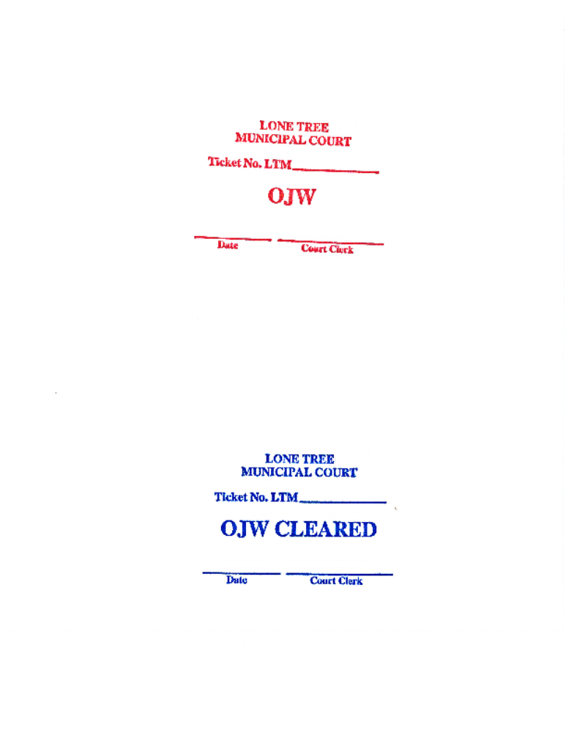

Slide 20
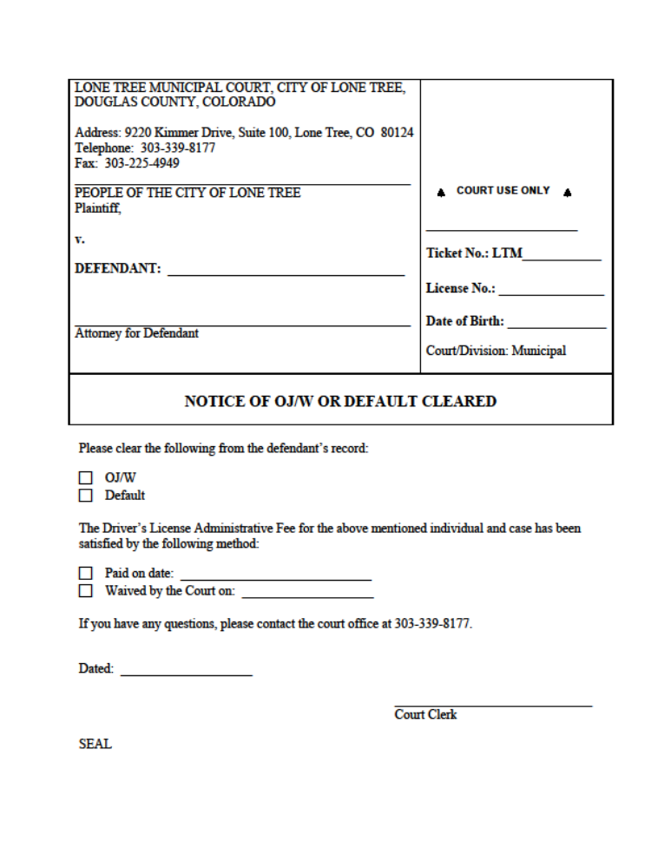

Slide 21
DEFAULT JUDGMENTS
a/k/a unpaid referee

Slide 22
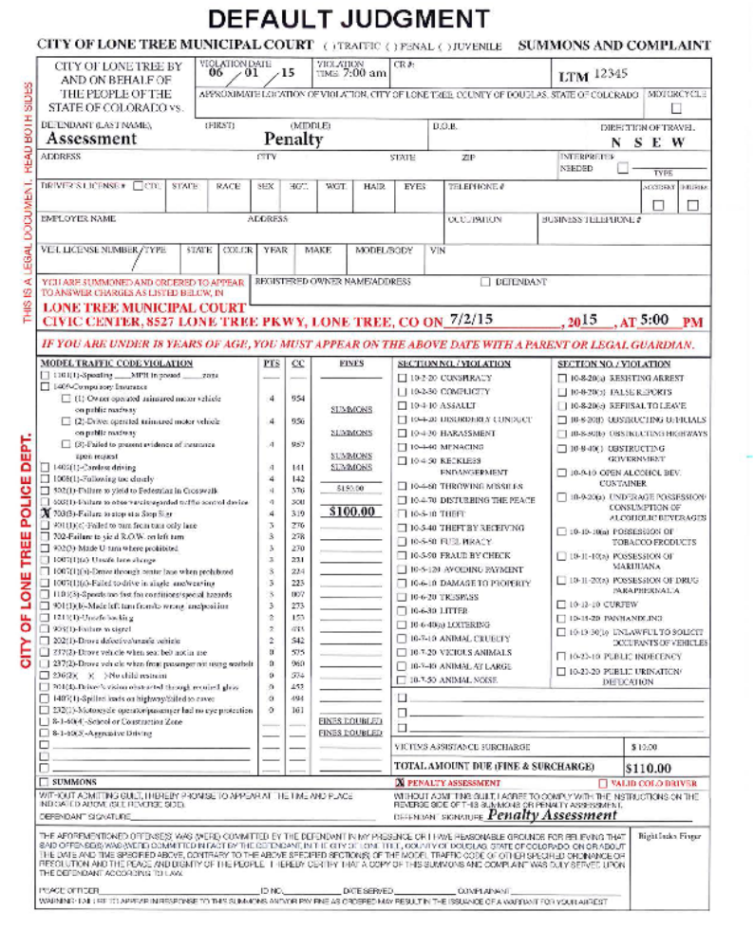
Handout is in your folder

Slide 23
DEFAULT JUDGMENT – UNPAID REFEREE
Traffic Infractions Only
  Jail cannot be a possible sentence
All criminal rights do not apply
Basically a civil matter
Same concept as Small Claims Court – if one party does not appear, the other party wins the judgment by default
If your court is not decriminalized, you cannot issue default judgments

Slide 24
DEFAULT JUDGMENT
DEFENDANT FAILED TO
Ticket Issued
Result
Appear in Court
Filed until can clear OJ/W
Default Judgment is issued
Pay fine
$30.00 fee assessed
Default forwarded to DMV
Penalty Assessment
DMV will access points and put hold on license
Traffic Infraction
Can pay fine or appear in court
Do not send in conviction transcript

Slide 25
Similar to the OJ/W process except default judgments can only be entered on traffic infractions
The defendant is found guilty by default for failure to pay or appear
A default judgment is issued and notification is sent to DMV
$30 fee added
Conviction and points added to DL history by DMV
Payment of fines and fees must be made before renewal or issuance of DL

Slide 26
DEFAULT JUDGMENT SUBMITTAL PROCESS
Court notifies DMV within 30 DAYS of issuance of default judgment
ACCEPTABLE FORMS OF NOTICE
  Stamped copy of ticket
  Computer Form
  Electronic
$30 OJ/W fee is added to court fines and costs
DMV will enter the conviction and points on the defendant’s driving history
DL cannot be renewed until all fines, fees and $30 OJ/W fee are paid to the court
  However, the Court can waive/ clear the OJ/W without payment being made

Slide 27
DMV will send a letter to defendants giving them a certain number of days (45) to submit proof of compliance (default paid) or their driver’s license will be cancelled and their driving privilege will be denied
This will show as a cancel and deny on their driving history
They will have to pay the re-instatement fee if the deadline is not met

Slide 28
DEFAULT JUDGMENT PAID
Mail Clearance to DMV – Default Paid
  Stamped copy of ticket
  Computer Form
  Electronic
  Fax if time is a factor
    DMV requests we only fax when absolutely necessary due to the high volume

Slide 29
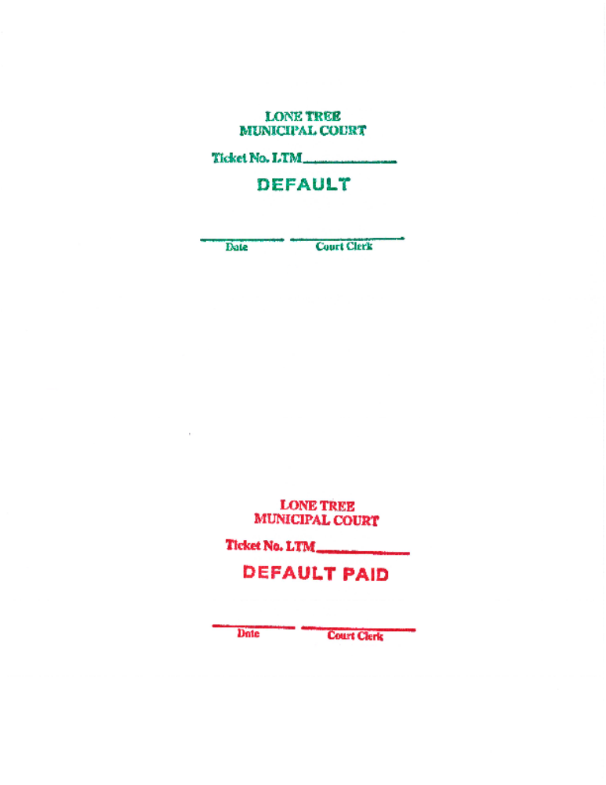

Slide 30



Slide 31
DMV RULES FOR DEFAULT JUDGMENTS
  Copy of summons must be clearly marked OJ/W (the court may also use a computer generated form)
  Copies musts be legible
  More than one summons per driver may be marked OJ/W
  Trim copies of summons
  No non-traffic charges except juveniles under 18 (except certain substance abuse violations)
  Only one OJ/W per case at any given time. If an OJ/W is cleared and then another warrant or judgment is issued, then a new OJ/W can be sent to DMV

Slide 32
CRS –OJ/W
C.R.S. 42-4-1709 (7) (a) no one can renew or have a driver’s license issued if the following exists
  an outstanding judgment for failure to pay penalty for traffic infraction
  an outstanding judgment for violating a state statute or municipal ordinance
  a bench warrant issued for violation of traffic offense (state statute or municipal ordinance)
  a bench warrant for failure to appear for any violation by a juvenile under 18 YOA

Slide 33
QUARTERLY PAYMENTS FOR FEES COLLECTED ON OJ/W’S & DEFAULTS
Every quarter, each court in Colorado required to to submit payment to DMV for $15.00 (½) for OJ/W fees collected during the quarter
The court keeps $15.00 (½) of the OJ/W fees collected during the quarter

Slide 34
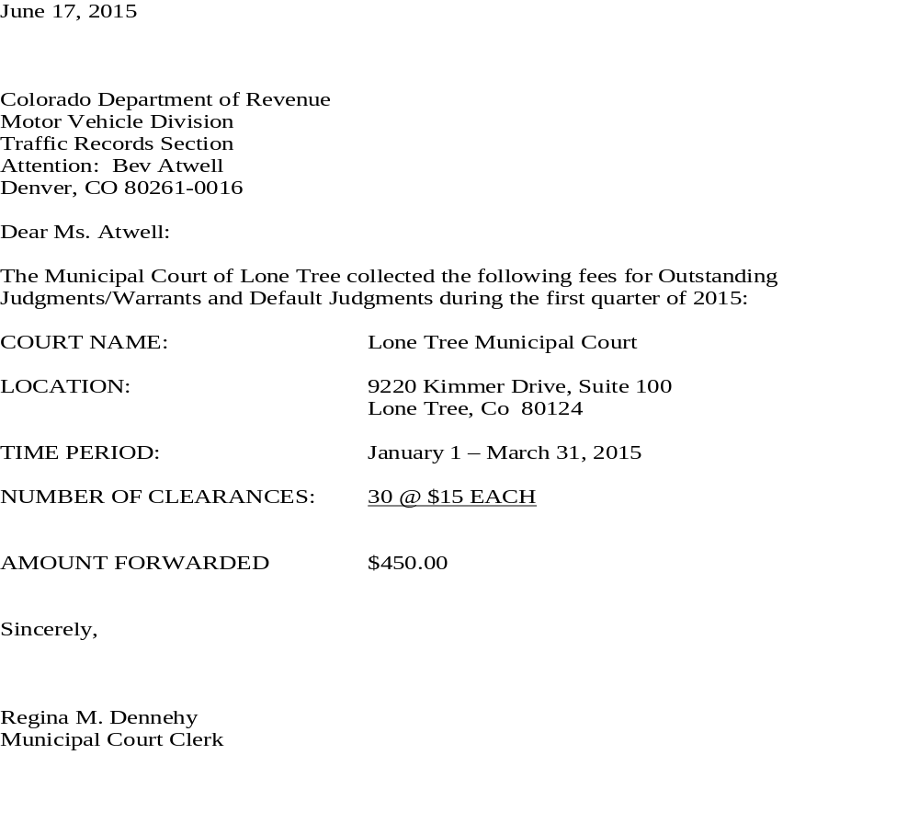

Slide 35
SUMMARY
Penalty Assessment/Traffic Infraction
Defendant can pay the fine or appear in court
Default Judgment is issued if defendant does not pay or appear
DMV will enter violation and points on driving history
Court does not report conviction when fine/costs are paid (DMV already took care of that step).

Slide 36
CORRECTING OJ/W or DEFAULT JUDGMENT ERRORS
If you made an error, such as sending in an OJ/W or Default by mistake, you can send a
VACATE OJ/W OR
VACATE DEFAULT JUDGMENT
Notification to DMV
This will stop a pending cancel/deny action

Slide 37
THIS PORTION IS COMPLETED, LETS TAKE A BREAK!!

Slide 38

SUSPENSION
  Takes the driving privilege away for a length of time – 1 day to 1 year on points
  Upon reinstatement, the driver gets a free re-issue IF the license is surrendered to the department after the person reinstates their driving privilege
  If the license if not surrendered the driver must purchase a new license.

Slide 39
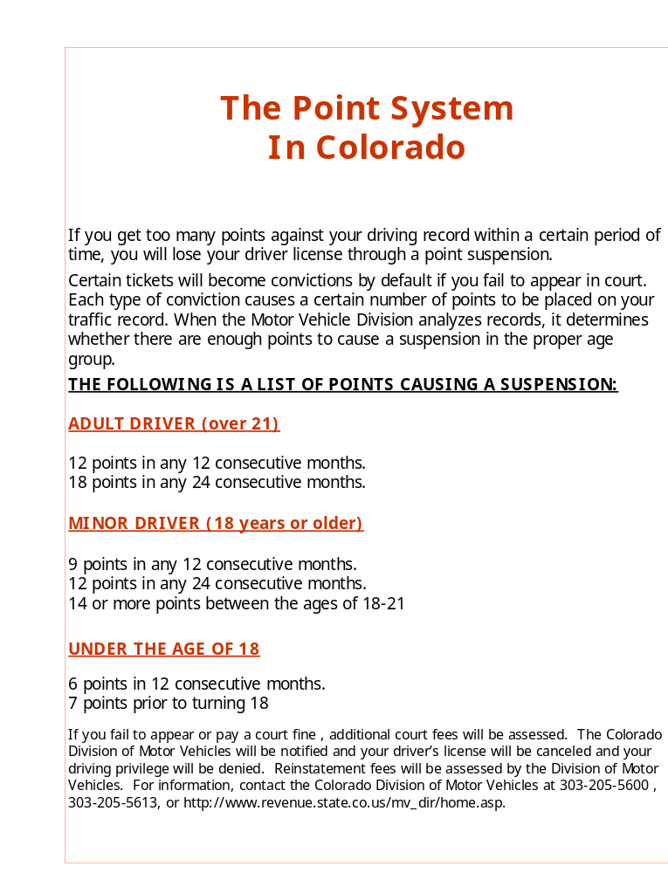

Slide 40
REVOCATION
  Takes the driving privilege for a specific length of time
  Driver must take both the written and driving test

Slide 41
CANCEL & DENY
Uncleared OJ/W’s and Default Judgments will result in DMV issuing a Cancel/Deny
  DMV will send the letter with the deadline to comply before the license is cancelled
The driver has to get their license reinstated because in addition to license being cancelled, their driving privilege was denied
Must pay reinstatement fee
Must provide proof of insurance
Driver has to get a new license
If license expired for more than one year, must take driving and written tests

Slide 42

  EXTRA CREDIT
  Motor Vehicles is a division of which department?

Slide 43


FAST FACT
YOU CAN RENEW YOUR DRIVER’S LICENSE ANYWHERE IN THE STATE.
LICENSE PLATES MUST BE RENEWED IN THE COUNTY IN WHICH YOU RESIDE.

Slide 44
WHAT IS REPORTED TO DMV
Traffic Convictions
  Do not need to report 0 point violations
    Unless defendant has CDL
  If the defendant has an out of state and you send in the conviction transcript, make sure on speeding tickets that the speed and speed zone is listed. DMV will return it to you have a range such as Speeding 10-19 over the posted limit. ( I.E. 75/55 )
  MIP if the outcome was a guilty finding or guilty plea

Slide 45

CONVICTIONS/TRANSCRIPTS
Report of Outcome/Disposition is reported to DMV within 10 days
Must Include:
  Defendant’s Name (Last, First, and MI), Address, and Date of Birth
  Ticket Number
  Violation
  Violation and Conviction Dates

Slide 46
  City (Court) and Agency who issued the citation (police department)
  Accident Notation – Yes or No
  Check if Commercial License
  Signed by court personnel
    This is a true abstract of the record of this court and is furnished pursuant to the requirements of CRS 42-4-1715.
    Judge or Clerk signs and dates

Slide 47

AMENDED TRANSCRIPT
Court can amend the conviction by submitting an Amended Transcript to correct an error made or found by the court
Mail or Fax the Amended
Transcript to DMV
Cannot submit electronically
DMV will process immediately

Slide 48
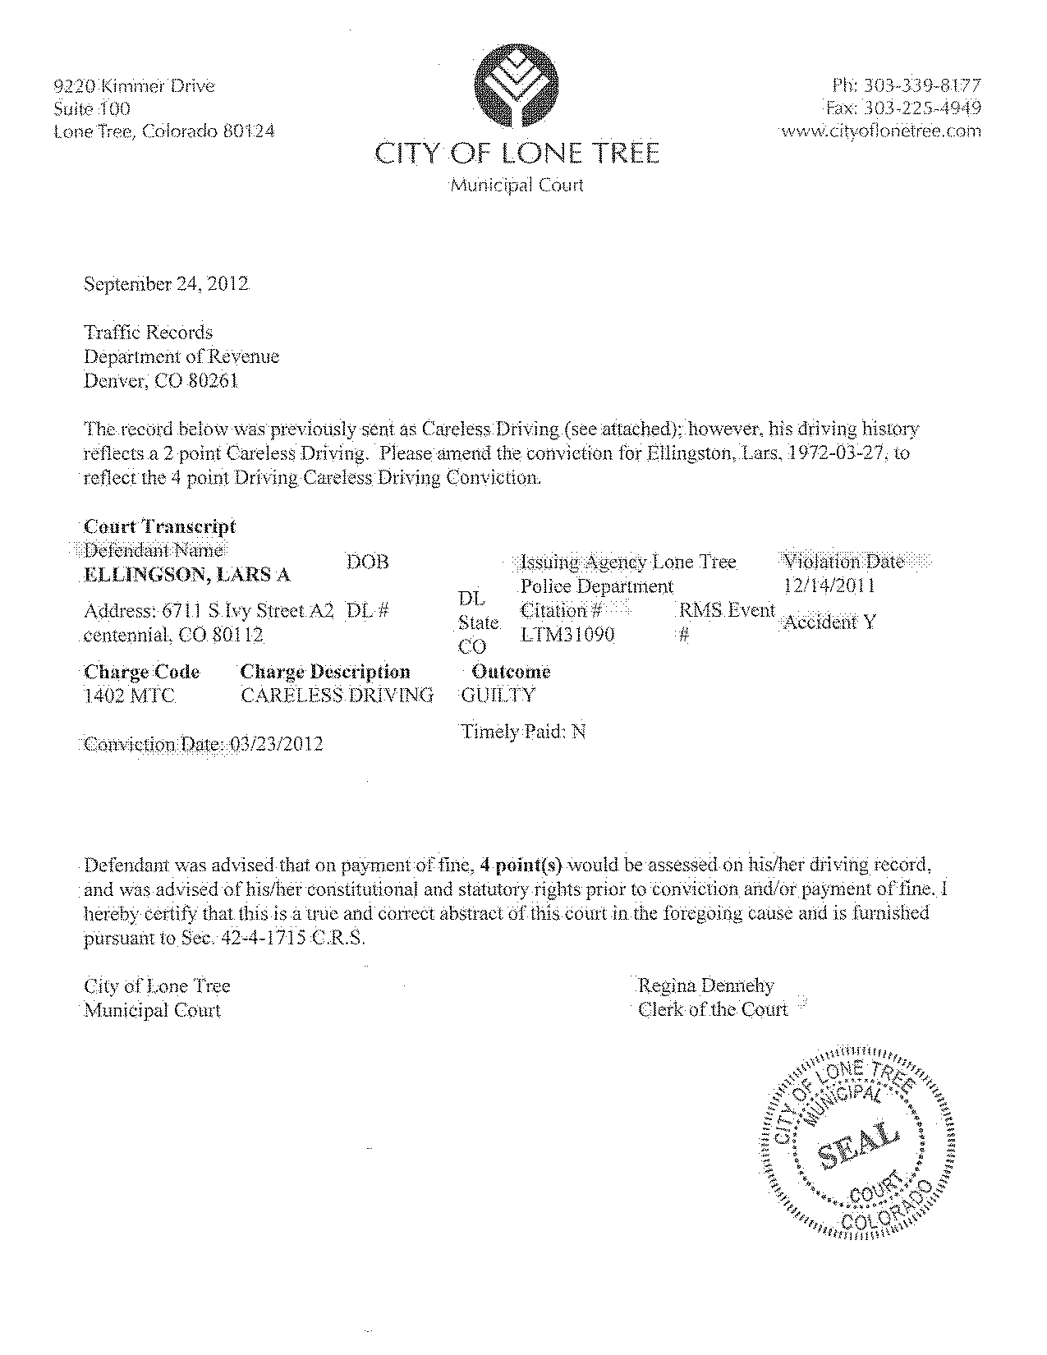
Amended
Transcript

Slide 49
DMV RECORDS
PUBLIC RECORDS – 7 YEARS FROM DATE OF VIOLATION
  INSURANCE COMPANIES CAN GO THROUGH A VENDOR AND CAN GET UP TO 7 YEARS
COLORADO IS A NO PURGE STATE. DRIVING HISTORIES (not public records) ARE NEVER PURGED, SO CRIMINAL JUSTICE AGENCIES HAVE ACCESS TO THE ENTIRE DRIVING HISTORY

Slide 50
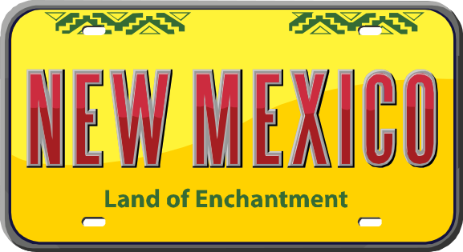
NON-RESIDENT VIOLATORS COMPACT - NRVC
What is the NRVC?
  Allows drivers from compact states the same treatment as resident drivers
  Defendant must have out of state license and out of state address
  Must comply with the requirements of the traffic summons – penalty assessment
  Each member state devises own procedures for enforcing the terms of the compact

Slide 51

What can NRVC NOT be used for?
  Collecting fines for parking tickets
  Collecting fines or unpaid portions of fines
  Securing a court appearance at a later date
  Citations which require suspension, revocation or mandatory court appearance
  Equipment, inspection, size and weight, parking, and transportation of hazardous materials violations

Slide 52
NRVC PROCEDURE
Notice of Failure to Comply form issued by DMV - 5 part form used throughout the process
  Original mailed to defendant as notice with time limit to comply (14 - 21 days)
  2nd copy sent to DMV if defendant fails to respond to notice. DMV forwards to home state
  3rd copy sent to defendant when compliance is met
  4th copy sent to DMV after compliance. DMV forwards to home state
  5th copy remains in court file.
  Must be completed in 6 months

Slide 53


Acceptable methods of
compliance for non-resident drivers
  Payment by mail, if allowed
  Personal appearance
  Appearance by attorney

Slide 54
When a NRVC is paid, you need to send in your conviction transcript, points are not assessed by DMV
The NRVC is similar to a default (failure to pay or appear)
  The court sends the Non-Compliance to DMV
  DMV reviews and forwards to the home state
  When paid, the court sends the Compliance to DMV and DMV forwards to the home state
  Lone Tree assesses court costs and an oj/w fee on all NRVC cases. We send the OJ/W fees collected with the quarterly payments to DMV

Slide 55
COLORADO NRVC PROCESS
Upon receipt from a compact state of non-compliance by a Colorado resident
  Send Notice and Order of suspension effective 30 days from the notice date
  Process stops upon receipt of information that compliance has been met within this 30 day period
  Suspension occurs if compliance not met
  Eligible to apply for reinstatement after payment of fines and payment of a $95.00 reinstatement fee

Slide 56






STATES NOT YET MEMBERS OF THE COMPACT

Slide 57
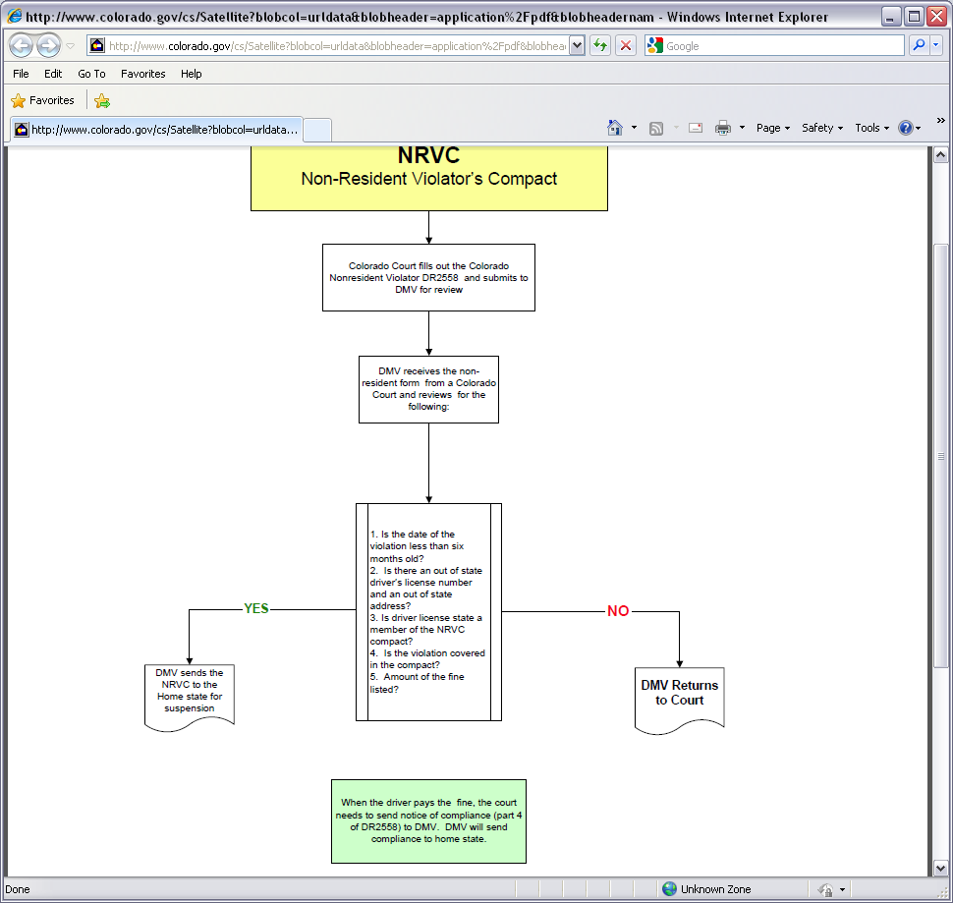
You have this hand out in your folder

Slide 58
UNDERAGE ALCOHOL CONSUMPTION/POSSESSION
C.R.S. 42-2-125 provides for the revocation of a minor’s (under 21 years) Driver’s License for conviction of
  C.R.S. 12-47-901 (1) (b) or (1) (C) -- purchase, possession or use of alcohol
Report all MIP convictions to DMV
  They will keep a data base and they will suspend the license if there is a prior conviction

Slide 59
NOTICE OF NONCOMPLIANCE OF COURT-ORDER
  Applies to alcohol cases only, such as MIP. If a defendant was ordered to take an alcohol/substance abuse class or to complete an evaluation and did not comply

Slide 60
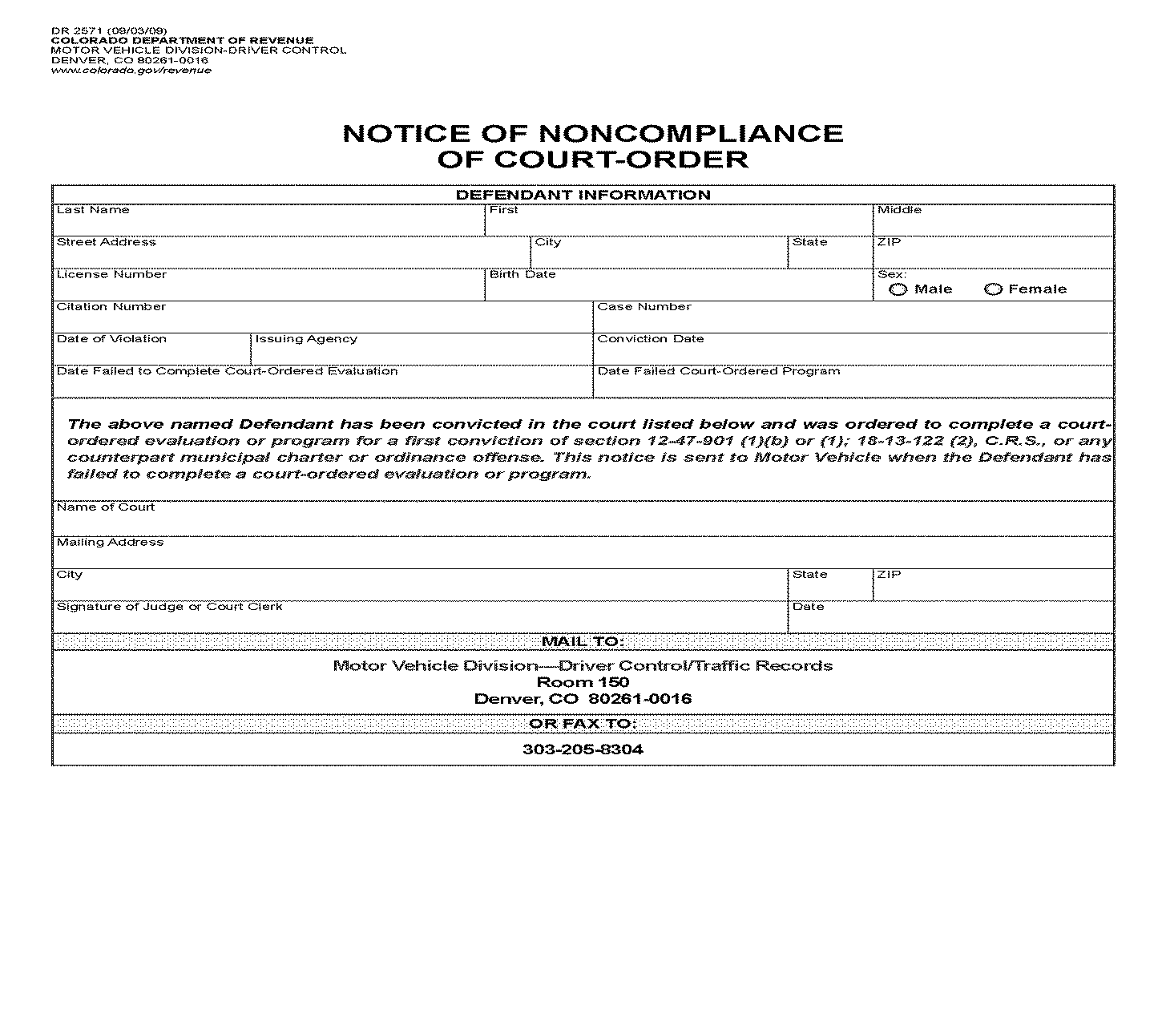
Notice of Noncompliance of Court Order
Complete and Mail to DMV

Slide 61

DESTRUCTION
ALWAYS SHRED ANY DRIVING HISTORIES, TRANSCRIPTS, OR TICKET COPIES

Slide 62
Questions about DMV Procedures
If you have questions about DMV procedures, don’t hesitate to call clerks at other courts, use the list serve or contact DMV directly.
A list of DMV contacts and their telephone numbers is provided with the handouts.

