Slide 1
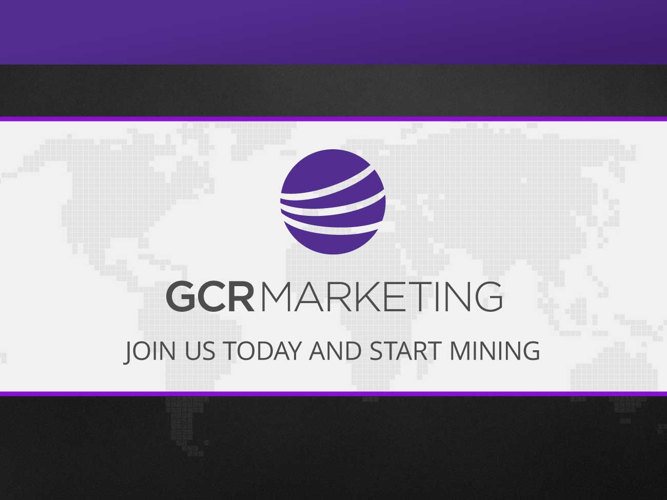
FAST START

Slide 2
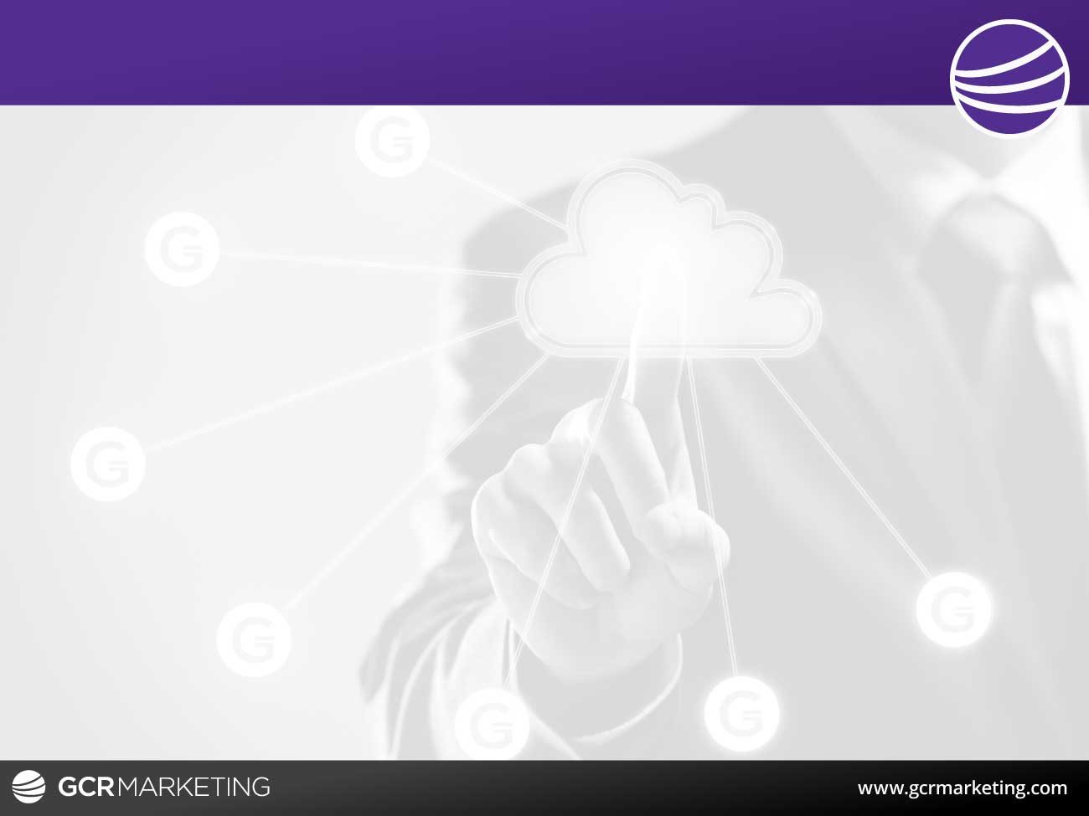
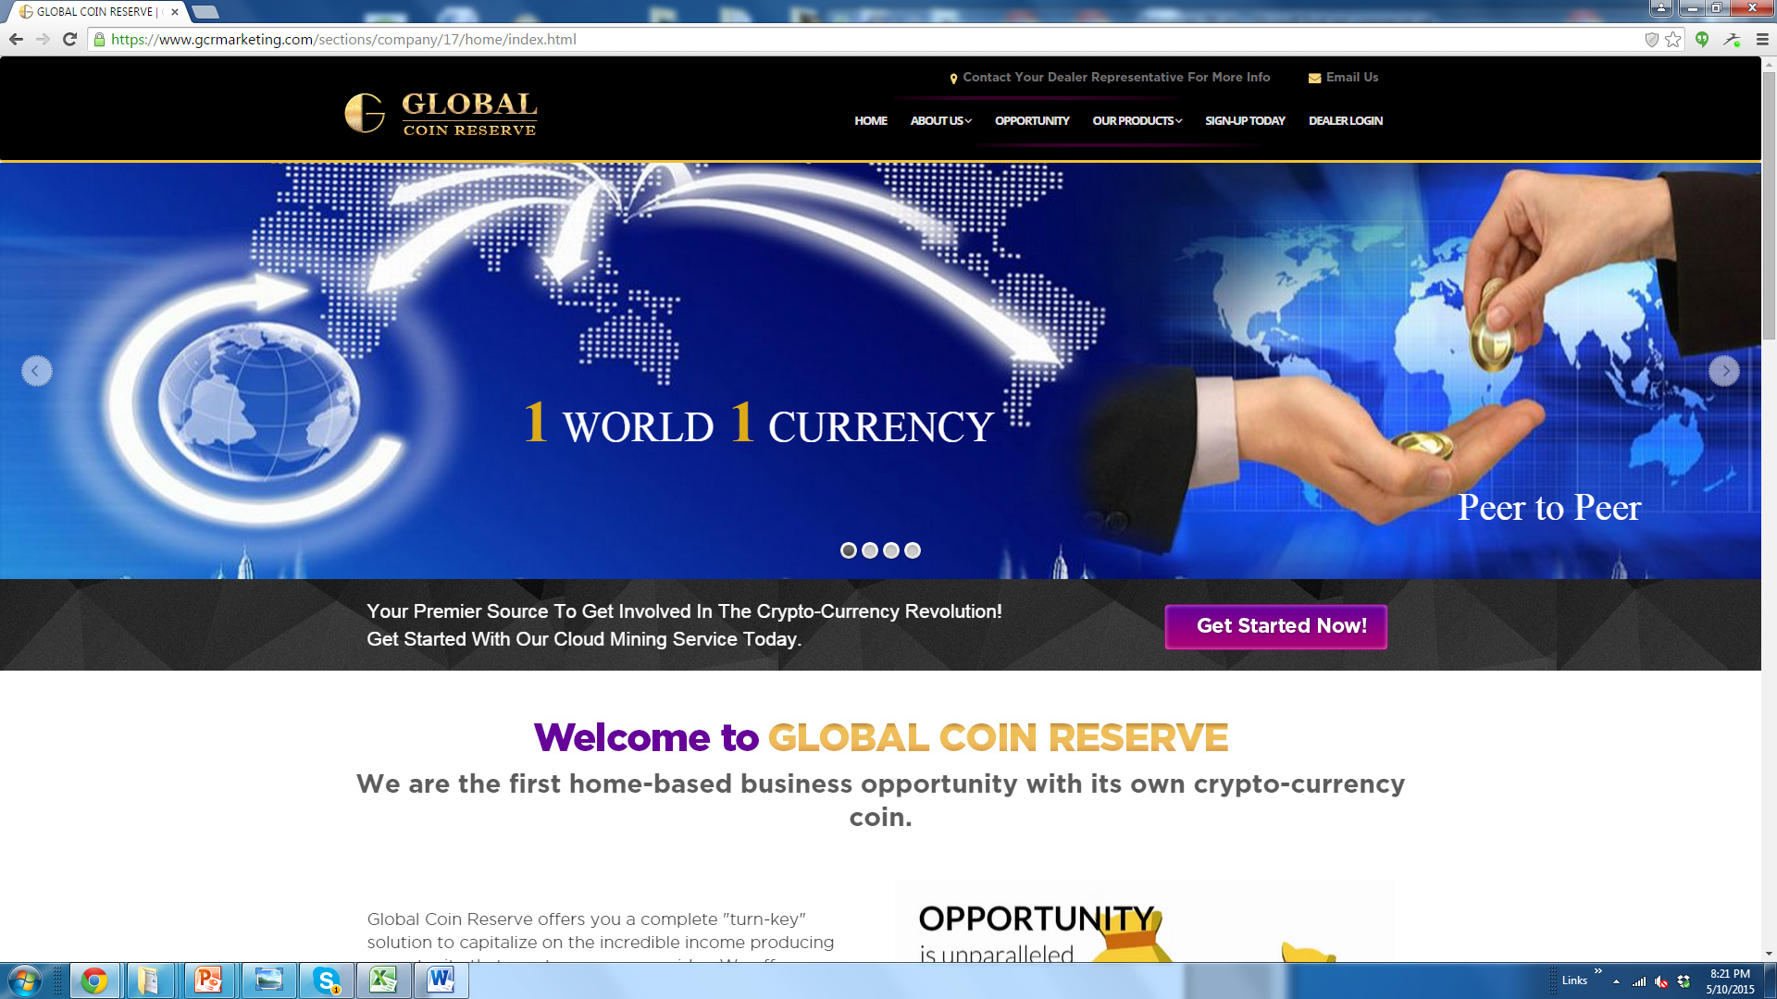
Getting Started
Click the sign up tab

Slide 3
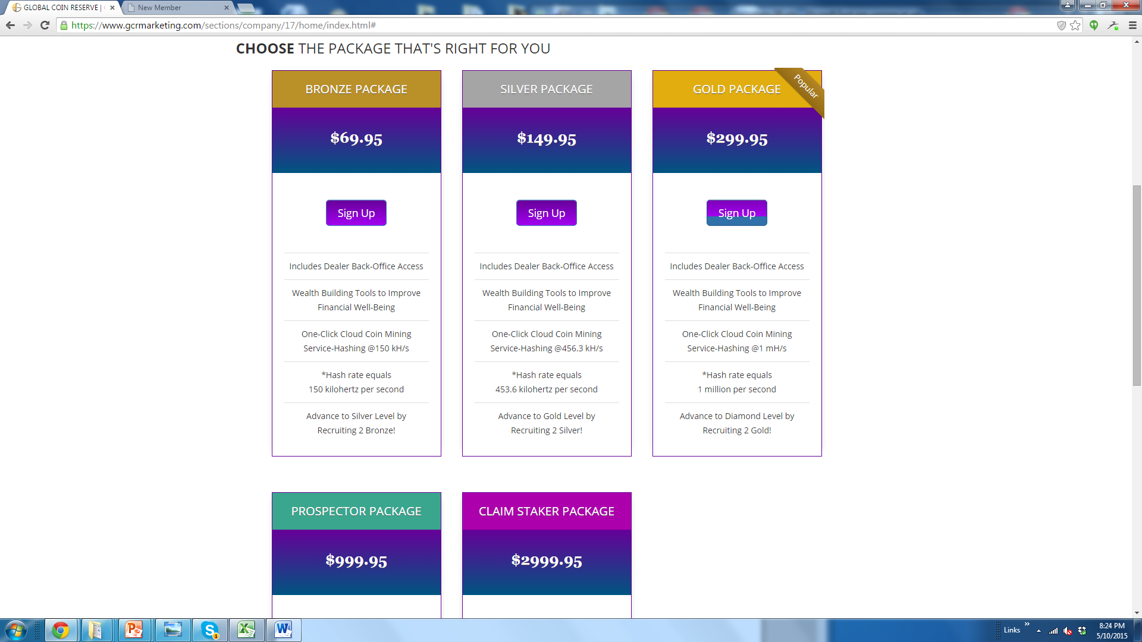
Selecting Your Package
This is VERY important!
Select your desired enrollment package and on the inside you can select your monthly. GCR will never deduct money from your accounts, because there is no bank account information or credit card on file. Your package can be adjusted higher or lower each month. You select what fits you best. If you choose not to mine for a month, you do not lose your coins; your mined coins will be yours for forever.

Slide 4
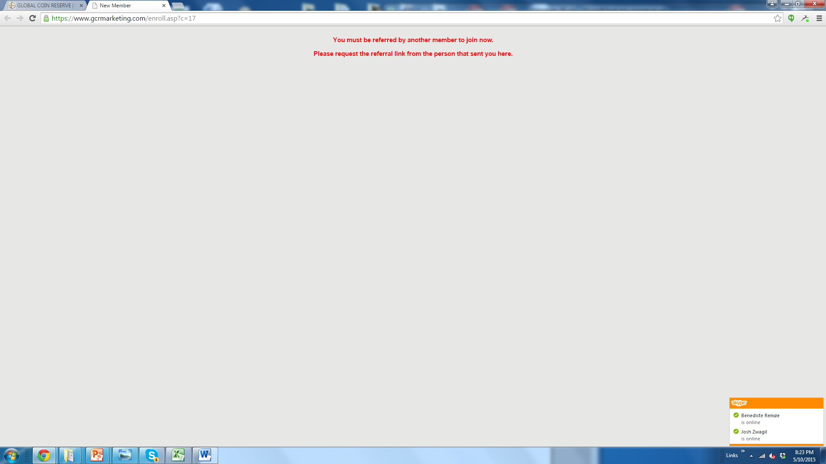
You must sign up by using a referral link, or you will see the message above.
You can not sign up directly with the company. Your link will look like this Http://YOURUSERID.GCRMarketing .com

Slide 5
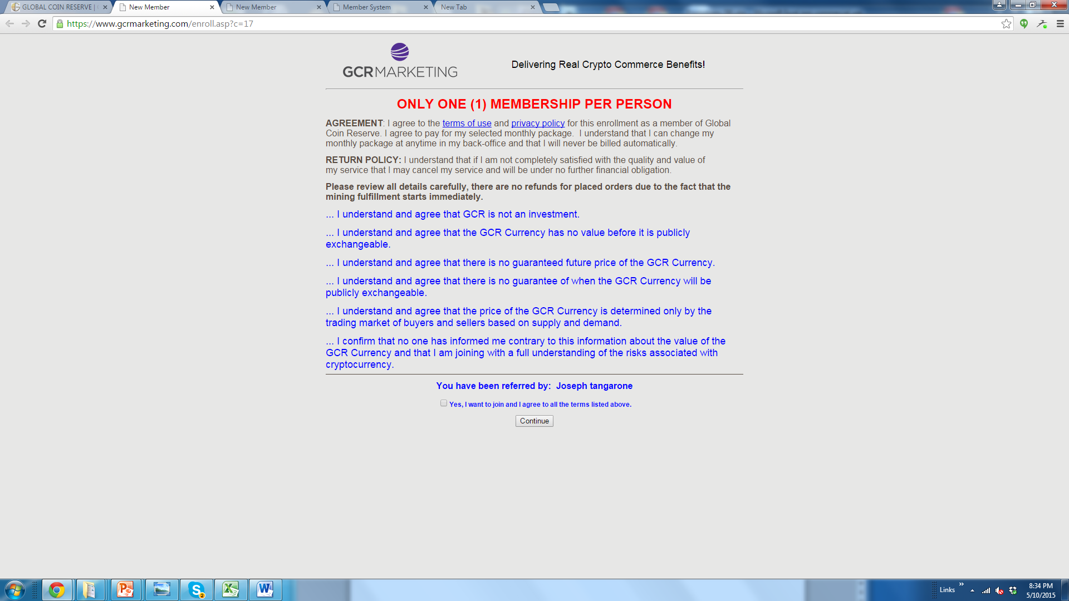
Review and click the box to continue

Slide 6
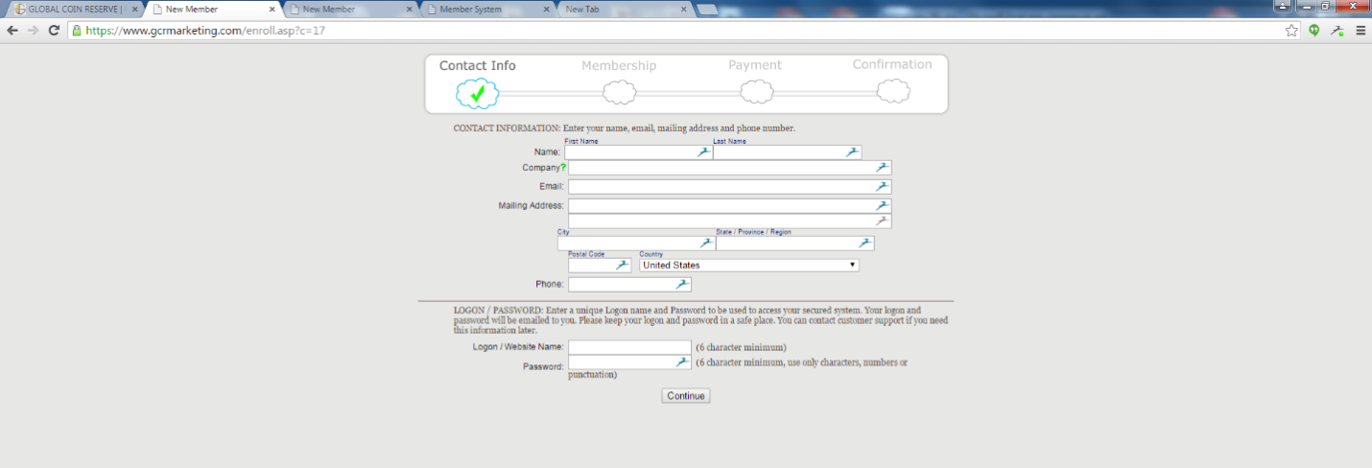
Completing Enrollment Information
Fill in your information.
You are only allowed 1 account per person;
No stacking allowed!
Once enrollment information has been entered, you will not be able
to change your User ID; it does not change throughout the system.

Slide 7
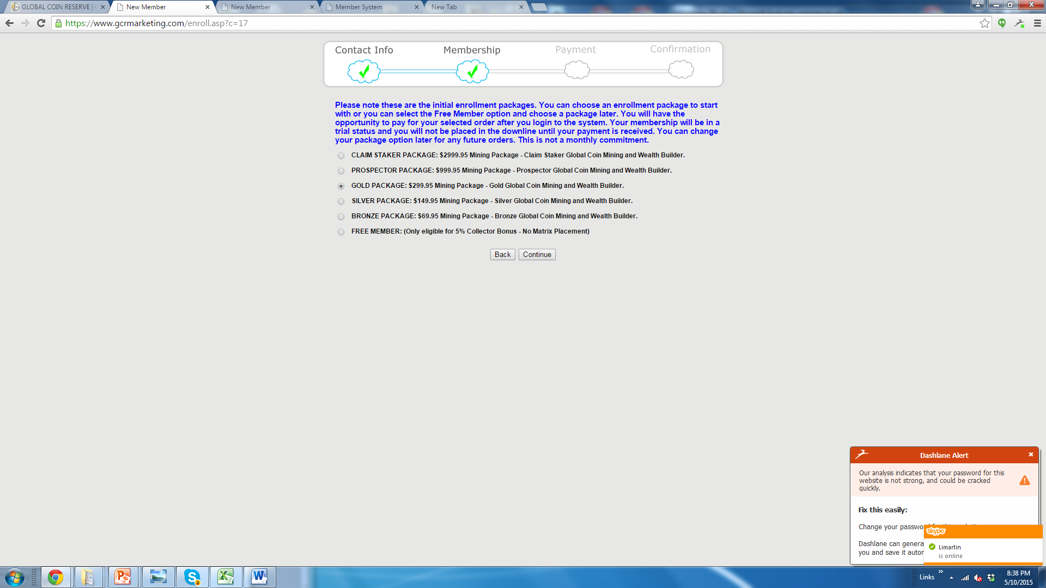
Selecting Enrollment Package
Here you select the enrollment package.
To bypass the payment, select the free package and upgrade on the inside.

Slide 8
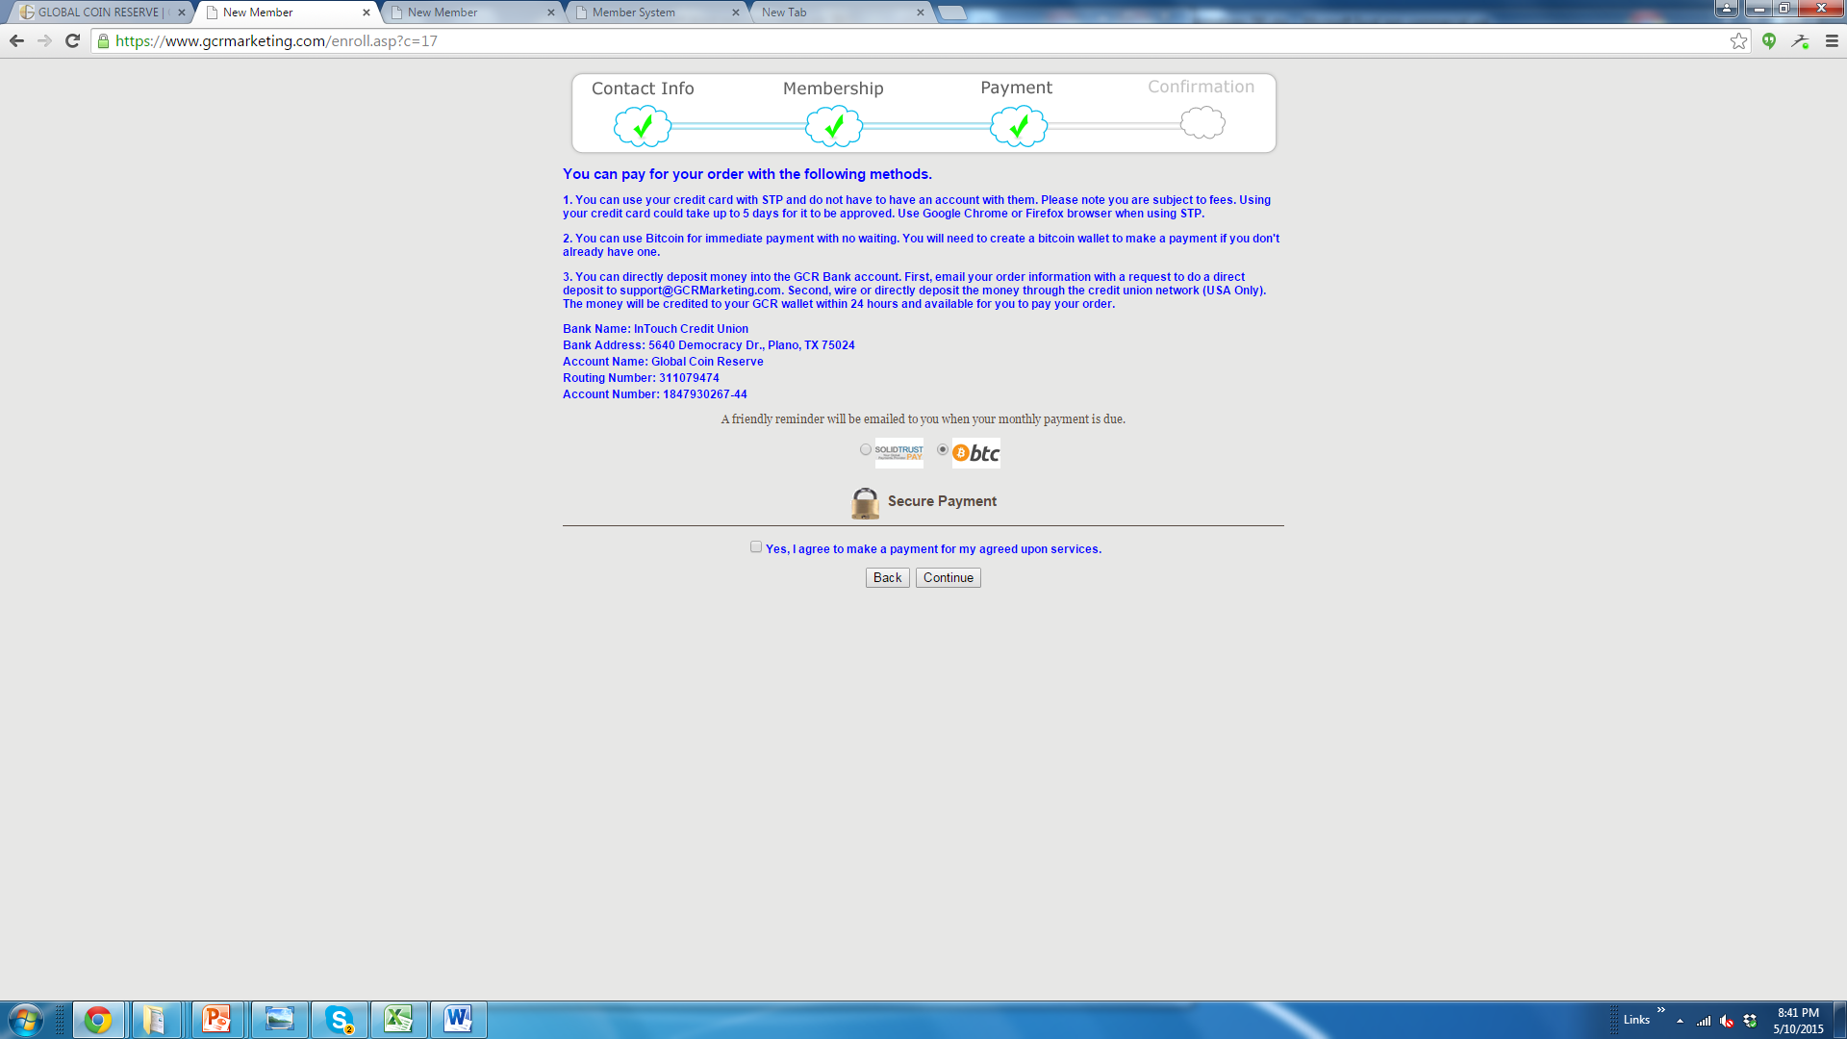
Paying for your Order

Slide 9
Method of Payments
#1 - Solid Trust Pay is an online payment processor where you may use your credit cards. It is subject to a fee.
You do not need to have an STP account to do this. It can take up to 72 hours to be approved. To rush approval, call STP customer support to verify it was you that made the purchase. You might even have to call your bank to approve an international transaction. https://www.solidtrustpay.com/
#2 – Bitcoin
You can pay with Bitcoin if you have a wallet. On the next page, we will show you how to set up an account.
#3 - Global Currency Reserve
New funding information:
You can send snail mail or overnight delivery to the corporate office.
Must be a certified check or money order. No Personal checks!
Send to: Global Currency Reserve 1400 Preston Road, Suite 400, Plano, TX 75093
Please Include your full name, User ID and Rep number on the check memo.
Also send a backup email with the same information to Finance@gcrmarketing.com
Your accounts ewallet will be credited once the check is received M-F. Please consider delays for holidays and weekends.

Slide 10
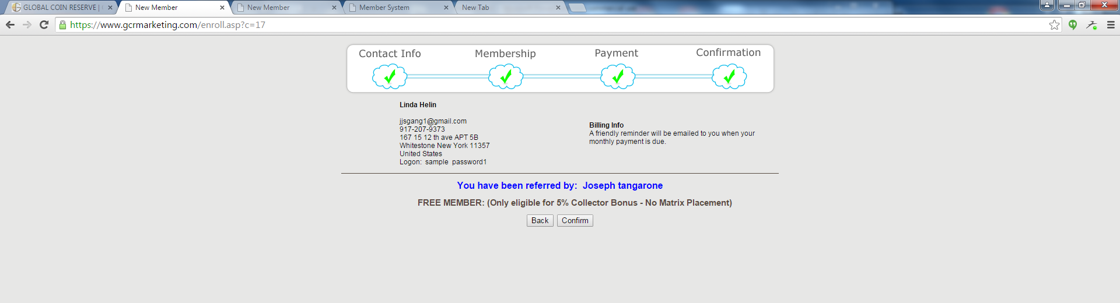
Completed Enrollment
Once completed, your information will show, which means you are also in the system. Very important - You will not be placed in the matrix until you upgrade.
You will receive a Welcome Letter with your information and your Sponsor will receive an email letting he/she know that you signed up.
Now go to www.GCRMarketing.com and log into your back office

Slide 11

Sample Welcome Letter
Hi Linda Helin
Your Logon is: sample
Your Password is: password1
Thank you for becoming a Dealer with GCR Marketing. You can login to your account and start building your business with the Logon and Password specified above. Referral Link: sample.GCRMarketing.com STEP 1: SETUP Your Bitcoin Wallet! Click Here to Learn How to Setup your Bitcoin Wallet so that you can make your payments to GCR Marketing to stay qualified for bonuses and start mining your own GCR Coins. Don't forget to bookmark your referral link and give it to all your personal referrals so they can also start leveraging technology to build wealth. Access to the system requires both a Logon ID and a Password. You will need both the next time you access the system. We put a lot of time, money and effort into building this dynamic system for you to help you reach your financial goals. We look forward to seeing you succeed with this new powerful system at your fingertips. If you need any further assistance, or feel you have received this message in error, please contact us directly. (Please do not reply directly to this email message). Thank you again, GCR Marketing Team

Slide 12
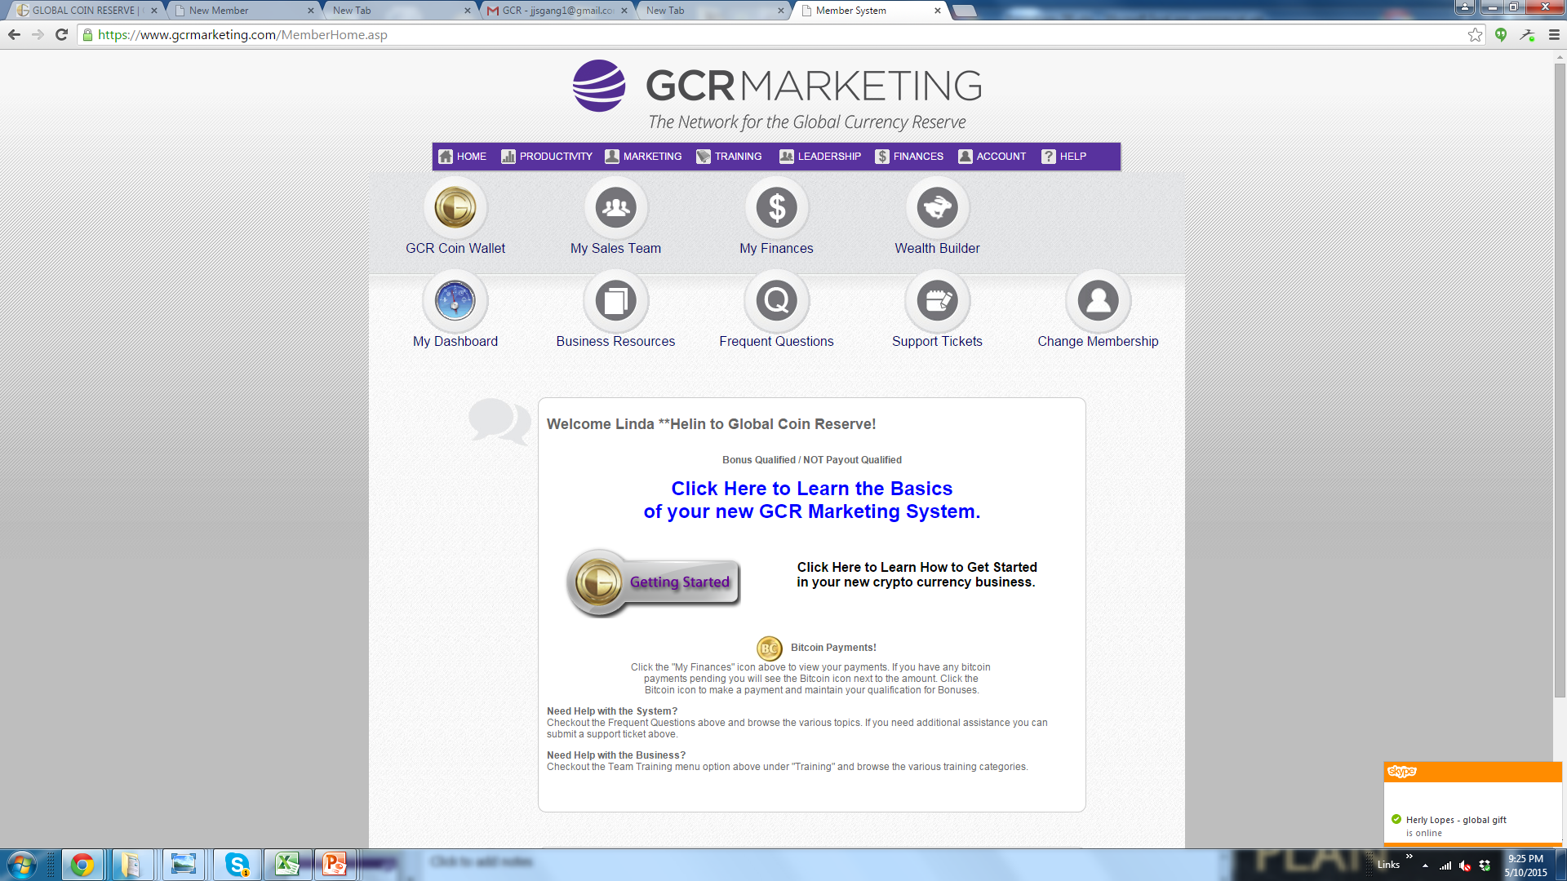
Back Office

Slide 13
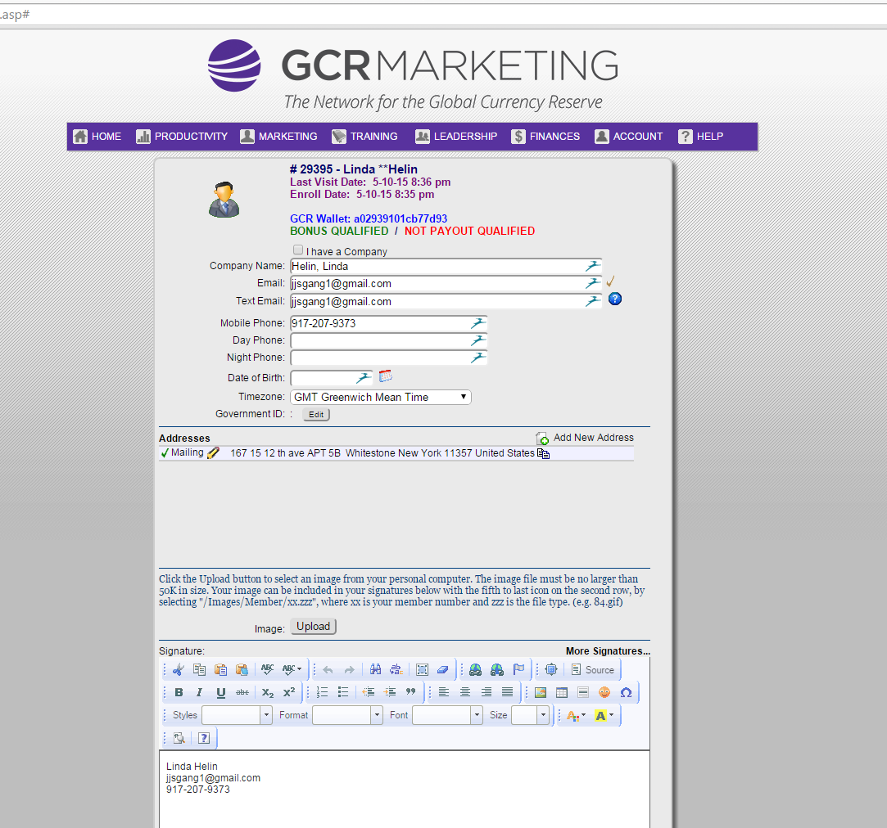
Checking Your Information
Please go to your profile and double check all your information is correct.
Fill in the signature box at the bottom with the information you want your prospects to see.

Slide 14
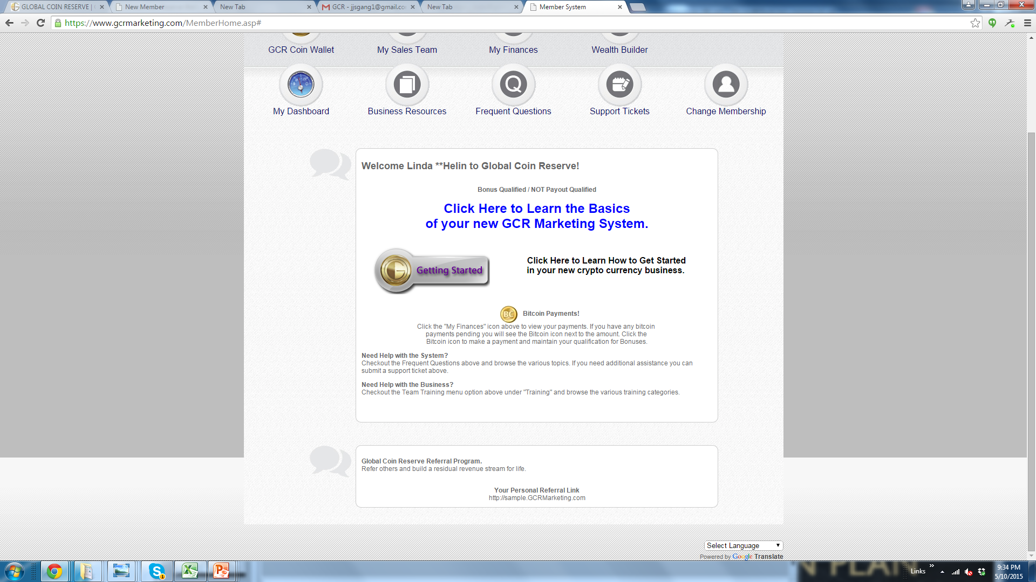
My Dashboard
My Dashboard is the hub of your back office
Your replicated link is on the front page of your back office.

Slide 15
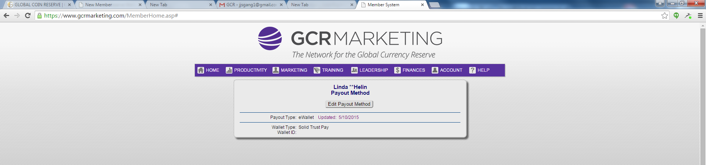
PAYOUT METHOD
Now it is time to decide how you want to be paid your commissions.
Go to Account and Payout Method
Click on pay out method - your selection is Bitcoin or STP.
If you select STP you must have an account. It will be a user name ID.
If you are using Bitcoin and have a Bitcoin address, please enter it now. We suggest, every Thursday night to check that your Bitcoin address is the same as you entered it.

Slide 16
DIFFERENT TYPES OF PLATFORMS
USA/Canada (many of us use Coinbase)
https://www.coinbase.com/
Europe (many use Kraken)
https://www.kraken.com/
India (many use Blockchain)
https://blockchain.info/
Once you have opened and completed the process, make sure you get verified for the max amount allowed. You will be able to get a Bitcoin address and then you can enter it in the payout process.

