Slide 1
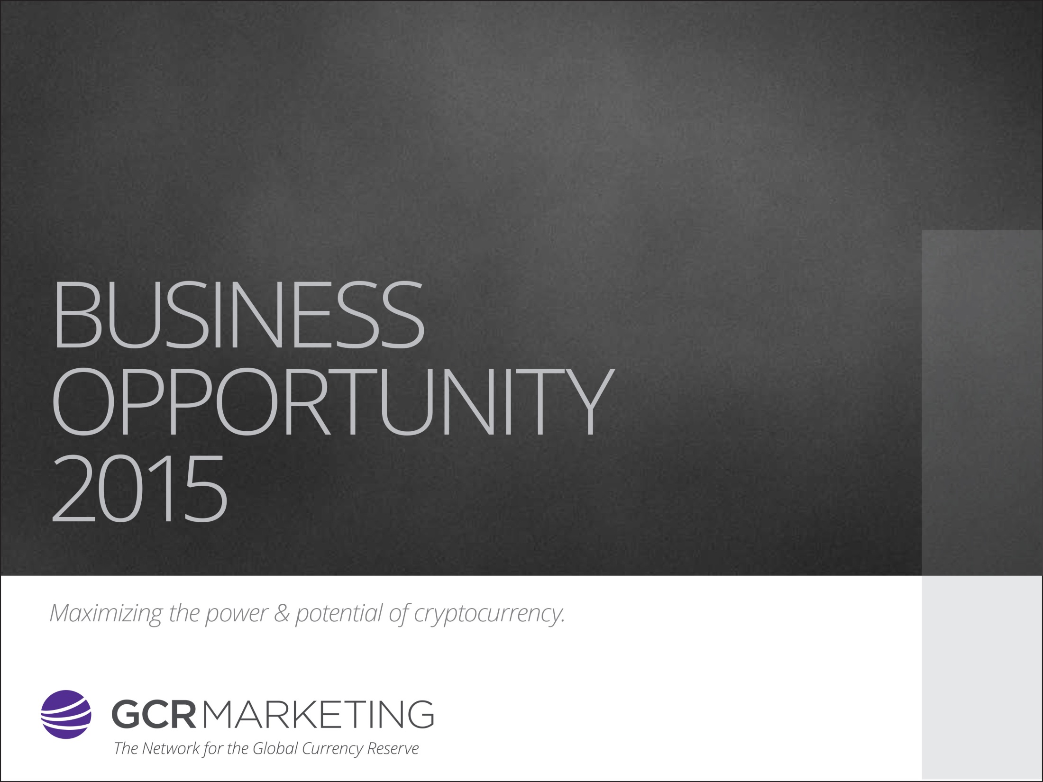
"This Presentation was created on
July 21, 2015, and supersedes all previous business presentations."

Slide 2
Disclaimer
Global Currency Reserve
"Global Currency Reserve is not in the business of selling cryptocurrencies. On the contrary, Global Currency Reserve provides a cloud mining solution to a relatively new cryptocurrency in the market. Due to the volatile nature of all cryptocurrencies, Global Currency Reserve cannot guarantee that the GCR coin will rise in value. While we feel our coin has signiﬁcant advantages over others on the market, we are in no position to offer guarantees. As an Afﬁliate for Global Currency Reserve, it’s your obligation to ensure that the cloud mining services are marketed appropriately and to refrain from implying that the GCR coin will increase in value. Although GCR has a strong business plan to add value to the coin, there is always a chance that the coin could be nearly worthless, depending on technology, the entrance of new competitors and market conditions."

Slide 3
What Is Cryptocurrency?
Decentralization of Money Worldwide
Cryptocurrency is the first financial system owned and controlled by the people.
A cryptocurrency is a medium of exchange like normal currencies such as USD, but designed for the purpose of exchanging digital information through a process made possible by certain principles of cryptography. Cryptography is used to secure the transactions and to control the creation of new coins.
Decentralization of Money Worldwide
Not controlled by any State, bank or financial institution
Transactions are performed directly from person to person
Unlike PayPal & credit card payments, transactions are irreversible
It can be exchanged with foreign currencies
Transactions are performed anonymously.

Slide 4
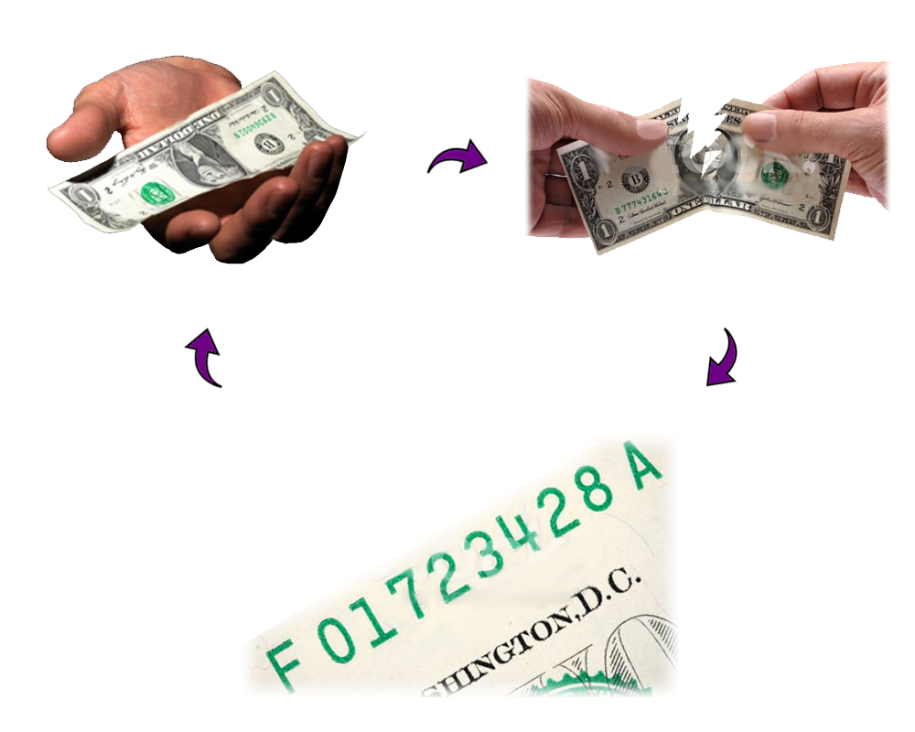
What Is Cryptocurrency?
Decentralization of Money Worldwide
“If you have a dollar bill and lost it or it was destroyed, it is gone…“
With cryptocurrency, all you need is the serial number and it has the value of a dollar bill!

Slide 5
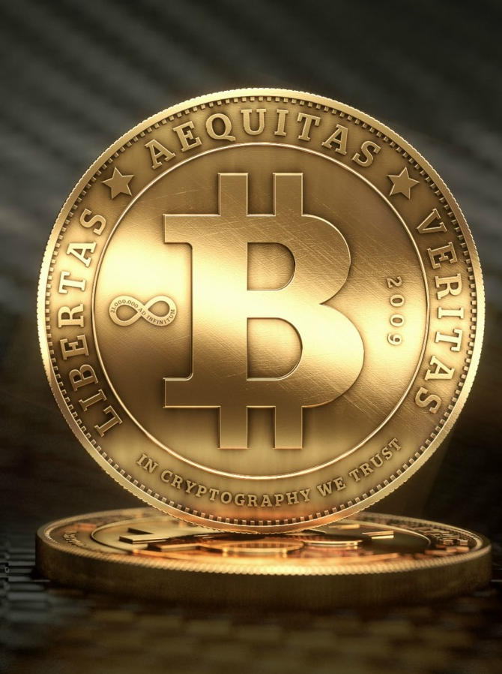
The Creation Of Bitcoin
Popular digital currency Bitcoin is expected to overtake e-commerce giant eBay's payment processor PayPal, in terms of US dollar transactions, in the near future.
// Bitcoin was the very first cryptocurrency, successfully created and circulated way back in 2009. Today, other cryptocurrencies called Altcoins are available to be used for online transactions.
The secret to successful cryptocurrency is that there must be a demand created through providing value. //

Slide 6
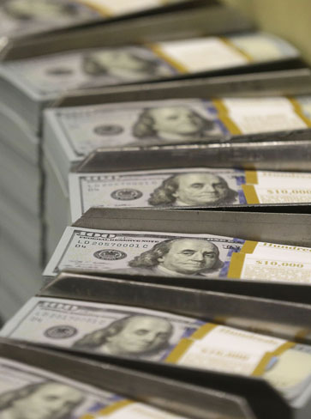
Reaching The Market Cap!
// Cryptocurrency has a market cap, a limit to its production. But look at fiat currencies. More Dollars, more Euros, etc., are being printed daily, which only weakens the currency and fuels inflation. //

Slide 7
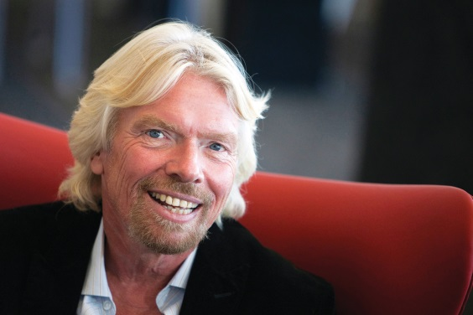
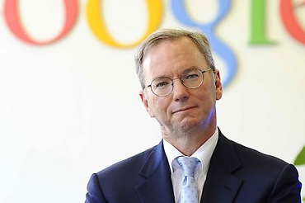
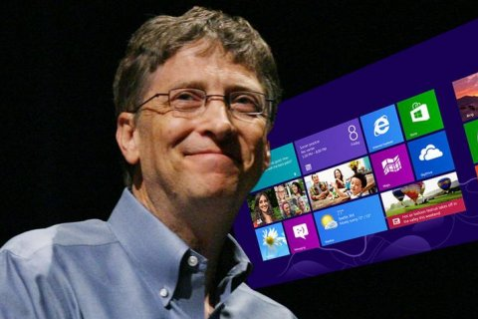
Who Is Talking About Cryptocurrency ?
“Virgin Galactic is a bold entrepreneurial technology. It’s driving a revolution and Bitcoin is doing just the same when it comes to inventing a new currency.”
Richard Branson
VIRGIN
“Bitcoin is a remarkable cryptographic achievement and the ability to create something that is not duplicable in the digital world has enormous value.”
Eric Schmidt
GOOGLE
“Bitcoins are better than currency.”
Bill Gates
MICROSOFT

Slide 8


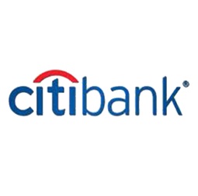


Who Is Accepting Cryptocurrency?
The CEO of the New York Stock Exchange (NYSE) recently announced that they had invested $75 million dollars in Coinbase, which is a currency exchange for Bitcoin.
Citibank Is Working On Its Own Digital Currency, Citicoin
Do you think that perhaps he knows something we don't?

Slide 9
Timing Is Everything
Technology Opportunity Trends
Personal computers mid-late 70s
Building software and hardware for the growing personal computer market
Internet Boom
VisiCalc software made them practical
Microsoft, Apple and Hewlett Packard
Google, Facebook
and Ebay
Many millionaires and billionaires have been created with each trend

Slide 10
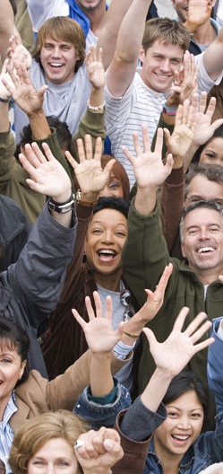
The Next Revolution is Here…
THE PEOPLE’S MONEY

Slide 11

What is GCR Marketing?
[Global Currency Reserve Marketing]
GCR Marketing is the Marketing Arm for
GCR Coin
As a Network Marketing Company with an objective to make the most of cryptocurrencies, we are fortunate to be able to take advantage of a very unique opportunity.

Slide 12
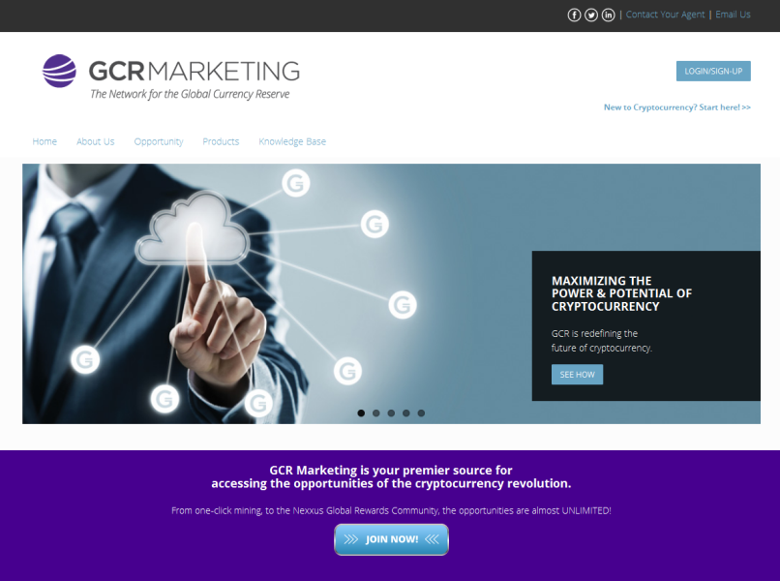
What is GCR Marketing?
[Global Currency Reserve Marketing]
Our Company
The Leadership team has over 100 years’ experience in the corporate and direct selling marketplace.
Together, the Company and the Agents will pave the way to a NEW ERA of financial and wealth-building products.
Our Mission
Our mission is to create a cryptocurrency with real value by generating a trading volume linked to its commercial use, and not the result of speculation.

Slide 13
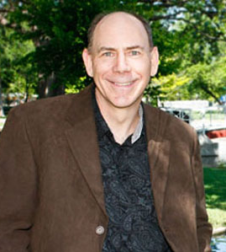
Meet the CEO
"We distinguish ourselves not only among network marketing businesses, but in cryptocurrency as well. We want to do something no one else in the industry is doing... creating real cryptocurrency value. The more we can provide opportunities for people to buy and use the GCR coin, the larger the network will grow.“
Bob Wood,
CEO & Co-Founder
Bob Wood (Texas, USA)
CEO, Global Currency Reserve Managing Partner and Co-Founder

Slide 14
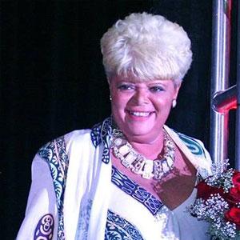
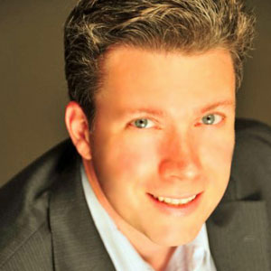
Meet the Management
Linda Helin (New York, USA)
CMO, Chairman of the Field Advisory Board, Global Currency Reserve Managing Partner
Mike Ward (Texas, USA)
COO, Global Currency Reserve Managing Partner and Co-Founder

Slide 15


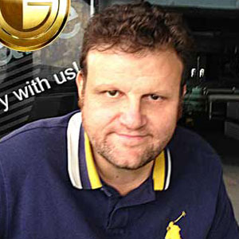
Meet the Leadership
Lisa Fields
(Texas, USA)
V.P., Director of North American Business Development
Ruben Arcas
(Spain)
V.P., Director of Hispanic Latino Business Development
Sasa D'Arco
(Italy)
V.P., Director of European Business Development

Slide 16
MINING IN THE CLOUD
ALL DAY, EVERY DAY, WHEREVER YOU ARE

Slide 17

1-Click Mining in the Cloud
GCR Marketing can help you benefit from cryptocurrency
even if you don’t know anything about mining.
GCR is a modern cryptocurrency using the advanced Proof of Stake protocol, which utilizes a decentralized network of computers owned by the coin-holders for the verification of transactions. The 99 million coins are managed through a private mining pool and distributed through the 1-click mining service.

Slide 18
Wealth-Building Tools
Global Currency Reserve is driven to help our members not only with their mining services but also to help improve their financial well-being. With our wealth-building platform, we can help you in the following ways:
Tax Estimator, Business Expense Manager, Debt Reduction Manager, Credit Repair Manager, and Financial Education Library.
MONEY & PROFIT
Building a foundation
for wealth
PROFILING CLIENTS
& STAFF
Ensuring continued business success
SALES & MARKETING
Empowering the heart of your business
GROWING YOUR BUSINESS
Creating your strategic plan
Plan
Profile
Sales
Profit

Slide 19

Free Marketing System
FREE Built-in marketing campaigns
Banners with personalized links
Personalized lead capture pages & videos
Drip campaign with 25 auto-responder emails
FREE SMS marketing.
We will help you build your business with a FREE advertising rotator

Slide 20
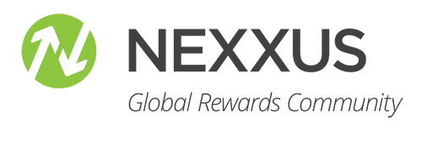
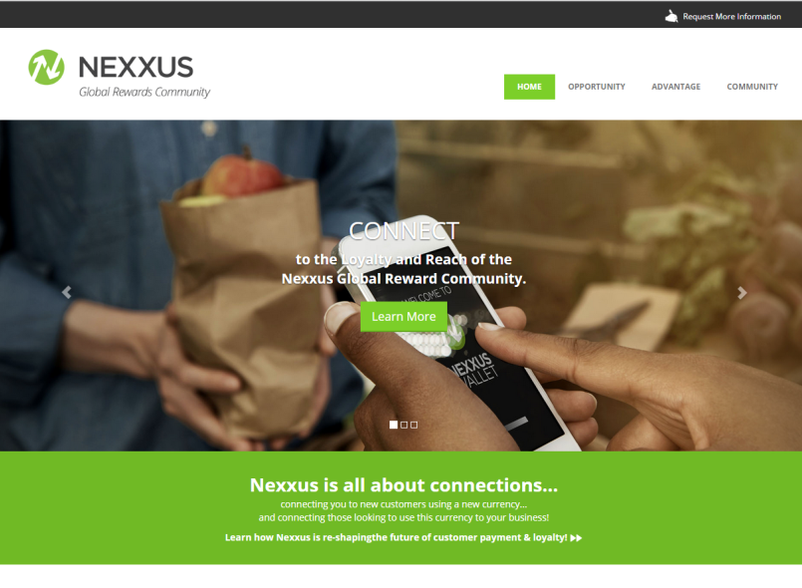
NEXXUS
Global Rewards Community
NEXXUS will become the Industry Solution to bring Cryptocurrency to the WORLD
Giving people a good reason to buy and use cryptocurrency

Slide 21
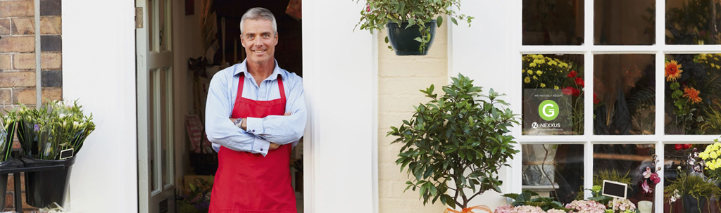
NEXXUS
Global Rewards Community
WHY NEXXUS?
Connect to the power of “Yes!” More and more people are using cryptocurrency to pay, and they want to buy goods and services from those companies accepting cryptocurrency.
HOW IT WORKS
It’s really quite simple. Approved merchants are allowed to sell their products and services in exchange for Bitcoin/GCR currency to the market of GCR customers. Each merchant selects the cash-back reward they wish to offer to customers paying with GCR currency.

Slide 22


The Public GCR Wallet
Global Rewards Community
Secure coins or send and receive coins from any GCR Coin Wallet.
Wallet also downloadable to your desktop.
THE PUBLIC GCR WALLET
IS FREE
FOR ALL

Slide 23

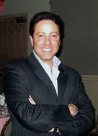
"The mission of the GCR Foundation is to increase the recognition, the value and the widespread global growth of the GCR cryptocurrency.”
All GCR Coin holders and Nexxus merchants will support the use and development of the coin.
They all share the common interests directed by the GCR Foundation Board of business and industry experts.
Barry Moniês
President & CEO
Computronix

Slide 24

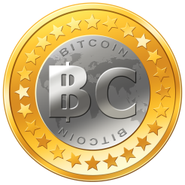


GCR CURRENCY
Bitcoin is the granddaddy of cryptocurrency; they have paved the way for the rest.....but have grown ONLY through "word of mouth" WITHOUT any marketing AT ALL!
There are many other Altcoins, but none have approached Bitcoin.
This has created a huge price gap between Bitcoin and the rest of the coins.
GCR has been recognized as one of the first companies to provide a solid business model on top of the cryptocurrency technology.
GCR will quickly fill that price gap!

Slide 25

What Makes Us Different?
LEVERAGED MARKETING FORCE
Strong Growth Through Networking
One of the biggest challenges of all, Cryptocurrrency is creating a market of users. GCR leverages a network of Agents with a financial incentive to promote and develop the rapidly growing GCR market.

Slide 26
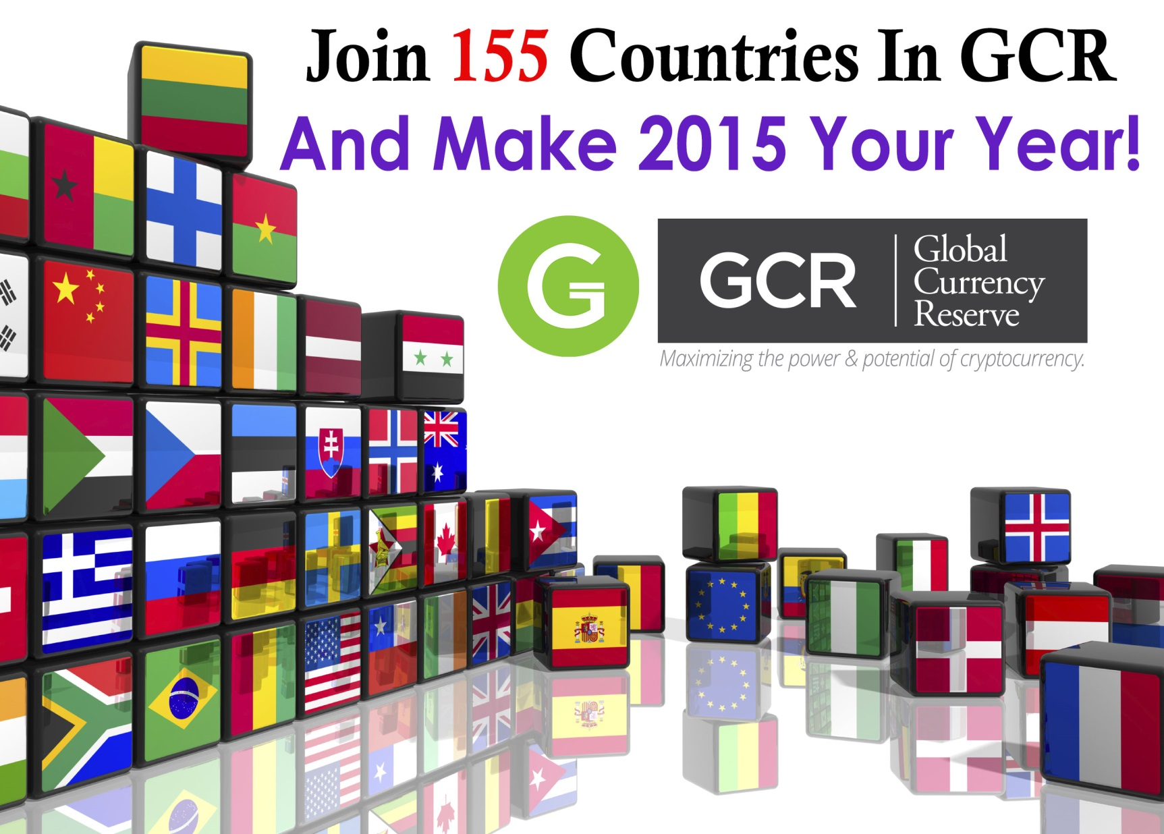

Slide 27



GCR Eco-System
NEXXUS
REWARDS COMMUNITY
FOUNDATION
FREE MARKETING
SYSTEM
NETWORKERS

Slide 28

Seize the Opportunity
The first ones to mine a cryptocurrency are always the ones that have the highest chance of
PROFITABILITY

Slide 29
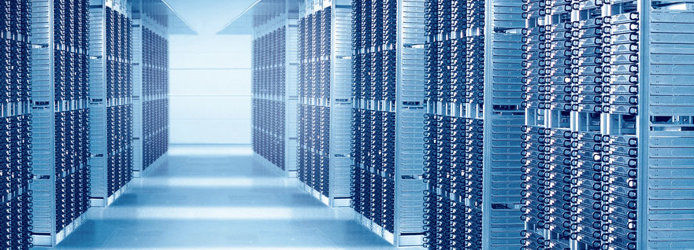
Seize the Opportunity
Global Currency Reserve
offers you 1-click cloud mining services from only
$69^{.95}

Slide 30




Our Product Packages
All monthly renewals are optional, packages can be changed at any time.
Gold
Prospector
Bronze
Silver
$299^{.95}
$999^{.95}
FREE
$69^{.95}
$149^{.95}
^{FREE}
Per month
Per month
Per month
Per month
No Mining
Mining Pool @150 Stakes
Mining Pool @450 Stakes
Mining Pool @1000 Stakes
Mining Pool @3,500 Stakes
5% Collectors Bonus
10% Collectors Bonus
10% Collectors Bonus
10% Collectors Bonus
10% Collectors Bonus
4 Levels of Team Bonus
6 Levels of Team Bonus
8 Levels of Team Bonus
8 Levels of Team Bonus
1 Level of Matching Bonus
1 Level of Matching Bonus

Slide 31
Seize the Opportunity
What would your ideal business include? GCR has it!
Contact a GCR member for Complete details of our Business Opportunity Compensation Plan.
Good Product
Legality
Profitable
Timely Payments
Cryptocurrency mining service with the best position in the market.
A company represented by top industry lawyers,.
The company pays up to 78% in direct sales Commissions for mining purchases.
Global Currency Reserve pays every Friday, with different
options to withdraw your earnings.

Slide 32
Income Disclosure
Global Currency Reserve Income Disclosure
The Global Currency Reserve Compensation Plan is an exciting opportunity that rewards you for selling a cutting edge cloud mining solution for a new alt-coin on the market. It’s a very competitive space where individual results will vary depending on commitment levels and sales skills of each participant. Since Global Currency Reserve has recently launched, it lacks enough statistical data to prepare reliable income disclosures. The numbers below reflect estimates prepared by the company pending a more detailed survey to be conducted after its first year. Based on industry standards and company projections, the average annual gross income for Affiliates is projected to be anywhere between $500 and $2,000. There will certainly be participants who will earn less while others will earn much more. We’re excited about the Global Currency Reserve Compensation.
Plan and we’re confident it will provide you a solid foundation to help you achieve
your financial goals. If income projections were presented to you prior to your enrollment, such projections are not necessarily representative of the income, if any, that you can or will earn through your participation in the Compensation Plan. These income projections should not be considered as guarantees or projections of your actual earnings or profits. Success with Global Coin Reserve results only from hard work, dedication, and leadership.

