Slide 1
A Systems-Based Approach to Elder Justice, with Guardians at the Forefront and Center Stage
WINGS Conference 2016, Seattle
Thursday, March 17, 2016
Philip C. Marshall
philipcmarshall@gmail.com
www.beyondbrooke.org
#beyondbrooke
Notes:
A Systems-Based Approach to Elder Justice, with Guardians at the Forefront and Center Stage
WINGS Conference 2016, Seattle
Thursday, March 17, 2016
Philip C. Marshall
philipcmarshall@gmail.com
www.beyondbrooke.org
#beyondbrooke
_____

Slide 2
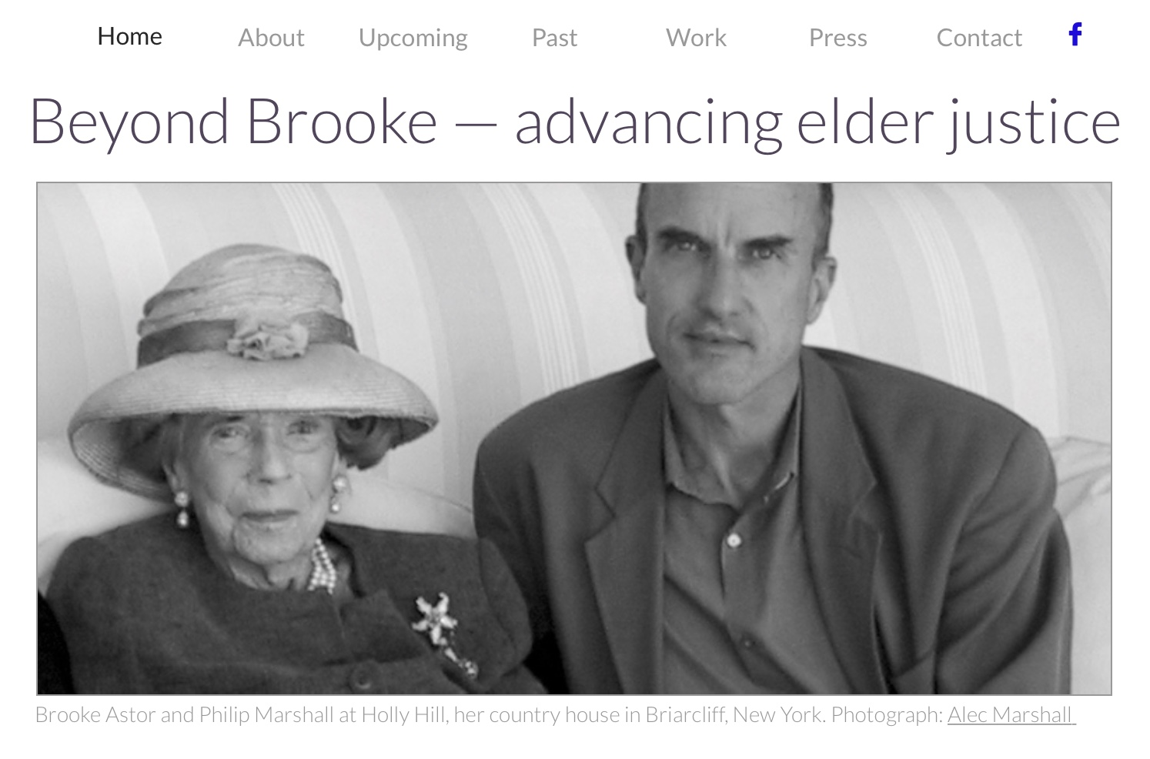
Philip C. Marshall • philipcmarshall@gmail.com
508.951.8562 • www.beyondbrooke.org

Slide 3

“Temple of Heaven with Tarere (Little Peach) aged 10,” Brooke Astor,
Bĕijīng, 1912. Personal collection.
Notes:
“Temple of Heaven with Tarere (Little Peach) aged 10,” Brooke Astor,
Bĕijīng. Personal collection.
____
1912
https://en.wikipedia.org/wiki/Puyi
Pǔyí
7 February 1906 – 17 October 1967
While still a child, he ruled as the Xuantong Emperor (simplified Chinese: 宣统帝; traditional Chinese: 宣統帝; pinyin: Xuāntǒng Dì; Wade–Giles: Hsuan1-t'ung3 Ti4) from 1908 until his abdication on 12 February 1912, after the successful Xinhai Revolution. From 1 to 12 July 1917, he was briefly restored to the throne as a nominal emperor by the warlord Zhang Xun. In 1932, after the occupation of Manchuria and Manchukuo was established by Japan, he was chosen in assuming the title of Chief Executive of the new state using the era name of Datong (Ta-tung). In 1934, he was declared the Kangde Emperor (Kang-te Emperor) of the puppet state of Manchukuo by the Empire of Japan, and he ruled until the end of the Second Sino-Japanese War in 1945.
After the People's Republic of China was established in 1949, Puyi was imprisoned as a war criminal for ten years, wrote his memoirs, and became a member of the Chinese People's Political Consultative Conference and the National People's Congress.
_____

Slide 4

Astor, Brooke. Patchwork Child. New York: Random House. 1962
Notes:
1902 — born
1962 — Patchwork Child, at age 60
2002 — at 100
“Although I am a child of the twentieth century, my background and childhood are so foreign to the life of today that in describing them I seem to be stealing pages from a nineteenth-century novelist.” — Brooke Astor
https://www.nickharvilllibraries.com/store/p1106/Patchwork_Child,_Signed_Presentation_from_Brooke_Astor_to_Albert_Hadley.html
[Signed Presentation to Albert Hadley] Astor, Brooke. Patchwork Child, Early Memories. First Edition. 1962. Book and dust jacket are both in very good condition—jacket shows repaired edge tears and rubbing. Book is inscribed on the flyleaf, “To Albert Hadley, with all good wishes, Brooke Astor, November 7, 1962.”
What shaped the character of this society grand dame and philanthropist? The answer lies in this fascinating book, in which Astor recalls her turn-of-century childhood, as the daughter of a naval officer stationed in [then] Imperial China, Hawaii, Panama, and Washington, D.C. It stimulated a sense of wonder and curiosity that burned bright for an entire century. This is a nice association copy. Albert Hadley designed the red lacquer library in Brooke’s Astor Park Avenue apartment, one of the most photographed rooms in New York.

Slide 5
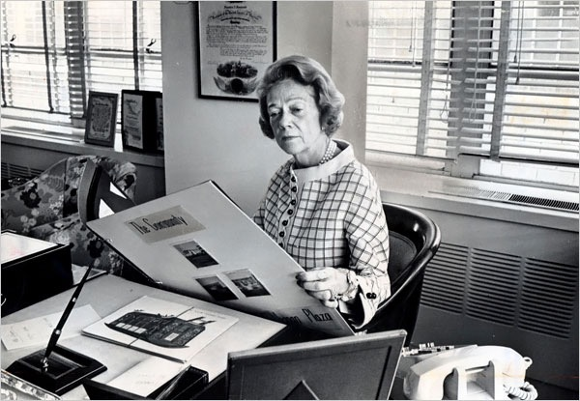
Brooke Astor, President, The Vincent Astor Foundation beginning January 27, 1960 (at age 59) until 1997 (at age 95).
Notes:
37 years as head of foundation
_____
http://pndblog.typepad.com/pndblog/2010/01/brooke-astor-the-peoples-philanthropist-neighborhood-development.html
Brooke Astor, the People's Philanthropist: Neighborhood Development
January 8, 2010
(Michael Seltzer is a regular contributor to PhilanTopic. In his previous post, he wrote about the late Brooke Astor's many contributions to and generous support for public spaces in New York City.)
Brooke Russell Astor became president of the Vincent Astor Foundation on January 27, 1960, almost a year to the day after her third and last husband, Vincent Astor, the great-great-grandson of America's first multi-millionaire, John Jacob Astor, died of a heart attack at the age of 67.
It was the beginning of what would turn out to be a tumultuous decade for America and the world, and the 59-year-old Mrs. Astor would use her position and fortune over the course of the decades that followed to become one of the most prominent and respected philanthropists in the country.
Along the way, she became an early proponent of a new form of urban development driven by community activists rather than all-powerful city planners (e.g., Robert Moses). Those activists rejected massive public housing projects as the answer to urban America's problems and sought to restore the economic and social vitality of New York City's four hundred-plus neighborhoods through genuine grassroots efforts.
The Astor Foundation's entry point into that work was its interest in youth. Although Vincent Astor himself never had children, he had a strong interest in what was then referred to as "disadvantaged youth." After his death, his wife honored that interest through an array of grants to youth development organizations in the city, including Project Broad Jump, Madison Square Boys & Girls Club, and Harlem Prep. In 1961 the foundation made its biggest grant up to that point, an award of $1.25 million, to United Neighborhood Houses in support of the latter's efforts to provide pre-teen programs at settlement houses throughout the city.
Grants like that were the catalyst for Mrs. Astor's increasingly frequent forays into the city's diverse neighborhoods. And as she traveled about, she witnessed firsthand the destruction inflicted on once-vibrant communities through ill-considered "urban redevelopment" schemes and came to learn how terribly misguided the then-favored approach to poverty amelioration was. Coney Island, where hundreds of one- and two-family homes were bulldozed to make way for multi-story apartment buildings, was, in her mind, the most egregious example of these wrong-headed policies. As she said on more than one occasion, "High rise, high crime."
(When I visited Honolulu in June 1968 as a VISTA volunteer, I was jarred by the sight of high-rise public housing in the middle of Kalihi-Palama, then considered one of that city's "ghettos." One didn't have to be a genius to see that the structures were as ill-suited to indigenous Hawaiians as were the grim brick monstrosities that had been built to house African-Americans who moved from the rural South to urban centers in the North after World War II.)
One of the Astor Foundation's best known grants came about as a result of a visit paid her in 1966 by New York's then-junior senator, Robert F. Kennedy. The senator, who was accompanied by Franklin Thomas, later to become a trustee and then president of the Ford Foundation, wanted to talk to Mrs. Astor about his interest in revitalizing the Bedford-Stuyvesant neighborhood of Brooklyn. As a result of his visit, the Vincent Astor Foundation awarded a grant of $1 million to support the creation of the Bedford-Stuyvesant Renewal and Rehabilitation Corporation (later reconstituted as the Bedford Stuyvesant Restoration Corporation) -- the first community development in the country and the prototype for the hundreds of such organizations that followed. Over the course of its existence, Restoration (as it was known) would attract more than $375 million in investments to Central Brooklyn and help over 20,000 youth and adults find jobs.
If anything, those conversations made Mrs. Astor more resolute about visiting prospective grantees on their home ground, even when others advised against it. While some of her male foundation colleagues derided her as a publicity-seeking socialite, she was ecumenical in terms of seeking counsel related to her grantmaking and relied a good deal on the advice of grassroots activists, local ministers, youth workers, and block association members. Their names rarely appeared on the pages of the city's tabloids, but Mrs. Astor found them and the foundation gave them funds and its imprimatur. Indeed, she became known as a keen scout of talent with an uncanny ability to size up individuals quickly and accurately.
By 1997, the year it closed its doors for good, the Vincent Astor Foundation had dispensed a total of $200 million in grants. On Mrs. Astor's watch and under the leadership of its executive director, Linda L. Gillies, the foundation processed approximately seven hundred requests for support and awarded a hundred or so grants a year. One has only to look at its grantee lists from the '60s, '70s, '80s, and '90s to understand the scope and depth of its reach -- and Mrs. Astor's commitment to New York and the people who call it home.
Brooke Astor earned the respect of politicians, community activists, other philanthropists, and the average person on the street by dint of her intelligence, wit, common sense, hard work, and, most importantly, humility. It may be a while before we see her like again, but her philanthropic legacy and that of the Vincent Astor Foundation will live on, in ways large and small, across all five of New York City's boroughs.
That's no small comfort in these uncertain times.
-- Michael Seltzer

Slide 6
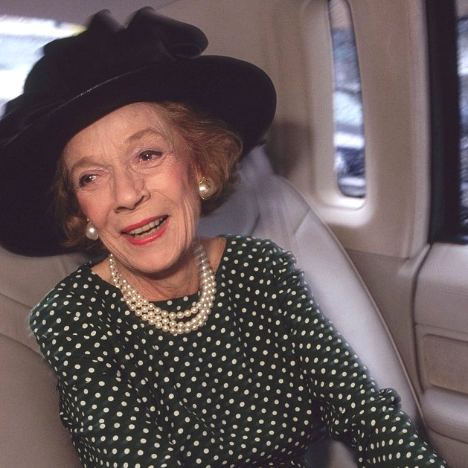
Brooke Astor. Photographer: Mark Peterson/CORBIS for The New York Times Magazine,
Notes:
Philanthropy
Before dying in 1959, Vincent Astor, my grandmother’s husband, established the Vincent Astor Foundation for the “alleviation of human suffering”.
My grandmother, as president, furthered the foundation’s mission by addressing the “quality of life”—achieved through “engaged philanthropy” decades before the practice was mainstream.
Well in to her 90s, she was center stage as “New York’s First Lady” and a “humanist aristocrat with a generous heart”.
_____
MARK PETERSON: UP CLOSE & PERSONAL, September 09, 2015
BY JIM COLTON
MP: One of my first assignments was for the New York Times Magazine, photographing Brooke Astor, the head of New York Society. I followed her around for several days. It was a world I had never seen before. One day we went to an elementary school in Harlem that Astor had given money to for library books. She was dressed in a Chanel dress with white gloves up to her elbows. The students looked at her like she was from Mars.
_____

Slide 7
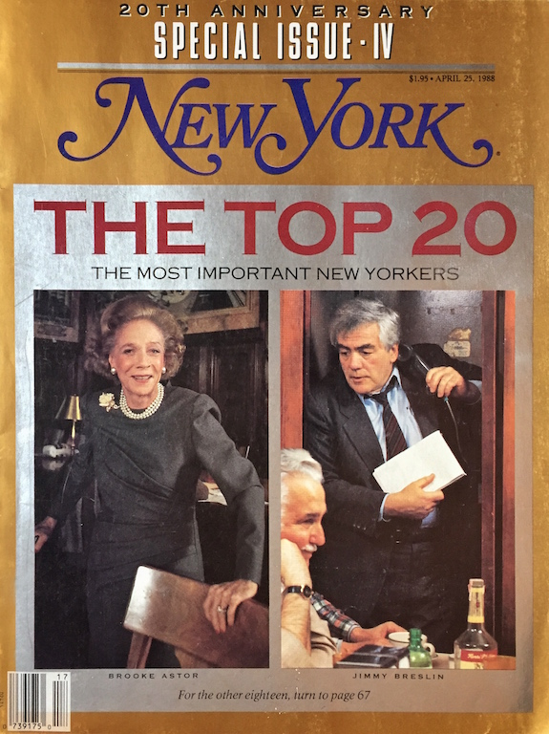
New York, cover. April 25, 1988.
Notes:
New York, cover. April 25, 1988.

Slide 8
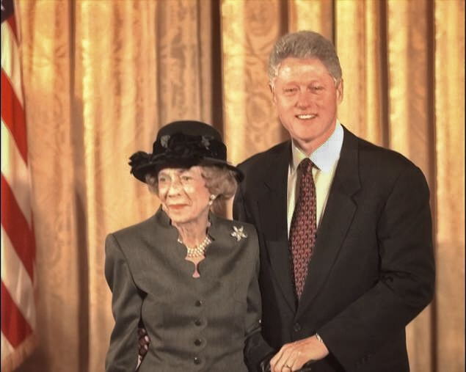
Brooke Astor (at age 96) and President Clinton, 1998. Photographer: Harry Hamburg.
Notes:
In 1998, at 96, she was awarded the Presidential Medal of Freedom by President Bill Clinton in recognition of her achievements.
By 100, she had disappeared from the limelight.
_____

Slide 9
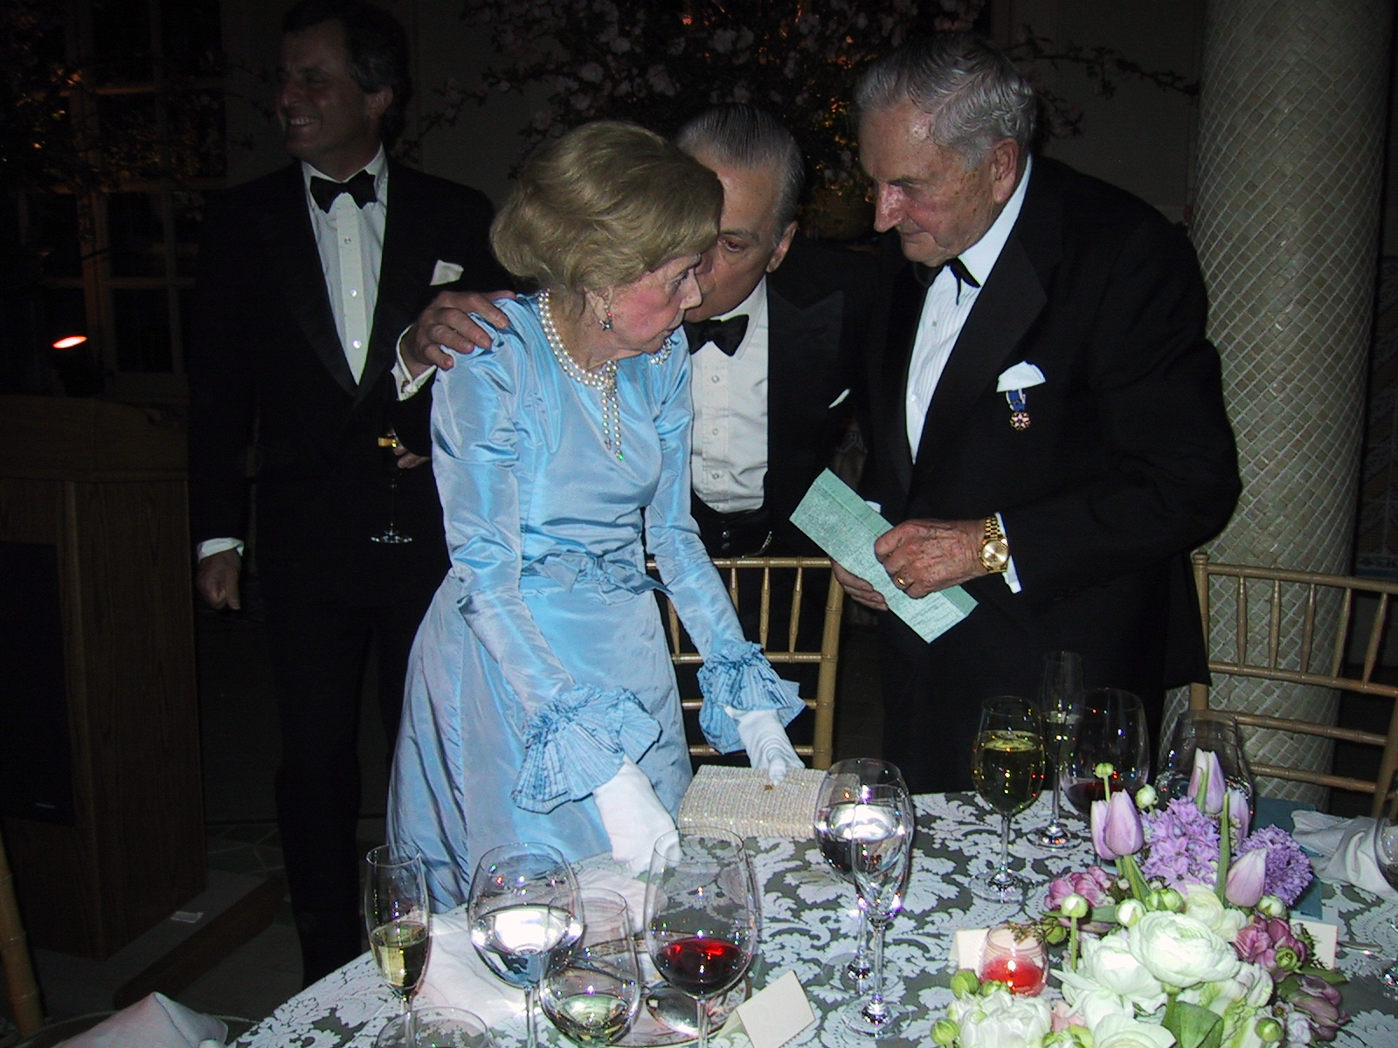
Brooke Astor and David Rockefeller (right), who hosted her 100th-birthday party at the Rockefeller estate, Pocantico Hills, New York, March 2002.
Notes:
Brooke Astor and David Rockefeller (right), who hosted her 100th-birthday party at the Rockefeller estate, Pocantico Hills, New York, March 2002.

Slide 10

Cakes at Brooke Astor’s100th-birthday party hosted by David Rockefeller, Pocantico Hills, New York, March 2002.
Notes:
Brooke Astor and David Rockefeller (right), who hosted her 100th-birthday party at the Rockefeller estate, Pocantico Hills, New York, March 2002.

Slide 11
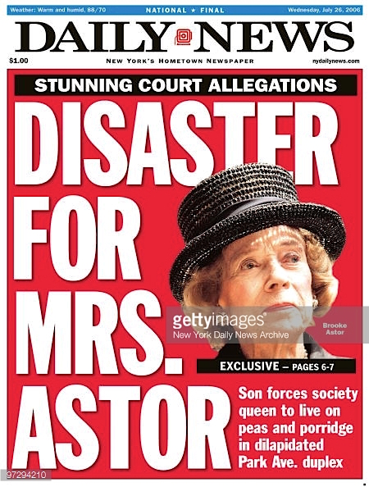
Front page, New York Daily News, July 26, 2006, Headline: Disaster for Mrs. Astor, Stunning Court Allegations. Getty Images, New York Daily News archives.
Notes:
This is until July 2006 when the content of my guardianship petition, which was to have been sealed, was discovered by the press—leading to front-page headlines reading “Disaster for Mrs Astor.”
My grandmother would certainly never want to be known as one of America’s most famous cases of elder abuse.
Nor did she, while in the throes of dementia, choose to be victimized; to be deprived, manipulated, and robbed—all as part of a calculated “scheme to defraud,” as later characterized by the Manhattan District Attorney.
Yet, the sad circumstances surrounding my grandmother have informed a timely, and timeless, cause in elder justice. This may be one of her greatest, most lasting legacies.
At 104, she unknowingly entered her second “encore career” as an advocate for elder Americans, including those two generations younger.
Just as her timing was critical with her intentional, philanthropy addressing “quality-of-life”which she started in the [her] sixties so, now, in her advanced age, she unintentionally advanced the cause of “quality of life at the end of life.”
One of the greatest impediments to elder justice is agism.
By example, my grandmother did so much to combat proactively this societal issue through the way she took on each day, year after year—from when she first headed the Vincent Astor Foundation in 1959 at age 57, to closing the foundation in 1997, when she was 95.
It is sadly ironic that my grandmother’s ageless attitude did not protect her from abuse and exploitation.

Slide 12

Brooke Astor and Chris Ely, Holly Hill, Briarcliff Manor, NY. 2002.
Notes:
— respecting my grandmother wish to “coming home” … nostalgia
— not just elder-abuse issue, societal issue
— agism
terminology: senior discount, elder abuse
— choice, free will, and self determination
I chose to act as I realize: to be complacent about elder justice is to be complicit in elder abuse.
And I realize: To be complacent about elder justice is to be complicit in elder abuse.
In fact, our national negligence is a proximate cause of elder abuse.
When our elders lose their sight, it's natural;
when we turn a blind eye to their plight, it’s negligent.
When our elders lose their hearing, it's natural;
when we are deaf to their cries for help, it’s negligent.
When our elders lose their voice, it's natural;
when we choose not to voice our concerns, it's negligent.
And when our elder’s capacity is reduced, it's natural;
when their assets are reduced, without consent, it's criminal.
_____
I could have disregarded heart-wrenching accounts, and discounted calls for help from staff, caregivers, and friends.
I could have found false consolation in thinking my grandmother had “had a good life” and, in the throes of dementia, wasn’t cognizant of her circumstances.
I could have maintained the fallacy that families should not air their dirty linen in public—even when financial assets are being laundered.
I could have been made complicit by the false prospect of “silence money” that would have increased my inheritance significantly.
I could have enabled my father by thinking “family first” and presume that my grandmother’s only child, only son—natural object of her affection—deserved all he sought.
But, I could never, ever live with any of these choices.
_____
Guardianship
Since the late 70s I have been a teacher and practitioner in conservation—architectural conservation.
As you can imagine, the term “conservator” took on new meaning as I desperately sought to help my grandmother.
After much work, I finally connected with my grandmother’s two closest friends, Annette de la Renta and David Rockefeller, who had managed to have my father open up her country house the year before.
We met in May 2006 and decided we must act.
It became clear that I should file a petition for guardianship.
We considered the option to speak with my father. But we knew that while my father held power of attorney for my grandmother, my father’s wife held power over him.
We also knew that, if my father was altered, my grandmother’s condition could be compromised—further.
Save a guardianship petition we had little recourse for my father was using his power of attorney as both a weapon…and a shield.
In July, in Supreme Court in New York City, I filed a petition seeking guardianship for my grandmother. It was supported by affidavits from friends, staff, and caregivers.
Immediately, temporary guardians of both her person and property were appointed. Lifelong friend Annette de la Renta (fashion designer Oscar de la Renta’s wife) was appointed as guardian for my grandmother. JPMorgan Chace was appointed as conservator of my grandmother’s assets.
The next week, we got my grandmother back to her country house to spend her last days free from fear.
On a side note, it was repeatedly reported in the media that I “sued” my father. Unfortunately, this inaccurate portrayal of my petition has done little to inform the public of options available for themselves—specifically about the critical role guardianship may play.
In my petition I stated that my father, with reference to his mother, ''… has turned a blind eye to her, intentionally and repeatedly ignoring her health, safety, personal and household needs, while enriching himself with millions of dollars.''
Immediately, my father lashed back at us—denying our accusations, mis-portraying our intentions, and intimidating us.
In October, after a three-month battle, and five days before our court date, a settlement was reached.
Temporary guardians were made permanent. My father returned over $11 million in assets and pledged over $10 million in collateral to cover any future claims. My father and two lawyers renounced any right to be appointed fiduciary.
_____

Slide 13
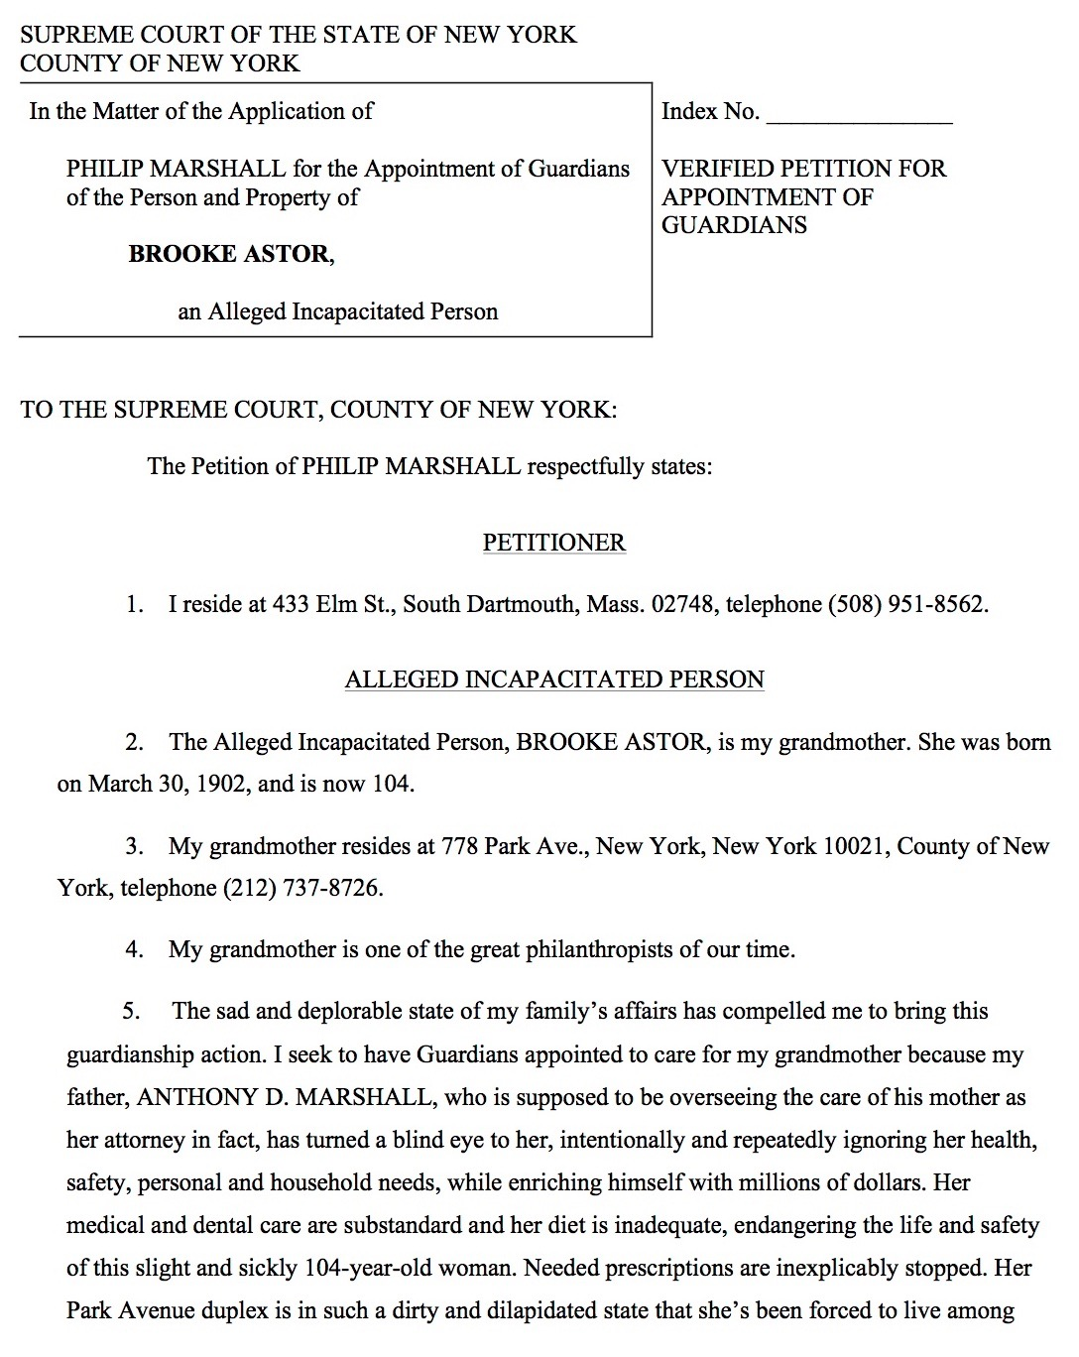
Guardianship Petition by Philip Marshall for Brooke Astor, Supreme Court of the State of New York, July 14, 2006, draft.
Notes:
Ira Salzman…
Through my guardianship petition, I learned a lot about choice and self-determination and supported decision making—not as much for my grandmother, as for myself, with so much help from so many.
I chose to act as I realize: to be complacent about elder justice is to be complicit in elder abuse.
And, through my decades, the day I exercised my greatest self-determination was when I signed my guardianship petition.
I learned so much about supportive decision-making: in helping my fragile, abused grandmother I was not alone.
Her abuse galvanized a collective, coordinated response by family, friends, staff, and caregivers all united by compassion and a common cause.
Individuals-in-sum with a great mixed skill-set. The strength of our diversity contributed much to our success.
At the outset, all we dreamed and prayed for was to be able to respect my grandmother’s wishes to return to her country house to end her days with care, comfort, and dignity.
But, once we took action, it was clear that we were addressing a much greater, national issue.
_____

Slide 14
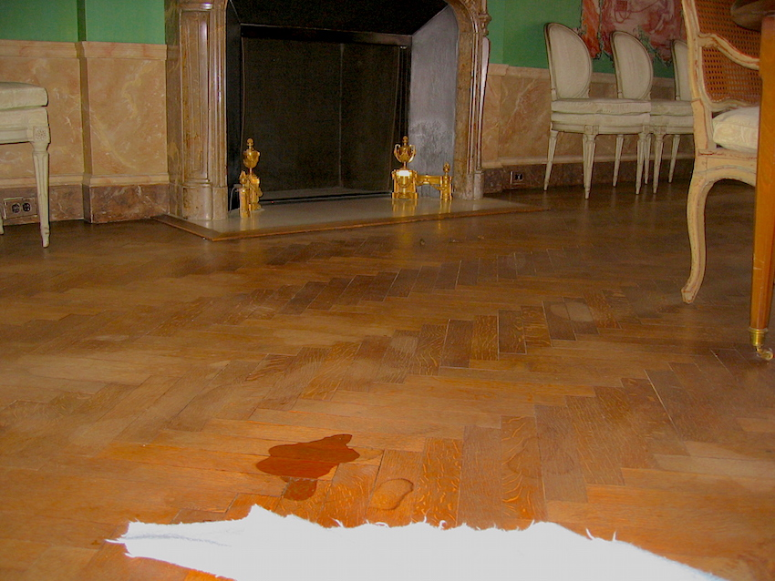
Guardianship
“Her bedroom is so cold in the winter that my grandmother is forced to sleep in the TV room in torn nightgowns on a filthy couch that smells, probably from dog urine.”
Guardianship Petition by Philip Marshall for Brooke Astor
Supreme Court of the State of New York. July 14, 2006, draft.
Dining room
778 Park Avenue, New York April 2, 2006.

Slide 15
Guardianship
“Now, because my grandmother’s weekday cook is poorly supervised by my father, my grandmother is reduced to eating oatmeal, Ensure and hot water for breakfast; pureed carrots and liver for lunch; and pea soup and ice water for dinner, Monday through Friday, week after week. A motivated weekend cook provides my grandmother with a variety of much tastier food.”
Guardianship Petition by Philip Marshall for Brooke Astor
Supreme Court of the State of New York. July 14, 2006, draft.

Slide 16
Guardianship
“My father is engaging in a consistent pattern of enriching himself at the expense of my grandmother. For example, in 2005 he took $2,384,999.92 in salary from her, presumably for overseeing her care and managing her affairs. (Anthony D. Marshall’s 2005 W-2 attached as Exhibit “D”).”
Guardianship Petition by Philip Marshall for Brooke Astor
Supreme Court of the State of New York. July 14, 2006, draft.

Slide 17
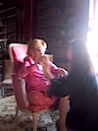
Guardianship
“One of the aides who takes care of my grandmother was present this past spring when my father questioned my grandmother’s physical therapist about the continuing need for physical therapy three times per week. The physical therapist expressed the opinion that physical therapy three times per week was in her best interest. Shortly thereafter, the frequency of physical therapy was reduced…”
Guardianship Petition by Philip Marshall for Brooke Astor,. Supreme Court of the State of New York.
July 14, 2006, draft.
Brooke Astor with therapist, June 20, 2006.

Slide 18
Guardianship
“She is unable to make decisions for herself. She is, however, alert and aware of her surroundings. She will smile when she sees a friend or a caretaker whom she likes. If there is something happening that she does not like, she will comment in some manner or use a gesture to maker her objection known. There is no doubt in my mind that my grandmother, BROOKE ASTOR, is in need of Guardians as provided for in Article 81 of the Mental Hygiene Law (MHL)…”
Guardianship Petition by Philip Marshall for Brooke Astor
Supreme Court of the State of New York. July 14, 2006, draft.

Slide 19
Guardianship (notes)
778 Park Avenue (BA residence)
Daniel Billy – keep away from office, retain laptop computer, lay off
Charlene Marshall – keep away from Brooke at all times
Tony Marshall – only allow when caretaker is in attendance
When can Brooke’s friends start visiting?
Country House, “Holly Hill” in Briarcliff
Chris Ely, former estate manager – rehire
When can Chris be rehired?
Personal notes, Philip Marshall. July 23, 2006.

Slide 20
elder ecology
Notes:
elder ecology
capacity — testamentary capacity
influence — undue influence
_____
Bronfenbrenner, U. (1979). The ecology of human development. Cambridge, MA: Harvard University Press.
Deborah Norris PhD , Pamela Fancey MA , Erin Power MPA & Pamela Ross MA (2013) The Critical-Ecological Framework: Advancing Knowledge, Practice, and Policy on Older Adult Abuse, Journal of Elder Abuse & Neglect, 25:1, 40-55 [Critical ecological model]
Karl Pillemer, Director, Cornell Bronfenbrenner Center for Translational Research, College of Human Ecology, Cornell University, http://www.bctr.cornell.edu
_____
Urie Bronfenbrenner…
Ecological systems theory, also called development in context or human ecology theory, identifies five environmental systems with which an individual interacts. The person's own biology may be considered part of the microsystem; thus the theory has recently sometimes been called "Bio-Ecological Systems Theory.”
“Furthermore, an ecological approach to the study of human development requires a reorientation of the conventional view of the proper relation between science and public policy. The traditional position, at least among social scientists, is that whenever possible social policy should be based on scientific knowledge. The line of thought I develop in this volume leads to a contrary thesis: in the interests of advancing fundamental research on human development, basic science needs public policy even more than public policy needs basic science. Moreover, what is required is not merely a complementary relation between these two domains but their functional integration.” (Brofenbrenner p.8) — reciprocal relation science and policy
In the context of Bronfenbrenner's ecological systems theory, this “requires a reorientation of the conventional view of the proper relation between science and public policy.” He notes that, “The traditional position, at least among social scientists, is that whenever possible social policy should be based on scientific knowledge.” What he counters is that, “basic science needs public policy even more than public policy needs basic science” with a “functional integration.” (Bronfenbrenner, date, p.8)
Specifically, five levels of environment--microsystem, mesosystem, exosystem, macrosystem, and chronosystem--will be utilized to organize and interpret existing research on the risk factors associated with elder abuse (Bronfenbrenner, 1979, 1986, 1997).
____
— P. 42, “Some also suggest that research examining victims is less likely to be funded than other research. The fact that funding is restricted for white-collar crime research, victimology research, and family violence research stacks the cards against research examining elder abuse crime victims. The lack of funding initiatives for research examining senior citizens issues in criminal justice granting agencies compounds the problem even more.”
— Pp. 38, “Describing the way that political issues actually become issues is not an exact science. Rather, a certain amount of speculation is needed. Nonetheless, Cobb and Elder (1983) developed an agenda building framework that outlines the way that issues change, broaden, and become significant to the general public.
According to Cobb and Elder, this model includes four levels:
issue creation,
issue awareness,
agenda entrance, and
issue resolution (see Figure 1).
Applying this model to elder abuse helps demonstrate the way that history has affected the way that behavioral scientists have examined this area.”
_____
Philip (part of talk removed from North Dakota) >
Ecology
I wish to discuss ecology, the “study of home.”
In 2013, Norris and co-writers at Mount Saint Vincent in Nova Scotia, address the concepts of “ecological theory” and “critical theory.”
Ecological theory considers reciprocal exchanges to maintain equilibrium in a system—and in relationships. In this arena, your work with persons under guardianship provides us with an opportunity to reframe the ecology of elder justice.
Relationships are also informed by our understanding of power relations, as described by critical theory. As guardians, you have so much to bring to the table when we discuss such relationships.
While many people who address family abuse consider control and power in a pathological context, your effort as guardians help frame our work with elders in a considerate, constructive context, which is so needed and can be so transformative.
Abuse is the, “…violent manifestation of unequal power relations.” (Norris, 2013)
Through you, guardianships allow us to consider intentionally how we care for others when our conventional equilibrium of relationships, which are predicated on independence and interdependence, are no longer as relative or reciprocal.
____
Our ‘elder economy’ is placed in the broader context of ‘elder ecology’— realizing that ecology is the “study of the household,” while economy translates as the “management of the household.”
This ecology can assess the “contextural risk factors” considered by Schiamberg and Gans (2000) in changing environments.
chronic stressors, acute shock, chronic stressors, + awareness… critical capacities
The following critical capacities pertain, first here, to elders; equally so to the rest of us; and, pertinent to today with an intentional realization that employs our digital domain (specifically big data) to prevent, predict and respond to elder financial exploitation—with our care for elders leading the way.
_____

Slide 21



elder ec logy
micro-
meso-
exo-
macro-
Bronfenbrenner, Uri.
Ecological Model of Human Development. Adapted.
chrono-systems
Notes:
personal
interpersonal
organizational
community
policy
_____
Uri Bronfenbrenner… Ecological systems theory, also called development in context or human ecology theory, identifies five environmental systems with which an individual interacts. The person's own biology may be considered part of the microsystem; thus the theory has recently sometimes been called "Bio-Ecological Systems Theory."
“Furthermore, an ecological approach to the study of human development requires a reorientation of the conventional view of the proper relation between science and public policy. The traditional position, at least among social scientists, is that whenever possible social policy should be based on scientific knowledge. The line of thought I develop in this volume leads to a contrary thesis: in the interests of advancing fundamental research on human development, basic science needs public policy even more than public policy needs basic science. Moreover, what is required is not merely a complementary relation between these two domains but their functional integration.” (Brofenbrenner p.8) — reciprocal relation science and policy
In the context of Bronfenbrenner's ecological systems theory, this “requires a reorientation of the conventional view of the proper relation between science and public policy.” He notes that, “The traditional position, at least among social scientists, is that whenever possible social policy should be based on scientific knowledge.” What he counters is that, “basic science needs public policy even more than public policy needs basic science” with a “functional integration.” (Bronfenbrenner, date, p.8)
Specifically, five levels of environment—microsystem, mesosystem, exosystem, macrosystem, and chronosystem--will be utilized to organize and interpret existing research on the risk factors associated with elder abuse (Bronfenbrenner, 1979, 1986, 1997).
o P. 42, “Some also suggest that research examining victims is less likely to be funded than other research. The fact that funding is restricted for white-collar crime research, victimology research, and family violence research stacks the cards against research examining elder abuse crime victims. The lack of funding initiatives for research examining senior citizens issues in criminal justice granting agencies compounds the problem even more.”
— Pp. 38, “Describing the way that political issues actually become issues is not an exact science. Rather, a certain amount of speculation is needed. Nonetheless, Cobb and Elder (1983) developed an agenda building framework that outlines the way that issues change, broaden, and become significant to the general public. According to Cobb and Elder, this model includes four levels: issue creation, issue awareness, agenda entrance, and issue resolution (see Figure 1). Applying this model to elder abuse helps demonstrate the way that history has affected the way that behavioral scientists have examined this area.”
_____
Karl Pillemer, Director Bronfenbrenner Center for Translational Research
Hazel E. Reed Professor in the Department of Human Development
Director, Cornell Institute for Translational Research on Aging
Professor of Gerontology in Medicine at the Weill Cornell Medical College
http://www.bctr.cornell.edu/projects/cornell-institute-for-translational-research-on-aging/

Slide 22

Clinical Capacity
Capacity Judgement
has capacity
has capacity
diminished capacity
lacks capacity
lacks capacity
Assessment of Older Adults with Diminished Capacity: A Handbook for Psychologists, American Bar Association Commission on Law and Aging, American Psychological Society, Association Assessment of Capacity in Older Adults Project Working Group, p. 29, 2008.
Notes:
Assessment of Older Adults with Diminished Capacity: A handbook for psychologists, American Bar Association Commission on Law and Aging, American Psychological Society, Association Assessment of Capacity in Older Adults Project Working Group, 2008
_____

Slide 23
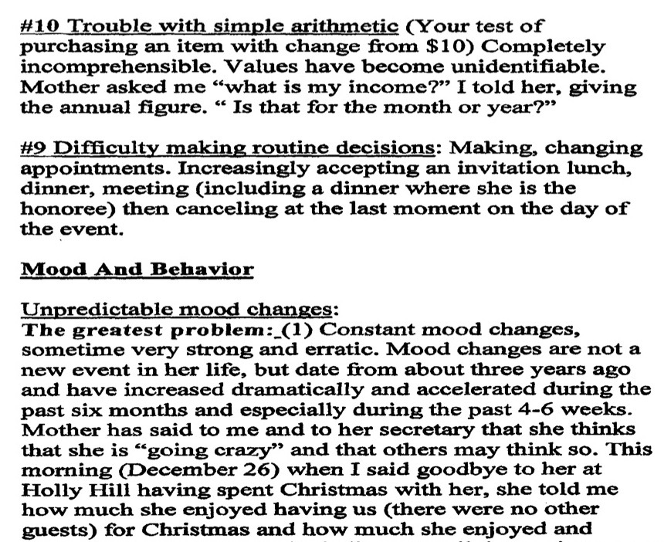
Letter from Anthony D. Marshall to Howard Fillit, M.D., neurologist, gerontologist, December 26, 2000.
Notes:
Seven-page letter from Anthony D. Marshall to Howard Fillit, M.D., neurologist, gerontologist. December 26, 2000.
_____
Re Alzheimers: Staff given list by Tony Marshall—but not any help. Contact BA’s lawyer. No medial backup.
_____

Slide 24
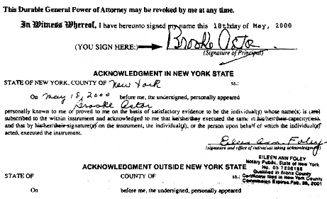

Durable General Power of Attorney by Brooke Astor to Anthony Marshall and Henry Christensen. May 18, 2000.
Notes:
Brooke Astor and David Rockefeller (right), who hosted her 100th-birthday party at the Rockefeller estate, Pocantico Hills, New York, March 2002.

Slide 25

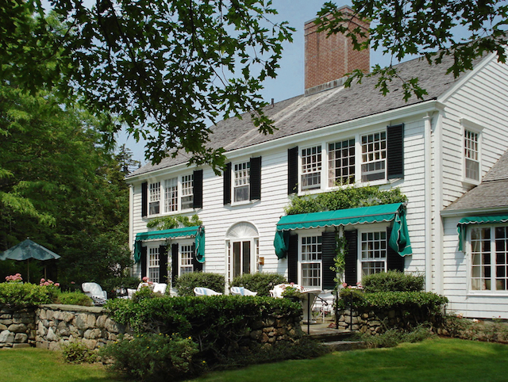
Brooke Astor, hiking in Maine above Northeast Harbor., c.1976
Cove End, Northeast Harbor, Maine.
Notes:
Red Flags top
After her hundredth birthday, I grew increasingly concerned for my grandmother. I began speaking with her supportive staff.
Here are but two—of too many—incidents.
A transaction in early 2002 raised red flags. I heard that while my father was cutting back on my grandmother’s expenses he had sold her favorite painting—one that she had bequeathed to the Metropolitan Museum of Art.
The sale realized $10 million, two of which my father kept as a “commission.”
On hearing of the sale, my grandmother, who had been led to believe she was running out of money, asked, "Now, can I buy dresses?"
My grandmother loved the peace and nature of her country house, where she had hoped to spend her final days.
In early 2005, my father closed the house and fired my grandmother’s most loyal staff member, her butler Chris Ely.
Later, back in her New York apartment, caregivers showed my grandmother a photograph of Chris. She thought he must have died because she couldn’t understand why else he was gone.
In mid 2005, only through the pressure of two of my grandmother’s closest friends, my father reluctantly agreed to reopen her country house.
I barely knew these friends at the time, but I was so grateful when I heard about their intervention.
But, by fall, my grandmother was back in New York City.
In early 2006, I spoke with more staff and caregivers. After hearing many new, independent accounts I became much more concerned—concerned not only about my grandmother’s compromised lifestyle; I was now concerned for her emotional and physical care—and for her life.
If my father and his wife had simply “taken” money and property of hers, but had provided for my grandmother, this story might have played out differently.
In fact, given her means, it would have been easy to provide what my grandmother wished for at the end of her life. As we learned later: support for a year would have cost much less than the legal fees for a week in criminal court.
But to witness my father and his wife’s greed, at my grandmother’s expense—at the cost of her psychological and physical well being—was something none of us could bear.
I was still not sure what to do. I sought advice from several trusted people including a sage high-school friend whose own family had been through a similar experience. He advised, “Philip, follow your heart first; then follow the money.”
Our greatest concern was my grandmother’s psychological abuse, one of the most difficult forms of elder abuse to give credence to much less document and assess.
So, in large part, the fallback was the financials.
This said, I am painfully aware that psychological and physical abuse, and neglect…and deprivation all go hand in hand with financial abuse as a means to manipulate and exploit elders—including my grandmother.
_____
Childe Hassam. Flags, Fifth Avenue (also known as Up the Avenue from 34th Street, May 1917) in Brooke Astor’s Library, 778 Park Avenue, New York, May 23, 2001.
_____
http://www.nytimes.com/2006/09/01/nyregion/01astor.html
http://www.artsjournal.com/culturegrrl/2012/03/brooke_astor_settlement_belate.html
According to the Met, “Although Mrs. Astor bequeathed this iconic work to the Metropolitan, it was wrongly sold in 2002. [The AG says it was in 2003.] The painting’s current whereabouts are unknown. The museum continues to regret that it will be unable to display the work for its public as Mrs. Astor so long hoped.”
A 2008 report by Serge Kovaleski in the NY Times said that Marshall, “who had the authority to oversee her [Astor’s] financial affairs, sold the painting to a gallery for about $10 million. Mr. Marshall—accused by his son in court papers of neglecting the needs of Mrs. Astor while enriching himself—took a 20 percent commission on the deal, or $2million.” The settlement provides the Met with $3 million (part of its $20 million), “in full satisfaction of its claim regarding the Childe Hassam.”
Although the settlement more than halved Marshall’s inheritance, he’s still left with a tidy $14.5 million.
Negotiations were led by the AG’s Charities Bureau chief, Jason Lilien, along with Assistant Attorneys General Carl Distefano and Lisa Barbieri.
_____

Slide 26


Childe Hassam. Flags, Fifth Avenue in Brooke Astor’s Library, 778 Park Avenue, NY, May 23, 2001.
Brooke Astor’s Library, 778 Park Avenue, New York, circa 2007.
Notes:
“Now may I buy dresses.”
Red Flags top
After her hundredth birthday, I grew increasingly concerned for my grandmother. I began speaking with her supportive staff.
Here are but two—of too many—incidents.
A transaction in early 2002 raised red flags. I heard that while my father was cutting back on my grandmother’s expenses he had sold her favorite painting—one that she had bequeathed to the Metropolitan Museum of Art.
The sale realized $10 million, two of which my father kept as a “commission.”
On hearing of the sale, my grandmother, who had been led to believe she was running out of money, asked, "Now, can I buy dresses?"
My grandmother loved the peace and nature of her country house, where she had hoped to spend her final days.
In early 2005, my father closed the house and fired my grandmother’s most loyal staff member, her butler Chris Ely.
Later, back in her New York apartment, caregivers showed my grandmother a photograph of Chris. She thought he must have died because she couldn’t understand why else he was gone.
In mid 2005, only through the pressure of two of my grandmother’s closest friends, my father reluctantly agreed to reopen her country house.
I barely knew these friends at the time, but I was so grateful when I heard about their intervention.
But, by fall, my grandmother was back in New York City.
In early 2006, I spoke with more staff and caregivers. After hearing many new, independent accounts I became much more concerned—concerned not only about my grandmother’s compromised lifestyle; I was now concerned for her emotional and physical care—and for her life.
If my father and his wife had simply “taken” money and property of hers, but had provided for my grandmother, this story might have played out differently.
In fact, given her means, it would have been easy to provide what my grandmother wished for at the end of her life. As we learned later: support for a year would have cost much less than the legal fees for a week in criminal court.
But to witness my father and his wife’s greed, at my grandmother’s expense—at the cost of her psychological and physical well being—was something none of us could bear.
I was still not sure what to do. I sought advice from several trusted people including a sage high-school friend whose own family had been through a similar experience. He advised, “Philip, follow your heart first; then follow the money.”
Our greatest concern was my grandmother’s psychological abuse, one of the most difficult forms of elder abuse to give credence to much less document and assess.
So, in large part, the fallback was the financials.
This said, I am painfully aware that psychological and physical abuse, and neglect…and deprivation all go hand in hand with financial abuse as a means to manipulate and exploit elders—including my grandmother.
_____
Childe Hassam. Flags, Fifth Avenue (also known as Up the Avenue from 34th Street, May 1917) in Brooke Astor’s Library, 778 Park Avenue, New York, May 23, 2001.
_____
http://www.nytimes.com/2006/09/01/nyregion/01astor.html
http://www.artsjournal.com/culturegrrl/2012/03/brooke_astor_settlement_belate.html
According to the Met, “Although Mrs. Astor bequeathed this iconic work to the Metropolitan, it was wrongly sold in 2002. [The AG says it was in 2003.] The painting’s current whereabouts are unknown. The museum continues to regret that it will be unable to display the work for its public as Mrs. Astor so long hoped.”
A 2008 report by Serge Kovaleski in the NY Times said that Marshall, “who had the authority to oversee her [Astor’s] financial affairs, sold the painting to a gallery for about $10 million. Mr. Marshall—accused by his son in court papers of neglecting the needs of Mrs. Astor while enriching himself—took a 20 percent commission on the deal, or $2million.” The settlement provides the Met with $3 million (part of its $20 million), “in full satisfaction of its claim regarding the Childe Hassam.”
Although the settlement more than halved Marshall’s inheritance, he’s still left with a tidy $14.5 million.
Negotiations were led by the AG’s Charities Bureau chief, Jason Lilien, along with Assistant Attorneys General Carl Distefano and Lisa Barbieri.
_____

Slide 27
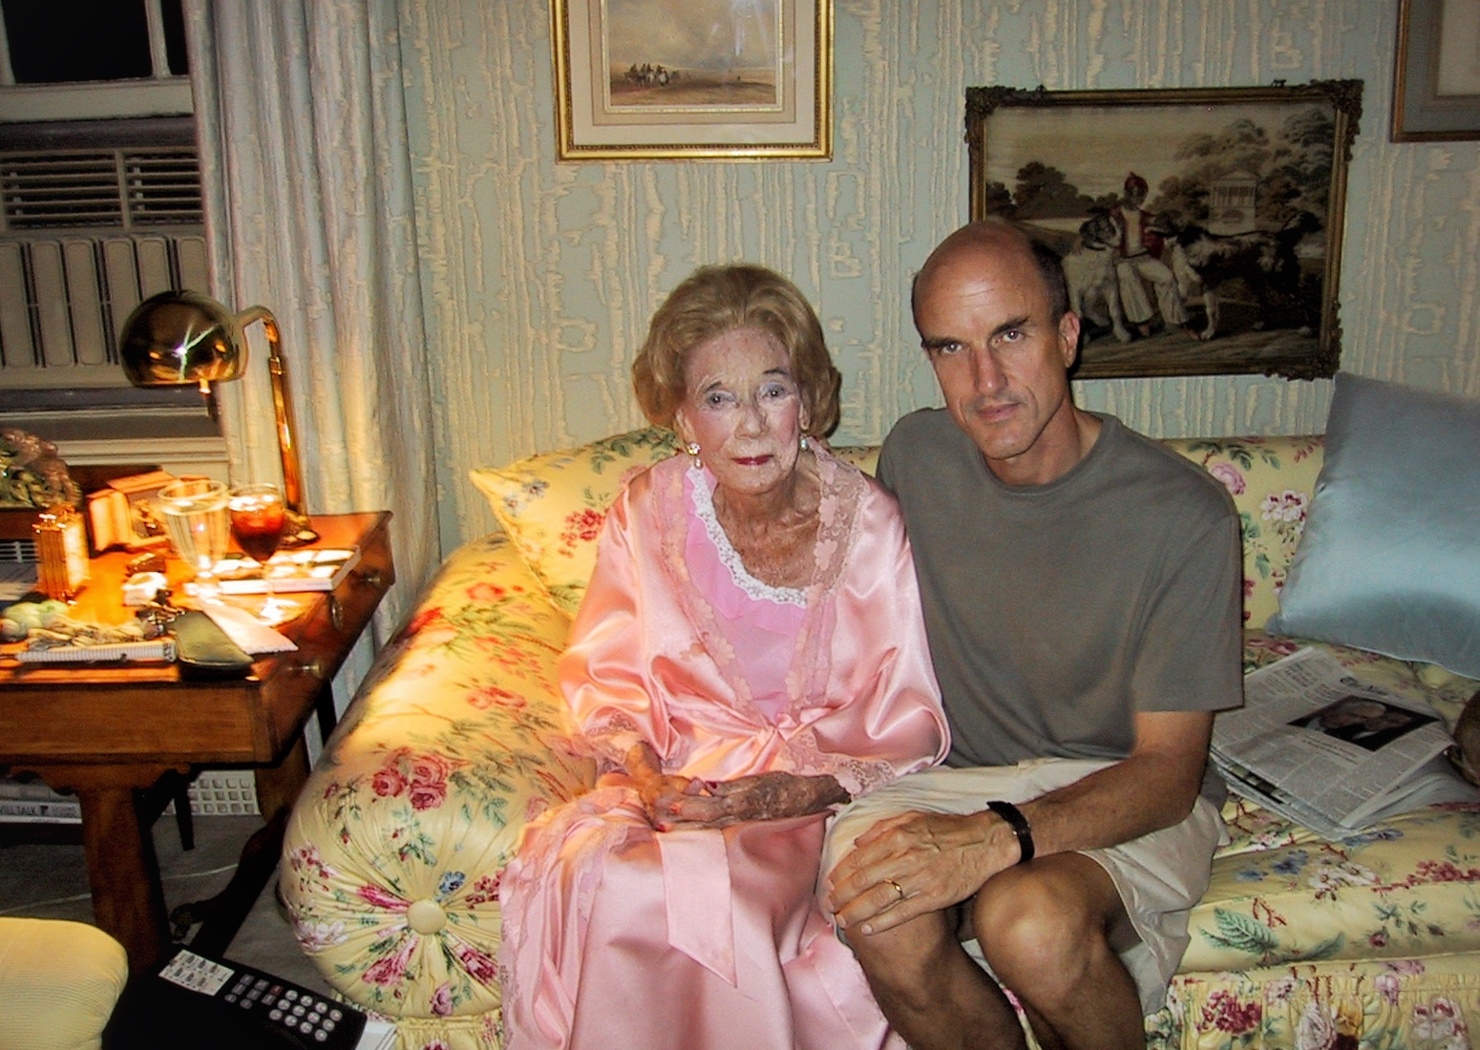
Brooke Astor and Philip Marshall in the library, 778 Park Avenue, NY. October 3, 2002.
Notes:
Brooke Astor and Philip Marshall in the library, 778 Park Avenue, NY. November 2003.
_____
Personal notes (prepared for the District Attorney)
October 2 and 3, 2002
New York
On October 3, I was planning to see my grandmother in her apartment for dinner. My father told me that my grandmother was not feeling well and I could not have dinner with her. That evening, I ran up (from the Knickerbocker Club) to deliver flowers via the doorman. When I arrived, through intercom, I was told that my grandmother was feeling better and it was suggested I come up for a few minutes, which I did.
_____

Slide 28
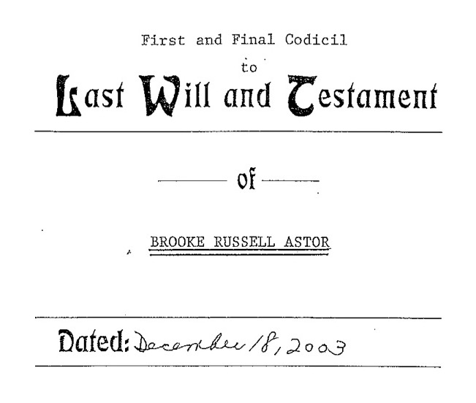
First and Final Codicil, Last Will and Testament of Brooke Russell Astor. Dated: December 18, 2003. Executed by Henry Christensen III, Senior Partner, Trust and Estates, Sullivan & Cromwell LLP
Notes:
Paul Cravath summary:
Reduces distribution from Vincent Astor Foundation Trust by 49% by reducing distributions to the NYLP and MET from 25% each to 8%;
Reduces other distributions by comparable amounts and puts the difference (i.e. 49%) in a charitable trust call the Anthony Marshall Fund and gives Mr. Marshall sole discretion to distribute the Funds to charity.
_____

Slide 29
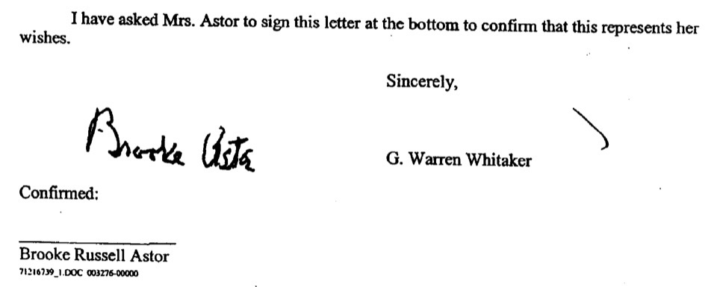
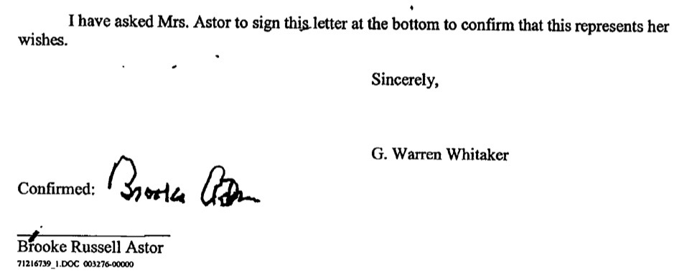
Letter from G. Warren Whitaker to Henry Christiansen, III, signed by Brooke Astor, re: Brooke Russell Astor [Power of Attorney], February 4, 2004, two versions.

Slide 30
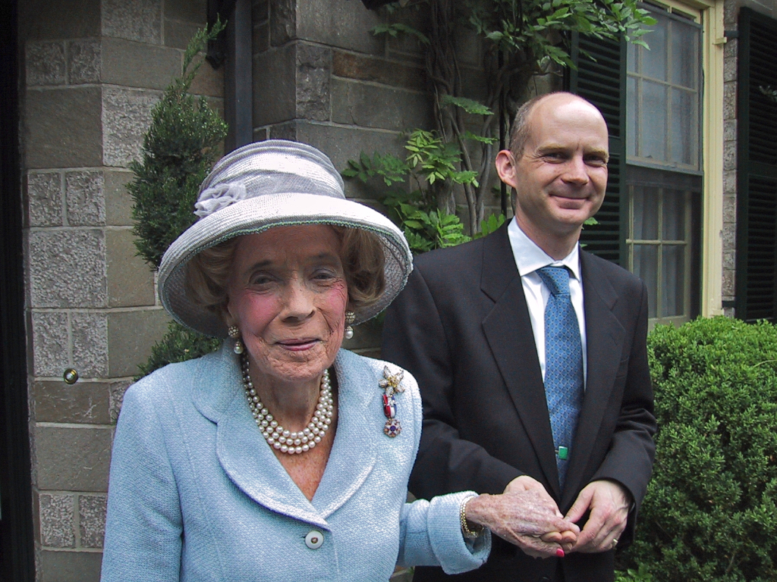
Brooke Astor and Chris Ely, Briarcliff Manor, NY. 2003.
Notes:
In my guardianship petition I sought to help my grandmother—and to help those who were helping her, yet whose efforts had been so compromised by my father.
_____
Staff: unsung heroes.
Chris… accustomed to what she was used to.
Alec, re being asked it he wanted Holly Hill, “It was too late.”

Slide 31

Personal records to be shredded. Mrs. Astor’s office, 778 Park Avenue, New York. Early 2006.

Slide 32
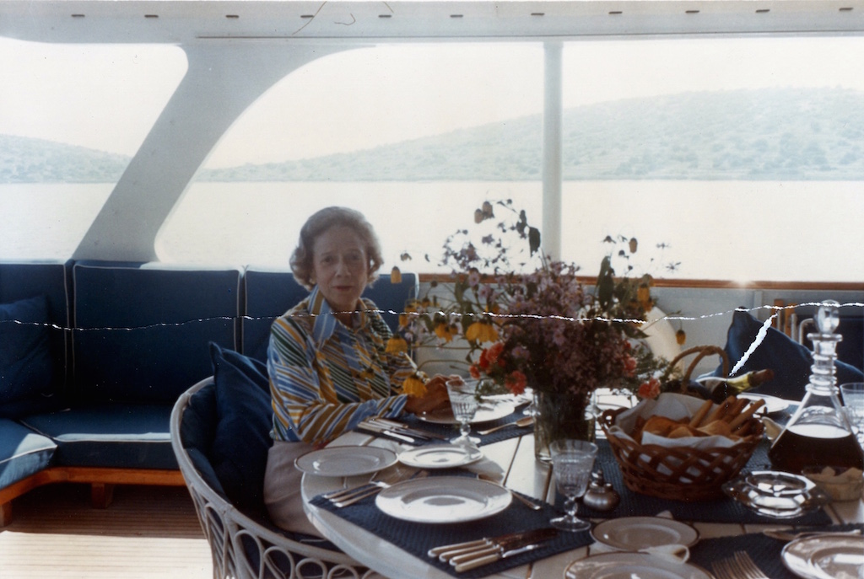
Brooke Astor, 1970s. Photograph from trash in downstairs office, 778 Park Avenue, New York, early 2006.

Slide 33
Elder Abuse
“Although this matter voluntarily settled before the hearing, I find the petitioner Philip Marshall was the prevailing party…”
“I make this ruling based on the conclusion of the court evaluator that the allegations in the petition regarding Mrs. Astor’s medical and dental care, and the other allegations of intentional elder abuse by the Marshalls, were not substantiated.”
Guardianship of Brooke Astor. Judge John E. H. Stackhouse, December 4, 2006
Notes:
Aftermath
In a December 2006 court decision, which largely addressed payment of legal fees, the guardianship Judge authorized reimbursement of my legal fees for bringing the guardianship petition, stating “Although this matter voluntarily settled before the hearing, I find the petitioner Philip Marshall was the prevailing party…”
Yet the judge also decided to award my father a portion of his legal fees, writing, “I make this ruling based on the conclusion of the court evaluator that the allegations in the petition regarding Mrs. Astor’s medical and dental care, and the other allegations of intentional elder abuse by the Marshalls, were not substantiated.”
I believe the court evaluator’s report never connected the dots and decimal points.
It never made a connection between the allegations in the guardianship petition and an appendix to his report: a long list of financial dealings, totaling tens of millions of dollars, identified by the temporary guardian of the purse, JPMorgan Chase.
Notably, Chase’s discovery was limited…as the court had denied the bank’s motion seeking expanded powers to conduct wide-reaching discovery, with subpoena power.
Further, the Judge had ruled [September 16, 2006] that “...[w]hile the propriety of the transfers of money and property to Anthony and Charlene Marshall is a key subject of the guardianship proceeding, it is not the Bank’s role to prove or disprove any of the allegations of the Petition.”
Now, nor did it seem to be the court evaluator’s role—when he dismissed these “transfers” as having no bearing on the case.
Nonetheless, these transfers had directly affected our out-of-court settlement. Guardianship was settled, and won, in large part, due to these financial findings.
The court evaluator’s report opened the door wide to claims that this was not elder abuse.
This claim probably has much to do with the widely misunderstood definition of abuse.
“Astor son is cleared”, headlined The New York Times, which quoted my father’s lawyer saying, “This is a case that was given birth from allegations that were absolutely fictitious regarding Mr. Marshall’s care of his mother.’”
On the dark December day of this decision, our Pyrrhic victory found us losing the war against elder abuse.
Was my grandmother’s guardianship to be elder justice’s Plessey v Ferguson?
Were we to repurpose the family’s dirty laundry as surrender flags, giving up on the greater cause in to which we had been so thrust?
Before guardianship, my grandmother was traumatized and in jeopardy. However she did not endure double jeopardy by being ‘revictimized’—only because she was not cognizant of the judge’s finding that, “elder abuse was not substantiated.”
In August 2007 my grandmother died at home, in peace, with grace and dignity, free from fear—and surrounded by loved ones.
Then, in Surrogate’s (in Westchester County), my father filed her 2002 will and two of three codicils—making changes that would give him control of almost $100 million.
_____

Slide 34
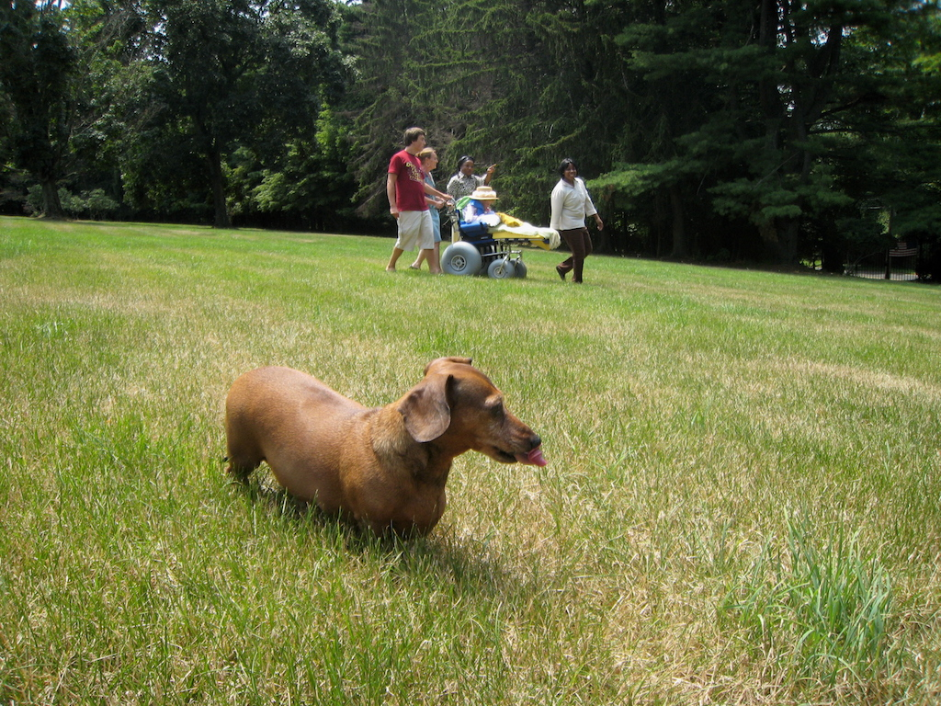
Brooke Astor with family and caregivers at Holly Hill, Briarcliff Manor, New York. July 2007.
Notes:
Brooke Astor with family and caregivers at Holly Hill, Briarcliff Manor, New York. July 2007.
____

Slide 35
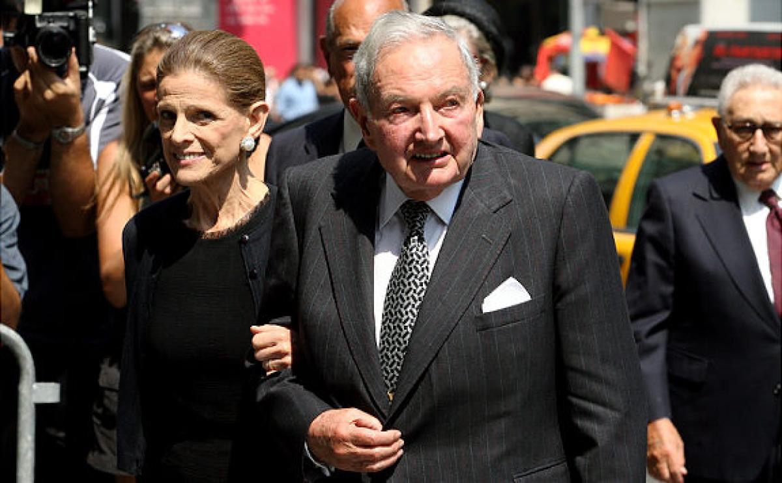
Annette de la Renta and David Rockefeller at Brooke Astor’s funeral, St. Thomas Church, New York. August 17, 2007. New York Daily News.
Notes:
http://www.nydailynews.com/news/astor-funeral-gallery-1.12162?pmSlide=1.12168
_____

Slide 36
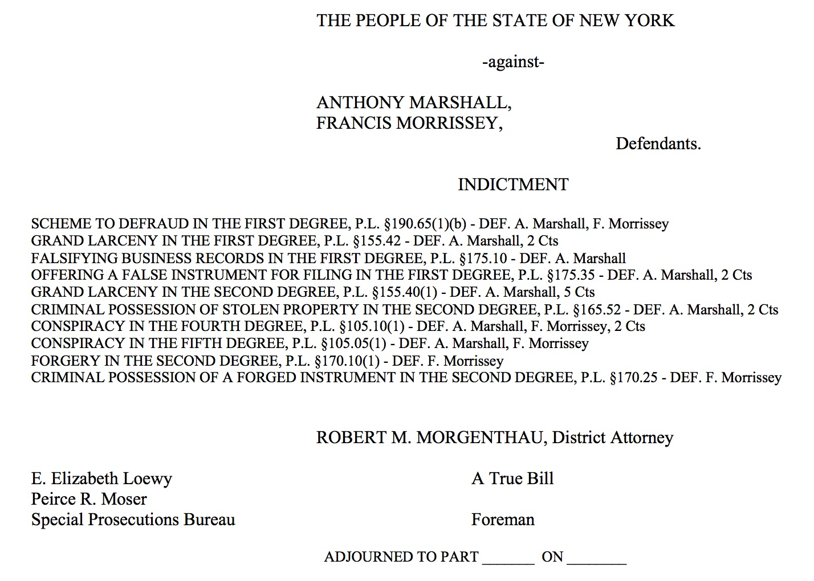
Brooke Astor's Son and Son's Attorney Are Indicted by a New York Grand Jury on Charges Alleging They Conspired to Defraud and Steal Millions From Her Estate, FindLaw.com, November 2007
Notes:
http://graphics8.nytimes.com/packages/pdf/nyregion/20071127_INDICT.pdf
Grand Jury

Slide 37
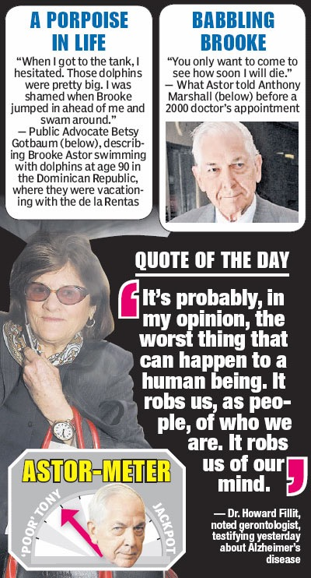
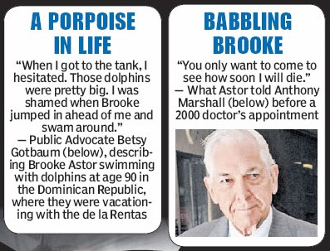
New York Post. May 6, 2009.
Reporting on criminal trail.
At age 90………………and 98.

Slide 38
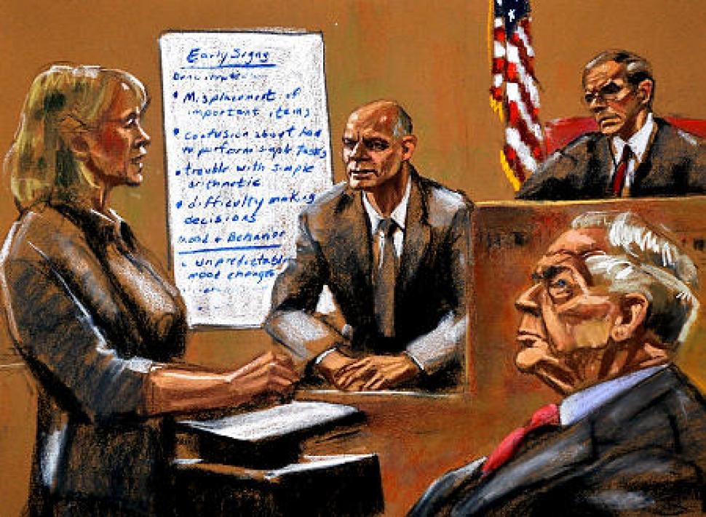
“Brooke Astor was not all there, ex-butler Chris Ely says in trial of Astor's son Anthony Marshall.” Joanna Molloy, New York Daily News, June 9, 2009. Sketch: Jane Rosenberg.
Notes:
http://www.nydailynews.com/new-york/brooke-astor-not-ex-butler-chris-ely-trial-astor-son-anthony-marshall-article-1.374041
Brooke Astor was not all there, ex-butler Chris Ely says in trial of Astor's son Anthony Marshall. Joanna Molloy, New York Daily News, June 9, 2009. Sketch: Jane Rosenberg.
_____
Back in October, only days after the guardianship was settled, a criminal investigation was launched by the Manhattan District Attorney.
With such great care on lawyer #3’s part to be at arm’s length from dealings, it is ironic to think that his final act, the execution of the third codicil, was the first matter that prompted the DA to take action.
In December 2006, just as my father declared that he had been vindicated, the DA’s office expanded its work, empanelled a grand jury and issued subpoenas.
In November 2007, my father and the third lawyer, Francis Morrissey, were indicted.
In April 2009 the criminal trail began—and proceeded, for months.
Today, you now know much more about the guardianship case than the jury did, even after six months.
That’s because all of the guardianship proceedings were barred from being introduced in criminal court.
For me, taking the stand was difficult. But not taking a stand, and not helping my grandmother, would have been more so.
Testifying against my father was very difficult.
But, more difficult, was having to recount the trauma imposed on my grandmother—all the while not being able to tell my whole story to the jury.
The jury’s verdict: My father was found guilty on 15 of the 16 counts against him.
After a spring and long, long summer of my father’s trail and after heart-wrenching testimony, this was a very bittersweet harvest.
Yet, this harvest has so nourished the cause of elder justice.
We had advanced from tribulation to trail. From the tribulation of hearing the allegations in my petition for guardianship were “unsubstantiated,” to a criminal trial that proved otherwise.
Even though much evidence was barred in the criminal court, I feel that the jury understood how elder abuse was used as a means to exploit and enrich in my father’s scheme to defraud his mother.
Save one, all counts were upheld upon appeal.
And later, in Surrogates—whose proceedings had been put on hold—through the efforts of the Attorney General, a settlement was reached that provided for charities (especially those with an emphasis on education) largely as my grandmother wished.
Here, too, if her wishes had not been met, New York teachers would have received nothing more than a lesson plan in how elder abuse can be used to exploit.
_____

Slide 39
Mental Capacity
“Paul Saunders, a lawyer for Mrs. de la Renta, said the main defense argument — that Mrs. Astor understood and consented to what her son was doing — had been undermined by the criminal verdict. ‘The jury clearly found that she did not,’ he said. ‘That’s important because her mental capacity is the central issue in the will contest.’”
Brooke Astor’s Son Guilty in Scheme to Defraud Her, John Eligon, The New York Times, October 8, 2009

Slide 40
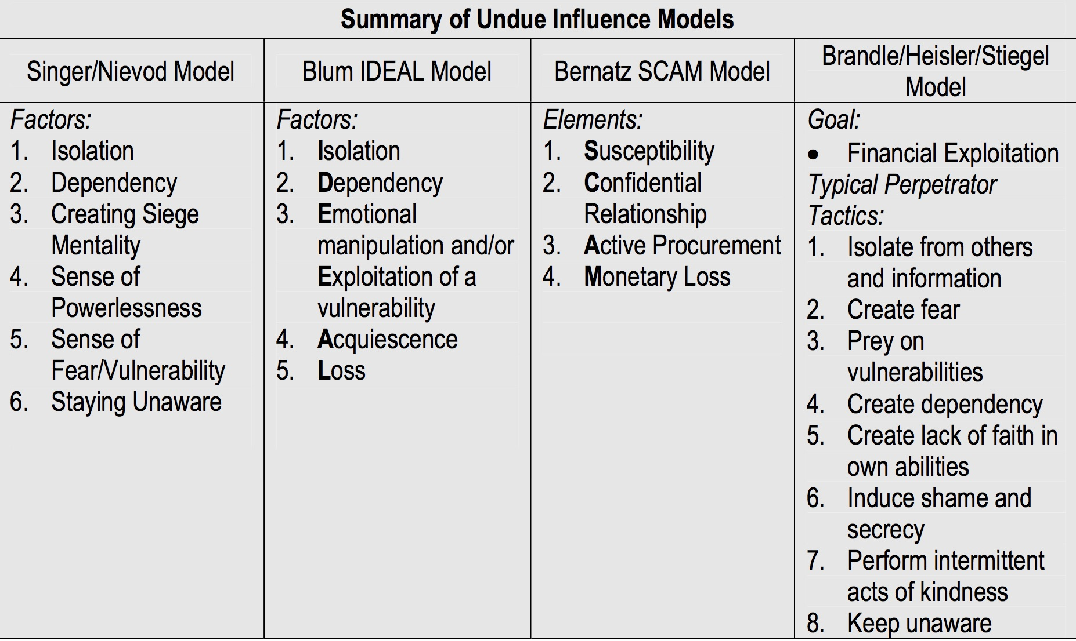
Undue Influence
Assessment of Older Adults with Diminished Capacity: A Handbook for Psychologists, American Bar Association Commission on Law and Aging, American Psychological Society, Association Assessment of Capacity in Older Adults Project Working Group, p.117, 2008.
Notes:
Assessment of Older Adults with Diminished Capacity: A handbook for psychologists, American Bar Association Commission on Law and Aging, American Psychological Society, Association Assessment of Capacity in Older Adults Project Working Group, 2008
_____
Singer/Nievod Model
Blum IDEAL model
Bernatz SCAM model

Slide 41
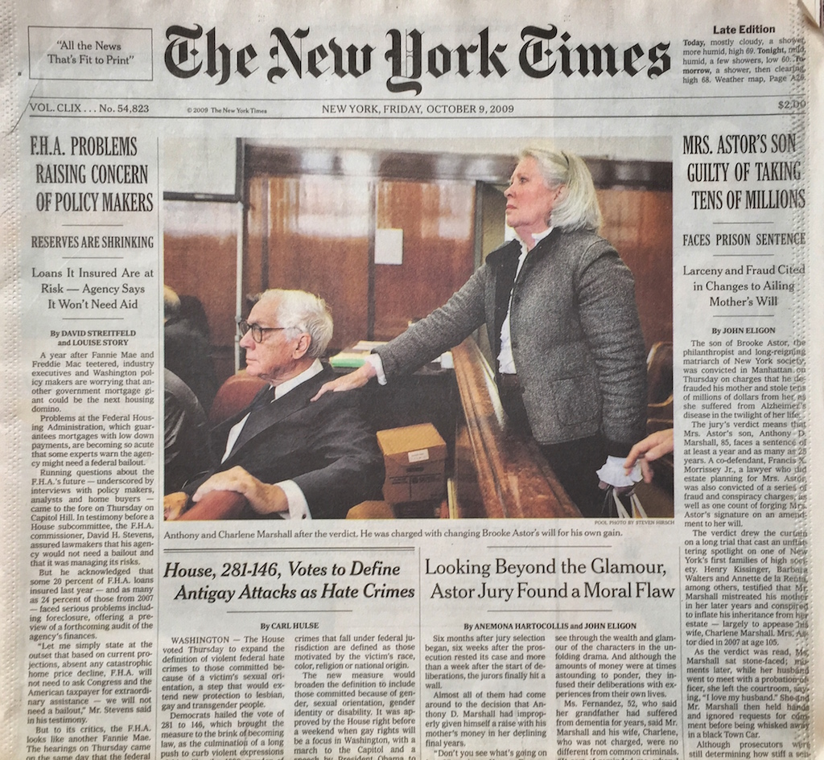
The New York Times, October 9, 2009.
Notes:
Eligon, John. Mrs. Astor’s Son Guilty of Taking Tens of Millions; Hartocollis, Anemone and John Eligon. Looking Beyond the Glamour, Jury Found Moral Flaw. The New York Times, October 8, 2009
_____
http://www.nytimes.com/2009/10/09/nyregion/09astor.html
Mr. Marshall was found guilty of 14 of the 16 counts against him. One of the acquittals was on the other first-degree grand larceny charge, for selling a Childe Hassam painting that his mother owned for $10 million and keeping a $2 million commission on the sale. The other was on a lesser charge of falsifying business records.
_____
http://www.nytimes.com/2009/10/09/nyregion/09jury.html
“Don’t you see what’s going on here?” one juror, Yvonne Fernandez, shouted out in the jury room. One of the last holdouts apparently felt threatened by the outburst, Ms. Fernandez said, and began to cry.
The trial of Mr. Marshall, the 85-year-old son of the socialite and philanthropist Brooke Astor, was a tale of morality,, and the sadness of it was not lost on the jury that on Thursday found him guilty of looting his mother’s estate.
Jurors said they had tried to see through the wealth and glamour of the characters in the unfolding drama. And although the amounts of money were at times astounding to ponder, they infused their deliberations with experiences from their own lives.
Ms. Fernandez, 52, who said her grandfather had suffered from dementia for years, said Mr. Marshall and his wife, Charlene, who was not charged, were no different from common criminals. “It sort of reminded me, when I was in Brooklyn years ago and there was a blackout, and the lower-income people were stealing refrigerators and TVs, and they felt that was due to them,” Ms. Fernandez said after the verdict.

Slide 42
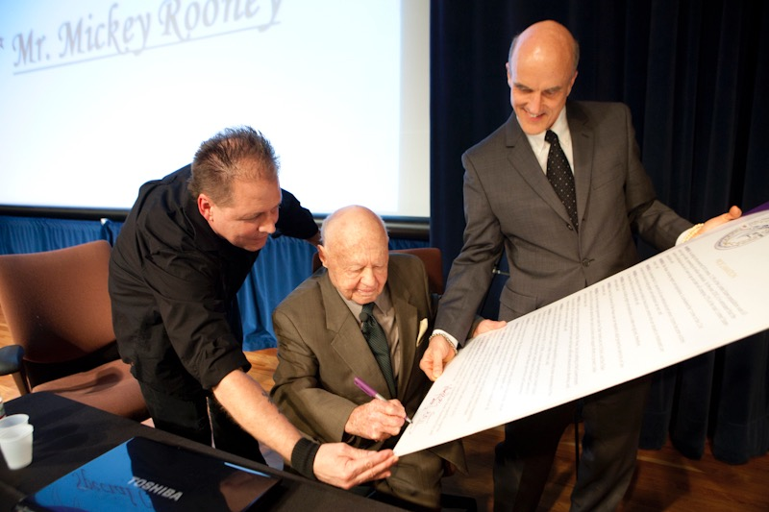
Elder Financial Protection Network, San Francisco, Conference. March 31, 2011. Photograph: Mona T. Brooks, http://monabrooks.com

Slide 43
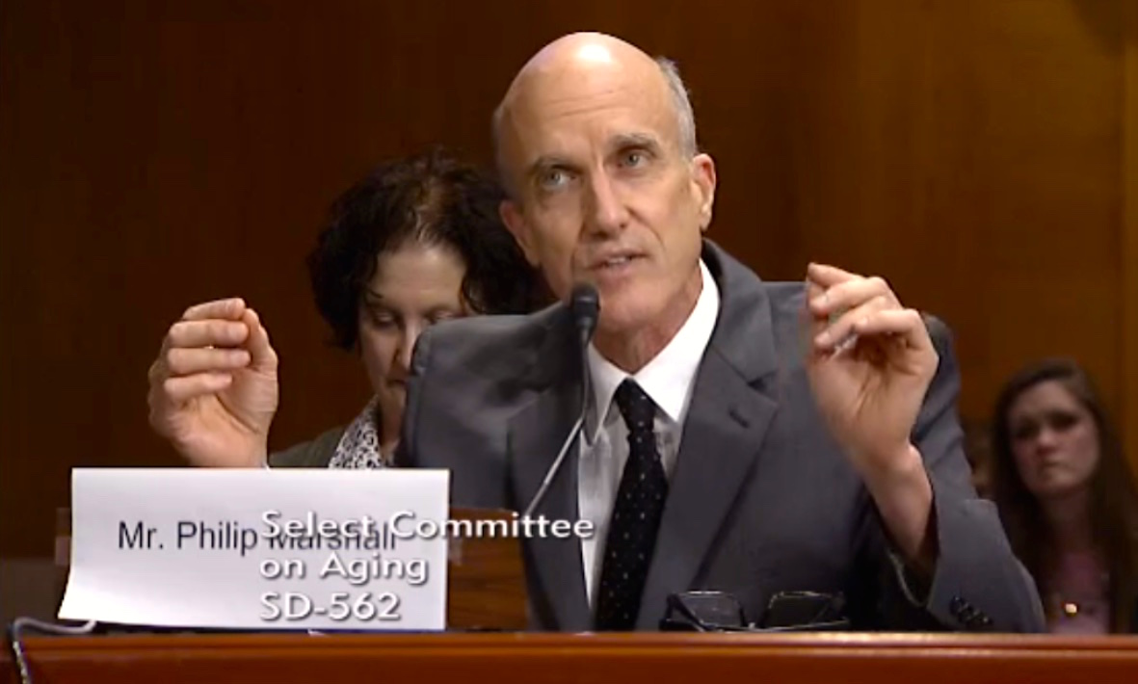
Broken Trust: Combating Financial Exploitation of Vulnerable Seniors, hearing and testimony, U.S. Senate Special Committee on Aging. February 4, 2015.

Slide 44
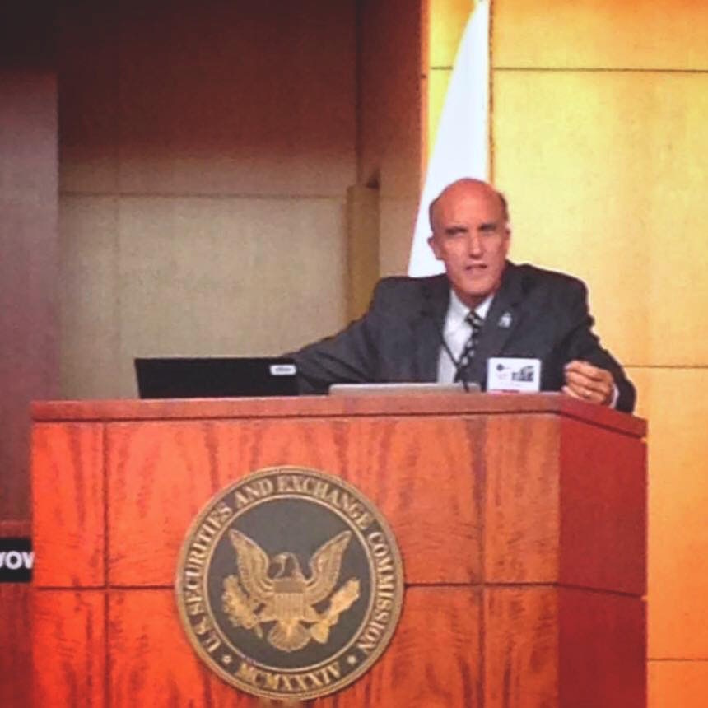
Philip Marshall presentation, How a Systems-Based Approach to Elder Justice and Big-Data Analytics will Help the Arrest of and Response to Elder Financial Exploitation. First Global Summit, World Elder Abuse Awareness Day, 10th Anniversary. June 15, 2015. Securities and Exchange Commission Building, Washington, DC.
Photograph courtesy of Diana Noel, Twitter, @D_firstNoel, June 15, 2015.
Notes:
Philip Marshall presentation, How a Systems-Based Approach to Elder Justice and Big-Data Analytics will Help the Arrest of and Response to Elder Financial Exploitation. First Global Summit, World Elder Abuse Awareness Day, 10th Anniversary. June 15, 2015. Securities and Exchange Commission Building, Washington, DC. Photograph courtesy of Diana Noel, @D_firstNoel, June 15, 2015.
_____

Slide 45
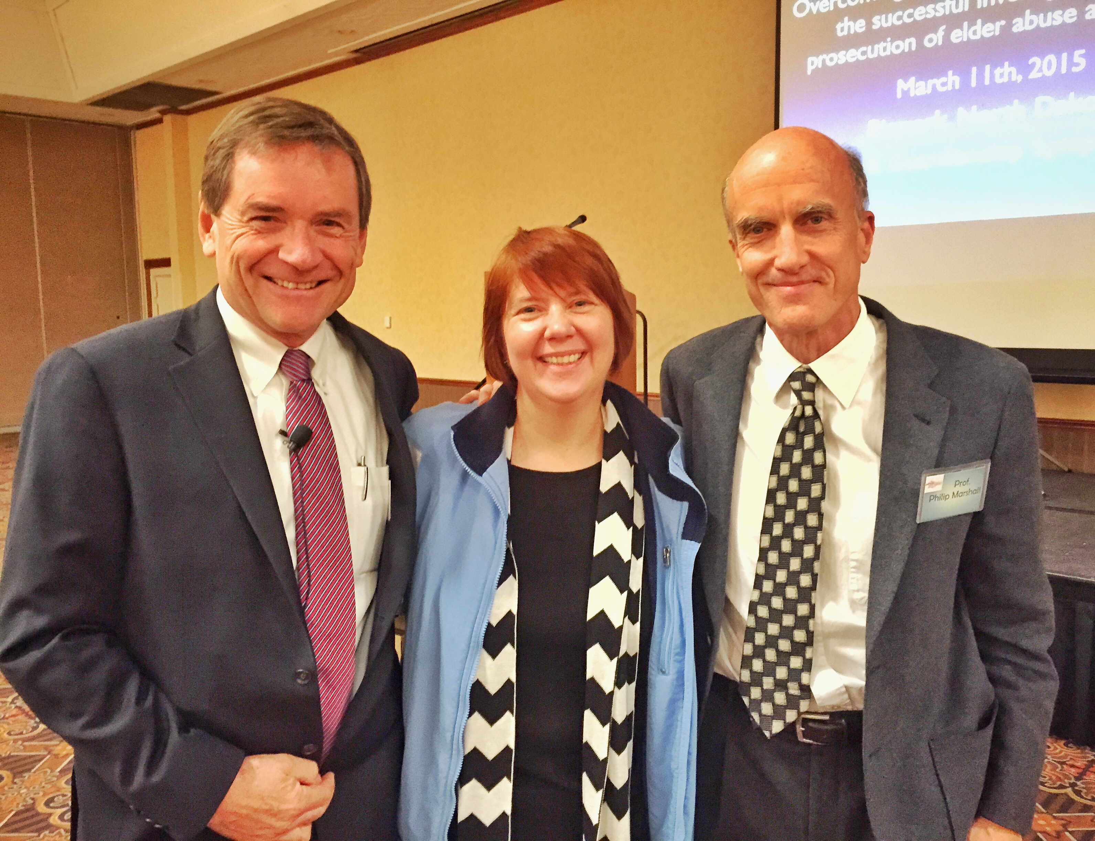
Paul R. Greenwood, Brenda K. Uekert, and Philip Marshall. North Dakota Adult Guardianship / Elder Justice Symposium, North Dakota Supreme Court, Bismarck. March 11-12, 2015.
Notes:
_____
Paul R. Greenwood, Deputy District Attorney, Head of Elder Abuse Prosecution Unit, Family Protection Division, San Diego District Attorneys Office
Brenda K. Uekert PhD, Principal Court Research Consultant, National Center for State Courts, Williamsburg VA
Conference of Chief Justices
Conference of State Court Administrators (Elders and the Courts Committee)
National College of Probate Judges, Mary Joy Quinn
_____
Erica Wood, Assistant Director, American Bar Association Commission on Law and Aging
_____
National Guardianship Network, established in 2002, consists of 11 national organizations dedicated to effective adult guardianship law and practice, including the
AARP
American Bar Association Commission on Law and Aging
ABA Section of Real Property, Trust and Estate Law
Alzheimer’s Association
American College of Trust and Estate Counsel
Center for Guardianship Certification
National Academy of Elder Law Attorneys
National Center for State Courts
National College of Probate Judges
National Disability Rights Network
National Guardianship Association
__
Conference of Chief Justices
Conference of State Court Administrators

Slide 46
Systemic Approach
“…elders conceptualize elder abuse on a societal level as well as an individual level.
“It is therefore necessary to develop a systemic approach to addressing the issue that can complement the current individualistic investigation model.”
Killick, Campbell, et al. Older People’s Conceptualization of Abuse:
A Systematic Review. Journal of Elder Abuse & Neglect, 27:100–120, 2015.
Notes:
_____
Gauging Aging, The Frameworks Institute, 2015
IMPLICATIONS FOR PRACTICE
The findings from the above review provide a valuable insight into the way in which older people conceptualize abuse. The themes identified have much in common with the definitions developed by professionals, but important differences need to be recognized, particularly in the development of policies and procedures to address abuse.
116 C. Killick et al.
First, not all respondents understood the concept of abuse of older people. Further, sexual and emotional abuse were often absent from older peoples’ definitions. Acceptance of the reality of abuse and its impact on older people is central to addressing the problem within populations. It is essential that awareness of abuse is raised among the general public, including potential victims. Effective prevention and protection require knowledge of the processes and confidence in their implementation.
Second, the reviewed research indicates that elders conceptualize elder abuse on a societal level as well as an individual level. It is therefore necessary to develop a systemic approach to addressing the issue that can complement the current individualistic investigation model. Preventive interventions that strengthen emotional bonds and support structures within families and communities seek to address the societal problems rather than the symptoms of abusive acts (Donohue, Dibble, & Schiamberg, 2008; Manthorpe, 2006).
Third, a common theme in the studies is the impact of ageism and disempowerment. It is therefore essential that processes intended to protect older people act to empower the individual. Critics of the existing protective [paternalistic] paradigm argue that it promotes ageist attitudes, which infantilize older people and focus on their deficits. Adult protection services need to be based on a clear understanding of the needs and wishes of victims (Nerenberg, 2008). Phelan (2008) argues for a human rights approach that recognizes the centrality of equality, dignity, and respect. In addition, principles of citizenship would redress social exclusion by promoting involvement and participation.
Finally, older people in these studies recognized the central role of family carers. Often they did not perceive investigation and prosecution as beneficial, preferring interventions that focused on family preservation or harm reduction (Lithwick, Beaulieu, & Gravel, 1999). Effective interventions need to be responsive to the wishes of older people and be able to offer support and services at the early stages of abuse (e.g., Brownell, 2005; Manthorpe, 2006).
There is some evidence that direct work addressing perpetrators’ behavior or attitudes can provide positive outcomes for both perpetrator and victim.
Similarly, programs to reduce carer stress or mental health issues have shown promising results (Sethi et al., 2011). As they develop, adult protection services have the potential to establish a range of services, in addition to limited investigative processes.
This would require engaging with service users to construct a “middle way” that balances support and protection (Douglas, 2005).
_____
Journal of Elder Abuse & Neglect, 27:100–120, 2015 Copyright © Taylor & Francis Group, LLC
ISSN: 0894-6566 print/1540-4129 online
DOI: 10.1080/08946566.2014.997374
Older People’s Conceptualization of Abuse: A Systematic Review
CAMPBELL KILLICK, PhD
South Eastern Health and Social Care Trust, Governance and Training, Downshire Hospital, Downpatrick, Northern Ireland, United Kingdom
BRIAN J. TAYLOR, PhD
Institute for Research in Social Sciences, University of Ulster, Belfast, Northern Ireland, United Kingdom
EMER BEGLEY, PhD
The Alzheimer Society of Ireland, Dublin, Ireland
JANET CARTER ANAND, PhD
School of Sociology, Social Policy and Social Work, Queen’s University Belfast, Belfast, Northern Ireland, United Kingdom
MARITA O’BRIEN, PhD
Age Action Ireland, Dublin, Ireland
The concept of elder abuse is a relatively recent one, and there is ongoing debate around its definition and interpretation. Policy in America, the United Kingdom, and Ireland has been criticized as being professionally driven and therefore paternalistic and dis- empowering. Little is known about older people’s understanding of the term “abuse” or the behaviors that they deem to be abu- sive. In this systematic review, eight databases were searched using agreed-upon criteria, and the results were assessed for relevance. Fifteen studies were included and are discussed under the themes of caregiving, domestic violence, society, abusive acts, and thresholds.
KEYWORDS decision making, elder abuse, judgment, review, social work
Address correspondence to Campbell Killick, South Eastern Health and Social Care Trust, 52a Church Street, Newtownards, Northern Ireland BT23 4EP, United Kingdom. E-mail: campbell.killick@setrust.hscni.net

Slide 47
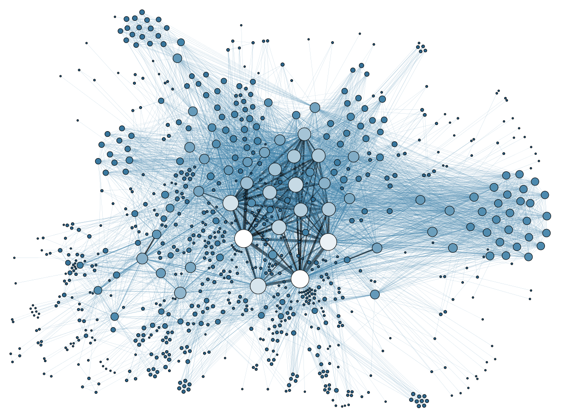
Grandjean, Martin. "La connaissance est un réseau.” Les Cahiers du Numérique 10 (3): 37–54, 2014. Detail.
Notes:
La connaissance est un réseau > Knowledge is a network
social network visualization
https://upload.wikimedia.org/wikipedia/commons/9/9b/Social_Network_Analysis_Visualization.png
Grandjean, Martin (2014). "La connaissance est un réseau". Les Cahiers du Numérique 10 (3): 37–54.
http://www.cairn.info/resume.php?ID_ARTICLE=LCN_103_0037
Knowledge is a network
Perspective on archival and encyclopedic organization
Network analysis is not revolutionizing our objects of study, it revolutionizes the perspective of the researcher on the latter. Organized as a network, information becomes relational. It makes potentially possible the creation of new information, as with an encyclopedia which links between records weave a web which can be analyzed in terms of structural characteristics or with an archive directory which sees its hierarchy fundamentally altered by an index recomposing the information exchange network within a group of people. On the basis of two examples of management, conservation and knowledge enhancement tools, the online encyclopedia Wikipedia and the archives of the Intellectual Cooperation of the League of Nations, this paper discusses the relationship between the researcher and its object understood as a whole.
_____
Nodes, edges > specific actors and their relationships can have a transformative change
And so it is, here and now, when APS can help advance transformation in the arena of guardianship, and in doing so, in what is the most vital aspect of our society and our life: self determination, guided by circumstances and support —through reciprocal relationships.
social network visualization
https://upload.wikimedia.org/wikipedia/commons/9/9b/Social_Network_Analysis_Visualization.png
Grandjean, Martin (2014). "La connaissance est un réseau". Les Cahiers du Numérique 10 (3): 37–54.
http://www.cairn.info/resume.php?ID_ARTICLE=LCN_103_0037
Knowledge is a network
Perspective on archival and encyclopedic organization
Network analysis is not revolutionizing our objects of study, it revolutionizes the perspective of the researcher on the latter. Organized as a network, information becomes relational. It makes potentially possible the creation of new information, as with an encyclopedia which links between records weave a web which can be analyzed in terms of structural characteristics or with an archive directory which sees its hierarchy fundamentally altered by an index recomposing the information exchange network within a group of people. On the basis of two examples of management, conservation and knowledge enhancement tools, the online encyclopedia Wikipedia and the archives of the Intellectual Cooperation of the League of Nations, this paper discusses the relationship between the researcher and its object understood as a whole.
_____
Gauging Aging, The Frameworks Institute, 2015
IMPLICATIONS FOR PRACTICE
The findings from the above review provide a valuable insight into the way in which older people conceptualize abuse. The themes identified have much in common with the definitions developed by professionals, but important differences need to be recognized, particularly in the development of policies and procedures to address abuse.
116 C. Killick et al.
First, not all respondents understood the concept of abuse of older people. Further, sexual and emotional abuse were often absent from older peoples’ definitions. Acceptance of the reality of abuse and its impact on older people is central to addressing the problem within populations. It is essential that awareness of abuse is raised among the general public, including potential victims. Effective prevention and protection require knowledge of the processes and confidence in their implementation.
Second, the reviewed research indicates that elders conceptualize elder abuse on a societal level as well as an individual level. It is therefore necessary to develop a systemic approach to addressing the issue that can complement the current individualistic investigation model. Preventive interventions that strengthen emotional bonds and support structures within families and communities seek to address the societal problems rather than the symptoms of abusive acts (Donohue, Dibble, & Schiamberg, 2008; Manthorpe, 2006).
Third, a common theme in the studies is the impact of ageism and disempowerment. It is therefore essential that processes intended to protect older people act to empower the individual. Critics of the existing protective [paternalistic] paradigm argue that it promotes ageist attitudes, which infantilize older people and focus on their deficits. Adult protection services need to be based on a clear understanding of the needs and wishes of victims (Nerenberg, 2008). Phelan (2008) argues for a human rights approach that recognizes the centrality of equality, dignity, and respect. In addition, principles of citizenship would redress social exclusion by promoting involvement and participation.
Finally, older people in these studies recognized the central role of family carers. Often they did not perceive investigation and prosecution as beneficial, preferring interventions that focused on family preservation or harm reduction (Lithwick, Beaulieu, & Gravel, 1999). Effective interventions need to be responsive to the wishes of older people and be able to offer support and services at the early stages of abuse (e.g., Brownell, 2005; Manthorpe, 2006).
There is some evidence that direct work addressing perpetrators’ behavior or attitudes can provide positive outcomes for both perpetrator and victim.
Similarly, programs to reduce carer stress or mental health issues have shown promising results (Sethi et al., 2011). As they develop, adult protection services have the potential to establish a range of services, in addition to limited investigative processes.
This would require engaging with service users to construct a “middle way” that balances support and protection (Douglas, 2005).
_____
Journal of Elder Abuse & Neglect, 27:100–120, 2015 Copyright © Taylor & Francis Group, LLC
ISSN: 0894-6566 print/1540-4129 online
DOI: 10.1080/08946566.2014.997374
Older People’s Conceptualization of Abuse: A Systematic Review
CAMPBELL KILLICK, PhD
South Eastern Health and Social Care Trust, Governance and Training, Downshire Hospital, Downpatrick, Northern Ireland, United Kingdom
BRIAN J. TAYLOR, PhD
Institute for Research in Social Sciences, University of Ulster, Belfast, Northern Ireland, United Kingdom
EMER BEGLEY, PhD
The Alzheimer Society of Ireland, Dublin, Ireland
JANET CARTER ANAND, PhD
School of Sociology, Social Policy and Social Work, Queen’s University Belfast, Belfast, Northern Ireland, United Kingdom
MARITA O’BRIEN, PhD
Age Action Ireland, Dublin, Ireland
The concept of elder abuse is a relatively recent one, and there is ongoing debate around its definition and interpretation. Policy in America, the United Kingdom, and Ireland has been criticized as being professionally driven and therefore paternalistic and dis- empowering. Little is known about older people’s understanding of the term “abuse” or the behaviors that they deem to be abu- sive. In this systematic review, eight databases were searched using agreed-upon criteria, and the results were assessed for relevance. Fifteen studies were included and are discussed under the themes of caregiving, domestic violence, society, abusive acts, and thresholds.
KEYWORDS decision making, elder abuse, judgment, review, social work
Address correspondence to Campbell Killick, South Eastern Health and Social Care Trust, 52a Church Street, Newtownards, Northern Ireland BT23 4EP, United Kingdom. E-mail: campbell.killick@setrust.hscni.net

Slide 48
Adult
Protective
Services with
MDTs
Notes:
Multidisciplinary teams
And so it is, here and now, when APS can help advance transformation in the arena of guardianship, and in doing so, in what is the most vital aspect if our shared society and our life…
Self actualize through determination, guided by circumstances and support—through reciprocal relationships.

Slide 49
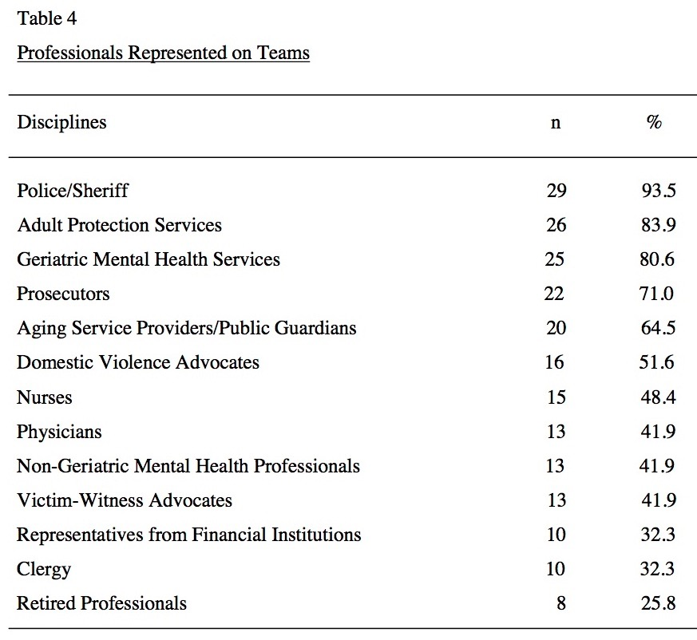
Multi-disciplinary Teams
Teaster, Pamela B., Lisa Nerenberg. A National Look at Elder Abuse Multidisciplinary Teams. Report for the National Committee for the Prevention of Elder Abuse Partner, National Center on Elder Abuse, 2002.
Notes:
Teaster, Pamela B., Lisa Nerenberg. A National Look at Elder Abuse Multidisciplinary Teams. Report for the National Committee for the Prevention of Elder Abuse Partner, National Center on Elder Abuse, 2002.
Table 4: Professionals Represented on Teams.
_____
Table 4
Professionals Represented on Teams
Police/Sheriff
Adult Protection Services
Geriatric Mental Health Services Prosecutors
Aging Service Providers/Public Guardians
Domestic Violence Advocates
Nurses
Physicians
Non-Geriatric Mental Health Professionals
Victim-Witness Advocates
Representatives from Financial Institutions
Clergy
Retired Professionals
Respondents were invited to list other disciplines and service
on their teams, and over half (51.6%) did so. These included
ethicists
animal care and control officers
public administrators
probation and parole personnel
code enforcement personnel
resource specialists
fire fighters
a retired judge
housing managers
housing advocates
personnel from assisted living facilities
members of public utility boards
in-home service providers
realtors
representatives from state long-term care licensing and regulatory agencies
hospital social workers
emergency medical personnel
providers of services for persons with developmental disabilities
media representatives
homeless shelter staff
health department personnel
health statistics specialists
health advocates
certified public accountants

Slide 50
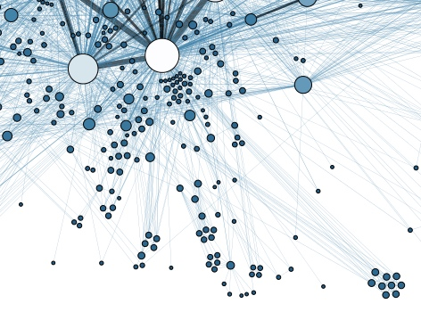
Grandjean, Martin. "La connaissance est un réseau.” Les Cahiers du Numérique 10 (3): 37–54, 2014. Detail.
Notes:
La connaissance est un réseau > Knowledge is a network
social network visualization
https://upload.wikimedia.org/wikipedia/commons/9/9b/Social_Network_Analysis_Visualization.png
Grandjean, Martin (2014). "La connaissance est un réseau". Les Cahiers du Numérique 10 (3): 37–54.
http://www.cairn.info/resume.php?ID_ARTICLE=LCN_103_0037
Knowledge is a network
Perspective on archival and encyclopedic organization
Network analysis is not revolutionizing our objects of study, it revolutionizes the perspective of the researcher on the latter. Organized as a network, information becomes relational. It makes potentially possible the creation of new information, as with an encyclopedia which links between records weave a web which can be analyzed in terms of structural characteristics or with an archive directory which sees its hierarchy fundamentally altered by an index recomposing the information exchange network within a group of people. On the basis of two examples of management, conservation and knowledge enhancement tools, the online encyclopedia Wikipedia and the archives of the Intellectual Cooperation of the League of Nations, this paper discusses the relationship between the researcher and its object understood as a whole.
_____
Nodes, edges > specific actors and their relationships can have a transformative change
And so it is, here and now, when APS can help advance transformation in the arena of guardianship, and in doing so, in what is the most vital aspect of our society and our life: self determination, guided by circumstances and support —through reciprocal relationships.
social network visualization
https://upload.wikimedia.org/wikipedia/commons/9/9b/Social_Network_Analysis_Visualization.png
Grandjean, Martin (2014). "La connaissance est un réseau". Les Cahiers du Numérique 10 (3): 37–54.
http://www.cairn.info/resume.php?ID_ARTICLE=LCN_103_0037
Knowledge is a network
Perspective on archival and encyclopedic organization
Network analysis is not revolutionizing our objects of study, it revolutionizes the perspective of the researcher on the latter. Organized as a network, information becomes relational. It makes potentially possible the creation of new information, as with an encyclopedia which links between records weave a web which can be analyzed in terms of structural characteristics or with an archive directory which sees its hierarchy fundamentally altered by an index recomposing the information exchange network within a group of people. On the basis of two examples of management, conservation and knowledge enhancement tools, the online encyclopedia Wikipedia and the archives of the Intellectual Cooperation of the League of Nations, this paper discusses the relationship between the researcher and its object understood as a whole.

Slide 51
“Guardianship as last resort.”
Guardianship
Notes:
“Guardianship as last resort.”
_____
http://www.ncea.aoa.gov/Resources/Publication/docs/APS-FlowChart-508.pdf
http://www.ncea.aoa.gov/Stop_Abuse/Partners/APS/index.aspx
For an illustration on the APS investigation process, please see the National Adult Protective Services Association (NAPSA)
_____

Slide 52
“Guardians as leaders, moving forward.”
Guardians
Notes:
“Guardians as leaders, moving forward.”
_____
…through transformation, not reformation;
in concert with an elder-care coalition.
_____

Slide 53
by elders
for elders
with elders
Notes:
by elders • for elders • with elders
_____
by elders
Frameworks Institute
http://frameworksinstitute.org/aging
_____
for elders
Guardianship
_____
martinis_2015_supported-decision_making_1505-bifocal.pdf
Supported Decision-Making relationships can be “of more or less formality and intensity,” including informal support by people who “speak with, rather than for, the individual with a disability,”21 formal “micro-board[s] . . . and circles of support”22 and other relationships offering varying types of support for various types of decisions. However, all Supported Decision-Making relationships share three common elements:
1. The recognition that the person has the right to make his or her own decisions;
2. The acknowledgment that the person can enter into a decision-making process or relationship without surrendering his or her right to make decisions; and
3. The understanding that the person may need assistance in making or communicating decisions “through such means as interpreter assistance, facilitated communication, assistive technologies and plain language.”23
Through these relationships, people may “receive support to understand relevant information, issues, and available choices, to focus attention in making decisions, to help weigh options,
to ensure that decisions are based on [their] own preferences, and . . . to interpret and/or communicate [their] decisions to other parties.”24
______
Gauging Aging, The Frameworks Institute, 2015
IMPLICATIONS FOR PRACTICE
The findings from the above review provide a valuable insight into the way in which older people conceptualize abuse. The themes identified have much in common with the definitions developed by professionals, but important differences need to be recognized, particularly in the development of policies and procedures to address abuse.
116 C. Killick et al.
First, not all respondents understood the concept of abuse of older people. Further, sexual and emotional abuse were often absent from older peoples’ definitions. Acceptance of the reality of abuse and its impact on older people is central to addressing the problem within populations. It is essential that awareness of abuse is raised among the general public, including potential victims. Effective prevention and protection require knowledge of the processes and confidence in their implementation.
Second, the reviewed research indicates that elders conceptualize elder abuse on a societal level as well as an individual level.. It is therefore necessary to develop a systemic approach to addressing the issue that can complement the current individualistic investigation model. Preventive interventions that strengthen emotional bonds and support structures within families and communities seek to address the societal problems rather than the symptoms of abusive acts (Donohue, Dibble, & Schiamberg, 2008; Manthorpe, 2006).
Third, a common theme in the studies is the impact of ageism and dis-empowerment. It is therefore essential that processes intended to protect older people act to empower the individual. Critics of the existing protective paradigm argue that it promotes ageist attitudes, which infantilize older people and focus on their deficits. Adult protection services need to be based on a clear understanding of the needs and wishes of victims (Nerenberg, 2008). Phelan (2008) argues for a human rights approach that recognizes the centrality of equality, dignity, and respect. In addition, principles of citizenship would redress social exclusion by promoting involvement and participation.
Finally, older people in these studies recognized the central role of family carers. Often they did not perceive investigation and prosecution as beneficial, preferring interventions that focused on family preservation or harm reduction (Lithwick, Beaulieu, & Gravel, 1999). Effective interven- tions need to be responsive to the wishes of older people and be able to offer support and services at the early stages of abuse (e.g., Brownell, 2005; Manthorpe, 2006). There is some evidence that direct work address- ing perpetrators’ behavior or attitudes can provide positive outcomes for both perpetrator and victim. Similarly, programs to reduce carer stress or mental health issues have shown promising results (Sethi et al., 2011). As they develop, adult protection services have the potential to establish a range of services, in addition to limited investigative processes. This would require engaging with service users to construct a “middle way” that balances support and protection (Douglas, 2005).
_____
Journal of Elder Abuse & Neglect, 27:100–120, 2015 Copyright © Taylor & Francis Group, LLC
ISSN: 0894-6566 print/1540-4129 online
DOI: 10.1080/08946566.2014.997374
Older People’s Conceptualization of Abuse: A Systematic Review
CAMPBELL KILLICK, PhD
South Eastern Health and Social Care Trust, Governance and Training, Downshire Hospital, Downpatrick, Northern Ireland, United Kingdom
BRIAN J. TAYLOR, PhD
Institute for Research in Social Sciences, University of Ulster, Belfast, Northern Ireland, United Kingdom
EMER BEGLEY, PhD
The Alzheimer Society of Ireland, Dublin, Ireland
JANET CARTER ANAND, PhD
School of Sociology, Social Policy and Social Work, Queen’s University Belfast, Belfast, Northern Ireland, United Kingdom
MARITA O’BRIEN, PhD
Age Action Ireland, Dublin, Ireland
The concept of elder abuse is a relatively recent one, and there is ongoing debate around its definition and interpretation. Policy in America, the United Kingdom, and Ireland has been criticized as being professionally driven and therefore paternalistic and dis- empowering. Little is known about older people’s understanding of the term “abuse” or the behaviors that they deem to be abu- sive. In this systematic review, eight databases were searched using agreed-upon criteria, and the results were assessed for relevance. Fifteen studies were included and are discussed under the themes of caregiving, domestic violence, society, abusive acts, and thresholds.
KEYWORDS decision making, elder abuse, judgment, review, social work
Address correspondence to Campbell Killick, South Eastern Health and Social Care Trust, 52a Church Street, Newtownards, Northern Ireland BT23 4EP, United Kingdom. E-mail: campbell.killick@setrust.hscni.net
_____

Slide 54
by elders
Notes:
by elders
Gauging Aging, The Frameworks Institute

Slide 55
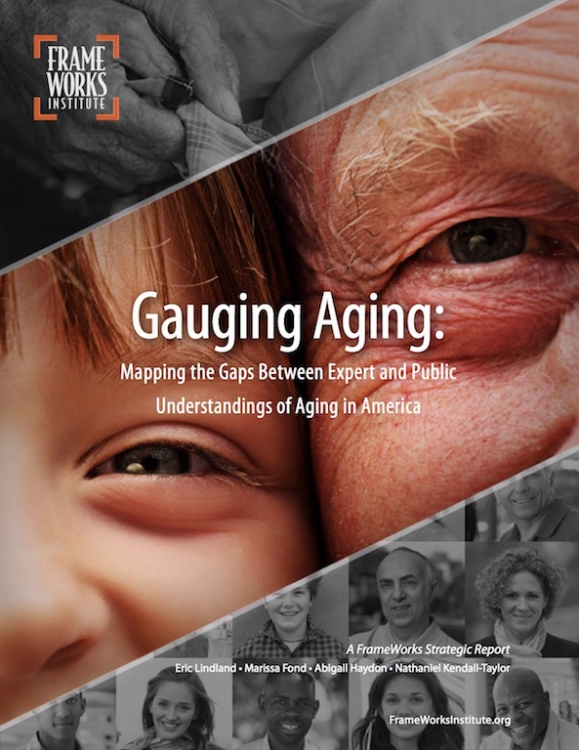
Gauging Aging: Mapping the Gaps between Expert and Public Understandings of Aging in America, FrameWorks Institute, 2015
Notes:
ReFraming Aging
http://www.screencast.com/t/MJfINaku1
http://www.americangeriatrics.org/about_us/lao/gauging_aging_report
Gauging Aging: Mapping the Gaps Between Expert and Public Understandings of Aging in America (2015) lays the groundwork for a larger effort to develop a new, evidence-based narrative around the process of aging in our country and the needs and contributions of older adults.
By comparing experts' views to those of the general public, the report details a set of communications challenges to elevating public support for policies and programs that promote the well-being of older adults.
Key among these issues is the public’s view of aging as a decidedly negative and deterministic process, as well as its overall fatalism about our collective ability to find solutions to the challenges of an aging population.
This research is distinct from most public opinion scholarship, which documents what people say by conducting polls or focus groups. In this report, experts took analysis a level deeper to document the assumptions and thought processes that inform what people say and how they structure their judgments and opinions.
This cultural-cognitive approach is powerful because identifying ways of thinking is key to developing more effective and strategic communication. By understanding the various ways that people are (and are not) able to think and reason about an issue, communicators can craft messages that avoid unproductive understandings, activate productive ones, and elevate new ways of thinking that are better aligned with policy goals.
In short, an understanding of how people think is a powerful tool in identifying the specific perceptual challenges that require reframing in our narrative on aging.
_____
Gauging Aging: Mapping the Gaps between Expert and Public Understandings of Aging in America.
The biggest problem with the dominant patterns of public understanding identified in FrameWorks' research is the deep assumption that individuals are exclusively responsible for how they age. In addition, while we know from previous research that the public maintains an ideal vision of aging, this 'ideal' is uncontested in these stories, leaving people with a view of aging that, according to experts, is deeply unrealistic. When the media and advocacy organizations fail to link successful aging to policies that enable older Americans to remain active and socially engaged, they actually reinforce the public's highly individualistic understandings of the aging process. The result is that people will understand the likelihood of successful aging to be about lifestyle choices rather than as affected by supports, larger social structures or public policies. Moreover, they are more likely to view poor seniors, and those with chronic illnesses, as having made bad choices, and not in relation to social determinants."
Moira O'Neil, Lead FrameWorks Researcher

Slide 56
“cognitive
capacity”

Slide 57
ideal
“This distinction between the ideal and the real is central in structuring the way that the public thinks about aging issues.”
Gauging Aging: Mapping the Gaps between Expert and Public Understandings of Aging in America, Frameworks Institute, 2015, p. 6
Notes:
ideal
_____
Gauging Aging
page 6.
Ideal'vs.'Real'
The public holds a set of aspirational models of the aging process structured by the ideals of self sufficiency, staying active, participating in leisure activities, and building intimacy with family and friends. These Ideal models of adult aging are in stark contrast with a set of understandings that are used to reason about what the aging process actually entails. This distinction between the ideal and the real is central in structuring the way that the public thinks about aging issues.The public’s dominant Real models of aging include shared understandings of aging as a process of deterioration, dependency, reduced potential, family dispersal and digital incompetence. These deep and negative shared understandings make the process of aging something to be dreaded and fought against, rather than embraced as a process that brings new opportunities and challenges for individuals and society.

Slide 58
real
Notes:
ideal
_____
http://frameworksinstitute.org/human-services1.html
http://frameworksinstitute.org/assets/files/humanservices/nhsa_mm_final_2015.pdf
In a time characterized by resource cuts, building public understanding of human services, and the political will to support them, is arguably the field's most important advocacy task. Understanding the urgent need for a new narrative about the contributions of human services to a thriving society, the National Human Services Assembly engaged the FrameWorks Institute to develop an evidence-based strategy for reframing the work of the sector. This new MessageMemo synthesizes the results from the Strategic Frame Analysis® on this topic, offering clear and actionable communications guidance for human services professionals. This project is generously funded by The Kresge Foundation and The Annie E. Casey Foundation
Selected findings and recommendations include:
• Americans believe that everyone has opportunities to "achieve" well-being and that people who experience hardships are those who have failed to seize those opportunities. Thinking in this way, people attribute success or failure solely to individual agency—whether someone has tried hard enough or not.
• Americans assume that human services are exclusively about the provision of direct services. They do not associate human services with the advocacy or prevention work that members of the field stress as essential parts of their work.
• Among alternatives tested, the Value of Human Potential showed the most robust effects in increasing public understanding of and support for human services. The positive effects of this value were amplified when combined with other frame elements.
• Comparing the work of human services to Construction proved to be a highly effective Explanatory Metaphor.

Slide 59
“The public holds a set of aspirational models of the aging process structured by the ideals of self sufficiency.
“These Ideal models of adult aging are in stark contrast with a set of understandings that are used to reason about what the aging process actually entails.
Gauging Aging: Mapping the Gaps between Expert and Public Understandings of Aging in America, Frameworks Institute, 2015, p. 6. Bold added.
Notes:
_____
Gauging Aging
page 6.
Ideal'vs.'Real'
The public holds a set of aspirational models of the aging process structured by the ideals of self sufficiency, staying active, participating in leisure activities, and building intimacy with family and friends. These Ideal models of adult aging are in stark contrast with a set of understandings that are used to reason about what the aging process actually entails. This distinction between the ideal and the real is central in structuring the way that the public thinks about aging issues.The public’s dominant Real models of aging include shared understandings of aging as a process of deterioration, dependency, reduced potential, family dispersal and digital incompetence. These deep and negative shared understandings make the process of aging something to be dreaded and fought against, rather than embraced as a process that brings new opportunities and challenges for individuals and society.
_____

Slide 60
“The Individual Effort solution mutes attention to a whole array of systemic and policy factors…this way of thinking directions attention away from the idea of a larger public and collective responsibility.”
Gauging Aging: Mapping the Gaps between Expert and Public Understandings of Aging in America, Frameworks Institute, 2015, p. 28. Bold added.
Notes:
Gauging Aging: Mapping the Gaps between Expert and Public Understandings of Aging in America 20
_____
paternalistic and disempowering
Journal of Elder Abuse & Neglect, 27:100–120, 2015 Copyright © Taylor & Francis Group, LLC
ISSN: 0894-6566 print/1540-4129 online
DOI: 10.1080/08946566.2014.997374
Older People’s Conceptualization of Abuse: A Systematic Review
CAMPBELL KILLICK, PhD
South Eastern Health and Social Care Trust, Governance and Training, Downshire Hospital, Downpatrick, Northern Ireland, United Kingdom
BRIAN J. TAYLOR, PhD
Institute for Research in Social Sciences, University of Ulster, Belfast, Northern Ireland, United Kingdom
EMER BEGLEY, PhD
The Alzheimer Society of Ireland, Dublin, Ireland
JANET CARTER ANAND, PhD
School of Sociology, Social Policy and Social Work, Queen’s University Belfast, Belfast, Northern Ireland, United Kingdom
MARITA O’BRIEN, PhD
Age Action Ireland, Dublin, Ireland
The concept of elder abuse is a relatively recent one, and there is ongoing debate around its definition and interpretation. Policy in America, the United Kingdom, and Ireland has been criticized as being professionally driven and therefore paternalistic and dis- empowering. Little is known about older people’s understanding of the term “abuse” or the behaviors that they deem to be abu- sive. In this systematic review, eight databases were searched using agreed-upon criteria, and the results were assessed for relevance. Fifteen studies were included and are discussed under the themes of caregiving, domestic violence, society, abusive acts, and thresholds.
KEYWORDS decision making, elder abuse, judgment, review, social work
Address correspondence to Campbell Killick, South Eastern Health and Social Care Trust, 52a Church Street, Newtownards, Northern Ireland BT23 4EP, United Kingdom. E-mail: campbell.killick@setrust.hscni.net
_______

Slide 61
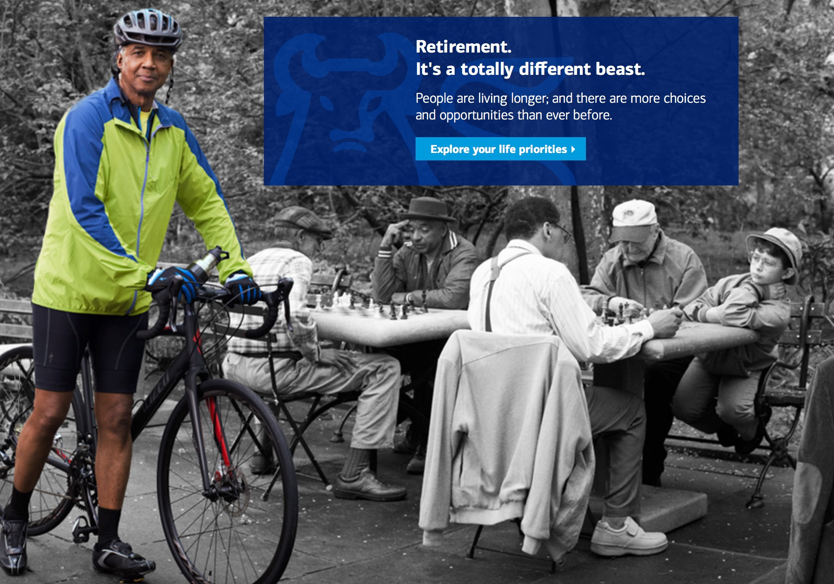
Merrill Lynch. Retrieved, October 19, 2015. https://www.ml.com
Notes:
http://frameworksinstitute.org/human-services1.html
http://frameworksinstitute.org/assets/files/humanservices/nhsa_mm_final_2015.pdf
In a time characterized by resource cuts, building public understanding of human services, and the political will to support them, is arguably the field's most important advocacy task. Understanding the urgent need for a new narrative about the contributions of human services to a thriving society, the National Human Services Assembly engaged the FrameWorks Institute to develop an evidence-based strategy for reframing the work of the sector. This new MessageMemo synthesizes the results from the Strategic Frame Analysis® on this topic, offering clear and actionable communications guidance for human services professionals. This project is generously funded by The Kresge Foundation and The Annie E. Casey Foundation…
Selected findings and recommendations include:
• Americans believe that everyone has opportunities to "achieve" well-being and that people who experience hardships are those who have failed to seize those opportunities. Thinking in this way, people attribute success or failure solely to individual agency—whether someone has tried hard enough or not.
• Americans assume that human services are exclusively about the provision of direct services. They do not associate human services with the advocacy or prevention work that members of the field stress as essential parts of their work.
• Among alternatives tested, the Value of Human Potential showed the most robust effects in increasing public understanding of and support for human services. The positive effects of this value were amplified when combined with other frame elements.
• Comparing the work of human services to Construction proved to be a highly effective Explanatory Metaphor.

Slide 62
individual
for elders
Notes:
for elders > damage control, for lack of maintaining collective capacity to help each other
Brenda Uekert used in How to Protect our Nation's Most Vulunerable Adults through Effective Guardianship Practices, September 2 webinar with Brenda Uekert, moderated by Paul DeLosh
https://vimeo.com/ncsc/review/138121427/c14015c5fc
clear and coherent

Slide 63

Guardianship trends
more
less
Notes:
trends

Slide 64
Guardianship trends
x
more >
less >
demographics
customized
public opinion
rights
options
x
Notes:
trends

Slide 65
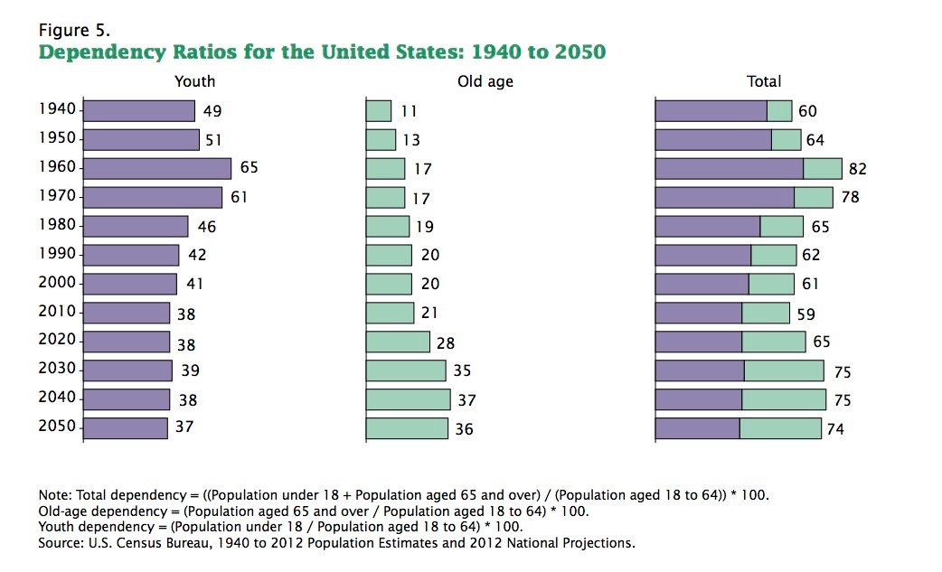
Ortman, Jennifer M., Victoria A. Velkoff, and Howard Hogan. An Aging Nation: The Older Population in the United States Population Estimates and Projections—Current Population Reports. U.S. Department of Commerce Economics and Statistics Administration, May 2014.
Notes:
aging_nation_2014_fig_5.jpg
Ortman, Jennifer M., Victoria A. Velkoff, and Howard Hogan. An Aging Nation: The Older Population in the United States Population Estimates and Projections —Current Population Reports. U.S. Department of Commerce Economics and Statistics Administration, May 2014

Slide 66
with elders
Notes:
invisible to indivisible
Stephen Covey > efficeint vs effective
martinis_2015_supported-decision_making_1505-bifocal.pdf
Supported Decision-Making relationships can be “of more or less formality and intensity,” including informal support by people who “speak with, rather than for, the individual with a disability,”21 formal “micro-board[s] . . . and circles of support” 22 and other relationships offering varying types of support for various types of decisions.
However, all Supported Decision-Making relationships share three common elements:
1. The recognition that the person has the right to make his or her own decisions;
2. The acknowledgment that the person can enter into a decision-making process or relationship without surrendering his or her right to make decisions; and
3. The understanding that the person may need assistance in making or communicating decisions “through such means as interpreter assistance, facilitated communication, assistive technologies and plain language.” 23
Through these relationships, people may “receive support to understand relevant information, issues, and available choices, to focus attention in making decisions, to help weigh options, to ensure that decisions are based on [their] own preferences, and . . . to interpret and/or communicate [their] decisions to other parties.” 24
______
Gauging Aging
IMPLICATIONS FOR PRACTICE
The findings from the above review provide a valuable insight into the way in which older people conceptualize abuse. The themes identified have much in common with the definitions developed by professionals, but important differences need to be recognized, particularly in the development of policies and procedures to address abuse.
First, not all respondents understood the concept of abuse of older people. Further, sexual and emotional abuse were often absent from older peoples’ definitions. Acceptance of the reality of abuse and its impact on older people is central to addressing the problem within populations. It is essential that awareness of abuse is raised among the general public, including potential victims. Effective prevention and protection require knowledge of the processes and confidence in their implementation.
Second, the reviewed research indicates that elders conceptualize elder abuse on a societal level as well as an individual level.. It is therefore nec- essary to develop a systemic approach to addressing the issue that can complement the current individualistic investigation model. Preventive interventions that strengthen emotional bonds and support structures within families and communities seek to address the societal problems rather than the symptoms of abusive acts (Donohue, Dibble, & Schiamberg, 2008; Manthorpe, 2006).
Third, a common theme in the studies is the impact of ageism and dis-empowerment. It is therefore essential that processes intended to protect older people act to empower the individual. Critics of the existing protective paradigm argue that it promotes ageist attitudes, which infantilize older people and focus on their deficits. Adult protection services need to be based on a clear understanding of the needs and wishes of victims (Nerenberg, 2008). Phelan (2008) argues for a human rights approach that recognizes the centrality of equality, dignity, and respect. In addition, principles of citizenship would redress social exclusion by promoting involvement and participation.
Finally, older people in these studies recognized the central role of family carers. Often they did not perceive investigation and prosecution as beneficial, preferring interventions that focused on family preservation or harm reduction (Lithwick, Beaulieu, & Gravel, 1999). Effective interven- tions need to be responsive to the wishes of older people and be able to offer support and services at the early stages of abuse (e.g., Brownell, 2005; Manthorpe, 2006). There is some evidence that direct work address- ing perpetrators’ behavior or attitudes can provide positive outcomes for both perpetrator and victim. Similarly, programs to reduce carer stress or mental health issues have shown promising results (Sethi et al., 2011). As they develop, adult protection services have the potential to establish a range of services, in addition to limited investigative processes. This would require engaging with service users to construct a “middle way” that balances support and protection (Douglas, 2005).
_____
Journal of Elder Abuse & Neglect, 27:100–120, 2015 Copyright © Taylor & Francis Group, LLC
ISSN: 0894-6566 print/1540-4129 online
DOI: 10.1080/08946566.2014.997374
Older People’s Conceptualization of Abuse: A Systematic Review
CAMPBELL KILLICK, PhD
South Eastern Health and Social Care Trust, Governance and Training, Downshire Hospital, Downpatrick, Northern Ireland, United Kingdom
BRIAN J. TAYLOR, PhD
Institute for Research in Social Sciences, University of Ulster, Belfast, Northern Ireland, United Kingdom
EMER BEGLEY, PhD
The Alzheimer Society of Ireland, Dublin, Ireland
JANET CARTER ANAND, PhD
School of Sociology, Social Policy and Social Work, Queen’s University Belfast, Belfast, Northern Ireland, United Kingdom
MARITA O’BRIEN, PhD
Age Action Ireland, Dublin, Ireland
The concept of elder abuse is a relatively recent one, and there is ongoing debate around its definition and interpretation. Policy in America, the United Kingdom, and Ireland has been criticized as being professionally driven and therefore paternalistic and dis- empowering. Little is known about older people’s understanding of the term “abuse” or the behaviors that they deem to be abu- sive. In this systematic review, eight databases were searched using agreed-upon criteria, and the results were assessed for relevance. Fifteen studies were included and are discussed under the themes of caregiving, domestic violence, society, abusive acts, and thresholds.
KEYWORDS decision making, elder abuse, judgment, review, social work
Address correspondence to Campbell Killick, South Eastern Health and Social Care Trust, 52a Church Street, Newtownards, Northern Ireland BT23 4EP, United Kingdom. E-mail: campbell.killick@setrust.hscni.net

Slide 67
individual
Notes:
individual
agency….

Slide 69
invisible
Notes:
invisible

Slide 70
visible
Notes:
invisible

Slide 71
individual
indivisible
Notes:
invisible
clear and coherent

Slide 72
interdependence
self
•
society
Notes:
interdependence
self • society

Slide 73
plenary guardianship
independence
in dependence
Notes:
Structured Decision-Making
nccd_structured_decision_making_system_for_adult_protection_DHS-6747-ENG.pdf
The Structured Decision Making® System
for Adult Protection
Guidelines and Procedures Manual
Manual Date: July 21, 2010 (updated November 15, 2012)
National Council on Crime & Delinquency
Structured Decision Making® (SDM) system: Assessment system comprised of research-based and structured assessments designed to provide workers with a simple, objective, and reliable framework to assess individuals involved in APS at critical decision points in the life of a case and to provide managers with information for improved planning, evaluation, and resource allocation.
______

Slide 74
options
independence
•
in dependence
Notes:
Supported Decision-Making
Structured Decision-Making
nccd_structured_decision_making_system_for_adult_protection_DHS-6747-ENG.pdf
The Structured Decision Making® System
for Adult Protection
Guidelines and Procedures Manual
Manual Date: July 21, 2010 (updated November 15, 2012)
National Council on Crime & Delinquency
Structured Decision Making® (SDM) system: Assessment system comprised of research-based and structured assessments designed to provide workers with a simple, objective, and reliable framework to assess individuals involved in APS at critical decision points in the life of a case and to provide managers with information for improved planning, evaluation, and resource allocation.
_____
EW 151024 >
SDT
rights
recognition by legal authorities: contracts, Medicaid,
TX 1881…first in nation; bill includes form, with warning re third party. > “pioneering stuff” also on restoration of rights, SDM can only be terminate if abuse, violation
Canada > representation agreement > support network

Slide 75
Options
person-centered planning
informal support (plan), ’circle of friends”
supported decision-making
assisted, guided decision-making
Structured Decision Making ® NCCD
power of attorney, financial (agent)
living will, health care advance directive
medical orders for sustaining life treatment, MOLST
limited guardian of the person (duties, duration)
limited fiscal guardian (duties, duration)
limited guardianship + other tailored options
more…
Notes:
http://leg2.state.va.us/dls/h&sdocs.nsf/e3259429414409e085256eb00060ca1d/bdea4a8000bdc03485257cc200556a1d?OpenDocument
centered planning
Consent, Capacity, and Substitute Decision Making
Pennsylvania Disability Rights Network
(does not include SDM)
Other states are also exploring supported decision making. For example, Pennsylvania’s Disability Rights Network has published a booklet entitled Consent, Capacity, and Substitute Decision Making. While helpful, this resource primarily offers definitions and explanations about types of decision making and types of substitute decision making. The concept of Supported Decision Making as a specific practice is not mentioned in the document.
https://www.drnpa.org/page/decision-making/
The State [Commonwealth] of Massachusetts has initiated a small pilot study to offer supported decision making to a group of 10 individuals currently under guardianship.
North Carolina and Maryland are also exploring the value of Supported Decision Making within their communities.
Other countries such as Australia, Canada, Sweden and England are also examining Supported Decision Making as an alternative to guardianship or other court- sanctioned substitute decision making arrangements. Indeed, reviews of these efforts have been published in Australia and Canada.

Slide 76
NGA Position Statement
“ Modern day respect for individual rights dictates that we must allow each individual to make or participate to the extent possible in personal decisions. Therefore, incorporation of SDM into guardianship standards is essential to evolving practice.”
Position Statement on Guardianship, Surrogate Decision Making and Supported Decision Making, National Guardianship Association, 2015.

Slide 77
NGA Position Statement
“Alternatives to guardianship, including supported decision making, should always be identified and considered whenever possible prior to the commencement of guardianship proceedings.”
Position Statement on Guardianship, Surrogate Decision Making and Supported Decision Making, National Guardianship Association, 2015.

Slide 78
Supported Decision Making
“The National Resource Center for Supported
Decision Making [NRDC] describes supported
decision making as:
...where people use trusted friends, family members, and professionals to help them understand the situations and choices they face, so they may make their own decisions—is a means for increasing self-determination by encouraging and empowering people to make their own decisions about the their lives to the maximum extent possible.”
Position Statement on Guardianship, Surrogate Decision Making and Supported Decision Making, National Guardianship Association, 2015.
NRDC, http://supporteddecisionmaking.org/
Notes:
http://leg2.state.va.us/dls/h&sdocs.nsf/e3259429414409e085256eb00060ca1d/bdea4a8000bdc03485257cc200556a1d?OpenDocument
Consent, Capacity, and Substitute Decision Making
Pennsylvania Disability Rights Network
(does not include SDM)
Other states are also exploring supported decision making. For example, Pennsylvania’s Disability Rights Network has published a booklet entitled Consent, Capacity, and Substitute Decision Making. While helpful, this resource primarily offers definitions and explanations about types of decision making and types of substitute decision making. The concept of Supported Decision Making as a specific practice is not mentioned in the document.
https://www.drnpa.org/page/decision-making/
The State [Commonwealth] of Massachusetts has initiated a small pilot study to offer supported decision making to a group of 10 individuals currently under guardianship.
North Carolina and Maryland are also exploring the value of Supported Decision Making within their communities.
Other countries such as Australia, Canada, Sweden and England are also examining Supported Decision Making as an alternative to guardianship or other court- sanctioned substitute decision making arrangements. Indeed, reviews of these efforts have been published in Australia and Canada.
_____

Slide 79
NGA Position Statement
“Whenever guardianship is necessary to assist a person, the guardianship must be limited, allow the maximum retention of individual rights, and be customized to the individual needs of the person under guardianship.”
Position Statement on Guardianship, Surrogate Decision Making and Supported Decision Making, National Guardianship Association, 2015.

Slide 80
Clinical Capacity
Capacity Judgement
has capacity
has capacity
diminished capacity
lacks capacity
lacks capacity
Assessment of Older Adults with Diminished Capacity: A Handbook for Psychologists, American Bar Association Commission on Law and Aging, American Psychological Society, Association Assessment of Capacity in Older Adults Project Working Group, p. 29, 2008.
Notes:
Assessment of Older Adults with Diminished Capacity: A handbook for psychologists, American Bar Association Commission on Law and Aging, American Psychological Society, Association Assessment of Capacity in Older Adults Project Working Group, 2008

Slide 81
Standards
“…issues are compounded further by the fact that there yet does not seem to be a uniformed standard by physicians for assessing decision-making capacity.
Volicer L, Ganzini L. “Health professionals’ views on standards for decision-making capacity regarding refusal of medical treatment in mild Alzheimer’s disease.” Journal of the American Geriatrics Society. 2003; 51(9):1270-1274. Cited in Moye, Jennifer. “Decision-Making Capacity in Long-Term Care Residents.” Annals of Long-Term Care, Volume 23, Issue 9, September 2015
Notes:
Moye, Jennifer. “Decision-Making Capacity in Long-Term Care Residents.” Annals of Long-Term Care, Volume 23, Issue 9, September 2015
Decision-Making Capacity in Long-Term Care Residents
Wednesday, September 23, 2015 - 16:15
Author(s):
Jennifer Moye, PhD1
Affiliation: 1Associate professor of psychology, Harvard Medical School, and geropsychologist, VA Boston Health Care System, Boston, MA.
Issue Number:
Volume 23 - Issue 9 - September 2015
http://www.annalsoflongtermcare.com/article/decision-making-capacity-long-term-care-residents
The understanding of patients’ ability to make informed, consensual decisions has frequently been a source of concern for clinicians; this is especially true in the long-term care (LTC) setting, in which diseases such as Alzheimer’s and dementia can sometimes make it difficult to recognize an individual’s decision-making capacities. Often, this challenge creates a tension between allowing a resident to maintain their autonomy and ensuring a residents’ safety.1
The term capacity is used by clinicians or other professionals to describe whether an individual can perform a specific task, be it the ability to drive or live independently, or to consent to health care or change a will.2 In many cases, an individual’s motor or physical skills can become compromised due to an injury or disease, but the deterioration of one’s cognitive decision-making seems especially daunting in the LTC setting. Studies have demonstrated that certain degenerative conditions can have a profoundly negative impact on one’s ability to consent to treatment.3 Indeed, researchers have found that patients with Alzheimer’s disease (AD) have significantly lower complex standards of appreciation, reasoning, and understanding when compared to healthy individuals.4 Additionally, patients with AD showed much more rapid decline in these and other basic functions over a 2-year period compared with healthy older adults, leading to more impaired medical decision-making capacities.4 Currently, an estimated 5.1 million people over the age of 65 have AD, a number that could grow to over 13 million by 2050 barring any significant advancement in medical care.5
These issues are compounded further by the fact that there yet does not seem to be a uniformed standard by physicians for assessing decision-making capacity.6 Therefore, the issue of informed, consensual decision-making has a profound influence on the social and medical dynamics of facilities, caretakers, and patients. Clinicians must have a strong understanding of the complexities involved in the proper handling of informed consent while not impeding proper medical care.
To better understand the complexities surrounding this important issue, Annals of Long-Term Care: Clinical Care and Aging® (ALTC) spoke with Jennifer Moye, PhD, associate professor of psychology at Harvard Medical School and a geropsychologist at VA Boston Health Care System. Dr. Moye has been a prominent figure in the field of geriatric psychology, authoring almost 100 publications pertaining to the topics of geriatric care and capacity assessment. Among her many accolades, Dr. Moye was the 2010 recipient of the American Psychological Association’s award for the Advancement of Psychology and Aging for her work in improving the quality of life for older adults and her advocacy for expanded mental health for veterans. Dr. Moye shared her thoughts on navigating the ethical, legal, and emotional implications of assessing decision-making capacity in older adults.
ALTC: What are some of the ethical implications of a patient’s clinician, caretaker, or family member taking on the responsibility of making decisions on behalf of a patient who lacks the capacity to make their own decisions?
Dr. Moye: Generally speaking, clinicians should not be making decisions on behalf of patients with diminished capacity because of an inherent conflict of interest—that is the clinician would have two roles as the decider and the clinician. In making decisions for another person, ethicists refer to two standards—substituted judgment and bests interests. When functioning as a surrogate decision-maker, we are being asked to stand in for the patient and make the decisions the patient would have made based on their values. If this is not known, the “best interest” standard allows the surrogate to make decisions that the surrogate thinks is in the best interest of the patient. These distinctions are important because sometimes surrogates immediately move to a best interest standard and may need to be reminded that as surrogates we are not making the decision we want for the patient, but making the decision the patient would want for themselves.
In the LTC setting, does decision-making have the potential to be compromised only in residents afflicted with neuropsychiatric diseases, or can it be compromised in other residents as well?
In the LTC setting, diminished decision-making capacity is most likely to be associated with a dementing illness but certainly could occur in the setting of any condition affecting the brain, including conditions such as cancer with brain metastases, for example. However, it is important to keep in mind that diminished capacity is defined by its functional presentation, not by the presence of a disease in and of itself.
What do you feel are the main factors that determines a patient’s decision-making capacity?
A commonly accepted model for medical decision-making capacity consists of four abilities: understanding diagnostic and treatment information, appreciating the personal significance of this information, reasoning about the risks and benefits in view of one’s personal values, and expressing a personal choice. Other models exist for other types of decisions (eg, financial, independent living, testamentary, etc.) Any good assessment of decision-making capacity starts with a good clinical interview in which the clinician seeks to understand the person’s history, values, and concerns or fears. At times, questions about a patient’s decision-making processes can arise simply because the information was not conveyed to the patient by the practitioner in a manner that could be understood (eg, using too technical language or speaking too quickly). By understanding the patient as a human being, and by insuring that the person understands the proposed treatments, the clinician can be in a better position to promote autonomy and convey respect for the patient’s dignity.
What are some of the measures clinicians can use to evaluate the decision-making capacity of their patients? How reliable are these tools?
There are many tools to support the clinician in directing an assessment of decision-making capacity to the cognitive and functional elements of capacity that are most consistent with legal and scientific frameworks. These are tools, however, and not precise measures; any capacity finding at its end point is a professional judgment. A list of these tools can be found in Appendix B of the American Bar Association/American Psychological Association Assessment of Capacity in Older Adults Project Working Group resource, Assessment of Older Adults with Diminished Capacity: A Handbook for Psychologists.7 Table 1 summarizes these tools and the functional capacities that they are used to assess.
Does a patient’s dignity ever get the way of his or her own protection? How can clinicians be sensitive to the autonomy of their patients while still providing the best possible care?
Perhaps imbedded in this question is the issue that some older adults hold fiercely to their desire to be independent—particularly as it concerns their desire to stay in their long beloved home. Sometimes what is framed as a capacity issue is really a “locking of horns” with a patient over the issue of control. Again, this can best be negotiated by understanding the values underlying the patient’s statements and knowing one’s own values as a clinician. Of course, a clinician must also recognize that patients who have intact decision-making capacity maintain “the right to make bad decisions.”
How active should clinicians be in scenarios in which a patient seems to have diminished decision-making capacity?
Clinicians involved in patient care have the obligation to obtain consent for care, which necessitates the patient must be informed, must be making a voluntary (non-coerced) decision, and must have the capacity to make that decision. As such, issues of capacity arise frequently in healthcare, although it should be noted that there is always a presumption of capacity. If there are situations in which the patient’s capacity appears compromised, a first active step for the clinician would be to support and enhance the patient’s capacities to participate in the decision-making. This might be done by addressing hearing (eg, if necessary, speak louder and slower; offer a “pocket talker”); providing information in verbal and written form; maximizing the extent to which a person can see any materials (eg, if necessary brighten lights, offer “readers”); and considering the patient’s anxiety and providing reassurance. Very often, but not always, patients prefer to make decisions with the support of family members and healthcare professionals—supported and collaborative decision-making. So another means of determining whether decision-making appears to be compromised is to ask the patient his or her preference for the involvement of others in decisions, and consider if it would be helpful and appropriate to involve family.
What legal implications should clinicians be aware of with regard to patients’ decision-making capacities?
Capacity (also called competency in some settings) is a legal concept. As such, clinicians will want to be aware of the relevant statutes in their jurisdiction that provide definitions so that assessments are consistent with the definition within the jurisdiction. Most often, diminished capacity is addressed clinically through enhancements and family support, as noted above. If the person lacks decision-making capacity, there may be legal implications that could consist of following the default surrogate consent law in the state (if it exists) to obtain legally required consent. If this is not possible, guardianship or conservatorship may be considered—but only after all less restrictive alternatives have been exhausted, such as durable powers of attorney. For example, a person may lack the capacity to make a health decision but still have the capacity to execute a power of attorney, as the definition of capacity is decision- and task-specific.
References
1. Berg, J. W., Appelbaum, P. S., Lidz, C. W., Parker, L. S. (2001). Informed consent: Legal theory and clinical practice. New York: Oxford University Press.
2. Moye J, Marson DC. Assessment of decision-making capacity in older adults: an emerging area of practice and research. J Gerontol B Psychol SciSco Sci.
3. Okonkwo O, Griffith HR, Belue K, et al. Medical decision-making capacity in patients with mild cognitive impairment. Neurology. 2007;69(15):1528-1535.
4. Huthwait JS, Martin RC, Griffith HR, et al. Declining medical decision-making capacity in mild AD: a two-year longitudinal study. Behav Sci Law. 2006;24(4):453-463.
5. Alzheimer’s Association. 2015 Alzheimer’s Disease Facts and Figures. Alzheimer’s & Dementia 2015;11(3)332+.
6. Volicer L, Ganzini L. Health professionals’ views on standards for decision-making capacity regarding refusal of medical treatment in mild Alzheimer’s disease. J Am Geriatr Soc. 2003; 51(9):1270-1274.
7. American Bar Association/American Psychological Association Assessment of Capacity in Older Adults Project Working Group. Assessment of Older Adults with Diminished Capacity: A Handbook for Psychologists. Washington DC: American Bar Association and American Psychological Association; 2008. https://www.apa.org/pi/aging/programs/assessment/capacity-psychologist-handbook.pdf.

Slide 82
Capacity Screening
Report
Response
Capacity
Screening
Options
+ Plan
Manage
Notes:
_____
http://www.ncea.aoa.gov/Resources/Publication/docs/APS-FlowChart-508.pdf
http://www.ncea.aoa.gov/Stop_Abuse/Partners/APS/index.aspx
For an illustration on the APS investigation process, please see the National Adult Protective Services Association (NAPSA)

Slide 83
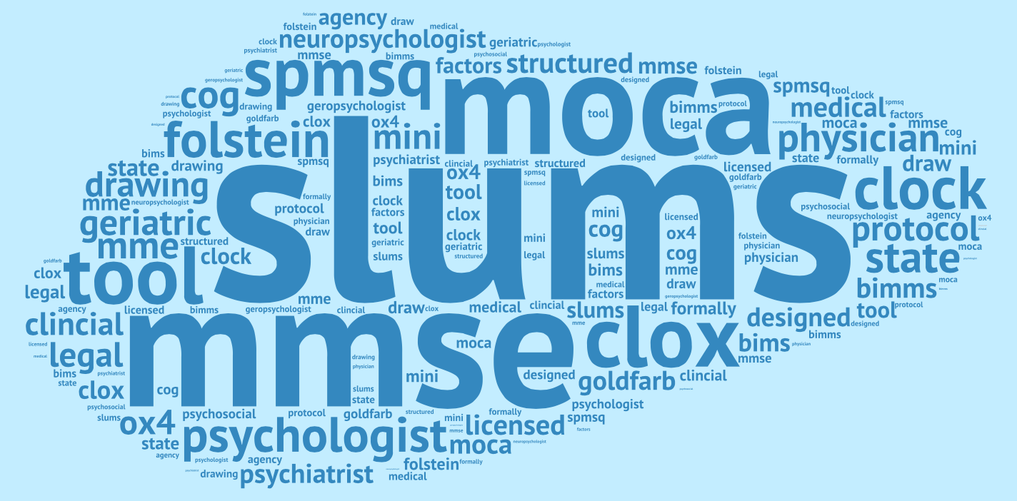
Assessing Cognitive Function
Word cloud based on NAPSA Guardianship Survey conducted NAPSA for Kim Grier, past president, National Guardianship Association, and Philip Marshall. September 16, 2015.
Notes:
Q4
Do you use an established protocol or tool for assessing capacity?
Answered: 65 Skipped: 44
A&Ox4
Bimms
CLOX I & II
Exit 25
Financial Capacity Tool developed by University of Alabama
Folstein
FROMAJE
SLUMS
Geriatric Depression Scale etc,
SPMSQ
Mini Mental status
MME
MMSE
MOCHA (PHNs in specific geographic are a resource because they are trained to use MOCHA.)
Mini-Cog
5 factors: Alertness, Orientation to PPT, Shoert-term memory, long-term memory and thought process
Clock Drawing Exercise
mental status tools
clinical assessment of Person-in-Environment
We designed two capacity forms (one for intake and one for investigation) that assess capacity as defined in the NH APS Statute
state assessment tool/medical record
we will ask more difficult questions about finances and medical conditions
_____

Slide 84
Capacity
person centered
decision specific
ability to understanding information and its meaning
ability to make an informed decision
fluid: conditional on personal capacity, environmental factors, and time
Notes:
View them as a person, just as us
respect how we make a decision, as does anyone else
____
Foundations of Social Work Practice in the Field of Aging
A Competency-Based Approach
Roberta R. Greene, Harriet L. Cohen, Colleen M. Galambos, and Nancy P. Kropf
ISBN: 978-0-87101-378-1. 2007. Item #3781. 320 pgs.
https://www.naswpress.org/publications/aging/foundations.html
Foundations of Social Work Practice in the Field of Aging
A Competency-Based Approach
Roberta R. Greene, PhD, MSW, is professor and Louis and Ann Wolens Centennial Chair in Gerontology at the School of Social Work, University of Texas-Austin. Dr. Greene is author of numerous publications, including Resiliency: An Integrated Framework for Practice, Research, and Policy (NASW Press, 2002); Social Work with the Aged and Their Families (Aldine De Gruyter, 2000); Social Work Practice: A Risk and Resilience Perspective (Thompson/Brooks/Cole, 2007); and Contemporary Issues of Care (Haworth Press, 2007). She currently is conducting research for the John Templeton Foundation.
Harriet L. Cohen, PhD, LCSW, is assistant professor in the Department of Scoial Work at Texas Christian University (TCU) in Fort Worth. She currently serves in national leadership roles in social work and aging, such as a John A. Hartford Geriatric Social Work Faculty Scholar. Her social work practice experience spans 26 years in a variety of nonprofit organizations to build community and organizational capacity to serve older adults and their families. Her research and publication interests include forgiveness and older Holocaust survivors, spirituality in midlife and older adults, and older lesbians and gay men issues.
Colleen M. Galambos, DSW, is a professor at the School of Social Work at the University of Missouri-Columbia. She is editor-in-chief of the Journal of Social Work Education and served as the former editor-in-chief of Health & Social Work. She was a curriculum consultant to the John A. Hartford Faculty Development Institute Project with the Council on Social Work Education and was a member of the Joint Commission on Accreditation of Health Care Organizations Professional and Technical Advisory Committee on Long-Term Care. She has written numerous journal articles and book chapters in gerontology.
Nancy P. Kropf, PhD, formerly at the University of Georgia, is now professor and director of the School of Social Work at Georgia State University. Her area of research and scholarship is late-life caregiving relationships, including rural grandparents raising grandchildren. She was a John A. Hartford Geriatric Social Work Scholar (1999-2001). Dr. Kropf has published numerous articles and books, including Teaching Aging: Syllabi, Resources Infusion Materials for the Social Work Curriculum (Council on Social Work Education, 2002); Gerontological Social Work: Knowledge, Service Settings, and Special Populations (Wadsworth, 2000); and Developmental Disabilities: Handbook for interdisciplinary practice (Brookline Books, 1995)
_____
Foundations of Social Work Practice in the Field of Aging
JoAnn Damron-Rodriguez
A Competency-Based Approach
A competency-based approach to social work practice in the field of aging requires practitioners, educators, and students to be grounded in the requisite knowledge and offer evidence of the effectiveness of their work. The Geriatric Social Work Competencies, developed through the collaboration of the John A. Hartford Foundation Geriatric Social Work Initiative programs—the Council on Social Work Education (CSWE) first Strengthening Aging and Gerontological Education in Social Work (SAGE–SW) Gero-Rich and now the National GeroEd Center and the New York Academy of Medicine (NYAM) Practicum Partnership Program (PPP), are now nationally adopted and have been incorporated in this text (see Appendix). This introduction familiarizes the reader with these competencies and addresses the need for social workers to
prepare for practice in a 21st century aging society access knowledge for contemporary practice define social work practice in aging identify evidence of the effectiveness of social work in the field of aging develop a competency-based approach to learning recognize core geriatric social work competences
self-assess individual growth in social work competence in aging.
The rationale for competency-based education and the need for students and practitioners to evaluate the effectiveness of their interventions are also discussed. The introduction advocates the use of the most current knowledge and best practices in the field of aging.
The text provides a strengths-based multisystemic orientation to foundation social work content for all social workers as well as those concentrating on the field of aging. Each chapter opens with the geriatric social work competencies thought necessary to carry out effective practice and issued by the CSWE Gero- EdCenter (www.Gero-EdCenter.org).
Chapter 1 discusses the present context of social work practice in the field of gerontology. Chapter 2 provides theoretical constructs to guide geriatric practice, and chapter 3 describes the heterogeneity of the aging population; chapters 4, 5, and 6 focus on the individual, families, and informal support systems. The orientation in chapter 7 is on group work. Chapter 8 on case management discusses both direct individual and family practice skills as well as the need to be able to navigate the services system at the organizational level. Chapters 9 and 10 relate to macro practice within organizations and the community.
Finally, chapter 11 addresses policy practice at the state and national level. These chapters further describe the impact of an aging society on its institutions and culture, including family structure, intergenerational and gender roles, work and retirement, dependency ratios, community engagement, and health and social services.
Factors Effecting Geriatric Social Work Practice in the 21st Century
Increased Life Expectancy
Educators have developed geriatric social work competencies in large measure as a response to the changing context of social work practice. Social work practice in the 21st century takes place in the midst of two major societal changes. First is the dramatic increase in life expectancy and the aging of society. Increased human longevity, a hallmark achievement of the 20th century, will have worldwide impact in the 21st century. The 28-year gain in average life expectancy since 1900 is unprecedented over the preceding 5,000 years of human history (see chapter 1). It is not only the dramatic increase in the number of older people that presents an imperative for social work practice in aging, but also the increased diversity of the older population in chronological age (65 to 120 years), birth cohort, race and ethnicity, socioeconomic status, immigration status, functional level, and cognitive capacity that require psychosocial assessment, intervention planning, program development, and policy advocacy (Torres-Gil & Moga, 2001; see chapter 2).
The aging of societies is a global phenomenon. The United Nations International Year of Older Persons in 1999 proclaimed that with thoughtful planning an aging society could become a “society for all ages” that would embrace multigenerational equity and meaningful involvement at all life stages. A society for all ages would acknowledge the interdependence of the individual and society (Lubben & Damron-Rodriguez, 2006). Scharlach and colleagues (2000) stated: “Overarching social work goals in an aging society include preservation of maximum independence, optimal functioning, dignity, and quality of life, through personal empowerment and effective and efficient service utilization” (p. 525).
Increase in Knowledge
The second societal change affecting contemporary social work practice is the exponential increase in knowledge. The explosion of knowledge about the human condition, particularly the aging process, forms the context for the competency-based approach for contemporary practice.
The Knowledge Age
The 21st century following the Industrial Revolution and the brief transitional period of the “information age” of the late 20th century has been conceptualized as the “knowledge age” (Haag, Cummings,
McCubbrey, Pinsonneault, & Donovan, 2006). Social work practitioners entering the workforce or continuing to work in the knowledge age must be equipped with distinct professional knowledge and the skills and the ability to acquire more knowledge continuously to serve their clients and society best.
In the knowledge age, information is often disseminated by technology. Computer technology and the Internet make the acquisition of information or the “use of science” more available for practitioners. Thus, social work education must prepare practitioners to be intelligent consumers of research. Using science also requires that the nuance and contextual application of findings be put into practice (Webb, 2001).
Individuals are living longer and healthier lives in part because of the extraordinary growth of biomedical knowledge and public health initiatives. The confluence of the rapid and large increase of the older population and the exponential increase in the dissemination of knowledge create an imperative for social workers to employ the most recent advances in knowledge in their practice with people living increasingly longer lives.
Developing countries cannot age successfully without the use of public health initiatives and population- based interventions such as improved sanitation methods and immunizations. It is these fundamental public health interventions that lead to the increased well-being of the populations of less-developed countries. Their demographic transition involves a shift from high fertility and mortality rates to those of more developed societies with lower fertility and mortality rates (Lubben & Damron-Rodriguez, 2006). This developmental transition takes place in two major stages (Rowe & Kahn, 1999). The first is a marked reduction in infant mortality and early childhood death rates; the second is a significant decrease in death rates among middle-aged and older adults. This reduction of mortality is attributable to an expansion of public health, nutrition, and health care. In an aging society, therefore, individuals have the potential to live longer and healthier lives (see chapter 1 for the use of knowledge and scientific thinking).
Social Workers as Knowledge Workers
Social workers are after all specialized knowledge workers. Over 30 years ago, Drucker (1998) defined knowledge workers as those who develop and use knowledge to accomplish their work. Social work can be defined by its specialized knowledge, values, and competencies, and social workers can be recognized as a special subset of knowledge workers with the requisite professional knowledge to create and improve policies, programs, and services for communities and individuals.
Drucker (1998) further stated that knowledge workers add value by processing existing information to create new information that can be used to define and solve problems better. Reflective practice, program evaluation, and social work research are good examples of this. Social work may be considered a problem- solving profession with practitioners using applied knowledge. According to Western Management Consultants (2002), the practitioner may be thought of as
a problem solver rather than a production worker or functionary
a person who uses intellectual rather than manual skills to earn a living
an individual who requires a high level of autonomy
a manipulator of symbols; someone paid for quality of judgment
someone who possess un-codified knowledge which is difficult to duplicate
someone who uses knowledge and information to add to deeper knowledge and information (Western Management Consultants, 2002).
Definition of Social Work in Aging
The development of geriatric social work competencies coincides with the profession’s interest in defining our practice domain. The bureau of health professions white paper definition of social work in aging is based on the generic description of the profession as described in the national association of social workers’ (NASW) (1981) Standards for the Classification of Social Work Practice (see Berkman, Dobrof, Damron-Rodriguez, & Harry, 1997). This definition of social work in aging relates essential social work roles to the needs of older people and their families as is described in the purposes of geriatric social work practice section. Terms for professional practice with older adults used throughout this book are “gerontological” (founded in knowledge of the aging process) and “geriatric” (based in interventions with older people with health-related issues), sometimes used interchangeably.
Geriatric practice is consumer directed, with the client given the choice in type of service, provider, and timing of care provision (Benjamin, 2001). It focuses on family caregiving. Although 80 percent of the care of older adults is provided by their informal support systems, social workers play a key role in assisting families in their caregiving role (Rizzo & Rowe, 2005; Stone, Reinhard, Achemer, & Rudin, 2002). Another major emphasis is on community care by hospitals or institutions or homes and communities.
Purposes of Geriatric Social Work Practice
Gerontological social workers should have the professional competence to
enhance developmental, problem solving, and coping capacities of older adults and their families promote effective and humane operation of delivery systems that provide resources and services to older people and their families
link older clients with systems that provide them with resources, services, and opportunities contribute to the development and improvement of social policies that enhance individual functioning throughout the life span. (Berkman et al., 1997)
Values of Geriatric Practice
In addition to having specialized professional knowledge, social work practice in the field of aging embodies values unique to the profession, adding a dimension that is a signature element of the profession as described in the book. These professional ethics and values are delineated in the Code of Ethics of the National Association of Social Workers (NASW, 2000) and are used along with knowledge and skills to accomplish the mission of the profession—“to enhance human well-being and help meet the basic human needs of all people, with particular attention to the needs and empowerment of people who are vulnerable, oppressed, and living in poverty” (p. 1).
The resilience-enhancing model (REM) (Greene, 2002) that forms the conceptual foundation for this text develops the new tenets of practice in aging for the present era and a philosophy for a new gerontology. Rather than an “aging as a problem” perspective of earlier gerontology and geriatric practice, resilience interventions are based on the self-direction and self-advocacy of older adults.
Evidence of Effectiveness
Social work decisions should be based on the best available evidence. The development of geriatric social work competencies is congruent with the profession’s interest in providing consumers with evidence of effectiveness. Social work is garnering evidence of the value added by the profession’s interventions to older adults’ quality of life (Duke, 2005; Grimier & Gorey, 1998; Morrow-Howell & Burnette, 2001). Rizzo and Rowe (2005) in a comprehensive review of research on social work intervention with older people reported the following intervention outcomes: shorter lengths of hospital stays; decrease in inappropriate use of emergency rooms; overall better coordination of health care; and greater ability of caregivers to cope. Several terms are used to describe the optimal use of outcomes research in practice. Evidence-based practice, practice guidelines, and best practices are types of knowledge (research) that can be applied to interventions.
Evidence-Based Practice
Evidence-based practice is
practice supported by research findings and demonstrated as being effective through a critical examination of current and past practices (www.cona-nurse.org/standards/glossary.htm)
clinical decision making based on a systematic review of the scientific evidence of the risks, benefits, and costs of alternative forms of diagnosis or treatment (www.moh.govt.nz/moh.nsf/0/15f5c5045e7a1dd4cc256b6b0002b038)
an approach to decision making in which the clinician uses the best evidence available, in consultation with the patient, to decide on which course of action suits the patient best (www.nhstayside.scot.nhs.uk/FoISA/Glossary.htm)
For example, the evidence of the effectiveness of community-based case management is based on its relatively low cost and the improved quality of life it provides for the frail elderly population (Duke, 2005).
Practice Guidelines
Practice guidelines are systematically developed statements to assist practitioners and patients in making decisions about appropriate health care for specific clinical circumstances (Institute of Medicine, Committee to Advise the Public Health Service on Clinical Practice Guidelines, 1990). Sets of practice techniques that have been evaluated and proved efficacious are practice guidelines.
Best Practices
Best practices are those that have been systematically identified, described, combined, and disseminated as effective and efficient clinical or management strategies for practicing clinicians (Mold & Gregory, 2003).
Competency Approach
A competency-based approach requires the demonstration of core knowledge, values, and skills in social work practice (Vass, 1996). Competency is measured along a continuum or a range of skill levels. The competence level can be adequate or highly qualified in a skill domain. Competency-based education and evaluation (CBE) as defined by Bogo and colleagues (2002) first requires an adoption of a set of defined skills as described in the Development of Geriatric Social Work Competencies section. A CBE approach also leads to the establishment of learning goals and the measurement of their achievement in classroom and field education (Bogo et al.).
Geriatric Social Work Competencies
The social work profession did not recognize the need for specific gerontological or geriatric knowledge until the mid-20th century. Lowy (1979) acknowledged that “prior to 1945, not much had been happening in social work with the aging” (p. 9). Social welfare was initially founded to carry out child welfare functions. It was not until the late 1960s and early 1970s that older people were considered a target population. This was a time when many professions began to recognize that specialized knowledge and training were required to serve older people (Damron-Rodriguez, 2006).
In 1995 the Bureau of Health Professions held a National Forum for Geriatric Education in which social work was one of the key professions. Each profession produced a white paper outlining a strategy for education and training (Berkman et al., 1997). In the late 1990s, the John A. Hartford Foundation, whose goal is to improve the care of older people by strengthening geriatrics in the health professions, turned its attention to social work continuing to fund projects in medicine and nursing geriatric education. Through
forums with social work leaders and production of white papers (Scharlach et al., 2000), the Hartford Geriatric Social Work Initiative was crafted. This initiative has had a major impact on the field of geriatric social work (Robbins & Rieder, 2002).
The Council on Higher Education Accreditation (CHEA), which oversees standards for 76 different specializations and professions including nursing, public health, pharmacy, medicine, counseling, education, pastoral care, and social work, reported that nationally 46 percent of these schools are competency based. The CHEA has now adopted a competency-driven model for accreditation of all professional schools (National Center for Higher Education Management Systems, 2000). Competence is used not only as a measure of education and training, but also as a measure for accreditation. The Joint Commission on Accreditation of Healthcare Organizations (2001), for example, stressed the value of competency-based geriatric education in preparing professionals for practice in health care. By establishing geriatric competencies, the field could shape curriculum, field training, and continuing education to prepare practitioners effectively to address the needs of older adults and their families.
Development of Geriatric Social Work Competencies
Research Development
Gerontological social work competencies have been developed over a multiyear period through several of the John A. Hartford social work initiatives. In 1999, CSWE received a grant, SAGE-SW. The project delineated 65 competencies based on a literature review, expert opinion, and a comprehensive survey of the field (Rosen, Zlotnik, & Singer, 2002). These competencies have been applied to aging curriculum development (Greene & Galambos, 2002). In 2000 competencies were being developed for the measurement of geriatric social work enhanced field education (Fortune & Damron-Rodriguez, 2002) by the NYAM PPP and resulted in the PPP Geriatric Social Work Competency Scale I. Scale I incorporated and condensed SAGE-SW competencies and focus group feedback from providers (Naito-Chan, Damron- Rodriguez. & Simmons, 2004). The Geriatric Social Work Competency Scale II is the most recent shorter measurement tool and is presented at the end of this chapter for use in the measurement of student’s assessment of skill level (see chapter appendix for Scale II). The Gero-Rich program and now the National GeroEd Center has brought the competencies to curriculum infusion for generalist practice (Hooyman, 2006).
The Hartford Geriatric Social Work Initiative has coalesced the multiple programs. Statistical measures and national advisory boards synthesized and adopted a common list of geriatric competencies composed of knowledge, skills, and values in four domains. These competencies, whether stated as learning objectives (GeroEd) or measurable skills (PPP), are the adopted skills set now available to guide curriculum development at schools and departments of social work (www.Gero-EdCenter.org and
www.socialworkleadership.org. The four domains of competencies are (1) values, ethics, and theoretical perspectives; (2) assessment; (3) intervention; and (4) aging services, programs, and policies. The competencies are presented in their totality in chapter 1 and the appropriate competencies are listed at the beginning of each chapter of the book to guide course development and discussion.
Classroom Infusion and Integration
Competencies have been related to curricula in the following ways:
Basic course descriptions are stated in competency-based terms.
Course objectives now specify competencies are targeted for aging infusion. Aging content in courses support geriatric competencies.
GeroEd teaching resources are used for educational supports and activities. Assessments of skill development are identified and a part of each course.
Student Assessment: Geriatric Social Work Competency Scale II
To assess student competency, instructors must distinguish the level of student performance. Students may also assess their own progress by using the PPP Geriatric Social Work Competency Scale II provided in the Appendix (Chung, Damron-Rodriguez, Lawrance, & Volland, 2007; Damron-Rodriguez, 2006). The PPP Geriatric Social Work Scale II is a self assessment of skill that is currently used in more than 35 schools of social work for measurement of competence. These evaluations at the various PPP sites have consistently demonstrated student increase in geriatric competence over the training period (Damron- Rodriguez, Lawrance, Barnett, & Simmons, 2007). The five levels of social work competence are categorized as
1. not skilled at all (I have no experience with this skill)
2. beginning skill (I have to consciously work at this skill)
3. moderate skill (This skill is becoming more integrated in my practice)
4. advanced skill (This skill is done with confidence and is an integral part of my practice)
5. expertskill(Icompletethisskillwithsufficientmasterytoteachothers).
Thus, evaluation and measurement are central dimensions of competency development. The Geriatric Social Work Competency Scale II can also be used to enrich field experience to
define learning objectives based on outcomes
structure student contracts identifying competencies
design field rotations to enhance experiences for competency development develop or use modules and teaching resources to link field and classroom
provide integrative seminars
train field instructors to use competencies in structuring field experience.
Further Measurement
The validity of assessment of competency through self-efficacy measures has been substantiated through research (Holden, Meenaghan, Anastas, & Metry, 2002). Bandura (1997) defined self-efficacy as belief in one’s capability to perform actions required to produce certain results or outcomes. Self-efficacy has been established as a reliable and valid construct for predicting performance in a variety of health disciplines. Self-efficacy is conceived to be task or domain specific. It is not measured by the number of skills acquired, but by the level of confidence felt necessary to accomplish specific outcomes. It requires organizing many subskills, including ones that are cognitive, social, emotional, and behavioral, into the competence to meet goal-directed outcomes (Bandura). Self-efficacy has a positive and significant relationship to academic performance and consistent goal accomplishment across multiple research studies (Multon, Brown, & Lent, 1991). The further development of this and other constructs to measure educational outcomes is imperative (Holden et al.; McKinley, Fraser, & Baker, 2000).
Other more objective measures are needed as the profession continues on the path of competency-based education (Bogo et al., 2002). Practice for the 21st century will require knowledge utilization at an unprecedented level. Competency-based evaluation of educational outcomes is therefore an important aspect of the movement toward best practices in aging. It can be used in educational planning for setting educational goals. Collaboration with and learning from other professions as they move toward geriatric competency measurement will be beneficial as well as provide additional benefits for social work education (American Geriatrics Society, 2000). As CSWE continues its revision of the Educational Policy Statement and Accreditation Standards, it is anticipated that social work educators will join the ranks of those using a competency-based approach. This book is intended to contribute to that endeavor.
Suggested Web Sites:
Projects funded by the Hartford Geriatric Social Work Initiative may be accessed at http://www.jhartfound.org.
The CSWE Gero-Ed Center funded by the John A. Hartford Foundation provides extensive resources for infusing content on gerontology in the social work curriculum and can be accessed at www.Gero-EdCenter.org.
The Social Work Leadership Institute of the New York Academy of Medicine provides access to evidence-based practice for geriatric social work through the Center for Aging Policy Evidence Database and Public Policy Clearing House at www.socialworkleadership.org.
The California Social Work Center Aging Initiative, a consortium of California schools that have
developed an aging competency-based curriculum for social work students. Their work is described at http://calswec.berkley.edu/aging_post04summit_execsummary.pdf.
The author wishes to acknowledge the contributions to the competency model of Patricia J. Volland, MSW, MBA, principle investigator of the Social Work Leadership Institute PPP and vice president, New York Academy of Medicine, and Frances P. Lawrance, consultant on the evaluation of PPP.
References
American Geriatrics Society. (2000). Core competencies for the care of older patients: Recommendations of the American Geriatrics Society. Academic Medicine, 75, 252–255.
Bandura, A, (1997). Self-efficacy: The exercise of control. New York: Freeman Press.
Benjamin, A. E. (2001). Consumer-directed services at home: A new model for persons with disabilities.
Health Affairs, 20(6), 80–95.
Berkman, B., Dobrof, R., Damron-Rodriguez, J., & Harry, L. (1997). Social work. In S. M. Klein (Ed.), A
national agenda for geriatric education: White papers (pp. 53–85). New York: Springer.
Bogo, M., Regehr, C., Hughes, J., Power, R., & Globerman, J. (2002). Evaluating a measure of student field performance in direct service: Testing reliability and validity of explicit criteria. Journal of Social Work Education, 38, 385–401.
Chung, G., Damron-Rodriguez, J., Lawrance, F. P., & Volland, P. (2007, February 2–4). Geriatric social work competence: Learning partnership involving student self-assessment and field instructor evaluation. Paper presentation at CSWE Gero-Ed Forum, Charleston, SC.
Damron-Rodriguez, J. A. (2006). Moving ahead: Developing geriatric social work competencies. In B. Berkman (Ed.), Handbook of social work in health and aging (pp. 1051–1068). New York: Oxford University Press.
Damron-Rodriguez, J. A., Lawrance, F. P., Barnett, D., & Simmons, J. (2007). Developing geriatric social work competencies for field education. Journal of Gerontological Social Work, 48(1/2), 139–169.
Drucker, P. (1998, October 5). Management new paradigms. Forbes, 162(7), 152–177.
Duke, C. (2005). The frail elderly community-based case management project. Geriatric Nursing, 26(2),
122–127.
Fortune, A. E., & Damron-Rodriguez, J. A. (2002). Model for geriatric social work practicum partnership
program. New York: New York Academy of Medicine.
Greene, R. R. (2002). Resiliency: An integrated approach to practice, policy, and research. Washington,
DC: NASW Press.
Greene, R., & Galambos, C. (2002). Social work’s pursuit of a common professional framework: Have we
reached a milestone? Advancing gerontological social work education. New York: Haworth Press. Grimier, A., & Gorey, K. (1998). The effectiveness of social work with older people: A meta-analysis of
conference proceedings. Social Work Research, 22, 60–64.
Haag, S., Cummings, M., McCubbrey, D., Pinsonneault, A., & Donavan, R. (2006). Management information systems for the information age (3rd Canadian ed.). Whitby, Ontario, Canada: McGraw Hill Ryerson.
Holden, G., Meenaghan, T., Anastas, J., & Metry, G. (2002). Outcomes of social work education: The case for social work self-efficacy. Journal of Social Work Education, 38, 115.
Hooyman, N. R. (2006). Achieving curricular and organizational change: Impact of the CSWE geriatric enrichment in social work education project. Alexandria, VA: Council on Social Work Education.
Institute of Medicine, Committee to Advise the Public Health Service on Clinical Practice Guidelines. (1990). Clinical practice guidelines: Directions for a new program. Washington, DC: Author.
Joint Commission on Accreditation in Healthcare Organizations. (2001). Comprehensive JCAHO accreditation manual for hospitals: The official handbook. Oakbrook Terrace, IL: Author.
Lowy, L. (1979). Social work with the aging: The challenge and promise of the later years. New York: Harper & Row.
Lubben, J. E., & Damron-Rodriguez, J. A. (2006). World population aging. In B. Berkman (Ed.), Handbook of social work in health and aging (pp. 939–946). New York: Oxford University Press.
McKinley, R. K., Fraser, R. C., & Baker, R. (2000). Model for directly assessing and improving clinical competence and performance in revalidation of clinicians. British Medical Journal, 32, 712–715.
Mold, J. W., & Gregory, M. E. (2003). Best practices research. Family Medicine, 35(2), 131–134. Morrow-Howell, N., & Burnette, D. (2001). Gerontological social work research: Current status and future
directions. Journal of Gerontological Social Work, 36, 63–81.
Multon, K. D., Brown, S. D., & Lent, R. W. (1991). Relation of self-efficacy beliefs to academic outcomes: A
meta-analytic investigation. Journal of Counseling Psychology, 38, 53–63.
Naito-Chan, E., Damron-Rodriguez, J. A., & Simmons, W. J. (2004). Identifying competencies for
geriatric social work practice. Journal of Gerontological Social Work, 43(4), 59–78.
National Association of Social Workers. (1981). NASW standards for the classification of social work
practice (Policy Statement 4). Silver Spring, MD: Author.
National Association of Social Workers. (2000). Code of ethics of the National Association of Social
Workers. Washington, DC: NASW Press.
National Center for Higher Education Management Systems. (2000). Competency standards model:
Another approach to accreditation review. Washington, DC: Council on Higher Education Accreditation.
Rizzo, V. M., & Rowe, J. (2005). Studies of the efficacy and cost-effectiveness of social work services in aging: A report commissioned by the National Leadership Council. Retrieved September 1, 2005, from http://socialwork.nyam.org/pdf/EfficacyFinal_Report.pdf
Robbins, L. A., & Rieder, C. H. (2002). The John A. Harford Foundation geriatric social work initiative. Journal of Gerontological Social Work, 39(3), 71–90.
Rowe, J. W., & Kahn, R. L. (1999). Successful aging. New York: Pantheon.
Scharlach, A., Damron-Rodriguez, J., Robinson, B., & Feldman, R. (2000). Educating social workers for
an aging society: A vision for the 21st century. Journal of Social Work Education, 36, 521–538. Stone, R., Reinhard, S. C., Achemer, J., & Rudin, D. (2002). Geriatric care managers: A profile of an
emerging profession [Research Report]. Washington, DC: American Association of Retired Persons. Torres-Gil, F., & Moga, K. B. (2001). Multiculturalism, social policy and the new aging. Journal of
Gerontological Social Work, 36(3/4), 13–31.
Vass, A. A. (Ed.). (1996). Social work competencies: Core knowledge, values, and skills. London: Sage
Publications.
Webb, S. A. (2001). Some considerations on the validity of evidence-based practice in social work. British
Journal of Social Work, 31, 57–79.
Western Management Consultants. (2002). Herding knowledge workers. Retrieved May 15, 2007, from http://www.wmc.on.ca/articles/article06.htm

Slide 85
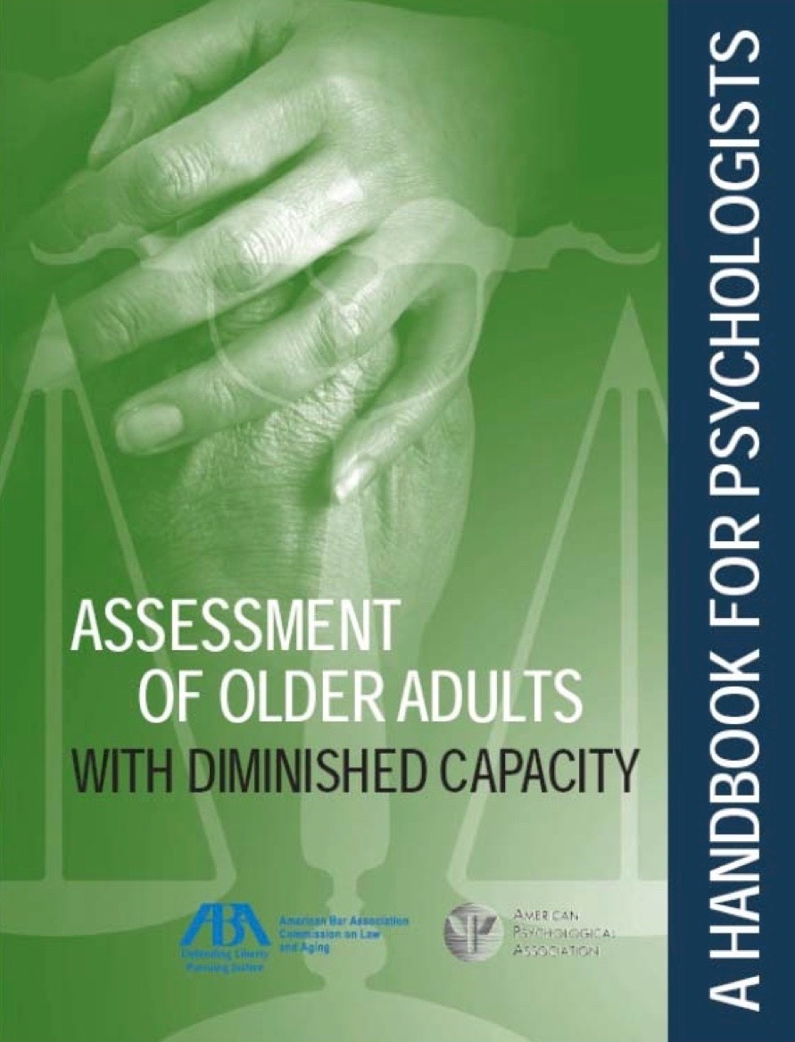
Assessment of Older Adults with Diminished Capacity: A Handbook for Psychologists, American Bar Association Commission on Law and Aging, American Psychological Society, Association Assessment of Capacity in Older Adults Project Working Group. 2008
Notes:
_____
Assessment of Older Adults with Diminished Capacity: A handbook for psychologists, American Bar Association Commission on Law and Aging, American Psychological Society, Association Assessment of Capacity in Older Adults Project Working Group, 2008

Slide 86
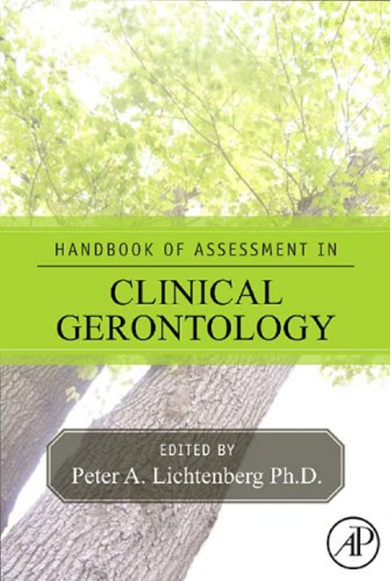
Litchenberg, Peter A., ed. Handbook of Assessment in Clinical Gerontology. Academic Press, Second edition, 2010.
Notes:
lichtenberg_2010_handbook_of_assessment_in_clinical_gerontology.pdf
584 CHAPTER 22 Assessment of Capacity
In determining capacity in guardianship hearings, judges rely upon “medical evidence,” usually in the form of a clinical report or certificate completed by a physician, psychologist or other qualified health care provider. Historically the basis for incapacity was the presence or absence of a medical diagnosis, and thus medical evidence was often provided by a physician who confirmed the diagnosis to the courts. Unfortunately, clinical evaluations for the purposes of guardianship have historically been, and for the most part remain to this date, very brief and conclusory (meaning the clinician offers a conclusion but does not describe the data that support the conclusion), not allowing for limitations to guardianship orders (Bulcroft, Kielkopf, & Tripp, 1991; Dudley & Goins, 2003; Keith & Wacker, 1992; Moye et al., 2007).
Recognizing these problems, state statutes for guardianship have undergone significant reform over the past 20 years to enhance due process protections, such as being certain the individual is notified of the guardianship hearing, making real accommodations to have the person present, and considering the individual’s choice of a guardian. The new laws have also matched statutory definitions of decision- making capacity to more empirically grounded understandings of the brain. Legal definitions of incapacity under guardianship have shifted away from diagnosis-based definitions to “functional” definitions. In most states, a diagnosis is a necessary but not sufficient component of incapacity. Courts are interested in diagnoses and how the disorders or symptoms of the disorder affect “function” (e.g., decision-making, judgment, behavior, etc.). Note that the law’s use of the word “functional” is different from psychology’s and gerontology’s use of the term. In the law, the term “functional abilities” is more general, referring to descriptions of the individual’s strengths and weaknesses in cognition and behavior. In gerontology, the term “functional abilities” is narrower, typically used in reference to activities of daily living (ADLs) and independent activities of daily living (IADLs) (Lawton & Brody, 1969). When courts ask for medical evidence to focus on function, they mean they want more than just a diagnosis; they want to know about the individual’s strengths and weaknesses in decision-making and judgment (e.g., neuropsychological test results), and everyday behavior (e.g., IADL or capacity instrument test results).
The American Bar Association Commission on Law and Aging keeps up-to-date, state-by-state charts of the legal definitions of incapacity in guardianship statutes, which are updated as they change. These tables (available at http://www.abanet.org/aging/guardianship/-lawandpractice/home.html) are a tremendous resource for clinicians who want to find the statutory citation for guardianship law in their state. In addition, by analyzing the different statutes across states, one can obtain a broad understanding of various legal standards for incapacity (although for any specific case the clinician must refer to the definition within the jurisdiction). Definitions of incapacity in guardianship laws tend to have one to four elements: the presence of a disabling condition; cognitive impairment; functional impairment; and a necessity element (degree of risk and failure of less restrictive alternatives that necessitates the guardianship intervention).
The Uniform Guardianship and Protective Proceedings Act (UGPPA) is a model guardianship law developed by a consensus body [the National Conference of Commissioners on Uniform State Laws (NCCUSL) http://www.nccusl.org] which for more than 100 years has worked to develop model laws that represent the most current legal thinking on a matter and may serve as models for states that are in the process of revising statutes. The UGPPA has been endorsed by leading elder law organizations. The definition of an incapacitated person in the Uniform Act is “an individual who, for reasons other than being a minor, is unable to receive and evaluate information or make or communicate decisions [cognitive component] to such an extent that the individual lacks the ability [functional component] to meet essential requirements for physical health, safety, or self-care [necessity component], even with appropriate technological assistance” [brackets added]. Although this definition does not have a diagnostic component, most states also require diagnostic information. An operationalized clinical example of the UGPPA definition might include the following information: an individual with Alzheimer’s dementia of moderate severity [disabling condition], who due to severe delayed memory and executive dysfunction [cognitive component] lacks the ability to make decisions regarding or independently manage personal care, health care, and finances [functional component] and, in the absence of close family, is at substantial danger of self-neglect and financial exploitation even when provided extensive in-home services and supports [necessity component].
Limited Guardianship
A key part of guardianship reform is a change in judicial practice to favor limited guardianship rather than full guardianship. Previously, courts found persons “incompetent” and appointed a plenary or full guardiandwith the authority to make all decisions for the incapacitated person (except for those excluded by statute), and with the incapacitated person (formerly called “the ward”) losing all deci- sional rights. Guardianship reform advocates assert that plenary appointments caused the individual to be “un-personed” in the eyes of the law, and have sought to emphasize the significant consequences of a plenary guardianship; namely, that the incapacitated individual was no longer a person in the eyes of the law due to a total loss of rights.
In recent years courts have moved away from the practice of full guardianship to favor (or in some states require) “limited” guardianship. Limited guardianship means that the judge’s guardianship order (sometimes called a “letter”) provides the guardian with limited authority to make decisions in only those areas where the individual requires assistance, and preserves rights in any area where the indi- vidual still has the capacity to make decisions. This practice is consistent with a contemporary scientific understanding of neurologic and psychiatric illness in which a person may have strengths and weak- nesses in cognitive functioning translating to intact or impaired specific capacities. Admittedly the practice of limited guardianship is harder for everyonedthe determination of the order is more nuanced and takes more time, the courts require more information from the clinician, and the clinician must take more time to provide detailed information. The push for limited guardianship is a matter of rights, attempting to balance the concerns of autonomy versus protection, and limit the removal of rights.
Capacity as Defined in Health Care Consent Law
Capacity to consent to medical treatment is a specific capacity rooted in the concept of informed consent, in which informed consent must be voluntary (the person must not be coerced), knowl- edgeable (the person must be informed about the condition, treatments, and alternatives), and the person must have the capacity to make the decision. The Uniform Health Decisions Act defines medical consent capacity as an individual’s “ability to understand the significant benefits, risks, and alternatives to proposed health care and to make and communicate a health care decision.” State- specific definitions regarding medical consent capacity are often located in advance directive statutes, durable power of attorney statutes, and in the body of case law. The capacity to consent to medical treatment is perhaps the most well-studied and discussed capacity.
In reviewing consent capacity law within the United States, various scholars have identified four discrete abilities that are often present in legal standards for medical consent capacity: the ability to understand diagnostic and treatment information; appreciate the significance of this information; reason about the risks and benefits of treatment alternatives; and evidence a choice (Grisso & Applebaum, 1998b). A problem in one or more of these areas, in concert with other factors, may lead to legal determinations of incapacity to make a medical decision. “Understanding” refers to the ability to comprehend diagnostic and treatment-related information. This concept includes not only the ability to remember newly presented words and phrases, but also the ability to comprehend the meaning of these words and phrases, and to exhibit that comprehension to the physician or evaluator. “Appreciation” refers to the ability to determine the significance of the treatment information relative to the individual’s situation, focusing on the nature of the diagnosis and the possibility that treatment would be beneficial, and involves both cognitive and emotional appreciation. Thus, “understanding” refers to whether the individual can comprehend basic information about a condition and treatment, while “appreciation” refers to whether the individual believes that the information is accurate and applies to him or her. “Reasoning” is the process of deciding on treatment by comparing alternatives in light of consequences, and through integrating, analyzing, and manipulating information. Reasoning involves including drawing inferences about the impact of alternatives on everyday life considering one’s own personal values and preferences. Although it is not usually explicitly stated, the verb “to make” in some health care capacity statutes may refer to the process of reasoning. “Expressing a choice” concerns the basic ability to communicate a decision about treatment, and applies to individuals who cannot or will not express a choice, or who are ambivalent. This legal framework for consent capacity translates fairly well into clinical assessments, as will be discussed later.
….
Problems with Clinical Assessment of Capacity
In the past, evaluations of capacity were addressed to physicians, in part because statutes governing matters of capacity in guardianship and health care law required a medical opinion, and hospital policies and procedures followed suit. Thus, historically, clinical evaluations of the capacity of older adults were based on a physician’s interview or the physician’s knowledge of the patient. More recently, standardized cognitive and functional assessments by licensed psychologists are the norm, particularly for complex cases, where discrete cognitive and functional data are needed. Now, many state laws recognize psychologists and in some states other practitioners (advance practice nurses, social workers, occupational therapists) as experts who can provide evidence or testify about civil capacities, and hospital policies and procedures reflect this shift.
Clinical assessments of capacity require an astute professional clinical judgment. A comprehensive clinical interview is an essential component. However, there can be problems with capacity assess- ments that rely only upon interview and do not include standardized assessments of cognition and function. When individual expert assessments of competency in elderly persons have been compared to multidisciplinary panel assessments, there is lack of agreement (Kaplan, Strange, & Ahmed, 1988; Rutman & Silberfeld, 1992). Furthermore, even when individual experts are consistent in their knowledge of legal standards for competency, they may apply them incorrectly and inconsistently (Markson, Kern, Annas, & Glantz, 1994). Low reliability of capacity evaluations is a particular concern for marginally demented patients, as physicians achieved only a 56% judgment agreement (kappa 1⁄4 0.14) in evaluating capacity to consent in mildly demented patients (Marson, McInturff, Hawkins, Bartolucci, & Harrell, 1997) even when shown a structured assessment, although reliability improved when clinicians were trained to consider the four legal standards for consent capacity (Marson, Earnst, Jamil, Bartolucci, & Harell, 2000).
The low reliability of capacity evaluations may be exacerbated by factors such as dual roles, affective reactions, insensitivity to individual differences (e.g., the impact of race, culture, religion on decisions), lack of empirical models and measures, and confusion about the task. A national survey of 395 clinical practitioners found continuing confusion regarding the assessment of capacity (Ganzini, Volicer, Nelson, & Derse, 2003). Common pitfalls included confusion between clinical assessments of capacity and legal determinations of competency, the belief that actions against medical advice indicate incapacity, and the assumption that cognitive or psychiatric disorders necessarily imply incapacity. Clinicians vary in what they consider to be appropriate risks (Clemens & Hayes, 1997) and “safe-enough gambles” for older adults in discharge planning. Determining where to draw the line in promoting an individual’s autonomy versus protecting the individual from harm can be extremely difficult.
Clinicians may zero in on different cognitive abilities in arriving at capacity conclusions (Marson, Hawkins, McInturff, & Harrell, 1997). Some clinicians may focus more on the patient’s “rationality” whereas others may focus more on the extent to which choices are consistent with values (Braun, Gurrera, Karel, Armesto, & Moye, in press).
Differences between how professionals and patients view life and treatment decisions is one factor that may influence reliability. Professionals estimate a patient’s quality of life differently, typically as less desirable, than does the patient (Starr, Pearlmann, & Uhlmann, 1986; Uhlmann & Pearlmann, 1991). In addition, family and physician proxies are poor at predicting patients’ treatment preferences (Seckler, Meier, Mulvihill, & Cammer Paris, 1991). In evaluating the extent to which decisions are “rational,” experts may have difficulty appreciating the elderly patient’s perspective, given that the elderly individual’s decision-making is informed by a lifetime of experience.
In fact, life experience may be an especially strong predictor of decision-making in older adults, who tend to focus more on interpersonal and experiential elements of problems than younger adults (Blanchard-Fields, 1996). Individual differences play a significant role in medical treatment decisions (Karel, 2000). For example, African Americans are more likely to choose life-sustaining medical treatments, with less concern about “quality of life,” than Caucasian Americans who are more con- cerned about “quantity of life” (Caralis, Davis, Wright, & Marcial, 1993; Eleazer et al., 1996; Hopp & Duffy, 2000), and for these and other reasons could be judged incorrectly to have higher rates of incapacity (Cairns et al., 2005). In a similar vein, individuals from ethnic minority groups were less likely to endorse the appropriateness of allowing surrogates to consent for an incapacitated person to participate in research (Kim et al., 2009). Cultural and religious values and beliefs may be critical determinants of an individual’s approach to medical decision-making (Garrett, Harris, Norburn, Patrick, & Danis, 1993; Klessig, 1992), as is an individual’s experiences with illness or caregiving (Allen-Burge & Haley, 1997; Collopy, 1999; Karel, Powell, & Cantor, 2004). For example, dementia caregivers may be less likely than non-caregivers to endorse life-sustaining interventions when asked to consider hypothetical scenarios (Allen-Burge & Haley, 1997).
As adults age, they may become more proficient decision-makers, considering less information before making decisions (Johnson, 1990; Meyer, Russo, & Talbot, 1995; Streufert, Pogash, Piasecki, & Post, 1990) and make decisions more quickly (Meyer et al., 1995). This has been described as a shift from analytic or controlled processing (Yates & Patalano, 1999) to one that uses shortcuts in the complex decision-making process (Finucane, Alhakami, Slovic, & Johnson, 2000; Kahneman, Slovic, & Tversky, 1982) or is more automatic (Titov & Knight, 1997). Reliance upon rule-based or automatic processing (versus analytic processing) may enable adults with diminished cognitive resources to compensate for their cognitive deficits. But if the capacity evaluation emphasizes analytic and controlled decisional processes, it may misjudge equally valid but less explicitly analytic decision- making.
Cultural Considerations in Capacity Assessment
Underlying the comments in the five preceding paragraphs is the issue of individual differences and cultural considerationsdthat the reliability and validity of capacity judgments may be affected by a failure to appreciate the impact of age, gender, race, education, socioeconomic status, on the process by which others arrive at decisions, and a failure to be sensitive to those differences between the evaluator and the person being evaluated.
Often a first step in a capacity evaluation is one of disclosuredand disclosure can pre-date the capacity referraldmeaning the capacity referral can be generated after a physician discloses a medical recommendation and the patient refuses treatment. Although it seems obvious, it is not uncommon to find a situation where the patient does not understand what is discloseddnot because the individual has a deficit in “understanding” but because the information was not disclosed in a manner the person could possibly understand because of language differences or diminished health literacy. When low English proficiency is noted, it is important to locate an examiner who speaks the patient’s native language, and is familiar with their culture, using native language equivalent (e.g., among other measures, the WAIS-III and Geriatric Depression Scale have Spanish forms), and if a native language speaking evaluator is not available, to use a professional translator. In addition, the examiner should directly ask the patient and family members about cultural considerations and values (see values section later), and consult with practitioners familiar with multicultural assessment (APA, 2005; Virnig & Morgan, 2002).
_____

Slide 87
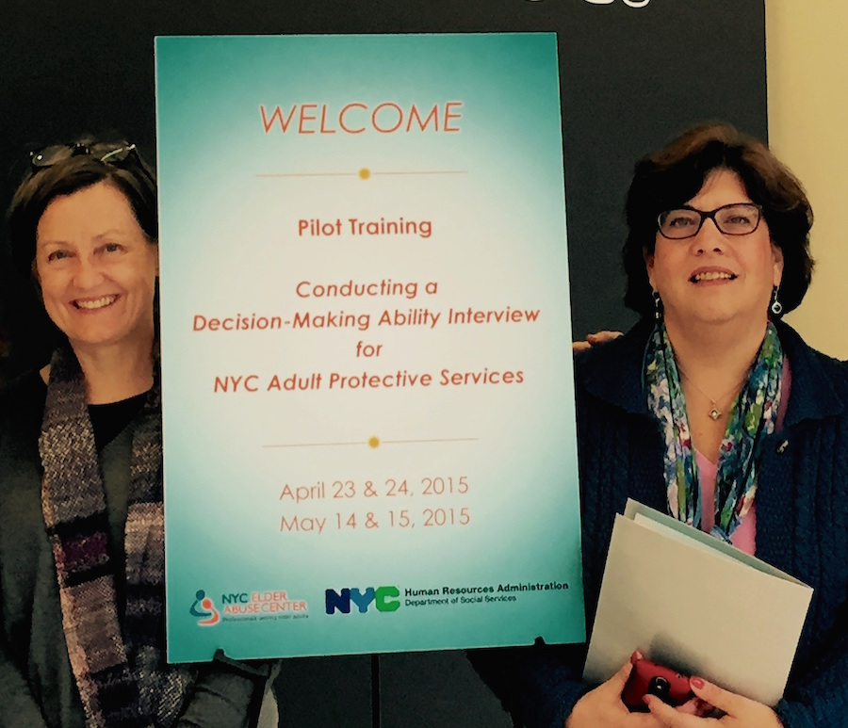
Interview of Decisional Abilities (IDA)
Peg Horan, NYC Elder Abuse Center MDT Coordinator/Elder Abuse Prevention Specialist and Dr. Veronica LoFaso, NYC Elder Abuse Center MDT Geriatrician.
Notes:
Peg Horan, LMSW, NYC Elder Abuse Center MDT Coordinator/Elder Abuse Prevention Specialist and
Dr. Veronica (Ronnie) LoFaso, NYC Elder Abuse Center MDT Geriatrician. A semi-structured interview tool, IDA (Interview of Decisional Abilities), was created for use by NYC APS caseworkers, and a pilot training was conducted in its use.
http://nyceac.com/aps-training-project-decision-making-ability-interview/
Peg Horan, LMSW, NYC Elder Abuse Center MDT Coordinator/Elder Abuse Prevention Specialist & Dr. Veronica LoFaso, NYC Elder Abuse Center MDT Geriatrician.
______
Project Overview:
In 2014, The New York Community Trust generously provided Phase One funding to the NYC Elder Abuse Center (NYCEAC) to develop and deliver a pilot curriculum to teach NYC Adult Protective Services (APS) staff to gather information about APS client decision-making abilities. A semi-structured interview tool, IDA (Interview of Decisional Abilities), was created for use by NYC APS caseworkers, and a pilot training was conducted in its use. The Phase One training imparted conceptual knowledge about decision-making capacity, provided experiential training necessary to support APS caseworkers in gathering information about clients’ decision-making abilities, encouraged triaging capacity referrals to psychiatry for further assessment and supported supervisors in their oversight of caseworkers’ provision of these services.
Phase One project goals were accomplished by:
Convening a Project Planning Committee (PPC) to provide expertise in the development of the curriculum and training and achieve the goals of the grant project. The PPC met in full capacity and in workgroups to discuss critical issues related to capacity assessments and crystalize the key concepts to include in the semi-structured interview tool and trainings. The PPC also provided guidance to a core PPC training group who fine-tuned the curriculum and the semi-structured interview tool, developed case studies, created a Train-the-Trainer curriculum and developed the project’s evaluation materials. Over the course of the project year, PPC members made many decisions to guide the project towards successful completion. Click here to view highlights of the PPC’s key decisions.
Developing a Semi-Structured Interview Tool – “Interview of Decisional Abilities (IDA)”: The purpose of IDA is to gather information about an APS client’s decision-making abilities and to guide referral to psychiatry, if needed, for assessment of decision-making capacity. Developing IDA required the Core Training Workgroup to carefully review the ACED (as components of IDA borrow from both the concepts and the structure of The Assessment of Capacity for Everyday Decision-making (the ACED), developed by Drs. Lai and Karlawish); assess each question and potential response; and determine the most effective way to ask that question and document the response. It was imperative to develop a semi-structured interview tool that accurately captured a client’s understanding and appreciation of his/her risk and service options and that would be understood by APS caseworkers. This process took 10 months with feedback from the APS mini-pilot participants, the full PPC, and an outside capacity research expert.
IDA has 6 steps, or anchor points, which include asking the client his/her understanding and appreciation of the problem and service option. The first step of the IDA is to complete a cover sheet, which helps the APS caseworker identify the issue or problem to use with IDA, i.e., the issue with the most imminent, acute risk. Each step provides simple instructions for utilization and clear information on what APS caseworkers should do with the information gathered. After the 6 steps are completed, the APS caseworker chooses one of the four case disposition options listed on the IDA. APS caseworkers utilize IDA during the APS assessment process. But IDA is only one part of the overall APS assessment process. IDA is uniquely designed to allow caseworkers to easily synchronize their assessment results with appropriate interventions.
Peg Horan, LMSW, NYC Elder Abuse Center MDT Coordinator/Elder Abuse Prevention Specialist & Dr. Veronica LoFaso, NYC Elder Abuse Center MDT Geriatrician.
Conducting a training for NYC APS caseworkers and supervisors: NYC APS leadership identified APS caseworkers and supervisors with all levels of experience and skill to participate in the training. This 2-day pilot training was designed for 50 APS caseworkers and supervisors and was conducted in April and May 2015. The training was completed twice with a 3-week field-testing period utilizing IDA with their clients in between Day 1 and Day 2. Click here to view training agendas for Day 1 and Day 2. After the formal training, a few caseworkers and supervisors were selected by APS leadership to continue field-testing IDA during July 2015. The training included an overview of cognition, cognitive impairment and decision-making abilities; instruction on the use of IDA; role-play exercises using case studies developed for utilizing IDA, including case studies and applying a case using; ongoing supervision; and the opportunity for practice and feedback over time.
The training design utilized didactic and experiential methods to convey information and develop skills. During the training, APS caseworkers had the opportunity to: a) practice IDA questions; b) apply the tool to case studies; c) document conclusions including observations, quotes, etc.; d) make a recommendation on client’s decision-making ability; and e) discuss results with supervisors. APS supervisors were taught the above as well as how to supervise APS caseworkers utilizing IDA with clients.
Obtaining feedback from training participants and trainers: This project charted new territory. Thus, a message of “learning together” and encouraging conversation was conveyed to the trainees throughout the training. In support of this message, the PPC designed an evaluation process promoting honest feedback, both positive and negative. Both trainers and participants evaluated the training. The participants completed a pre/post-test and feedback forms and provided feedback on notecards during a training exercise and then again during a post-training phone meeting. The PPC trainers discussed the training pilot’s overall successes and challenges. The project results provide insight into the benefits, complexities and challenges of standardizing how APS caseworkers assess decision-making capacity. Critical feedback gathered from the training is fully integrated into the project’s planning for Phase Two (funding pending), including refining IDA, the training curriculum, and improving teaching methods.
For more information:
If you would like more information about this pilot project, please contact Pam Ansell, Project Coordinator, at paa2014@med.cornell.edu or NYCEAC. Please note that IDA and the training curriculum are in the pilot stage of development and thus are not available for distribution at this time.

Slide 88

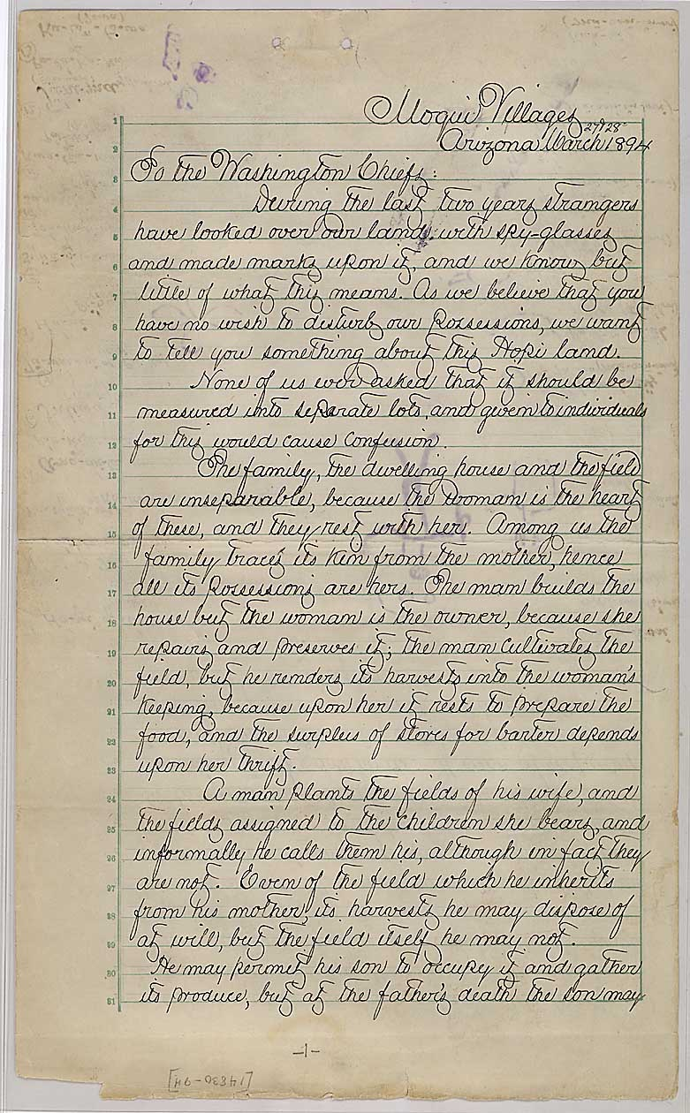
U.S. Capitol, Washington, DC. C. 1982.

Slide 89
Grandjean, Martin. "La connaissance est un réseau.” Les Cahiers du Numérique 10 (3): 37–54, 2014. Detail.
Notes:
La connaissance est un réseau > Knowledge is a network
social network visualization
https://upload.wikimedia.org/wikipedia/commons/9/9b/Social_Network_Analysis_Visualization.png
Grandjean, Martin (2014). "La connaissance est un réseau". Les Cahiers du Numérique 10 (3): 37–54.
_____
http://www.cairn.info/resume.php?ID_ARTICLE=LCN_103_0037
Knowledge is a network
Perspective on archival and encyclopedic organization
Network analysis is not revolutionizing our objects of study, it revolutionizes the perspective of the researcher on the latter. Organized as a network, information becomes relational. It makes potentially possible the creation of new information, as with an encyclopedia which links between records weave a web which can be analyzed in terms of structural characteristics or with an archive directory which sees its hierarchy fundamentally altered by an index recomposing the information exchange network within a group of people. On the basis of two examples of management, conservation and knowledge enhancement tools, the online encyclopedia Wikipedia and the archives of the Intellectual Cooperation of the League of Nations, this paper discusses the relationship between the researcher and its object understood as a whole.
_____
Nodes, edges > specific actors and their relationships can have a transformative change
And so it is, here and now, when APS can help advance transformation in the arena of guardianship, and in doing so, in what is the most vital aspect of our society and our life: self determination, guided by circumstances and support —through reciprocal relationships.
social network visualization
https://upload.wikimedia.org/wikipedia/commons/9/9b/Social_Network_Analysis_Visualization.png
Grandjean, Martin (2014). "La connaissance est un réseau". Les Cahiers du Numérique 10 (3): 37–54.
http://www.cairn.info/resume.php?ID_ARTICLE=LCN_103_0037
Knowledge is a network
Perspective on archival and encyclopedic organization
Network analysis is not revolutionizing our objects of study, it revolutionizes the perspective of the researcher on the latter. Organized as a network, information becomes relational. It makes potentially possible the creation of new information, as with an encyclopedia which links between records weave a web which can be analyzed in terms of structural characteristics or with an archive directory which sees its hierarchy fundamentally altered by an index recomposing the information exchange network within a group of people. On the basis of two examples of management, conservation and knowledge enhancement tools, the online encyclopedia Wikipedia and the archives of the Intellectual Cooperation of the League of Nations, this paper discusses the relationship between the researcher and its object understood as a whole.

Slide 90
“Guardians as leaders, moving forward…
“Guardians”
…in concert with others in a multi-disciplinary elder-care coalition.”

Slide 91
Guardianship
“Guardians”

Slide 92
Guardianship +
SDM
“Guardians”

Slide 93
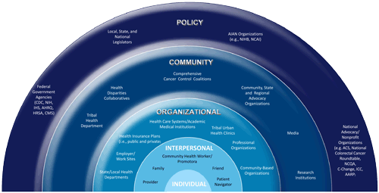
Social Ecological Model
Socio-ecological model (SEM) adapted by the Division of Cancer Prevention and Control, Centers for Disease Control and Prevention. http://www.cdc.gov/cancer/crccp/sem.htm
Notes:
http://www.cdc.gov/cancer/crccp/sem.htm
CDC adapted the social ecological model (SEM) of health promotion to represent the Colorectal Cancer Control Program’s (CRCCP’s) multi-level approach to colorectal cancer prevention.
_____
http://thespoke.earlychildhoodaustralia.org.au/little-known-way-make-service-flexible-improve-quality/

Slide 94
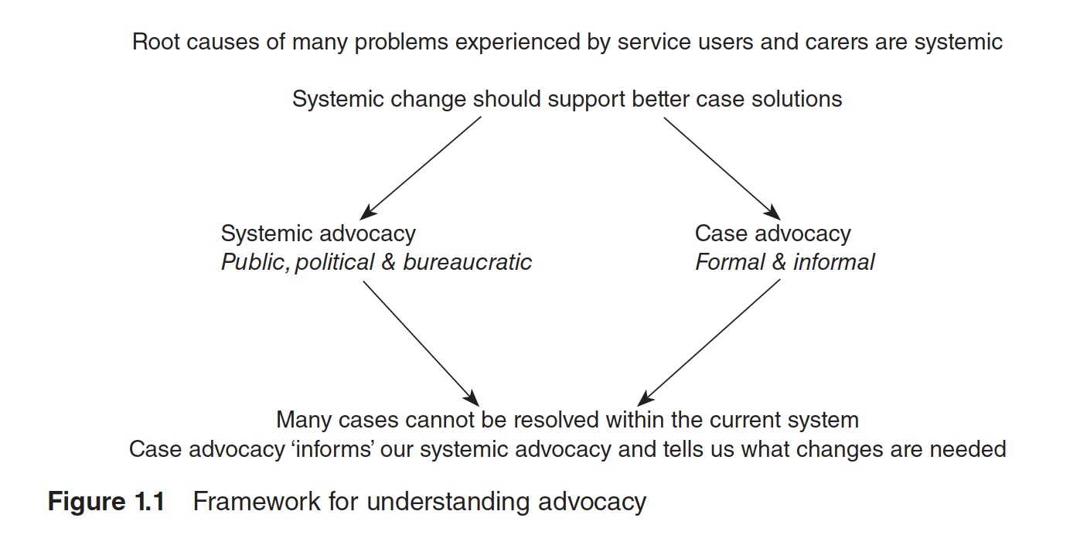
Advocacy and Public Policy
national representation and coordination
with broad coalition
state coordination and advocacy via WINGS
local advocacy and involvement
Notes:
survey
articulation
sustainability: continuity and congruity
_____

Slide 95
Advocacy and Public Policy
national representation and coordination
with broad coalition
state coordination and advocacy via WINGS
local advocacy and involvement
Notes:
survey
articulation
sustainability: continuity and congruity

Slide 96
Advocacy
“Advocacy for individuals, communities and systems is not just a suggested activity… It’s not a ‘do it if you have some extra time’ or a ‘do it if the inequity and disparity are very great’ activity. It is a requisite.”
Broader Vision of the Social Profession by Elizabeth J. Clark. Executive Director, National Association of Social Workers, 2009, p. 2
Notes:
Guardians ‘advocates’ for dependents
http://www.pearsonhighered.com/assets/hip/us/hip_us_pearsonhighered/samplechapter/0205473768.pdf
“Advocacy is the cornerstone upon which social work is built. It is
so important that it is framed in three sections of our Code of
Ethics. Advocacy for individuals, communities and systems is not
just a suggested activity for social workers. It’s not a ‘do it if you
have some extra time’ or a ‘do it if the inequity and disparity are
very great’ activity. It is a requisite.”
NASW Executive Director, ELIZABETH J. CLARK.1 (page 1)

Slide 97
Advocacy (with individuals)
“Advocacy…promotes equality, social justice and social inclusion. It can empower people to speak up for themselves. Advocacy can help people become more aware of their own rights, to exercise those rights and be involved in and influence decisions that are being made about their future.”
Definition as part of the guidance for Independent Mental Capacity Advocates introduced through the Mental Capacity Act 2005 in England
Notes:
http://www.sagepub.com/sites/default/files/upm-binaries/58102_Dalrymple_&_Boylan.pdf
Jane Dalrymple and Jane Boylan 2013.
Effective Advocacy in Social Work.
SAGE Publications Ltd
Advocacy can be defined in many ways, but the following definition is a useful starting point. This definition is part of the guidance for Independent Mental Capacity Advocates introduced through the Mental Capacity Act 2005 in England. It relates to people who use mental health services and are deemed to lack capacity – a group who can struggle to have a voice in the systems and structures that impact on their lives:
“Advocacy … promotes equality, social justice and social inclusion. It can empower people to speak up for themselves. Advocacy can help people become more aware of their own rights, to exercise those rights and be involved in and influence decisions that are being made about their future.” (Lee, 2007: 7)
Mental Capacity Act 2005 — Code of Practice
https://www.gov.uk/government/uploads/system/uploads/attachment_data/file/224660/Mental_Capacity_Act_code_of_practice.pdf
Department for Constitutional Affairs
Mental Capacity Act 2005
Code of Practice
Issued by the Lord Chancellor on 23 April 2007 in accordance with sections 42 and 43 of the Act
London: TSO
Published by TSO (The
Stationery Office)
Third Impression 2007
___
The Mental Capacity Act 2005, covering England and Wales, provides a statutory framework for people who lack capacity to make decisions for themselves, or who have capacity and want to make preparations for a time when they may lack capacity in the future. It sets out who can take decisions, in which situations, and how they should go about this. The Act received Royal Assent on 7 April 2005 and will come into force during 2007.
___
_____
Making decisions
The Independent Mental Capacity Advocate (IMCA) service
This booklet provides information on the Independent Mental Capacity Advocate (IMCA) service established by the Mental Capacity Act.
It is not a statutory Code of Practice issued under the Mental Capacity Act 2005 and is not a guide to how the law will apply to specific situations.

Slide 98
Local Advocacy and Involvement…
Private
Public
Local / State
WINGS groups, subgroup
Guardianship associations, local boards, commissions on aging, disability, mental health
Interstate
…from case to cause, coordinated.

Slide 99
Advocacy and Public Policy
national representation and coordination
with broad coalition
state coordination and advocacy via WINGS
local advocacy and involvement
Notes:
survey
articulation
sustainability: continuity and congruity

Slide 100
(united) states

Slide 101
Laboratories of Democracy
“It is one of the happy incidents of the federal system that a single courageous state may, if its citizens choose, serve as a laboratory; and try novel social and economic experiments without risk to the rest of the country.”
Opinion, in dissent, by U.S. Supreme Court Justice Louis Brandeis in New State Ice Co. v. Liebmann, 285 U.S. 262, 1932.
Notes:
https://en.wikipedia.org/wiki/Laboratories_of_democracy
Laboratories of democracy is a phrase popularized by U.S. Supreme Court Justice Louis Brandeis in New State Ice Co. v. Liebmann to describe how a "state may, if its citizens choose, serve as a laboratory; and try novel social and economic experiments without risk to the rest of the country."[1] Brandeis was an Associate Justice on the Supreme Court of the United States from 1916 to 1939.
This concept explains how within the federal framework, there exists a system of state autonomy where state and local governments act as social “laboratories,” where laws and policies are created and tested at the state level of the democratic system, in a manner similar (in theory, at least) to the scientific method.
The Tenth Amendment of the United States Constitution provides that “all powers not delegated to the United States by the Constitution, nor prohibited by it to [from] the States, are reserved to the States respectively, or to the people.” This is a basis for the "laboratories of democracy" concept, because the Tenth Amendment assigns most day-to-day governance responsibilities, including general "police power", to the state and local governments. Because there are 50 semi-autonomous states, different policies can be enacted and tested at the state level without directly affecting the entire country. As a result, a diverse patchwork of state-level government practices is created.
_____
http://thefederalist.com/2015/03/23/republicans-should-stop-promoting-laboratories-of-democracy/
Brandeis, who was appointed to the Supreme Court by Woodrow Wilson in 1916 and served until 1939, was an ardent Progressive and rejected the constitutionalism of the American founders.
He disdained any ideas of unchanging, permanent truths and instead, following John Dewey’s theory of experimentalism, posited that the scientific method should be the central idea that animates public policy.
Dewey’s conception of experimentalism looked at things in terms of their usefulness for human life; controlled experiments could yield what he termed “warranted assertions,” which provide useful data to solve concrete problems but do not constitute absolute knowledge.
As a result, the formerly self-evident truth that all men are created equal was not available to human knowledge and, according to Dewey, really never had been.
Brandeis’s politics, of which his jurisprudence was a subset, is best described as follows: “The reformer’s role was to guide the forces of social experimentation and thus to direct change along the lines of evolution rather than revolution.”
Because Brandeis believed in slow processes of evolutionary change rather than the quick, violent change of revolution, he subscribed to the social Darwinism of the Left, of which Lester Frank Ward was an early proponent.
Leftist social Darwinists differed from their brethren on the Right in that they contended government must drive social and economic progress. Right social Darwinists such as William Graham Sumner reasoned that, taking a laissez faire approach, the forces of evolution would work without government interference; in other words, using a phrase often attributed to Charles Darwin but actually coined by Herbert Spencer, the survival of the fittest would work itself out through an uncompromising process dictated by nature.
This is the intellectual and philosophical foundations through which one should view Brandeis’s often invoked but rarely scrutinized phrase.
States Should Experiment On the Populace
Brandeis’s states as laboratories expression is from his dissent in New State Ice Co. v. Liebmann (1932), a case involving the constitutionality of an Oklahoma statute that required those wanting to manufacture, sell, or commercially distribute ice to obtain a license from the state’s Corporation Commission. The case was decided 7-2 in favor of Liebmann, who attempted to sell ice within the Oklahoma City limits without a license. The Court argued that the statute in question infringed upon Liebmann’s economic liberty and therefore his right to due process under the Fourteenth Amendment.
In dissent, Brandeis argued that new economic conditions, which the Founders had not anticipated, necessitated that “[t]here must be power in the States and the nation to remould, through experimentation, our economic practices and institutions to meet changing social and economic needs.”
Although one could argue that Brandeis here limits experimentation only to social and economic needs, recall that in the next year Franklin Roosevelt and his brain trust, which included advisors Adolph Berle and Rexford Tugwell (the latter argued for a nationally planned economy and abolishing private business), used those means to transform the American regime. As FDR argued in the Commonwealth Club Address, statesmanship in the industrial age meant redefining “rights in terms of a changing and growing social order.”
Thus Brandeis took for granted the government’s role in using science to help emancipate man from the social and economic ills he formerly could not escape.
As he argued, “It is one of the happy incidents of the federal system that a single courageous State may, if its citizens choose, serve as a laboratory; and try novel social and economic experiments without risk to the rest of the country.”
As G. Alan Tarr has noted, although Brandeis’s formula seems to side with the liberty of individuals to act using their various unequal talents and skills, “over the longer term, the tendency would be toward policy uniformity, as states emulated the successful policies of sister states.”
Brandeis’s ultimate goal was repudiating the diversity among the states as the result of state experimentation, which the federal government would then likely adopt and enforce nationwide. National planning by experts in the bureaucracy who would rely on the scientific method divorced from natural law or natural rights, in his thinking, displaced consent of the governed. It goes without saying that this completely repudiates what Republicans and conservatives should stand for.
One not need accept the foregoing entirely when invoking Brandei’s dictum. But constantly appealing to his famous phrase distorts how we think about federalism and the ground of federalism. Republicans and conservatives should scrap it and stick with something more amenable to the principles and practices of the founders.
_____

Slide 102
Data, Terminology
“Encouraging Collection of Data on Adult Guardianship, Adult Conservatorship, and Elder Abuse Cases by All States.” Resolution 14, CCJ-COSCA, 2009.
State Court Guide to Statistical Reporting, Court Statistics Project, NCSC and COSCA, version 2.1, October 8, 2015.
Date: http://ccj.ncsc.org/~/media/Microsites/Files/CCJ/Resolutions/08012009-Encouraging-Collection-of-Data-on-Adult-Guardianship-Adult-Conservatorship.ashx
Statistics: http://www.courtstatistics.org/~/media/Microsites/Files/CSP/State%20Court%20Guide%20to%20Statistical%20Reporting%20v%202point1%20final.ashx
Notes:
“Encouraging Collection of Data on Adult Guardianship, Adult Conservatorship, and Elder Abuse Cases by All States.” Resolution 14, CCJ-COSCA, 2009.
State Court Guide to Statistical Reporting, Court Statistics Project, NCSC and COSCA, version 2.1, October 8, 2015. Provides the definitions of guardianships and conservatorships to ensure consistency in data collection across states..
_____
http://www.eldersandcourts.org/~/media/Microsites/Files/cec/GuardianshipSurveyReport_FINAL.ashx
http://ccj.ncsc.org/~/media/Microsites/Files/CCJ/Resolutions/08012009-Encouraging-Collection-of-Data-on-Adult-Guardianship-Adult-Conservatorship.ashx
Karp, Naomi and Erica Wood. Guarding the Guardians: Promising Practices for Court Monitoring. Washington, DC: AARP. 2007. http://assets.aarp.org/rgcenter/il/2007_21_guardians.pdf
DC: AARP_____
wings_2011_introduction.pdf
D. Show Me the Numbers
We as a nation are essentially working in the dark when describing adult guardianship practice. Data and research are scant to nonexistent. Many courts and states do not know the number of adults under guardianship in their jurisdiction, let alone the demographics. While the Associated Press estimated the total number of adults under guardianship nationally at approximately 400,000 in 1988, 38 the current number is unknown. In 2011, the National Center for State Courts estimated that there are 1.5 million active pending adult guardianship cases—but that this number could, in fact, range from fewer than one million to more than three million.39
Anecdotal evidence suggests guardianship practice can range from quietly heroic, to satisfactory, to unknowingly deficient, to malfeasant, but the proportions are not clear. In the United States we have not one guardianship system, but fifty- one and more, with tremendous variance from state to state, court to court, judge to judge—and guardian to guardian.
38 — Bayles & McCartney, supra note 8.
39 — Brenda K. Uekert & Richard Van Duizend, Adult Guardianships: A “Best Guess” National Estimate and the Momentum for Reform, in FUTURE TRENDS IN STATE COURTS 2011: SPECIAL FOCUS ON ACCESS TO JUSTICE 107, 109 (2011).
______
wings_2011_introduction.pdf
D. Show Me the Numbers
We as a nation are essentially working in the dark when describing adult guardianship practice. Data and research are scant to nonexistent. Many courts and states do not know the number of adults under guardianship in their jurisdiction, let alone the demographics. While the Associated Press estimated the total number of adults under guardianship nationally at approximately 400,000 in 1988, 38 the current number is unknown. In 2011, the National Center for State Courts estimated that there are 1.5 million active pending adult guardianship cases—but that this number could, in fact, range from fewer than one million to more than three million.39
Anecdotal evidence suggests guardianship practice can range from quietly heroic, to satisfactory, to unknowingly deficient, to malfeasant, but the proportions are not clear. In the United States we have not one guardianship system, but fifty- one and more, with tremendous variance from state to state, court to court, judge to judge—and guardian to guardian.
38 — Bayles & McCartney, supra note 8.
39 — Brenda K. Uekert & Richard Van Duizend, Adult Guardianships: A “Best Guess” National Estimate and the Momentum for Reform, in FUTURE TRENDS IN STATE COURTS 2011: SPECIAL FOCUS ON ACCESS TO JUSTICE 107, 109 (2011).
______

Slide 103
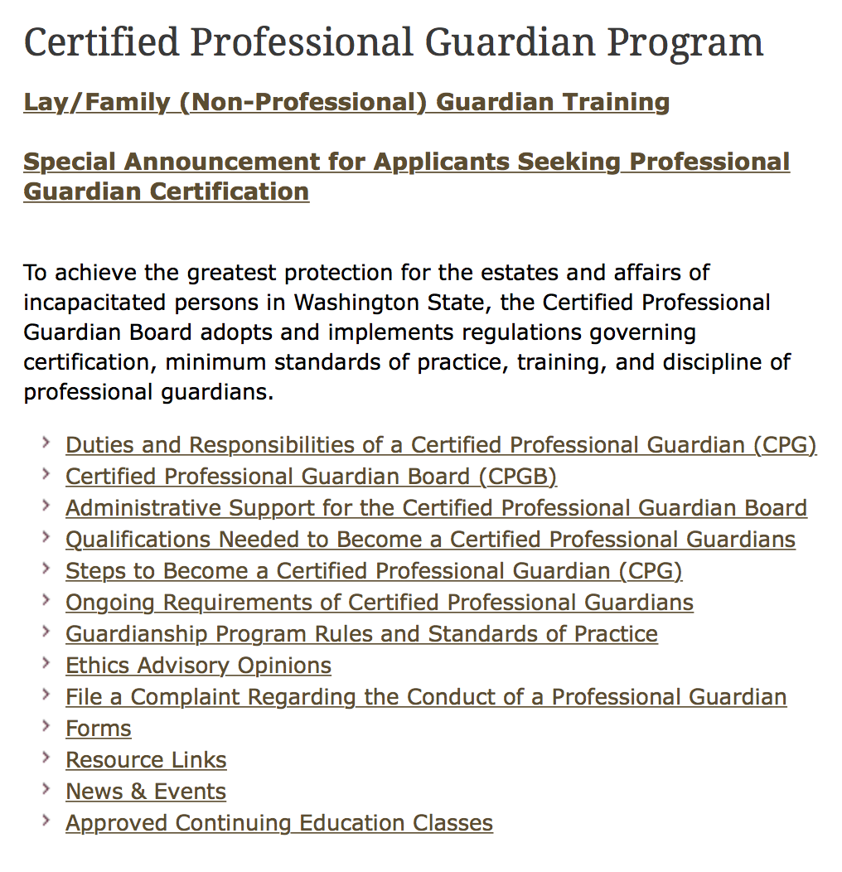

Certified Professional Guardian - WA
Certified Professional Guardian Program, Washington Courts. http://www.courts.wa.gov/programs_orgs/Guardian/ Retrieved 10/20/15.
Notes:
Certified Professional Guardian Program, Washington Courts.
http://www.courts.wa.gov/programs_orgs/Guardian/ Retrieved 10/20/15.

Slide 104
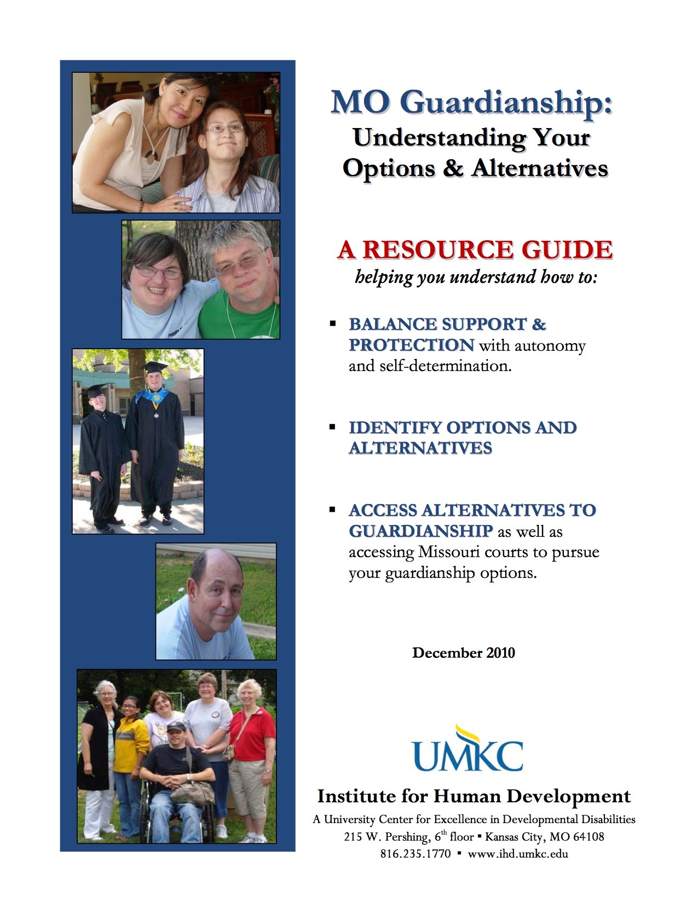
Guardianship - MO
MO Guardianships: Understanding Your Options & Alternatives. UMKC Institute for Human Development, University of Missouri-Kansas City, 2010.
http://www.moddcouncil.org/uploaded/MO%20Guardianship%20RESOURCE%20GUIDE%20rev%20Dec%202010.pdf
Notes:
http://www.moddcouncil.org/uploaded/MO%20Guardianship%20RESOURCE%20GUIDE%20rev%20Dec%202010.pdf

Slide 105

Alternatives - TX
HB 39 — “Relating to guardianships for incapacitated persons and to substitutes for guardianships for certain adults with disabilities.” [least restrictive alternatives]
SB 1881 — Supported Decision-Making Agreement Act
SB 1882 — Bill of Rights for Wards
Texas, 2015
Notes:
J. Martinis > issue: no definition of capacity
HB 39 — alternatives to guardianships (24 included, with formal/informal services)
SB 1881 — Supported Decision-Making Agreement Act
SB 1882 — Bill of Rights for Wards
HB 1438 — Relating to probate matters, including guardianships and other matters related to incapacitated persons [due process]
http://www.arcofbmt.org/texas-legislative-update/
Another big win for disability rights was in the area of Guardianship Reform.
CSHB 39
http://www.capitol.state.tx.us/BillLookup/History.aspx?LegSess=84R&Bill=HB39
http://www.legis.state.tx.us/tlodocs/84R/billtext/html/HB00039F.HTM
helps ensure that the wants and needs of an individual with IDD are addressed when deciding if a person with IDD needs a legal guardian. The bill will require those looking to obtain guardianship to list less restrictive alternatives; requires court to consider informal/formal supports and services; requires more information from doctors; consideration of ability to choose residence; alternatives training for applicant’s attorney; and supported decision-making agreements.
SB 1882
http://www.capitol.state.tx.us/BillLookup/History.aspx?LegSess=84R&Bill=SB1882
creates a bill of rights for people under guardianship and HB 1438 ensures due process in court-initiated guardianship proceedings.
HB 1438 ensures due process in court-initiated guardianship proceedings.
http://www.capitol.state.tx.us/BillLookup/History.aspx?LegSess=84R&Bill=HB1438
http://www.thearc.org/file/Guardianship-White-Paper.pdf
HB 39 by Representative Smithee and SB 1881 by Senator Zaffirini both address alternatives to guardianship, among other issues. Alternatives to guardianship are ways to support people with IDD to make their own decisions without taking away their rights through a guardianship. Under HB 39, courts must first consider if any alternatives to guardianship exist that would meet the needs of the proposed ward and prevent a guardianship. The law lists 24 alternatives to guardianship, and the court must present clear and convincing evidence that these alternatives have been considered for the proposed ward. Additionally, the law adds formal and informal long-term services and supports to the list of alternatives that must be considered. Finally, the law requires the attorney for the proposed ward to receive one hour of training on alternatives to guardianship.13 SB 1881, also known as the Supported Decision-Making Agreement Act, establishes supported decision-making (discussed in more detail below) as an informal alternative to guardianship.
_________
https://en.wikipedia.org/wiki/Texas
Texas is nicknamed the Lone Star State to signify Texas as a former independent republic, and as a reminder of the state's struggle for independence from Mexico. The "Lone Star" can be found on the Texas state flag and on the Texas state seal.[9] The origin of the state name, Texas, is from the word, "Tejas", which means 'friends' in the Caddo language.
https://en.wikipedia.org/wiki/Caddo
The Caddo Nation is a confederacy of several Southeastern Native American tribes. Their ancestors traditionally inhabited much of what is now East Texas, northern Louisiana and portions of southern Arkansas and Oklahoma. Today the Caddo Nation of Oklahoma is a federally recognized tribe with its capital at Binger, Oklahoma. Descendants of the historic Caddo tribes can all be enrolled as members in the Caddo Nation, with documentation of at least 1/16th ancestry. The several Caddo languages have converged into a single language.
_______
Erica Wood, 151024
Three states have a bill of rights: FL, MN, MI
Texas, Senate 1882 has 24 individual rights
______
Terry Hammond, 151024
90 bills, about 20 passed.

Slide 106
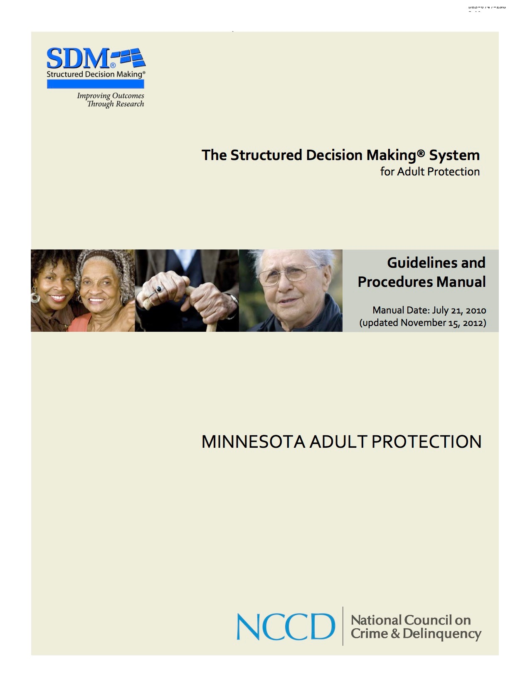
Structured Decision Making ® - MN
The Structured Decision Making ® System for Adult Protection, Minnesota Adult Protection. National Council on Crime & Delinquency. 2014.
http://www.nccdglobal.org/blog/the-structured-decision-making-model-in-adult-protection-in-minnesota
Notes:
http://www.nccdglobal.org/assessment/sdm-structured-decision-making-systems/adult-protection
Adult protection is a growing service area, where research-based assessment instruments can help agencies make the best use of limited resources to promote the safety of older adults and adults with disabilities. The Structured Decision Making® (SDM) model for adult protection services assists agencies and workers in making better decisions for and with vulnerable adults. This evidence- and research-based system identifies the key points in the life of an adult protective services (APS) case and uses structured assessments to improve the consistency and validity of each decision. The SDM® model for adult protection seeks to reduce subsequent harm to vulnerable adults and to improve the delivery of appropriate services through four assessments:
• Intake assessment: This assessment has screening and response priority components. The screening section helps adult protection hotline workers determine if the current report requires an APS investigation response. The response priority section helps workers determine how swiftly an investigation must be initiated for those reports accepted for investigation.
• Safety assessment: The assessment helps workers at all points in a case determine if a vulnerable adult is safe in his/her current situation. If threats to the client's safety are identified, the assessment guides the worker to engage the client (and any caregivers who may be present) in a safety planning process that seeks to contain the threats while respecting the vulnerable adult's right to final decision making and self-determination.
• Risk assessment: This actuarial assessment estimates the likelihood of future harm to vulnerable adults, and assists investigation workers in determining which cases should be recommended to receive ongoing services, if the agency provides long-term case management.
• Strengths and needs assessment: The SNA informs case planning by structuring the worker's assessment of the vulnerable adult's strengths and needs and those of a primary caregiver (if applicable) across a common set of domains of functioning. For the case plan, priority areas of need are chosen as the focus of efforts to improve the vulnerable adult's long-term safety.
_____
http://www.nccdglobal.org/news/six-minnesota-counties-receive-award-for-implementing-nccd-s-structured-decision-making-system-
Six Minnesota Counties Receive Award for Implementing NCCD’s Structured Decision Making System in Adult Protective Services
December 7, 2012
A collaborative of six Minnesota counties was recognized December 3 for outstanding service—an outcome of its partnership with NCCD.
Dakota, Hennepin, Olmsted, Ramsey, Steele, and Washington counties received an Association of Minnesota Counties’ (AMC) 2012 Outstanding Service Award for the development and use of the Structured Decision Making® (SDM) system in adult protective services (APS).
NCCD and the collaborative continue to meet monthly to discuss implementation issues and create best-practice policy around the SDM® system. Due to the project’s success, the Minnesota Department of Human Services will begin implementing the APS SDM system statewide beginning in January 2013.
_____
Use of a Standardized Tool in Assessment and Service Decisions for Vulnerable Adults
TOPIC
Use of a standardized structured decision making tool in response to reports of adult maltreatment received from the common entry point is required under 2013 Session Law, Chapter 63, Sec. 17 which amends duties of county social service agency under Minnesota Statutes, section 626.557, subdivision 10, effective August 1, 2013.
PURPOSE
To promote safety for maltreated vulnerable adults.
CONTACT:
Department of Human Services, Adult Protection
Jennifer Kirchen or Mary McGurran 651-431-2609 or (800) 882-6262 dhs.adultprotection@state.mn.us
SIGNED
LOREN COLMAN
Assistant Commissioner
Continuing Care Administration
The 2013 Minnesota Legislature made revisions to the Vulnerable Adult Act (VAA) requiring counties use a standardized tool in carrying out duties under the VAA, effective August 1, 2013. This legislation supports the state’s policy requiring investigation of reports of suspected maltreatment and the provision of protective services in appropriate cases. The use of the tool is funded through an on-going grant from the Minnesota Board on Aging. Information entered into the tool will be accessible to the Department of Human Services. Data from the tool will be available for service planning, program management and evaluation.
Research demonstrates that the use of structured frameworks results in more reliable, accurate and consistent decisions than professional judgment alone. In 2009, six Minnesota counties collaborated with the National Council on Crime and Delinquency (NCCD) on the development of a standardized structured decision making (SDM) tool for use by adult protection staff. Counties involved in development of the tool were Dakota, Hennepin, Olmsted, Ramsey, Steele and Washington.

Slide 107


Conservator Account Auditing Program
Conservators submit transactions through a mandatory online reporting system, MyMNConservator.
Centralized conservator account auditing center.
Received the 2015 Justice Achievement Award from the National Association for Court Management.
Notes:
http://www.mncourts.gov/About-The-Courts/NewsAndAnnouncements/ItemDetail.aspx?id=1162
Minnesota’s conservator auditing program earns national award, recognition
Posted: Wednesday, July 15, 2015
A new program launched by the Minnesota Judicial Branch to better protect elderly and vulnerable adults from financial abuse has received the 2015 Justice Achievement Award from the National Association for Court Management.
The Conservator Account Auditing Program (CAAP) is a nation-leading initiative to protect the assets of vulnerable individuals – persons with developmental disabilities, Alzheimer’s disease, dementia, or traumatic brain injuries – for whom the court has appointed a conservator to manage the individual’s financial affairs.
“Today in Minnesota, thousands of elderly and vulnerable adults rely on a conservator to responsibly manage their financial affairs,” said Minnesota Supreme Court Chief Justice Lorie S. Gildea. “While we know the vast majority of conservators strive to always work in the best interests of those they serve, we also know that conservators acting unethically, illegally, or negligently can severely harm the quality of life and financial security of a vulnerable individual and his or her family. Through the Conservator Account Auditing Program, Minnesota has put in place one of the strongest safeguards in the nation to protect vulnerable individuals from fraud and mismanagement by conservators.”
Through CAAP, the Minnesota Judicial Branch has modernized and improved the way the state oversees the work of conservators.
Before the implementation of CAAP, conservator records were submitted to the court on paper, frequently accompanied by boxes of receipts and other documentation. This unwieldy process put a heavy burden on local district court staff responsible for overseeing the work of conservators. The CAAP program changed this process in two fundamental ways:
• Conservators now submit transactions through an intuitive, online reporting system that has the look and feel of many popular financial applications. This system, called MyMNConservator, is the first and only online mandatory reporting tool for conservators in the country. It provides text and video support for conservators, automatically performs calculations, and provides ready access to expense and receipt details. Most importantly, the system contains built-in “red flag” logic that automatically reviews filed accounts and alerts auditors to possible errors, inconsistencies, or transactions that require further review.
• The program also established a centralized conservator account auditing center, staffed by a team of trained experts who conduct compliance audits on conservator accounts from across the state. By centralizing this important auditing work, CAAP has led to stronger oversight of conservatorship accounts, while freeing up significant staff resources at the district court level.
Today, CAAP is monitoring the assets of 4,600 vulnerable individuals in Minnesota, with assets totaling more than $720 million.
The stronger oversight of conservator accounts provided by CAAP is already resulting in better protection of elderly and vulnerable adults. In nearly 14 percent of cases audited under the program, auditors have found concerns of loss, inappropriate loans or expenditures, or commingling of funds. Audit letters have frequently prompted repayment of funds from conservators. Hearings held on these audits have resulted in discharge of conservators, judgments and orders for repayment, and criminal prosecution and conviction.
This enhanced oversight of conservators is especially important considering recent statistics highlighting the growing amount of money lost through exploitation of elders in the United States. A 2011 MetLife Study estimated the national annual financial loss at $2.9 billion dollars – an increase of 12 percent over their findings in 2008. More recently, the 2015 True Link Report on Elder Financial Abuse estimated that seniors lose $36.48 billion each year to elder financial abuse.
As other states respond to the troubling increase in elder financial abuse, CAAP has quickly become one of the most effective and celebrated conservator auditing programs in the country. The National Center for State Courts is coordinating a plan to share the MyMNConservator online reporting system, along with other program elements, with other states across the country. Staff from the CAAP program have been asked to give presentations about the program to court leaders in other states and other countries, including the Netherlands and Finland.
“In just a year of full implementation, CAAP has already provided significant benefits to conservators, the court system, and, most importantly, the vulnerable individuals who depend on conservators to protect their financial assets,” said Chief Justice Gildea. “We are honored to receive this national recognition for the CAAP program, and are pleased to see the real impact this program is having on the lives of those who rely on conservators for their financial well-being.”
According to the National Association for Court Management, the Justice Achievement Award was established to “publicly recognize courts and related organizations for meritorious projects and exemplary accomplishments that enhance the administration of justice.” In addition to this national award, the CAAP program will also receive a 2015 State Government Innovation Award from the University of Minnesota’s Humphrey School of Public Affairs later this month.
_____
http://www.mncourts.gov/Help-Topics/MyMNConservator.aspx
MyMNConservator (MMC) is an online conservator account reporting application that allows conservators to file their inventory and annual accountings electronically. If you are thinking about becoming a conservator, please view the Guardianship and Conservatorship Educational Video.
MMC is exclusively for conservator reports. Guardians responsible for filing annual personal well-being reports must file them electronically through their attorney or on paper. Forms are available at in Court Forms.
_____
http://www.mncourts.gov/Help-Topics/Guardianship-and-Conservatorship.aspx
The Conservator Account Auditing Program (CAAP) operates statewide to audit conservator accounts and provide information and recommendations to the district courts and to conservators.
The mission of the Conservator Account Auditing Program (CAAP) is to safeguard the assets of protected persons through the oversight of conservators by conducting professional compliance audits. CAAP will promote public trust and confidence by collaborating with local courts to provide education, establish consistency of best practices in managing conservator accounts and maintain a statewide online system for the reporting of accounts.
CAAP audits all first annual accounts with bondable asset balances over $3000, subsequent accounts at regular intervals and accounts referred for audit by the court. Accounts $3000 and below are subject to local examination.
Accounts are directed to the audit queue via programming within the MyMNConservator (MMC) accounting program. Your report history tab will display reports that are in the audit queue as in the following example:….

Slide 108

WINGS
stakeholder engagement, collaboration
collaboration: court-community partnership
improve practice, provide options
in state > national
Notes:
http://www.naela.org/NGN/Summits_on_Guardianship/History/NGN/Summits_on_Guardianship/History.aspx?hkey=ed8f7a49-dc08-44b0-b9be-b4313011f515
http://epubs.utah.edu/index.php/ulr/issue/view/72
_____
http://www.naela.org/NGN/WINGS/State_WINGS_Groups_in_Action/NGN/WINGS/State_WINGS.aspx
State WINGS Groups in Action
By combining the efforts of all court and community guardianship stakeholders into WINGS, states can better improve
judicial processes,
protect individual rights and meet needs,
address insufficient funding and
ensure guardian accountability and fiduciary standards.
The National Guardianship Network in 2013 selected four states to pilot Working Interdisciplinary Networks of Guardianship Stakeholders (WINGS).
These states were New York, Oregon, Texas, and Utah.
Funding for the WINGS project was generously provided by the State Justice Institute and the Albert and Elaine Borchard Foundation Center on Law and Aging.
In 2015, the National Guardianship Network named an additional six WINGS states.
These jurisdictions are Washington, DC; Indiana; Minnesota; Mississippi, Washington; and Wisconsin. (The Wisconsin WINGS was launched independently by the state’s Chief Justice.) Funding for these WINGS was generously provided by the State Justice Institute, the Atlantic Philanthropies Designated Gift Fund, and two anonymous donors.
Additionally, three states independently have developed similar stakeholder groups – Ohio, Missouri, and West Virginia.
Current highlights of state WINGS activities as of June 2015 are below.
New York
The New York State Unified Court System, Office of Court Administration, convened a WINGS Summit at White Plains in March, 2014, bringing together a broad-based group of about 60 stakeholders representing over 30 entities, including those who work with both Article 81 guardianships (general adult statute) and Article 17A (developmental disabilities) under the banner of “Setting the Agenda for Guardianship in New York: Fewer Resources, Greater Collaboration.” Based on responses to the survey, the Steering Committee assigned each summit participant to one of three workgroups: (1) pre-commencement guardianship issues; (2) models of guardianship; and (3) post-appointment guardianship issues. Each workgroup had two facilitators and a structured process for reaching recommendations. The NY-WINGS Summit built on an earlier 2011 statewide meeting on adult guardianship under Article 81 sponsored by the Cardozo School of Law.
The New York Summit resulted in formation of three ongoing workgroups:
• Pre-Commencement Issues;
• Models of Guardianship; and
• Post-Appointment Issues.
Contact: Michele Gartner
Special Counsel for Surrogate and Fiduciary Matters
New York State Unified Court System
Oregon
OR-WINGS first met in Salem in August 2013, followed by bimonthly or quarterly meetings thereafter. WINGS membership includes representatives from 28 aging, disability, legal, judicial, and mental health agencies and organizations. OR-WINGS developed a charter that states an objective to maintain interdisciplinary representation from these organizations. OR-WINGS has developed these workgroups:
• Training, Education & Supports for System Partners;
• Support Services for Family, Lay & Prospective Guardians; and
• Protected Person Advocacy and System Access.
OR-WINGS also has participated in legislative advocacy, including support for a successful bill to establish a statewide public guardianship program; and a successful bill concerning volunteer visitor programs.
Oregon WINGS Accomplishments
• Oregon WINGS produced a brochure entitled “Guardianship in Oregon: Explained in Brief for Medical and Other Care Professionals.”
• Oregon WINGS produced a booklet for families entitled Options in Oregon to Help Another Person Make Decisions: Guardianship, Conservatorship and Other Options in Oregon.
• Oregon WINGS is completing a person-centered planning tool for guardians.
• Oregon WINGS expanded key materials on an existing aging and disability site to create a consumer friendly web page on the Aging and Disability Resource Connection site that collects in one place all resources concerning decision-making options.
• Oregon WINGS was profiled nationally at the 2014 conference of the National Adult Protective Services Association; and at the Spring 2015 conference of the National College of Probate Judges.
Contact: Fred Steele
Legal Services Developer
State Unit on Aging
Oregon Department of Human Services
Texas
The Texas Office of Court Administration convened the first meeting of TX-WINGS in November 2013 in Austin. The meeting opened with a presentation of the results of a statewide survey on adult guardianship issues, completed by close to 300 participants. Top issues considered at the meeting included support for lay guardians, alternatives to guardianship, public guardianship, and capacity assessment. WINGS reports to the Texas Supreme Court’s Elder Law Task Force, and will continue to meet regularly.
TX-WINGS held its second meeting in June 2014; and has created three ongoing workgroups:
• Alternatives to guardianship (including supported decision-making);
• Support for lay guardians; and
• Person-centered assessments.
TX-WINGS conducted a study of guardianship files and practices in 14 counties without a statutory probate court and from which fewer than 100 guardianship cases were filed in FY 2013. See Texas Guardianship Cases: Improving Court Processes and Monitoring Practices in Texas Courts.
Members of TX-WINGS have participated in key legislative advocacy.
Contact: David Slayton
Administrative Director
Texas Office of Court Administration
Scott Griffith, JD/MPA
Director of Research and Court Services
Office of Court Administration
Amanda Stites
Research Specialist
Texas Office of Court Administration
Utah
In April 2013, the Utah Administrative Office of the Courts convened a large working steering committee to plan a WINGS Summit, which took place in November 2013 in Salt Lake City. Discussions of the three subgroups of the summit were published in three key articles in the 2014 Utah Bar Journal – “Improving Service Delivery to Protected Persons and Their Guardians,” “The Challenge of Submitting Competent Medical Evidence of Incapacity in Guardianship Proceedings,” and “Person-Centered Planning and Supported Decision-Making.”
Most recent Utah accomplishments are:
1. Organized public classes for guardians and caregivers on alternatives to guardianship, guardianship procedures, and community resources in fall 2015.
2. Published extensive information on guardianship and conservatorship on the Utah State Courts website.
3. Established Attorney Signature Program that provides free and low-cost legal representation to vulnerable adults in guardianship proceedings.
4. International profiling of the Utah guardianship monitoring program at the Third World Congress on Adult Guardianship in May 2014.
5. Featured panel consisting of Utah WINGS leaders at the 13th Rocky Mountain Geriatric Conference.
6. Established an active Utah WINGS listserve for information exchange.
7. Adopted the bylaws.
Planned activities:
1. Reach out to the Utah minorities to be an active part of WINGS.
2. Organize public classes on guardianship in Spanish.
3. Create an online training program on guardianship, its alternatives, and community resources.
See the Utah WINGS web page for the latest minutes and agenda.
Contact: Hon. David Connors
WINGS chair
Second District Court
Karolina Abuzyarova
801-578-3925
WINGS and Court Visitor Program Administrator
Utah State Courts
Indiana
An Indiana Adult Guardianship State Task Force was convened in Spring 2008. The membership represents key Indiana public/private agencies and organizations that serve or advocate for at-risk adults in need of guardianship services and by individual guardianship professionals, advocates, and others with an interest in the provision of quality guardianship services.
The 35-plus members of the Task Force have been supported in their work by the participation of the major Indiana state agencies with the responsibility of providing services to adults in need of guardianship services. The purpose of the Task Force is “to convene an interdisciplinary group of Indiana key stakeholders to examine the public policy, legal and service delivery issues, and needs related to adult guardianship and to support the development and provision of community-based adult guardianship services across the state.” The initial support for the Task Force came from the Indiana Adult Guardianship Services Project of The Arc of Indiana and funding was provided through a grant from the Indiana FSSA Division of Disability and Rehabilitative Services.
In 2013, the Indiana Task Force secured legislative appropriations for volunteer guardian programs, an adult guardianship registry and establishment of an Office of Adult Guardianship.
In 2015, based on the extensive work of the Task Force, the National Guardianship Network named Indiana as a WINGS state.
Contact:
Becky Pryor
Indiana Adult Guardianship State Task Force
Mississippi
The coordinator for the new MS-WINGS is:
T’Shia Gordon
Administrative Office of Courts
Minnesota
The coordinators for the new MN-WINGS are:
Jeff Shorba
State Court Administrator
Minnesota Judicial Branch
Ben Ashley-Wurtman
Mental Health Association of Minnesota
Washington
The Washington State Supreme Court convened its inaugural WINGS Conference in Wenatchee, Wash., August 7, 2015. More than 200 individuals representing a broad-based group of stakeholders, including judicial officers, court staff, professional guardians, lay/family guardians, persons with developmental disabilities, family members of persons in a guardianship, social workers, guardians ad litem, attorneys, advocates, mental health professionals, seniors, legislators, and more attended and discussed recommendations to improve Washington’s delivery of decisional-support. Speakers included Chief Justice Barbara Madsen, Washington State Supreme Court and Mary Joy Quinn, WINGS Technical Advisor from the National Guardianship Network.
Prior to the conference, very high-level recommendations were identified using an online survey that was completed by 454 persons from the same diverse populations that attended the conference. The Steering Committee prioritized the high-level recommendations from the online survey and over-laid recommendations from several reports that were completed in Washington State in recent years. Prioritized recommendations clustered into three areas – 1) Supporting the family and friends of persons needing decisional support; 2) Improving assessment of persons needing decisional support; and 3) Improving Guardianship Standards and Practice. Three temporary subcommittees comprised of volunteers who expressed an interest in the topic areas met multiple times, refined recommendations in each area, and prepared presentations for the conference.
Structured, facilitated stakeholder discussions conducted during the conference resulted in 23 prioritized recommendations. Four ongoing workgroups were formed to refine recommendations further and implement.
1. Legislative – Provide advice and recommendations on all matters dealing with legislation, including court rules, to WINGS. During active legislative session, the Committee will monitor bills of potential interest to WINGS and select those to be tracked. The Committee may recommend positions on bills for consideration by the full WINGS Steering Committee.
2. Long-Range Planning/Strategic Planning – Develop effective approaches to long-range planning for WINGS. Members shall be advocates for and play a leadership role in long-range planning and shall promote a long-term commitment to improving the state’s system of decision-support.
3. Standards and Best Practice – Develop and recommend that WINGS encourage and/or advocate adoption of standards, guidelines, and best practices for entities involved in the delivery of decision-support, including courts, guardians, guardians ad litem, attorneys, and other professionals.
4. Training – Develop and recommend development of educational resources and training materials for all entities involved in determining the need for, selecting, or delivering decision-support.
A fifth ad hoc workgroup, Conference Planning, was also formed.
Washington received a Hartford Change AGEnts Action Community Grant, to pursue practice change goals by utilizing the Hartford Change AGEnt Online Platform as a focal point to drive conversation in conjunction with external activities. The Online Platform is a way to connect WINGS participants in each state and throughout the United States. It’s a tool to keep stakeholders informed and for those stakeholders who enjoy a social media platform similar to Facebook and Linkedin, it’s a way to remain engaged between meetings and teleconferences.
Funding began on July 1, 2015, and will conclude on September 30, 2016. The funding will be utilized in service of specific community activities, including the costs of planning and facilitating in-person meetings, teleconferences, and other community events. The WINGS Online Community has been launched and is available to all WINGS groups. Invitations to other WINGS groups will be sent soon. Please click here to view the community.
Contact:
Shirley Bondon
Administrative Office of the Courts
Washington DC
The coordinator for the new DC-WINGS is:
Anne Meister
Probate Division, Superior Court
Wisconsin
WI-WINGS held a summit on May 27, 2015. The coordinator is:
Hon. Andrew Bissonnette
Executive Assistant to the Chief Justice
Three additional states also have established guardianship court-community partnerships:
• In Ohio, an Interdisciplinary Guardianship Committee is a permanent subcommittee of the state Supreme Court. The Subcommittee recommended new Supreme Court Rules, which were adopted in March 2015. In addition, work has begun on pre-service and continuing education for adult guardians.
Contact:
Hon. Dixie Park
Probate Judge, WINGS Chair
Stark County Probate Court
Stephanie Graubner-Nelson
Policy and Research Counsel, Children & Families Section
The Supreme Court of Ohio
• In Missouri, MO-WINGS grew out of a broadly inclusive task force convened by the Missouri Developmental Disabilities Council. It has been working on a draft revision of the state guardianship code, which is currently open for comment.
Contact:
Dolores Sparks
Program Specialist
Missouri Planning Council for Developmental Disabilities
• In West Virginia, Legal Aid has organized a broad-based Roundtable focused on adult guardianship reform.
Contact:
Jennifer Taylor
Ombudsman Attorney
Legal Aid of West Virginia
Social Security Coordination. The Office of the Commissioner, Social Security Administration, has designated SSA representatives to participate in each of the four new state WINGS groups, as well as the additional state groups. This participation will help to promote needed coordination between state courts with jurisdiction over adult guardianship and the SSA representative payee system.
The SSA Commissioner’s Office also has organized conference calls for the state WINGS coordinators and the SSA designated WINGS representatives.

Slide 109

WINGS
WINGS Tips State Replication Guide for Working Interdisciplinary Networks of Guardianship Stakeholders, 2014. Produced by the National Guardianship Network and Supported by the State Justice Institute and the Borchard Foundation Center on Law and Aging. SJI award # SJI-12-N-157.
Notes:
WINGS Tips State Replication Guide for Working Interdisciplinary Networks of Guardianship Stakeholders, 2014. Produced by the National Guardianship Network and Supported by the State Justice Institute and the Borchard Foundation Center on Law and Aging. SJI award # SJI-12-N-157.

Slide 110
Advocacy and Public Policy
national representation and coordination
with broad coalition
state coordination and advocacy via WINGS
local advocacy and involvement
Notes:
survey
articulation
sustainability: continuity and congruity

Slide 111
Broken Trust: Combating Financial Exploitation of Vulnerable Seniors, hearing and testimony, U.S. Senate Special Committee on Aging. February 4, 2015.
Notes:
www.aging.senate.gov/hearings/broken-trust_combating-financial-exploitation-of-vulnerable-seniors
_____

Slide 112
Uniform Adult Guardianship and Pro-tective Proceedings Jurisdiction Act
enacted
introduced 2015
Enactment Status Map Retrieved on10/20/15 from http://www.uniformlaws.org/
Notes:
Not enacted: Fl, GA, KS, LA, MI, NC, TX, VI, WI
2015: pick up RI, NH
____
Addresses the issue of jurisdiction over adult guardianships, conservatorships & other protective proceedings, providing a mechanism for resolving multi-state jurisdictional disputes. The goal is that only one state will have jurisdiction at any one time.
_____
Adult Guardianship and Protective Proceedings Jurisdiction Act, State-State. Retrieved on 10/2015 from http://www.uniformlaws.org/Act.aspx?title=Adult%20Guardianship%20and%20Protective%20Proceedings%20Jurisdiction%20Act
Enactment Status — Addresses the issue of jurisdiction over adult guardianships, conservatorships & other protective proceedings, providing a mechanism for resolving multi-state jurisdictional disputes. The goal is that only one state will have jurisdiction at any one time.
http://www.uniformlawcommission.com/Act.aspx?title=Adult%20Guardianship%20and%20Protective%20Proceedings%20Jurisdiction%20Act
________________________
ABA Resolution 100A , American Bar Association, adopted by the House of Delegates, August 12-13, 2013
___
2004, a GAO report, Guardianships: Collaboration Needed, found a lack of coordination among state courts handling guardianship, the VA fiduciary program, and the SSA representative payee program. The GAO concluded that “this lack of coordination may leave incapacitated people without the protection of responsible guardianship and representative payees.”
The GAO recommended that SSA convene an interagency study group to increase the ability of representative payee programs to protect federal benefit payments from misuse. The GAO recommended that the study group assess the costs and benefits of sharing the identities of common beneficiaries, common fiduciaries and fiduciaries who fail to fulfill their duties. The SSA disagreed with these recommendations, stating that the federal Privacy Act prohibits disclosing such information without individual consent.
• However, if there is a published statement of “routine use” that permits such disclosure, consent of the individual would not be necessary. 5 U.S.C §552a.
___
In 2006, the GAO reported that “with few exceptions, courts and federal agencies don’t systematically notify other courts or agencies when they identify someone who is incapacitated, nor do they notify them if they discover that a guardian or a representative payee is abusing the person.” The report noted that “although VA, HHS and OPM indicated their willingness to participate in such a study group, SSA disagreed with this recommendation and its position has not changed. . . .”
• U.S. Government Accountability Office, Guardianships: Little Progress in Ensuring Protection for Incapacitated Elderly People, GAO-06-1086T (September 2006).
In 2006, the AARP Public Policy Institute and the ABA Commission on Law and Aging convened a “Roundtable on Representative Payees and Guardianship” before the AARP National Policy Council consumer & Housing Committee. The Roundtable included judges, as well as officials from Social Security and the VA Fiduciary Office, in an effort to follow up on the GAO reports.
In 2007, a report by the National Research Council of the National Academies, following a Congressional direction for such a study, found that “state court guardianship and conservatorship programs operate totally independently from the SSA Representative Payee Program even through the program requires any beneficiary who has a guardian or conservator to also have a payee appointed by SSA. In addition, there is no coordination between SSA and state courts for the training of guardians, conservator, and payees regarding the filing of annual reports.”
• National Research Council, Improving the Social Security Representative Payee Program: Serving Beneficiaries and Minimizing Misuse (2007).
Further, the report indicated that “conflicts among federal law, SSA policies, and state practices” could arise when the representative payee and the guardian are not the same person. The report recommended that SSA give preference to existing court-appointed guardians when designating a payee.
A 2011 GAO report on Oversight of Federal Fiduciaries found that gaps in information sharing continued to exist, and recommended disclosure of information by
federal agencies to state courts: “It is . . . in the best interest of incapacitated beneficiaries for federal agencies to disclose certain information about these beneficiaries and their fiduciaries to state courts.”
• U.S. Government Accountability Office, Incapacitated Adults: Oversight of Federal Fiduciaries and Court-Appointed Guardians Needs Improvement (2011).
Finally, at the May 2013 meeting of the Elder Justice Coordinating Council established by the Elder Justice Act of 2009, among the nine proposals for increased federal involvement presented was a proposal to “reduce financial exploitation by fiduciaries through enhanced oversight and collaboration among federal and state entities.”
• See U.S. Administration on Aging, “Elder Justice Coordinating Council: Proposals for Increased Federal Involvement,” as presented to the Council on May 13, 2013, http://www.aoa.gov/AoA_programs/Elder_Rights/EJCC/meetings/docs/2013_05_13_EJCC-Proposals.pdf
_____
State-State
Uniform Adult Guardianship and Protective Proceedings Jurisdiction Act
map
Government Accountability Office, Guardianships: Collaboration Needed to Protect Incapacitated Elderly People, p. 22, GAO-04-655 (July 2004) cited in ABA Resolution 100A , American Bar Association, adopted by the House of Delegates, August 12-13, 2013, page 5.

Slide 113
Conservator Account Auditing Program
Conservators submit transactions through a mandatory online reporting system, MyMNConservator.
Centralized conservator account auditing center.
Received the 2015 Justice Achievement Award from the National Association for Court Management.
Notes:
http://www.mncourts.gov/About-The-Courts/NewsAndAnnouncements/ItemDetail.aspx?id=1162
Minnesota’s conservator auditing program earns national award, recognition
Posted: Wednesday, July 15, 2015
A new program launched by the Minnesota Judicial Branch to better protect elderly and vulnerable adults from financial abuse has received the 2015 Justice Achievement Award from the National Association for Court Management.
The Conservator Account Auditing Program (CAAP) is a nation-leading initiative to protect the assets of vulnerable individuals – persons with developmental disabilities, Alzheimer’s disease, dementia, or traumatic brain injuries – for whom the court has appointed a conservator to manage the individual’s financial affairs.
“Today in Minnesota, thousands of elderly and vulnerable adults rely on a conservator to responsibly manage their financial affairs,” said Minnesota Supreme Court Chief Justice Lorie S. Gildea. “While we know the vast majority of conservators strive to always work in the best interests of those they serve, we also know that conservators acting unethically, illegally, or negligently can severely harm the quality of life and financial security of a vulnerable individual and his or her family. Through the Conservator Account Auditing Program, Minnesota has put in place one of the strongest safeguards in the nation to protect vulnerable individuals from fraud and mismanagement by conservators.”
Through CAAP, the Minnesota Judicial Branch has modernized and improved the way the state oversees the work of conservators.
Before the implementation of CAAP, conservator records were submitted to the court on paper, frequently accompanied by boxes of receipts and other documentation. This unwieldy process put a heavy burden on local district court staff responsible for overseeing the work of conservators. The CAAP program changed this process in two fundamental ways:
• Conservators now submit transactions through an intuitive, online reporting system that has the look and feel of many popular financial applications. This system, called MyMNConservator, is the first and only online mandatory reporting tool for conservators in the country. It provides text and video support for conservators, automatically performs calculations, and provides ready access to expense and receipt details. Most importantly, the system contains built-in “red flag” logic that automatically reviews filed accounts and alerts auditors to possible errors, inconsistencies, or transactions that require further review.
• The program also established a centralized conservator account auditing center, staffed by a team of trained experts who conduct compliance audits on conservator accounts from across the state. By centralizing this important auditing work, CAAP has led to stronger oversight of conservatorship accounts, while freeing up significant staff resources at the district court level.
Today, CAAP is monitoring the assets of 4,600 vulnerable individuals in Minnesota, with assets totaling more than $720 million.
The stronger oversight of conservator accounts provided by CAAP is already resulting in better protection of elderly and vulnerable adults. In nearly 14 percent of cases audited under the program, auditors have found concerns of loss, inappropriate loans or expenditures, or commingling of funds. Audit letters have frequently prompted repayment of funds from conservators. Hearings held on these audits have resulted in discharge of conservators, judgments and orders for repayment, and criminal prosecution and conviction.
This enhanced oversight of conservators is especially important considering recent statistics highlighting the growing amount of money lost through exploitation of elders in the United States. A 2011 MetLife Study estimated the national annual financial loss at $2.9 billion dollars – an increase of 12 percent over their findings in 2008. More recently, the 2015 True Link Report on Elder Financial Abuse estimated that seniors lose $36.48 billion each year to elder financial abuse.
As other states respond to the troubling increase in elder financial abuse, CAAP has quickly become one of the most effective and celebrated conservator auditing programs in the country. The National Center for State Courts is coordinating a plan to share the MyMNConservator online reporting system, along with other program elements, with other states across the country. Staff from the CAAP program have been asked to give presentations about the program to court leaders in other states and other countries, including the Netherlands and Finland.
“In just a year of full implementation, CAAP has already provided significant benefits to conservators, the court system, and, most importantly, the vulnerable individuals who depend on conservators to protect their financial assets,” said Chief Justice Gildea. “We are honored to receive this national recognition for the CAAP program, and are pleased to see the real impact this program is having on the lives of those who rely on conservators for their financial well-being.”
According to the National Association for Court Management, the Justice Achievement Award was established to “publicly recognize courts and related organizations for meritorious projects and exemplary accomplishments that enhance the administration of justice.” In addition to this national award, the CAAP program will also receive a 2015 State Government Innovation Award from the University of Minnesota’s Humphrey School of Public Affairs later this month.
_____
http://www.mncourts.gov/Help-Topics/MyMNConservator.aspx
MyMNConservator (MMC) is an online conservator account reporting application that allows conservators to file their inventory and annual accountings electronically. If you are thinking about becoming a conservator, please view the Guardianship and Conservatorship Educational Video.
MMC is exclusively for conservator reports. Guardians responsible for filing annual personal well-being reports must file them electronically through their attorney or on paper. Forms are available at in Court Forms.
_____
http://www.mncourts.gov/Help-Topics/Guardianship-and-Conservatorship.aspx
The Conservator Account Auditing Program (CAAP) operates statewide to audit conservator accounts and provide information and recommendations to the district courts and to conservators.
The mission of the Conservator Account Auditing Program (CAAP) is to safeguard the assets of protected persons through the oversight of conservators by conducting professional compliance audits. CAAP will promote public trust and confidence by collaborating with local courts to provide education, establish consistency of best practices in managing conservator accounts and maintain a statewide online system for the reporting of accounts.
CAAP audits all first annual accounts with bondable asset balances over $3000, subsequent accounts at regular intervals and accounts referred for audit by the court. Accounts $3000 and below are subject to local examination.
Accounts are directed to the audit queue via programming within the MyMNConservator (MMC) accounting program. Your report history tab will display reports that are in the audit queue as in the following example:….

Slide 114
Conservatorship Accountability Project
National Center for State Courts (NCSC)
Project seeks to modernize conservatorship accounting and tracking processes and build safeguards to protect vulnerable adults from financial exploitation.
Indiana, Iowa, and Texas to pilot the project; New Mexico and Nevada received planning awards.
Goal is to adapt the Minnesota conservatorship software to their state/local court jurisdictions.
Funding from State Justice Institute and includes collaboration with the Minnesota Judicial Branch and its Conservator Account Auditing Program (CAAP).
Notes:
http://www.eldersandcourts.org/Guardianship/Conservatorship-Accountability-Project.aspx
Pilot States
A competitive application process was used to designate five pilot states, which were announced on January 15, 2016. Three states received implementation awards: Indiana, Iowa and Texas. Additionally, Nevada and New Mexico were the recipients of planning awards, with the expectation that they will require additional time and planning to move into the implementation phase. Each state will receive technical assistance from the NCSC team and will form the core of the CAP Network. The goal of the Network is to share processes, software refinements, products, and data findings.
How to Participate in the CAP Network
The CAP Network consists of state and/or local courts who are striving to adapt the Minnesota conservatorship software to their jurisdiction. Courts that have the capacity to carry out this project on their own are invited to do so. NCSC expects all courts that acquire the MMC source code and are moving toward implementing the software join the CAP Network so that experiences and innovations can be shared among members.
_____
From: Williams, Brenda
Sent: Thursday, October 22, 2015 11:08 AM
To: 'CCJ@LISTSERV.NCSCONLINE.ORG' <CCJ@LISTSERV.NCSCONLINE.ORG>
Cc: Uekert, Brenda <buekert@ncsc.org>
Subject: Conservatorship Accountability Project: Call for Pilot States
The below message is sent with the approval of Chief Justice VandeWalle and SCA Callie Dietz.
Dear Chief Justices and State Court Administrators:
The National Center for State Courts is now accepting applications from state courts to be among three states/territories to pilot the Conservatorship Accountability Project (CAP). This project is supported by a generous grant from the State Justice Institute and includes collaboration with the Minnesota Judicial Branch and its Conservator Account Auditing Program (CAAP). The purposes of the project are to modernize conservatorship accounting and tracking processes and build safeguards to protect vulnerable adults from financial exploitation.
NCSC will provide technical assistance to three states to pilot the conservatorship software. We anticipate that most TA requests will fall into the following areas: Adapting software to state laws and forms; programming; integrating the software with case management systems; mapping business processes; developing implementation plans; resolving issues in piloted jurisdictions; creating standardized reports; establishing auditing procedures; developing manuals and training materials; training staff on the CAP program; and developing follow-up protocols. States also have the opportunity to develop and implement conservatorship software independently and gain access to the source code used in MyMNConservator.
For information on the CAP project and details on how to apply to become a pilot state, visit the following webpage:
http://www.eldersandcourts.org/Guardianship/Conservatorship-Accountability-Project.aspx
(The site includes a PDF-fillable application form which is best viewed in Internet Explorer)
The application deadline is Friday, December 11. Pilot states will be announced in January 2016. The webpage includes background resources, information on a free demonstration for those unfamiliar with the software, and all application instructions/materials. Please contact the project director, Dr. Brenda K. Uekert, buekert@ncsc.org, with questions.

Slide 115
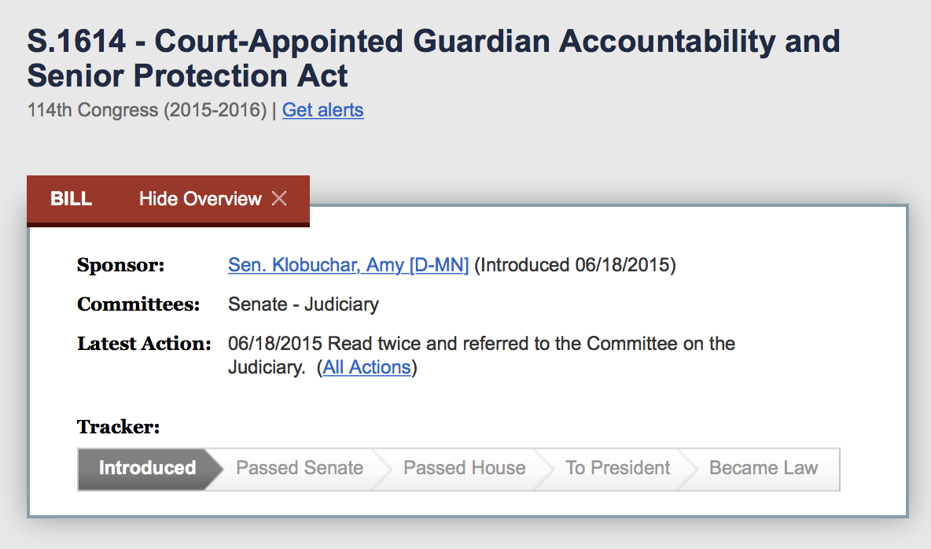
S.1614 — Court-Appointed Guardian Accountability and Senior Protection Act, 114th Congress (2015-2016)
https://www.congress.gov/bill/114th-congress/senate-bill/1614
Retrieved, October 24, 20145
Notes:
S.1614 — Court-Appointed Guardian Accountability and Senior Protection Act
114th Congress (2015-2016)
Sponsor: Sen. Klobuchar, Amy [D-MN]
Introduced 06/18/2015
Committees: Senate - Judiciary
Latest Action: 06/18/2015
Read twice and referred to the Committee on the Judiciary.
Latest Action: 06/18/2015 Read twice and referred to the Committee on the Judiciary.
_____
Senator Klobuchar’s Guardianship Legislation
NGA is asking its members to contact their United States Senators to request their support of the Court-Appointed Guardian Accountability and Senior Protection Act (S.1614). This is a bipartisan bill that Senators Klobuchar and Cornyn introduced. The bill was passed by the Senate Judiciary Committee last Congress, but was not taken up by the full Senate. Its primary purpose is to provide funds to state courts to assess access to and the quality of guardianship and implement changes to improve any deficiencies. Please look for an upcoming action alert requesting your help in securing cosponsors for S. 1614.
____

Slide 116

PRACTICAL guardianship tool
presume
reason
ask
community
team
identify abilities
challenges
appoint
limit
Notes:
ABA PRACTICAL
aba_guardianship_practical_tool_wood_150900.pdf
Erica Wood
9 Steps of the PRACTICAL Tool
Presume
Reason
Ask
Community
Team
Indentify abilities
Challenges
Appoint
Limit
_____
Test a New Practice Tool ­­
Reduce the Need for Guardianship and Support Decision­ Making
The PRACTICAL tool guides lawyers in identifying decision­making options that are less restrictive than guardianship. PRACTICAL is an acronym for nine steps lawyers can take to identify these options.
Who Can Volunteer
Does your practice include counseling and representation on guardianship, health care and financial decision­making? Do you frequently represent petitioners in guardianship cases?
Do you represent respondents in guardianship cases?
Do you serve as guardian ad litem for the court?
Are you interested in helping to advance practices that support adults with disabilities in decision­making and that may reduce the need for guardianship?
What Volunteering Entails
Use the PRACTICAL tool in at least 3 cases over 3 months Complete a brief questionnaire about the tool
What Benefits You Get
Exposure to new practice ideas
Recognition in project materials
Free printed copy of the final tool, background guide, and checklist
Be on the cutting edge
_____

Slide 117
Advocacy and Public Policy
national representation and coordination
with broad coalition
state coordination and advocacy via WINGS
local advocacy and involvement
Notes:
Federal Programs
_____
wings_2011_introduction.pdf
A 2004 report32 found insufficient oversight and a dire lack of coordination between state guardianship courts and federal representative payment programs in Social Security and the Department of Veterans Affairs. A 2010 report 33
33 — U.S. GOV’T ACCOUNTABILITY OFFICE, GAO-10-1046, GUARDIANSHIPS: CASES OF FINANCIAL EXPLOITATION, NEGLECT, AND ABUSE OF SENIORS (2010), available at http://www.gao.gov/new.items/d101046.pdf.
__
Finally, a July 2011 GAO report 35 again assessed the need for coordination between the Social Security Administration, the Department of Veterans Affairs, and state courts concerning guardians and fiduciaries. It also suggested ways the federal government could support stronger oversight. A senate bill36 introduced in October 2011 aimed to provide grants to state courts for improved screening, monitoring and systems assessment.
It also suggested ways the federal government could support stronger oversight. A senate bill36 introduced in October 2011 aimed to provide grants to state courts for improved screening, monitoring and systems assessment.
35 — 5 U.S. GOV’T ACCOUNTABILITY OFFICE, GAO-11-678, INCAPACITATED ADULTS: OVERSIGHT OF FEDERAL FIDUCIARIES AND COURT-APPOINTED GUARDIANS NEEDS IMPROVEMENT (2011), available at http://www.gao.gov/new.items/d11678.pdf.
36 — S. 1744, 112th Cong. (2011). The bill was introduced by Senator Amy Klobuchar of Minnesota.
37 — See, e.g., NAT’L ORG. TO STOP GUARDIANSHIP ABUSE, http://stopguardianabuse.org (last visited Apr. 8, 2012); NAT’L ORG. TO END GUARDIANSHIP ABUSE, http://www.stopelderabuse.net/index_files/NOEGAMission.htm (last visited Apr. 8, 2012).
38 Bayles & McCartney, supra note 8.
_____
_____
ABA Resolution 2013
Background. Critical to an understanding of the proposed resolution is information about: (1) demographic changes; (2) three fiduciary systems -- state/territorial guardianship systems, the Social Security Representative Payment Program, the VA Fiduciary Program; and (3) the recent rise in financial exploitation.
__
There is no data on the number of adults under guardianship in the U.S. However, in 2011 the National Center for State Courts estimated that the number of active, pending cases is between 1.5 million and three million, but could range from fewer than 1 million to more than three million.
Uekert, Brenda & Van Duizend, Richard, “Adult Guardianships: A ‘Best Guess’ National Estimate and the Momentum for Reform, Future Trends in State Courts 2011, National Center for State Courts.
___
(2) Social Security Representative Payees. Social Security's Representative Payment Program provides financial management for the Social Security and SSI payments of beneficiaries who are not able to manage their Social Security or SSI benefits. Close to 5.6 million beneficiaries have representative payees -- including over 3.9 million children and almost 1.6 million adults, of which approximately 700,000 are age 65+. These payees may be family members, other individuals or organizations.
Representative payees must receive the beneficiary’s Social Security funds and use them in the best interest of the beneficiary, paying for current and foreseeable needs. Payees must keep careful records, and submit reports to the Social Security Administration. Representative payees are authorized only to manage the agency benefits, not the person’s other funds.
Social Security Administration, Office of Retirement and Disability Policy, Annual Statistical Supplement, 2012.
Violations and misuse of funds by Social Security and other representative payees have ranged from high visibility egregious cases to more routine exploitation of benefits, control of funds beyond the benefits, charging of excessive fees, and failure to keep records and submit reports. While misuse and mismanagement is not common, it does occur in the mammoth SSA program. SSA officially reported the amount of misuse in the program as less than 0.01 percent, but a 2007 National Research Council study required by Congress found misuse in 0.2 percent of payees.
National Research Council, Improving the Social Security Representative Payee program: Serving Beneficiaries and Minimizing Misuse (2007).
An egregious 1988 case involving a boarding home operator payee
U.S. Senate, Special Committee on Aging, SSA’s Representative Payee Program: Safeguarding Beneficiaries From Abuse, Hearing, Serial No. 101-5, p. 2 (June 1989).
who abused individuals with disabilities led to an SSA contract with the National Disability Rights Network to have state protection and advocacy agencies review selected organizational payees.
Office of the Inspector General, Social Security Administration, “The Social Security Administration’s Oversight of Employer Representative Payees, Congressional Response Report, A-13-10-20125(2010).
___
(3) VA Fiduciary Program. The Veterans Fiduciary Program was established to protect Veterans and other beneficiaries who, due to injury, disease, or age, are unable to manage their financial affairs. Usually, the fiduciary is a family member, but in some cases is a paid fiduciary and may be a court-appointed guardian. In the fiscal year 2010, the VA reported approximately $696 million in benefits payments to more than 102,000 beneficiaries with a cumulative estate value of $3.1 billion.
VA Office of Inspector General, Veterans Benefit Administration: Audit of the Fiduciary Program’s Effectiveness in Addressing Potential Misuse of Beneficiary Funds, 09-01999-120 (March 2010).
The VA Office of Inspector General has reported on inappropriate use of beneficiary funds by VA fiduciaries, and cited concerns with VA efforts to safeguard beneficiary assets. In 2010, the Government Accountability Office issued a report on the VA fiduciary program, recommending improved approaches to protecting benefits managed by fiduciaries, including better collection and reporting of misuse data.
Government Accountability Office, VA’s Fiduciary Program: Improved Compliance and Policies Could Better Safeguard Veterans’ Benefits, GAO-10-241 (February 2010).
(fn 21 note) ). Note that some coordination does take place through the Uniform Veterans Guardianship Act. In states that have adopted this Act, state courts must notify the VA when they appoint a guardian for a veteran, and send copies of court orders and accountings.
___
Other Federal/State/Territorial Representative Payment Programs. Other federal agencies have representative payment programs as well. For example, the Office of Personnel Management has a system which in 2004 had over 11,000 beneficiaries. Railroad Retirement also has a representative payee system. Some state and territorial agencies have similar programs.
Government Accountability Office, Guardianships: Collaboration Needed to Protect Incapacitated Elderly People, GAO-04-655 (July 2004).
See, “Acting for Impaired Railroad Retirement Beneficiaries,” http://www.rrb.gov/opa/qa/pub_1302.asp .
___
nickitas_middough_aries_2011_policy_and_politics_for_nurses_and_other_health_professionals_advocacy_and_action .pdf

Slide 118
Gravity
XI.
If you would hit the mark, you must aim a
little above it;
Every arrow that flies feels the attraction
of earth.
Longfellow, Henry Wadsworth. In the Harbor, Elegiac Verse, XI. Houghton Mifflin & Co.,1882.
Notes:
http://quod.lib.umich.edu/m/moa/ACS1491.0001.001/59?rgn=full+text;view=image;q1=attraction
http://www.poetryloverspage.com/poets/longfellow/elegiac_verse.html
Henry Wadsworth Longfellow
Elegiac Verse
From In the Harbor
I
Peradventure of old, some bard in Ionian Islands,
Walking alone by the sea, hearing the wash of the waves,
Learned the secret from them of the beautiful verse elegiac,
Breathing into his song motion and sound of the sea.
For as the wave of the sea, upheaving in long undulations,
Plunges loud on the sands, pauses, and turns, and retreats,
So the Hexameter, rising and singing, with cadence sonorous,
Falls; and in refluent rhythm back the Pentameter flows?
II
Not in his youth alone, but in age, may the heart of the poet
Bloom into song, as the gorse blossoms in autumn and spring.
III
Not in tenderness wanting, yet rough are the rhymes of our poet;
Though it be Jacob's voice, Esau's, alas! are the hands.
IV
Let us be grateful to writers for what is left in the inkstand;
When to leave off is an art only attained by the few.
V
How can the Three be One? you ask me; I answer by asking,
Hail and snow and rain, are they not three, and yet one?
VI
By the mirage uplifted the land floats vague in the ether,
Ships and the shadows of ships hang in the motionless air;
So by the art of the poet our common life is uplifted,
So, transfigured, the world floats in a luminous haze.
VII
Like a French poem is Life; being only perfect in structure
When with the masculine rhymes mingled the feminine are.
VIII
Down from the mountain descends the brooklet, rejoicing in
freedom;
Little it dreams of the mill hid in the valley below;
Glad with the joy of existence, the child goes singing and
laughing,
Little dreaming what toils lie in the future concealed.
IX
As the ink from our pen, so flow our thoughts and our feelings
When we begin to write, however sluggish before.
X
Like the Kingdom of Heaven, the Fountain of Youth is within us;
If we seek it elsewhere, old shall we grow in the search.
XI
If you would hit the mark, you must aim a little above it;
Every arrow that flies feels the attraction of earth.
XII
Wisely the Hebrews admit no Present tense in their language;
While we are speaking the word, it is is already the Past.
XIII
In the twilight of age all things seem strange and phantasmal,
As between daylight and dark ghost-like the landscape appears.
XIV
Great is the art of beginning, but greater the art is of ending;
Many a poem is marred by a superfluous verse.

Slide 119
Gravity
X.
Like the Kingdom of Heaven, the Fountain
of Youth is within us;
If we see it elsewhere, old shall we grow
in the search.
Longfellow, Henry Wadsworth. In the Harbor, Elegiac Verse, X. Houghton Mifflin & Co.,1882.
Notes:
http://quod.lib.umich.edu/m/moa/ACS1491.0001.001/59?rgn=full+text;view=image;q1=attraction
http://www.poetryloverspage.com/poets/longfellow/elegiac_verse.html
Henry Wadsworth Longfellow
Elegiac Verse
From In the Harbor
I
Peradventure of old, some bard in Ionian Islands,
Walking alone by the sea, hearing the wash of the waves,
Learned the secret from them of the beautiful verse elegiac,
Breathing into his song motion and sound of the sea.
For as the wave of the sea, upheaving in long undulations,
Plunges loud on the sands, pauses, and turns, and retreats,
So the Hexameter, rising and singing, with cadence sonorous,
Falls; and in refluent rhythm back the Pentameter flows?
II
Not in his youth alone, but in age, may the heart of the poet
Bloom into song, as the gorse blossoms in autumn and spring.
III
Not in tenderness wanting, yet rough are the rhymes of our poet;
Though it be Jacob's voice, Esau's, alas! are the hands.
IV
Let us be grateful to writers for what is left in the inkstand;
When to leave off is an art only attained by the few.
V
How can the Three be One? you ask me; I answer by asking,
Hail and snow and rain, are they not three, and yet one?
VI
By the mirage uplifted the land floats vague in the ether,
Ships and the shadows of ships hang in the motionless air;
So by the art of the poet our common life is uplifted,
So, transfigured, the world floats in a luminous haze.
VII
Like a French poem is Life; being only perfect in structure
When with the masculine rhymes mingled the feminine are.
VIII
Down from the mountain descends the brooklet, rejoicing in
freedom;
Little it dreams of the mill hid in the valley below;
Glad with the joy of existence, the child goes singing and
laughing,
Little dreaming what toils lie in the future concealed.
IX
As the ink from our pen, so flow our thoughts and our feelings
When we begin to write, however sluggish before.
X
Like the Kingdom of Heaven, the Fountain of Youth is within us;
If we seek it elsewhere, old shall we grow in the search.
XI
If you would hit the mark, you must aim a little above it;
Every arrow that flies feels the attraction of earth.
XII
Wisely the Hebrews admit no Present tense in their language;
While we are speaking the word, it is is already the Past.
XIII
In the twilight of age all things seem strange and phantasmal,
As between daylight and dark ghost-like the landscape appears.
XIV
Great is the art of beginning, but greater the art is of ending;
Many a poem is marred by a superfluous verse.

Slide 120
Philip C. Marshall • philipcmarshall@gmail.com
508.951.8562 • www.beyondbrooke.org
Notes:
http://beyondbrooke.org

Slide 121
Brooke Astor and Chris Ely, Holly Hill, Briarcliff Manor, NY. 2002.

