Slide 1
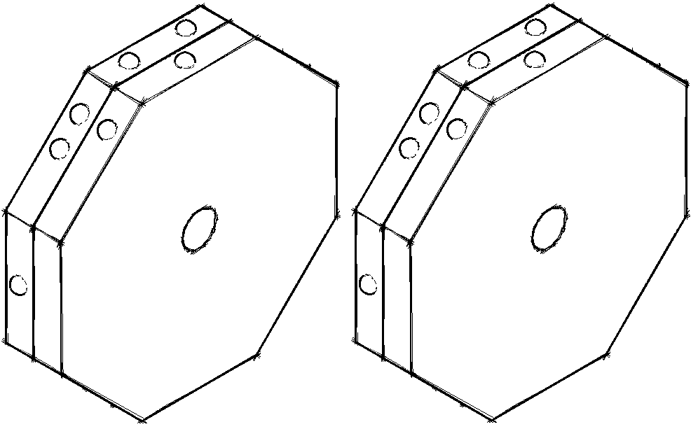
Brailleb k
Refreshable Braille Display
April 19, 2016
Department of Electrical & Computer Engineering
Notes:
‹#›
spend a little time giving the audience a sense of what to expect. simple, cheap, help learn braille

Slide 2




Team
Richard Lam
EE, ‘16
Team Manager
Raveena Kothare
EE, ‘16
Steven Golonka
EE, ‘16
Faculty Advisor: Professor Dennis Goeckel
Department of Electrical & Computer Engineering
Notes:
‹#›

Slide 3
Introduction
Braillebook:
The Braille Tutor
“Only a quarter of blind Americans of working age actually have jobs, and it is surely no coincidence that almost all of them can read Braille.” ¹
Today, 10% of blind children are taught Braille²
  Compare to 50% in the 1950s
Braille texts are expensive
  Costs several times more than ordinary books
  Electronic refreshable Braille displays cost $2000-$8000³
Department of Electrical & Computer Engineering
[1] http://www.economist.com/news/science-and-technology/21654564-tab...
[2] http://www.economist.com/news/international/21595475-new-technology-cou...
[3]http://www.bbc.com/news/technology-27243376
Notes:
‹#›
Talk about how it would work- text file is loaded onto device, row of characters is displayed, user presses buttons to go to next/previous line
Can be used in workplace or recreationally
Include economist quote

Slide 4
braillebook: A Learning Tool
User will be able to read the displayed line of Braille and compare it to the output of the text-to-speech output
Market competition:
  BraillePen 12 Touch: 12 cell display, bluetooth keyboard, compatible with text to speech software, $1150
  Smart Beetle 14-Cell Braille Display: compatible with popular screen reader software, audio prompt for menu, $1200
  Brailliant BI 40: 40 cell display, compatible with screen reader software, $2995
Department of Electrical & Computer Engineering
Notes:
talk about braillebook as a learning tool

Slide 5
Proposed CDR Deliverables
Fully functional electromechanical display
  20 characters
  Buttons for: Previous Line, Next Line, Read Line
  Switch for: Power ON/OFF
Desktop Application
Line refreshes in 5 seconds
Fully packaged device
Production cost: <$400
Department of Electrical & Computer Engineering
Notes:
Ask Prof. Goeckel- How should we mention that we want our target audience of this product to be people who are learning braille? this is a
77x12x13

Slide 6
Proposed FPR Deliverables
Fully functional electromechanical display
  20 characters
  Buttons for: Previous Line, Next Line, Read Line
  Switch for: Power ON/OFF
Desktop application is compatible with screen reading software
Line refreshes in 10 seconds on average
Fully packaged device
Production cost: <$400
As per evaluators’ suggestions from CDR
Department of Electrical & Computer Engineering
Notes:
Ask Prof. Goeckel- How should we mention that we want our target audience of this product to be people who are learning braille? this is a
77x12x13

Slide 7

Proposed FPR Deliverables
Fully functional electromechanical display
  20 characters
  Buttons for: Previous Line, Next Line, Read Line
  Switch for: Power ON/OFF
Desktop application is compatible with screen reading software
Line refreshes in 10 seconds on average
Fully packaged device
Production cost: <$400
As per evaluators’ suggestions from CDR
Department of Electrical & Computer Engineering
Notes:
Ask Prof. Goeckel- How should we mention that we want our target audience of this product to be people who are learning braille? this is a
77x12x13

Slide 8
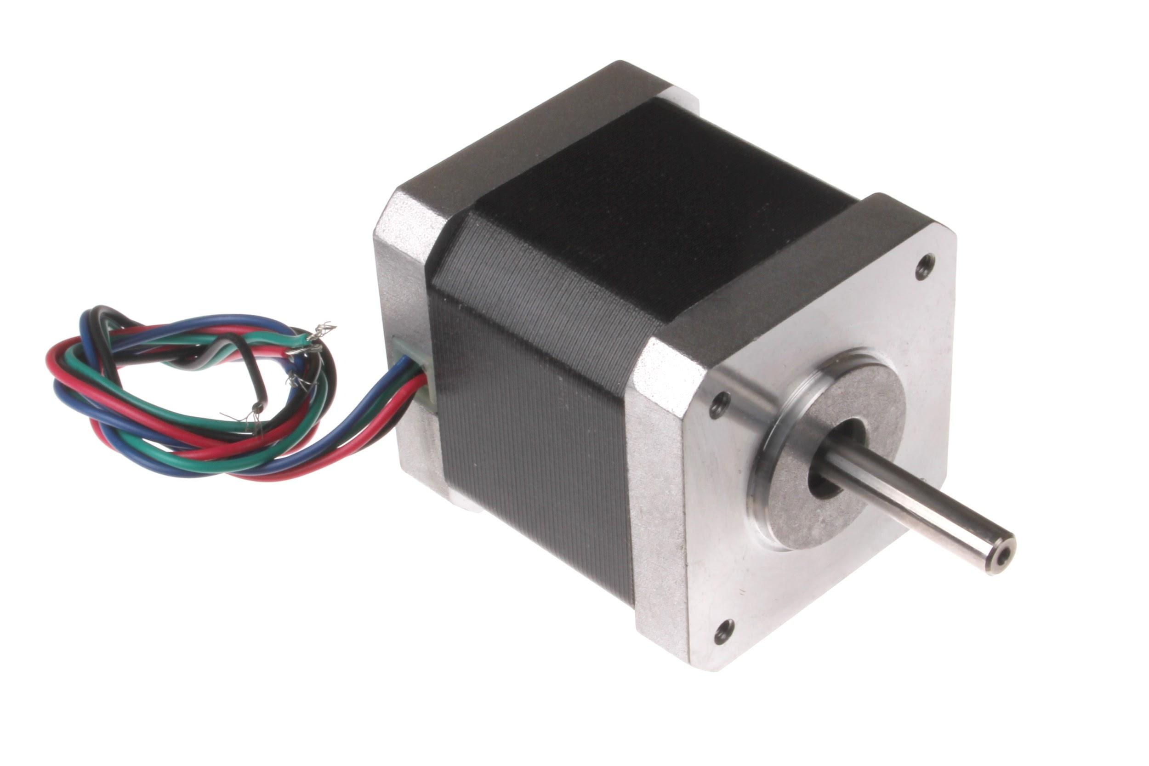
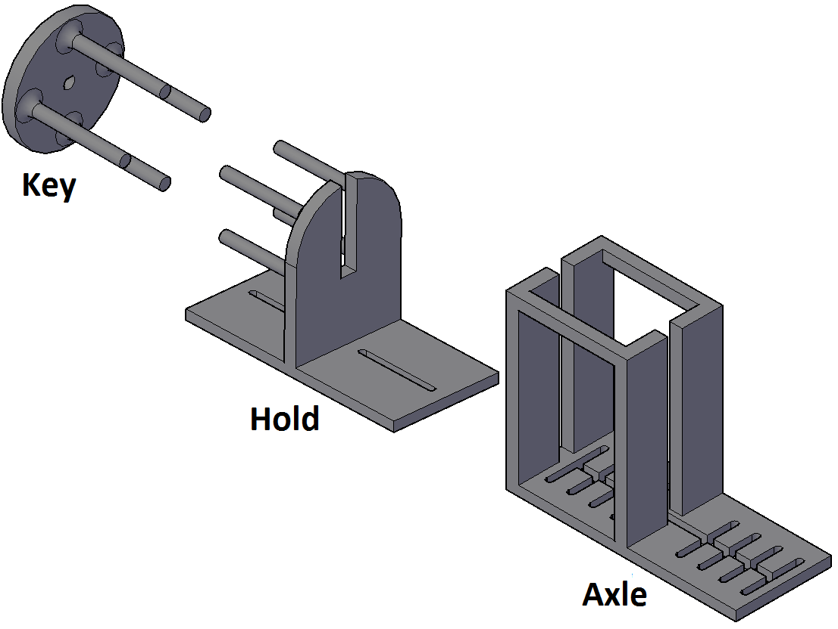

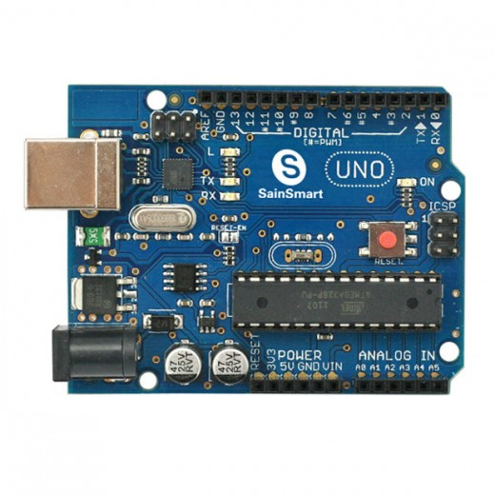
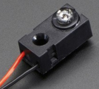
System Overview
Mechanical Display
Computer
Arduino
Motors
IR Sensor
User Interface Peripherals
Department of Electrical & Computer Engineering
Notes:
give overview of system
add octagonal wheel

Slide 9
System Block Diagram
Department of Electrical & Computer Engineering

Slide 10
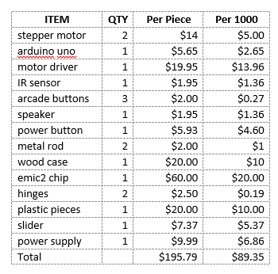
Cost of Materials

Slide 11
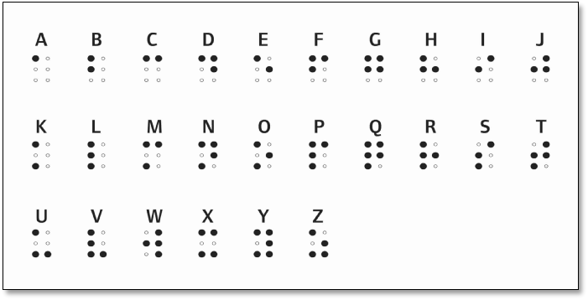

Department of Electrical & Computer Engineering
Notes:
‹#›

Slide 12

Questions & Discussion
Department of Electrical & Computer Engineering
Notes:
‹#›

Slide 13

Department of Electrical & Computer Engineering
Notes:
‹#›

