Slide 1

Notes:
My name is Deborah Gonzales and in addition to my MLS, I have a Master’s in Clinical Counseling and an almost Master’s in Speech Language Pathology.
Since I’ve been a librarian, I’ve spent about 75% of my time being a programming librarian.
I am currently the Senior Services Librarian at Arapahoe Libraries in Arapahoe County Colorado, which is in southern Metro Denver.

Slide 2
Deborah Gonzales ~ Senior Services Librarian ~ Arapahoe Libraries
Services that we provide to seniors in our community
Lobby Stops
Books by Mail
Home Delivery Services
Book Talks for Seniors
Book-a-Librarian for Seniors
Programming in Skilled Nursing and Memory Care units
Notes:
I am very fortunate because Arapahoe Libraries created my position as a result of a wonderful mill levy increase and they have given my lots of freedom to developing services for seniors in our community.
One of the areas, I concentrate on, is programming for memory care units. I currently provide 10 programs a month in different memory care units
The groups I serve range from beginning stage dementia to late/advanced stage dementia

Slide 3
Do you remember your high school prom?
How many children do you have?
Did you have fun this weekend?
"I don't like it when people ask me to remember…
I can't remember!!!"
Notes:
When I first began providing outreach programming to memory care units, I brought picture books, short stories and “reminiscing” materials with the goal of helping people to access memories. Things seemed to be going OK until one day during a program a lady began to cry and said “I don’t like it when people ask me to remember! I can’t remember!” I told her that I was so very sorry and that I would be more careful in the future.”

Slide 4
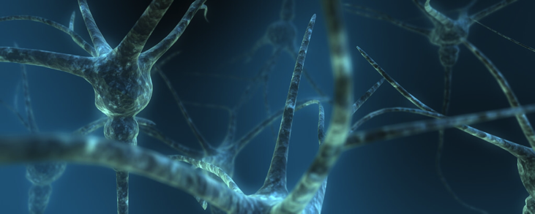
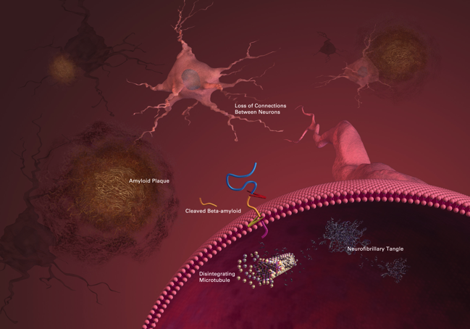
Most types of dementia are a one way journey
Notes:
Slide 2
At this point I pulled back and reassessed my goals and methods for these programs. After being truthful with myself, I realized that these programs weren’t as satisfying as things I had done in the past. I knew that I could work well with people with dementia because my father passed from Alzheimer’s and my grandmother had dementia from brain trauma. So...I started reading studies, I googled, I took classes from the Alzheimer’s Association, I watched Teepa Snow videos and a variety of TED talks. I have a list of my favorites posted in the drop box.
The conclusions that I reached were as follows:
Most dementias are a one-way journey.
I will use alz as an example and even though the various dementias have different pathologies and presentations, the linear aspects are similar
These beautiful blue neurons are from a healthy brain. They are smooth and electrical signals are able to flow easily.
As Alzheimer's progresses "sticky proteins" clump together and clog neural pathways with "plaques" and "tangles" inside the neurons
Which in turn causes cell death

Slide 5
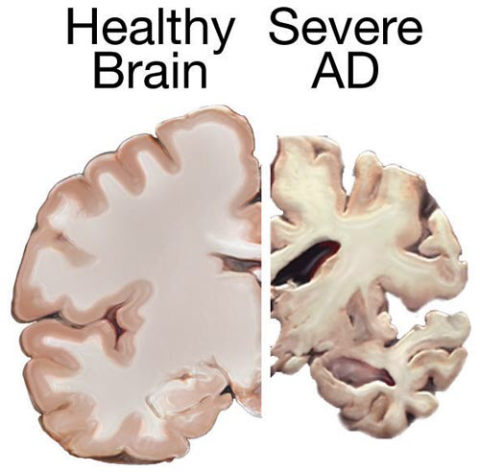
Currently, there are
medications that delay
the onset of severe
symptoms and slow
down the progression of
the disease.
However, there is no cure
as of yet.
Notes:
ALZ starts in the hippocampus, the area of the brain responsible for memory storage and retrieval – that's why memory loss is one of the first symptoms of ALZ
From there, the disease works it's way through the brain, eventually attacking the brain stem, which controls critical body functions such as swallowing and breathing.
Currently, there are medications that delay the onset of severe symptoms and slow down the progression of the disease. However, there is no cure yet!
The wiring in people brain is similar but there are differences due to experiences, health etc. So sometimes a random memory will surface because the disease missed that pathway
As a result I do my best to eliminate words like "remember" from my vocabulary

Slide 6
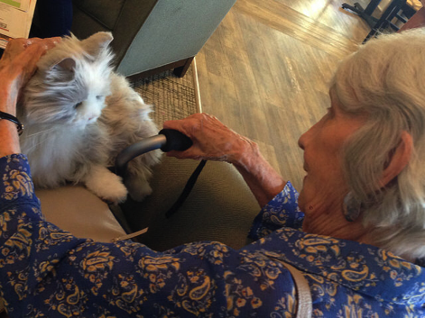
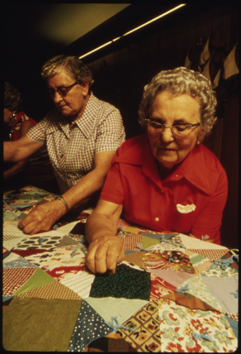
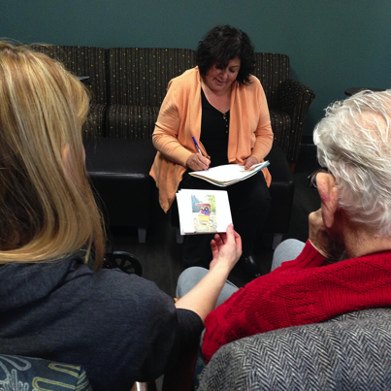
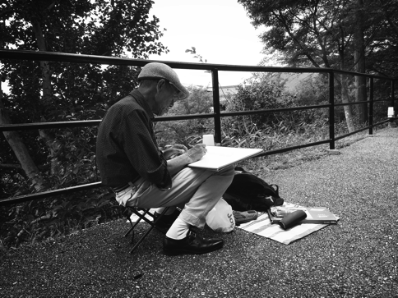
Even though memories and cognitive functioning may be impaired, people with dementia have loads of creativity
It's possible to build joyful interactive programming for people with dementia

Slide 7
Early to mid-stage dementia:
TimeSlips
Story
Rummage Wagon
Notes:
The program runs anywhere from a 45 min to 1 hour.
It takes a lot of energy to participate in a program and the further along people are, they will tire sooner

Slide 8
TimeSlips
An improvisational storytelling technique which allows everyone to participate equally.
Notes:
The first part of the program consists of an improvisational storytelling activity called TimeSlips.
TimeSlips was developed by Anne Davis Basting in 1998. She also wrote a book ~ Forget Memory: Creating better lives for people with dementia.
So…this is how it works:
I will pass out a picture …like this….

Slide 9

TimeSlips
Notes:
…. The picture is somewhat staged (not a portrait) It kind of implies action or a mystery…
Then I ask open-ended questions and record responses..this part is extremely important…by asking open ended questions…the playing field is level, it allows all participants to use their creativity.
I pause frequently to read what we have so far…the read-back should be somewhat animated or dramatic…this helps to keep everyone engaged and focused
I like to record the input in lines others like to use paragraphs…I like how the lines result in a piece that feels like spoken word poetry.
The next 3 slides are results from some of my programs

Slide 10

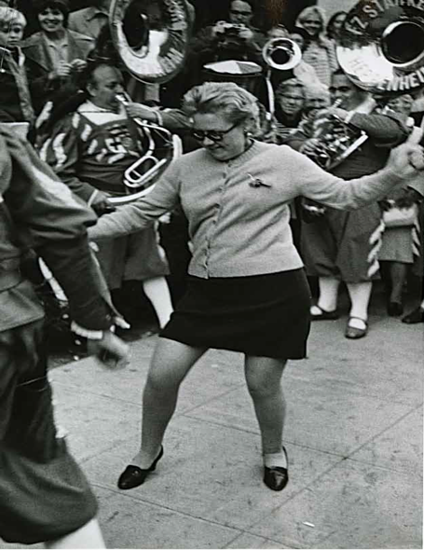
Dancing in the Street
Outdoors
By a sidewalk
It's warm out
Look at all those wonderful instruments
If only we could hear...If only we could hear!
She has a key to get back in her room
Hanging on her sweater
To me, she looks like a Barbara
She's doing a dance and she's proud of it!
She has to get thinner
Look at all the instruments, at least four
There are people in the background
She's brave, isn't she?
She's able to dance to whatever she is hearing
Or...she's a show off
She's got the urge to dance to the music
She's got the band all around her
It's fall or spring
Whatever it is, she's happy
And a show off
She may be pretty good...she's very good
The key could be for her room, her house or her heart
Notes:
This group is in the early mid stages of dementia

Slide 11
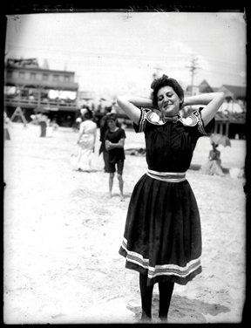
Saturday Afternoon on the Boardwalk
Florence Nightingale
She's very relaxed, sexy and happy
Self confident, she's posing
She came from her parents; it's easier that way!
She likes boys
She's a showoff
She might have a family but she doesn't care about them right now
She wishes she didn't have to wear those stockings
She wants to be in a beauty contest, Atlantic City,
on the Boardwalk, Miss America
And she wants to go swimming
She's gotta take that uniform off
She'll either be a knockout or we'll throw stones at her
Then she'll go swimming, the water will like that!

Slide 12
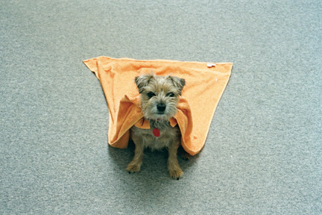
Fly Me to the Moon!
We have Super Man here
Super Dog!
That dog is so cute
his name is Fly Boy
He belongs to Fly Mama!
He's going to a costume party
One assumes he can fly...
Fly Girl and Super Kitty
will be at the party
They will compare capes!

Slide 13
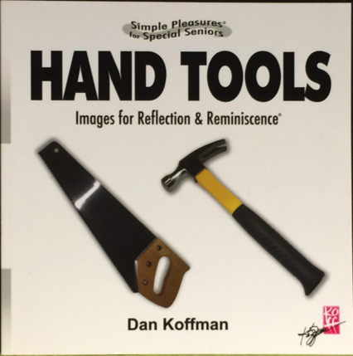




Story
Notes:
Then as a transition, I’ll read a picture book written specifically for people with dementia.
They really love these stories… they attend much more closely than when I read children’s picture books.
Here are a few:
There’s something about that smile works really well for beginning to mid stage dementia
these books work much better for late stage dementia

Slide 14
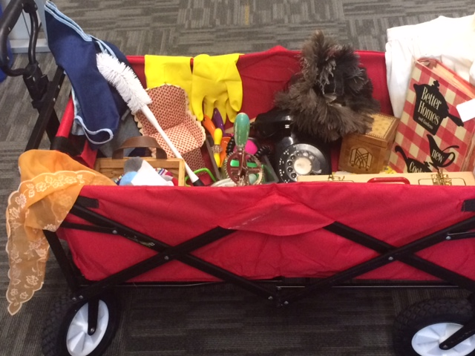
Rummage
Wagon
Notes:
The last thing we do is the rummage wagon. I have this great collapsible red wagon that I pile stuff in and we rummage through it for the remainder of the program. Here are a few examples of topical themed rummage wagons
We just look at the stuff...depending on what stage of their disease they are and how they are feeling that day sometimes they remember things..most often, we just have fun looking at all the things and wondering what they were used for

Slide 15
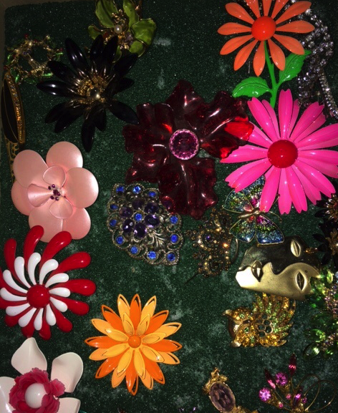

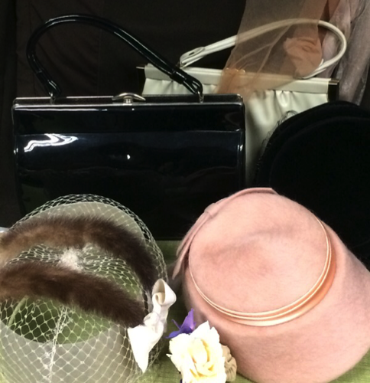
Fashion

Slide 16
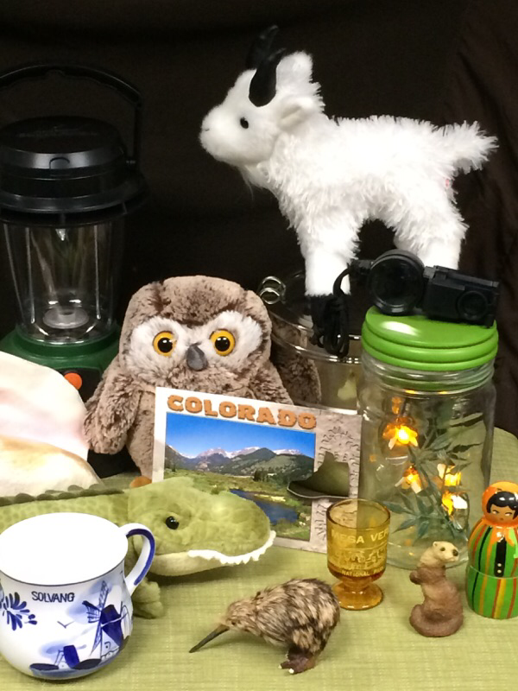
Travel
and adventure

Slide 17
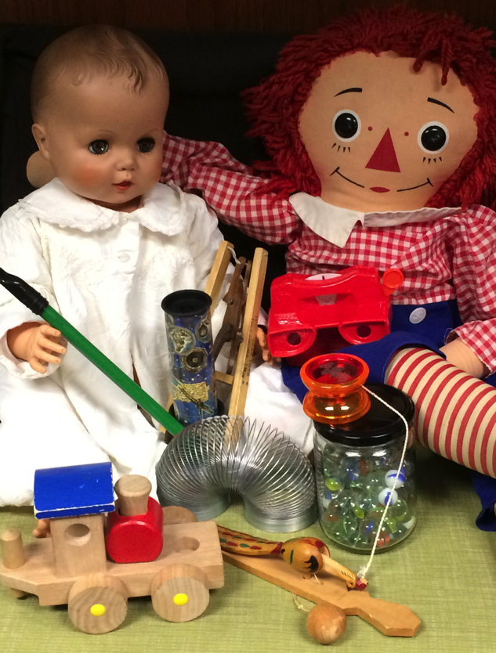
Toys
Notes:
At the end of each session I try to say goodbye to people individually or at the very least to make eye contact.
It’s amazing how many people don’t look people with dementia in the eye.

Slide 18

And when things don't go as expected...
go with the flow

Slide 19
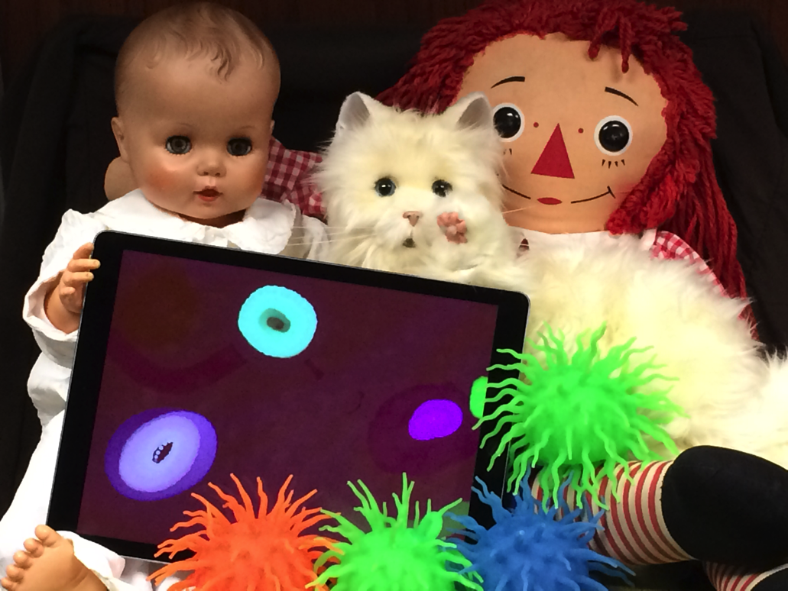
Notes:
At least 2 of the 10 units I visit a month have people that are so advanced that many of them are non-verbal.
This threw a wrench into my improvisational storytelling
For these special people, I present my program differently
We have these great therapy cats that I was lucky enough to buy…show cat
And I've found these great apps by Brian Eno….Bloom and Trope (they only work for ipads at this point
They are also fond of the dolls
And I'm working on making Montessori inspired sensory books
I hand out the cats and the sensory books and then I wander around the room and spend time with individuals…playing with the apps
I sometimes have to rest their hand on mine as we pet the cat or work the app…remember this population probably gets little to no programming because …well they're very difficult to program for.

Slide 20

Remember to take care of yourself
Notes:
Last of all, this job can be hard at times, you will see people fade and some may even die during your time of knowing them...so here are some tips to take care of your generous heart....
Know that it’s OK to feel sad when things change
Breathe! Deep breaths 8 seconds in, hold for 3 and 10 out can really clear your mind
Exercise (yoga, running etc)
Be creative! I passionately believe that's why this programming helps people with dementia, it's creative!
And you don't have to be an artist, coloring books are all the rage for a reason, and if you have other creative interests, more power to you
Journal…put down your concerns and fears then close the cover
Talk to someone

Slide 21
dgonzales@arapahoelibraries.org

