Slide 1
Programming to Engage Children and Their Families
Read, Play, Make!
By Amytha Willard
awillard@sccl.org

Slide 2
Quick Facts
Our collaborative system makes up 7 cities surrounding San Jose: Campbell, Cupertino, Gilroy, Morgan Hill, Milpitas, Los Altos, Saratoga, unincorporated
Urban, suburban, rural

Slide 3
Bookmobile Facts
45 stops
6 staff members: 1 ft supervising librarian, 1 pt librarian, 1 pt library assistant, 1.5 ft clerks, 1 pt page.
Vehicle size
  Esther (small) 22 ft. long, 1800 items

Slide 4
Programs
Mini Maker Faire
Family Craft Kits
Early Literacy Kits
Read for Fun Backpacks

Slide 5
Mini Maker Faire
Who – Families who live at affordable housing sites
Where – Village Avante, Cochrane Village, Murphy Ranch and Sobrato Apartments.
What – Brought 3D Printer, drawbot, circuit scribe, sewing machine, MakeyMakey.
Why – To provide access to technology and just have a good time creating and making things!

Slide 6
Mini Maker Faire
Many of our residents only get access to this opportunity through guidance at school and occasional fieldtrips to science and technology museums. Financial burdens can also be a reason why many families can’t explore the opportunity. Often times families are just too busy or just don’t have the materials on hand to make these inventions.

Slide 7
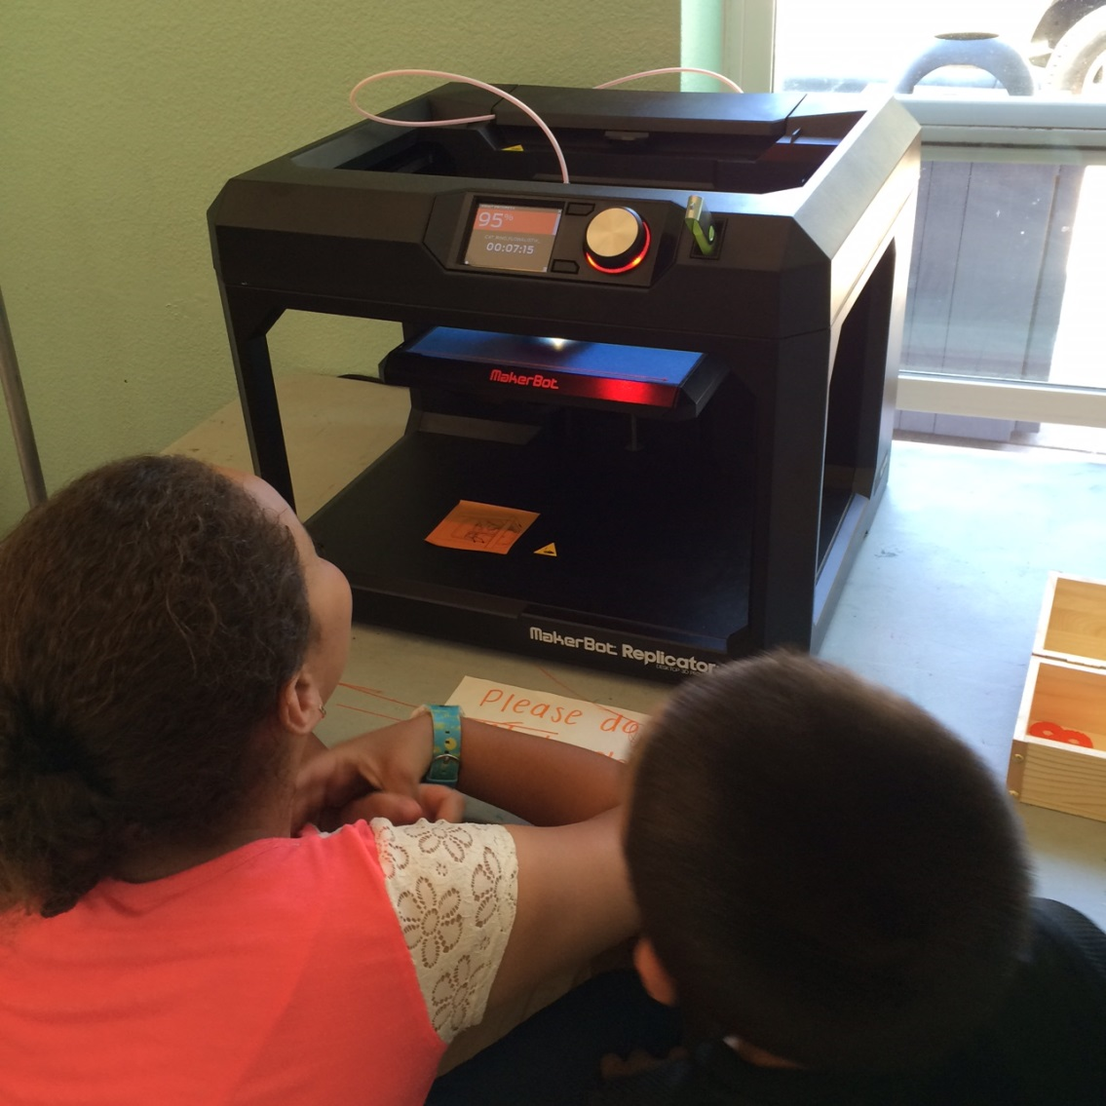
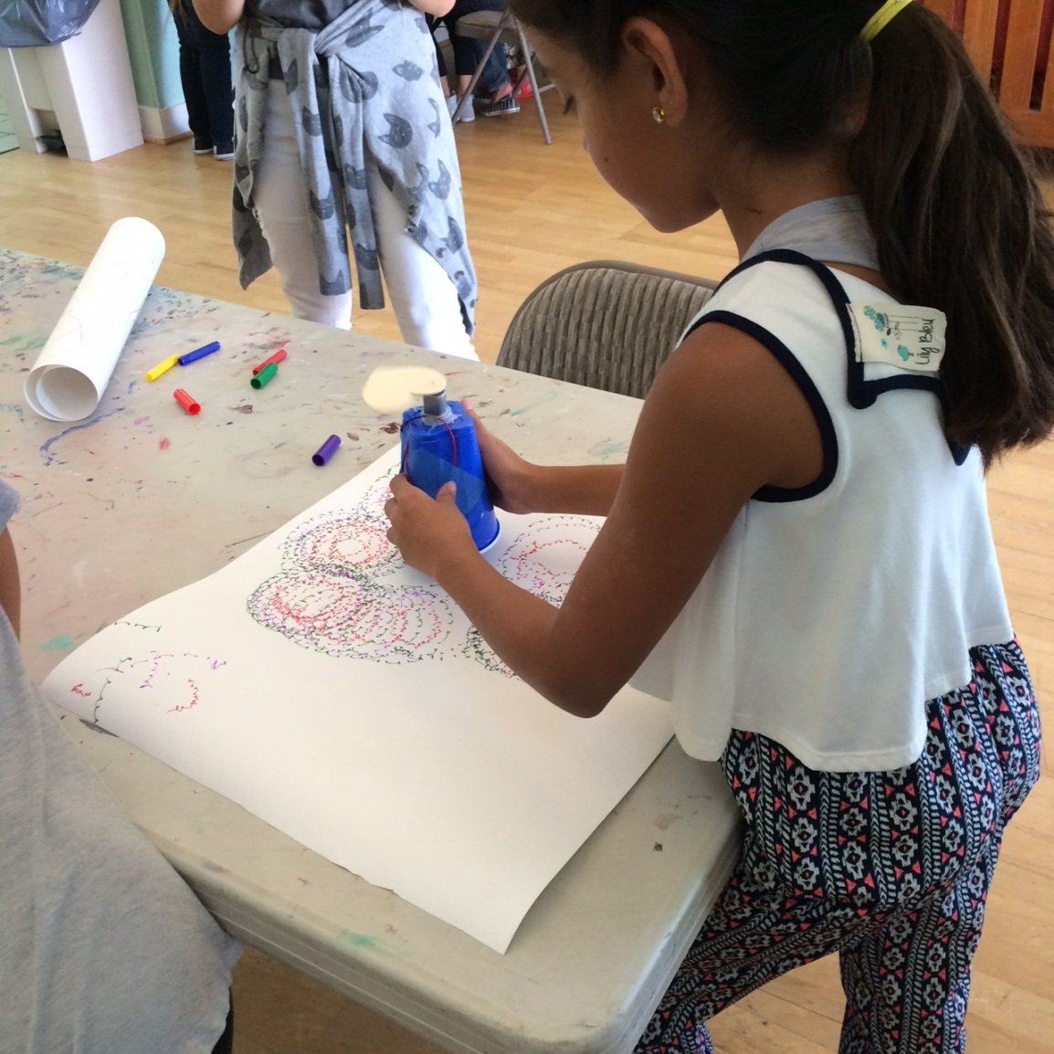
Mini Maker Faire

Slide 8
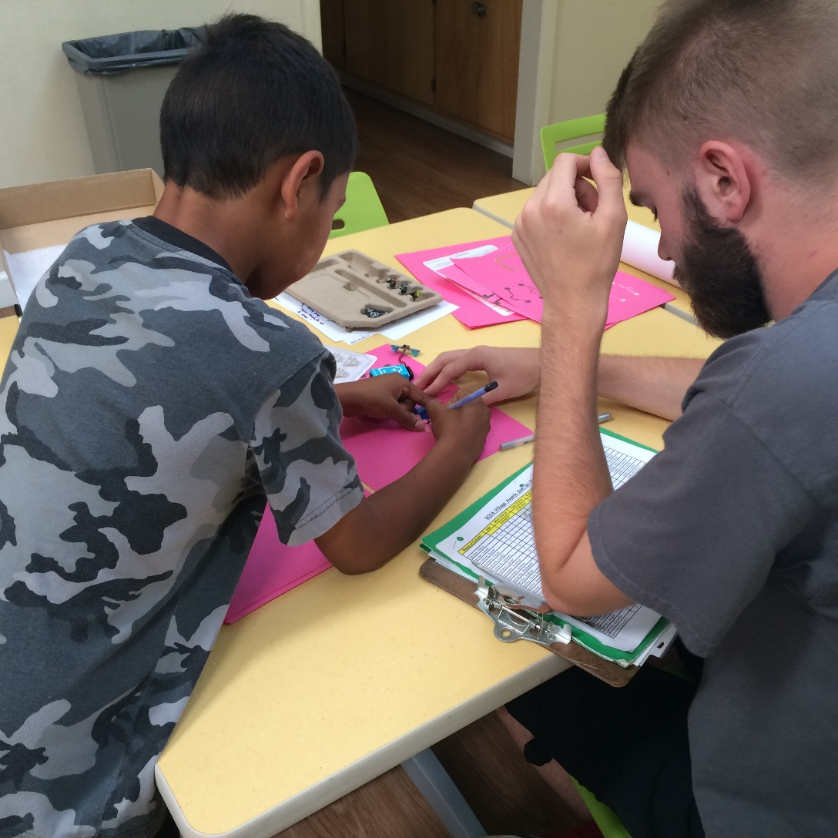
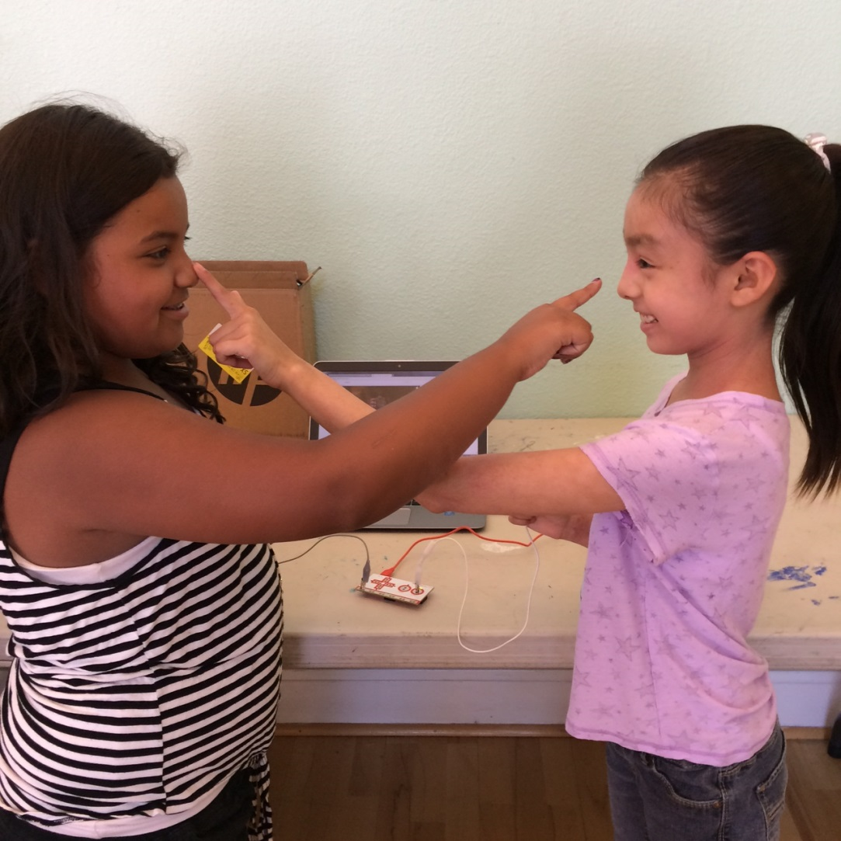
Mini Maker Faire

Slide 9
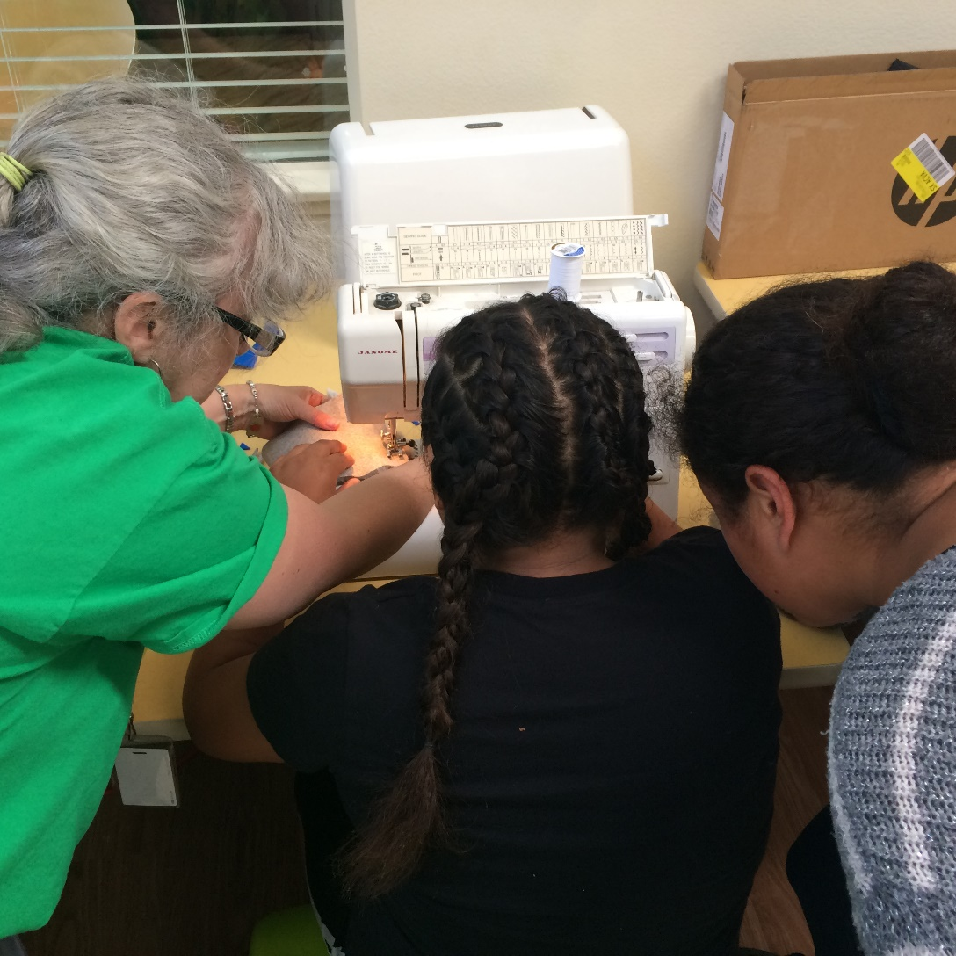
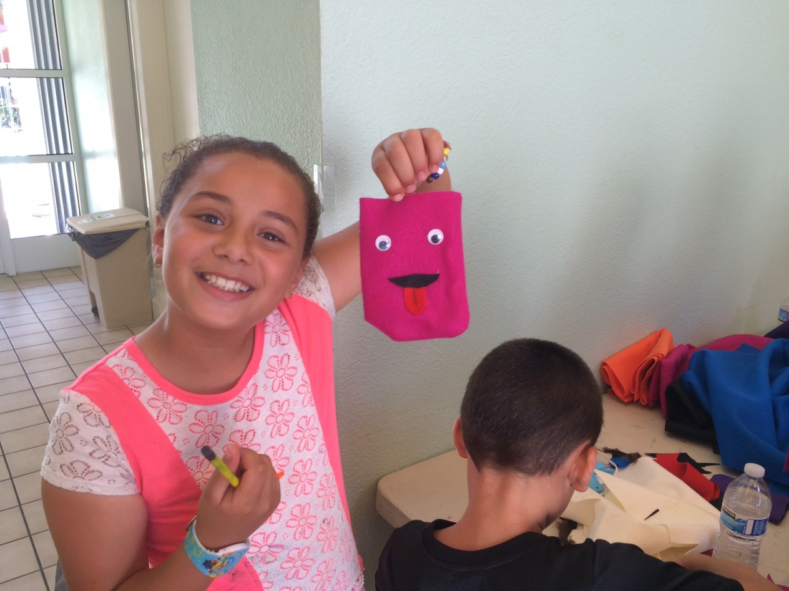
Mini Maker Faire

Slide 10
Early Literacy Kits
Who – Special needs, Medically fragile children aged 0-6+
Where – Lucille Packard, Scribbles and Giggles, Chandler Tripp School

Slide 11
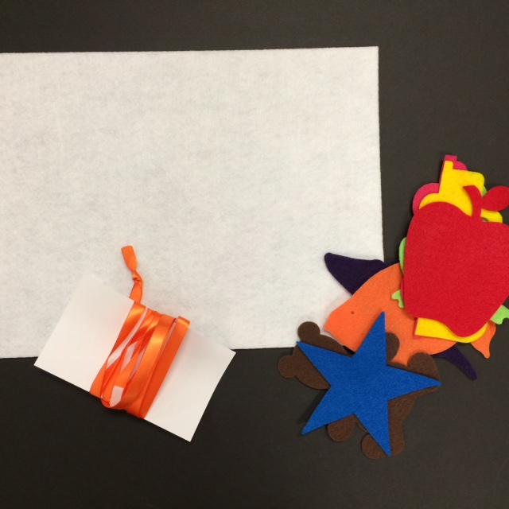
Early Literacy Kits
What – Literacy kit that contains a book, pamphlet, shakey egg, scarf, flannel board in an easy to carry to go kit. In English and Spanish.

Slide 12
Early Literacy Kits
Why – When you have a child with special medical needs, that becomes the focus.
When is there time to go to the library?
Who will teach the parents rhymes and songs?
Learning is just as important for those with special medical needs.
Convenient, easy, to go.

Slide 13
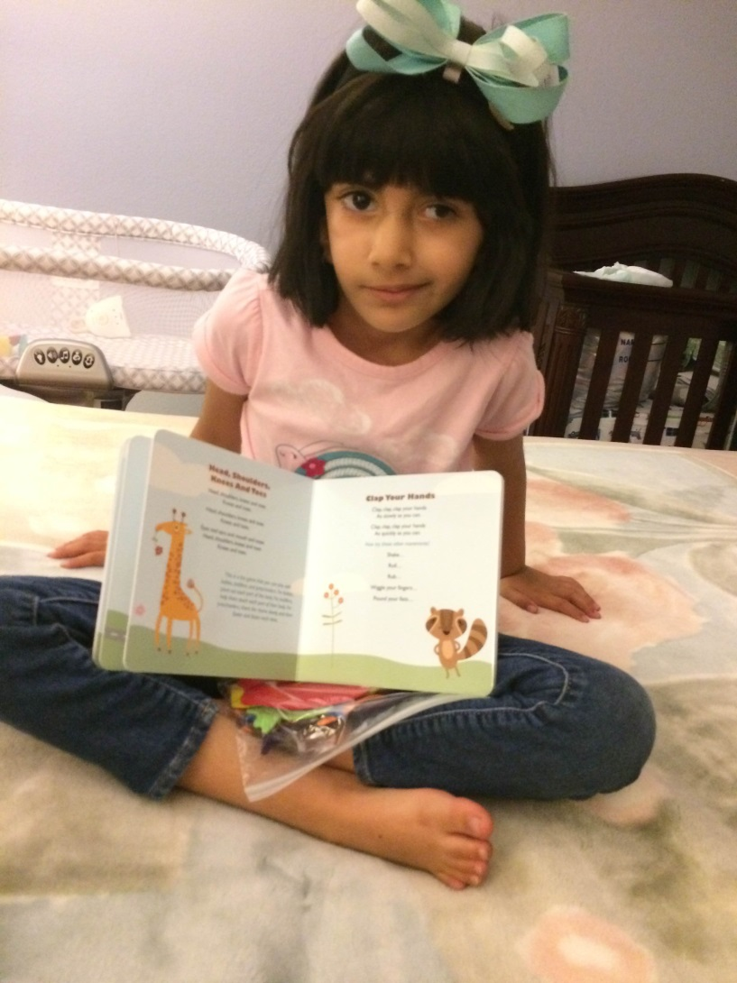
Early Literacy Kits
Ms. Ginger,
Sophie used her kit yesterday and enjoyed it a lot.
She loved reading the book, and she acted the rhymes out.
I liked the shaker egg a lot as its a great way to incorporate new language/sounds. I used it with Sophie and she learnt how to coordinate sound with my words.
Sophie used the felt board to put her rewards (shapes) on whenever she did something nice throughout the evening. She came up with the idea on her own.
I've attached some pictures to give you an idea about how she did.
Regards,
Nadia

Slide 14
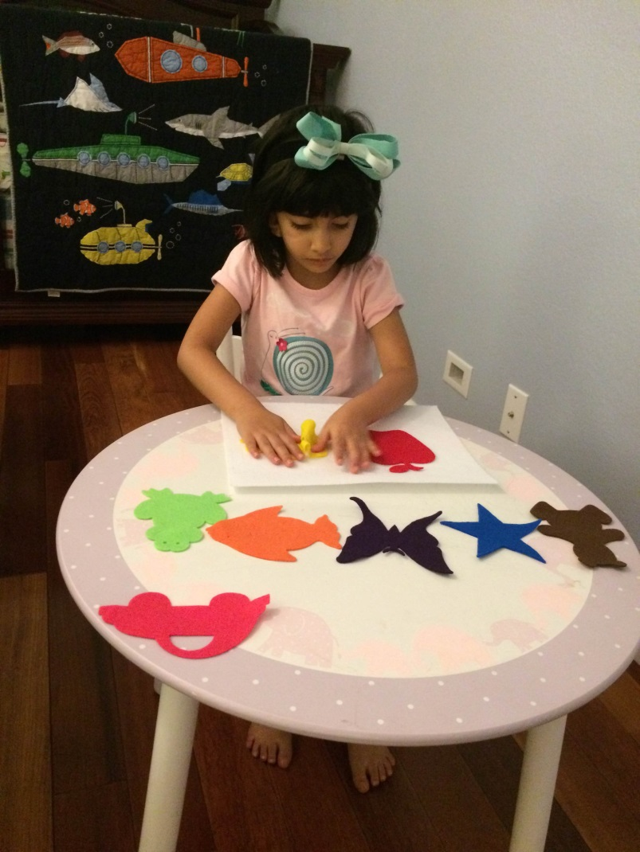
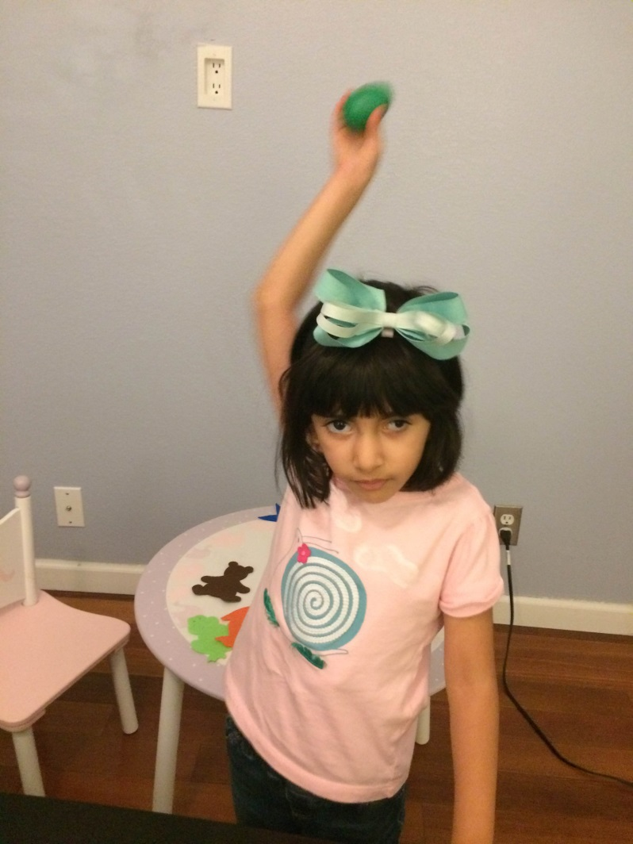
Early Literacy Kits

Slide 15
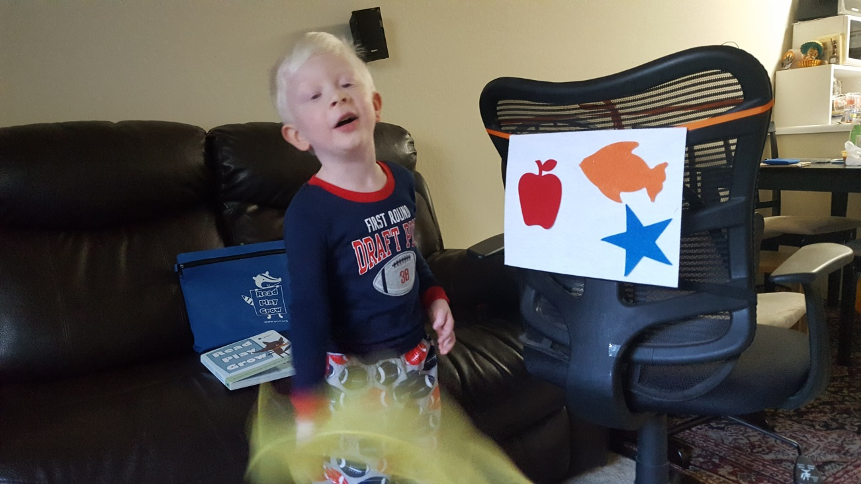
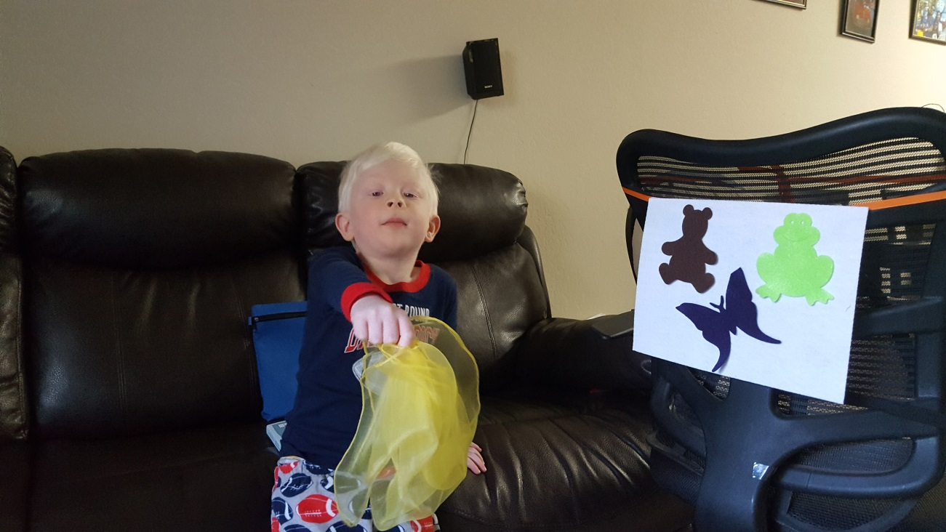
Early Literacy Kits

Slide 16
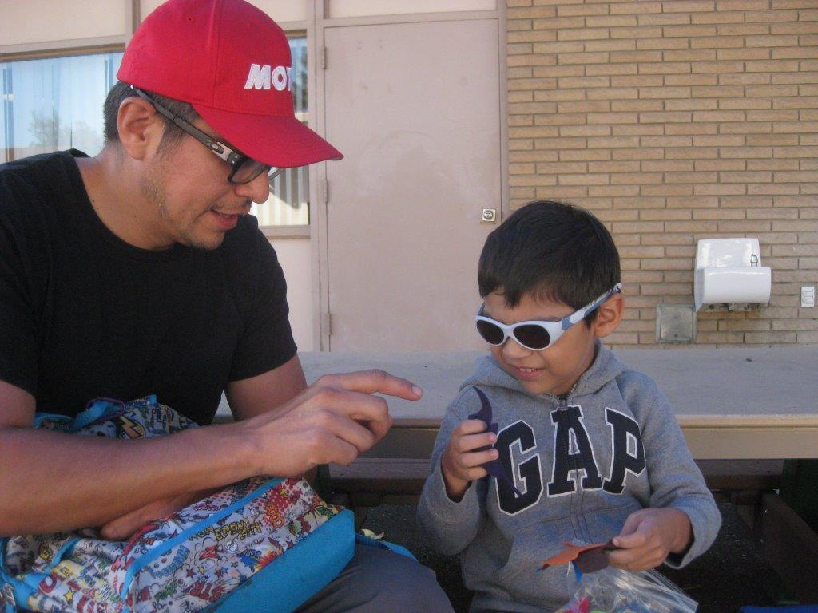
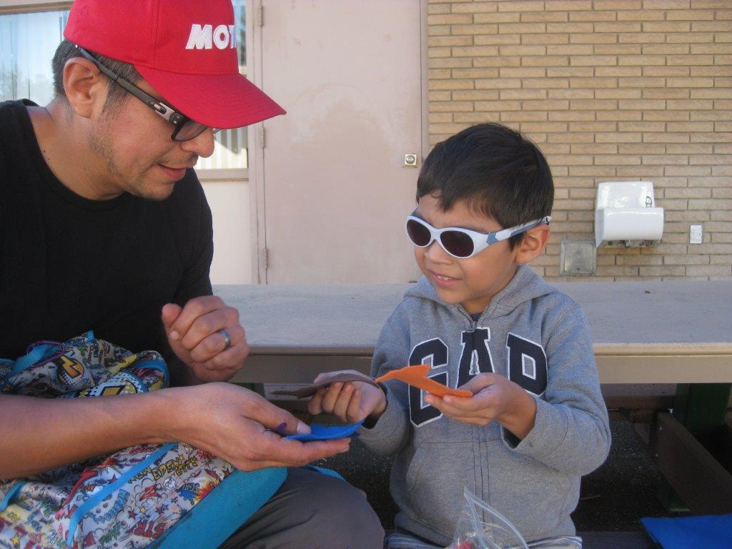
Early Literacy Kits

Slide 17
Family Craft Kits
Who – Aimed at kids aged 8+ and their families.
Where – All over! Housing and neighborhoods, not really schools.
Why – Craft programs are really popular, it would be great to have them to go.

Slide 18
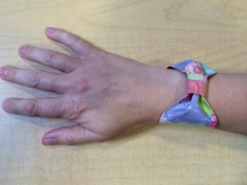
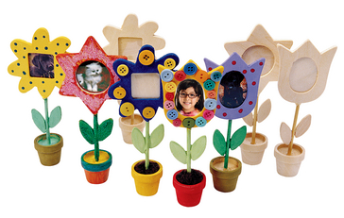
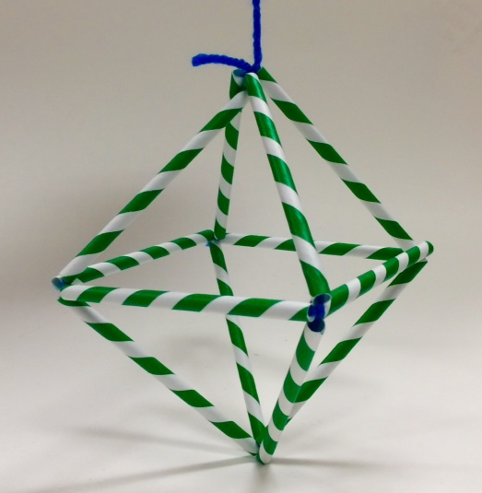
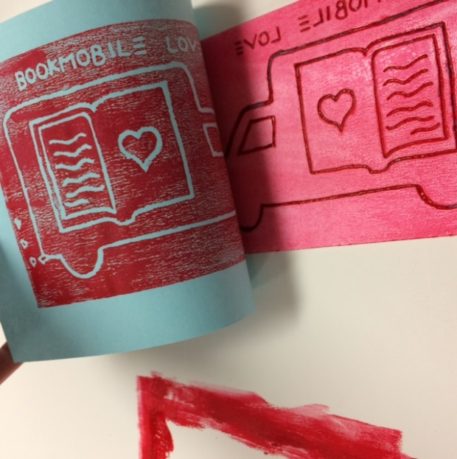
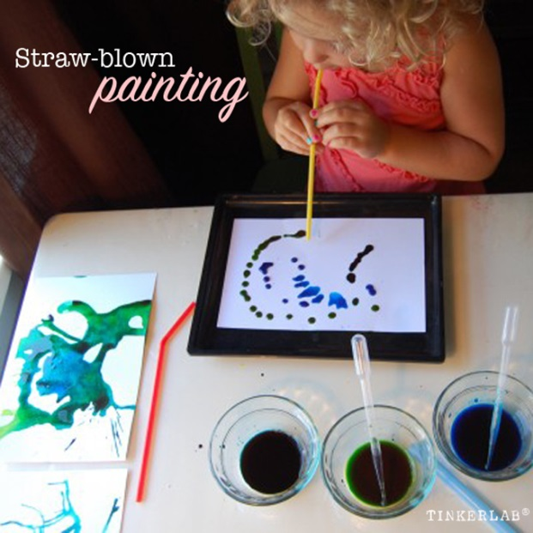
Family Craft Kits
What – 5 kits that can be borrowed. Patrons can make as much as they want and return the supplies like scissors, extra paint, etc.

Slide 19
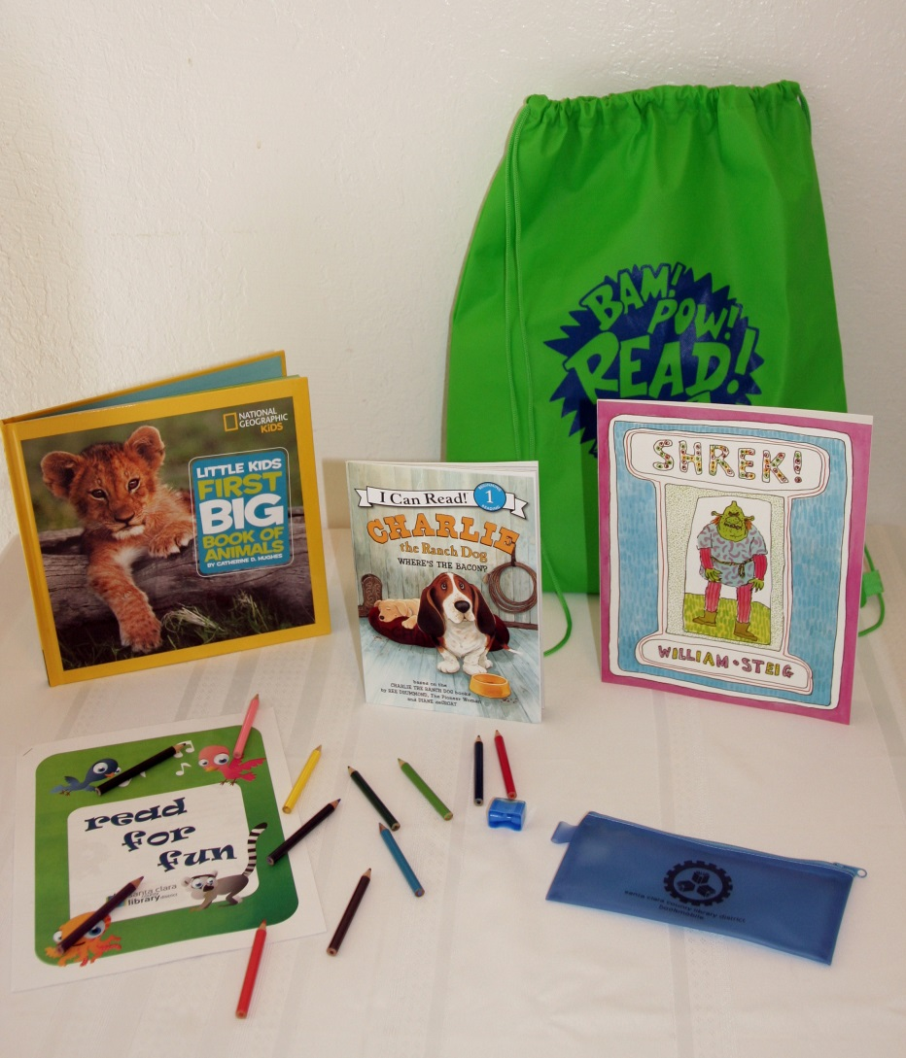
Read for Fun Backpacks
Who – For 1st and 2nd graders
Where – Elementary school in low income area.
What – Each 1st and 2nd grader received a backpack with 2 fiction books, 1 non-fiction book, a work book and a rainbow pencil.
Why – After talking with the teachers we thought this would help improve summer slide.

Slide 20
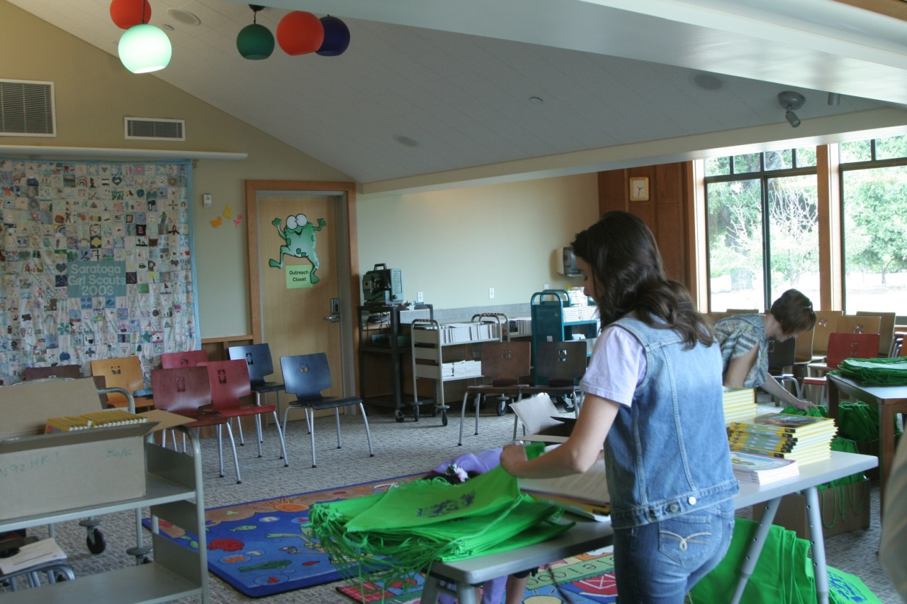
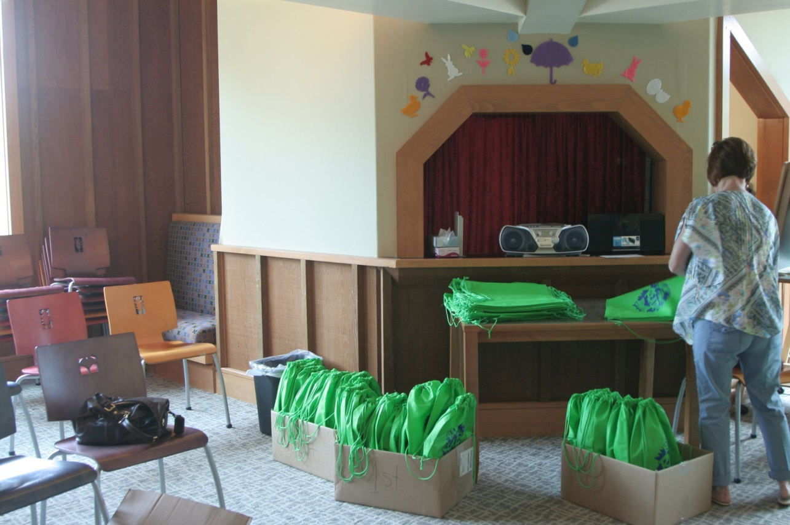
Read for Fun Backpacks

Slide 21
Read for Fun Backpacks
Even though literacy is a big push at school, several of our students do not have reading books at home, and many do not have the opportunity to go to the library. Providing the literacy packs gives them access to reading material during the summer break. For many of them, the literacy packs are the beginning of their own book collections.

Slide 22
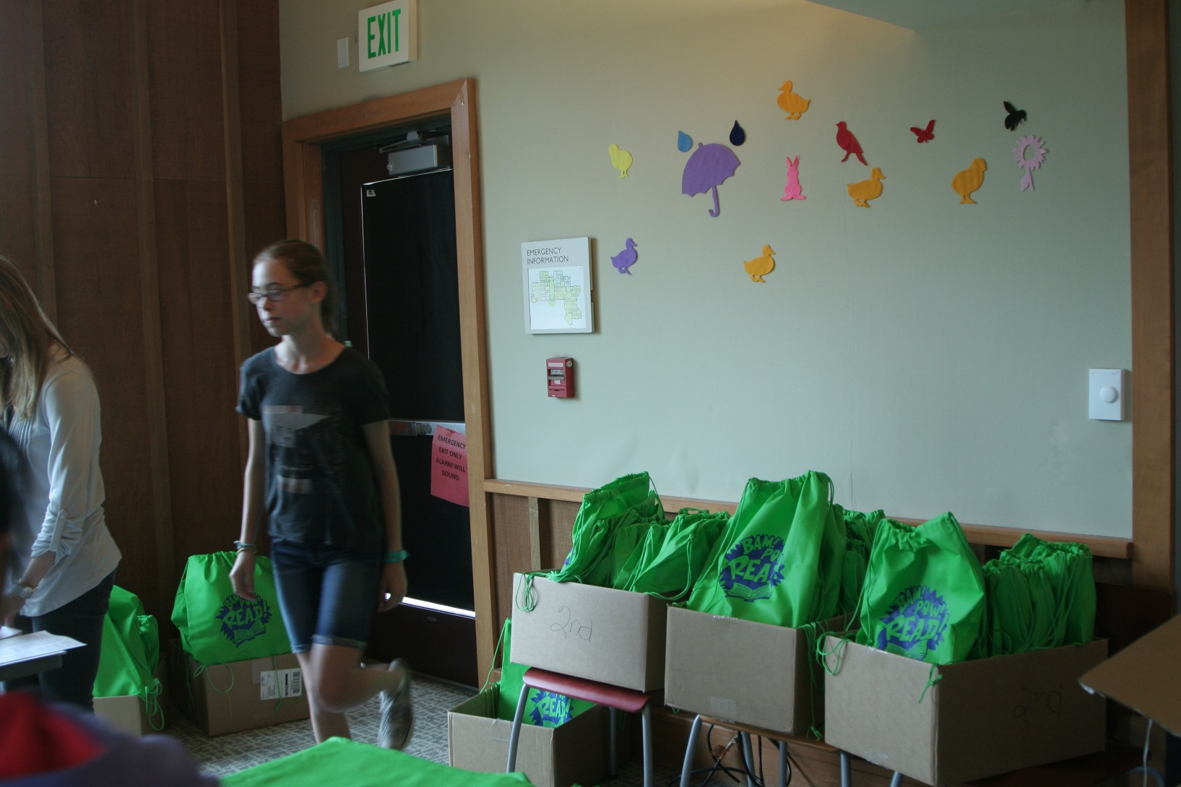
Read for Fun Backpacks

Slide 23
Funding
We received funding through the Cupertino Friends of the Library and the Saratoga Friends of the Library.
Mini Maker Faire $25
Family Craft Kits $472
Early Literacy Kits $2617
Read for Fun Backpacks $3443

Slide 24
How do you sell your idea?
Write a business plan
What can you do with nothing (you know: $$$ and staff)
How does your project support your mission statement/goals?
Keep statistics
Find support – partnership organizations, people with money, charity, volunteers, coworkers, managers etc.

Slide 25
What I Learned
Make sure you have the time.
Make sure you have the staff.
Accept that things may take longer to put together than you like.
Keep really good data.

