Slide 1
1 Book
2 books
Old books new Books
The tale of Books For Bedtime

Slide 2
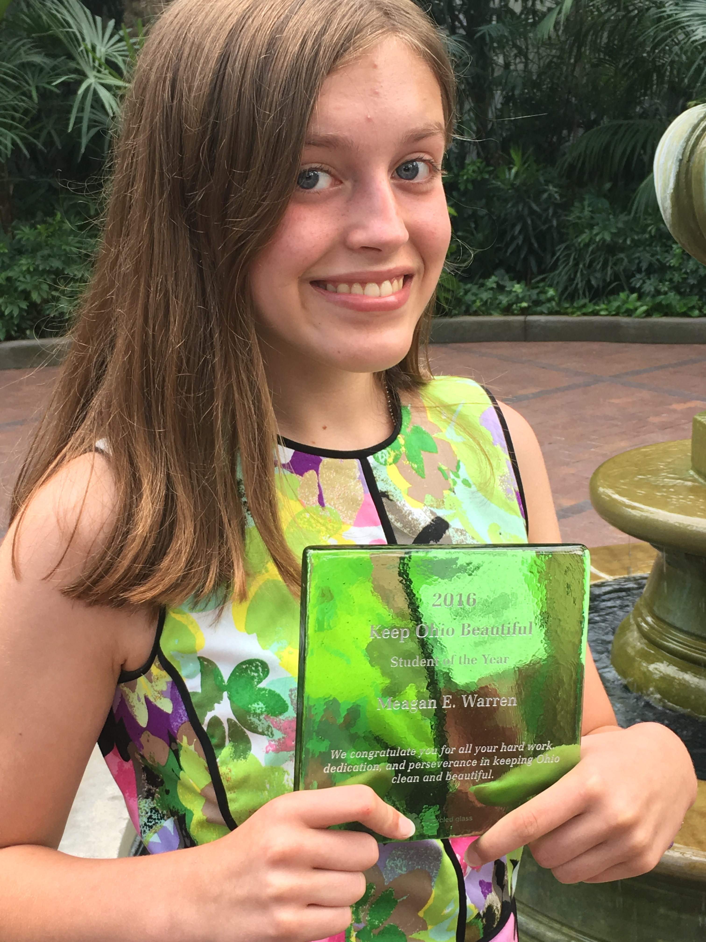
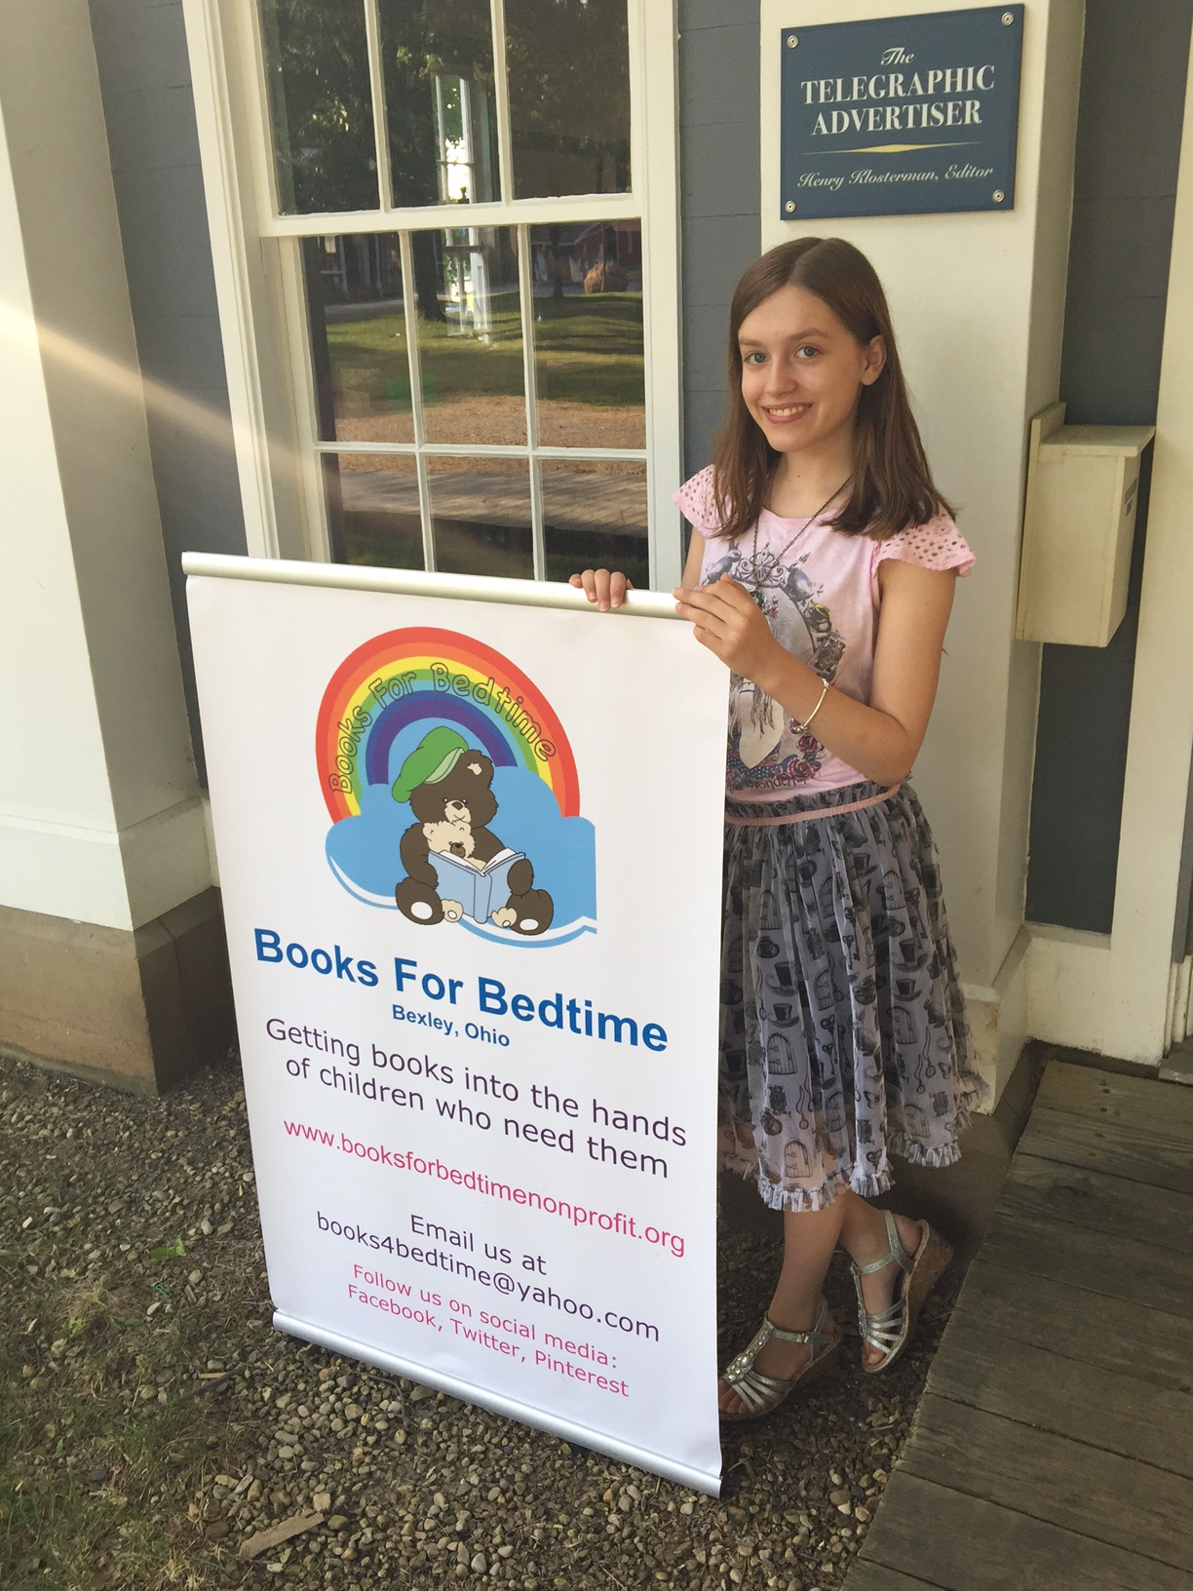
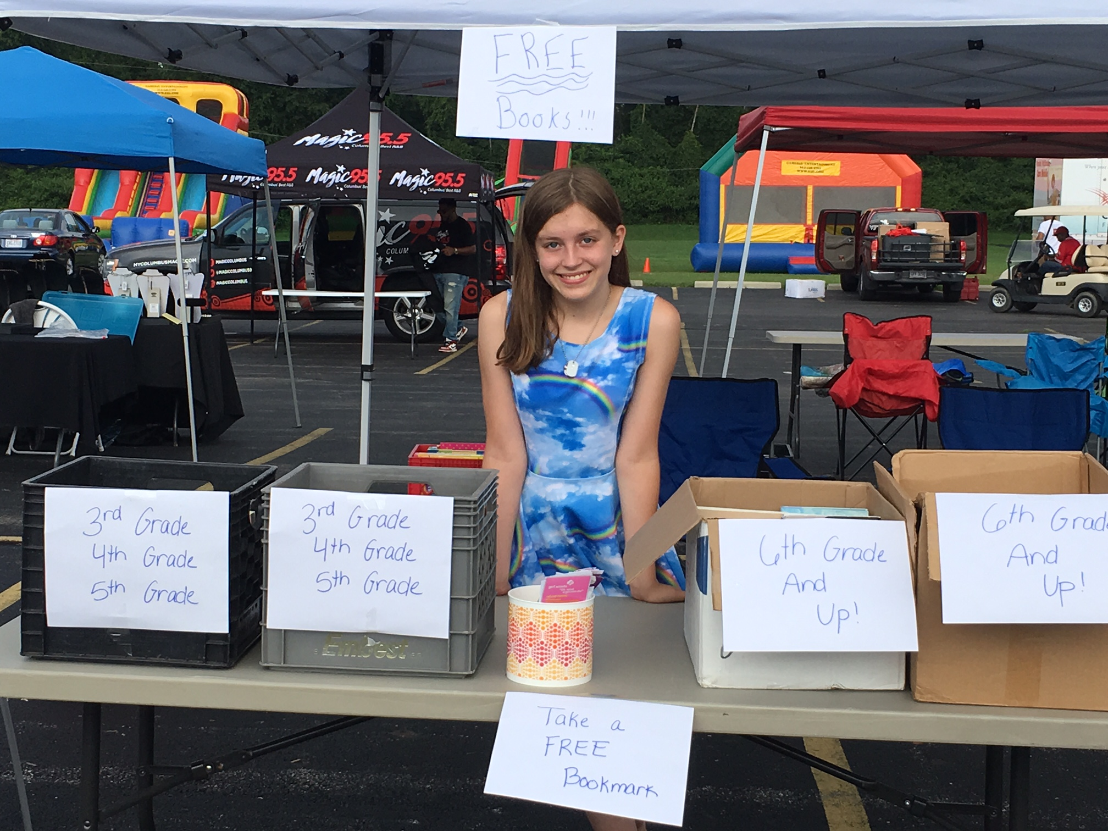
Who?

Slide 3
Facebook Stories Video!
https://www.facebook.com/FacebookStoriesEnglish/videos/1229959153709660

Slide 4
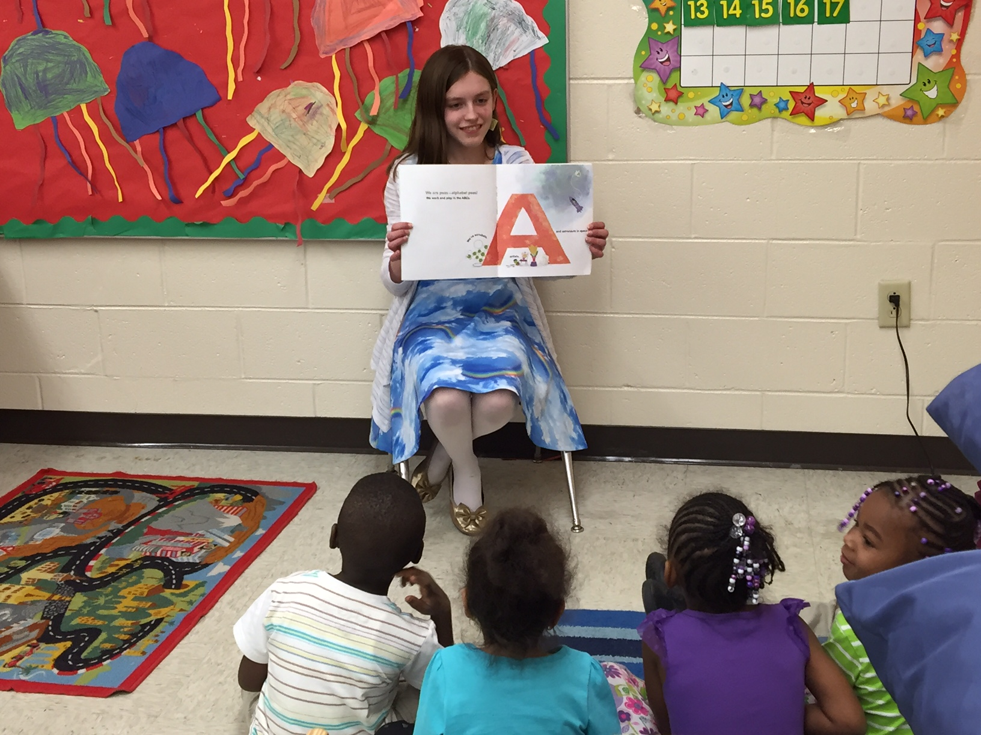
What?
Books For Bedtime!!
501(C)3
Encouraging literacy
Public speaking
Around 23,000 books
At 58 different locations

Slide 5
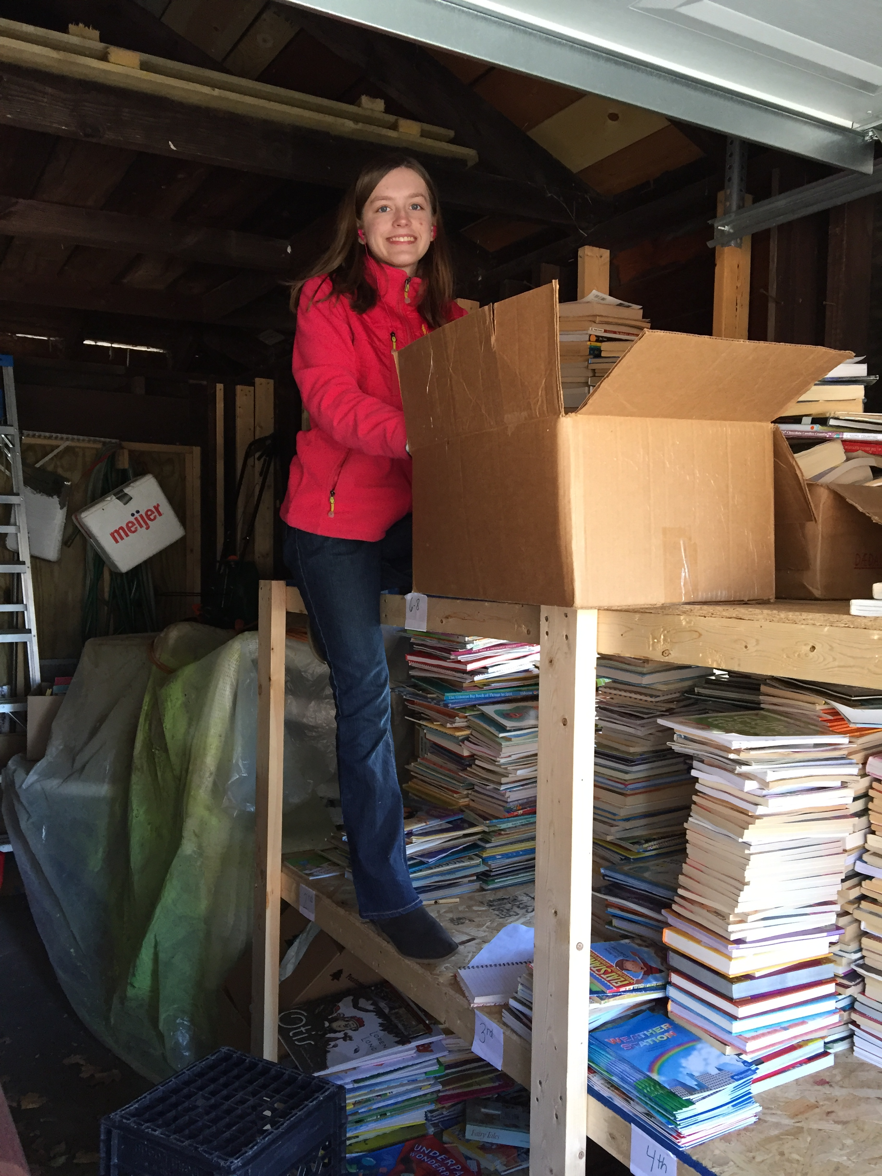
When?
Founded: August 20, 2014
501(C)3: May 2015
All year long!
School hours, weekends, evenings

Slide 6
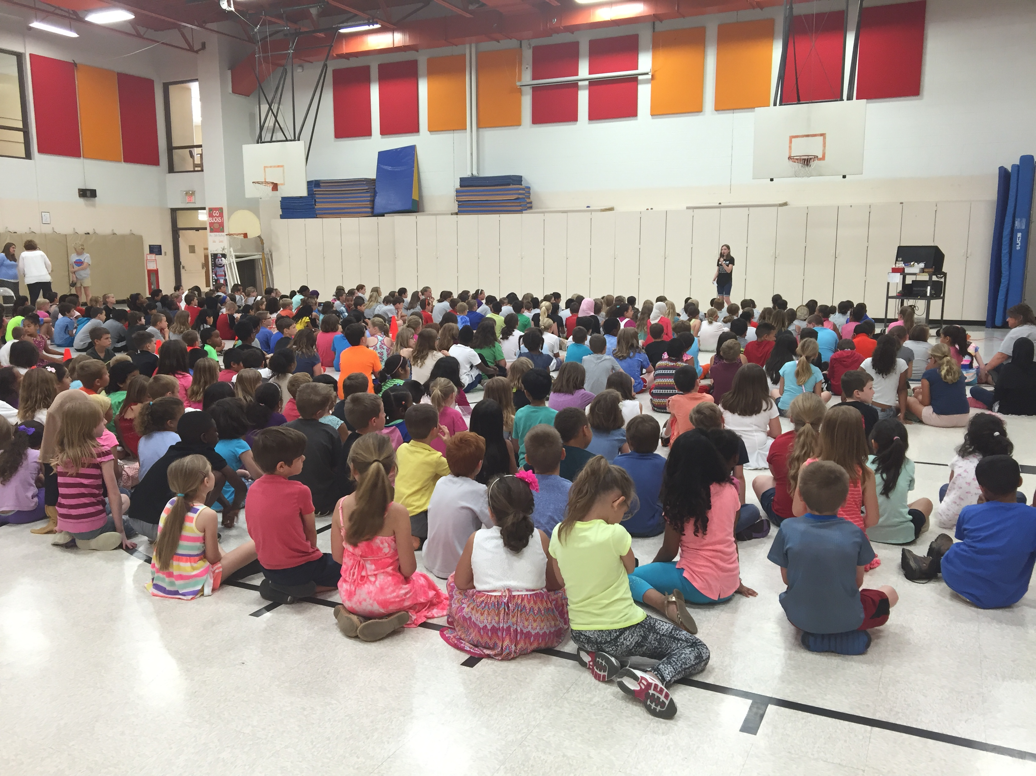
Where?
Central Ohio and beyond!
Schools, homeless shelters, food pantries, new immigrant organizations, and more!

Slide 7
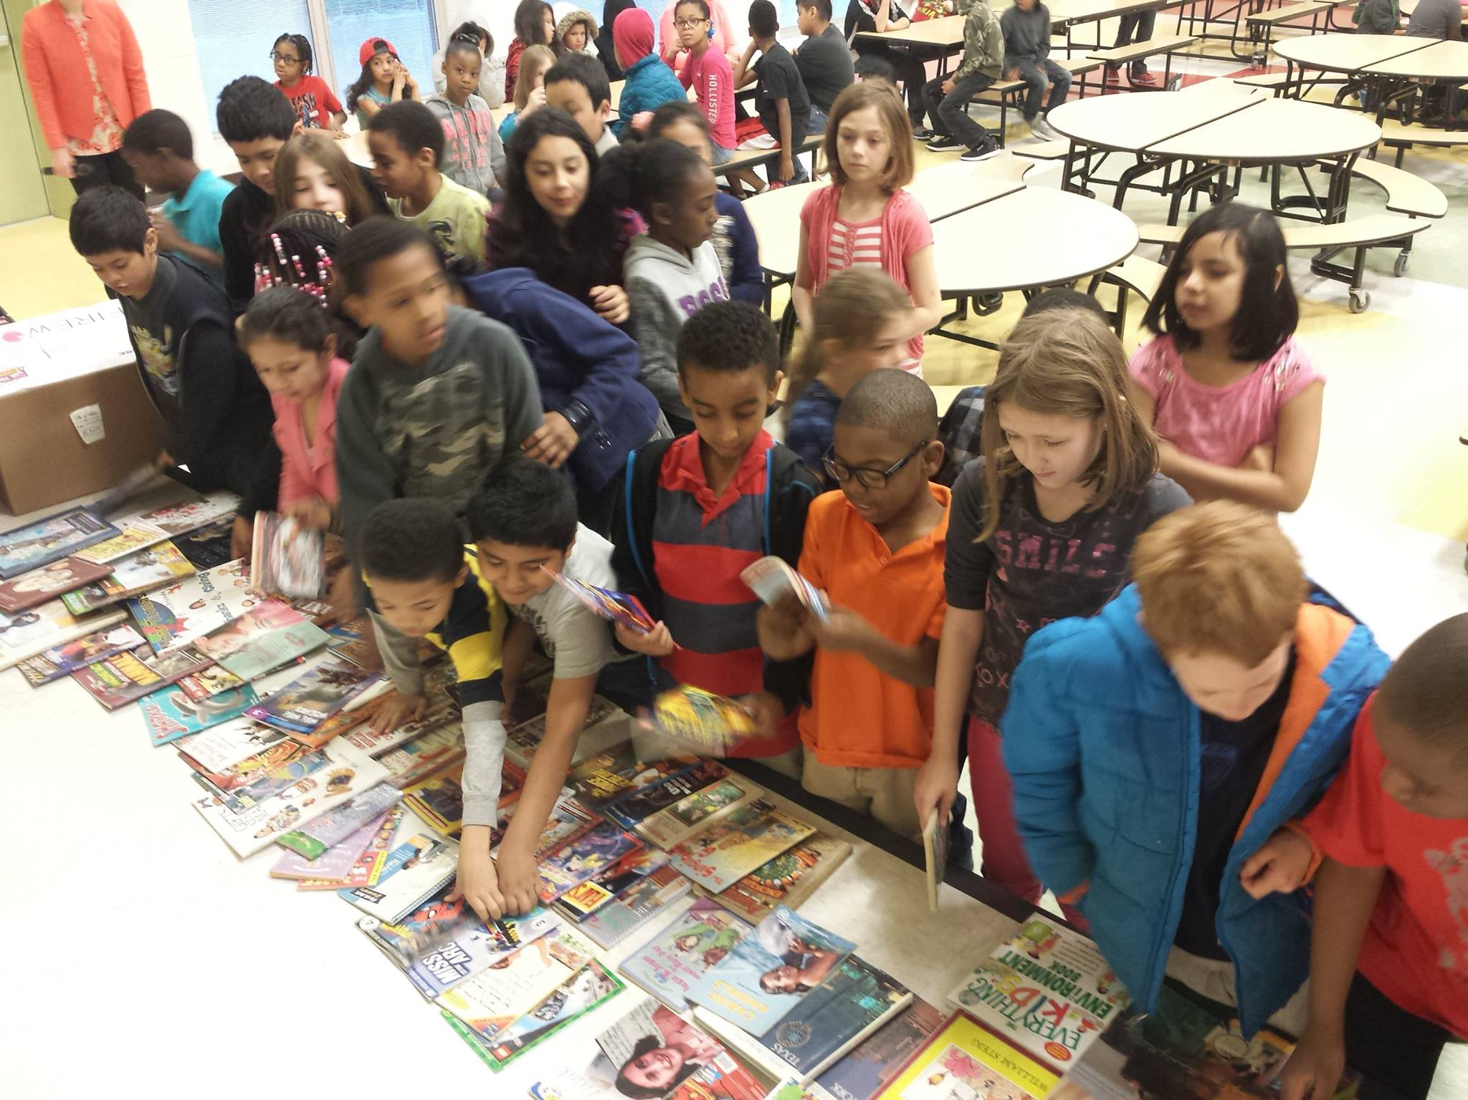
How?
With the support of individuals and organizations!
Word of mouth
Social media
Grants and donations

Slide 8
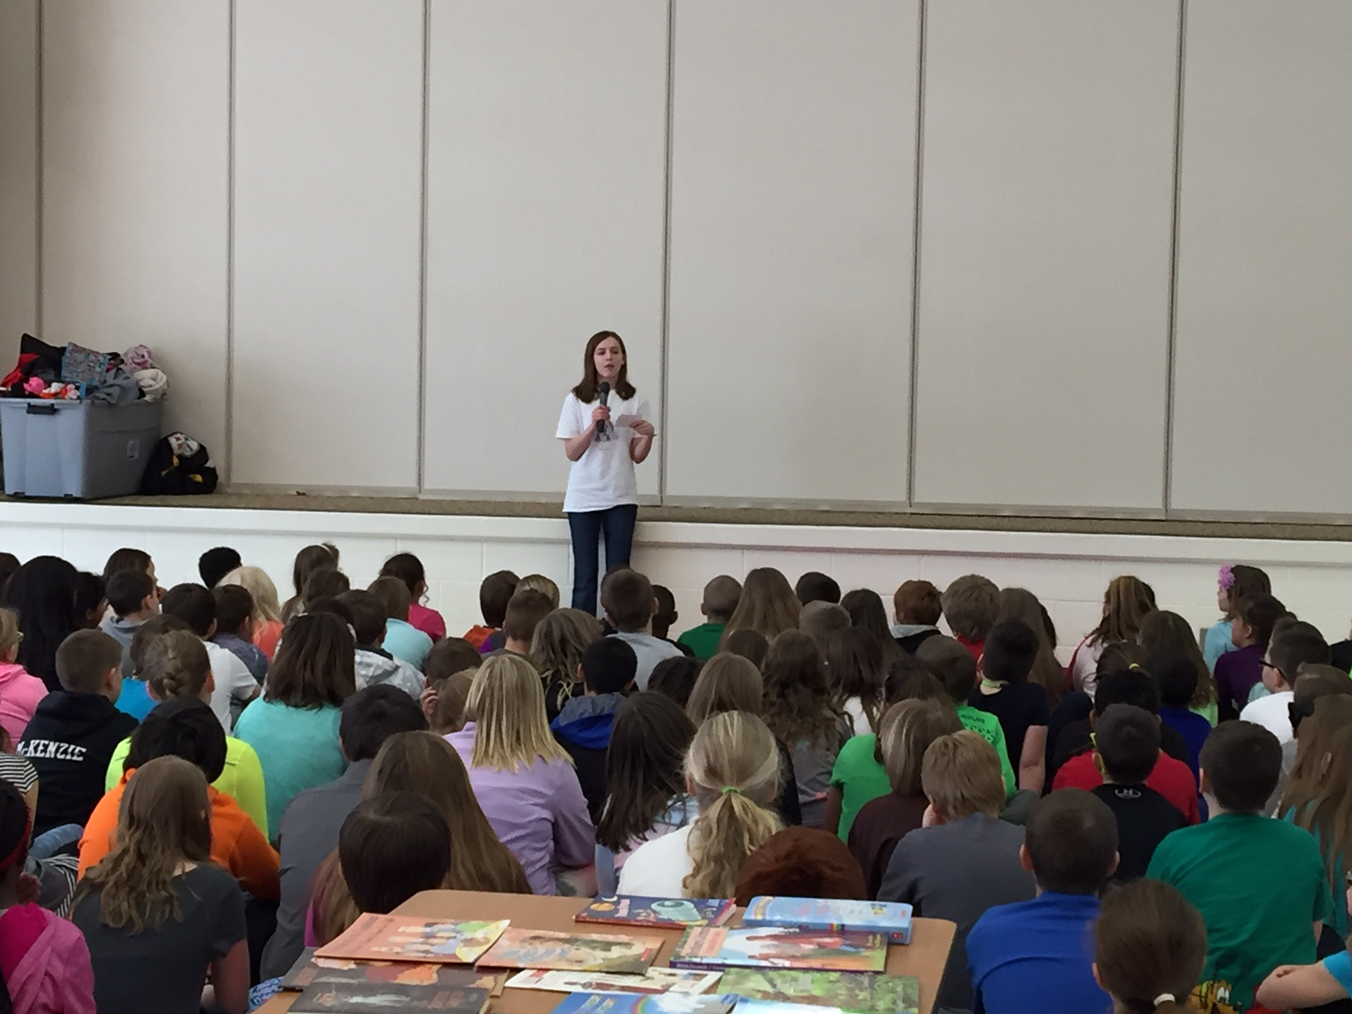
Why?
Love books!
Help those who don’t have books get them
Spread literacy

Slide 9
Contact Us!!
Facebook: Books For Bedtime Nonprofit
Twitter: @book4bedtime
Email: books4bedtime@yahoo.com
Website: Www.booksforbedtimenonprofit.org

