Slide 1
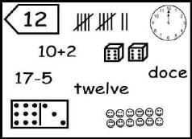
Name Collection Boxes
Standard 2.1: Numbers, Number Systems and Number Relationships
C. Represent equivalent forms of the same number through the use of concrete
Objects, drawings, words names and symbols to 100.

Slide 2
What are they??
a box-like diagram containing a number, used for collecting equivalent names for a number.
A name collection box is a math activity in which the student must find different ways to write the number in the corner of the box. For example, if the number is five, a student may use five tally marks, a nickle, a pentagon, five pennies, 2+3, 4+1, 11-6, and so on.

Slide 3
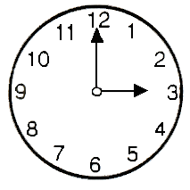
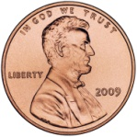
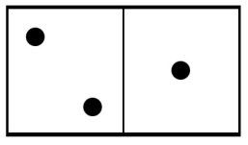
How can a 3 be represented?
5-2
3
tres
3+0
XXX
lll
1+3
Name Collection Box
Notes:
Children use name-collection boxes to develop the idea that there are many equivalent names for one number. Arithmetic, for the most part, involves replacing numbers or expressions with equivalent numbers or explanations. For example, we replace 5 + 7 with 12 or 1/2 with 1/4 + 1/4.
Because of this, it’s an important concept for children to understand.
All name-collection boxes features a label attached to a box with an open space for writing. The idea is to fill up the box with different names for the number on the label. Numbers can be named using operations, words in any language, tally marks, Roman numerals, and so one.
Here’s an example for the number 12. We can say 24 minus 12, a dozen, 6 times 2, etc.

Slide 4
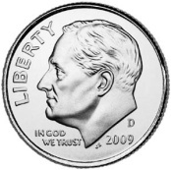

How can a 12 be represented?
12
15-3
a dozen
XXXX
XXXX
XXXX
12+0
llll llll ll
9+3
Name Collection Box
Notes:
Children use name-collection boxes to develop the idea that there are many equivalent names for one number. Arithmetic, for the most part, involves replacing numbers or expressions with equivalent numbers or explanations. For example, we replace 5 + 7 with 12 or 1/2 with 1/4 + 1/4.
Because of this, it’s an important concept for children to understand.
All name-collection boxes features a label attached to a box with an open space for writing. The idea is to fill up the box with different names for the number on the label. Numbers can be named using operations, words in any language, tally marks, Roman numerals, and so one.
Here’s an example for the number 12. We can say 24 minus 12, a dozen, 6 times 2, etc.

Slide 5
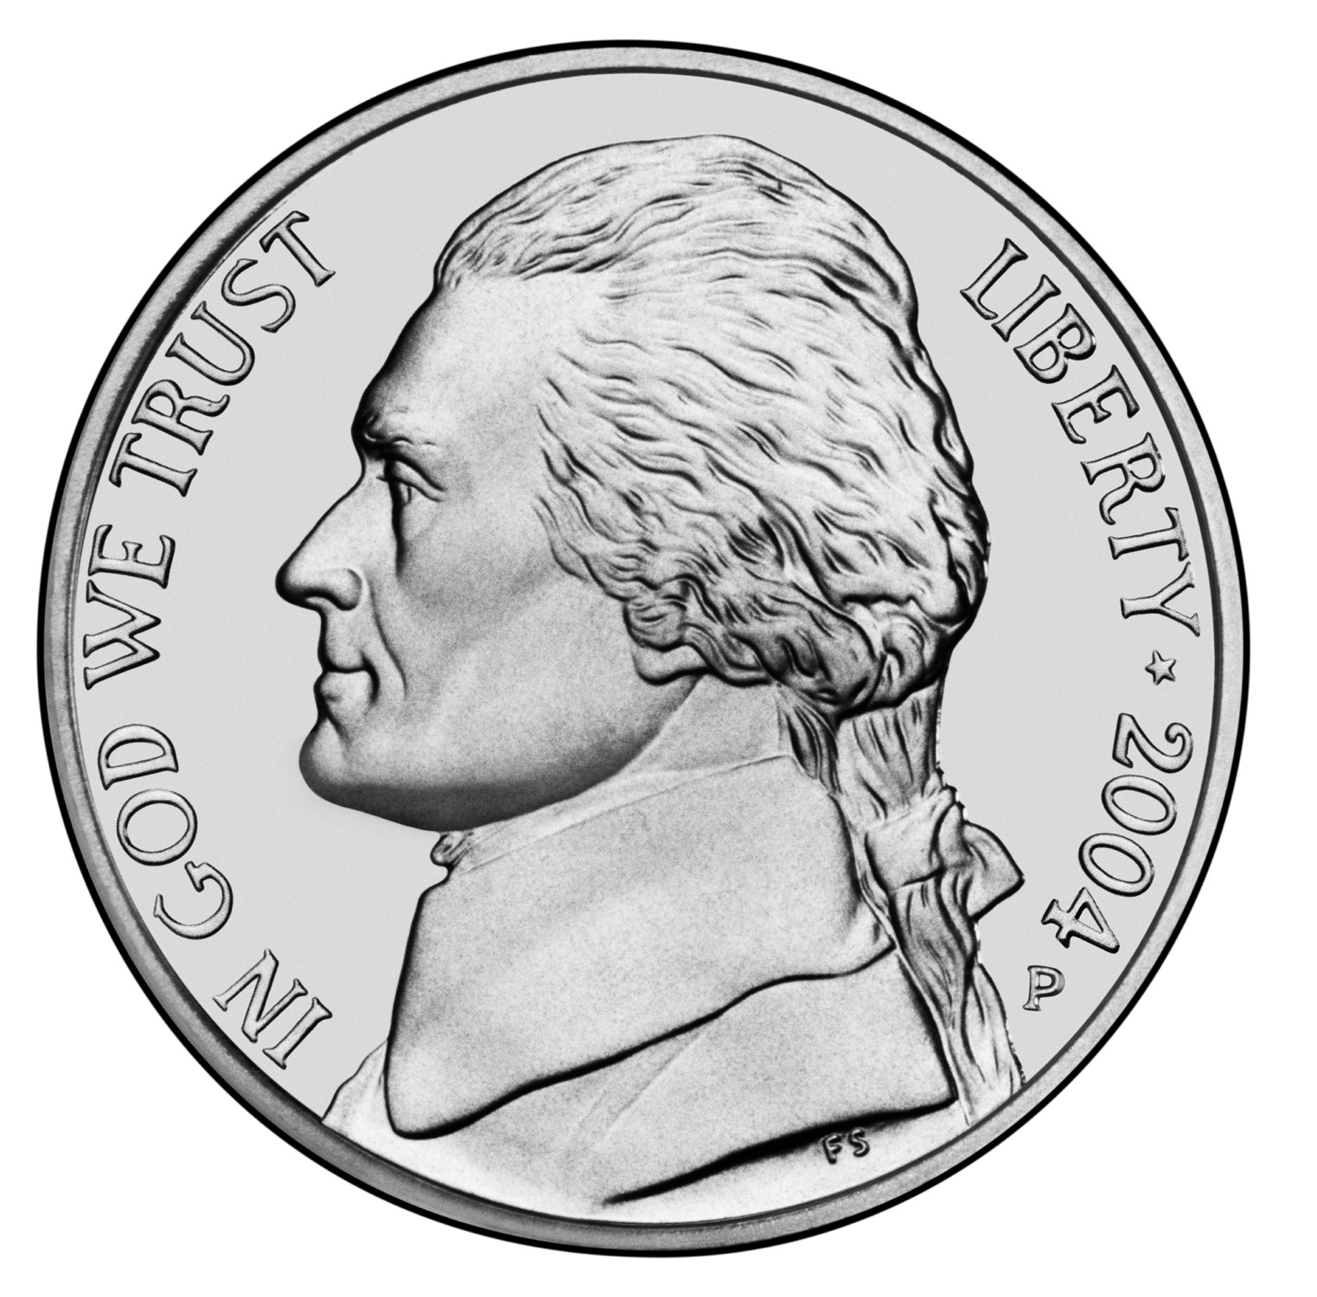

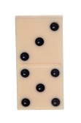
How can a 8 be represented?
8
11-3
ocho
XXXX
XXXX
8+0
llll lll
5+3
Name Collection Box
Notes:
Children use name-collection boxes to develop the idea that there are many equivalent names for one number. Arithmetic, for the most part, involves replacing numbers or expressions with equivalent numbers or explanations. For example, we replace 5 + 7 with 12 or 1/2 with 1/4 + 1/4.
Because of this, it’s an important concept for children to understand.
All name-collection boxes features a label attached to a box with an open space for writing. The idea is to fill up the box with different names for the number on the label. Numbers can be named using operations, words in any language, tally marks, Roman numerals, and so one.
Here’s an example for the number 12. We can say 24 minus 12, a dozen, 6 times 2, etc.

Slide 6
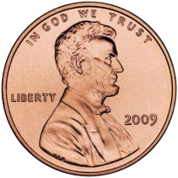

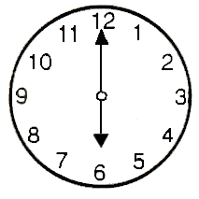
How can a 6 be represented?
6
9-3
a half dozen
llll l
6+0
XXXX
XX
3+3
Name Collection Box
Notes:
Children use name-collection boxes to develop the idea that there are many equivalent names for one number. Arithmetic, for the most part, involves replacing numbers or expressions with equivalent numbers or explanations. For example, we replace 5 + 7 with 12 or 1/2 with 1/4 + 1/4.
Because of this, it’s an important concept for children to understand.
All name-collection boxes features a label attached to a box with an open space for writing. The idea is to fill up the box with different names for the number on the label. Numbers can be named using operations, words in any language, tally marks, Roman numerals, and so one.
Here’s an example for the number 12. We can say 24 minus 12, a dozen, 6 times 2, etc.

Slide 7

How can a 1 be represented?
1
100-99
one
X
1+0
llll llll ll
9+3
Name Collection Box
Notes:
Children use name-collection boxes to develop the idea that there are many equivalent names for one number. Arithmetic, for the most part, involves replacing numbers or expressions with equivalent numbers or explanations. For example, we replace 5 + 7 with 12 or 1/2 with 1/4 + 1/4.
Because of this, it’s an important concept for children to understand.
All name-collection boxes features a label attached to a box with an open space for writing. The idea is to fill up the box with different names for the number on the label. Numbers can be named using operations, words in any language, tally marks, Roman numerals, and so one.
Here’s an example for the number 12. We can say 24 minus 12, a dozen, 6 times 2, etc.

Slide 8


How can a 5 be represented?
5
10-5
five
XXXX
X
3+2
4+1
llll
Name Collection Box
Notes:
Children use name-collection boxes to develop the idea that there are many equivalent names for one number. Arithmetic, for the most part, involves replacing numbers or expressions with equivalent numbers or explanations. For example, we replace 5 + 7 with 12 or 1/2 with 1/4 + 1/4.
Because of this, it’s an important concept for children to understand.
All name-collection boxes features a label attached to a box with an open space for writing. The idea is to fill up the box with different names for the number on the label. Numbers can be named using operations, words in any language, tally marks, Roman numerals, and so one.
Here’s an example for the number 12. We can say 24 minus 12, a dozen, 6 times 2, etc.

Slide 9

How can a 2 be represented?
2
11-9
dos
XX
5-3
ll
2+0
two
Name Collection Box
Notes:
Children use name-collection boxes to develop the idea that there are many equivalent names for one number. Arithmetic, for the most part, involves replacing numbers or expressions with equivalent numbers or explanations. For example, we replace 5 + 7 with 12 or 1/2 with 1/4 + 1/4.
Because of this, it’s an important concept for children to understand.
All name-collection boxes features a label attached to a box with an open space for writing. The idea is to fill up the box with different names for the number on the label. Numbers can be named using operations, words in any language, tally marks, Roman numerals, and so one.
Here’s an example for the number 12. We can say 24 minus 12, a dozen, 6 times 2, etc.

Slide 10


How can a 10 be represented?
10
10-0
diez
XXXX
XXXX
XX
5+5
llll llll
9+1
Name Collection Box
Notes:
Children use name-collection boxes to develop the idea that there are many equivalent names for one number. Arithmetic, for the most part, involves replacing numbers or expressions with equivalent numbers or explanations. For example, we replace 5 + 7 with 12 or 1/2 with 1/4 + 1/4.
Because of this, it’s an important concept for children to understand.
All name-collection boxes features a label attached to a box with an open space for writing. The idea is to fill up the box with different names for the number on the label. Numbers can be named using operations, words in any language, tally marks, Roman numerals, and so one.
Here’s an example for the number 12. We can say 24 minus 12, a dozen, 6 times 2, etc.

Slide 11
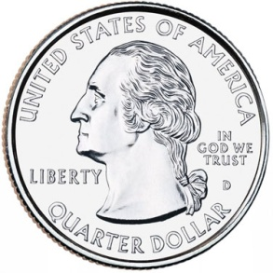
How can a 25 be represented?
25
25-0
Twenty- five
XXXXX
XXXXX
XXXXX XXXXX XXXXX
10+15
llll llll llll llll llll
Name Collection Box
Notes:
Children use name-collection boxes to develop the idea that there are many equivalent names for one number. Arithmetic, for the most part, involves replacing numbers or expressions with equivalent numbers or explanations. For example, we replace 5 + 7 with 12 or 1/2 with 1/4 + 1/4.
Because of this, it’s an important concept for children to understand.
All name-collection boxes features a label attached to a box with an open space for writing. The idea is to fill up the box with different names for the number on the label. Numbers can be named using operations, words in any language, tally marks, Roman numerals, and so one.
Here’s an example for the number 12. We can say 24 minus 12, a dozen, 6 times 2, etc.

