Slide 1

Medeco 4
High Security Key System
Overview and Playbook

Slide 2

Table of Contents
Overview
M4 Video
M4 Exploded View
Emerging Threats
What is the Moveable Element?
Revolutionary Movable Element
Movable Element in Action
Shuttle-pin Geometry
10-pin Cylinder, 10-cut Key
Unprecedented Master Keying Capability
Testing, Certifications and Patent
M4 BiLevel
Definitions and Terminology
Key Machine Parts and Pinning Components
Key Management Ecosystem
How it all Fits Together
Contact for more information
Resources

Slide 3
Medeco Overview
Medeco 4 (M4) is the latest key system from the name that built High Security.
With more security features than any key system we’ve ever made, and an innovative design that protects against the latest threats.
It’s a new day
in high security.

Slide 4






Medeco 4 Overview
Medeco 4 (M4) is the latest key system from the name that built High Security. With more security features than any key system we’ve ever made, and an innovative design that protects against the latest threats, it’s a new day in High Security.
Patented Key Control
Protects against unauthorized duplication of keys.
Protection Against 3D Printing
A patent-pending movable element in the key deters against unauthorized 3D printed copies of keys or blanks
Picking and Bumping Protection
Cylinder side pins, a shuttle lift pin, and a movable key element engage a sidebar that prevents the key from turning until the elements are rotated and aligned in the correct position, protecting against bumping, picking and other attacks.
Uses Existing Hardware
M4 cylinders are available in a wide variety of formats, retrofitting most hardware on the market.
Protection From Physical Attack
UL 437 listed and stand up to drilling, picking, and other forms of physical attack ANSI/BHMA
A156.30 certified.
Special Angled Cut Keys
A special key cutting machine and access to Medeco-specific blanks are required to duplicate M4 keys, which are available in multiple levels of restriction to support every need.
Master Keying Capabilities
M4 cylinders can be master keyed into a system that includes M4 and M4 BiLevel. Very large systems are possible.

Slide 5

Medeco 4 Video

Slide 6
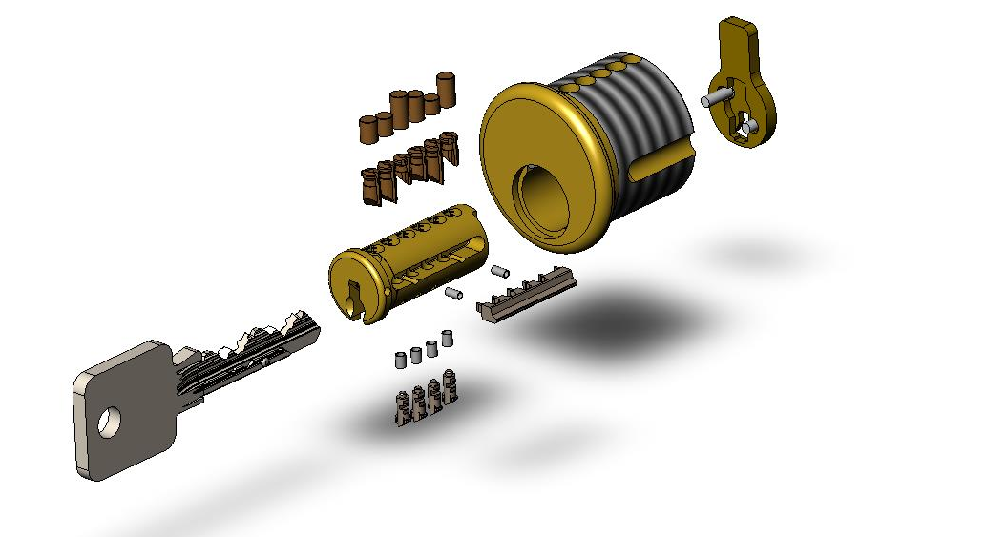
Medeco 4 Exploded View
Featuring New Cylinder Side Pins, Shuttle Lift Pin, Sidebar, and Key Movable Element
Shell
Driver Pins
Cam
Twisting Bottom Pins
(improved)
Plug
Primary blade cuts
(Same as M3 - angled offset cuts)
Multiple Drill Resistant Inserts
Double Locking Sidebar
Movable Element
Lift Pin
Finger Pins
Side Pins
Secondary Side Cuts
Components in bold are new for Medeco 4

Slide 7

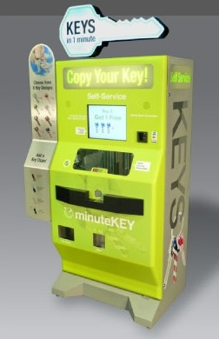
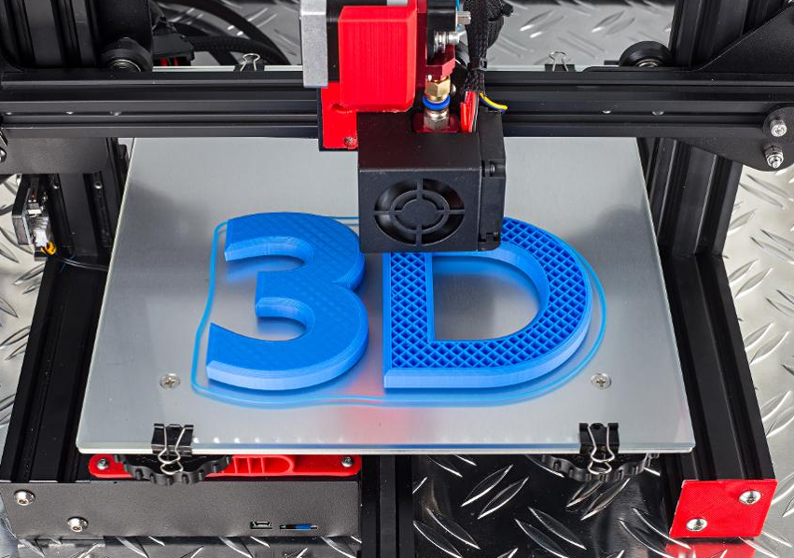
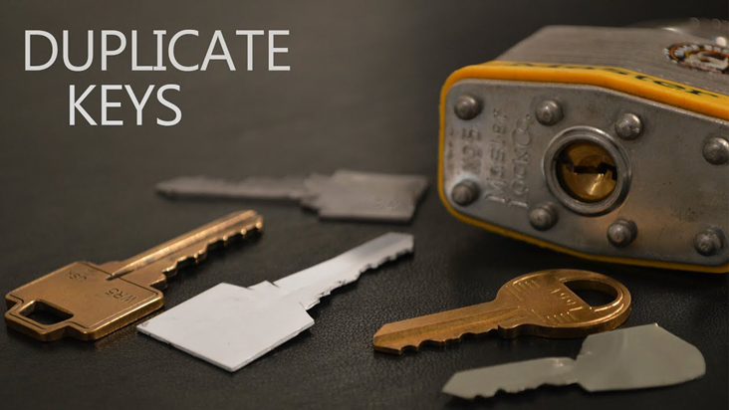
Prevent Key Duplication
Mobile apps enable keys to be 3D copied by scanning a photo of the key
3D Copying allows keys to be duplicated without authorization using photos or drawings
Convenience Kiosks make duplicates for anyone with a copy of the key
Conventional keys without angled cuts, movable elements or other deterrents can be easily printed

Slide 8
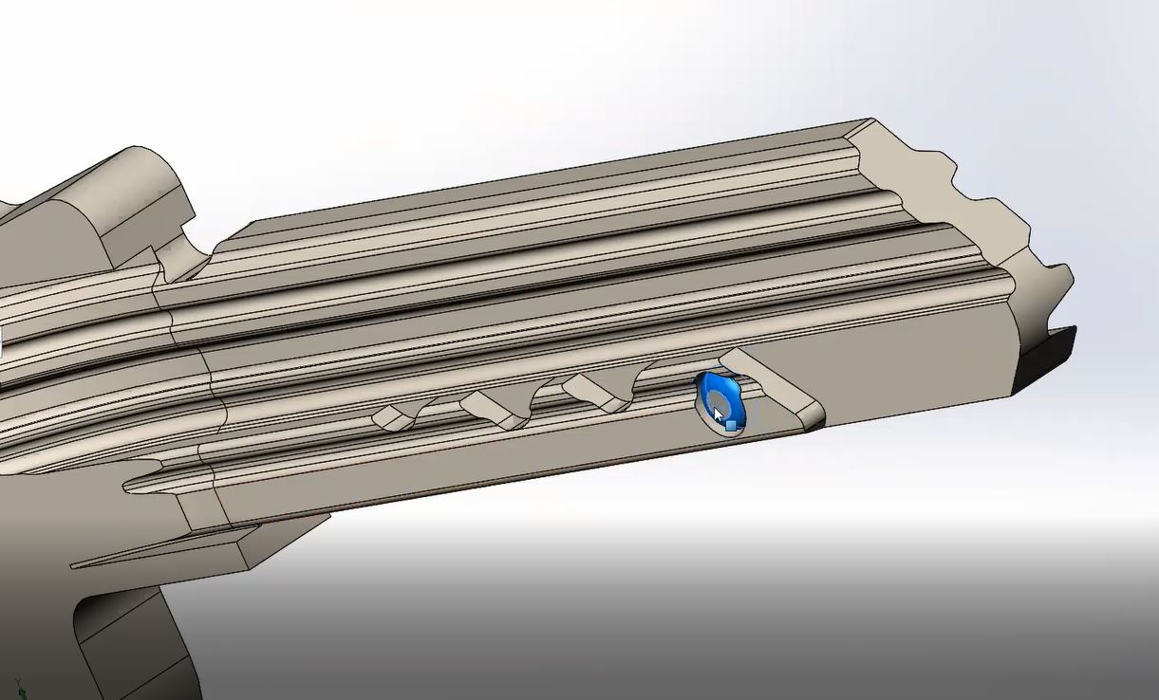
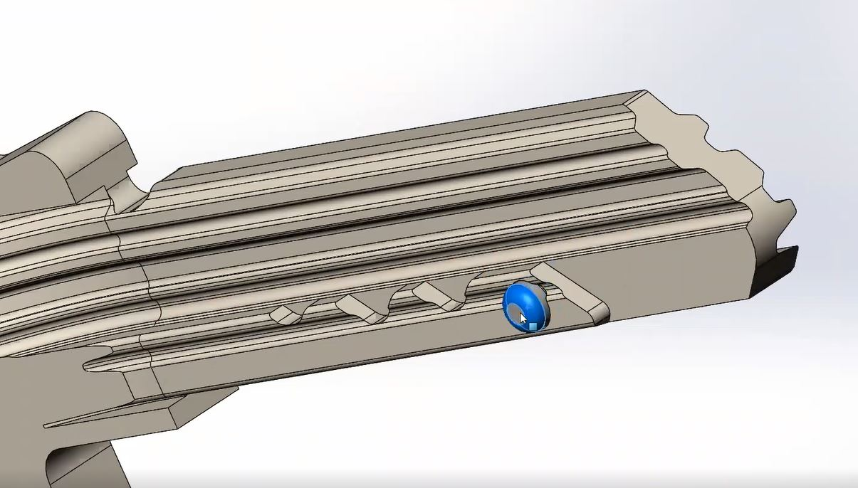
Medeco 4 Movable Element
MOVABLE ELEMENT IN
MOVABLE ELEMENT OUT
For Key Insertion
For Lift Pin Engagement

Slide 9
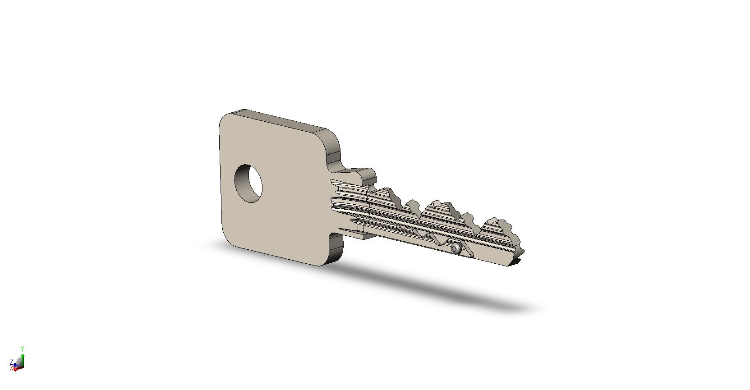
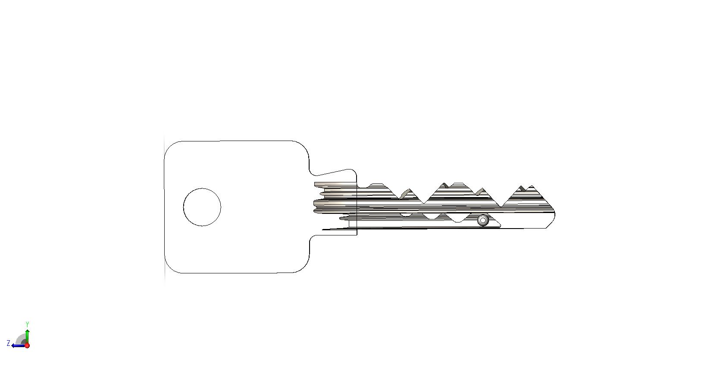
Medeco 4 Movable Element
  Movable element helps deter against 3D key copying
Primary cuts
Secondary cuts
Secondary bitting/side pins
in any of four positions.
Movable Element
Secondary bitting/side pin positioning has 3 depths.

Slide 10
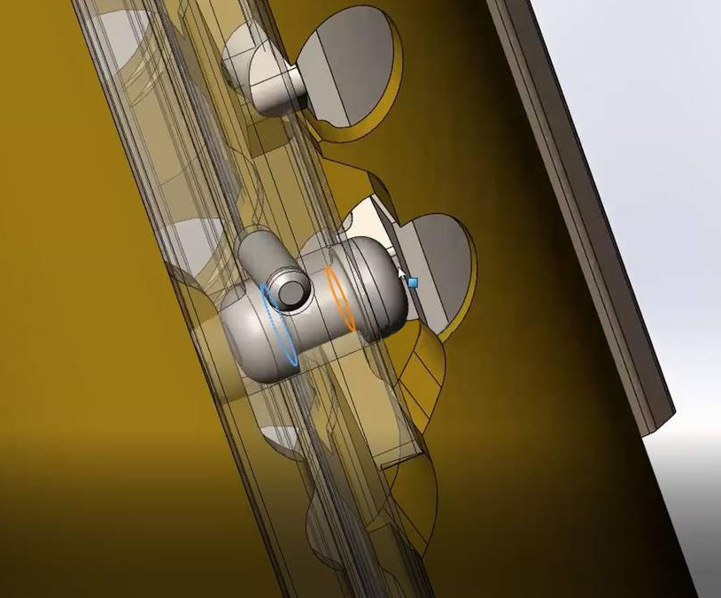
Movable Element Geometry
The movable element is made of 303 stainless steel
Permanently retained by a stainless-steel retention pin in the bottom of the key blade
Movable element is not field changeable

Slide 11
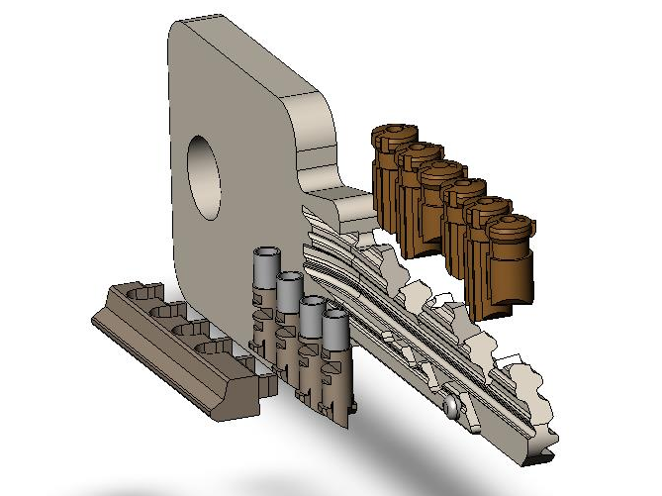
10-Pin Cylinder, 10-Cut Key
State-of-the-art, attack-resistant technology
Primary cuts
6 Biaxial-style split pin tumblers, twisting on angled, offset cuts on key blade
4 Side Pins consisting of 3 Finger Pins and 1 Lift Pin interacting with the Shuttle Pin (movable element)
Movable Element provides 3D key and blank copy protection
All 10 pins sidebar controlled for extreme attack resistance
Expanded master keying capability
Unique keyway Pre-cuts using side pins
Brand new patent protection to 2040.
Secondary cuts
Movable element

Slide 12
Unprecedented Master Keying Capability
2,000 times Greater than any ANSI/BHMA Grade 1 conventional lock!
Evolution of Medeco Master Keying
Biaxial
Medeco 3
Medeco 4
Original
Conventional Lock
4,096
Theoretical
Combinations-
2-Level System
15,625
Theoretical
Combinations-
2-Level System
1 Million
Theoretical
Combinations-
2-Level System
6 Million
Theoretical
Combinations-
2-Level System
9 Million
Theoretical Combinations -
2-Level System
50% Increase Over M3!

Slide 13

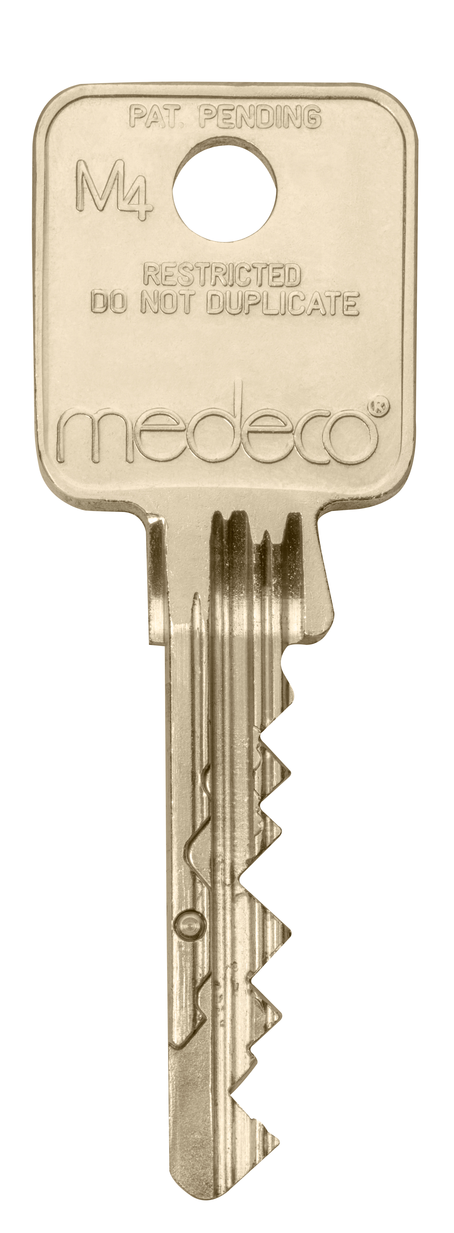
Testing, Certifications, and Patents
Durable & Reliable:
  Movable Element design in commercial use for over 8 years—proven durable and reliable
  Cycle-tested over 300k cycles (ANSI/BHMA Grade 1 requires only 40k!)
UL 437 for High Security Cylinders certified
Patent protection to 2040
ANSI/BHMA A156.30 and A156.5
International filings designated for protection around the world

Slide 14
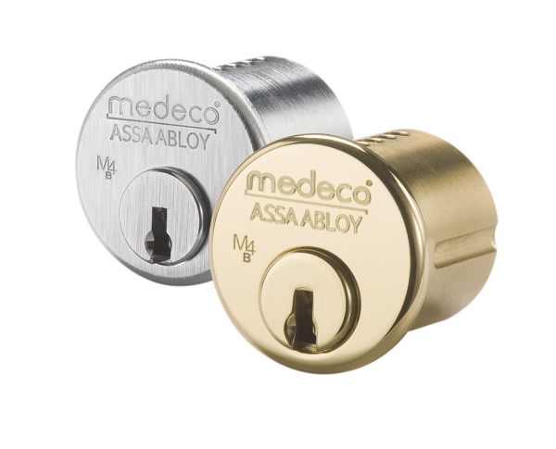
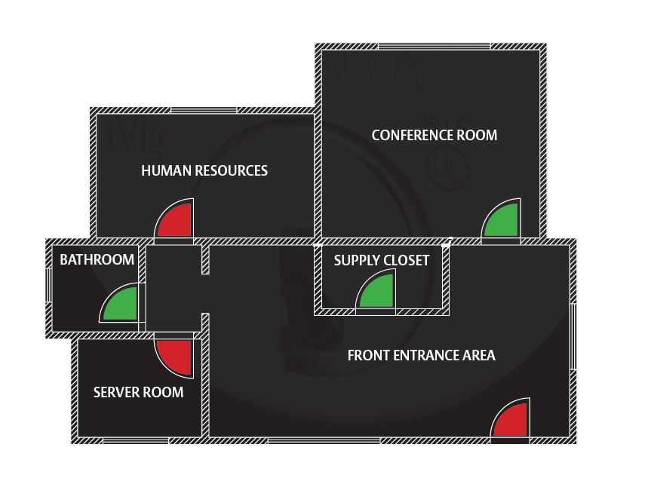
Medeco 4 BiLevel
Allows facilities to have a combination of high-security cylinders (M4) and cost-efficient cylinders (M4 BiLevel), all on the same key system
Ideal for any application requiring patented key control where physical high security is not necessary
Does not include enhanced UL 437 resistance, which ensures the customer is not paying for high-security features that may not be needed for certain openings
Entry-level key system that can be upgraded
to UL 437 cylinder later
M4
M4 BiLevel

Slide 15
Definitions and Terminologies
Profile = Keyway
Keyway = Cross-sectional opening in plug
Shuttle Pin = movable element in key
Side pin = Finger and/or Lift pins
Finger Pin = Side Combination pin
Lift Pin = Side Pin interacting with Shuttle Pin
Side code = Lift Pin location + Finger Pin cuts
Medeco 4 is the name, M4 is the abbreviation
Technology Codes
H – M4
P – M4 BiLevel
Pinning Codes
S – Sub-assembled - with side pins
N – Sub-assembled - No side pins
P – Pinned (includes side pins)
M – Master Pinned (blade pins only)
R – Master pinned (blade & side pins)
See catalog for complete ordering information

Slide 16
Key Machine Parts and Pinning Components
95-210100-MED4 Key Clamp Kit (new machines) – clamp, handle, quick-change pin
95-210130-MED4 Key Clamp Retrofit Kit – clamp, handle
TP-F57-X Side Combination Pins - #1, #2, #3 (pack of 10)
TP-F57-X Side Master Pins - #4, #5 (pack of 10)
TP-F57-0 Side Lift Pins - #0 (pack of 10)
CP-031560 Side Pin Springs (pack of 100)
CP-0845A0 Sidebar – 5 pin
CP-0846A0 Sidebar – 6 pin
KH5701* Side Pin Kit – 30 each side pins, 100 side springs
94-0323* Key Decoder Gauge
See catalog for current pricing information.
*Contact Medeco Customer Service for availability

Slide 17

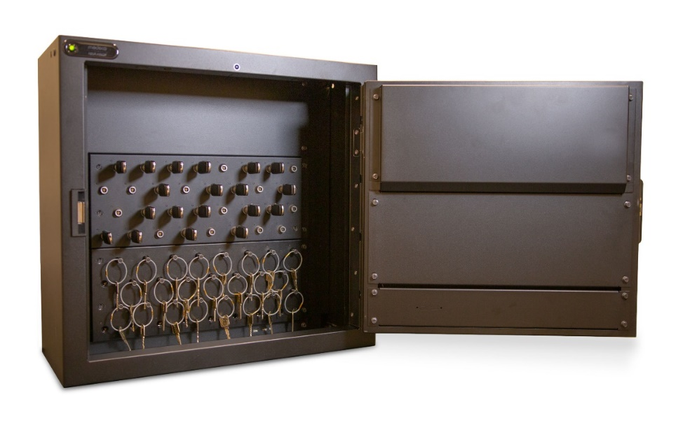

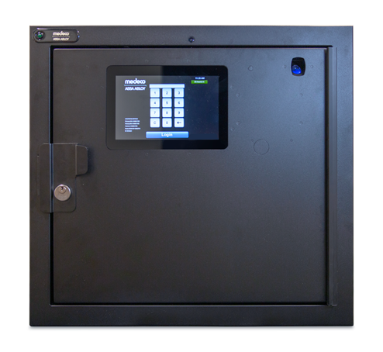
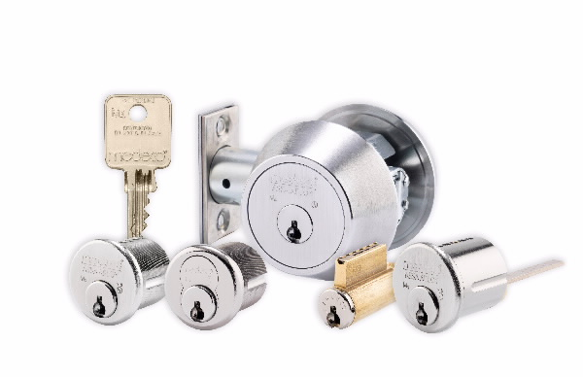
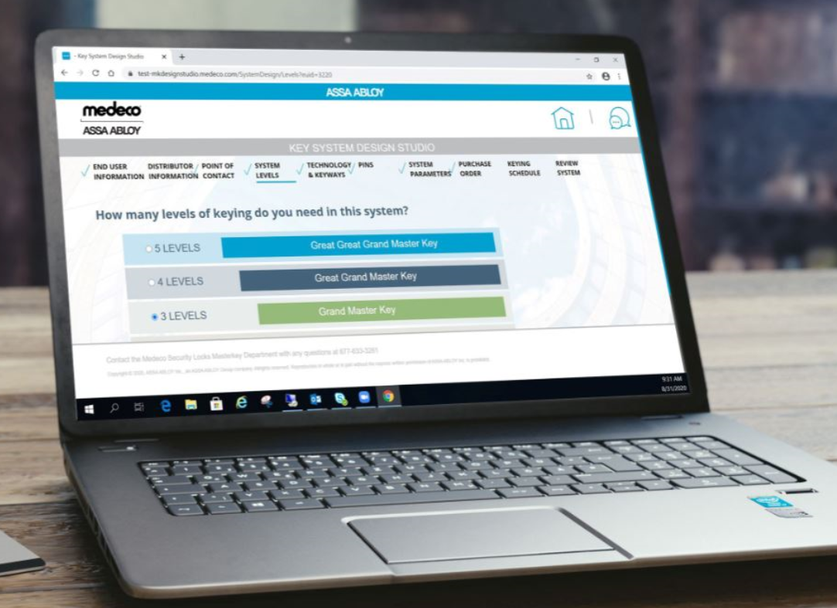
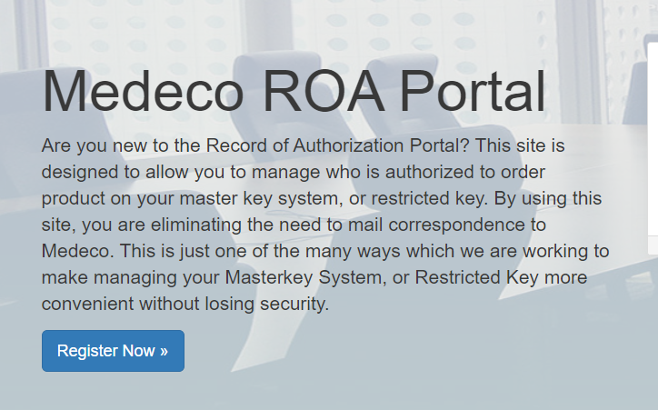
Key System Management
Medeco Redefines Key Control…Again!
Professional Services
Intelligent Key Cabinets
Medeco 4 ties into an ecosystem of digital key system management programs, tools, and services to eliminate complexity, simplify communications, and make true key control an achievable goal.
Key System Design Studio
Record of Authorization Portal
Register Now

Slide 18
How it All Fits Together
More Innovation
More Protection
Triple locking components
Interactive pins and elements
Redefines “High Security”
Digital tools and ecosystem to help design and manage systems
Patent (pending) protected to 2040 to control distribution and duplication of keys
Domestic and Int’l patents offer global protection
Advanced feature in key helps protect against 3D printer duplication
More Combinations
More Security
UL437 Listed
Enhanced pick resistance
State-of-the-art design protects from the most severe physical attacks
Advanced 10-pin configuration provides ultra-enhanced master key capability

Slide 19
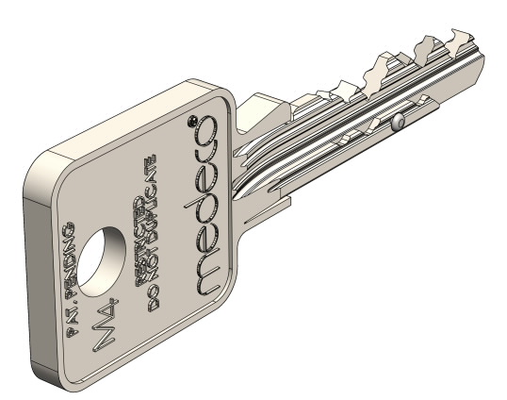
Frequently Asked Questions
What material are the keys made of?
Medeco only supplies cut keys and key blanks that are constructed of the highest quality nickel silver.
Is the M4 key system patented?
Yes - it is a highly restricted, utility patented keyway that is protected through 2040.
Have you had to defend your patent in court before?
Yes - Medeco has a strong history of enforcement with our patents. There are legal ramifications for any person who makes copies of our patented keyway without proper authorization.

Slide 20
Partners
Frequently Asked Questions
What happens when the patent on the M4 key system expires?
Even after patent expiration, Medeco 4 will still offer a high degree of protection/attack resistance and restricted key control.
Do you have a warranty of your keys?
Yes – Medeco offers a lifetime warranty on mechanical key blanks.
What kind of key machines are available?
A Biaxial or Medeco3 Biaxial key machine can be used for M4 with the addition of an M4 quick change vise jaw. Other commercially available key machines (such as ITL9700 and 9700A, HPC, Framon, Silca Futura Edge Plus, etc.) may also be available.

Slide 21

Certification Training
Certification Trainings are held
at the factory in Salem, Virginia.
The hands-on certification trainings include:
Disassembly and assembly of cylinders
Key decoding
Cylinder pinning
More
Click here to register!

Slide 22
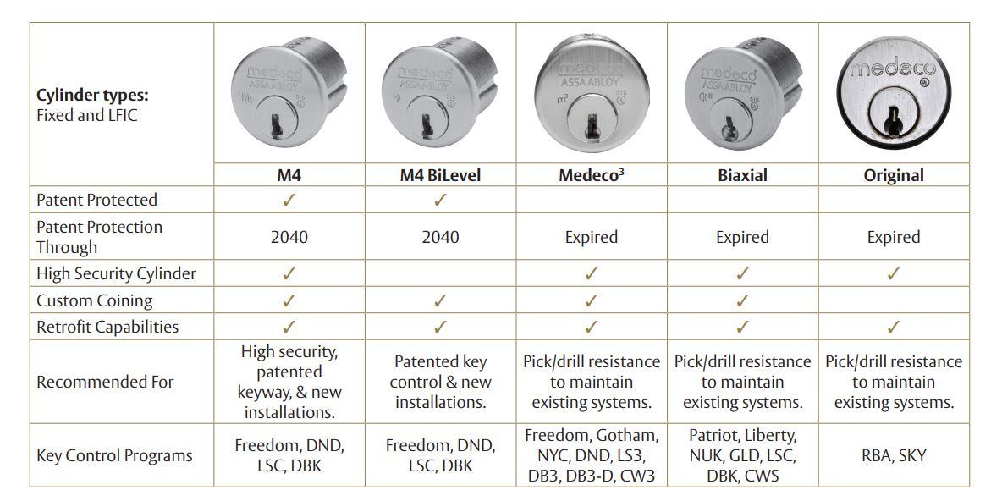
Technology Comparison

Slide 23
Why Medeco 4
Features | Benefits
M4 keyways are only sold through authorized Medeco dealers | Key Control – From the company that invented key control.
New strong utility patent | Protection against unauthorized duplication of keys through at least 2040
Expansive key system compatibility | Side cuts, moveable element in the key, and double cuts provide superior master keying capability as compared to conventional keyways
Nickel silver keys | Stronger keys – more resistant to key breakage
Key machine upgrade | Easy-to-install clamp allows for cutting of M4 keys
3D printing duplication protection | Moveable element in the key blade cannot be replicated with 3D scan/print

Slide 24
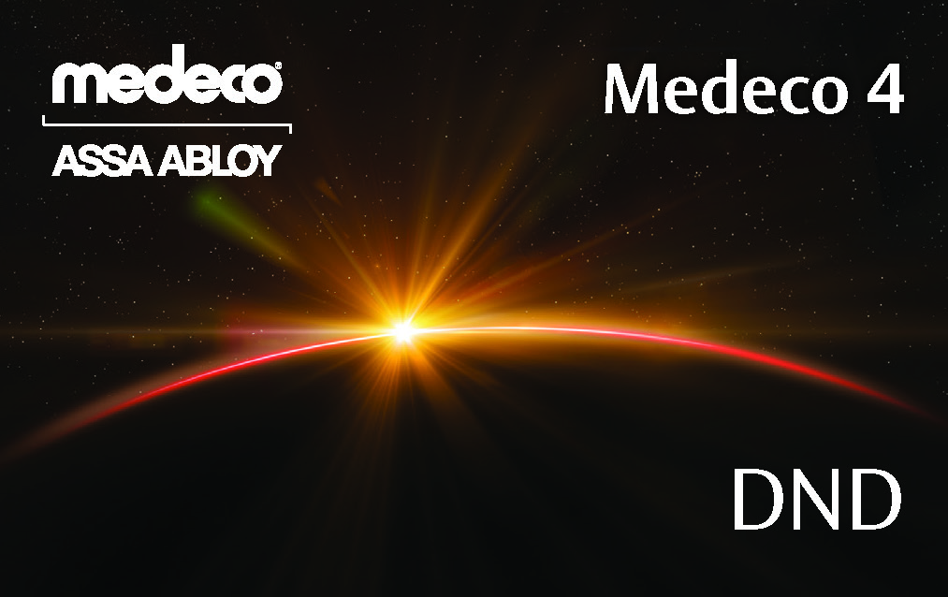
Key Control Programs
Dealer/Service Center
  This program offers instant local access to additional keys with protection from unauthorized copying. Consumers simply return to the security provider from which they purchased the locks. The security professional will have key records on file locally and referencing the owner or authorized users of the key system.
Carded Programs
  Authorized individuals are issued a card with embossed control data and a space for their signature. To obtain key duplicates, card holders present the card to any participating Medeco security professional. The data and signature will be verified and a key can then be issued. A card program is ideal for residences or businesses that need keys available nationwide.
Wholesale/Distributor Programs
  Authorized individuals are issued a card with embossed control data and a space for their signature. To obtain key duplicates, card holders present the card to any participating Medeco security professional. The data and signature will be verified, an order form is sent to an authorized distributor, and a key is issued by the distributor.
Factory Restricted Program
  Additional cut keys are only available from the Medeco factory and only with the proper signature.

Slide 25
Key Control Programs
More Innovation
The technology built into M4, including the movable key element, and side and lift pins in the cylinder, stretch the boundaries of features that can be built into a lock and key system.
More Protection
Cylinder side pins and a lift pin which engage the sidebar prevent the key from turning until the elements are aligned in the correct position, protecting against bumping and picking.
Patent-pending movable element in the key deters against 3D printed copies of keys.
More Combinations
Secondary side-pin bittings provide expanded master keying capabilities.
M4 cylinders can be master keyed into a system that includes M4, M4 BiLevel and M4 CLIQ keys and cylinders.
More Security
Patent-pending key control protects against unauthorized duplication of keys.
Medeco specific key blanks and key cutting machine are required to duplicate M4 keys, which are available in multiple levels of restriction to support every need.

Slide 26
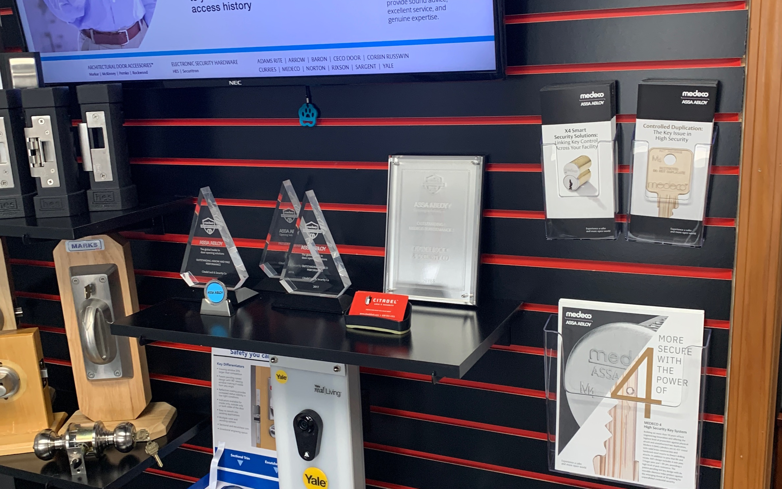
Dealer/Service Center Benefits
Dealer can obtain factory certification and training on system setup, installation, and ongoing support:
  Master keyed system design
  Pinning cylinders
  Cutting keys
  Ongoing system services
High security platform that’s factory controlled and limited in the marketplace:
  Medeco restricted dealer keyway programs offer security professionals a restricted key section to deploy systems for multiple customers in their local markets
  Custom coining program offers security professionals a “business card” on every key blank
  Gives customers a direct way to find and contact your business
  Recurring revenue opportunity as cylinders and keys are deployed on the dealers’ restricted keyway
Recognized on Medeco’s website as a certified program dealer
M4 offers extensive master key capability for any customer size
Quick turn opportunity to capture the sale immediately by investing in inventory that can be pinned, keyed, and deployed same day

Slide 27
Distributor/Wholesale Benefits
Stock, deploy and service systems to dealers and/or end users seeking a trained professional to provide key system management
  Customers invest in a restricted distributor/wholesaler keyway program
  Custom coining program offers distributors/wholesalers a “business card” on every key blank ordered
  Gives customers a direct way to find and contact your business
  Recurring revenue opportunity as cylinders and keys are deployed on the distributor/wholesaler restricted keyway
Provide restricted product to customers nationwide
Unmatched Master key system flexibility -suitable for system of any size
Quick turn opportunity to capture the sale immediately by investing in inventory that can be pinned, keyed, and deployed same day

Slide 28
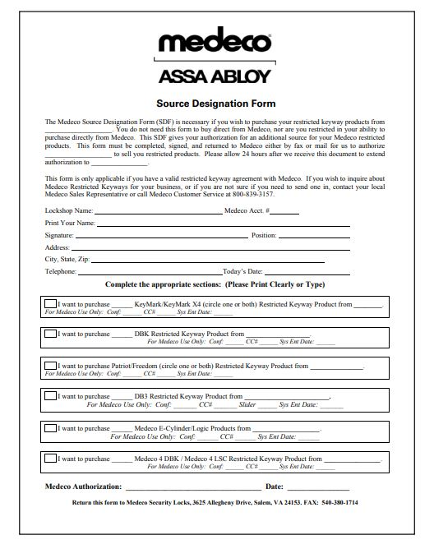
Source Designation Form
Medeco³ Key Control Programs – Channel Partners
Source Designation Form
Medeco is proud to provide our dealer/distributor channel partners with multiple sources for procuring our products.
We’ve partnered with the leading Wholesale Distributors to carry select dealer/distributor cylinders on the shelf to provide quick, easy, and efficient supply of our product lines.
As part of our commitment to key control, Medeco requires a Source Designation Form (SDF) to be completed if you wish to purchase your restricted keyway products from our Wholesale Distribution Partners.
  Individual SDF’s are required for each wholesaler you wish to purchase from
  SDF’s offer the ability to purchase any or most of your restricted keyway products from a Regional or National Wholesale Partner
To take advantage of the inventory carried on the shelves from these wholesalers, please contact your wholesaler of choice or Medeco to obtain your source designation form.

Slide 29
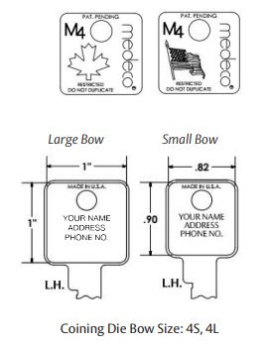
LSC Program Details
Features/Benefits
Patented key control and millions of
keying combinations. (50% more keying
combinations than Medeco 3).
Allows dealer to manage and maintain key systems for customers
Utilizes a restricted key control agreement to ensure product is only available to contracted dealers.
Key duplication is restricted to the original LSC locksmith dealer partner who provided the system to the end user
ALOA coining available for ALOA members
Dealer can order direct or through distribution
Requirements
Buy-In: $20,000 NET, plus key machine. No annual purchase agreement
Coining die (if coining die doesn’t exist)
250 key blank minimum
Ideal Locksmith: Industry leaders who seek high level of key control for their businesses. Security professional with well-established single retail location or multiple retail locations

Slide 30
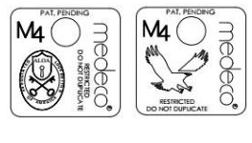
DBK Program Details
Features/Benefits
Patented key control and millions of keying combinations (50% more keying combinations than Medeco 3)
Allows dealer to manage and maintain key systems for customers
Key duplication is restricted to the original DBK locksmith dealer partner who provided the system to the end user
Coining Die Bow Size: 4S, 4L
Requirements
  Must order through distribution with Source Designation form
  Buy-In: $6,000 net to dealers, plus key machine. No annual purchase requirement
  Coining die (if coining die doesn’t exist)
  250 key blank minimum
  Ideal Locksmith: Well-established security professionals (single retail location or multiple retail locations) seeking restricted keyway product to service their customer base

Slide 31

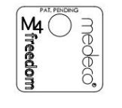
Freedom Program Details
Features/Benefits
Utilizes computerized communications between the locksmith’s location and the Medeco factory
Authorization cards are tracked electronically and audit trail is generated each time a key is cut
Customer can go to any Freedom dealer for additional keys or service
Coining Die Bow Size: 4L
Authorization card is required to obtain key copies at any participating Medeco 4 Freedom dealer nationwide (U.S. & Canada)
Requirements
Buy-In: $1,500 net to dealers, plus a coining die (if coining die doesn’t exist). No annual purchase requirement. No annual purchase requirement
200 key blank minimum
Nationwide program
Ideal Locksmith: Does not want to invest in high-end or higher restricted carded programs. Also, ideal for the mobile locksmith

Slide 32
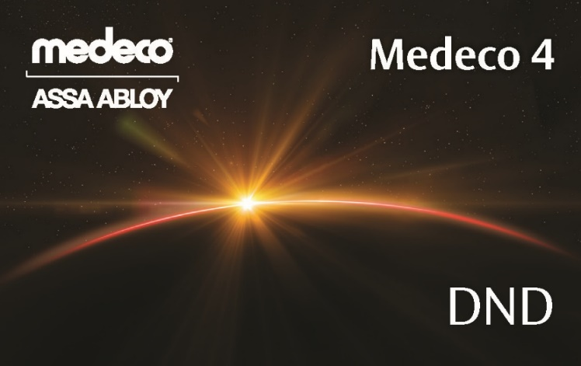
DND Distributor Details
Features/Benefits
Requires positive identification with authorization card for key duplication
Authorization card (pictured) supplied with each key system or key code when shipped from factory.
Key blanks are only sold to authorized DND distributors
Process for obtaining DND cut keys:
  1) End-user presents authorization card to participating locksmith
  2) Locksmith fills out restricted key order form along with authorized cardholder’s signature
  3) Order form is sent to authorized distributor
  4) Distributor processes request and supplies locksmith with DND cut keys
Requirements
Buy-In: $20,000 NET 1st branch, $10,000 NET for subsequent branches thereafter
No annual purchase requirement
600 key blank minimum
Medeco approved key machine required
Applications
Nationwide program
Ideal Dealer: wants to offer
Medeco high security solutions

Slide 33
Onboarding Process
Review all available restricted key programs with prospective dealer/distributor
Medeco Sales Representative will request a “Restricted Key Control Agreement”
Dealer must read and agree to terms of the “Key Control Agreement”
Dealer signs a hard copy of the agreement and delivers it to Medeco via the following methods:
• U.S. Mail: 3625 Alleghany Drive, Salem, Virginia 24153; Attention: Contracts Department
• U.S. email: rhonda.loyd2@assaabloy.com
• Canada Mail: Medeco Key Records, 160 Four Valley Drive, Vaughan, ON L4K 4T9
• Canada Email: orders.medeco.ca@assaabloy.com
Along with the agreement dealer must provide the following:
• Source Designation Form (if ordering through wholesalers)
• Opening Purchase Order totaling required NET investment
• Completed Coining Die Form

Slide 34
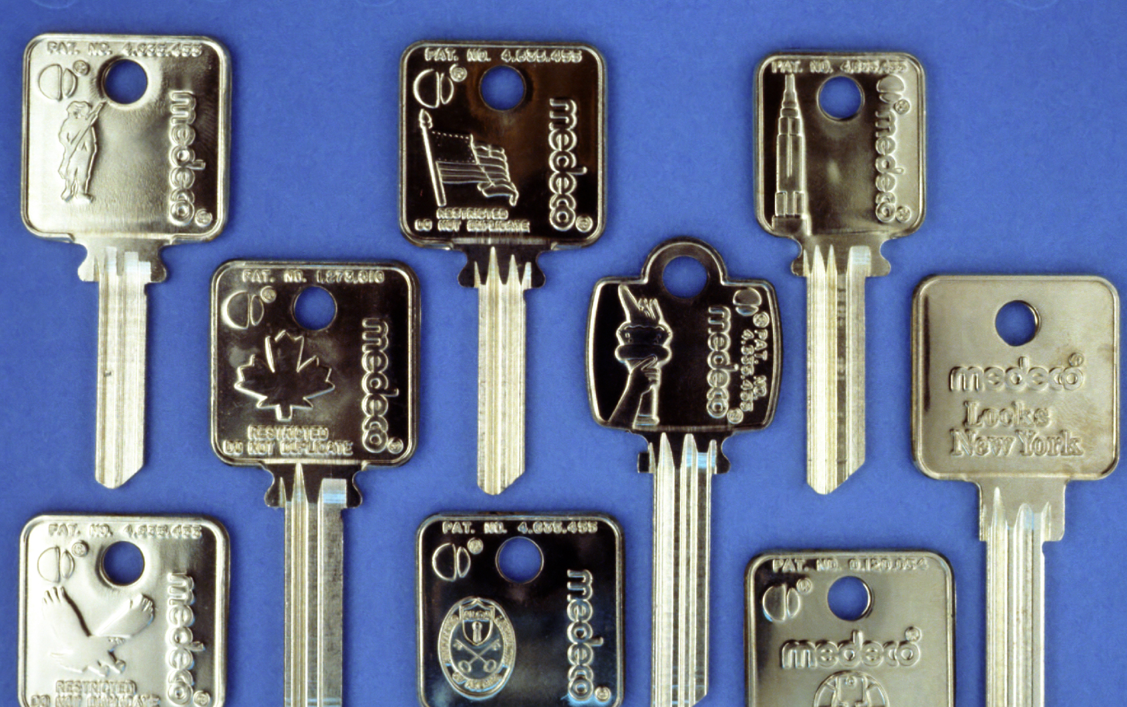
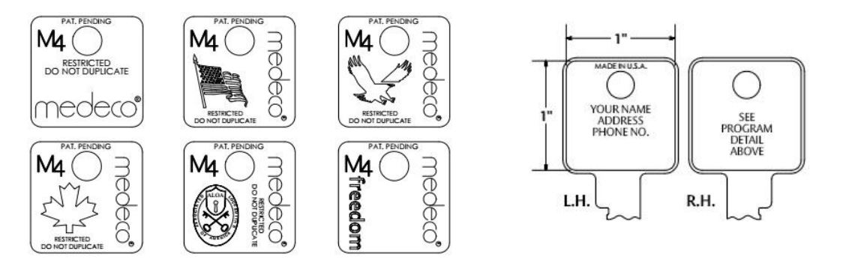
Custom Coining Program
Custom coining is a factory key marking process that is used to enhance the security value of the key. It uses the same process as the US Treasury Department for marking currency, leaving the key with a raised marking and jewelry style finish.

Slide 35

Custom Coining Program
Custom coining dies provide dealers and distributors with a unique way to market their business.
Coining dies may include:
• Company name
• Company logo
• Physical address
• Contact information
• Custom design or artwork
  Providing end users, dealers, distributors and Medeco with a means of elite key control.
• Every key blank shipped from Medeco contains a coining die for security and key control purposes

Slide 36









Key Control Program Applications
RESIDENTIAL
K-12
HOSPITAL
BANKING
OFFICE
UNIVERSITY
MILITARY
UTILITY
RETAIL

Slide 37
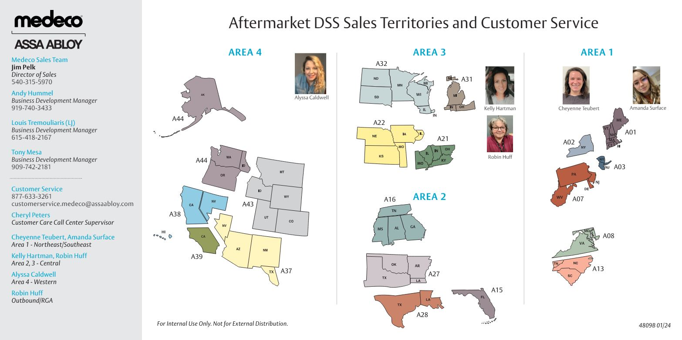
Medeco Contact Information
Director of Sales - Jim Pelk, jim.pelk@assaabloy.com
East- Andy Hummel, Business Development Manager, andy.hummel@assaabloy.com
Central - Louis Tremouliaris (LJ), Business Development Manager, louis.tremouliarisjr@
assaabloy.com
West- Tony Mesa, Business Development Manager
tony.mesa@assaabloy.com
909-742-2181

Slide 38
Resources
M4 Brochure
M4 Website
M4 Checklist for New Dealers
Sell Sheet
M4 BiLevel Sell Sheet
M4 Key Control Programs –
Channel Partners
Catalog
M4 Video
Medeco Mechanical Key Selling Points
Key System Self-Evaluation
On-Site Certification Flyer
Training Page

Slide 39
Thank You

