Slide 1
Transforming Well-Being and Security
Disruptive Technology for Healthier, Secure, More Productive Environments
PITCH DECK
Virexit Technologies Inc Making Discoveries That Change Lives
OTC TICKER: VXIT
https://virexittechnologies.com
(Authorized Reseller of AirROS by Sage Industrial and ZERO-RADIATION Passive Portal)

Slide 2


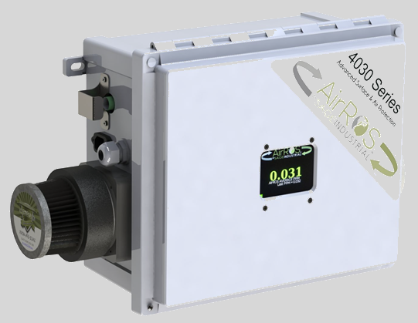
VIREXIT TECHNOLOGIES
Making Discoveries That Change Lives
EXECUTIVE SUMMARY
  Objectives
    Intro To Products
    Virexit’s Goals
  Key Takeaways
    Total Addressable Market (TAM)
    Unique Technologies
    Large Moat
"AirROS isn't just a product—it's a paradigm shift," said a spokesperson for the VirExit Technologies team. "We're enabling businesses and homes to proactively neutralize airborne and surface threats with science-backed technology that works continuously, quietly, and safely."- Virexit Team

Slide 3



EXECUTIVE Summary
“
“ Today, we stand at the crossroads of public safety and health, empowered to address two urgent global crises with innovative solutions:
The AirRoS by Sage Industrial System, revolutionizing indoor air quality and pathogen mitigation.
The Passive Portal ZERO-RADIATION, setting new standards in walkthrough weapons detection.
Poised for rapid growth, we invite you to join us as we pave the way towards safer, healthier environments globally, seizing unique opportunities to lead and expand in these critical markets."
Dr James H Garced
Consultant, Virexit Technologies
FEDERAL SPOTLIGHT AND FUNDING
BROAD
MARKET (TAM)
OBJECTIVE:
To raise capital and secure strategic partnerships to bring AirROS by Sage Industrial’s groundbreaking indoor air purification solution and Passive Portal’s NO-Radiation Walkthrough Weapons Detection to a global market starting with key verticals in New York City.
KEY TAKEAWAYS:
Rapidly growing Total Addressable Market (TAM): The market for indoor air quality (IAQ) and weapons detection solutions is on an exponential growth path, driven by heightened public awareness due to the pandemic and mass shootings, respectively.
Unique Technology + Large Moat: AirROS by Sage Industrial’s and Passive Portal proprietary systems offer proactive wellness, safety and security along with significant energy savings. This is protected by patented processes and ongoing R&D, creating a high barrier to entry for competitors.
Positive ROI: Reduced health risks, fewer sick days, improved productivity, increased security, mass shooting prevention, along with tightening regulations and public attention ensure rapid return on investment.
SOLVING TODAY’S URGENT HEALTH & SAFETY ISSUES WITH TOMORROW’S TECHNOLOGY FOR INDUSTRIES WORLDWIDE
VIREXIT POSITIONED
FOR RAPID GROWTH
KEY PARTNERSHIPS
RAPID GROWTH
AGGRESSIVE MARKETING
DISRUPTIVE TECHNOLOGIES

Slide 4
AIRRoS by Sage Industrial
Disruptive Technology Optimizing Indoor Air Quality (IAQ) & Pathogenic Mitigation (PM)
DEFINING THE PROBLEM
  What Is Indoor Air Quality (IAQ)
  IAQ Market Size,
  Market Forecast
  Key Drivers of Growth

Slide 5



DEFINING THE PROBLEM
What Exactly Is Indoor Air Quality (IAQ)?
DEFINITION & IMPORTANCE
KEY FACTORS THAT AFFECT IAQ
Indoor Air Quality (IAQ) measures the condition of the air inside buildings and structures, focusing on:
  Levels of pollutants (e.g., pathogens, particles, chemicals, allergens)
  Ventilation effectiveness and circulation
  Thermal and humidity comfort
Particulates & Pollutants
  Dust, mold spores, pet dander, smoke, and other airborne particles
Volatile Organic Compounds (VOCs)
  Emissions from cleaning agents, paints, solvents, and building materials
Pathogens & Microorganisms
  Viruses, bacteria, and fungi that cause illness
CO2 & Humidity Levels
  Impact occupant comfort, alertness, and productivity
WHY IT MATTERS
KEY TAKEAWAY
Health: Poor IAQ triggers respiratory issues, allergies, and infections
Productivity: Higher absenteeism and reduced cognitive performance are linked to poor air quality
Economic Impact: Businesses face lost revenue from employee downtime and potential liability issues
Compliance: Increasing regulations demand facilities meet certain IAQ standards
Effective IAQ management is vital for ensuring health, safety, and peak performance in any indoor environment.

Slide 6
GLOBAL INDOOR AIR QUALITY
MARKET SIZE
Europe (~25%)
Strict environmental and safety standards, coupled with growing public health concerns, support steady adoption of IAQ and pathogen mitigation measures.
North America (~35%)
The largest share due to strong regulations, high public awareness (especially post-pandemic), and significant investment in advanced HVAC and filtration technologies.
Asia-Pacific (~30%)
Rapid urbanization and industrialization, particularly in China and India, drive significant demand for IAQ solutions; rising middle-class populations increase focus on health and well-being.
Latin America (~5%)
Growth underpinned by increasing regulations and modernization of aging infrastructure, though economic constraints may limit faster adoption.
Middle East & Africa (~5%)
Driven by new construction projects (specifically in the Gulf states) and a growing awareness of indoor health issues, though market penetration varies widely by country.

Slide 7
MARKET OPPORTUNITY IN INDOOR AIR QUALITY
TOTAL ADDRESSABLE MARKET (TAM)
HIGH VALUE VERTICALS
Corporate Offices, Education, Healthcare, Hospitality, and Residential Apartments lead the highest demand due to large occupant density, regulatory scrutiny, and liability risk. food processing manufacturing
KEY DRIVERS OF GROWTH
Heightened Public Awareness
Evolving Government Regulations & Standards
Corporate Responsibility & ESG Initiatives
Aging Infrastructure & Outdated HVAC Systems
The COVID-19 pandemic drastically increased public concern regarding airborne pathogens and overall indoor air safety. This heightened awareness drives demand for solutions that proactively mitigate viruses, bacteria, and other pathogens.
Federal, state, and local authorities are introducing stricter building codes, ventilation requirements, and health guidelines for schools, healthcare facilities, and commercial buildings. Compliance efforts significantly boost the market for advanced IAQ and pathogen mitigation technologies.
Revenue optimizing businesses provide healthy, safe work environments and demonstrate strong Environmental, Social, and Governance (ESG) practices. Many organizations now prioritize IAQ improvements to protect occupant well-being and reduce liability.
Much of the U.S. building stock features older HVAC systems ill-equipped to handle modern airflow and pathogen reduction needs. Upgrading or retrofitting these systems with advanced IAQ technologies creates a substantial, sustained market demand.

Slide 8

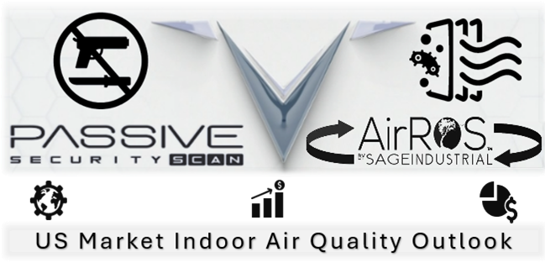
ABOUT US
OUR MISSION IS CLEAR: To reshape the future of safety and health. We are dedicated to identifying and introducing innovative safety and health products that redefine industry standards. Our commitment to excellence, visionary leadership, and relentless pursuit of promising safety and health solutions set us apart.
AT VIREXIT TECHNOLOGIES, we believe in safeguarding all human life including our most precious aspects of life—our children and the vulnerable. We pioneer cutting-edge weapons scanning technology, ensuring schools, government facilities, churches, and commercial buildings with occupants are shielded from the threat of violence.
SIMULTANEOUSLY, OUR GROUNDBREAKING Indoor Air, Pathogenic Mitigation Air Purification Technology protects against unseen biological threats in all large occupied commercial and public facilities.
WE ASPIRE TO CREATE environments where safety is a birthright, inspiring a future where innovation becomes synonymous with the well-being of all. Join us on this transformative journey, where the future of safety and health is redefined with excitement, motivation, and inspiration.
Indoor Air Quality / Pathogenic Mitigation
IAQ/PM GLOBAL MARKET RESEARCH REPORT 2023-2027
The Indoor Air Quality / Pathogenic Mitigation (IAQ) Solution Market size is estimated to grow at a CAGR of 7.32% between 2022-2027.
The market size is forecast to increase by USD 13.21 billion. The rapidly expansive growth of the market is driven by the perfect storm of a post-pandemic surge in public awareness, governmental awareness initiatives, and an antiquated infrastructure crisis throughout the international market.
The increasing number of government regulations and federal grants becoming available continue to drive this change, as more and more studies confirm the negative impact on health and lifespan.
“
architects of a safer, healthier, and more secure world
US Market: Indoor Air Quality
U.S. Indoor Air Quality Market 2023 – Projected 2022 – 2027
The U.S. indoor air quality market is projected to grow from $9.8 billion in 2022 to $11.9 billion in 2027 at a compound annual growth rate (CAGR) of 4.1% during the forecast period.
- The Virexit Team
OTC Ticker: VXIT
VirExit Technologies Inc.
Common Stock
https://www.otcmarkets.com/stock/VXIT
Source: https://www.technavio.com/report/indoor-air-quality-solutions-market-industry-analysis
Source: https://finance.yahoo.com/news/united-states-indoor-air-quality-125300190.html

Slide 9
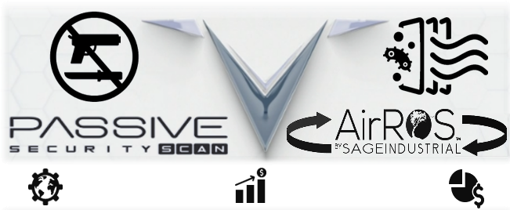

OUR
MISSION
OUR
ISION
North America Indoor Air Quality Market
01
INNOVATE FOR EXCELLENCE. At VirExit Technologies, we are not content with the status quo; we challenge it. Our commitment to innovation is the cornerstone of our sphere of activity in which we specialize. We understand that safety and health is not a static concept—it evolves with time and technology.
The indoor air quality solutions market in North America is expected to record a significant growth rate during the forecast period.
The region is among the early users of modern technologies in the fields of indoor air quality services and equipment.
One of the major factors stimulating the markets growth is the rising variety of pollutants in the region.
The number of regulations and regulatory bodies, such as The US Environmental Protection Agency (EPA), is also increasing to further fuel the growth of the market..
CONNECT VIREXIT’S EXPERT HEALTH, SAFETY, AND SECURITY REPRESENTATIVES TO THE PEOPLE IN SEARCH OF COMPREHENSIVE SOLUTIONS THEY MAY TRUST.
01
02
TOMORROW’S TECHNOLOGY TODAY. That’s why we are dedicated to leading the way in innovation, consistently uncovering and introducing cutting-edge safety and health solutions that redefine industry standards.
02
DELIVERING UNMATCHED SOLUTIONS TAILORED TO YOUR NEEDS .
03
EXCLUSIVITY UNLEASHED. In the world of safety, health, and technology, exclusivity is a rare gem. VirExit Technologies offers an invitation-only insight into a future where safety and technology seamlessly integrate. We believe in delivering solutions that are not just effective but also exclusive, ensuring that our clients have access to groundbreaking technologies that set them apart from the competition.
03
RESULTING IN PEACE OF MIND FOR COMMUNITES AND BUSINESSES WORLDWIDE .

Slide 10
AIRRoS by Sage Industrial
Disruptive Technology Optimizing Indoor Air Quality (IAQ) & Pathogenic Mitigation (PM)
IMPACT ON BUSINESS AND PEOPLE
  Why IAQ Matters
  Public Awareness
  Harmful Pollutants
  Harmful Pathogens
  Physical Parameters
  Negative Impact Of Poor IAQ/PM

Slide 11


WARNING LIGHTS ARE FLASHING.
Long Term Impact on Business and Well-Being
RISK OF INACTION: Substantial impact on employee well-being (physical and mental), hence on business productivity across multiple industries with a year over year impact on business’s financial bottom line.
According to the U.S. Environmental Protection Agency (EPA), poor indoor air quality affects nearly 50% of the commercial buildings in the U.S., and it is also responsible for more than 10 million lost workdays per year.
If this issue is not rectified, U.S. businesses will see revenue decreases as a result of a decrease in employee productivity and an increase in liability. If action is not taken soon, employees’ well-being will pay a significant price in the coming years.

Slide 12
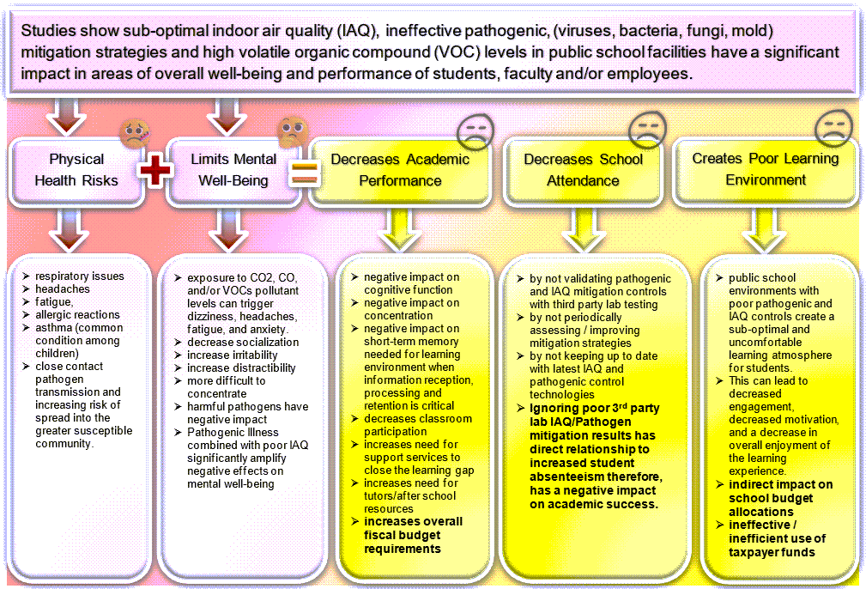
WHY INDOOR AIR QUALITY (IAQ) MATTERS?
Indoor air quality (IAQ) is a significant concern in today's environmental health landscape. As we spend approximately 90% of our time indoors, the air within our homes, offices, schools, and commercial spaces plays a crucial role in our overall health and well-being. IAQ refers to the quality of the air inside buildings as determined by pollutants, humidity, and ventilation levels, and its impact on the occupants' health and comfort.
UNIVERSITIES AND SCHOOL’S IAQ – SICK BUILDING SYNDROME
Impact on Students
Decreased Concentration & Learning: Poor air quality causes headaches, fatigue, and irritation, making it harder for students to focus in class.
Higher Absenteeism Rates: Frequent exposure to airborne pathogens (viruses, bacteria, mold) increases the likelihood of illness, leading to more missed school days and lost funding.
Worsening of Existing Conditions: Students with asthma or allergies may experience more severe symptoms, further impacting school performance and well-being.
Impact on Teachers and Staff
Elevated Stress & Fatigue: Prolonged exposure to pollutants and pathogens contributes to persistent health issues, reducing energy and effectiveness in teaching.
Increased Sick Leave: Chronic respiratory issues or infections among teachers lead to more sick days, disrupting classroom consistency and student progress.
Reduced Job Satisfaction: Poor indoor air quality may negatively affect morale, specifically when concerns about personal and student health remain unaddressed.

Slide 13



PUBLIC AWARENESSS OF INDOOR AIR QUALITY (IAQ)?
Public awareness and expectations regarding indoor air quality (IAQ) are rising as studies link poor IAQ to respiratory issues and cognitive decline. Increased ventilation, air filtration, and pollutant monitoring are becoming standard demands in homes and workplaces. According to the EPA, 'Americans, on average, spend approximately 90% of their time indoors, where the concentrations of some pollutants are often 2 to 5 times higher than typical outdoor concentrations' (EPA, 2023).
Why Indoor Air Quality Matters
Source: https://hsph.harvard.edu/news/office-air-quality-may-affect-employees-cognition-productivity/
*Source: https://www.sciencedirect.com/science/article
/abs/pii/S016041201630681X
Source: https://healthpolicy-watch.news/indoor-air-pollution-a-slow-killer-in-need-of-awareness-data-and-investment/
Health Implications
Economic Impact
Public Awareness
Poor IAQ may lead to a wide range of health problems, from immediate effects like headaches, dizziness, and fatigue to long-term effects such as respiratory diseases, heart disease, and cancer. Vulnerable groups such as children, the elderly, and those with pre-existing health conditions are particularly at risk.
Beyond health, poor indoor air quality also affects productivity and learning. Studies have shown that improved IAQ may lead to better job performance, leading to downstream increases in business revenue and higher academic achievement in schools, leading to higher socio-economic achievement. *45 Billion Cost/Year in CA
Increasing awareness and tightening regulations around air quality are driving demand for IAQ improvement solutions. Governments and health organizations worldwide are establishing stricter guidelines to ensure safe indoor environments.

Slide 14
HARMFUL INDOOR AIR POLLUTANTS ON WELL-BEING
BIOLOGICAL CONTAMINANTS
CHEMICAL POLLUTANTS
Viruses
Short-Term Impact: may lead to acute respiratory infections (e.g., colds, flu), fever, and general malaise.
Long-Term Impact: Repeated exposure to airborne viruses may exacerbate chronic respiratory conditions and compromise immune response over time.
Bacteria
Short-Term Impact: Bacterial pathogens may cause respiratory tract infections, triggering coughs and fevers.
Long-Term Impact: Ongoing exposure increases the risk of more serious infections, particularly in immunocompromised individuals, and may heighten antibiotic resistance issues.
Mold & Fungal Spores, Allergens
Short-Term Impact: Irritation of eyes, nose, throat; allergic reactions such as sneezing and coughing.
Long-Term Impact: Chronic exposure may lead to or worsen asthma, other pulmonary disorders, and systemic health problems if toxic molds (e.g., black mold) are present. In some cases, repeated exposure may lead to new sensitivities or more severe allergic conditions.
Formaldehyde
Sources: Pressed wood products, furniture, insulation, permanent-press fabrics.
Short-Term Impact: Irritation of eyes, nose, and throat; headaches; nausea.
Long-Term Impact: Known human carcinogen; potential to exacerbate asthma.
Toluene
Sources: Paint thinners, nail polish, adhesives, and some cleaning agents.
Short-Term Impact: Dizziness, headaches, irritation of the eyes and respiratory.
Long-Term Impact: Central nervous system effects (fatigue, difficulty concentrating), potential kidney and liver damage with prolonged exposure.
Benzene
Sources: Tobacco smoke, vehicle exhaust, stored fuels, certain household products.
Short-Term Impact: Drowsiness, dizziness, increased heart rate; eye, skin, and lung irritation.
Long-Term Impact: Known carcinogen; linked to leukemia and other blood disorders.
* Other Harmful VOC’s
Xylene; Methylene Chloride (Dichloromethane); Perchloroethylene (PERC); Acetone; 2-Butoxyethanol

Slide 15


PHYSICAL PARAMETERS IMPACT ON INDOOR AIR
PHYSICAL PARAMETERS
Particulate Matter (PM2.5, PM10)
Sources: Combustion processes (cooking, smoking), outdoor air pollution, dust.
Short-Term Impact: Eye, nose, throat irritation, exacerbation of asthma or COPD.
Long-Term Impact: Heightened risk of cardiovascular disease, chronic bronchitis, reduced lung function.
Humidity Levels (Too High or Too Low)
Short-Term Impact: High humidity encourages mold growth and dust mites, leading to allergic reactions. Low humidity causes dry skin, throat, and mucous membranes, making people more susceptible to infections.
Long-Term Impact: Persistent mold or dryness may contribute to chronic respiratory issues and create unhealthy indoor environments.
Temperature Extremes
Short-Term Impact: Discomfort, fatigue, inability to focus, potential heat exhaustion or hypothermia in extreme cases.
Long-Term Impact: Chronic discomfort and stress on the body, potentially leading to reduced productivity and well-being.
Air Pressure & Ventilation
Short-Term Impact: Poor ventilation may trap pollutants and pathogens, leading to immediate respiratory irritation.
Long-Term Impact: Stale, contaminated air circulation heightens the likelihood of chronic illness, “Sick Building Syndrome.”
Source: https://www.sciencedirect.com/science/article/pii/S2772653324000145#:~:text=It%20is%20stated%20in%20studies,%2C%20and%20agriculture%20%5B23%5D.
Source: https://pmc.ncbi.nlm.nih.gov/articles/PMC2796751/
Key Takeaway
Effective indoor air quality management must address all three categories —
Biological
Chemical
Physical
— to safeguard short- and long-term health. By systematically reducing pathogens, controlling pollutants, and optimizing humidity and temperature, facilities may significantly improve occupant well-being and productivity.

Slide 16

“
Negative Economic & Business Impact
01
Negative Impact of Poor Indoor Air Quality
Poor IAQ causes increased absenteeism, decreased productivity, and higher operational costs for businesses. Employees frequently become sick or work at reduced capacity, which drives up healthcare expenses and disrupts workflow.
Referenced Study: Fisk, W.J., Black, D., & Brunner, G. (2011). Changing occupant health costs due to reductions in indoor environmental exposures in U.S. offices. Indoor Air, 21(5), 357-367.
Key Finding: Demonstrated that improving indoor environmental quality may reduce employee sick leave, thus lowering health-related costs and increasing overall productivity.
Socio-Economic Impact
02
Poor IAQ disproportionately affects vulnerable communities (e.g., low-income areas, older school buildings), leading to amplified health disparities, educational setbacks, and added strain on public resources. In schools, inadequate air quality correlates with absenteeism and lower academic performance.
Referenced Study: Mendell, M.J., & Heath, G.A. (2005). Do indoor pollutants and thermal conditions in schools influence student performance? A critical review of the published literature. Indoor Air, 15(1), 27.
Key Finding: Highlights that poor ventilation and exposure to indoor pollutants in schools may be associated with reduced test scores and increased absenteeism, thus impacting long-term socio-economic opportunities.
Key Takeaway
From lost business productivity to entrenched health and social inequalities, poor IAQ is a complex issue. These referenced studies and WHO guidelines confirm the broad and quantifiable impact that inadequate air quality may have on economies, communities, and businesses, individual health.
Health Risk
03
Chronic exposure to contaminants such as mold, VOCs, and pathogens may worsen respiratory conditions (e.g., asthma), heighten the risk of cardiovascular problems, and lead to more frequent infections. This contributes to general discomfort, reducing quality of life for building occupants.
Referenced Study: World Health Organization (WHO). (2009). Guidelines for Indoor Air Quality: Dampness and Mould. WHO Regional Office for Europe.
Key Finding: Indicates a clear link between damp or moldy environments and respiratory illnesses, affirming that poor IAQ may trigger or aggravate health conditions in both children and adults.

Slide 17
AIRRoS by Sage Industrial
Disruptive Technology Optimizing Indoor Air Quality (IAQ) & Pathogenic Mitigation (PM)
SOLUTION – AIRROS BY SAGE INDUSTRIAL
    IAQ Market Competitors
    Technological Advantages
    Positive Impact & Value Proposition
    Partnerships
    3rd Party Empirical Lab Data

Slide 18
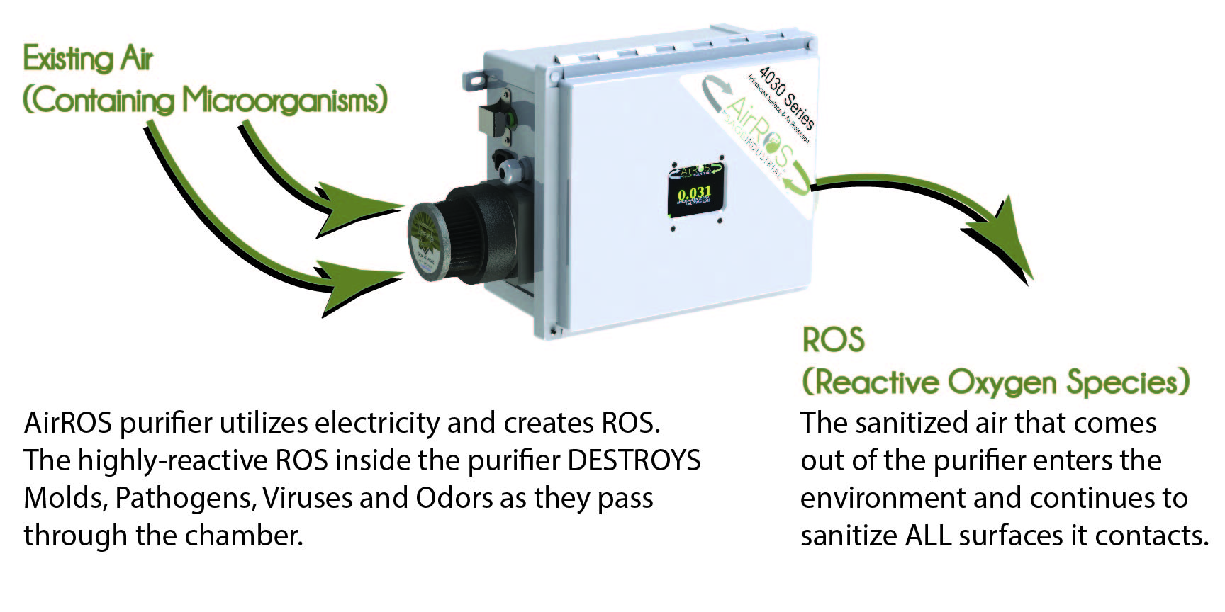
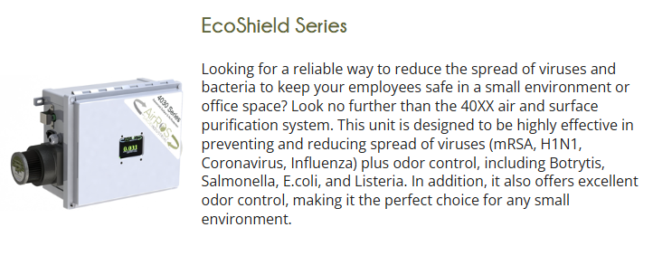

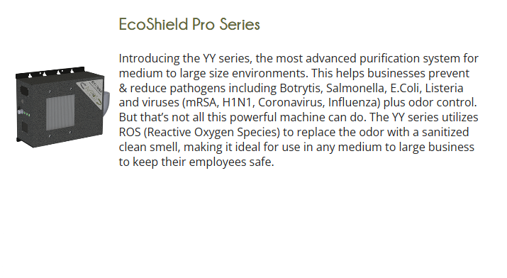
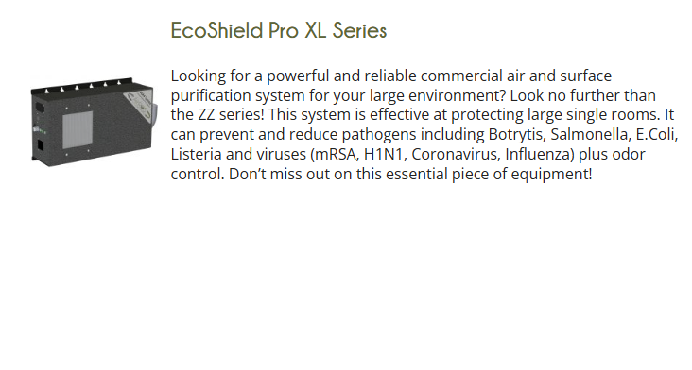
OUR SOLUTION
AirRoS By Sage
HOW OUR TECHNOLOGY WORKS
AirROS by SAGE Surface & Air Purifiers utilize high voltage & high frequency-controlled pulses, but very low amperage to create non-thermal plasma & generate ROS (Reactive Oxygen Species). ROS are the sanitation/cleaning agents that prevent and destroy Molds, Viruses, & other Pathogens and control / eliminate Odor in the Air and Surfaces in 2 stages.
OUR LOW ENERGY TECHNOLOGY
Our patented technology uses ultra-low energy to create ROS which will destroy, purify & defend against bacteria, molds (Botrytis, Salmonella, E.Coli, Listeria) and other pathogens, reduces Cross-Contamination and Eliminates/Neutralizes odor.

Slide 19
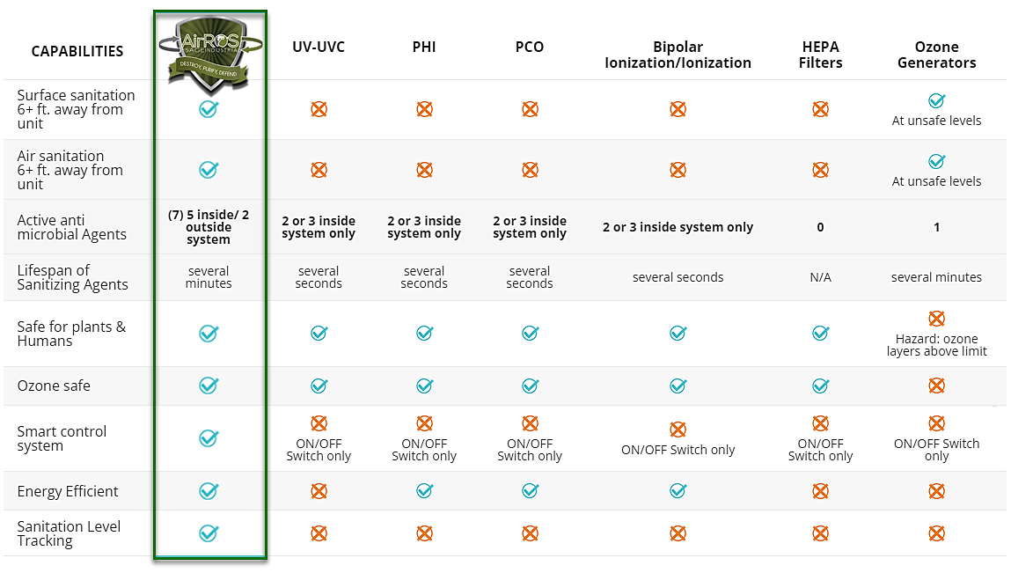
LARGE COMPETITIVE MOAT

Slide 20
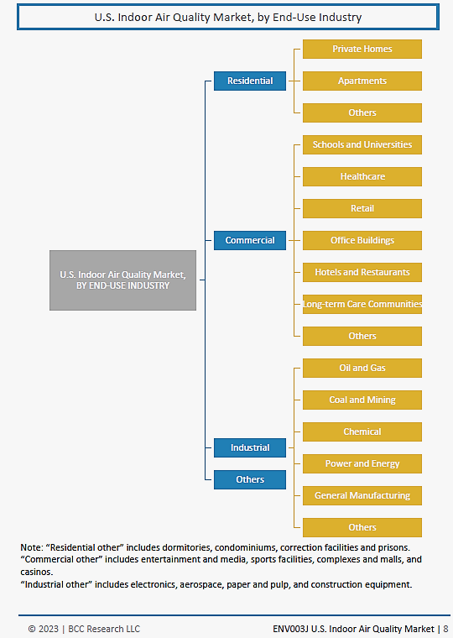
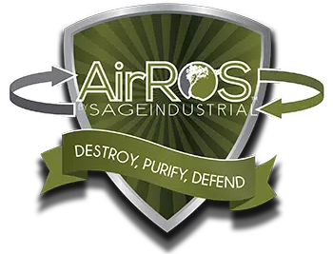
VIREXIT’S IAQ TECHNOLOGICAL BENEFITS
Optimize IAQ
AirRoS by Sage employs advanced filtration and purification technology to remove pollutants, allergens, and pathogens from in-room air and direct on-surface, ensuring a healthier environment for occupants.
Market Growth Potential:
The global IAQ market is projected to grow substantially, driven by an increasing recognition of the health benefits of clean air, advancements in technology, and the integration of smart home and building management systems. As public consciousness rises and technology becomes more accessible, the demand for IAQ solutions is anticipated to surge, offering specific significant investment opportunities.
Pathogenic Mitigation
AirRoS by Sage utilizes RoS technology to mitigate pathogens both in the room air and on surfaces, providing comprehensive protection against harmful microorganisms.
Why AirRoS by Sage Deserves your Attention:
Comprehensive IAQ/PM Technology: AirRoS by Sage goes beyond mere air purification. It’s a comprehensive in-air and on-surface solution designed to combat indoor pollutants effectively.
Cost-Effective: While budget constraints are a reality, compromising on indoor air quality shouldn’t be an option. AirRoS by Sage offers a cost-effective approach to cleaner air, providing excellent value without compromising quality.
Energy Efficient: It’s crucial to consider the energy efficiency of any solution we implement. AirRoS by Sage not only cleans the air but does so in a cost-efficient manner, ensuring sustainability without sacrificing performance.
3rd Party Lab Tested: Skeptical about claims? AirRoS by Sage’s efficacy is backed by rigorous third-party lab testing. Rest assured; you’re investing in a solution that has been proven effective in improving indoor air quality.
Investment Opportunity:
Indoor air quality market is not just about enhancing health and comfort—it's also a rapidly evolving industry ripe with opportunities for innovation, growth, and investment. This intersection of technology, health, and business presents a compelling proposition for stakeholders looking to make a meaningful impact while achieving substantial returns.
Surface Treatment
AirRoS by Sage treats surfaces within the indoor environment stemming from the unit’s photocatalytic surface coating. This ensures that not only the air but contaminants on surfaces are neutralized, resulting in any lingering odors being effectively eliminated.
Continuous Action 24/7
With exposure to unit’s UV light and moisture from the air, it ensures a constant and ongoing process of odor elimination, maintaining a fresh and clean indoor environment for occupants.

Slide 21

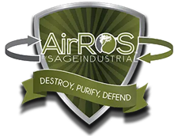


POSITIVE IMPACT & VALUE PROPOSITION OF AIRROS BY SAGE INDUSTRIAL
Proactive Pathogen Mitigation
AirROS employs advanced oxidation and proprietary technologies, reducing viruses, bacteria, mold, and VOCs.
Creates safer indoor environments that meet or exceed emerging regulatory standards.
Energy & Cost Savings
Efficient purification system reduces load on existing HVAC by maintaining cleaner coils and ductwork.
Extends the lifespan of HVAC infrastructure in aging buildings.
Enhanced Occupant Experience
Cleaner air leads to fewer complaints, improved well-being, and greater occupant satisfaction.
Demonstrable ROI via improved productivity, reduced absenteeism, and compliance with green building certifications.
Third-Party Validated
Independently tested in labs and on-site before and after installation, providing empirical evidence of effectiveness and immediate proof of ROI.
PROVEN RESULTS: Whether it’s commercial buildings, fitness facilities, restaurants, churches, casinos, hotels, events, or more, AirROS commercial air and surface purifiers provide the ultimate solution for eliminating COVID-19 and ensuring top-tier sanitation. Our system offers the only SAFE, EFFECTIVE, and CONTINUOUS 24/7 inactivation and neutralization of airborne and surface viruses, microbes, and odors—all while staff and customers are present.
4
MINUTES
In only 4 minutes of ROS treatment on various types of surfaces (stainless steel, plastic, tile), we had a 90% reduction/kill.
15
MINUTES
15 minutes, had a 3.85 log that’s 99.98% reduction/kill (36,000,000CFU’s down to 5,200CFU).
30
MINUTES
30 minutes, had a 6.65 log that’s 99.99997% reduction/kill (down to 10CFU’s).
45
MINUTES
The coronavirus is undetectable in less than 45 minutes on ALL things the air touches without using any other mitigation processes.

Slide 22



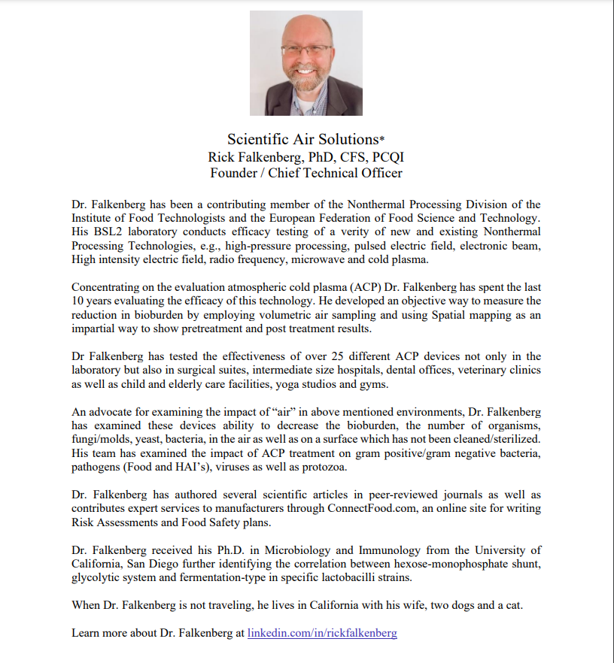

STRONG PARTNERSHIPS
THIRD-PARTY LAB TESTING: PROOF POSITIVE
Empirical Evidence: Pre- and Post-Installation Testing
  Partner with certified independent labs to perform microbial and particle count tests.
  Data is collected before AirROS installation and again after a determined run-time, illustrating clear pathogen and contaminant reductions.
Reporting and Transparency
  Provide clients with detailed, easy-to-read reports that demonstrate tangible improvements in air and surface quality.
  This empirical data supports compliance requirements, and justifying budget allocations.
Ongoing Monitoring
  Continuous IAQ monitoring services, giving building managers real-time oversight of air quality metrics.
  Positions AirROS as a comprehensive indoor air solution with recurring maintenance revenue, not just a one-time installation cost.

Slide 23
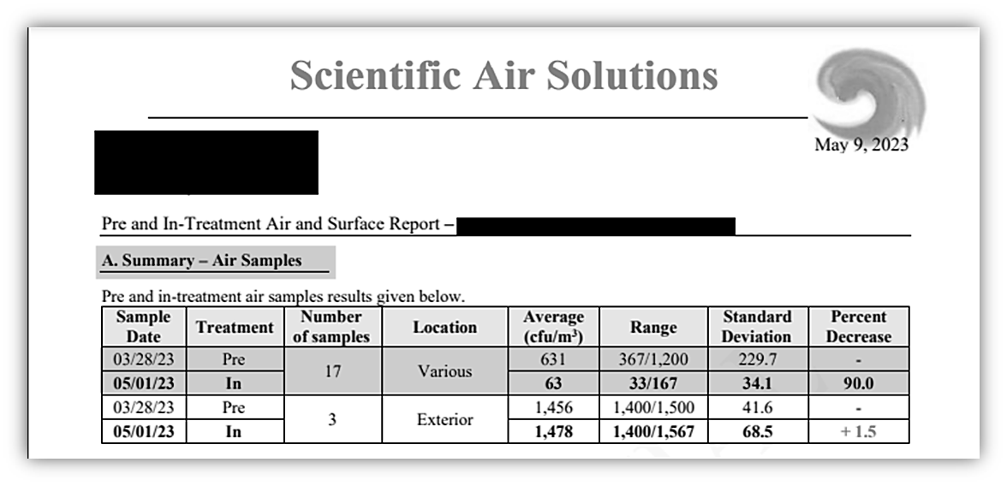
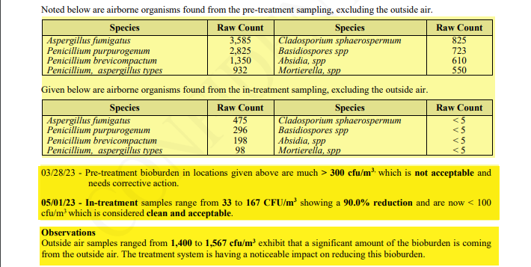
3RD PARTY LAB SCIENTIFIC AIR SOLUTIONS
01
AIR TEST SAMPLES
Pre-Treatment Sampling vs In-Treatment Sampling
summary of results
3/28/23 – Pre-Treatment Sampling:
Bio-burden Air Samples are much above > 300 cfu/m³ which fall in “not acceptable range and require corrective action.”
5/01/23 – (AirROS), In-Treatment Sampling:
Bio-burden Air Samples show 90% reduction and < 100 cfu/m³, which falls in the “clean and acceptable.”
02
OBSERVATIONS
OUTSIDE AIR SAMPLES RANGE:
“1400 to 1567 cfu/m³ shows significant amount of Bio-burden coming from outside air that falls in the “not acceptable/needs corrective action range.”
Conclusion
The AIR-RoS by Sage Treatment System is having a noticeable and measurable impact on reducing this bio-burden.

Slide 24
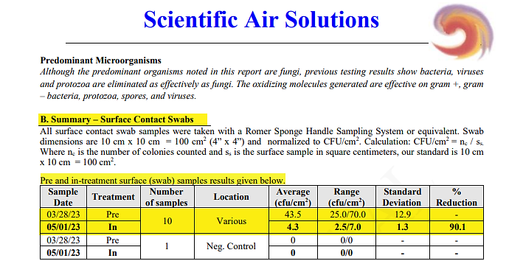

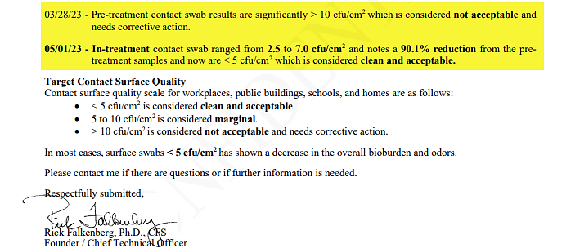
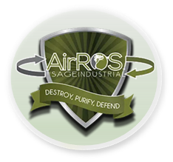
01
3RD PARTY LAB SCIENTIFIC AIR SOLUTIONS
SURFACE TEST SAMPLES
Pre-Treatment Sampling vs In-Treatment Sampling
summary of SURFACE results
3/28/23 – Pre-Treatment Sampling:
Average 43.5 cfu/cm²; Range 25.0/70.0 cfu/cm²; SD 12.9
5/01/23 – (AirROS), In-Treatment Sampling:
Average 4.3 cfu/cm²; Range 2.5/7.0 cfu/cm²; SD 1.3
02
02
Conclusion OF SURFACE TESTING
Resulted in % Reduction of 90.1%

Slide 25
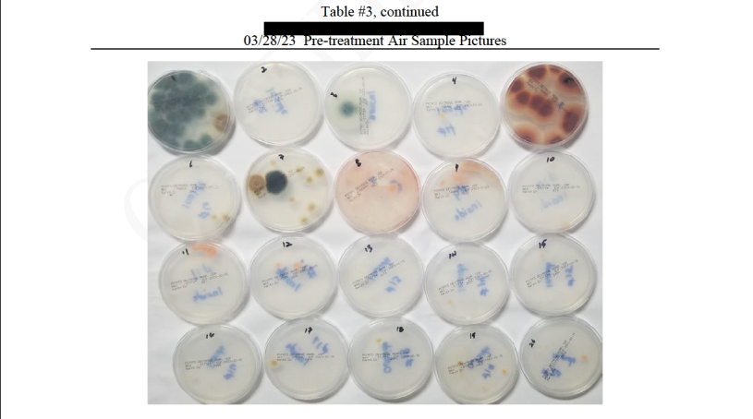
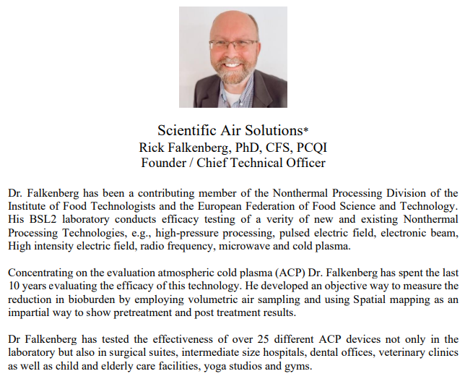
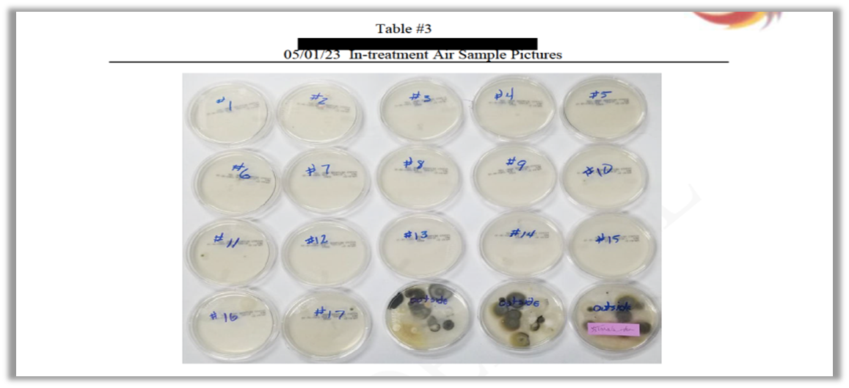
01
3RD PARTY LAB SCIENTIFIC AIR SOLUTIONS
PRE-TREATMENT AIR PICTURE SAMPLES
3/28/23 – Pre-Treatment Air Sample Pictures
02
IN-TREATMENT AIR PICTURE SAMPLES
5/01/23 - In-Treatment Air Samples

Slide 26
AIRRoS by Sage Industrial
Disruptive Technology Optimizing Indoor Air Quality (IAQ) & Pathogenic Mitigation (PM)
SALES STRATEGY
    Use Cases
    Referral Incentive Program
    Launch In Metropolitan NYC – Why NYC?
    Targeted Approach
        Partnerships
        Penetration
        Scaling

Slide 27
Virexit referral incentive
MONETIZE LEADS THAT TRANSACT!
Tier 01: Profits from $0 - $100,000.00; Earn 2%.
Tier 02: Profits from $100,000.01 - $250,000.00; Earn 3%.
Tier 03: Profits from $250,000.01 - $500,000.00; Earn 4%.
Tier 04: Profits from $500,000.01 - $750,000.00; Earn 5%.
Tier 05: Profits from $750,000.00 - $1,000,000.00; Earn 6%.
Tier 06: Profits above $1,000,000.00; Earn 7% of Profits.
AirRoS USE CASES - DIVERSE MARKET
Office Buildings
Pro Sports Arenas
Cannabis Industry
Problem: Employee productivity, absenteeism, & liability from poor air quality.
Solution: A healthier workplace environment improves morale, reduces sick days, and enhances corporate reputation.
Problem: Huge crowds, high likelihood of disease spread, reputational risk if fans get sick.
Solution: Comprehensive air purification to ensure safe, enjoyable fan experiences.
Problem: Strict humidity and pathogen control for cultivation; odor management; regulatory environment.
Solution: Maintains mold-free operations, reduces odor, and helps meet compliance.
Florist Shops
Hotels & Restaurants
Problem: Mold, mildew, and humidity control; short product life cycles.
Solution: AirROS technology keeps perishable plants fresh longer, reducing shrinkage and waste.
Hospitality Industry
Schools & Universities
Problem: Guests demand clean, safe spaces; negative reviews if air feels “stale” or there are odor issues.
Solution: Proactive purification leads to better guest experiences, online reviews, and return visits.
Problem: Guests demand clean, safe spaces; negative reviews if air feels “stale” or odor issues.
Solution: Proactive purification leads to better guest experiences, online reviews, and return visits.
Problem: High density, older buildings, susceptible populations (children, young adults).
Solution: AirROS reduces airborne pathogens, lowering absenteeism and creating a safer learning environment.
Daycare Centers
Apartment Complexes
Retail
Problem: Children are more susceptible to infections; close interactions spread illnesses quickly.
Solution: Continuous pathogen mitigation may drastically reduce outbreak occurrences.
Grocery Stores
Problem: Shared hallways, lobbies, gym spaces often poorly ventilated; occupant turnover is high.
Solution: Continuous air quality control in common areas increases tenant satisfaction and retention.
Problem: High foot traffic, varied ventilation, must ensure customer comfort and safety.
Solution: Cleaner air extends customer dwell time and purchase likelihood.
Problem: Strict regulatory environment for food safety, odor control, perishable goods.
Solution: Improves shelf life of products, reduces contamination risk, aligns with HACCP (Hazard Analysis and Critical Control Points).
Long-Term Care
Government Facilities
Commercial Buildings
Problem: Highly vulnerable occupants, strict regulations, and existing HVAC often inadequate.
Solution: Significantly reduces risk of hospital-acquired infections and cross-contamination; satisfies regulatory compliance.
Problem: Aging infrastructure, large volume of visitors, compliance with public health mandates.
Solution: Demonstrates government commitment to public well-being and cost savings on HVAC upgrades.
Problem: Large-scale facilities with complex HVAC systems; occupant complaints.
Solution: Centralized systems that handle large volumes of air, ensuring consistent air quality.
Fitness Facilities
Problem: Shared equipment, gym spaces, often poorly ventilated; occupant turnover is high.
Solution: Continuous air quality control in common areas increases tenant satisfaction and retention.

Slide 28


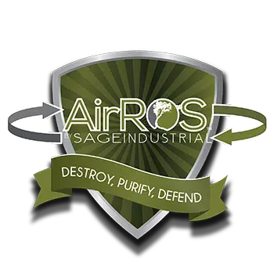





WHY LAUNCH IN METROPOLITON NYC ?
Huge concentration of public and private buildings, global business center, and diverse industry verticals.
Regulatory Stringency: NYC often leads in adopting stricter building codes and health mandates.
High ROI Case Study Potential: Successful implementation in NYC resonates nationwide and globally.
2 Public Libraries, 4 Subway System, 1 Government Buildings, 3 Schools
Millions pass through daily; strong public interest in improved air quality to reduce disease transmission and enhance public trust.
NYC is a global culinary and hospitality hub; compliance with new ventilation standards is a must, and brand reputation is paramount.
Identify pilot programs in high-visibility public facilities (libraries, municipal buildings).
Partner with real estate developers, public private facilitators and property managers for office and multi-family projects.
Showcase successful transformations to generate international and global awareness.
SALES
STRATEGY
01
Density & Visibility:
02
NYC Public Facilities:
AGGRESSIVE CAMPAIGN NEW YORK CITY
Restaurants & Hospitality:
03
04
Launch Plan:

Slide 29




SALES
STRATEGY
Direct Sales & Key Account Management: Focus on large facility owners, property management firms, and government agencies.
Partnerships: Collaborate with major HVAC service companies, facility management solutions providers, and industry-specific associations.
Case studies: highlighting quantifiable benefits (cost savings, occupant satisfaction, regulatory compliance).
Tailored ROI calculators for each segment (schools, healthcare, hospitality, etc.).
Utilize high-profile clients in NYC to endorse success stories.
Collaborate with local chambers of commerce, building associations, and city government programs for healthier buildings.
After building a strong portfolio of Metropolitan NYC success stories, replicate with major urban centers across the U.S.
Partner with global organizations, trade missions, and conferences to expand internationally.
TARGETED APPROACH IN METROPOLITON NYC
01
Hyperfocused Targeted Approach :
PARTNERSHIPS
PENETRATION
02
Vertical-Specific Marketing :
SCALING
AGGRESSIVE CAMPAIGN NEW YORK CITY
03
Leverage Local NYC Influence :
04
Scaling Nationally & Globally :

Slide 30
AIRRoS by Sage Industrial
Disruptive Technology Optimizing Indoor Air Quality (IAQ) & Pathogenic Mitigation (PM)
EVENTS WITH DECISION MAKERS
    Trade Shows
    Booth Strategy
    Conferences

Slide 31

TRADE SHOWS AND CONFERENCES
SALES
STRATEGY
01
BuildingsNY (New York)
website: buildingsny.com
date: 2025 dates TBD (typically held in May)
location: New York, NY
about: Ideal for reaching building owners, property managers, and facility engineers in the NYC region.
AHR Expo (International HVACR Event)
website: ahrexpo.com
date: 2026 dates TBD
location: Orange County Convention Center in Orlando, Florida
about: One of the largest gatherings for HVAC and refrigeration professionals, key for forging partnerships.
Greenbuild International Conference and Expo
website: greenbuildexpo.com
dates: November 4–7, 2025
location: Los Angeles Convention Center, Los Angeles, California
about: Focus on sustainable building, perfect platform to showcase AirROS’s energy and health benefits.
Infection Control Today Summit
website: infectioncontroltoday.com
dates: 2025 dates TBD
location: TBD
about: Targets healthcare decision makers, a direct audience for AirROS’s pathogen mitigation.
HITEC (Hospitality Industry Tech Exposition & Conference)
website: hftp.org
dates: June 16–19, 2025
location: Indiana Convention Center, Indianapolis, Indiana
about: Specifically for hotels, large resorts, and restaurant chains seeking innovative technology solutions.
Cannabis Business Conference & Expo
website: cannabismeansbusiness.com
dates: June 4–5, 2025
location: Javits Convention Center, New York City
about: Direct line to growing cannabis industry players and addresses their unique regulatory and air quality needs.
02
Attend Key Trade Shows & Conferences
03
04
AGGRESSIVE MARKETING Nationwide
05
06

Slide 32
TRADE SHOWS AND CONFERENCES
SALES
STRATEGY
07
AHCA/NCAL Convention & Expo (Nursing Homes Long-Term Care Facilities)
website: ahcancal.org
Dates: October 19–22, 2025​
Location: Mandalay Bay Resort, Las Vegas, Nevada​
about: This convention brings together professionals from nursing centers and assisted living communities, offering AirROS the opportunity to demonstrate its air purification systems that enhance resident health and comply with stringent health standards.​
Virginia Health Care Association (VHCA-VCAL) Trade Show
website: vhca.org
dates: September 15–18, 2025​
location: The Hotel Roanoke & Conference Center, Roanoke, Virginia
about: A prime venue to connect with decision-makers and purchasing officers in Virginia's nursing centers, showcasing AirROS's solutions for improving air quality and infection control.​
Health Care Facilities Innovation Conference
website: ​ ashe.org
dates: July 27–30, 2025
location: Greater Columbus Convention Center, Columbus, Ohio
about: This conference provides a platform to engage with healthcare facility professionals, presenting AirROS's innovative air purification technologies that contribute to safer patient environments.
The HFA Show 2025 - Fitness Facilities
website: healthandfitness.org
dates: 2025 dates TBD
location: TBD
about: As a premier event for health and fitness brands, this show allows AirROS to connect with fitness facility operators seeking advanced air purification to ensure clean and safe workout environments.
Attend Key Trade Shows & Conferences
08
AGGRESSIVE MARKETING
Nationwide
09
10

Slide 33
TRADE SHOWS AND CONFERENCES
SALES
STRATEGY
11
International Contemporary Furniture Fair (ICFF) - Office Buildings
website: javitscenter.com
dates: TBD typically held in May
location: Jacob K. Javits Convention Center, New York City, New York
about: ICFF attracts architects and designers involved in office building projects, offering AirROS the chance to highlight its solutions for enhancing indoor air quality in modern workspaces.
National School Boards Association (NSBA) Annual Conference
website: nsba.org
dates: April 4–6, 2025
location: Georgia World Congress Center
about: This conference gathers education leaders, providing AirROS an avenue to present air purification systems that create healthier learning environments in schools.
American Association of School Administrators (AASA) National Conference on Education
website: ​aasa.org
dates: July 27–30, 2025
location: TBD
about: Engage with superintendents and school administrators to discuss how AirROS can improve air quality, supporting student and staff health.
Florists' Review 50 Must-Attend Floral Events
website: floristsreview.com
dates: Multiple Dates
location: Multiple Locations
about: Participating in top floral events allows AirROS to demonstrate how its technology can extend the freshness of floral products by maintaining optimal air quality.
Attend Key Trade Shows & Conferences
12
AGGRESSIVE MARKETING Nationwide
13
14

Slide 34
TRADE SHOWS AND CONFERENCES
SALES
STRATEGY
15
Building Owners and Managers Association (BOMA) International Conference & Expo
website: boma.org
dates: June 28- July 1, 2025
location: Boston Convention & Exposition Center
about: Connect with property managers and building owners to showcase AirROS's role in enhancing indoor air quality, contributing to tenant satisfaction and building value.
National Association of Home Builders (NAHB) International Builders' Show (IBS)
website: buildersshow.com
dates: February 17-19, 2026
location: Orlando, Florida, Orange County Convention Center
about: Present AirROS's solutions to builders interested in integrating advanced air purification systems into new constructions, promoting healthier living and working spaces.
American Institute of Architects (AIA) Conference on Architecture
website: ​conferenceonarchitecture.com
dates: June 10-13, 2026
location: San Diego Convention Center
about: Engage with professionals who influence building designs, introducing AirROS's technologies that can be incorporated to enhance air quality in various structures.
International Facility Management Association (IFMA) World Workplace Conference & Expo
website: worldworkplace.ifma.org
dates: Sept 17-19, 2025
location: Minneapolis, MN
about: A gathering of facility management professionals, offering AirROS the chance to demonstrate how its products can improve air quality management across diverse facilities.
Attend Key Trade Shows & Conferences
16
17
AGGRESSIVE MARKETING Nationwide
18

Slide 35
SALES
STRATEGY
TRADE SHOW TABLE STRATEGY
Table Layout & Visuals
Large, bold signage emphasizing “PROVEN Pathogen & VOC Mitigation” and “On-Site 3rd Party Testing Before & After.”
Interactive monitors showcasing IAQ data, time-lapse disinfection demonstrations, and customer testimonials.
Live Demonstrations
Compact demonstration unit to show instant pathogen reduction results (or a controlled lab-simulation video).
Display easy-to-understand lab reports and side-by-side “before & after” air quality metrics.
Value-Driven Collateral
Industry-specific brochures with real ROI figures, quotes from satisfied customers, and compliance data.
Handouts on how AirROS integrates with existing HVAC systems, emphasizing easy deployment.
Lead Capture & Follow-Up
Incentivize sign-ups for free site assessments or pilot installations with special trade show discounts.
Use digital lead capture (tablet or QR codes) for immediate follow-up, scheduling in-person visits or webinars.
Expert Presence
Have technical staff on-hand to answer in-depth questions from engineers or facility managers.
Schedule mini-presentations every hour on the hour to gather an audience and demonstrate the technology’s effectiveness.
01
Trade Show Table Strategy for Maximum Impact
02
03
AGGRESSIVE MARKETING Nationwide
04
05

Slide 36
AIRRoS by Sage Industrial
Disruptive Technology Optimizing Indoor Air Quality (IAQ) & Pathogenic Mitigation (PM)
FINANCIAL HIGHLIGHTS & ASK
  Revenue Model
  Forecast & ROI
  Use of Funds
  Exit Opportunities

Slide 37

FINANCIAL HIGHLIGHTS & ASK (For Investors)
80%
Revenue Model
Product Sales & Installation: Initial unit plus installation charges.
Subscription & Maintenance: Recurring revenue from filter replacements, maintenance, remote monitoring subscriptions.
Forecast & ROI
High-Margin Technology: IP-protected product with premium pricing justified by proven results.
Scalable Service Model: Maintenance and subscription fees create a stable, growing revenue base.
Use of Funds
R&D to refine and expand product lines for new pathogens and targeted industries.
Marketing & Sales to quickly penetrate NYC, then expand across the U.S. and globally.
Strategic Partnerships & Distribution Channels to increase brand visibility and adoption rate.
Exit Opportunities
Acquisition by a major HVAC or facility management conglomerate.
Ongoing stable dividend model for investors as the business matures.
70%
60%
30%
2025
2026
2027
2028

Slide 38
CLOSING &
NEXT STEPS
1.
Call to Action
2.
Roadmap
3.
Contact Information
FOR INVESTORS
Join us in transforming global health by championing better indoor air with tomorrow’s technology today and onsite 3rd Party Lab Verification.
FOR FACILITY MANAGERS & OWNERS
Let’s schedule a pilot program or site assessment to demonstrate measurable IAQ improvements with AirRoS.
FOR COMMUNITY MEMBERS
Take advantage of Virexit’s Referral Incentive Program and Monetize Leads that Transact!
  Referrals: referrals@virexittechnologies.com
Refer to Slide 27 - Endless Use Cases Scenarios where AirRoS can maintain a healthy indoor air environment 24/7.
IMMEDIATE FOCUS
Join us in transforming global health by championing better indoor air with AirRoS.
Focus on AirRoS NYC pilot programs (public libraries, subway system, key government buildings, fitness facilities).
Invite communities to join our mission and monetize leads that transact with Virexit’s Referral Incentive Program.
NEAR-TERM
Let’s schedule a pilot program or site assessment to demonstrate measurable IAQ and security.
LONG-TERM
Rapid national and global expansion, leveraging results from high-profile NYC implementations.
EMAIL
jim@katzaroff.com
PHONE
509.531.1671
WEBSITE
https://virexittechnologies.com
SALES
sales@virexittechnologies.com
Virexit Leadership stands ready to share industry use case results, schedule test pilots, demos, site assessments, or have investor discussions immediately.

Slide 39

FINAL NOTE
With AirROS by Sage Industrial, we deliver a proven, lab-validated solution that redefines indoor air quality in a rapidly evolving market. By focusing on New York City first—where dense population, aging infrastructure, and strict regulatory oversight converge—we create a high-impact showcase that can scale nationally and internationally. More than a mere HVAC improvement, it’s a disruptive technology targeting one of the most critical yet often overlooked issues in every occupied space: the air we breathe.
Thank you for considering these investment and partnership opportunities. We look forward to working with you to make both indoor air quality and public security a standard everyone can count on.

Slide 40







OUR
CONTACT
PHONE
LOCATION
EMAIL
INVESTORS
James Carl Katzaroff, CEO
+1 509-531-1671
Virexit Technologies INC.
1280 Lexington Avenue
FRNT2 #1292
New York, NY 10028
jim@katzaroff.com
ir@virexittechnologies.com

Slide 41
THANK YOU

