Slide 1
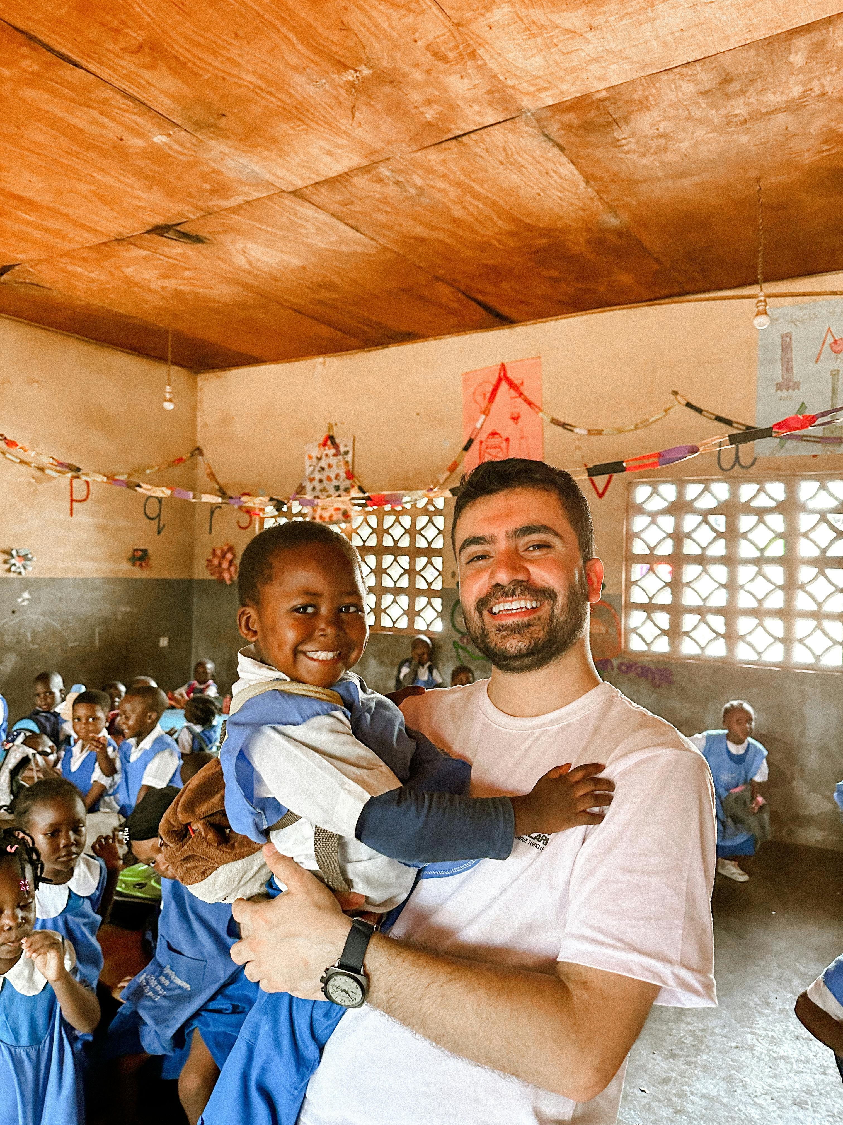

Staying Healthy During Your Service
West & Central Africa Posts
People Serve International (PSI) Empowerment Through Service
Pre-Departure Virtual Training

Slide 2

Introductions
Please type your name, host country & sector in the chat.

Slide 3

Guidelines
Mute when not speaking.
Use the chat for questions and comments.
Participate actively during polls and discussions.
Technical issues? Contact our producer!
The recording will be available after the session.

Slide 4
Agenda
1. Guidelines
2. Illnesses
3. Prevention
4. Treatment
5. Emergencies
Duration: 1 hour

Slide 5
Learning Objectives
Determine the most likely illness based on recognizable symptoms.
Implement risk mitigation strategies to minimize exposure to health risks.
Demonstrate appropriate protocols for responding to specific health conditions and medical crises.

Slide 6

True or False?
Answer in the chat.
Mosquitoes only bite at night.
You should avoid ice in drinks in-country.
Drinking bottled water is always safe.

Slide 7
Why Understanding Health Risks Matters
Complications in Non-Industrialized Setting
Routine
Stomach upset
dehydration
Toothache
severe infection
Broken arm
permanent misalignment, nerve damage, chronic pain
Reducing risk is the best defense!

Slide 8

Common Health Risks
What health risks do you think are the most common?
Type your answers in the chat.

Slide 9

Diseases Vaccines Can Prevent
Required by Host Country
Required by PSI
Chickenpox, MMR, Tetanus, Polio
Hep A & B, Typhoid, Meningococcal Disease, Rabies
Depends on Personal Situation
Cholera, BCG, Influenza
Yellow Fever

Slide 10
Diseases With No Vaccines
Malaria, Dengue, Zika
Schistosomiasis (Bilharzia)
Water/ Food
Giardia and other parasites
Freshwater
Blood/ Mosquito
SOURCE
SOURCE
SOURCE

Slide 11

Other Health Risks
Environmental Hazards
Mental Health Challenges
Sexually Transmitted Diseases

Slide 12
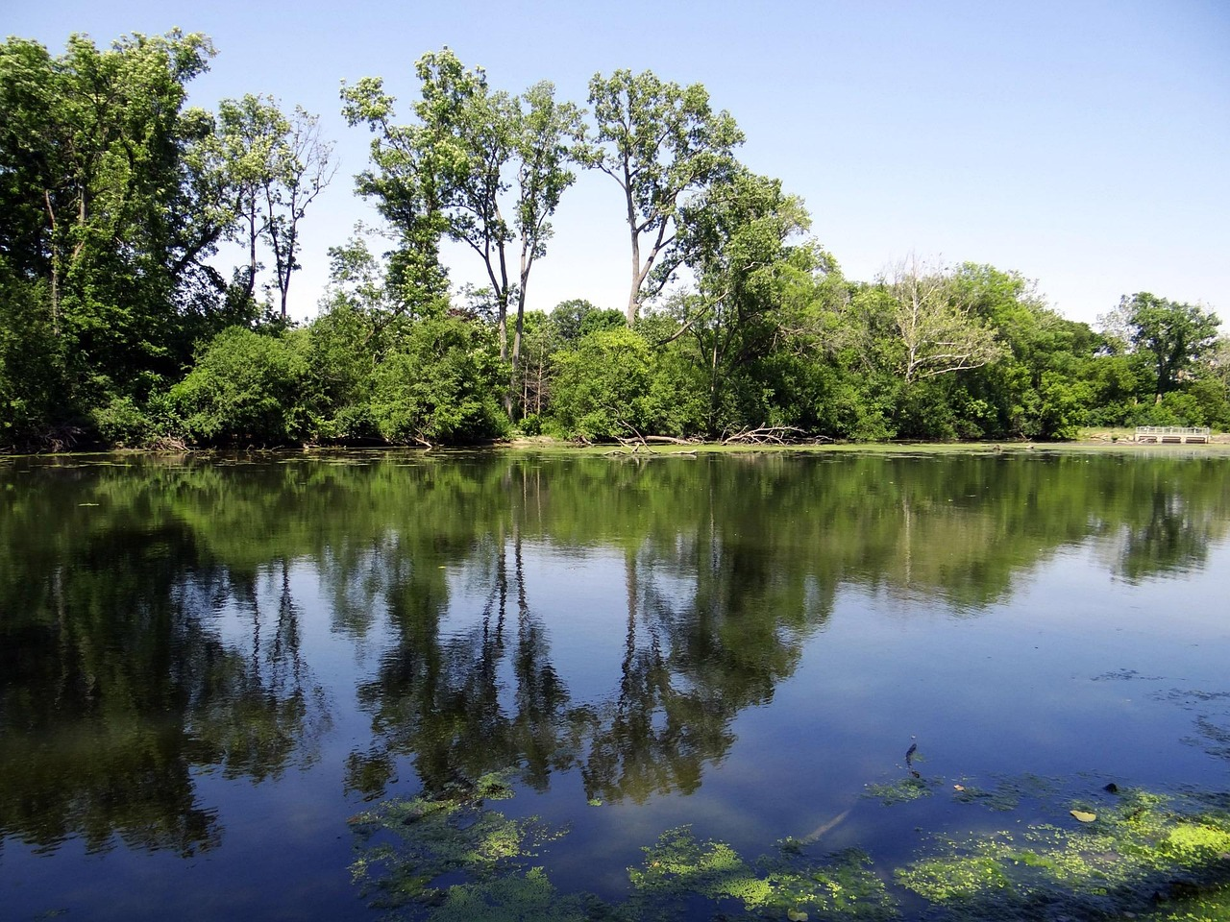

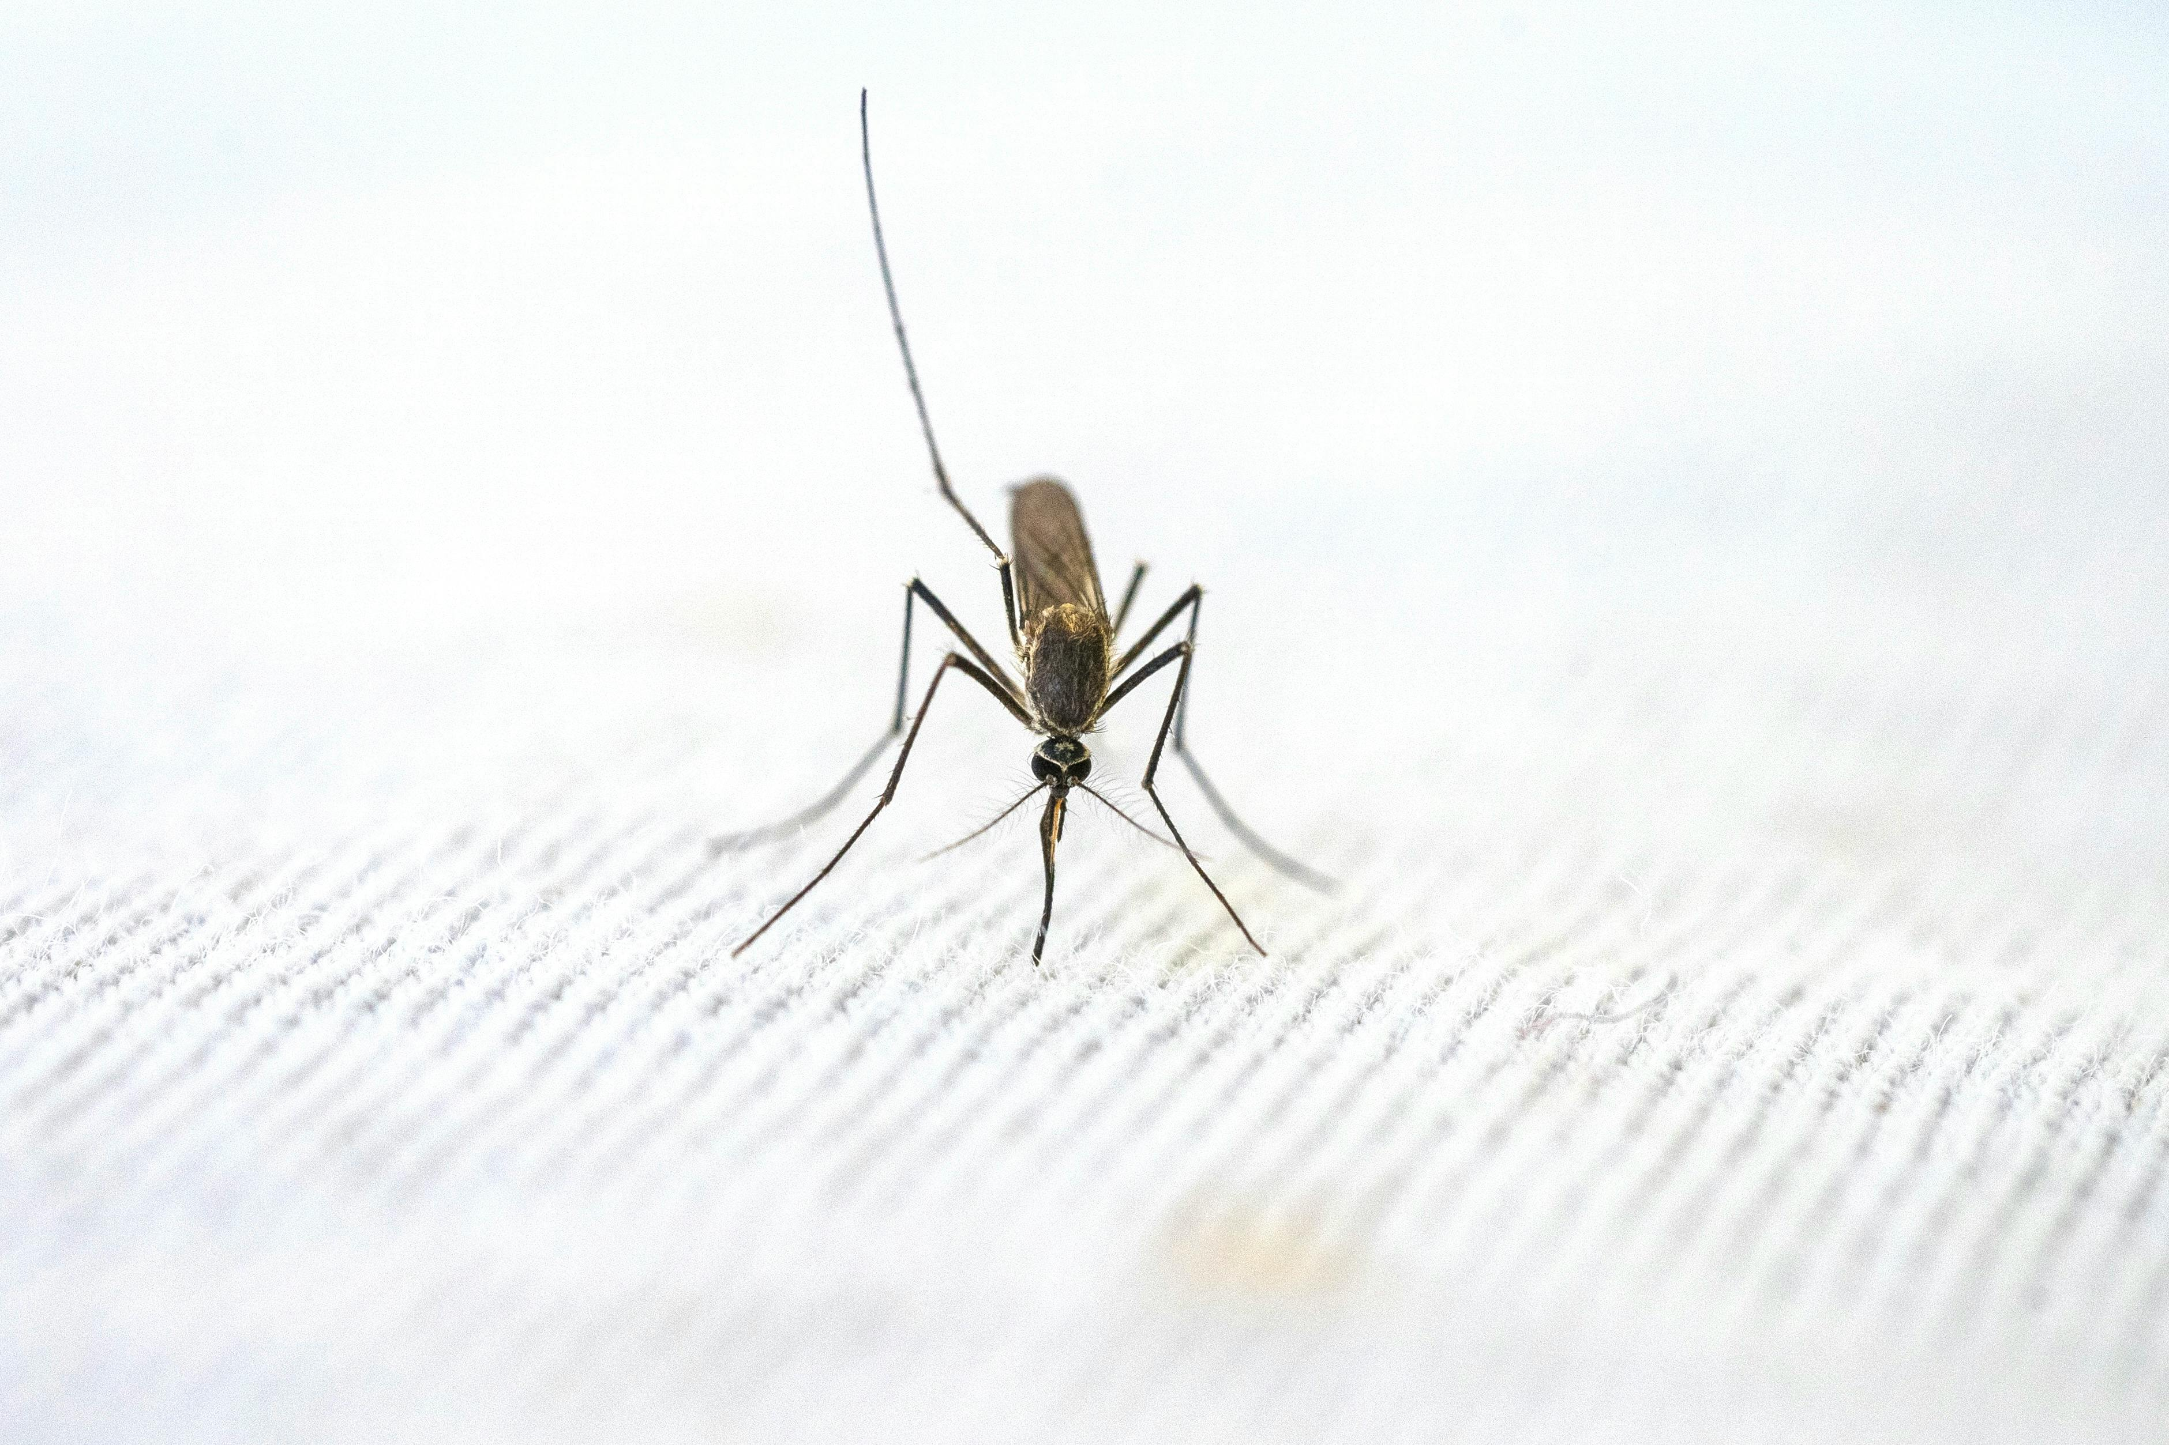
Review
Schistosomiasis (Bilharzia)
Giardia and other parasites
What is one possible illness that can come from each?
Malaria, Dengue, Zika

Slide 13
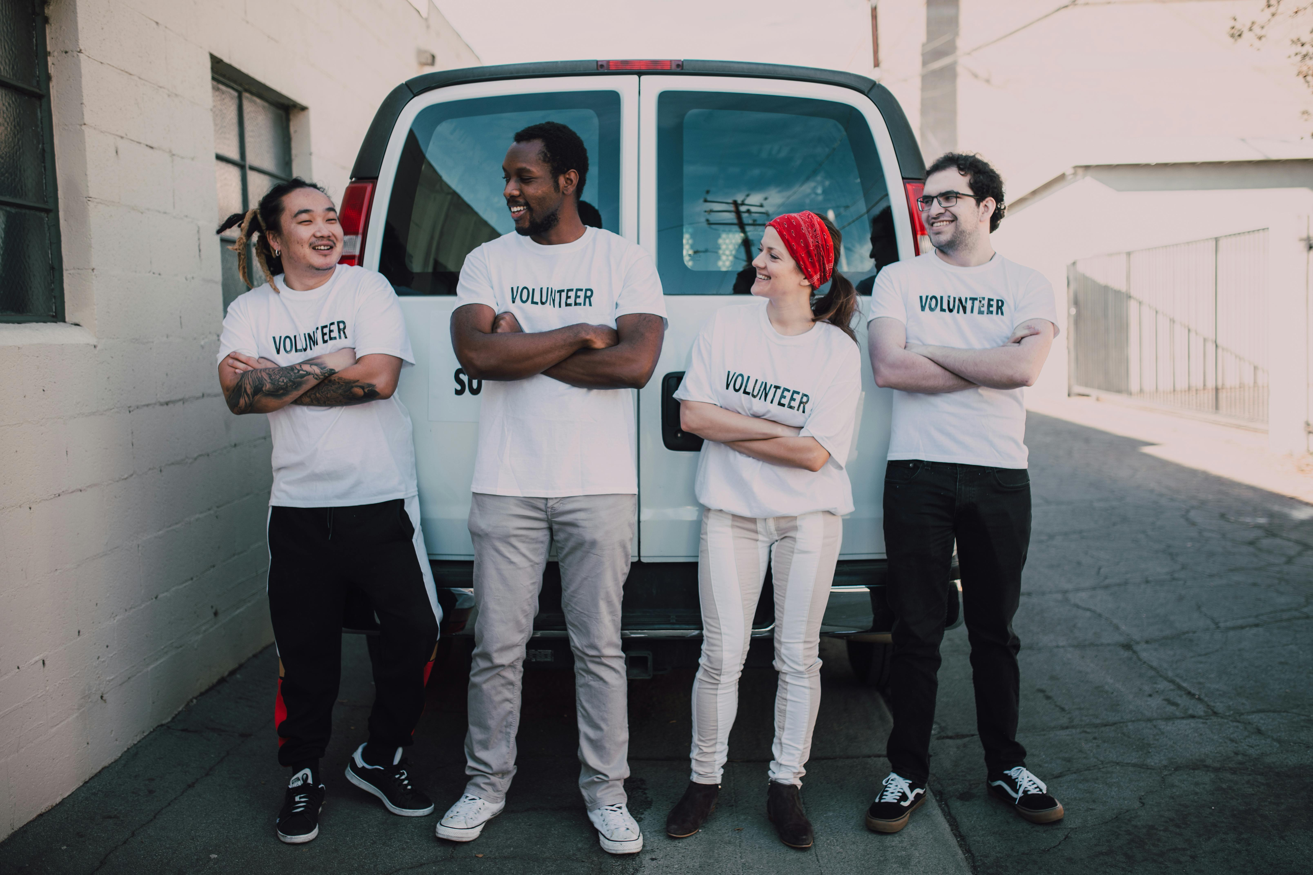
Can you stay healthy during your service?
YES!
Take the proper precautions.
We’re here to support you every step of the way!

Slide 14
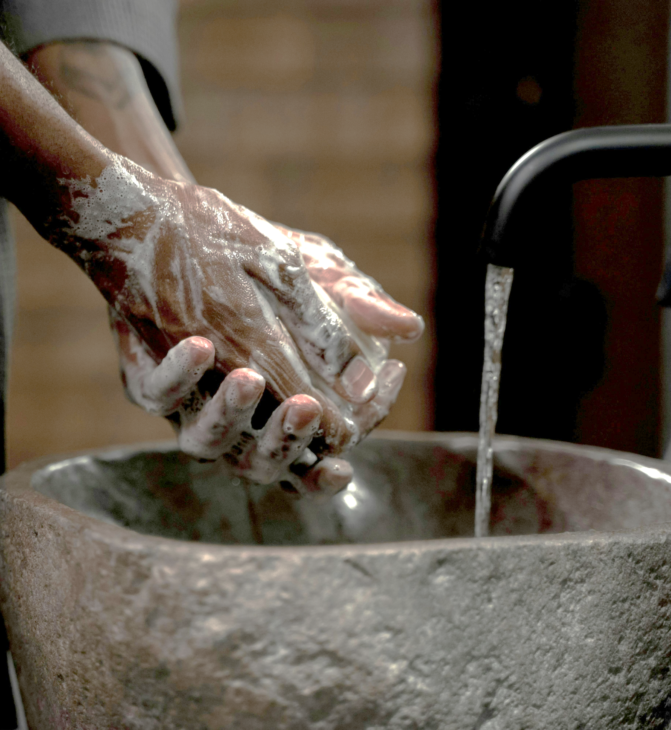
Preventive Health Measures
An ounce of prevention is worth a pound of cure.
Basic hygiene practices
Proper hand washing and sanitizing
No freshwater swimming!

Slide 15

Protection from Mosquitoes
Anti-malarial prophylactic medications
Mosquito nets
Insect repellents: with DEET, picaridin, oil of lemon eucalyptus
Long sleeves
Avoid stagnant water

Slide 16
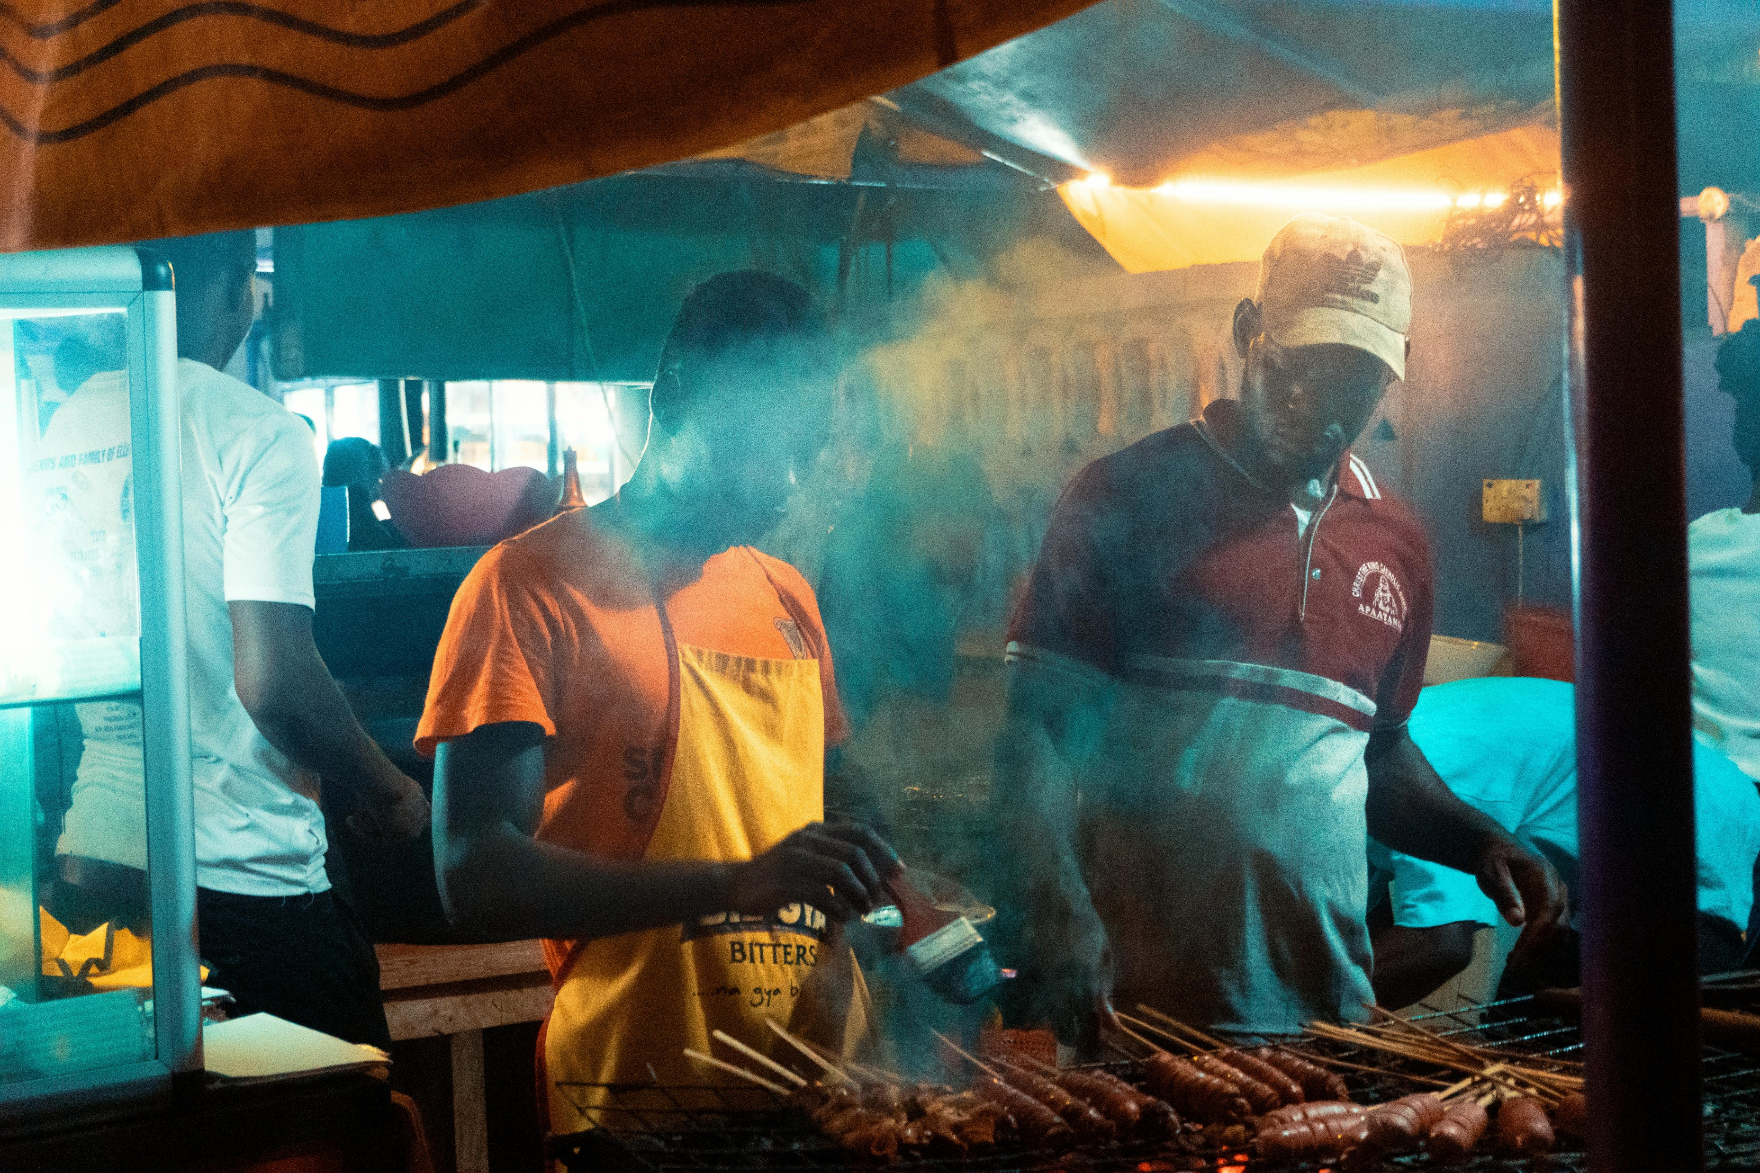
Food Safety
Street food: observe the operation first.
Raw meats and uncooked produce bring higher risks.
Eat only cooked vegetables.
Eat fruit with thick skin.

Slide 17
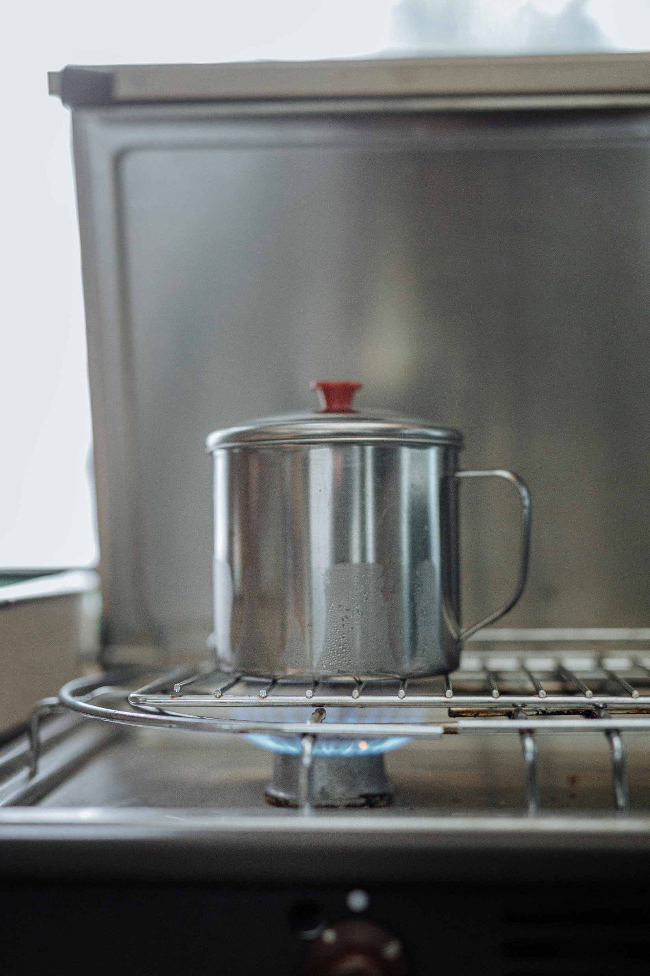
Clean Water
Avoid ice.
Brush your teeth with bottled/ purified water.
Purification:
Boil for one minute.
Add chlorine. (2 drops per liter)
Use water Purification Tablets. (Wait 30 minutes)

Slide 18

Recap
Good hygiene and proper handwashing are essential.
Use mosquito nets, repellents, and prophylactic medications.
Be vigilant about food and water safety.
Prevention is your first line of defense against health risks.

Slide 19
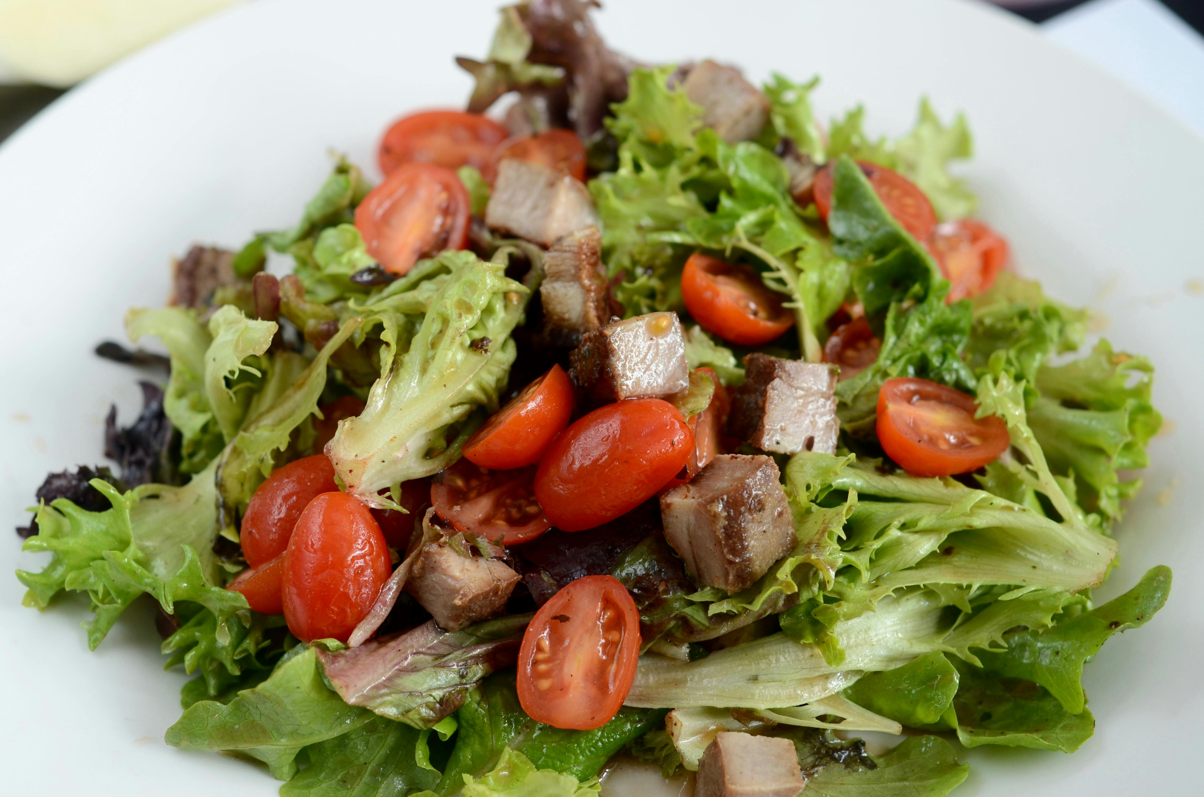
Review: Safe or Unsafe?
Type your answer in the chat.
Enjoying a boiled egg for breakfast
Taking a dip in a freshwater lake
Safe!
Unsafe!
Eating a banana you bought in the market
Unsafe!
Safe!

Slide 20


Treatment Protocols
Protocols for responding to health conditions and medical crises

Slide 21
Common Symptoms & Protocols
Symptom | Possible Cause | Protocol
Dehydration | Heat exposure, diarrhea | Drink oral rehydration salt solution.
Fever | Malaria or other disease | Monitor fever. Submit a malaria slide.
Vomiting or Diarrhea | Giardia or other parasite via contaminated food or drink | Follow the BRAT diet. Hydrate. Submit stool sample.

Slide 22
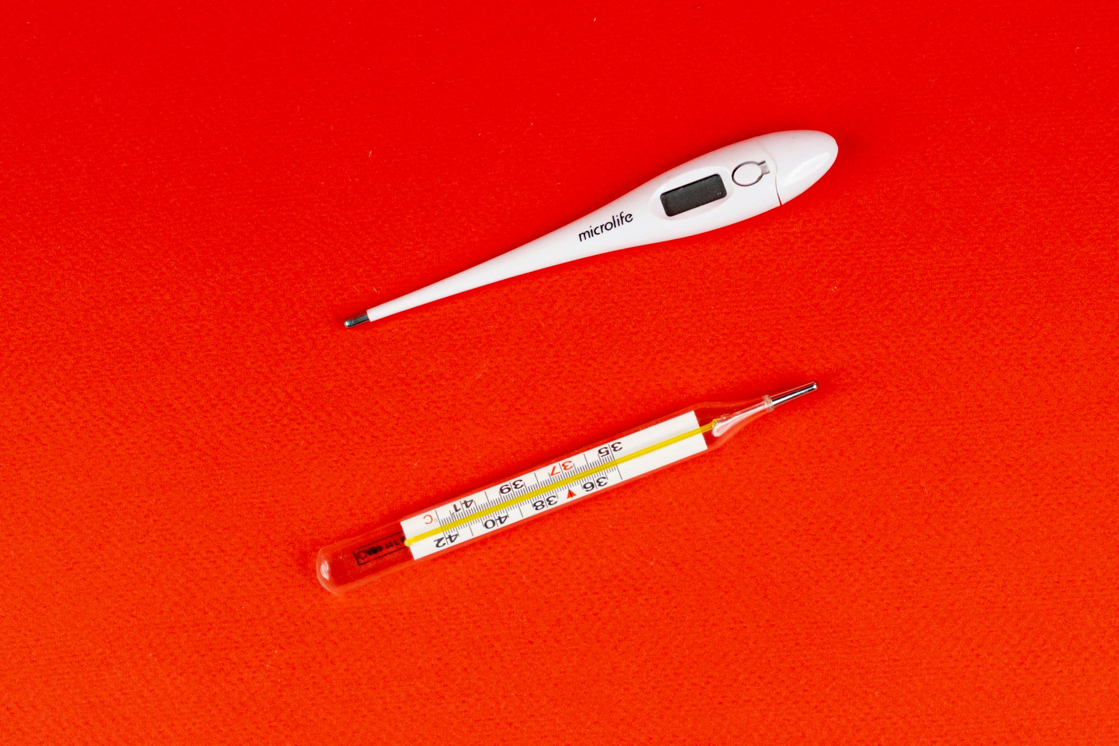
Malaria Protocol
Take a malaria slide to confirm diagnosis.
Monitor and record your fever.
Take aspirin.
Remote areas only: Take Fansidar.
Know when to self-treat versus seeking professional care.

Slide 23
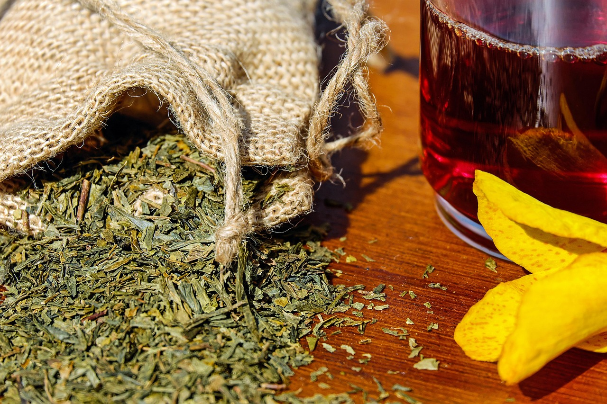
Traditional Treatments
Practitioners often use unsterilized water and tools.
PSI cannot vouch for their efficacy or their safety.

Slide 24

Breakout Room Activity
What Would You Do?
“You’ve felt fatigued, nauseous, and feverish off and on for 4 days. What could this be?
Create a Medical Action Plan, listing the steps that follow the recommended protocol.

Slide 25
Debrief
“You’ve felt fatigued, nauseous, and feverish off and on for 4 days. What could this be?
What steps do you take?”
Possible Illness: malaria, parasites
Medical Action Plan:
Take aspirin for the fever.
Keep careful record of fever.
Inform buddy of your symptoms via text. (recommended, but optional)
Make and submit a malaria slide.

Slide 26
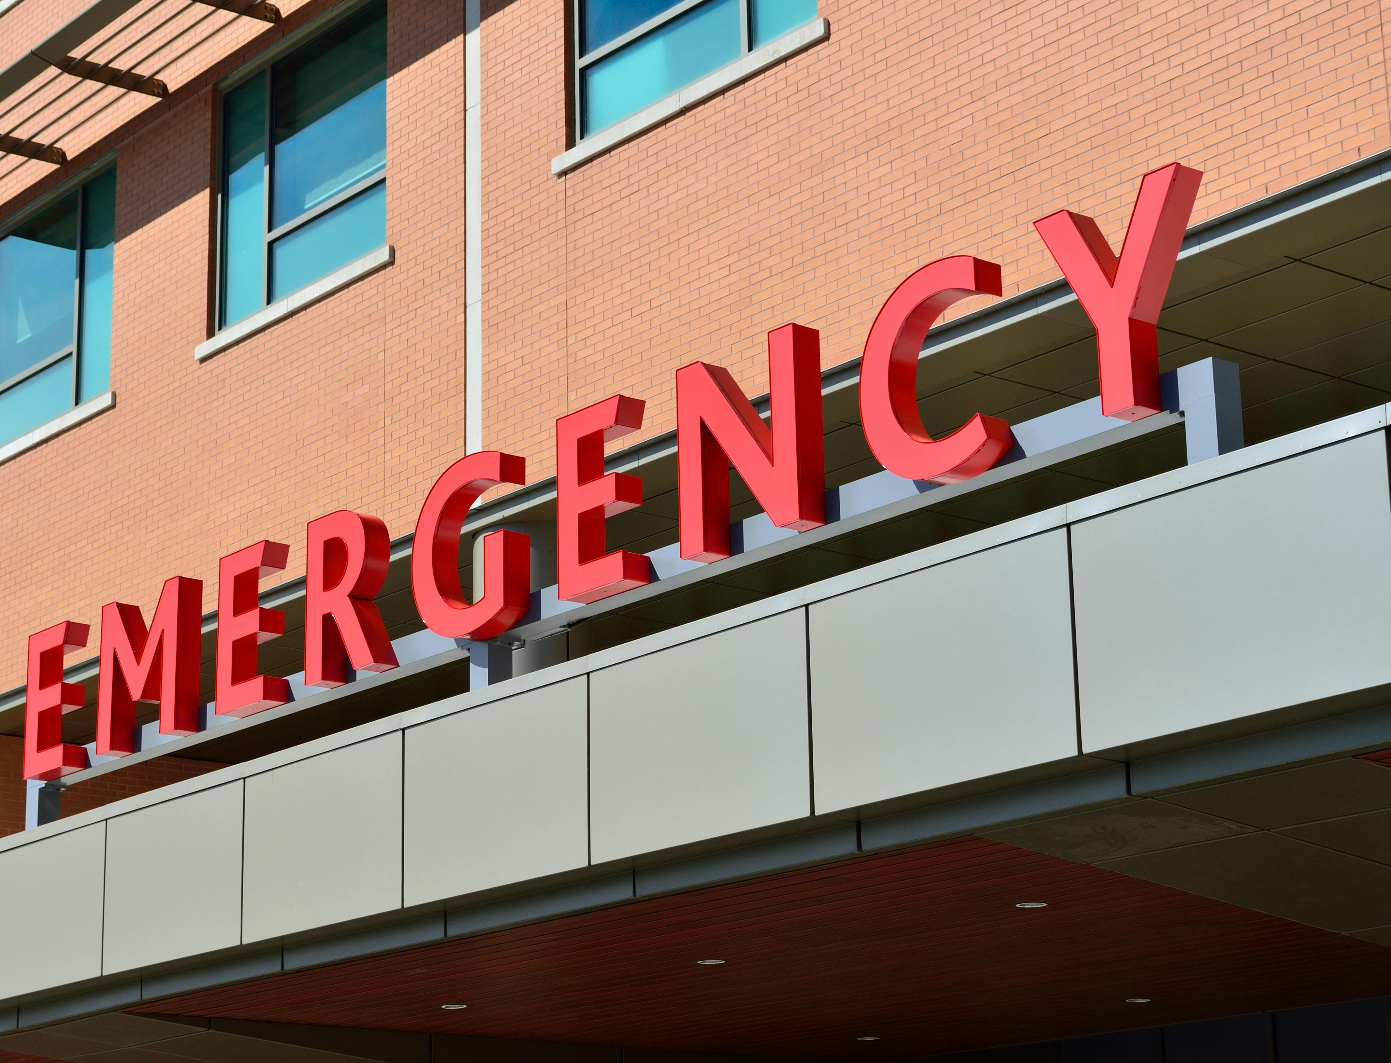
Medical Emergencies
Living in a place with no 911 services
Establish a buddy system and know your local contacts.
Have emergency contact information ready.

Slide 27
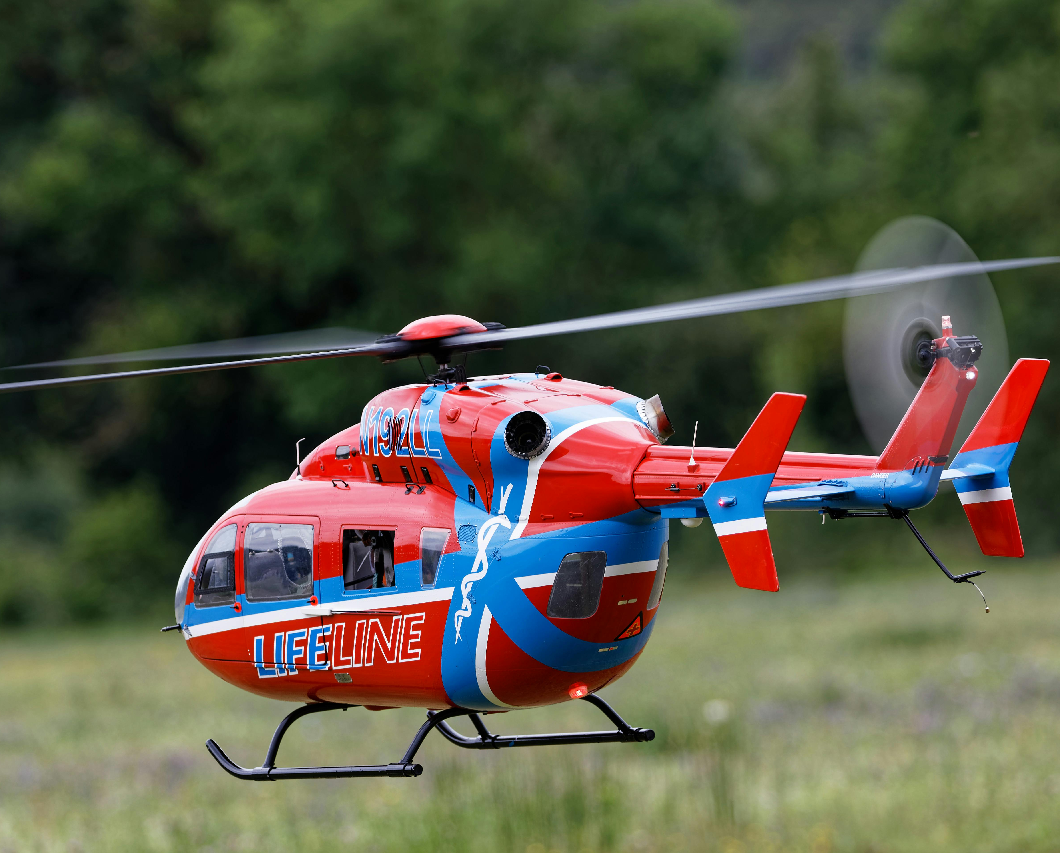
Medical Evacuation
A joint decision: local medical provider and Country Director
Local facilities understand our standards

Slide 28
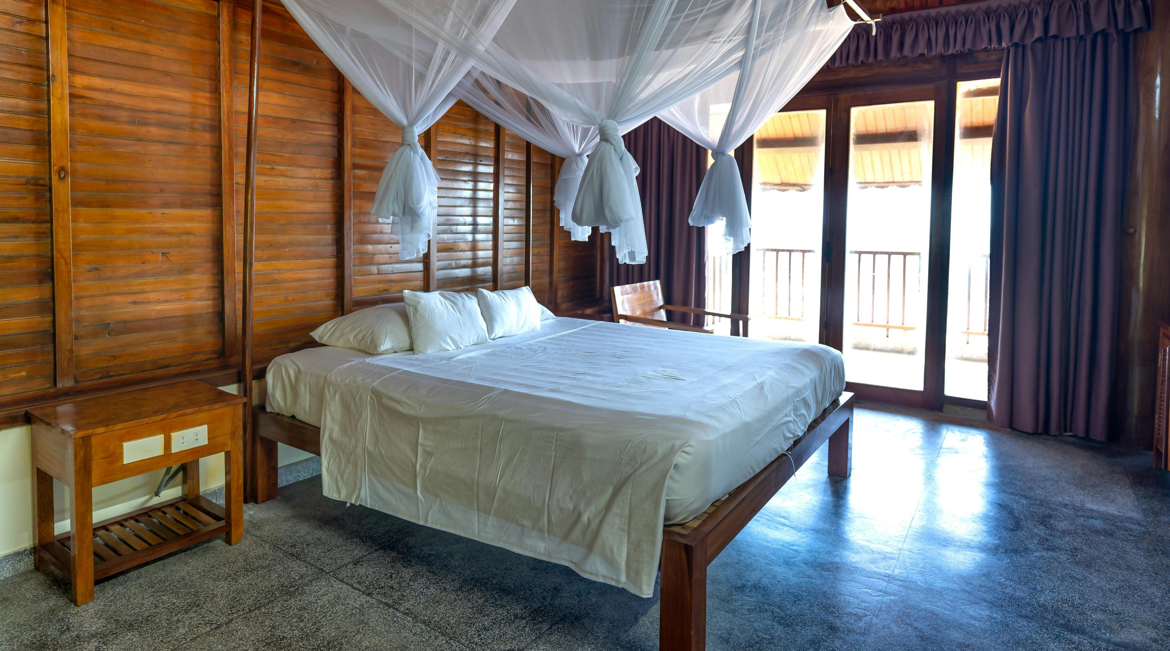
Takeaways
Describe common health risks and how they can impact you.
Implement strategies to minimize exposure to these health risks.
Demonstrate the right protocols for various health conditions and crises.
Key Takeaway: Health risks are manageable with awareness, prevention and a plan.

Slide 29
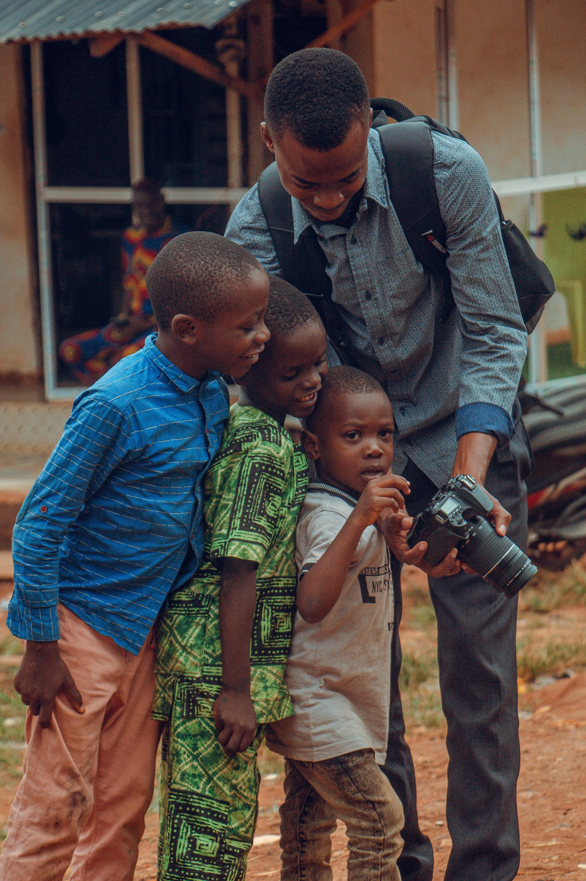
A Journey of Growth & Impact
Staying healthy means you can:
Contribute positively to the country you're serving.
Gain confidence, direction, and ambition.
Experience personal growth and a deeper awareness of our world.

Slide 30

Questions?
Type your questions in the chat or raise your hand to speak.

Slide 31
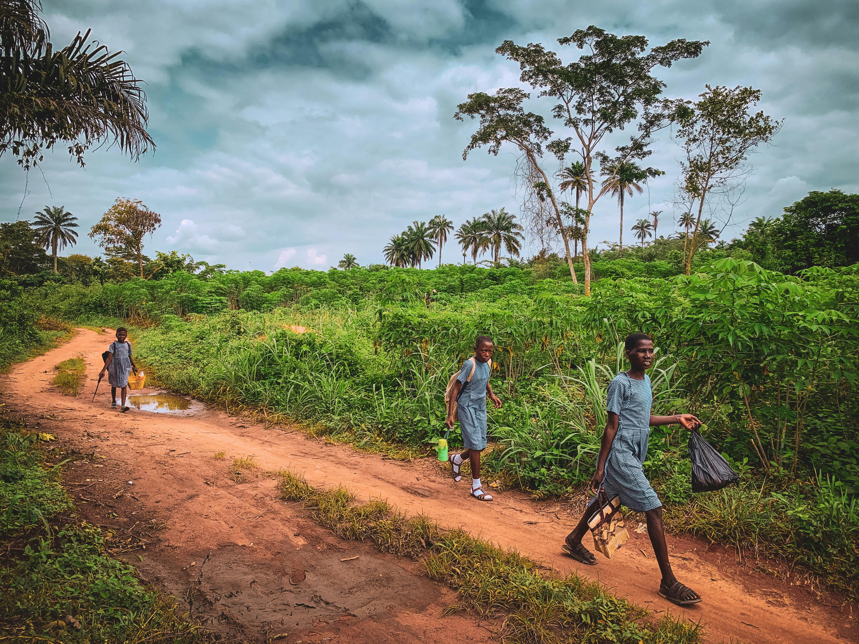
Next Steps
Read through the Health Workbook.
Feel free to email me with any follow-up questions.
Next Trainings

Slide 32
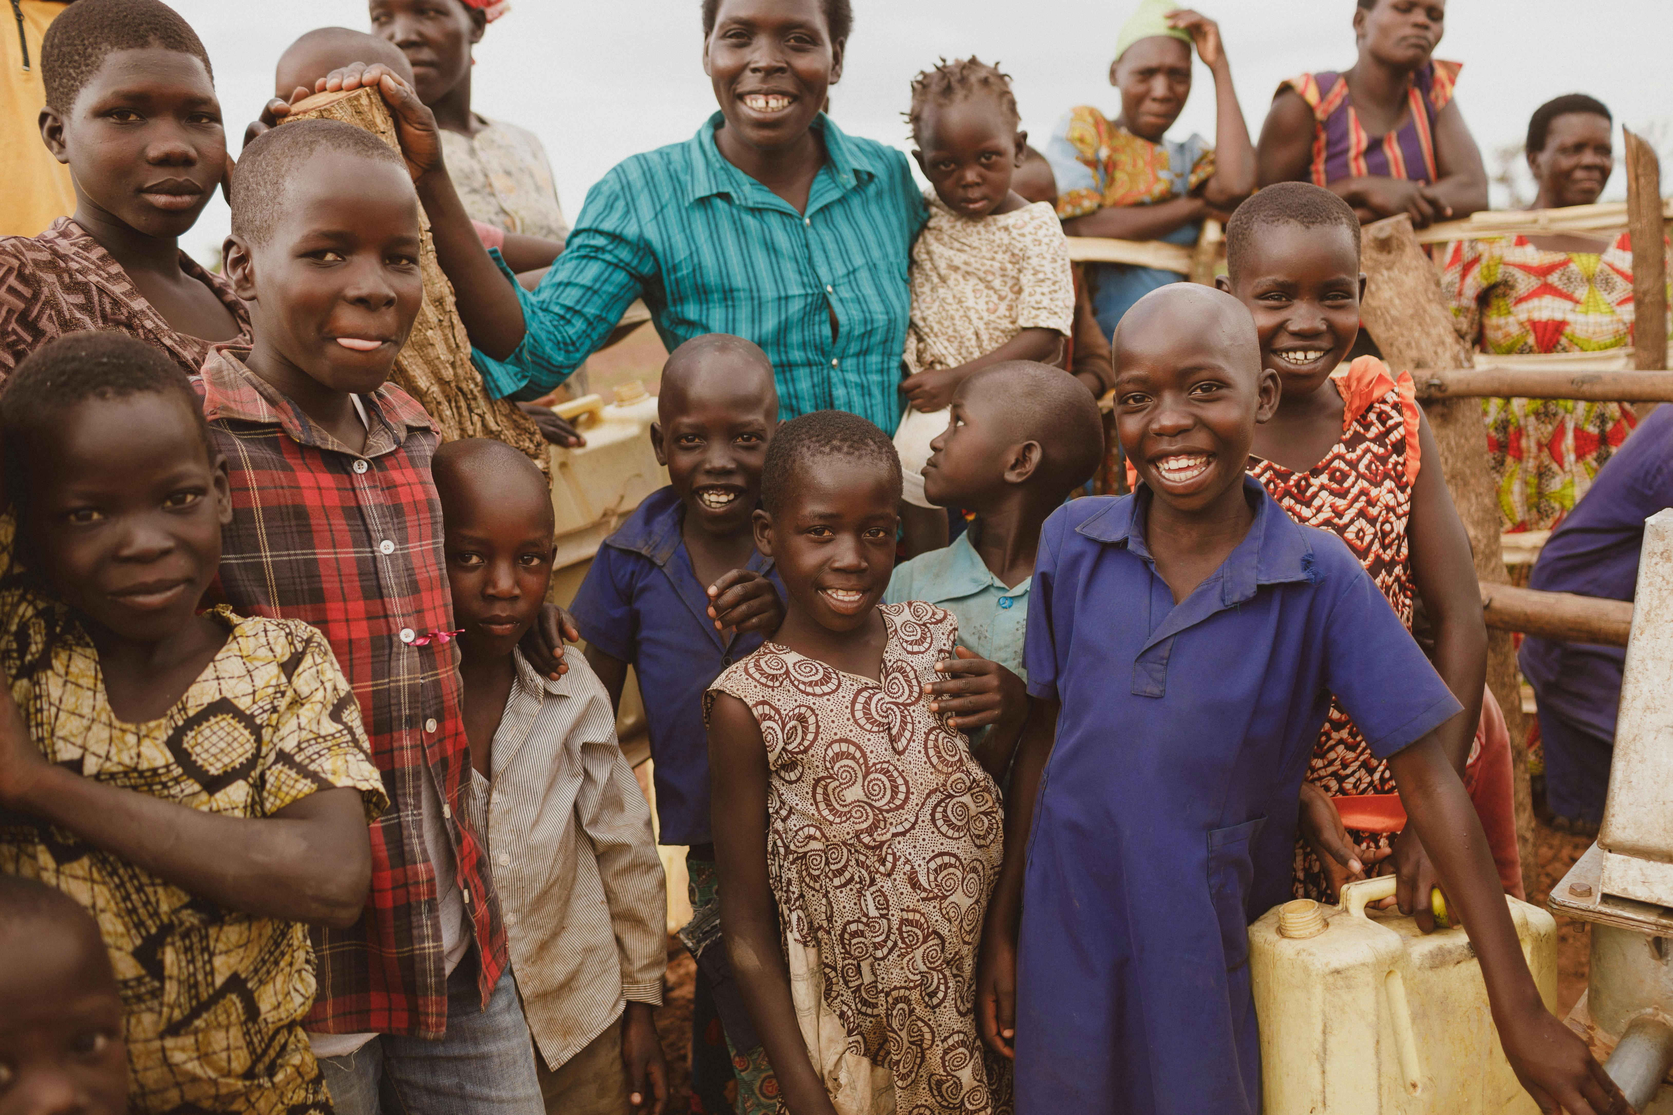
Thank you!
Contact Name
Contact Email
Contact Phone Number
www.peopleserveinternational.com/preservice

