Slide 1
REDCap at Children’s Hospital of Philadelphia
Multi-Language Management

Slide 2
What is Multi-Language Management (MLM)?
A built-in REDCap feature that enables translation in multiple languages of the “User Interface” for both data entry forms and survey display items, alerts and ASIs.
Useful for all study teams looking to increase inclusivity and diversify participation in their studies.

Slide 3
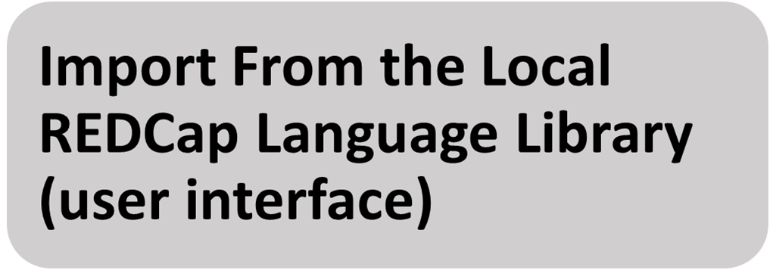
MLM Configuration

Slide 4
MLM DOES NOT auto-translate your REDCap project-specific language

Slide 5
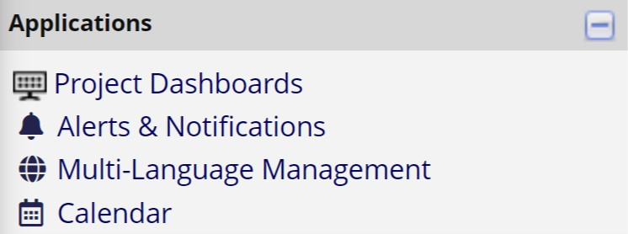
MLM: Location
MLM feature is located under the “Application” tab on the left hand side of the REDCap screen.
MLM is only visible for users with “Project Design and Setup” rights

Slide 6
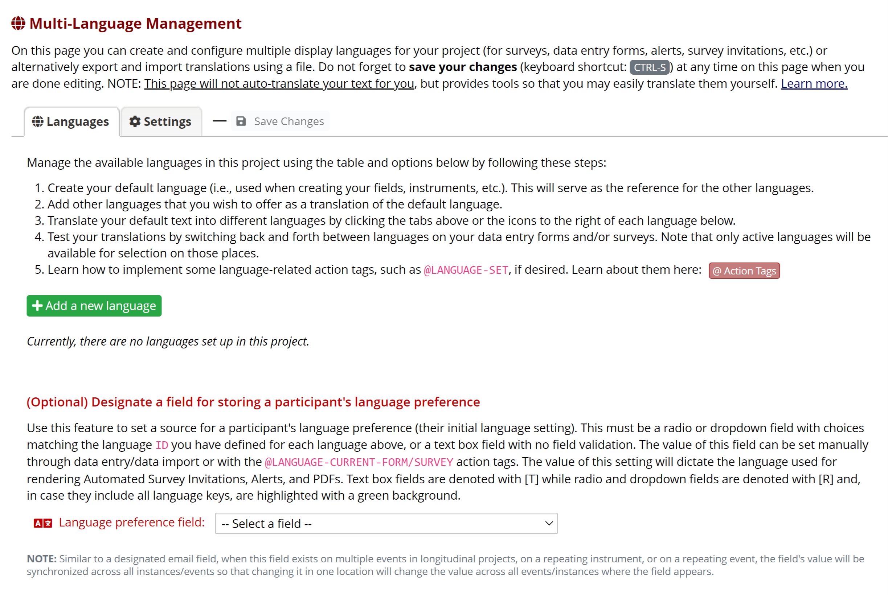
MLM: Setup Page
Add default language first: the default language is the language that is shown when no user language preference is found.

Slide 7
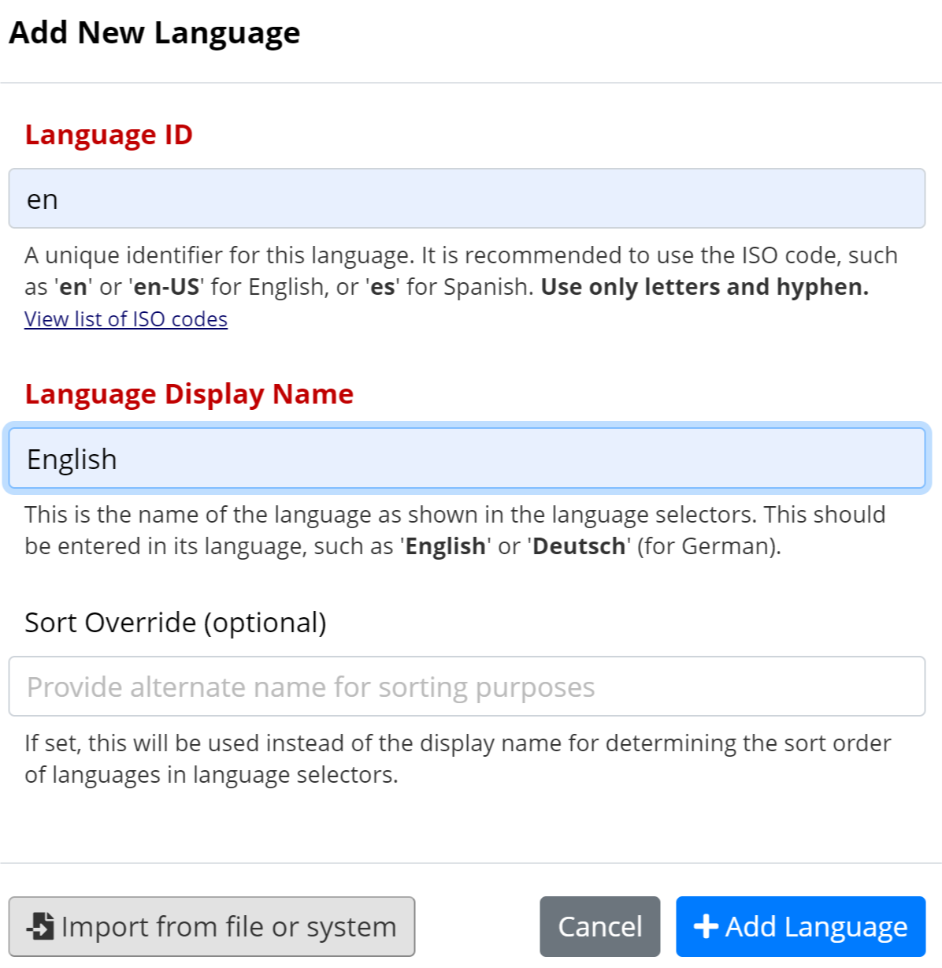
MLM: Add a new language
Method 1: Translate from scratch *** STANDARD REDCap Implementation ***
Click on “View list of ISO codes” to find your language ISO code
Type the language name you would like displayed for participants
To finish adding the new language click on “Add Language”

Slide 8
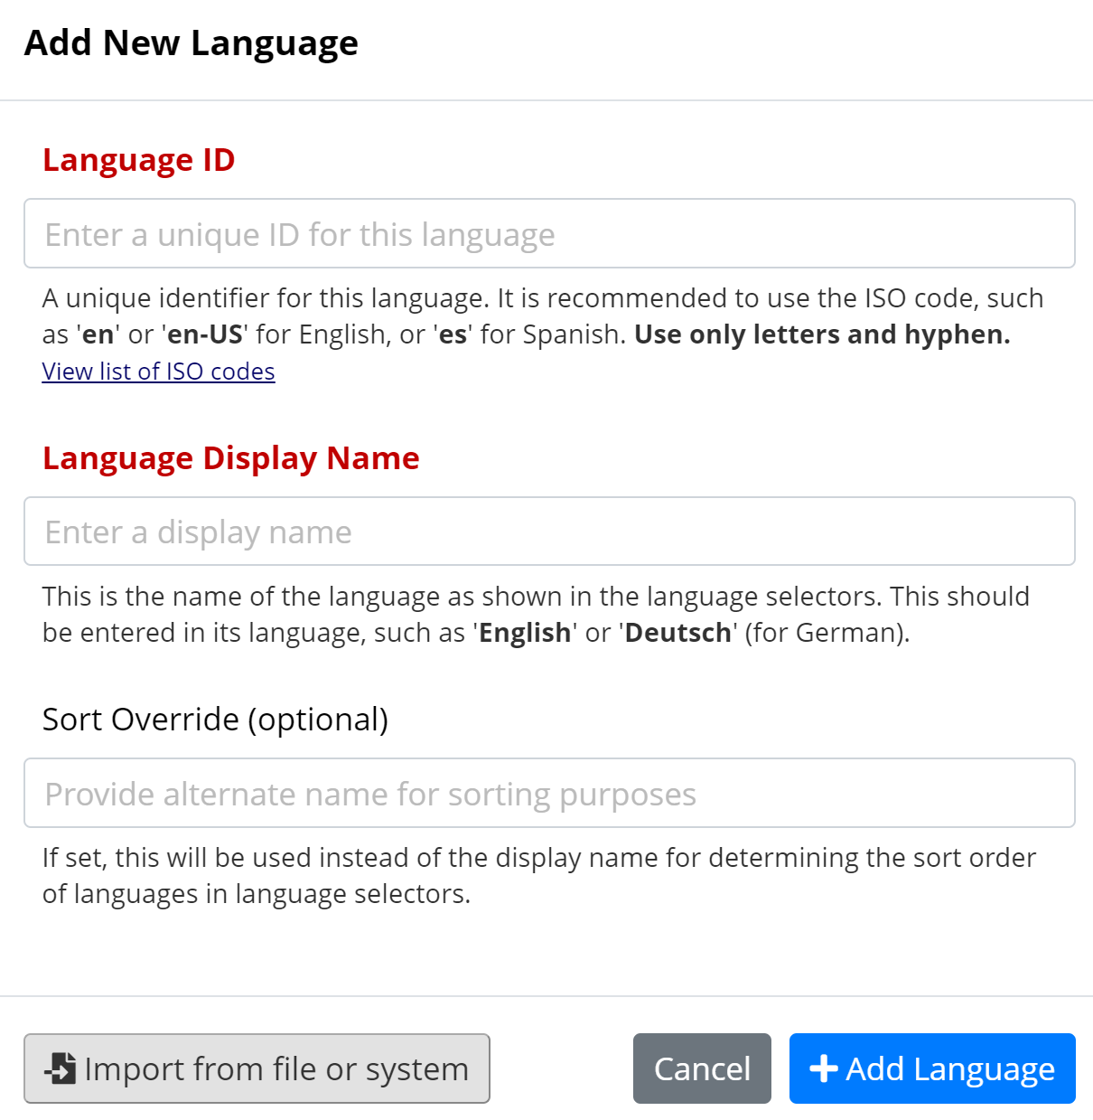
MLM: Add a new language
Method 2: Import from REDCap Library ***ONLY translate user interface***
Click on “Import from file or system” to select from available languages to translate the user interface only

Slide 9
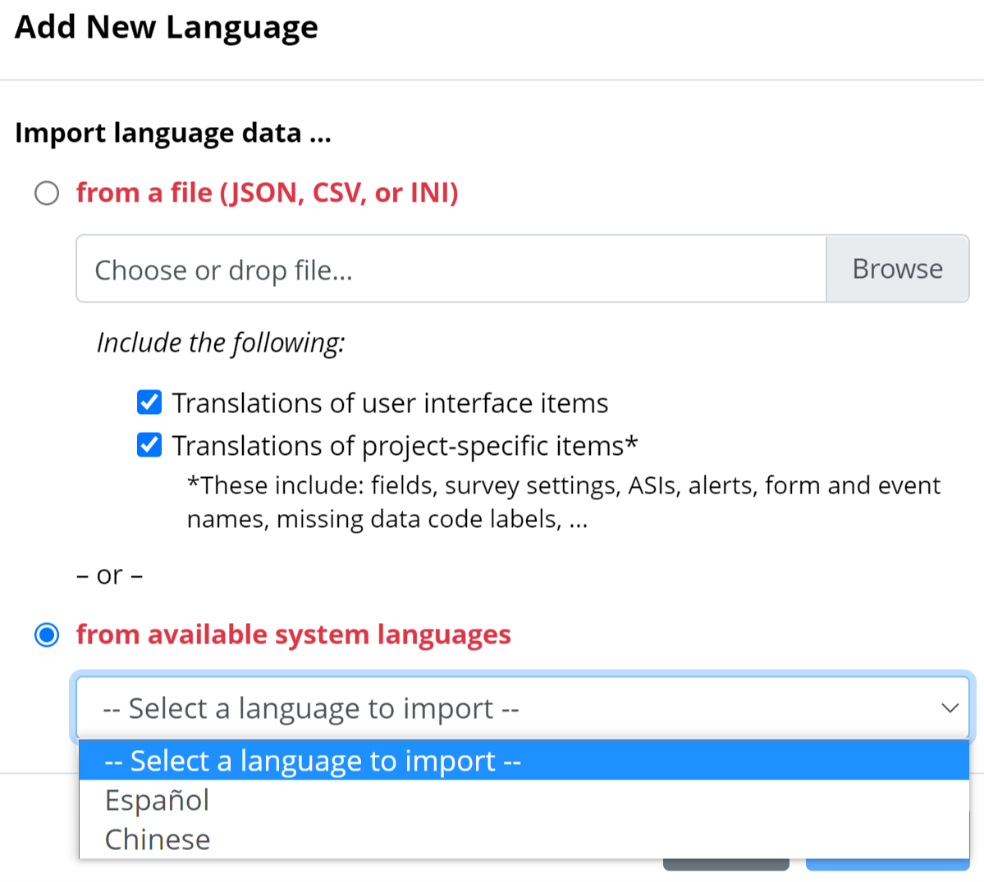
MLM: Add a new language
Method 2: Import from REDCap Library ***ONLY translate user interface***
Choose to select “from available system languages”

Slide 10
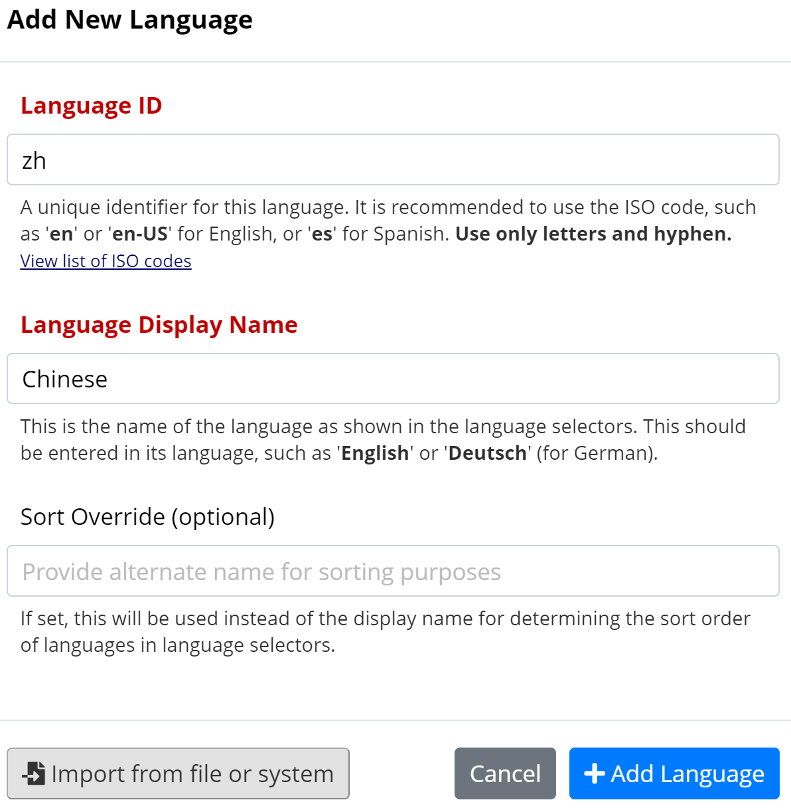
MLM: Add a new language
Method 2: Import from REDCap Library ***ONLY translate user interface***

Slide 11
MLM: Add a new language
Active = turning on and off the languages that can be chosen for translation by user or participant
Default = language shown when there is no preferred language chosen
Fallback = is the language displayed when there is no translation available
RTL (RIGHT TO LEFT) = languages read from right to left such as Arabic or Hebrew
Actions = translate, edit, export or delete languages (same as tabs above)

Slide 12
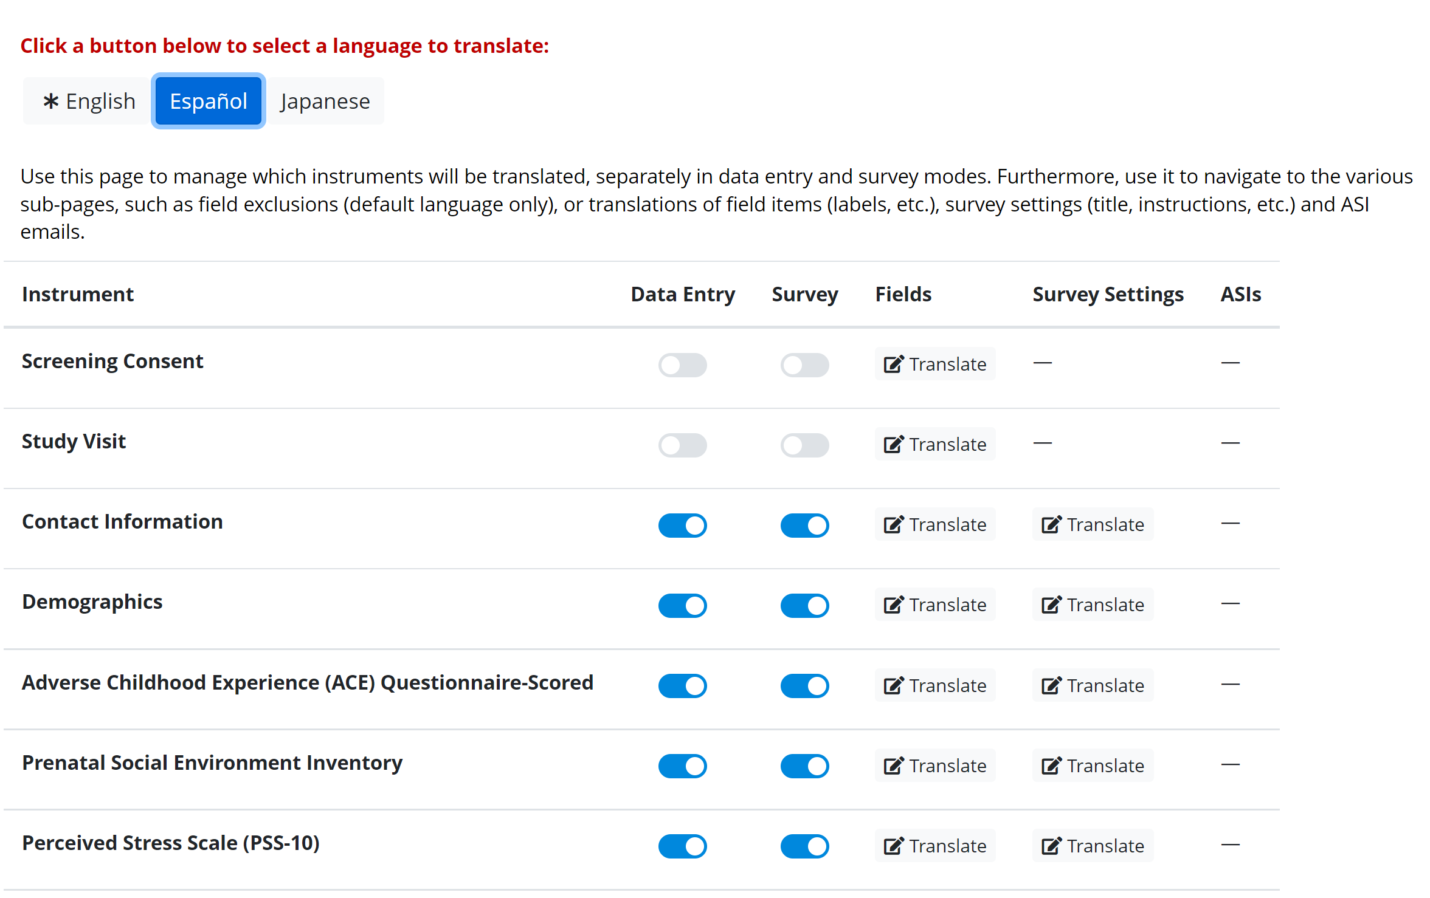
MLM: Translating from scratch

Slide 13
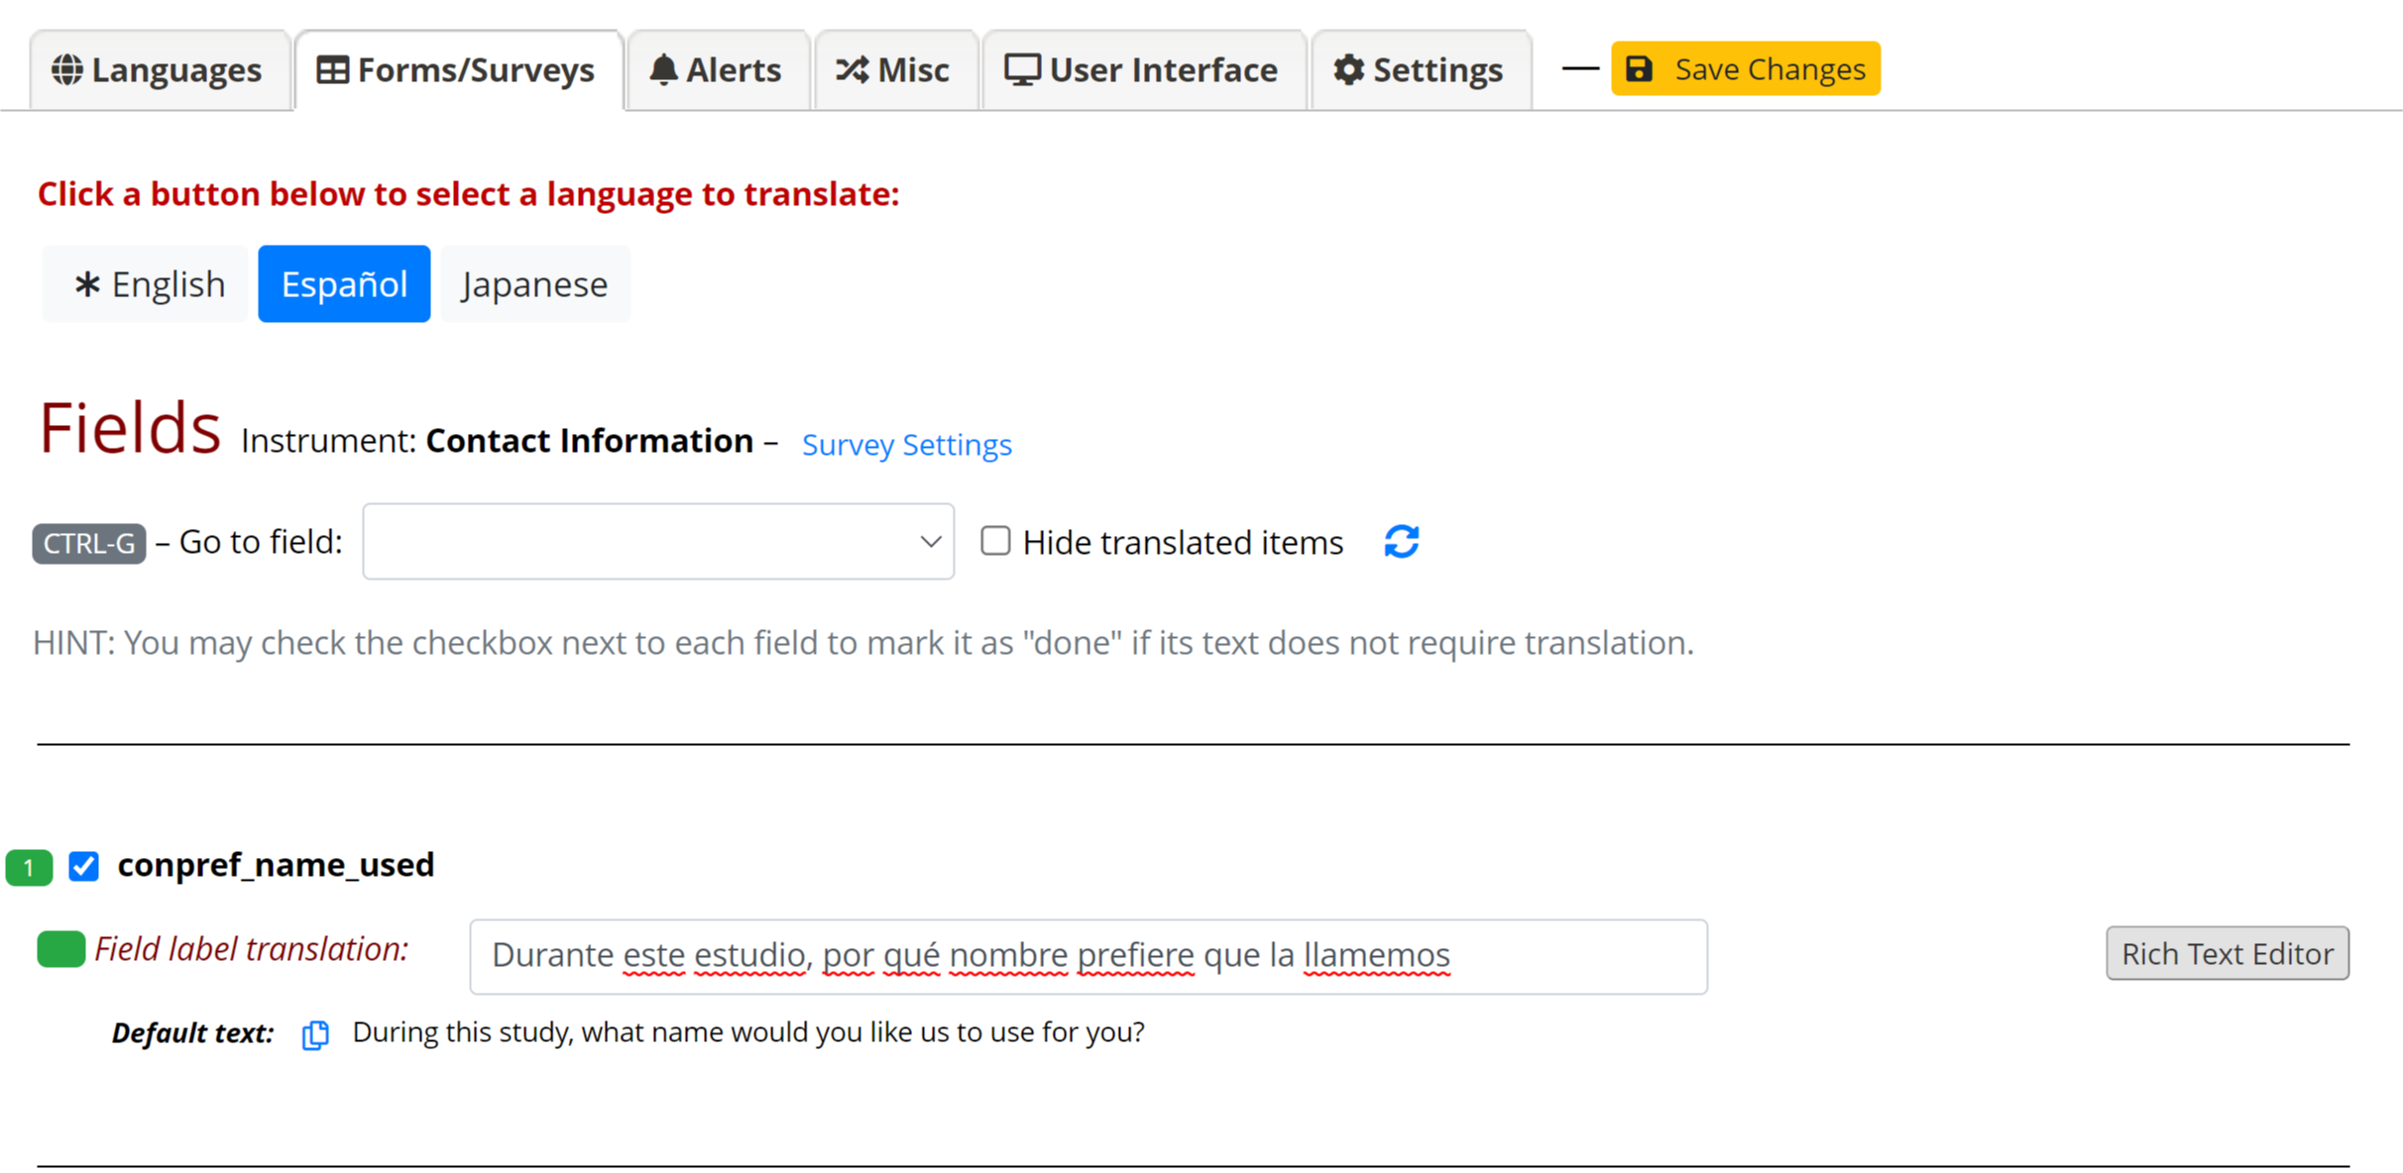
MLM: Translating from scratch
Variable name

Slide 14
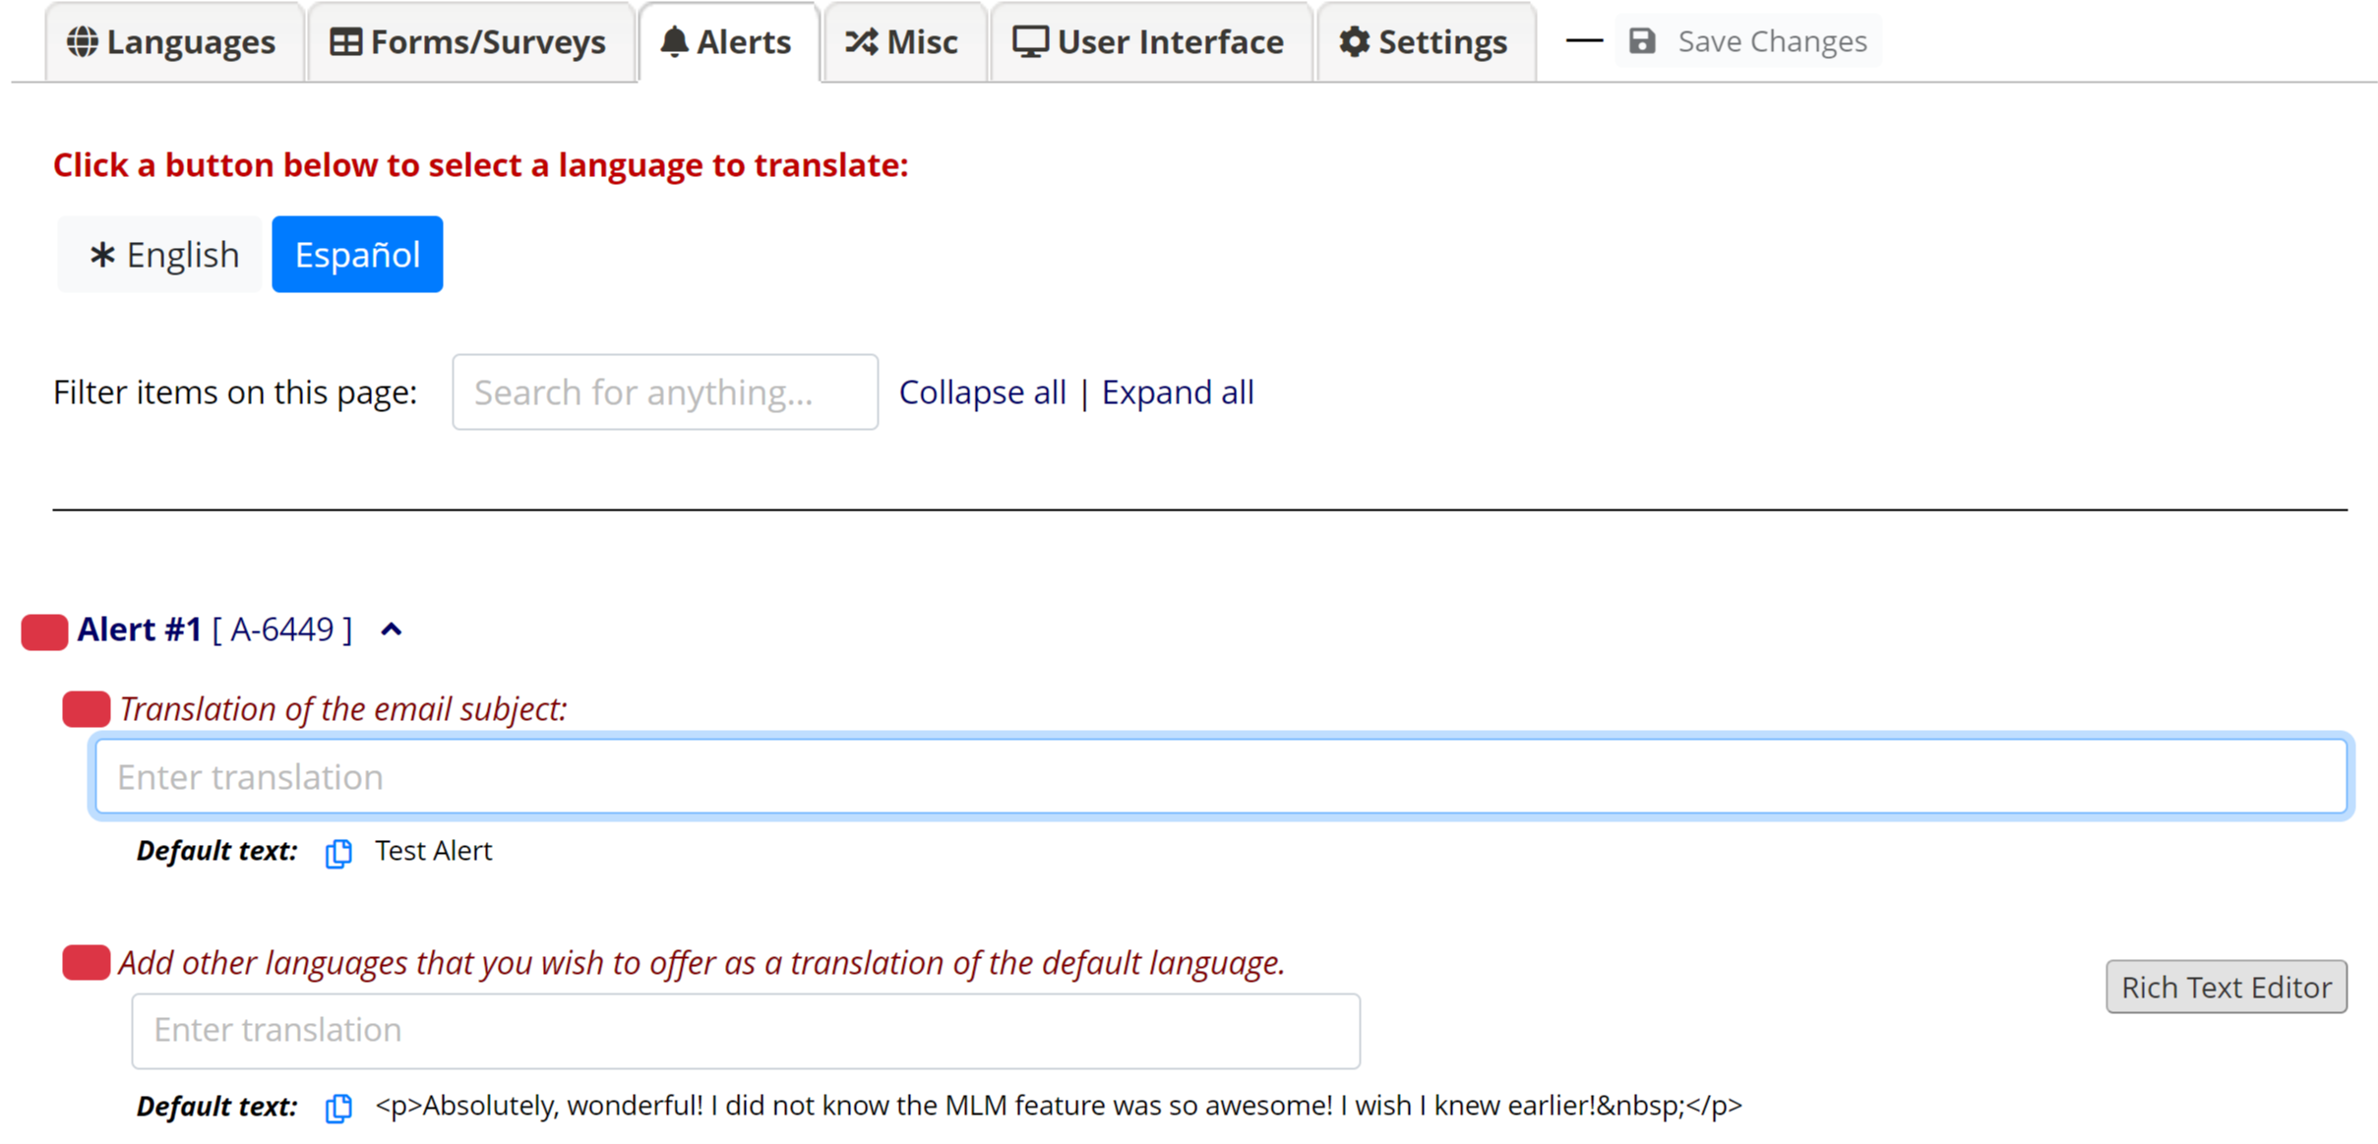
MLM: Translating Alerts
Make sure to copy all html, piped or field embedded variables into the translation text

Slide 15
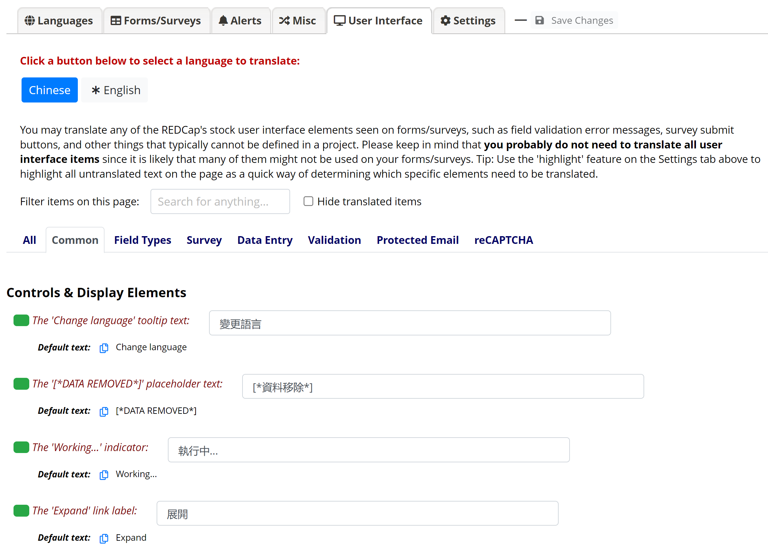
MLM: Translating User Interface

Slide 16
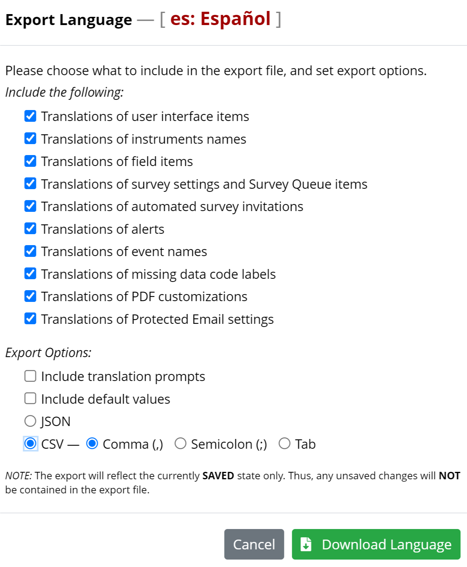
MLM: Exporting a Language
Go back to list of languages and choose the language file needed for export here
Export language file as either a JSON or CSV

Slide 17
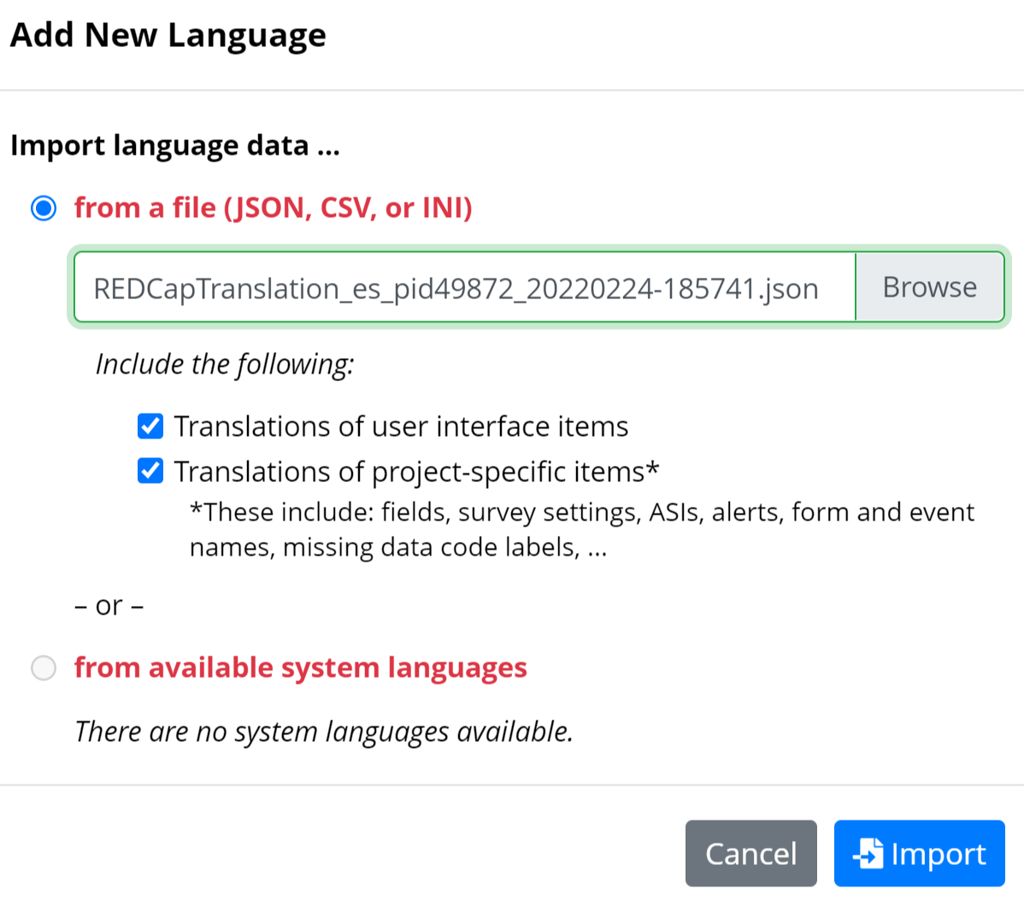
MLM: Importing a Language
Import the new language file here.

Slide 18
DEMO TIME

Slide 19
MLM: CHOP Language Services
Translation Services:
Information on translation services or link https://at.chop.edu/family-services/language-services/intranet-pages/translation-services
Request For Translation Of Documents or link https://redcap.chop.edu/surveys/?s=JJXA3R3MXH

