Slide 1
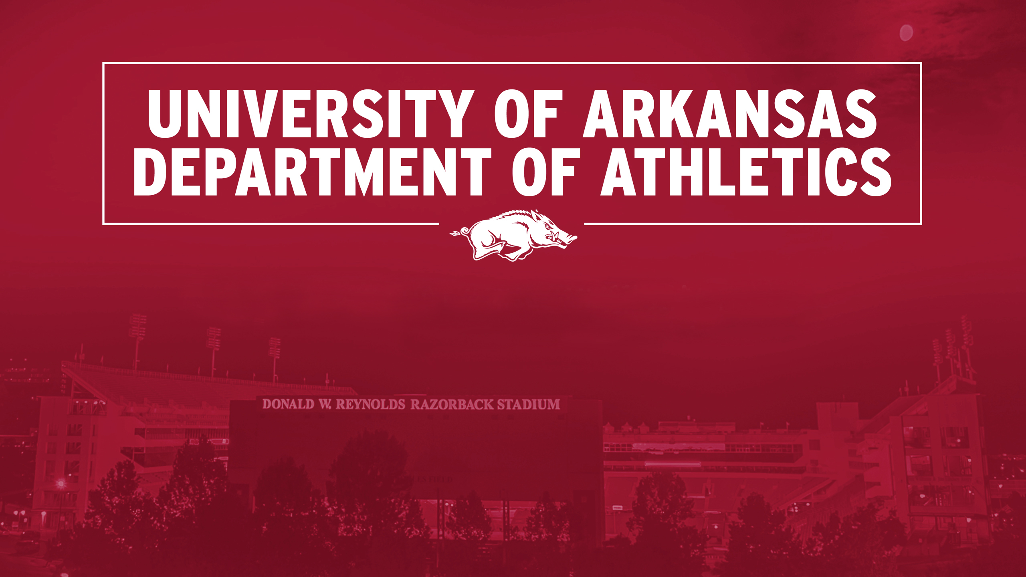
Campus Partner ICS Fair
Sept. 20, 2017
Michael Harris, Director of Licensing

Slide 2

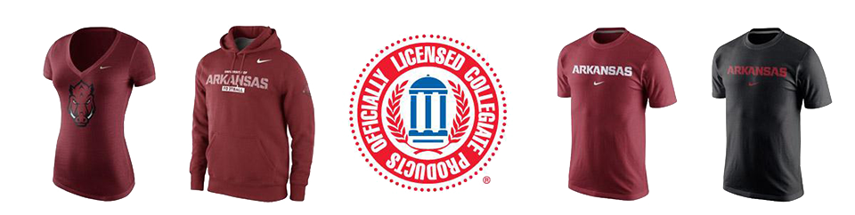
LICENSING OFFICE
Approval of all items with the University Logo, Seal or Razorback (retail or campus use)
Enforcement – Unlicensed product, counterfeiting, unapproved use of marks by companies (advertising, products)
Contracting of all licensees through Collegiate Licensing Company
Crafter’s Program (max. 500 items or $2,500 in sales annually)
The Licensing Program
3,000 Licensees
3.5 million items sold last year
  Apparel makes up 65 percent of all sales
  T-shirts and Hats are the best selling products
  Women’s market is the fastest growing apparel segment

Slide 3








TRADEMARKS
A trademark is a word, logo or package design, or a combination of them, used by a manufacturer or merchant to identify its goods or services and to distinguish them from others.
Words include:
University of Arkansas ®
Arkansas ®
Razorbacks ®
Wooo Pig Sooie ®
Wooo Pig ®
Pig Sooie ®
Go Hogs ™
Hogs ™
Sooieet ™
Note: The appropriate “cardinal” is the color PMS 201.

Slide 4
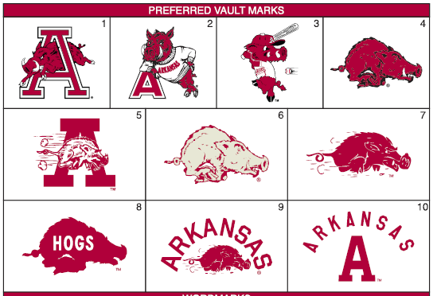
VAULT MARKS

Slide 5

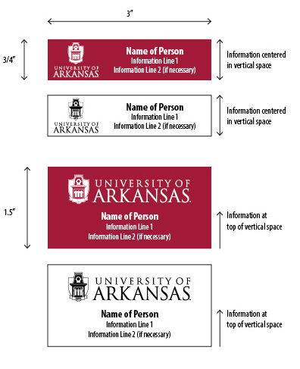


TRADEMARKS
Nametags
Working with Licensees to get to this format over the next year.
University Seal
Official Documents like diplomas and certificates
Limited retail like padfolios/folders, sweatshirts and T-shirts
Academic & Administrative Lock-ups
Myriad Bold Condensed Font first line below the bar
Myriad Condensed italics on the second line
Every Office and Department has one. Contact University Relations if you need it.

Slide 6






COMMON MISTAKES
Incorrect
Correct
Incorrect
Correct
Logo and Words should appear together
The body of the Razorback should be lighter than the outline
Incorrect
Correct
Incorrect
Correct
Woo Pig Sooie
Wooo Pig Sooie
The shield should always be lighter than Old Main Tower

Slide 7
GENERAL PROHIBITIONS
University trademarks (words or logos) CANNOT BE USED in association with:
Alcoholic Beverages
Illegal drugs
Cigarettes or other tobacco products
Sexually oriented products or services
Religious affiliations (exception for RSOs group names)
Products or organizations
Political campaigns (including campus elections), parties or organizations
Private gaming or games of chance
Firearms or other weapons

Slide 8

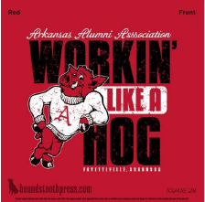
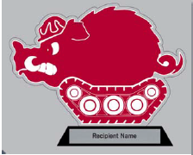



POLICY CHANGES
Recent policy changes:
NO CARICATURES of the Razorback
We are working with IMGCL to create a standardized “Big Red” mascot that can be used instead
NO DESIGNS INSIDE the Razorback
SPONSORSHIPS
Groups with rights to use the University logos can have sponsorships for its own events using University Marks.
Not Permitted
Permitted

Slide 9
USING THE TRADEMARKS
CAMPUS DEPARTMENTS:
  CAN use the University Old Main Shield logos
  CANNOT use the Razorback or Athletics trademarks
  CANNOT use older “Vault” logos (University or Athletics)
  CANNOT use “caricatures” of a Razorback

Slide 10

LICENSED VENDORS
Collegiate Licensing Company (CLC) manages all marks associated with the University and collects and distributes royalties.
  Royalties are based on a percentage of the wholesale price of a product to a retailer.
It is necessary to use vendors (local or national) that are licensed through CLC to print/produce items with licensed words or marks.
A complete list of licensees and their contact information is available by contacting Licensing Office (harrismr@uark.edu) or Procurement.
If there is not a licensed vendor that makes the product you are looking to do, have your vendor contact me via email to look into a one-time license

Slide 11
QUESTIONS?
THANK YOU!
Wooo Pig Sooie!
®

