Slide 1

Tap into AAA: Help, Deals and Value at Their Fingertips

Slide 2


Slide 3
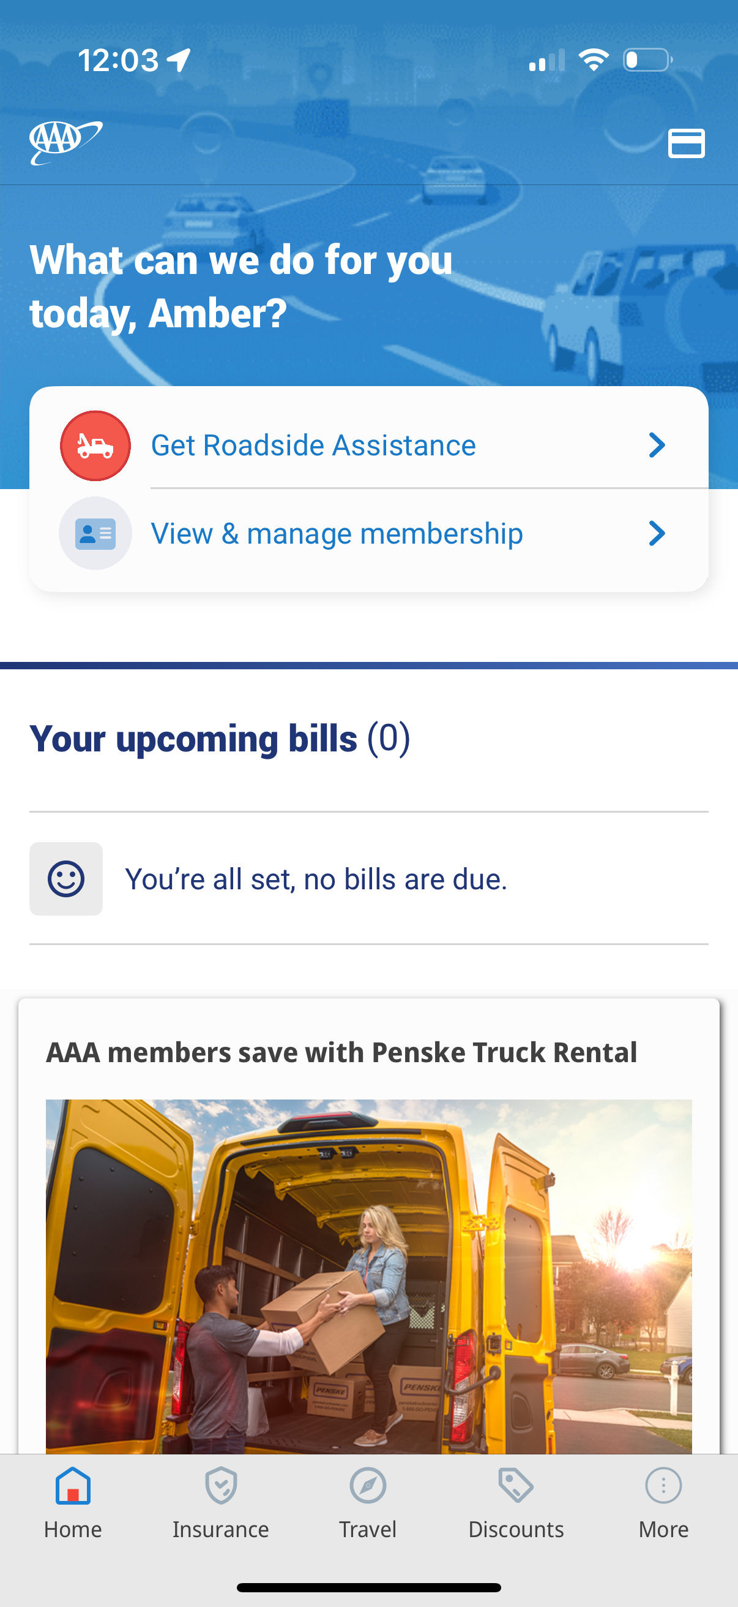

How to Download the AAA Auto Club App
Android or Apple App Store
Scan this QR Code
Enter Zip Code
Follow Instructions
Important: Member ID number will be needed to set up account

Slide 4
Move the Needle on KPIs
Member Satisfaction
Revenue per Member
First-Time Resolution Rate
Operational Cost Reduction
Mobile App Adoption

Slide 5

The Digital Drive Challenge
Are you ready for a scavenger hunt?

Slide 6

“My car won’t start. Can you help me?”

Slide 7

“Can you tell me which hotels in Cancun give AAA discounts?”

Slide 8

“I need to cancel. It’s too expensive and I need to save money.”

Slide 9
Every member. Every interaction.
Unlock their AAA world with just a tap.

Slide 10
Be a AAA App Advocate
Always ask “Do you have our app yet?”
Offer app setup help.
Highlight one relevant benefit based on your conversation.
Keys to driving digital adoption:
Actively listen for opportunities to showcase membership benefits.
Showcase something new the member didn’t know about.
Anticipate questions and provide clear responses.
End the member interaction on a positive note.

