Slide 1
Human Body Posture Detection & Correctness System
Ayush Shrivastava (15UCC009)
Sangeet Sagar (15UEC053)
Department of Electronics and Communication Engineering
The LNM Institute of Information Technology, Jaipur
May 2018
Jaipur)
1 / 17

Slide 2
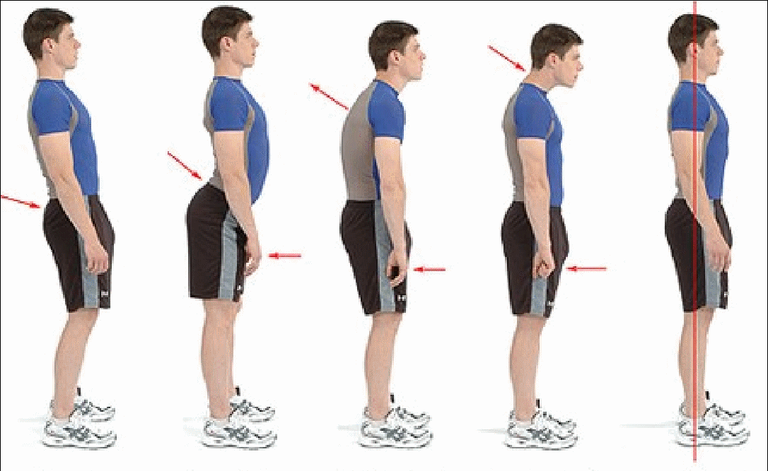
Outline
Introduction
Literature Survey
Proposed Work
Implementation
Results
Discussion and Future Work

Slide 3
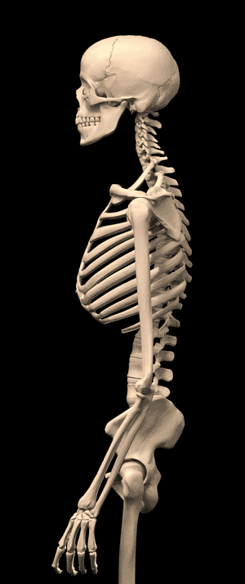
Problem Statement
Build a real time human body posture detection and correctness system using accelerometer sensor and NodeMCU (ESP8266). Also, build a mobile app to caution the user in case his/her posture is incorrect.
Real time model training and data mapping.
Poor body posture prompts numerous medical problems. Wrong posture issues, which extend from back agony to weariness may ascend and influence our day by day exercises.

Slide 4
Introduction
Posture is a way in which a human holds his body so that there is less strain on muscles during movement.
Poor body posture leads to many health issues. Incorrect posture problems, which range from back pain to fatigue may rise up and affect our daily activities.
A wearable device has been designed in the form of belt. The main aim of the system is to detect the correct or incorrect posture by detecting the changes occurring in human posture using sensors like accelerometer.

Slide 5
Literature Survey
Sonali Chopra, “Wearable Posture Detection and Alert System”, Proceedings of the SMART -2016
Verified the system by sitting in different postures like (moving forward, backward, tilted in different directions, straight etc).
“Detection of posture and motion by accelerometry: a validation study in ambulatory monitoring”,F. Foerster, M. Smeja, J. Fahrenberg.
Four sensors (IC Sensor Model 3031) were used for detection of posture and motion
The Vitaport 2 (Vitaport EDV Systeme GmbH, Erftstadt, Germany) was used for the multichannel recording.

Slide 6
Proposed System
We will be using ADXL335 accelerometer sensor which measures the acceleration force.
Inquire about and configure the correctness of the general postures
Configure accelerometer with the NodeMCU.
Investigate and compute the output of the accelerometer as analog output to give the desired outcome.
Build a mobile app and a web server for the user.

Slide 7
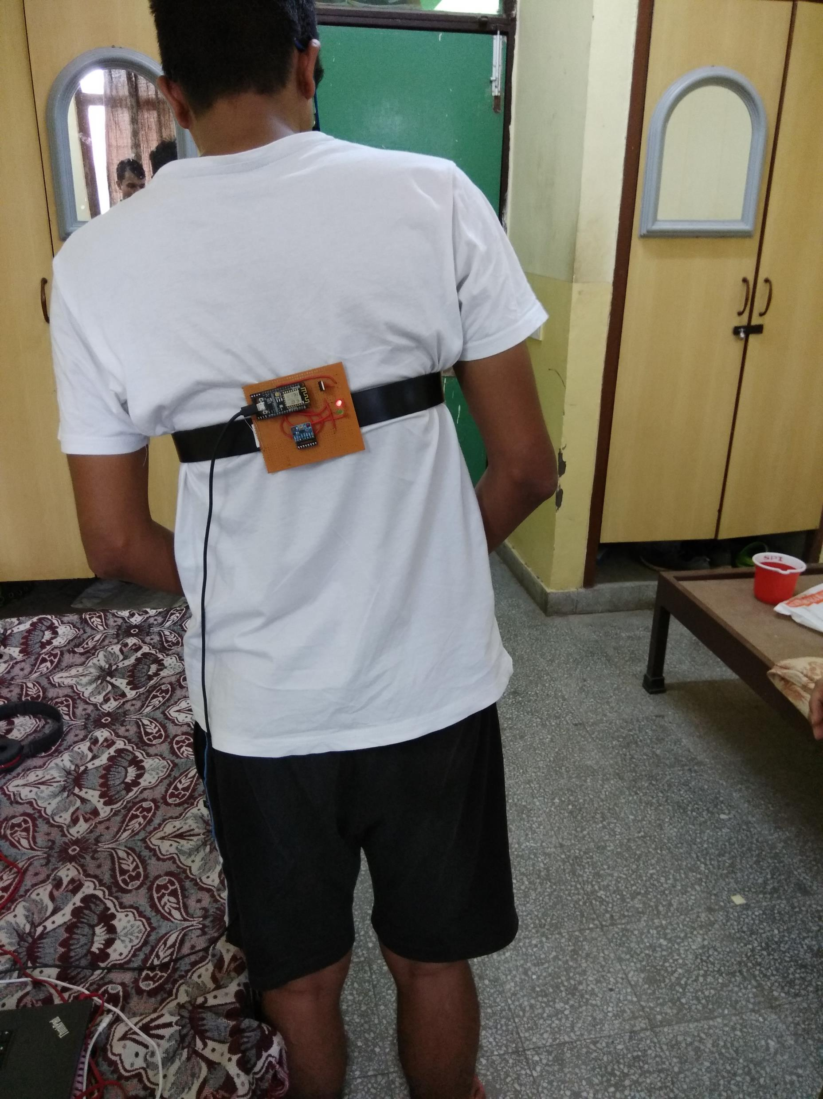
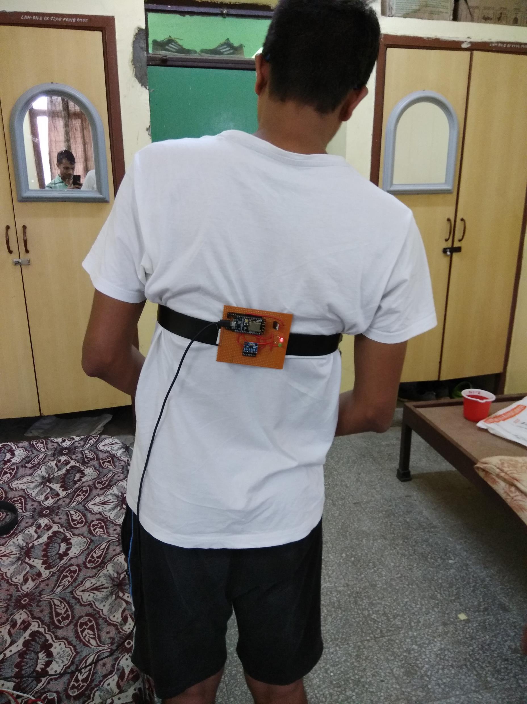
Proposed System

Slide 8
Components ADXL 345
Complete 3-axis acceleration measurement system
Operating Voltage Range: 2 volts -3.6 volts
Supply Current: 145 μA
I/O voltage range: 1.7 V to VS
Free-fall detection

Slide 9
Components : Applications of ADXL345
Fitness equipment
Handsets
Medical instrumentation
Gaming and pointing devices
Industrial instrumentation
Personal navigation devices

Slide 10
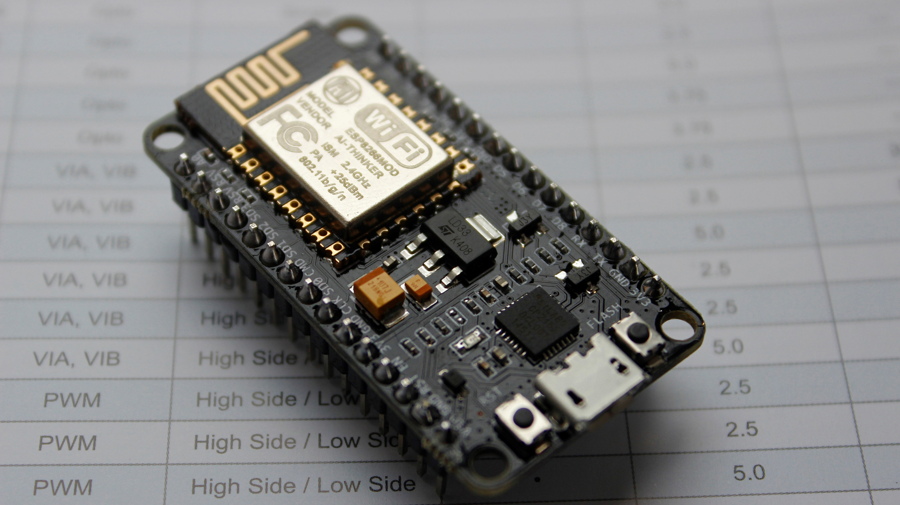
Components: NodeMCU (ESP8266)
Developer ESP8266 Opensource Community
Type Single-board microcontroller
Operating system XTOS
CPU ESP8266
Memory 128kBytes
Storage 4MBytes
Network Protocols IPv4, TCP/UDP/HTTP/FTP.

Slide 11
Components:Applications of NodeMCU (ESP8266)
Home appliances
1
Home automation
2
Smart plugs and lights
3
Mesh network
4
Industrial wireless control
5
Baby monitors
6

Slide 12
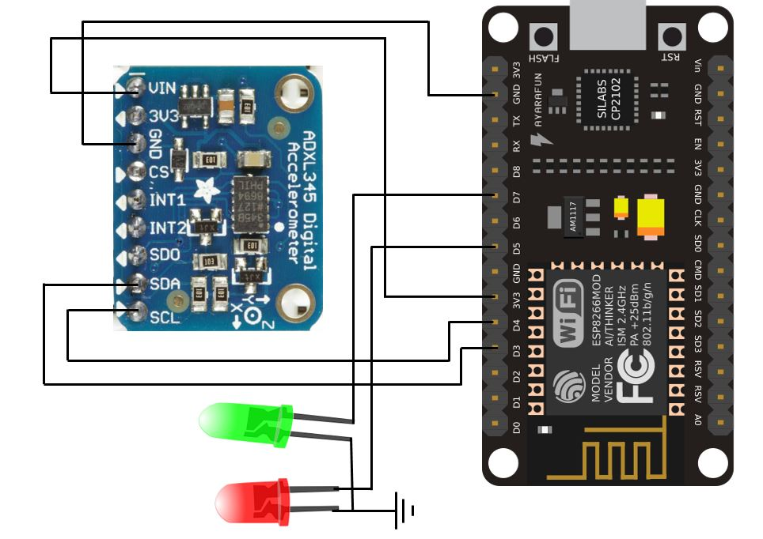
Circuit Diagram

Slide 13
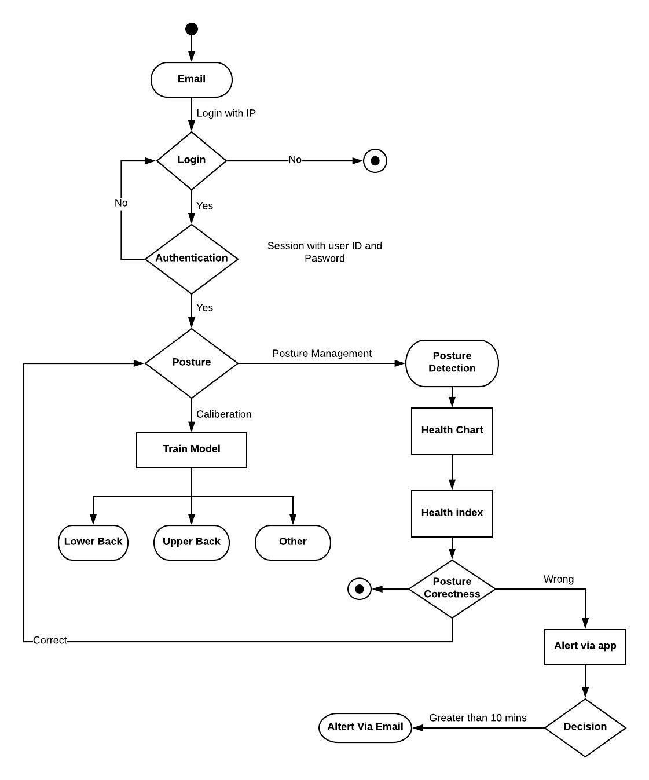
Activity Diagram

Slide 14
Implementation

Slide 15
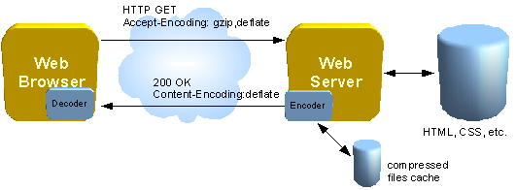
Web Server
NodeMCU supports multiple modes for WiFi setup such as Station , Access Point (AP) and other combinations.
We have established the web server using <WiFiClient.h> and <ESP8266WebServer.h> library
Frontend part of the web server was done using HTML,CSS and JavaScript. Since the nodemcu provides 128Kb memory only so all the libraries are uploaded online and are accessed on runtime.
Using Accelerometer values of x, y and z axis are recorded and sent to the web server using AJAX

Slide 16
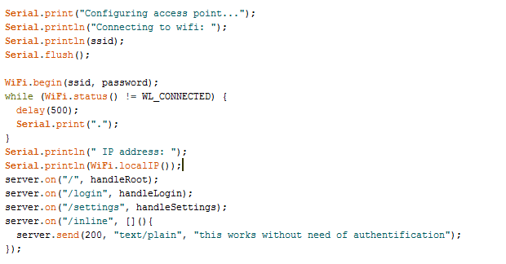

Slide 17
E-Mail Service
Google App script has been created by our team for sending the appropriate mail using “GO” framework and is uploaded in our google drive.
1
In Nodemcu C Program SendValueToGoogle() function is created which will generate the interrupt and send arguments to the google script and Email is sent.
2
In Email user will get the IP address of nodemcu in the network for the authentication purpose
3
SendValueToGoogle() function and snapshot of google script are attached below

Slide 18
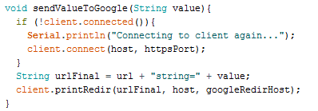

Slide 19
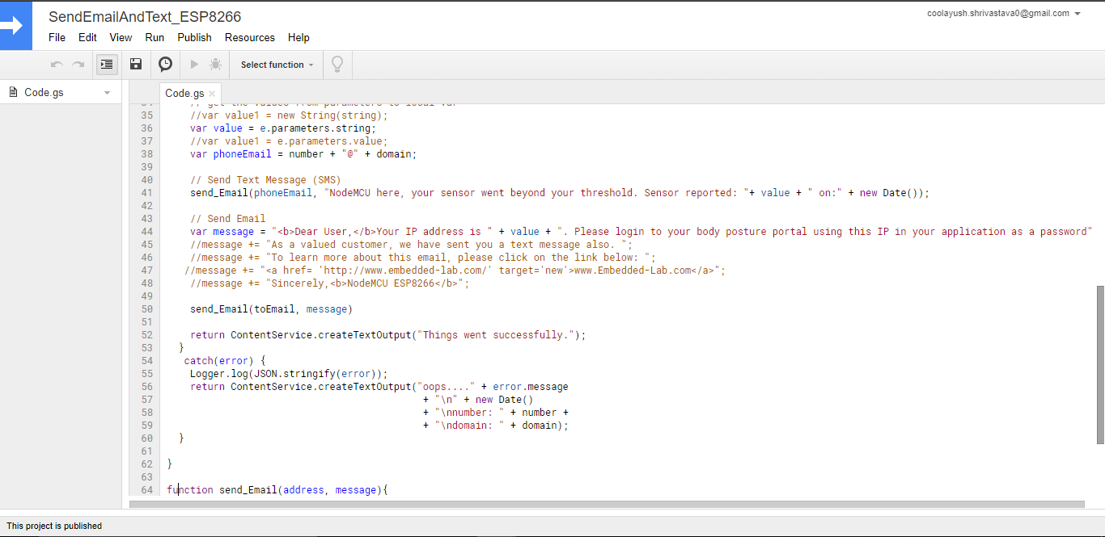

Slide 20
Reading Values from Accelerometer
ReadAccel() function take argument (1,2,3) as input. If value of variable is 1 than it will return analog value of X-axis, If value is 2 than Y-axis and 3 for Z-axis. Value is stored in an array named buffer values of accelerometer axis are left shifted by 8bits (Each axis reading comes in 16 bit resolution, ie 2 bytes. Least Significant Byte first!! thus we are converting both bytes in to one int) The accelerations in raw format are stored in registers – DATAX0, DATAX1, DATAY0, DATAY1, DATAZ0 and DATAZ1.

Slide 22
Model Training
Module for training model is created which means that this module is responsible for calibrating user’s posture by asking user to perform some basic movements. Values of users’ calibrations are stored in a buffer in form of coordinates which is then pass to posture detection module which maps all the coordinate provided and generate the threshold (allowed) values for posture detection.
Snap of calibration function for training model is attached bellow.

Slide 24
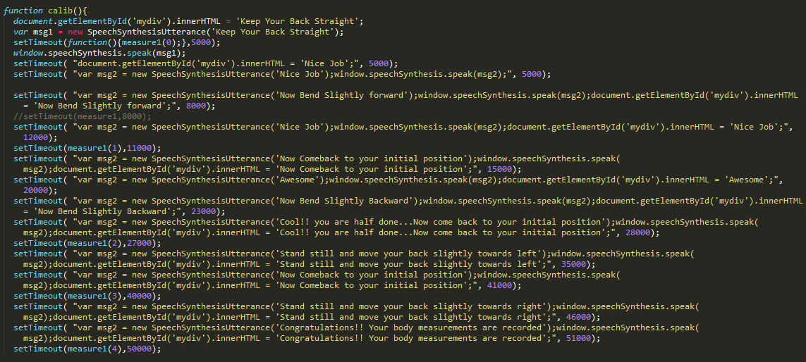

Slide 25
Health Chart
HealthChart module is responsible for the user’s to see the chart which will generate the data of previous 10 time units So, User can keep record of their posture and see their “posture progress”

Slide 26
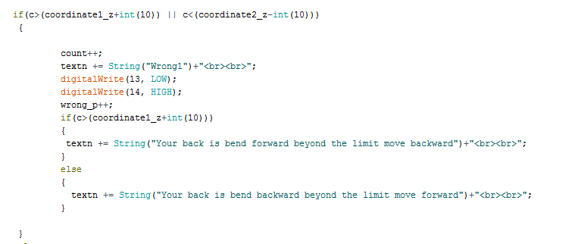
Code for posture detection

Slide 27
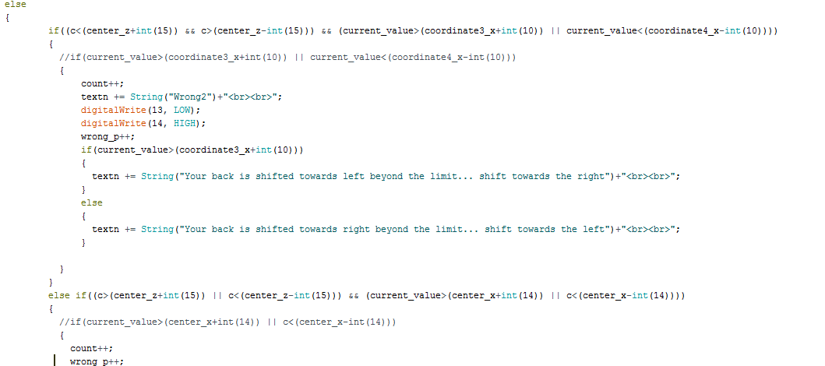
Code for posture detection

Slide 28
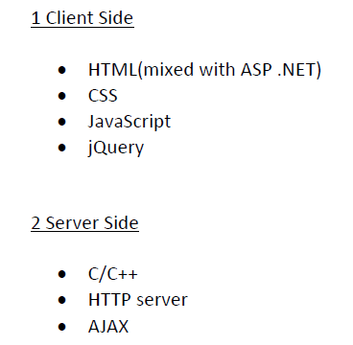
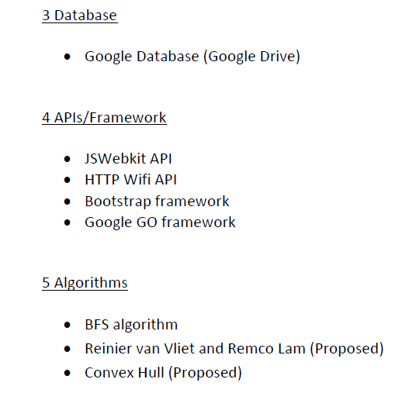
Technologies Used

Slide 29
Correct Posture? Huh? What’s that?
A good posture the body is balanced so to produce least fatigue
Body is held without any sense of effort.
Advantages
Improves appetite
Psychological balance
Prevention of diseases and disorders

Slide 30
Common Postural Deformities
Kyphosis
Flat Foot
Round Shoulders
Postural Deformities
Bowlegs
Lordosis
Knock Knees
Scoliosis

Slide 31
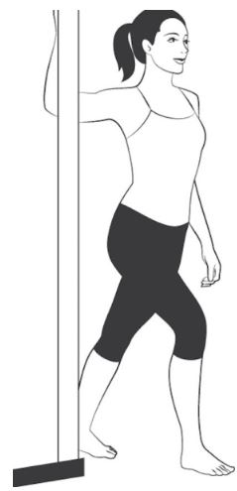
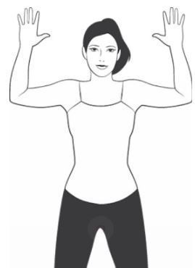
6 Exercises To Reverse Bad Posture
Doorway Stretch
Wall Angel
Chin Tuck

Slide 32
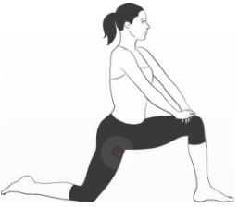
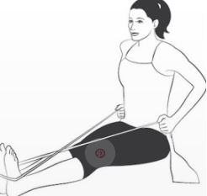
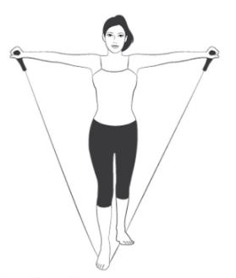
6 Exercises To Reverse Bad Posture
The V-Move
Hip Flexor Stretch
The X-Move

Slide 33
Conclusion & future work
A system which is in the form of a belt is designed help correct incorrect body posture and maintaining body and mind healthy.
System alerts the user about their inaccurate posture in time via a mobile app.
User will also be able to track real time activity of his posture.
A lot of back related problems can be cured by correcting postures during different works in life.

Slide 34
Conclusion & future work
HealthChart feature is introduced in the application through which user can see the chart which will generate the data of previous 10 time units So, User can keep record of their posture and see their “posture progress”
Mobile Application is also created which is currently in beta version, Which provides the same functionalities as a web application
For optimizing the results of model training better algorithm like convex hull is needed which will find at any given instance if given point is inside the polygon or not. Here polygon is the virtual area in which posture is correct if at any given instance point is beyond this area than wrong posture will be indicated
We have planned in future to use more sensors so that more accurate and full body scan/mapping is possible

Slide 35
Bibliography
Qiang Li, John A. Stankovic, “Accurate, Fast Fall Detection Using Gyroscopes and Accelerometer-Derived Posture Information” IEEE 2009 Body Sensor Networks, DOI 5226903
Sonali Chopra, “Wearable Posture Detection and Alert System”, Proceedings of the SMART -2016, IEEE Conference ID: 39669 5th International Conference on System Modeling & Advancement in Research Trends, 25th_27'h November 2016
Ismail Wilson Taifa, “Anthropometric measurements for ergonomic design of students’ furniture in India”, Engineering Science and Technology, an International Journal 20 (2017) 232–239.
A. Singh, D. Kumar, P. Srikanth, “An Intelligent Multi-Gesture Spotting Robot to Assist Persons with Disabilities”, International Journal of Computer Theory and Engineering, Vol. 4, No. 6, December 2012.
D. Mcllwraith, J. Pansiot and G. Z. Yang, "Wearable and ambient sensor fusion for the characterization of human motion," Intelligent Robots and Systems (IROS), 2010 IEEE/RSJ International Conference on, Taipei, 20 I 0, pp. 5505-5510. 18-22 Oct. 20 I O.
U. Lindemann, A. Hock, M. Stuber, W. Keck, and C. Becker, “Evaluation of a fall detector based on accelerometers: A pilot study,” Medical and Biological Engineering and Computing, vol. 43, no. 5, pp. 548–551, Oct 2005.

