Slide 1
ASTRO CORP.
Operation and Prospect Report
Stock symbol：3064
December, 2022

Slide 2
Public Statements and Reminders
Information related to the operations and strategies provided in this report is not intended as investment advice for shareholders and investors.
The forecasts and opinions on future operations mentioned in this report are mainly based on information and data open to public.
Information in this report including estimations of future operations remains risks and the actual results may differ from the estimation.

Slide 3
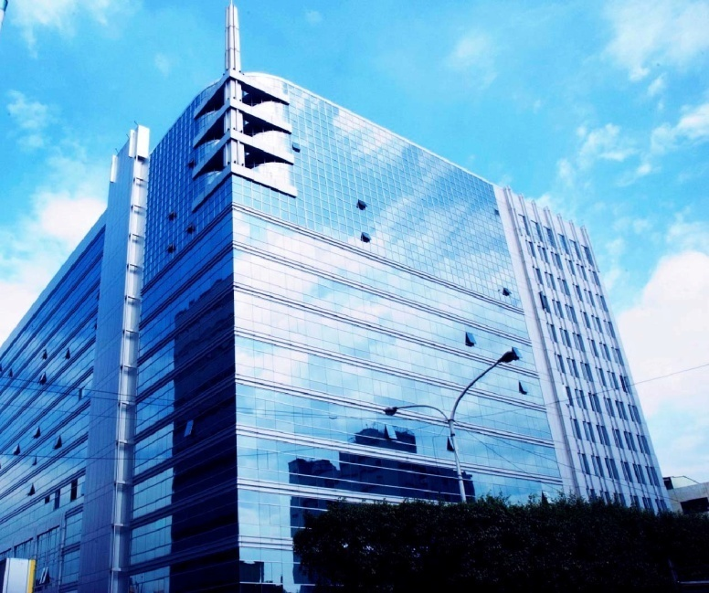
About Us
Establishment 2000/08/02
Type Company Limited By Shares
Public offering 2002/06/06
2003/05/29 emerging
2004/06/09 over-the-counter Stock Symbol：3064
Number of employees
116 (2022/11)
123 (2021/11)
162 (2020/11)

Slide 4
Enterprise Architecture
New Taipei City
ASTRO
CORPORATION
100 %
Hong Kong
98.68 %
Kinmen
100 %
Dominican
100 %
Hong Kong
54.23 %
New Taipei City
Hong Kong Gaming Technology Co Ltd
Astro Development& Consulting Co Ltd
Astro Gaming
Dominican corp
Astro Gaming
Limited
Astro Amusement Corp
100 %
Beijing
Long Cai Technology
(Beijing)Co Ltd

Slide 5
Technical Field
Live streaming technology and system
VLT cross-regional management system
App game production
Online gaming platform and management system
Crypto currency online gaming operation system
Software system, 2D, 3D design
Online games, 2D, 3D game engines
Creativity planning & design

Slide 6
R & D Focus and Achievements
Development of online gaming systems, live streaming games and related products.
After years of development and thousand times of tests and reviews, Astro system has obtained the Italian Video Lottery (VLT) license in 2016, becoming the eighth in the world, and the first and only in Asia to obtain the most advanced EU video lottery license.
Astro is now working with SISAL, Italy's second largest VLT operator, providing software, hardware, system and games in Italy and Morocco.
Training and development of network-related IT technology and IDC construction.

Slide 7
Core Businesses
Live-dealer streaming system
Live streaming lottery system
Electronic gaming and software
Instant sport lottery machine
Lottery management system
Gaming entertainment system
casino management system

Slide 8
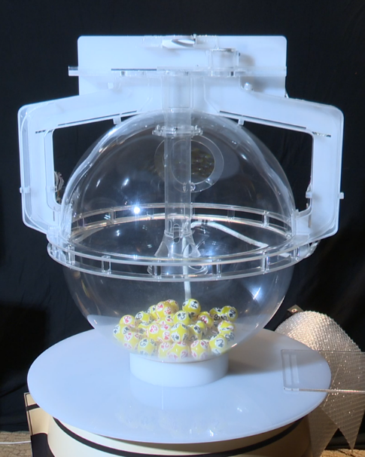
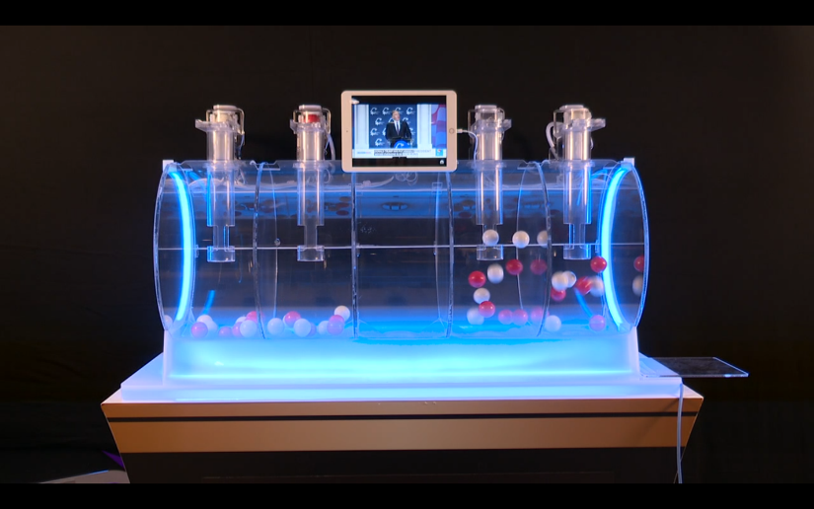
Live Streaming Dealer & Lottery

Slide 9
Electronic Slot Games

Slide 10
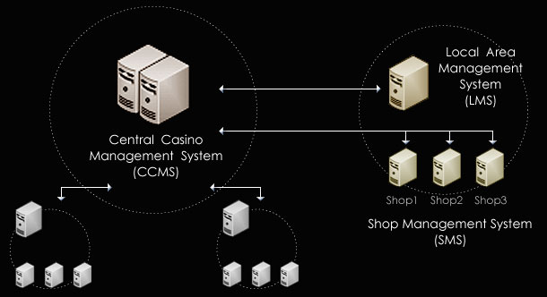
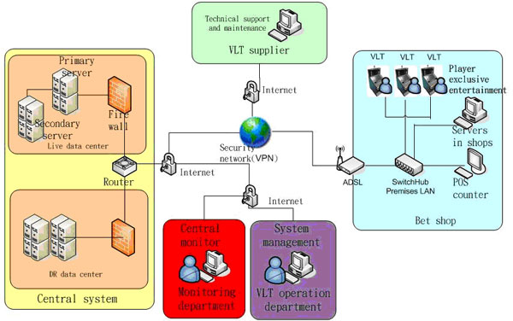
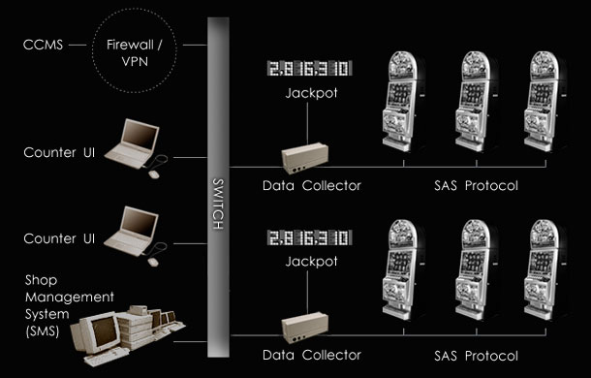
System Development
Lottery System
VLT System
CMS system

Slide 11
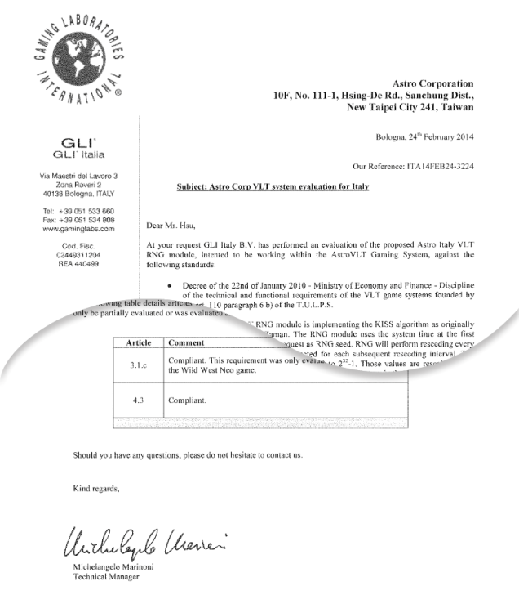
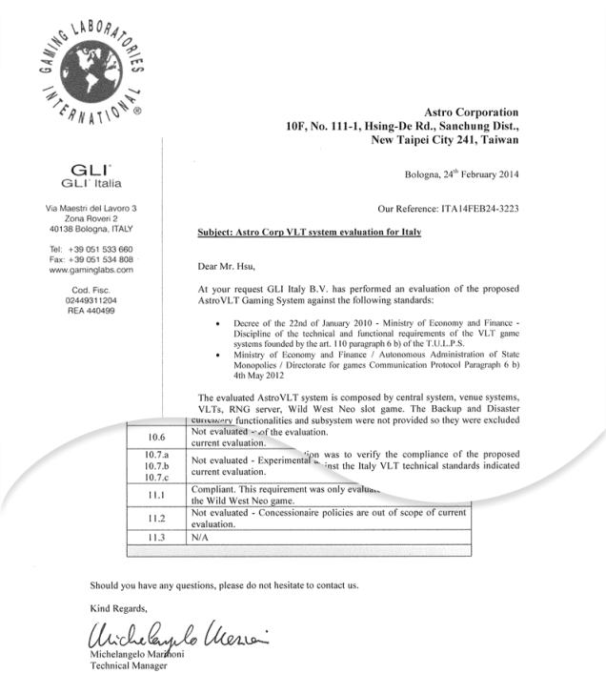
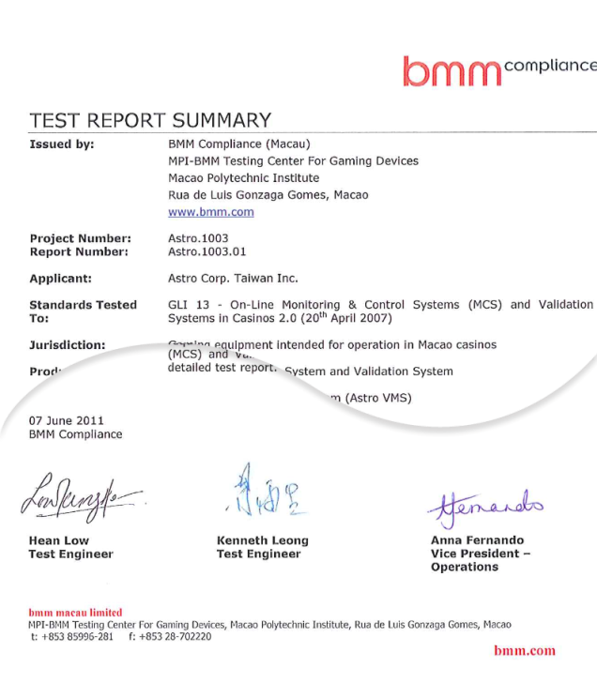
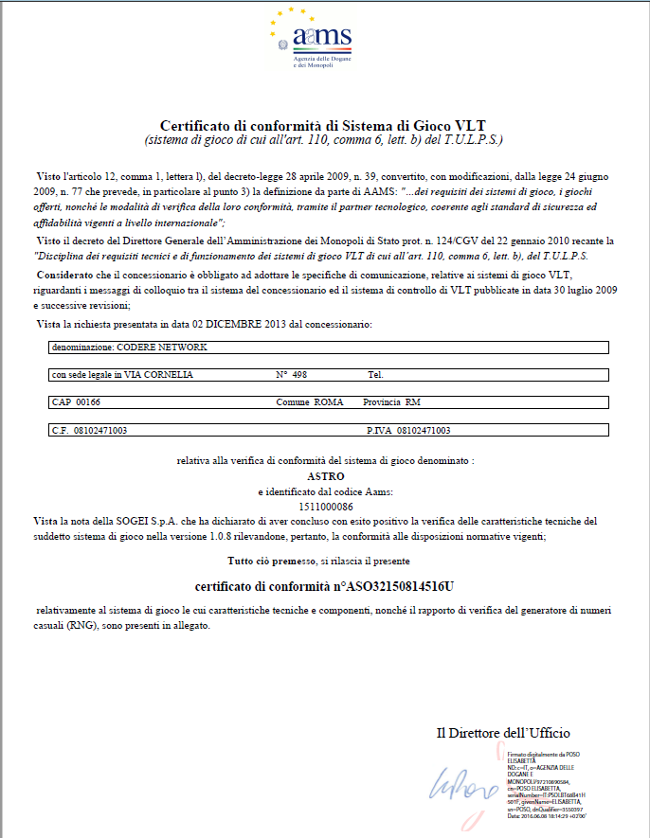
Italy and Macau Certifications

Slide 12
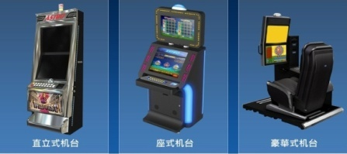
System
Games
Cabinets
Astro has cover both general entertainment and casino games, we are a professional gaming and online platform company.

Slide 13
2022Q3 Consolidated B/S
Astro Corporation and its Subsidiaries
Consolidated Balance Sheet
(Expressed in Thousands of New Taiwan Dollars)
 | September 30, 2022 | September 30, 2021
Cash and cash equivalents | 75,471 | 131,178
Financial assets at fair value through profit or loss - current | 5,771 | 1
Financial assets measured at amortized cost - current | 47,580 | 50,040
Accounts receivable and other receivables | 29,217 | 21,629
Inventories | 3,931 | 6,265
Other current assets | 14,872 | 16,102
Financial assets at fair value through profit or loss - non-current | 14,809 | 11,746
Property, plant and equipment | 221,176 | 242,694
Other non-current assets | 34,617 | 49,052
Total assets | 447,444 | 528,707
Contract liabilities - current | 14,194 | 14,716
Notes payable, accounts payable and other payables | 22,695 | 219,919
Other current liabilities | 6,242 | 5,742
Long-term loans | 180,000 | 180,000
Long-term notes payable | 52,900 | 0
Net defined benefit liabilities | 0 | 6,657
Other non-current liabilities | 8,970 | 15,039
Total liabilities | 285,001 | 442,073
Common stock | 433,715 | 267,384
Capital surplus | 774 | 0
Retained earnings | (306,265) | (221,003)
Other equity | 19,433 | 18,541
Non-controlling interests | 14,786 | 21,712
Total equity | 162,443 | 86,634
Total liabilities and equity | 447,444 | 528,707

Slide 14
2022Q3 Consolidated I/S
Astro Corporation and its Subsidiaries
Consolidated Statements of Comprehensive Income
(Expressed in Thousands of New Taiwan Dollars)
 | For the three-month periods ended September 30, 2022 | For the three-month periods ended September 30, 2021 | For the nine-month periods ended September 30, 2022 | For the nine-month periods ended September 30, 2021
Operating revenues | 19,813 | 30,792 | 63,561 | 193,165
Operating costs | (13,519) | (10,487) | (39,270) | (46,241)
Gross profit | 6,294 | 20,305 | 24,291 | 146,924
Operating expenses | (34,299) | (50,060) | (118,924) | (155,552)
Operating loss | (28,005) | (29,755) | (94,633) | (8,628)
Non-operating income and expenses | 4,991 | (8,170) | (599) | (16,983)
Income tax expense | - | - | - | -
Net loss | (23,014) | (37,925) | (95,232) | (25,611)
Other comprehensive income | 295 | (44) | 974 | 966
Total comprehensive income | (22,719) | (37,969) | (94,258) | (24,645)
Net income attributable to:
Shareholders of the parent | (21,292) | (36,186) | (90,034) | (20,236)
Non-controlling interests | (1,722) | (1,739) | (5,198) | (5,375)
 | (23,014) | (37,925) | (95,232) | (25,611)
Comprehensive income attributable to:
Shareholders of the parent | (20,997) | (36,230) | (89,060) | (19,270)
Non-controlling interests | (1,722) | (1,739) | (5,198) | (5,375)
 | (22,719) | (37,969) | (94,258) | (24,645)
Earnings per share(NT$):
Earnings per share - basic | (0.50) | (1.35) | (2.79) | (0.76)

Slide 15
Our Next Step 1
Accelerate the transformation of network business
Based on our 20 years experience in the global gaming market, We are going to provide our online gaming system to our used international customers who needs to be transform or increase the online gaming business.
Astro has transformed most of its electronic products online and is recently developing live streaming dealers and lottery products, selling video sources to Southeast Asia, Europe and the United States and the revenue has gradually stabilized since last year.
Discussing with Italian operator SISAL about operating an online game platform, and strive to become an online game supplier certified by the Italian government.

Slide 16
Our Next Step 2
Expansion of VLT system
After obtaining the Italian VLT license, Astro has signed further Agreements with Italian operator SISAL on VLT-related software, hardware, systems and games. We are expecting to enter the system procurement stage and continue to expand in the Italian market.
Astro has obtained an exclusive Moroccan national electronic gaming license with SISAL and the system development has been completed, currently waiting for the review by the Moroccan government.

Slide 17
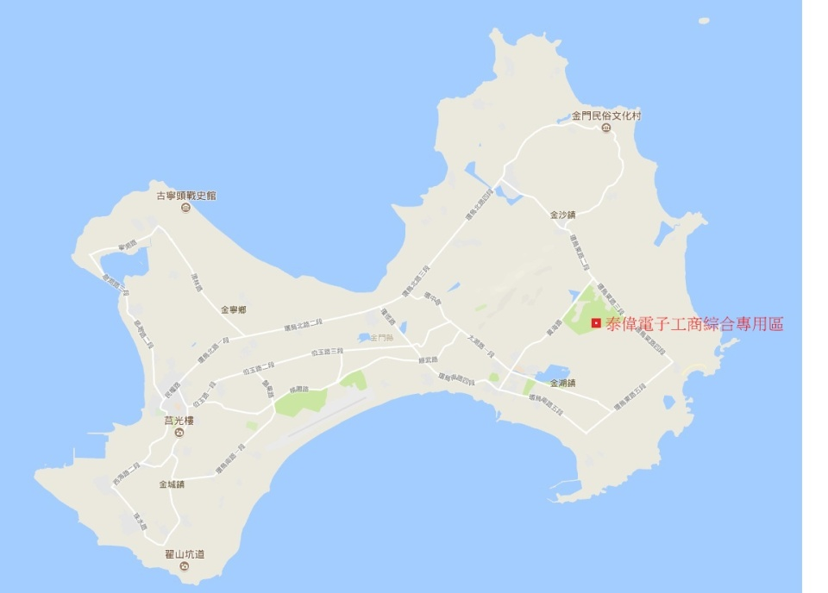
Our Next Step 3
Preparing for the development plan of Astro Kinmen Industrial and
Commercial Complex
Astro's land in Kinmen
Comprehensive Industrial
and Commercial Zone has
a developable area of 8
hectares, which is currently
the only large developable
industrial and commercial
land in Kinmen.

Slide 18
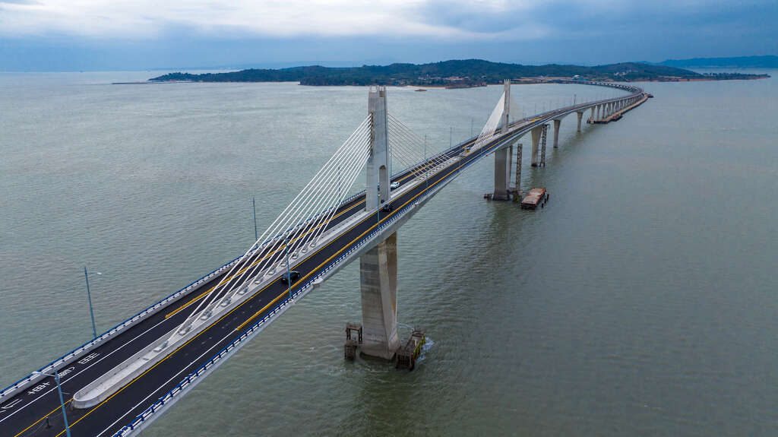
Preparing for the development plan of Astro Kinmen Industrial and
Commercial Complex
The Kinmen Bridge is the largest cross-sea
bridge in Taiwan. It connects Kinmen and
little Kinmen, with a total length of about
5.4 kilometers. After 10 years of construction
, it was opened to public on October 30 this
year. Through the connection of Kinmen
and little Kinmen, it effectively promotes
sightseeing in the Kinmen area. As well as
economic development, it has become
a popular new tourist attraction and a new
landmark of Kinmen.
In order to adjust the content of the plan, an application has been made to change and extend the development period, and a public exhibition briefing session has been held in November.
The urban plan has been submitted, and it is expected to complete the urban design review next year and obtain the building license as an important business in the future.

Slide 19
Thank you
Q&A

