Slide 1

ASTRO CORP.
Operation and Prospect Report
Stock symbol：3064
December, 2024

Slide 2
Public Statements and Reminders
Information related to the operations and strategies provided in this report is not intended as investment advice for shareholders and investors.
The forecasts and opinions on future operations mentioned in this report are mainly based on information and data open to public.
Information in this report including estimations of future operations remains risks and the actual results may differ from the estimation.

Slide 3
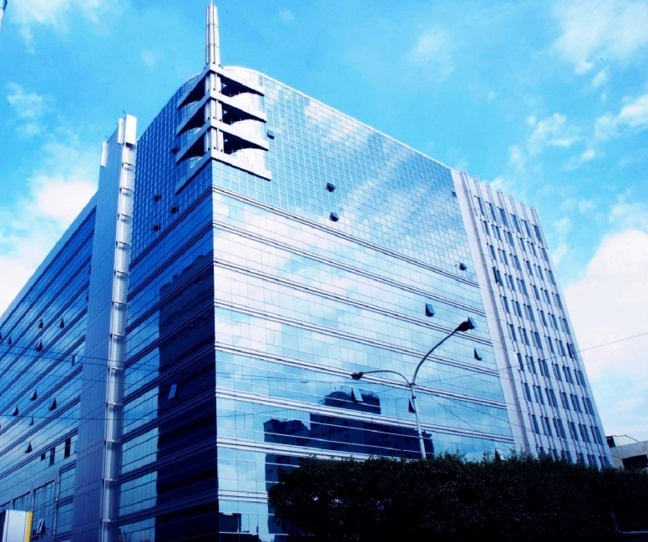
About Us
Establishment 2000/08/02
Type Company Limited By Shares
Public offering 2002/06/06
2003/05/29 emerging
2004/06/09 over-the-counter Stock Symbol：3064
Number of employees
90(2024/11)
94 (2023/11)
116 (2022/11)

Slide 4
Enterprise Architecture
New Taipei City
ASTRO
CORPORATION
98.68 %
Kinmen
100 %
Hong Kong
Astro Development& Consulting Co Ltd
Hong Kong Gaming Technology Co Ltd
100 %
Beijing
Long Cai Technology
(Beijing)Co Ltd

Slide 5
Technical Field
Live streaming technology and system
VLT cross-regional management system
App game production
Online gaming platform and management system
Crypto currency online gaming operation system
Software system, 2D, 3D design
Online games, 2D, 3D game engines
Creativity planning & design

Slide 6
R & D Focus and Achievements
Development of online gaming systems, live streaming games, live streaming lottery machine and related products.
After years of development and thousand times of tests and reviews, Astro system has obtained the Italian Video Lottery (VLT) license in 2016, becoming the eighth in the world, and the first and only in Asia to obtain the most advanced EU video lottery license.
Develop a new generation of float machines, sicbo 2 machines, lucky roulette machines and other machines, provide customized design professional services, and increase the sales of physical machines in the Macau market.
Training and development of network-related IT technology and IDC construction.

Slide 7
Core Businesses
Live streaming lottery system
Electronic gaming and software
Instant sport lottery machine
Lottery management system
Gaming entertainment system
casino management system

Slide 8
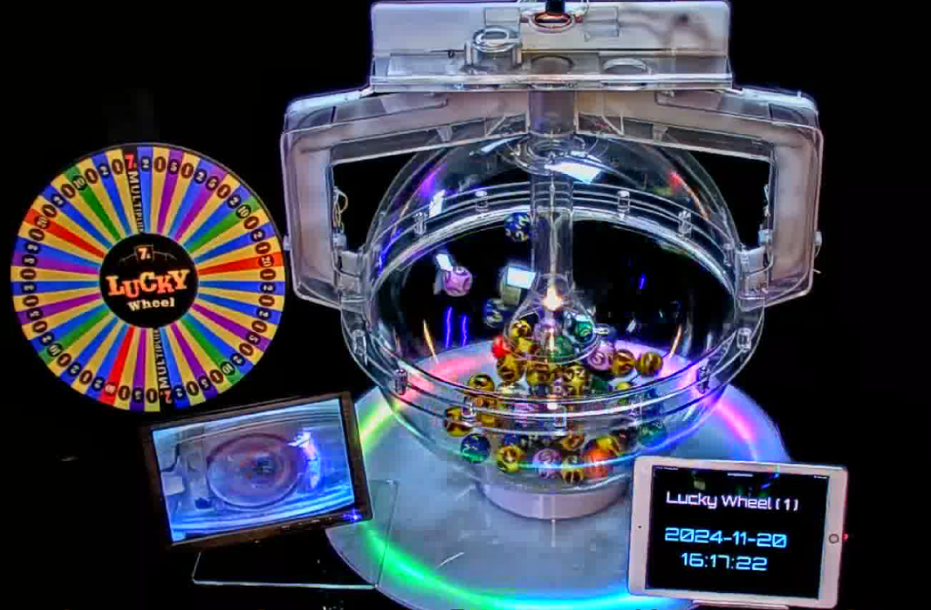
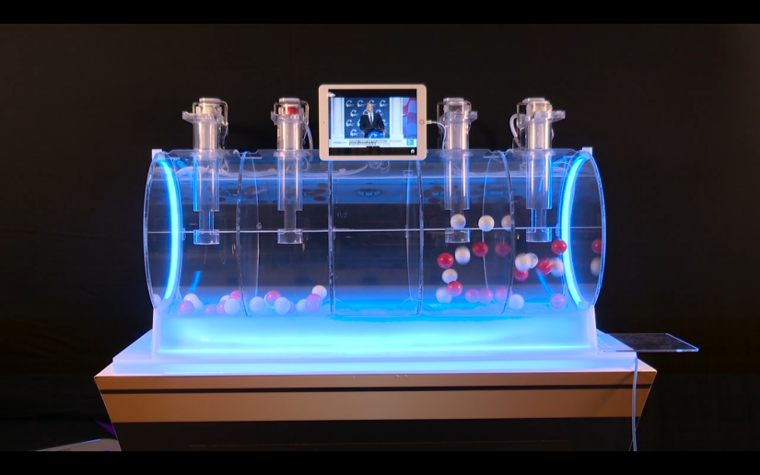
Live Streaming Lottery Machine

Slide 9

























Electronic Slot Games

Slide 10
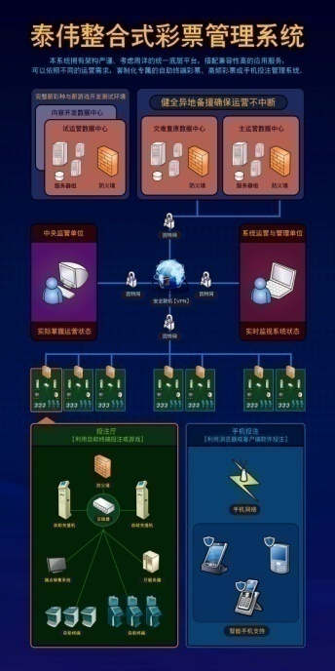
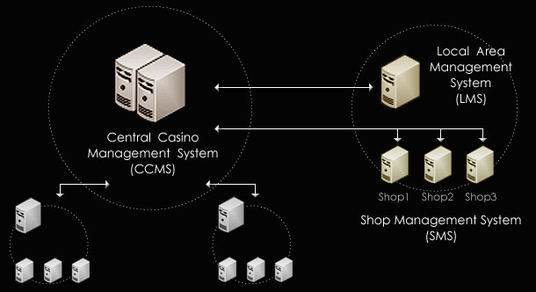
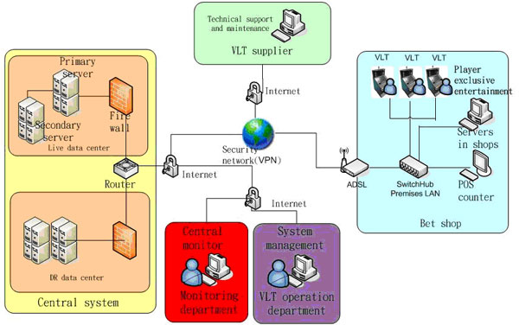
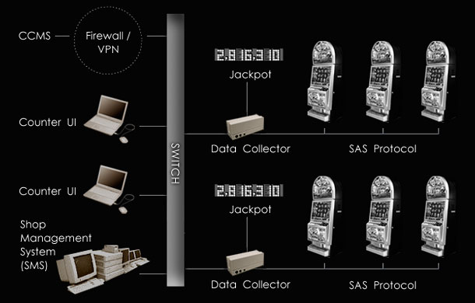
System Development
Lottery System
VLT System
CMS system

Slide 11
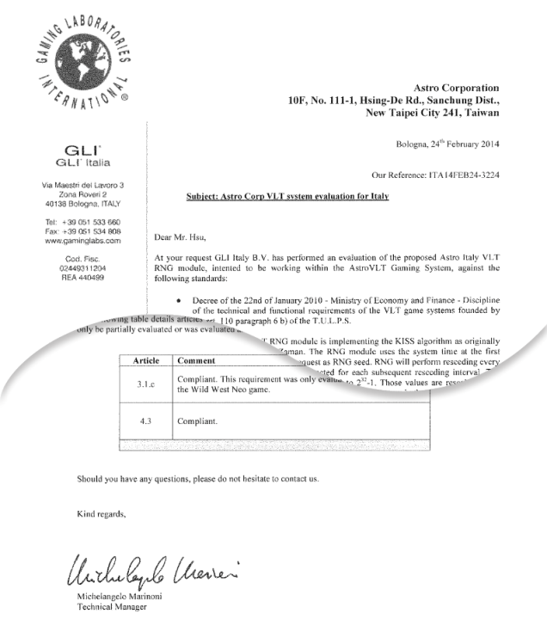
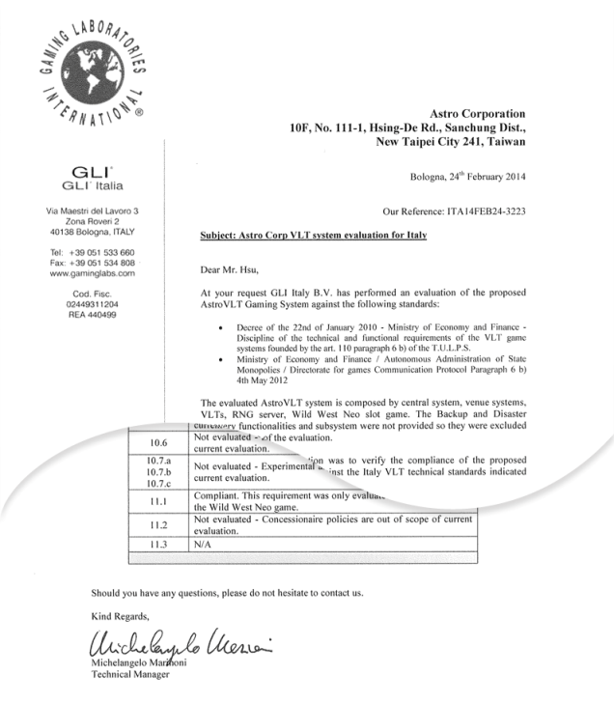
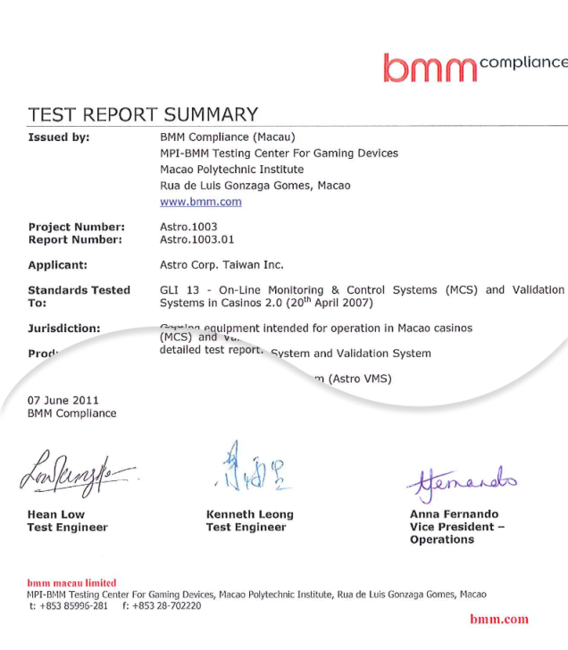
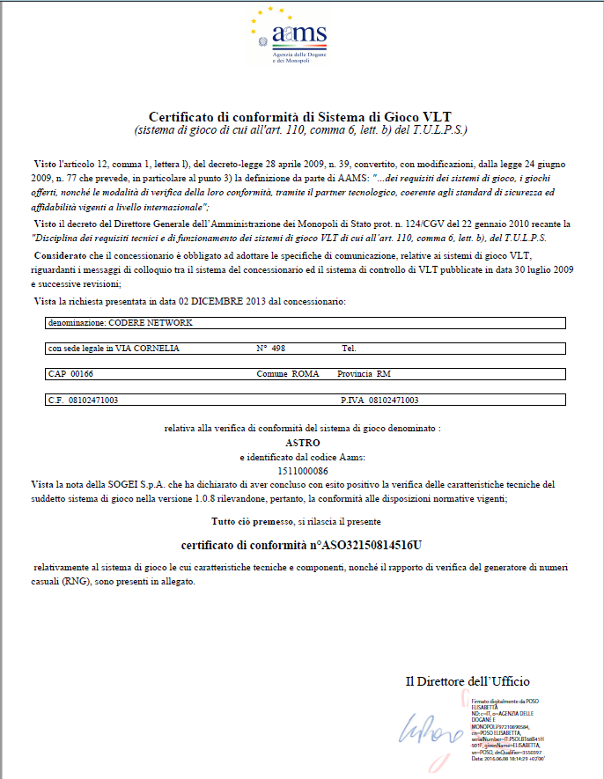
Italy and Macau Certifications

Slide 12
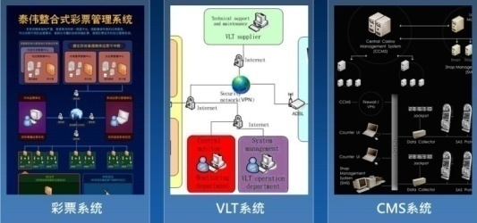

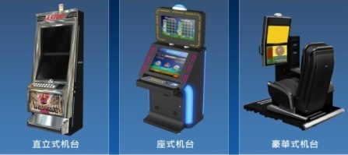
System
Games
Cabinets
Astro has cover both general entertainment and casino games, we are a professional gaming and online platform company.

Slide 13
2024Q3 Consolidated B/S
Astro Corporation and its Subsidiaries
Consolidated Balance Sheet
(Expressed in Thousands of New Taiwan Dollars)
 | 30-Sep-24 | 30-Sep-23
Cash and cash equivalents | 57,226 | 50,531
Financial assets at fair value through profit or loss - current | 1 | 5,588
Financial assets measured at amortized cost - current | 26,860 | 29,007
Accounts receivable and other receivables | 25,898 | 26,638
Inventories | 2,284 | 2,533
Other current assets | 4,825 | 15,095
Financial assets at fair value through profit or loss - non-current | 25,188 | 18,467
Property, plant and equipment | 210,520 | 212,289
Other non-current assets | 29,119 | 20,736
Total assets | 381,921 | 380,884
Contract liabilities - current | 6,925 | 14,180
Notes payable, accounts payable and other payables | 24,255 | 69,914
Other current liabilities | 9,290 | 171,257
Long-term loans | 169,624 | 11,210
Long-term notes payable | 52,900 | 0
Other non-current liabilities | 7,104 | 3,167
Total liabilities | 270,098 | 269,728
Common stock | 130,115 | 433,715
Capital surplus | 774 | 774
Retained earnings | (30,212) | (338,040)
Other equity | 6,952 | 6,810
Non-controlling interests | 4,194 | 7,897
Total equity | 111,823 | 111,156
Total liabilities and equity | 381,921 | 380,884

Slide 14
2024Q3 Consolidated I/S
Astro Corporation and its Subsidiaries
Consolidated Statements of Comprehensive Income
(Expressed in Thousands of New Taiwan Dollars)
 | For the three-month periods ended September 30, 2024 | For the three-month periods ended September 30, 2023 | For the nine-month periods ended September 30, 2024 | For the nine-month periods ended September 30, 2023
Operating revenues | 38,238 | 28,936 | 94,109 | 68,883
Operating costs | (11,018) | (2,479) | (14,604) | (6,618)
Gross profit | 27,220 | 26,457 | 79,505 | 62,265
Operating expenses | (22,833) | (25,614) | (71,395) | (86,479)
Operating loss | 4,387 | 843 | 8,110 | (24,214)
Non-operating income and expenses | (1,490) | 1,387 | (2,540) | 17,258
Income tax expense | - | - | - | -
Net loss | 2,897 | 2,230 | 5,570 | (6,956)
Other comprehensive income | (123) | 199 | 708 | (12,547)
Total comprehensive income | 2,774 | 2,429 | 6,278 | (19,503)
Net income attributable to:
Shareholders of the parent | 2,642 | 3,942 | 5,574 | (1,790)
Non-controlling interests | 255 | (1,712) | (4) | (5,166)
 | 2,897 | 2,230 | 5,570 | (6,956)
Comprehensive income attributable to:
Shareholders of the parent | 2,519 | 4,141 | 6,282 | (14,337)
Non-controlling interests | 255 | (1,712) | (4) | (5,166)
 | 2,774 | 2,429 | 6,278 | (19,503)
Earnings per share(NT$):
Earnings per share - basic | 0.20 | 0.30 | 0.43 | (0.14)

Slide 15
Our Next Step 1
Accelerate the transformation of network business
Based on our 20 years experience in the global gaming market, We are going to provide our online gaming system to our used international customers who needs to be transform or increase the online gaming business.
Astro has transformed most of its electronic products online and is recently developing live streaming dealers and lottery products, selling video sources to Southeast Asia, Europe and the United States and the revenue has gradually stabilized since last year.
Astro has provided professional machine customization design services to Macau customer LT Game to increase physical machine sales in the Macau market.

Slide 16
Our Next Step 2
Expanding on network collaboration marketing platform
Developing the "Call Me" service on the Line official. This product is designed to integrate the call system of restaurants or medical facilities, providing the function of querying and notifying upcoming calls, also providing business information and online order/takeout/reservation functions which can be used to increase the number of users, facilitate big data analysis, and implement precise marketing, thereby providing merchants with more effective channel promotion and marketing resources.
Developing a "game co-creation platform" on mobile and PC. This product has three major functions: game store, game forum, and developer services. It aims to subvert the traditional game industry structure and provide advanced mobile game development technology for small and medium-sized game developers, so that the platform can provide a variety of game types to meet the needs of various game enthusiasts.

Slide 17
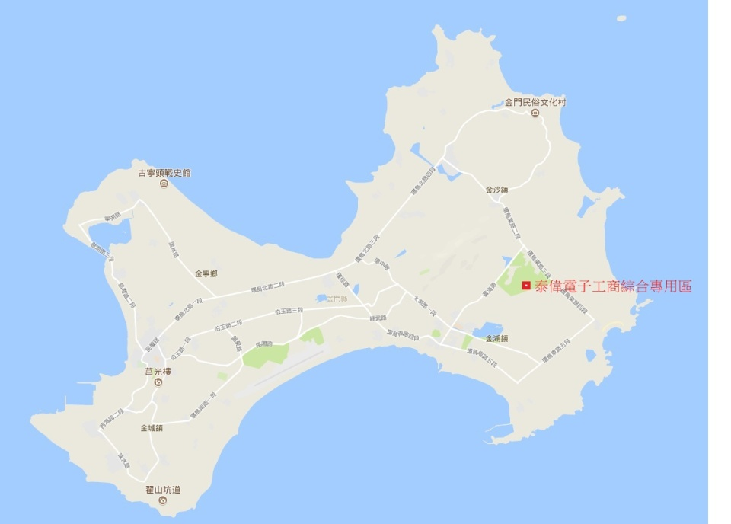
Our Next Step 3
Preparing for the development plan of Astro Kinmen Industrial and
Commercial Complex
Astro's land in Kinmen
Comprehensive Industrial
and Commercial Zone has
a developable area of 8
hectares, which is currently
the only large developable
industrial and commercial
land in Kinmen.

Slide 18
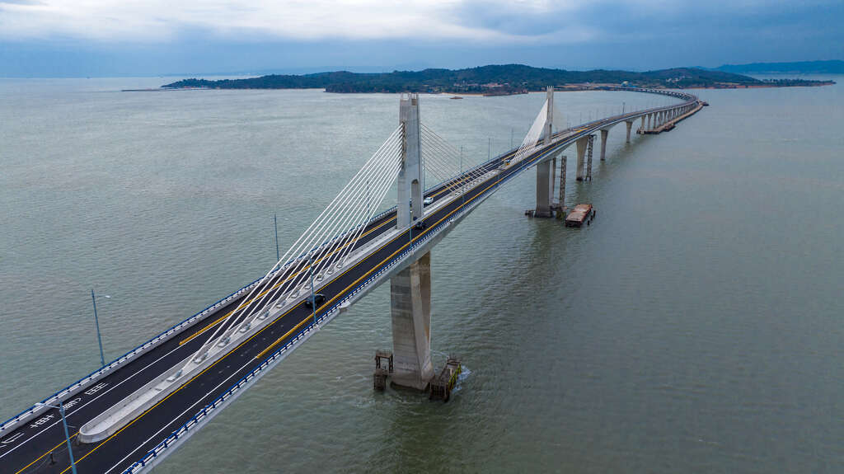
Actively preparing for the development plan of Astro Kinmen Industrial and
Commercial Complex
The Kinmen Bridge is the largest cross-sea
bridge in Taiwan. It connects Kinmen and
little Kinmen, with a total length of about
5.4 kilometers. After 10 years of construction
, it was opened to public on October 30, 2022.
Through the connection of Kinmen and little
Kinmen, it effectively promotes sightseeing
in the Kinmen area. As well as economic
development, it has become a popular new
tourist attraction and a new landmark of
Kinmen.
In order to adjust the content of the plan, an application has been made to change and extend the development period, a public exhibition briefing session has been held in November, 2022 and has entered the meetings of the Urban Planning Commission in the year 2023.
The urban plan has been submitted, and it is expected to complete the urban design review next year and obtain the building license as an important business in the future.

Slide 19
Thank you
Q&A

