Slide 1
Inclusion of topics concerning developmental disabilities into the medical curriculum of future doctors
Johannes, Fellinger
Johannes Kepler University
Austria
Inclusive practices in universities and higher education institutions
Wednesday, February 21, 2024
14:00 – 15:20

Slide 2


Slide 3


Slide 4


Slide 5
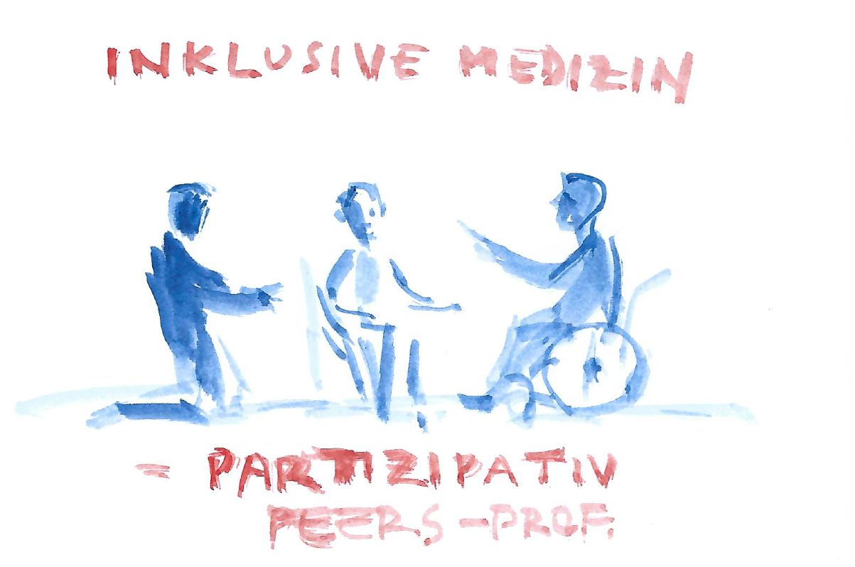

Slide 6


Slide 7
Medical Faculty Johannes Kepler Universität
Founded in 2014
Inclusion of the needs of people with developmental disabilities in the curriculum
Since 2014 around 600 students taught with this curriculum
Sign language course

Slide 8
Inclusion of developmental disabilities into the medical curriculum for future doctors
Ethics
Paediatrics
Neurology
Psychiatry
Otorhinolaryngology
Compulsory elective subject
Developmental Medicine

Slide 9
Competences taught…
Considering the individual needs of persons with disabilities (medical and psycho-social needs)
Emphasize the dignity and rights of people with disabilities
Considering the role of parents and relatives
Equipping the future doctors with necessary skills to interact effectively with individuals with disabilities and their relatives and
to work multi-, inter and transdisciplinary

Slide 10

Contact: johannes.fellinger@bblinz.at

