Slide 1
Creativity and Technology for disability inclusion
Andrew Choe
Sensee World
United States
Educational Resources for visually impaired Students
14:10-15:10, 24 February 2024
Notes:
Please add your notes here.
Title; Creativity and Technology for disability includion
Andrew Choe, Sensee World, United States, Zero Project Scaling Solutions Fellows Pitch
#ZeroCon24
Day and Time of Session

Slide 2

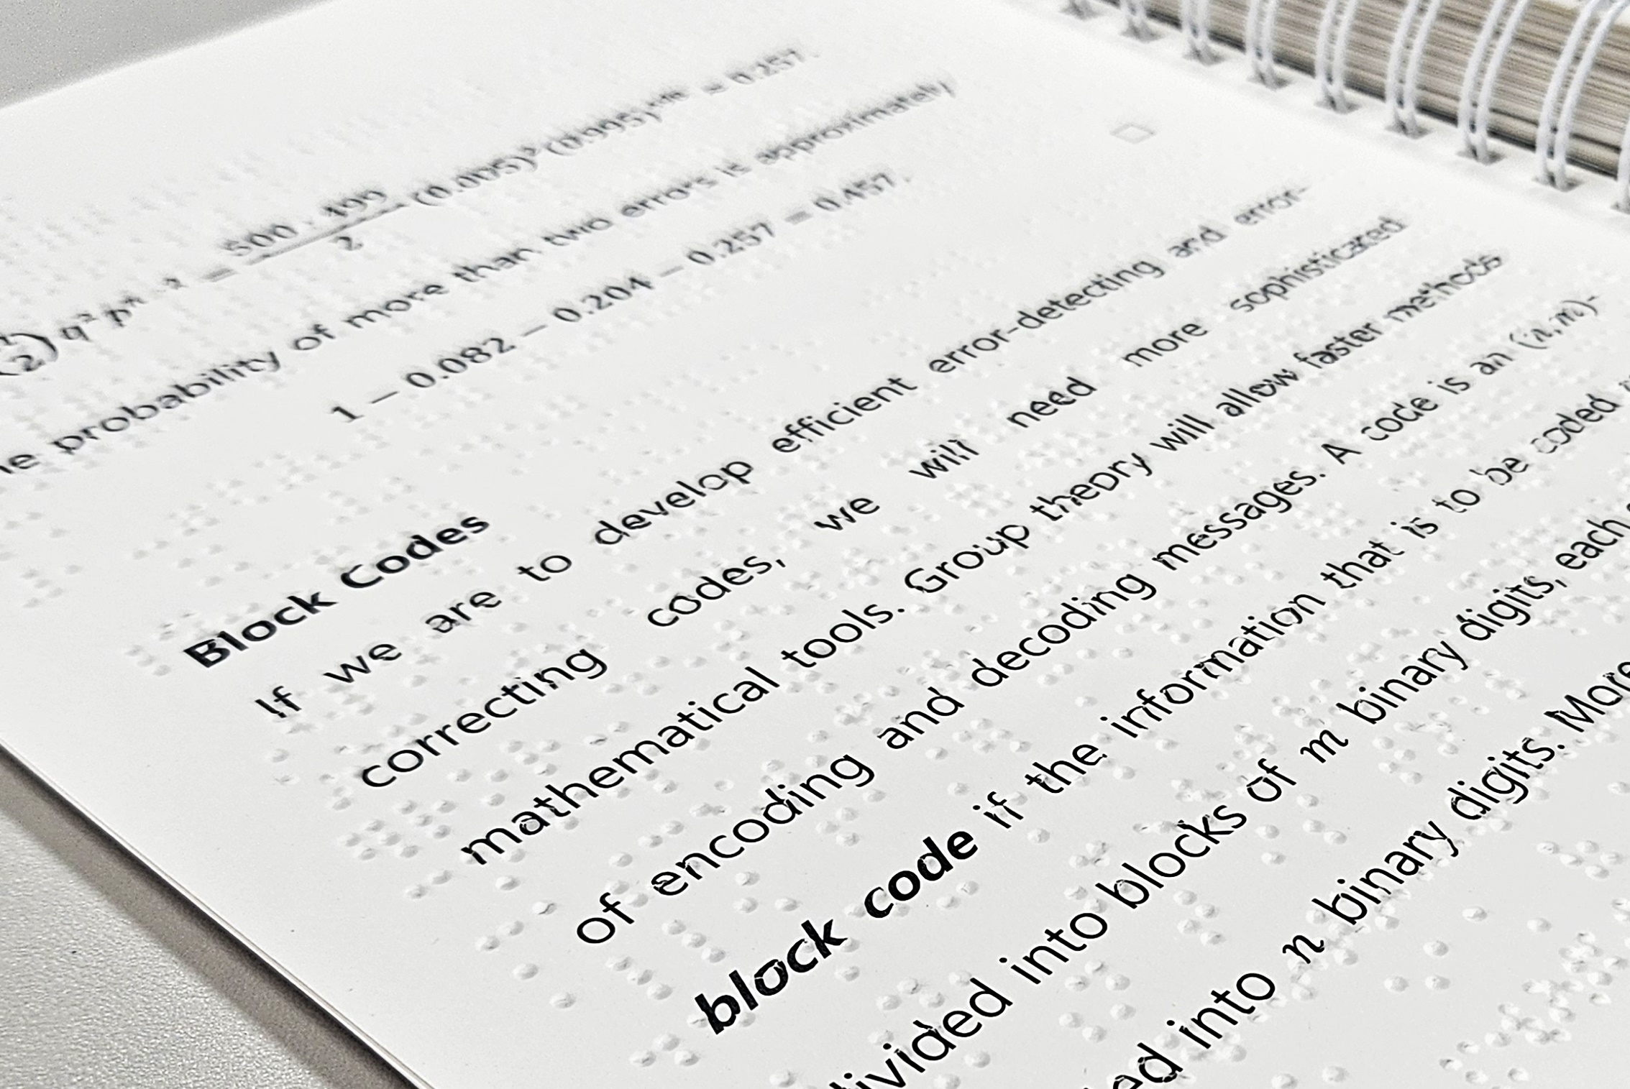
Vision
Touch the World and See the Unseen
Breaking down the barrier
Commitment to producing products that can be shared by all (home and school)
Notes:
Sensee’s vision is “touch the world and see the unseen”. Our vision is core of everything we do. We believe our technology along with our creative products can open possibilities that people have never imagined.
Our books have both text and braille in order for products to be able to be shared among family members or in school.

Slide 3
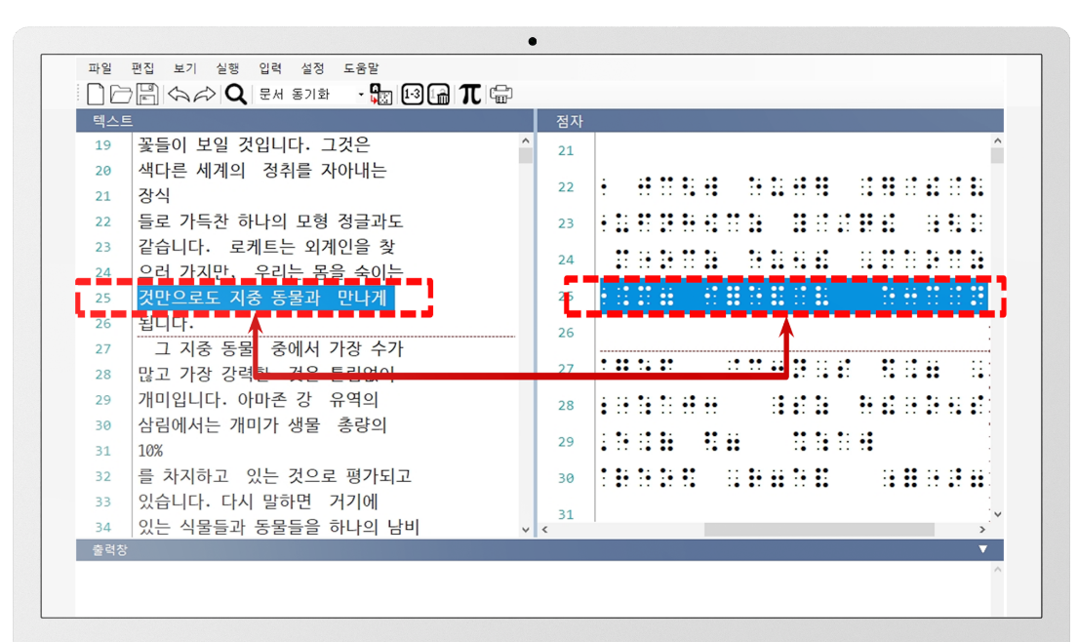
Technology – Transcription and Editor
Starts with detailed customized XML data. – allows software to make automated decisions in complex cases, such as tables.
Minimize working hours
Efficient and easy editing
Flagging undefined cases and formatting issues
Machine learning tools to assist manual fixing
Line-to-line comparison
Notice Braille Conversion Alert History
Notes:
We think about how we can make things easy and efficient. Our editor allows people to easily use our products and machine learning capability that allows complex transcription, such as Math and Science to be transcribed in much shorter time (within a day) vs. over a year.

Slide 4
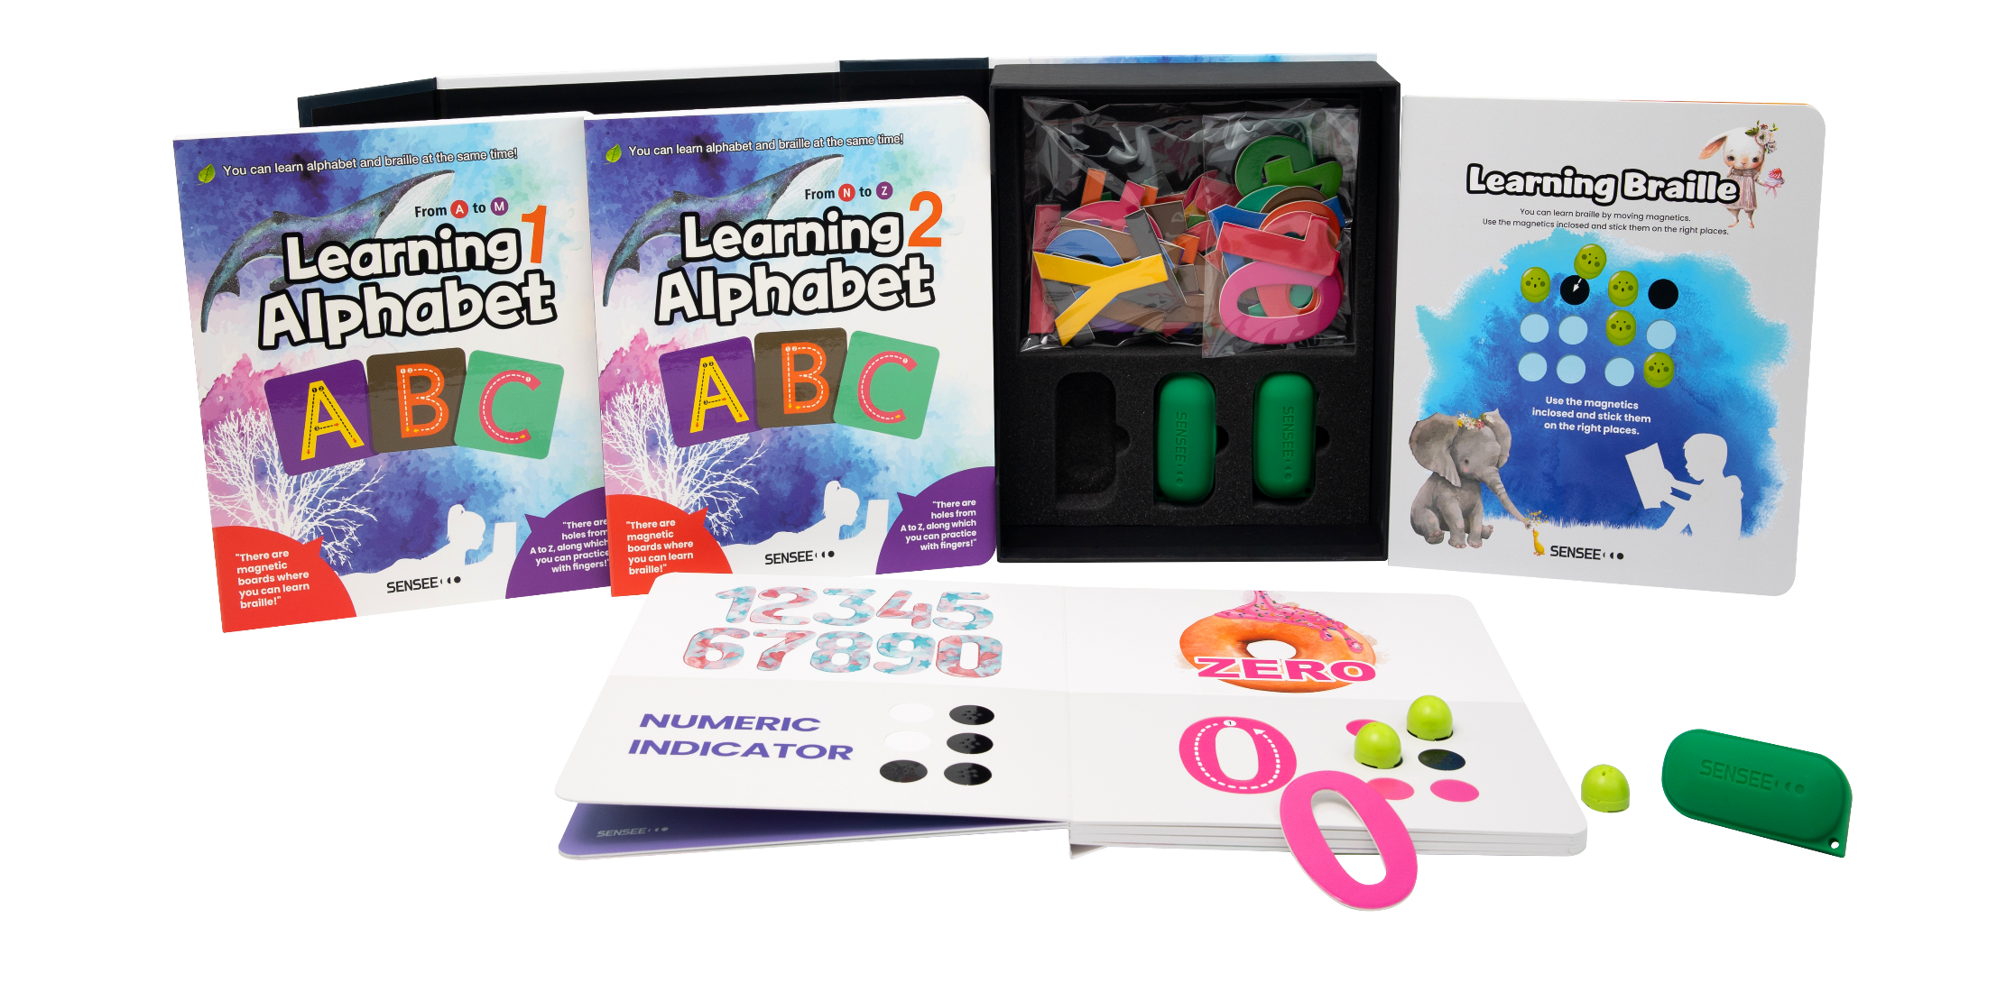
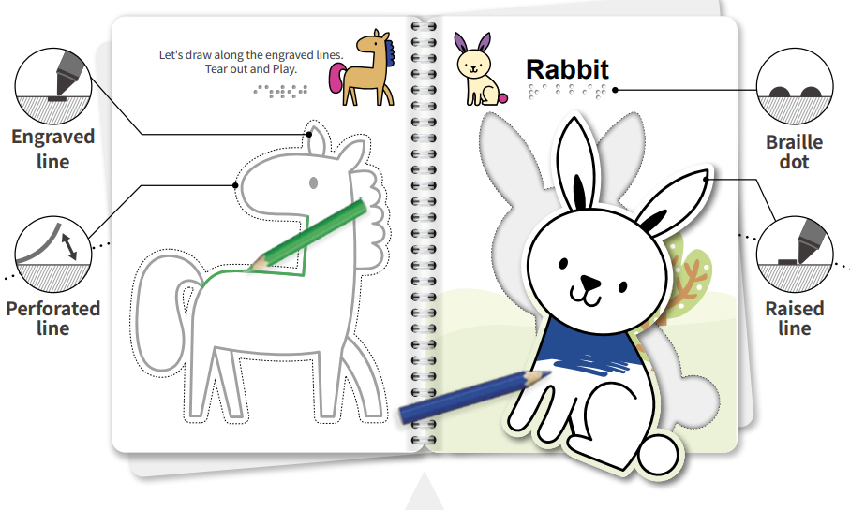
Creative products – learning kit and coloring books
Focus on user experience
Play and learn
Can be used in classrooms
Can be shared be all
Visually impaired and autistic
Notes:
We also have creative products that make learning braille fun and easy. Also our coloring books provide new experience for visually impaired kids as well as autistic children.

Slide 5
Evolution and Expansion
Developing advanced transcription program in other languages (science and math)
Transcription
Increase diversity of product offerings
Offer products in different markets (Korea/US to other markets)
Products
Semi-automated facility to fully automated facility – reduce production cost
Expand footprint to other markets
Manufacturing
Notes:
In terms of next steps, we need to evolve and expand. In terms of complex transcription, such as math, we have gotten to where transcription can be done within a day. And length of time will be shorter as we transcribe more books. We have begun working on English version, but we are aiming to develop for other languages as well. In terms of products we would like to work with any publisher or organizations to distribute our products or help create products for those organizations. Finally, we are in process of building fully automated facility which will significantly reduce production costs, and we are very much interested in expanding our manufacturing footprints to other geography.

