Slide 1
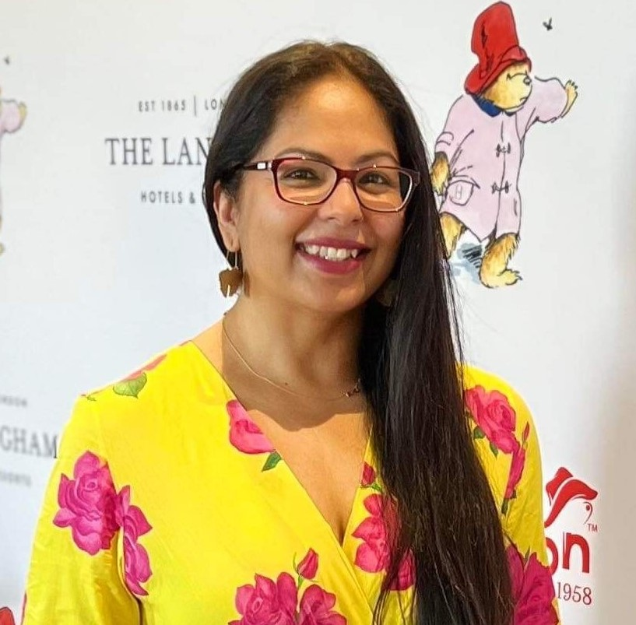

Directing Change Scholarship
Sharon Kumar, Head of Programs
Australian Disability Network
Australia
Entrepreneurship and leadership development for young people with disabilities
Thursday, 22 February 2024 14:40 – 16:00
Notes:
Directing Change Scholarship, presented by Sharon Kumar from Australian Disability Network, Australia. Panel for Entrepreneurship and leadership development for young people with disabilities on Thu 22 Feb 24, from 14:40-16:00

Slide 2

Who are we?
We are an Australian not-for-profit that helps organisations engage with and employ people with disability.
Our vision is a disability confident Australia
We build employer capability and are the employer voice to government, industry and community to achieve the inclusion of people with disability.
Notes:
We are an Australian not-for-profit that helps organisations engage with and employ people with disability.
Our vision is a disability confident Australia
We build employer capability and are the employer voice to government, industry and community to achieve the inclusion of people with disability.

Slide 3
What issue are we solving today?
In Australia, there is very low representation of people with disability in Australian boardrooms. The Directing Change Scholarship (DCS) was created to solve these challenges:
Financial barriers to access governance education
Low awareness of the importance of having disability representation in the boardroom
Low experience of supporting accessibility in the boardroom
Notes:
What issue are we solving today?
In Australia, there is very low representation of people with disability in Australian boardrooms. The Directing Change Scholarship (DCS) was created to solve these challenges:
Financial barriers to access governance education
Low awareness of the importance of having disability representation in the boardroom
Low experience of supporting accessibility in the boardroom

Slide 4
DCS is the solution
The Program
Program inclusions
Program benefits
An 8-month scholarship program for aspiring leaders with disability, designed to increase the representation of people with disability in Australian boardrooms
1 x Board Governance course with the Australian Institute of Company Directors (AICD)
8 x month tailored mentoring from an Australian company director
Practical and relevant guidance, and networking opportunities
2 x Director Briefings to director community around access and inclusion in boardrooms
Bespoke matching to ensure a good fit
Program delivered over an extended period to allow for connection and growth
Opportunities for both Mentors and Scholars to learn about access and inclusion
Removal of financial barriers to access education
Notes:
The Program
An 8-month scholarship program for senior leaders with disability, designed to increase the representation of people with disability in Australian boardrooms
Program inclusions
1 x Board Governance course with the Australian Institute of Company Directors (AICD)
8 x month tailored mentoring from an Australian company director
Practical and relevant guidance, and networking opportunities
2 x Director Briefings to director community around access and inclusion in boardrooms
Program benefits
Bespoke matching to ensure a good fit
Program delivered over an extended period to allow time for connection and growth
Opportunities for both Mentors and Scholars to learn about access and inclusion
Removal of financial barriers to access Board Governance education

Slide 5
Who is involved?
Australian Institute of Company Directors
Scholars/Mentees
Mentors
AICD is the largest director membership organisation in the world. Their goal is to improve the governance of Australian boards.
People with disability aspiring for board roles.
376 applicants over 2 years for 37 scholarship places.
Mentors are Australian Company Directors who are members of AICD.
586 applications over 2 years for 37 Mentor roles.
Notes:
Who is involved?
Australian Institute of Company Directors
AICD is the largest director membership organisation in the world. Their goal is to improve the governance of Australian boards.
Scholars/Mentees
People with disability aspiring for board roles.
376 applicants over 2 years for 37 scholarship places.
Mentors
Mentors are Australian Company Directors who are members of AICD.
586 applications over 2 years for 37 Mentor roles.

Slide 6
What has changed?
AICD
Scholars/Mentees
Mentors
Program amendments made to make AICD’s worldclass governance courses accessible and inclusive
Premise reviews conducted on all AICD premises
Disability Confidence Training for staff
Access and inclusion is now business as usual for AICD
Financial barriers to governance education removed
54 scholars over 3 years
After surveying 16 Scholars from the 2022 cohort:
11 were actively looking for or had applied for board roles
7 confirmed success in obtaining a board role
2 of these were paid roles
Director’s toolkit developed
827 Directors attending briefings
More than 500 Directors now interested in taking on mentor roles for people with disability aspiring to be on boards
Notes:
What has changed?
AICD
Program amendments made to make AICD’s worldclass governance courses accessible and inclusive
Premise reviews conducted on all AICD premises
Disability Confidence Training for staff
Access and inclusion is now business as usual for AICD
Scholars/Mentees
Financial barriers to governance education removed
54 scholars over 3 years
After surveying 16 Scholars from the 2022 cohort:
11 were actively looking for or had applied for board roles
7 confirmed success in obtaining a board role
2 of these were paid roles
Mentors
Director’s toolkit developed
827 Directors attending briefings
More than 500 Directors now interested in taking on mentor roles for people with disability aspiring to be on boards

Slide 7

In their words
Notes:
Hear from the scholars and mentors of the program in their own words about the benefits of the scholarship. The video is captioned.

