Slide 1
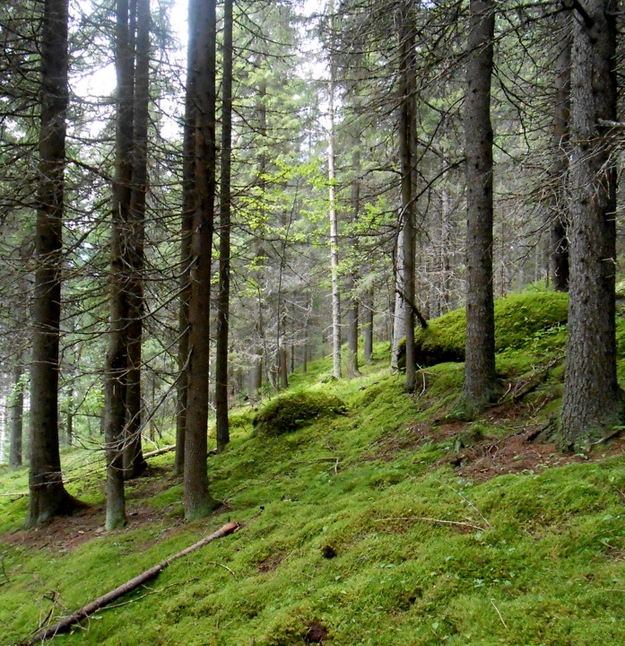
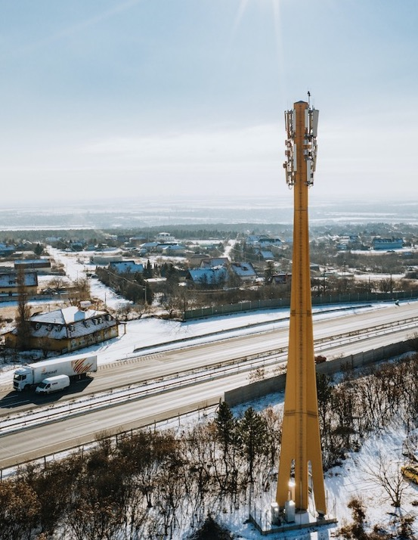
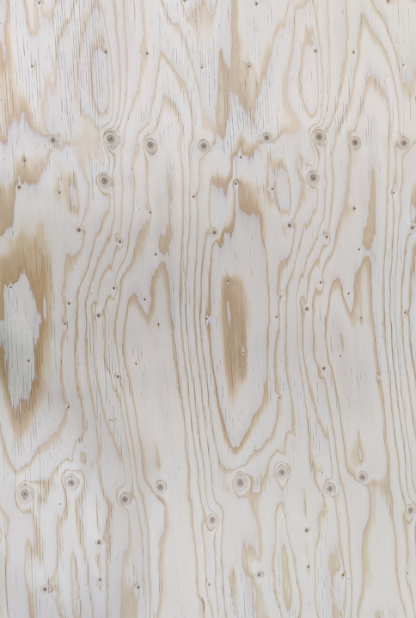

Ecopol ®
Ecotelligent is an engineering provider of sustainable telecoms infrastructure solutions and services
Picea abies Kuusi Spruce Fichte Épicéa Lucfenyő Smrk Smreka Abete rosso

Slide 2
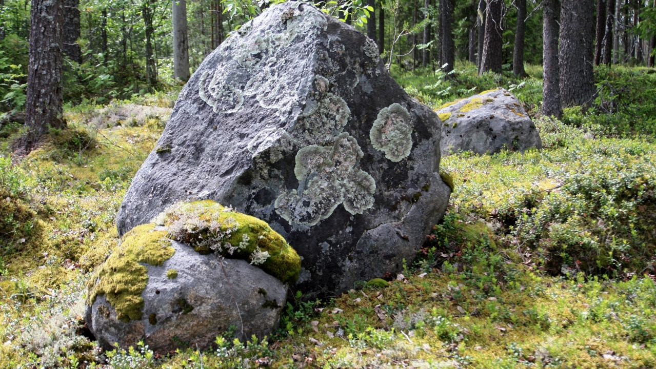


Ecotelligent Ltd was founded in 2017 to
provide and develop environmentally friendly engineered solutions for the telecommunication market
in Finland where there are
Excellent knowledge of timber construction
Sustainable forest management and construction science
Fast development of telecommunication technology
Notes:
Ecotelligent is a company based in Finland and we provide alternatives for telecommunication towers.

Slide 3
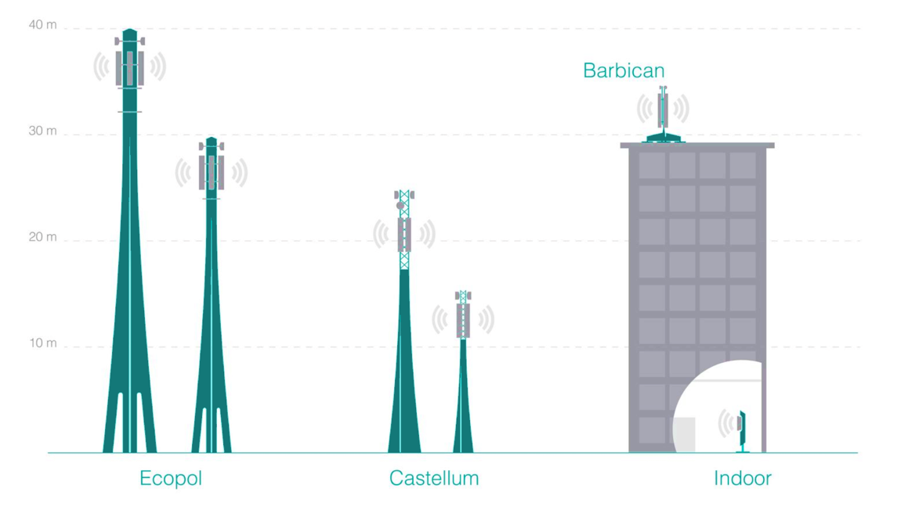
Load bearing capacity Competitive pricing Low CO2
Low
emission
Negative
emission
Barbican ®
Neutral
emission
Ecopol ®
Castellum ®
Indoor ®
Notes:
At the moment our company provides several kinds of wooden structured solutions for the telecom infrastructure market. Our structures are suitable for countryside, parks for rooftops.
Ecotelligent’s products point out two concrete examples:
How to reduce CO2 emission in the telecom tower industry. Substituting and replacing carbon intensive parts (steel, carbonfiber) of the towers by engineered wood parts which have excellent strength potentials but significantly low carbon emission.
How to pay attention to the pleasant living environment. Providing an aesthetical alternative for the living space that enables the provision of good telecom network coverage, including future network generations.

Slide 4
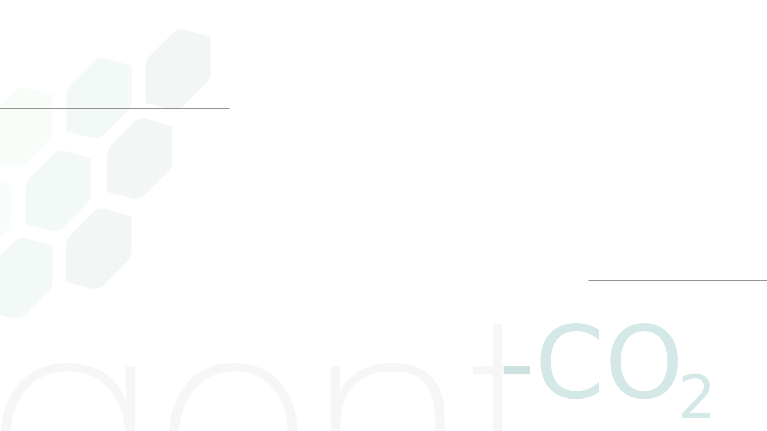

Climate friendly solutions
Our products are mainly from engineered wood
The wood we use are from certified forests
Natural carbon sink
Each product is monitored by One Click LCA system
Verified Carbon net-negative product
Lower carbon footprint for your telecom site
Notes:
Our main construction material: engineered wood like Glued and laminated wooden products. We are also utilizing the characteristics of circular economy while we use products/materials from surplus production.
Wood is a renewable resource; it is a natural carbon sink or biological sequester which means that the wooden plates we use contain CO2 by nature and it captures it until it is used and properly maintained.
Ecotelligent uses engineered wood originated from the responsibly managed forest. This way we can assure that the wood we use is meant for industrial use and it was harvested responsibly.
Each product we develop is monitored by a One Click LCA system, which is an instrument to follow the Lifelong greenhouse gas emission of the construction. The carbon footprint can be monitored by this OneClick system while the production phase and the use phase and recycling/ reusing phase. This is a wildly used certified tool to measure the carbon footprint of the construction.
And to give even more value to our products, we have ongoing verification processes caried out by a third party, the Natural resources institute of Finland. This institute verifies our products, the verification process is based on the CO2 emission of the production of the tower structures.
OWhat are the 4 steps of LCA methodology?
These standards describe the four main phases of an LCA:
Goal and scope definition.
Inventory analysis.
Impact assessment.
Interpretation.
ne Click LCA is the Building Life Cycle Assessment tool that allows you to calculate the environmental impacts of your building in less than one hour

Slide 5
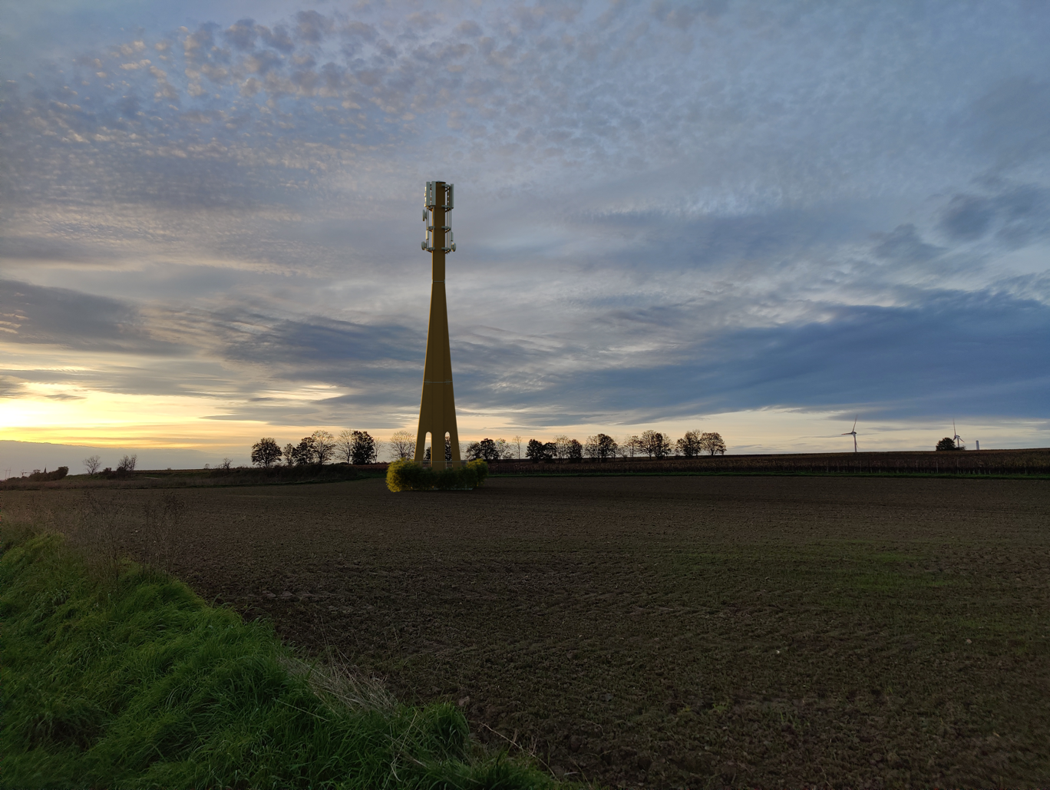
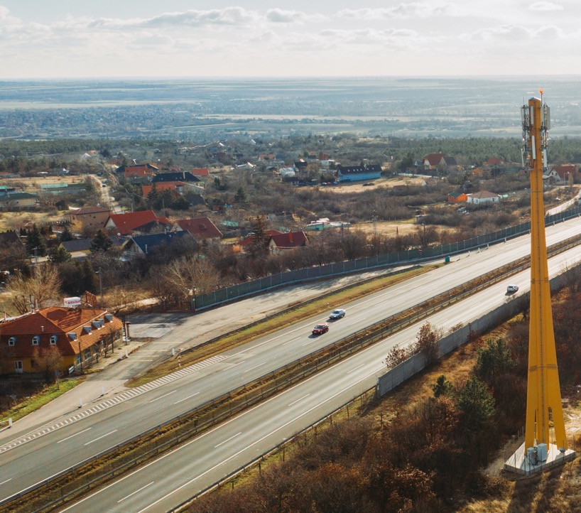
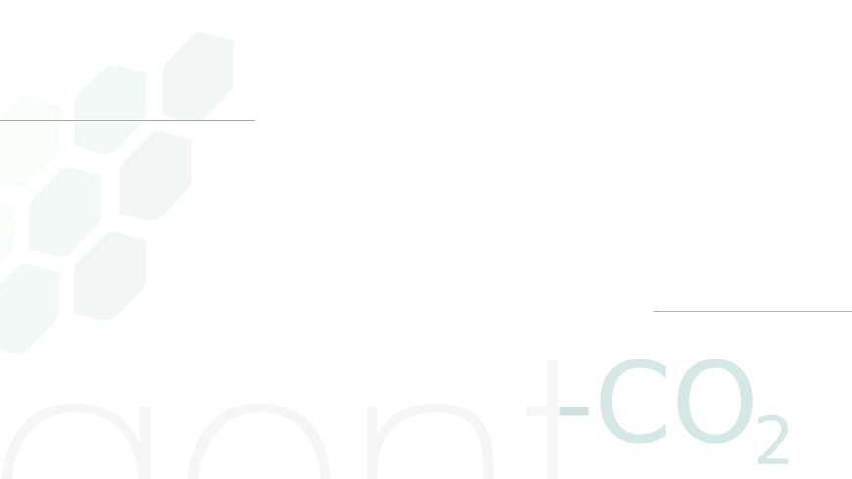
Advantages
Previously denied sites get building permissions with Ecopol
Sustainable comparing to similar steel or concrete solutions
Welcomed for protected and residential areas or national parks
CO2 footprint telecom site compensation
Design and tailorability
Aesthetically fits to the environment
Appreciated telecom site
Notes:
Here you can see some of the advantages listed by our clients. The wooden structures are appreciated by local residential areas because of the construction material and the appearance of the tower.
The products are also appreciated by our clients because of the tailor ability and designing ability of the construction.
It is welcomed by the local communities and authorities in Finland, Italy, Hungary, Croatia and Germany because it gives the Authority alternatives for sensitive areas like National parks or protected sites and residential areas.
The Ecopol itself (which will be soon visible in several settlements in Croatia) was awarded already twice. First in 2010 in Hungary for being a sustainable solution for the telecom site. And in Italy Ecopol received an innovation award in 2022.

Slide 6
Product | CO2 emission | Operator count | Engineered wood |  | Price from € | Height meters
Ecopol® |  | 4 | LVL GLT |  |  | 30 or 40
Castellum® |  | 2 | LVL |  |  | Any from 10 to 25 m
Barbican® |  | 3 | CLT or LVL |  |  | Any from 1 to 4
Low
emission
Neutral
emission
Negative
emission
Notes:
Here you can see our products also assorted by their carbon footprints
Our Ecopol is law carbon which means that most of the steel parts of the tower is substituted by engineered wooden parts The ratio of wood to steel is 3 to 1 for Ecopol
So with Ecopol we are able to rich up to 50% lower carbon footprint compering to the steel monopole towers with a same load bear capacity.
Castellum, a carbon nature product, made from LVL or CLT wooden plates but if the customer requires, we can use lattice part at the top.
Our barbican is carbon negative, it is a floating structure made from surplus LVL or Glue lam. Our Barbican is verified as a Carbon net-negative product means that by producing the Barbican rooftop structure to your telecom site it will capture more CO2 during its lifetime than it will emit during the production phase.
LVL Laminated Veneer Lumber
CLT Cross Laminated Timber
GLT Glued Laminated Timber

Slide 7
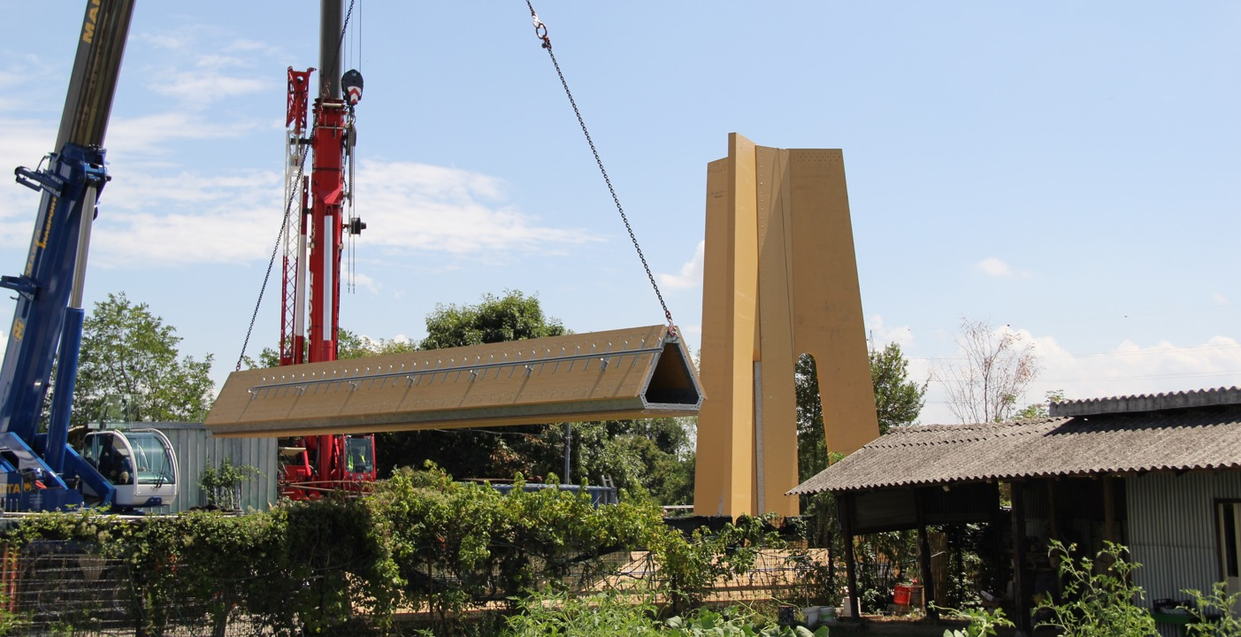
Ecopol tower building

Slide 8
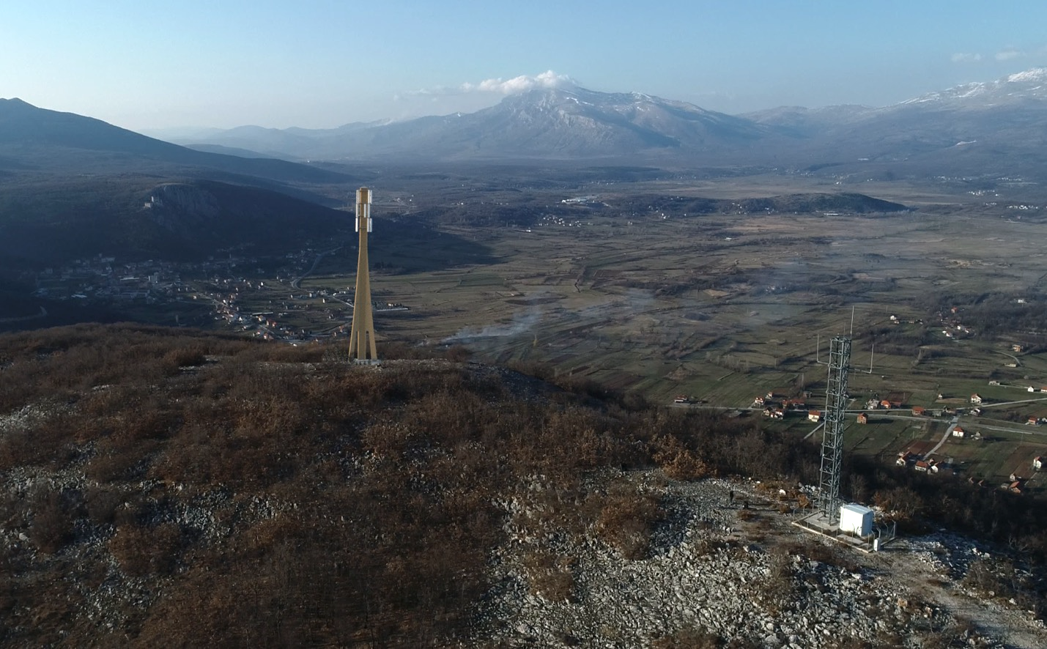
Ecopol tower visualisation

Slide 9
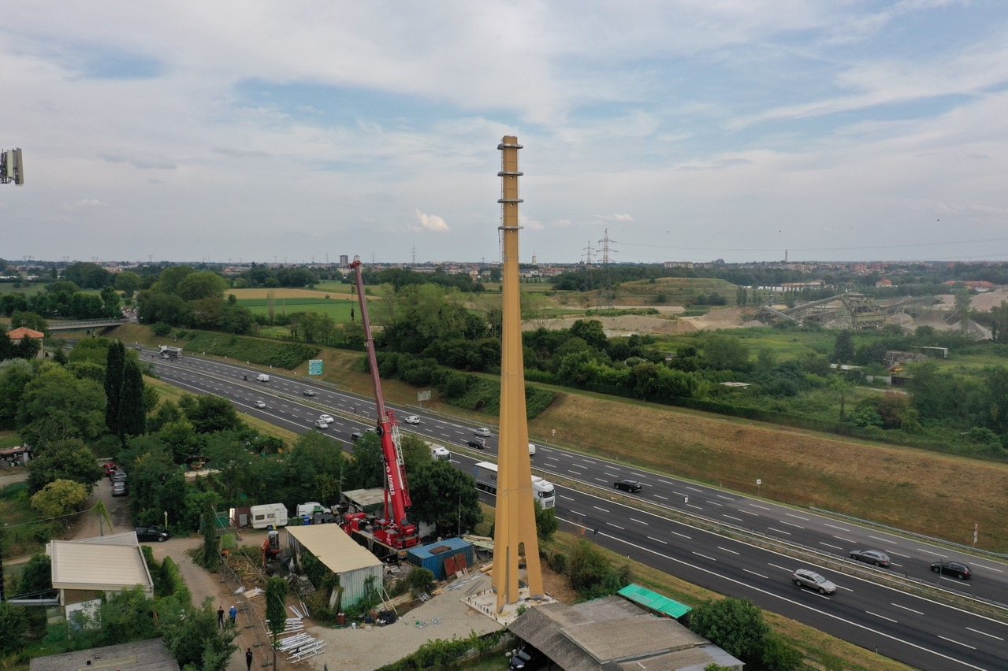
Ecopol 40 meter tower in Milan

Slide 10

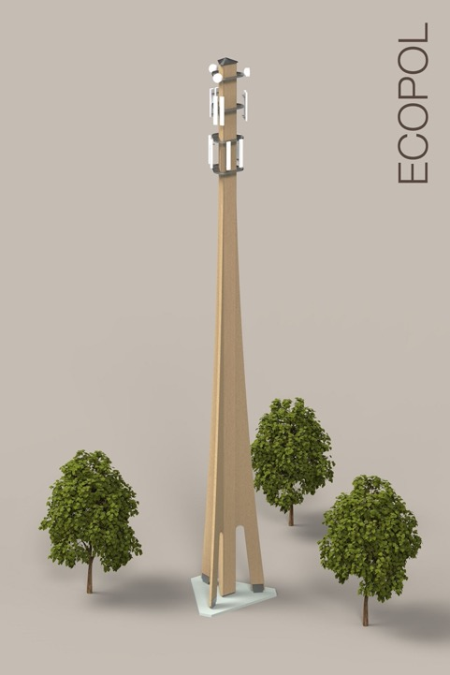
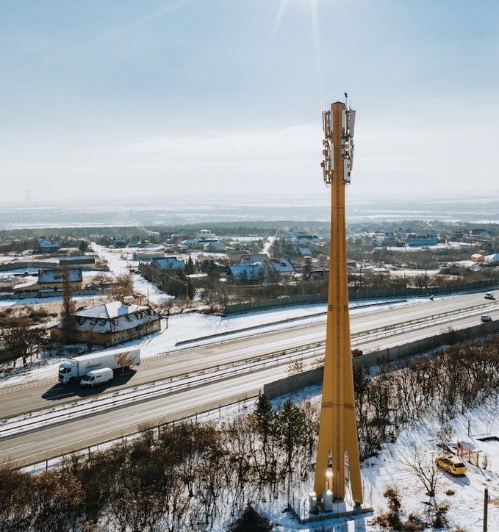
Ecopol®
A macro site infrastructure for mobile networks
30-40 meter
Tenancy up to 4 operators
Excellent load bearing capacity
Equipment wind surface up to 30 m²
30 years of use
100% re-usable or recyclable
Low carbon footprint with carbon sink
Tailoring option for the customer
Low Carbon emission
Notes:
Carbon negative Brabican tower:
Our Barbican is verified as a Carbon net-negative product means that by producing the Barbican rooftop structure, it will capture more CO2 during its lifetime than it will emit during the production phase.

Slide 11
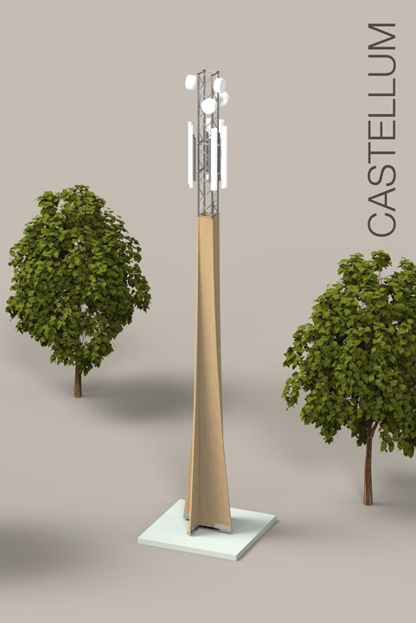
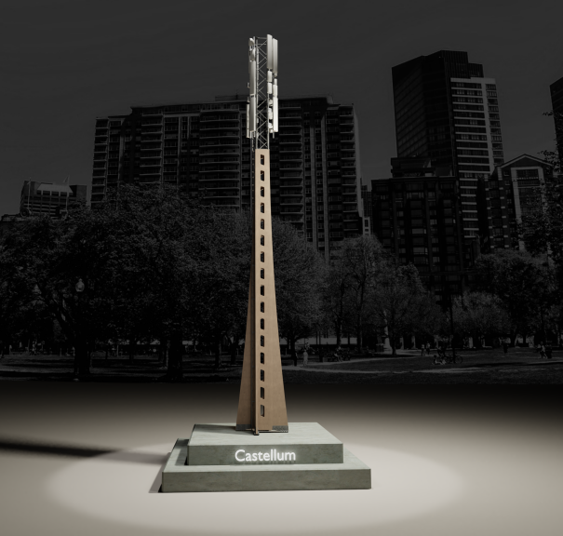
Castellum®
A pole site infrastructure for mobile networks
10-25 meter
Good load bearing capacity
Equipment wind surface on top to 15 m²
Tenancy 2-3 operators
Accomodates the needs for Smart City
Carbon neutral footprint with carbon sink
30 years of use as well as temporary
100% re-usable or recyclable
Tailoring option for the customer
Carbon neutral

Slide 12
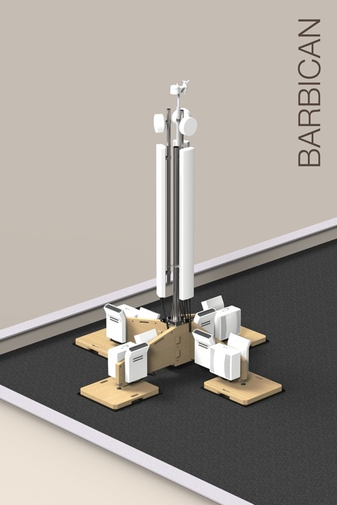
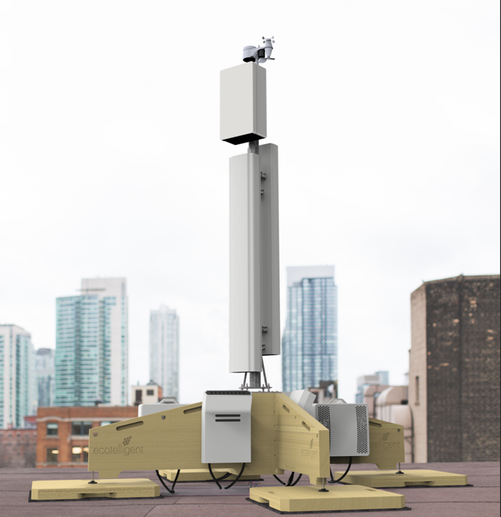
Barbican®
A rooftop site infrastructure for mobile networks
Carbon negative
15 minutes installation time
Up to 5 meter
Extraordinary load bearing capacity
Tenancy up to 3 operators
Carbon negative, CO2 storage
Up to 30 years of use
No drilling or harming the roof
100% re-usable or recyclable
Tailoring option for the customer
Notes:
Barbican is a Carbon negative prodect verified by the Natural resources institute of Finland.
This is the first and only verified Carbon negative product in the telecom tower industry!
Also for sloping roof with 15% inclination angle.
Carbon negative Brabican tower:
Our Barbican is verified as a Carbon net-negative product means that by producing the Barbican rooftop structure, it will capture more CO2 during its lifetime than it will emit during the production phase.

Slide 13
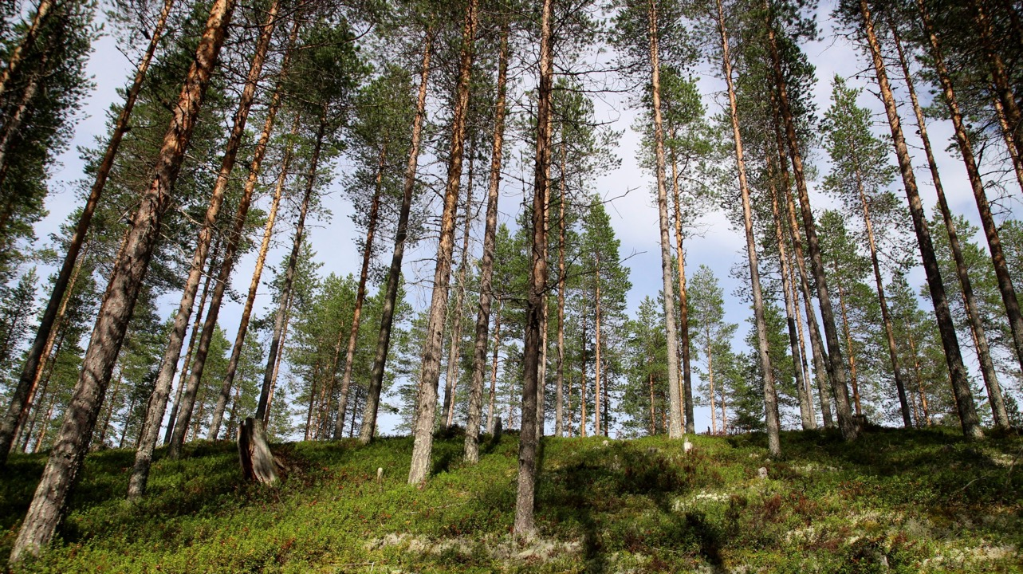
By choosing environmentally friendly construction materials like engineered timber, even the telecom tower structure can be carbon neutral
Ecotelligent works closely together with customers and tackles the challenge of reducing carbon footprint and provide low carbon telecom tower structures and reinforcements

Slide 14

Please contact us
at
https://vimeo.com/557090199
Ecotelligent Ltd
Patteristontie 21 B
80400 Ylämylly
Finland
Gyöngyi Mátray
CEO
gm@ecotelligent.fi
Phone +358 50 355 0905
Matti Pölönen
CTIO
matti@ecotelligent.fi
Phone +358 50 548 7788

