Slide 1
Early Childhood Intervention support for Ukrainian refugees
Tiziana Fantucchio, Lyzaveta Drannikova
EASPD, Belgium
Educational and support strategies during humanitarian
crises
February 21, 2024
04:00 pm– 05:20 pm CET
Notes:
Early Childhood Intervention support for Ukrainian refugee
Lyzaveta Drannikova and her colleague
EASPD, Belgium
Educational and support strategies during humanitarian
crises
February 21, 2024
04:00 pm– 05:20 pm CET

Slide 2

EASPD – European Association of Service providers for Persons with Disabilities
EASPD is the European Association of Service Providers for Persons with Disabilities and represents over 20,000 support services for persons with disabilities across Europe.
We promote equal opportunities for people with disabilities through effective and high-quality service systems.
Notes:
Description of the European Association’s of Service Providers for Persons with Disabilities goal, scope of work, and values

Slide 3
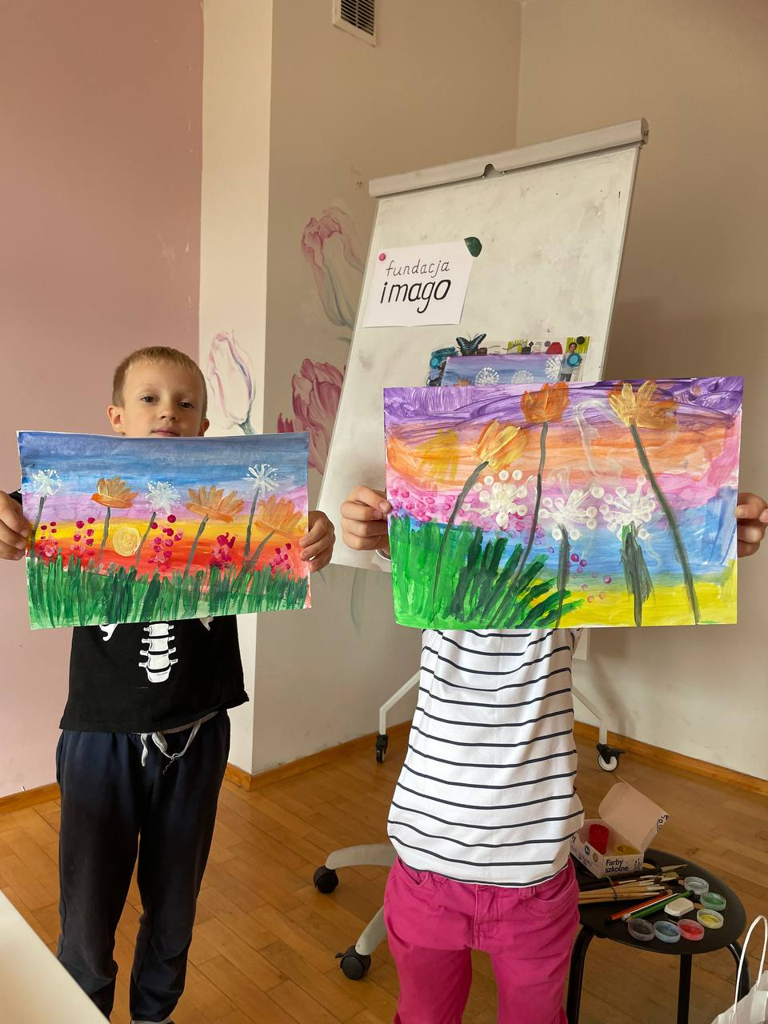
ECDUR project – Emergency Early Childhood Development Support for Ukrainian Refugees
Organised in partnership with UNICEF
Goal: support Ukrainian families fleeing the war with young children at risk of developing/with disabilities or developmental delays
How: with the help of 5 leading social organisations from Poland, Slovakia, Bulgaria, Romania, and Moldova:
  Reaching over 12,000 children and caregivers with direct support
  Building national system capacity in the participating countries to provide ECD services to children and families who require them
  Advocating for a greater emergency ECI/ECD response on national and EU levels
Notes:
Key elements of the ECDUR (Emergency Early Childhood Development Support for Ukrainian Refugees) project. It is organized in partnership with UNICEF, it’s goal, and how it is realized (namely, via 3 streams: direct support to Ukrainian families fleeing the war with young children at risk of developing/with disabilities or developmental delays; national capacity building; advocacy).

Slide 4
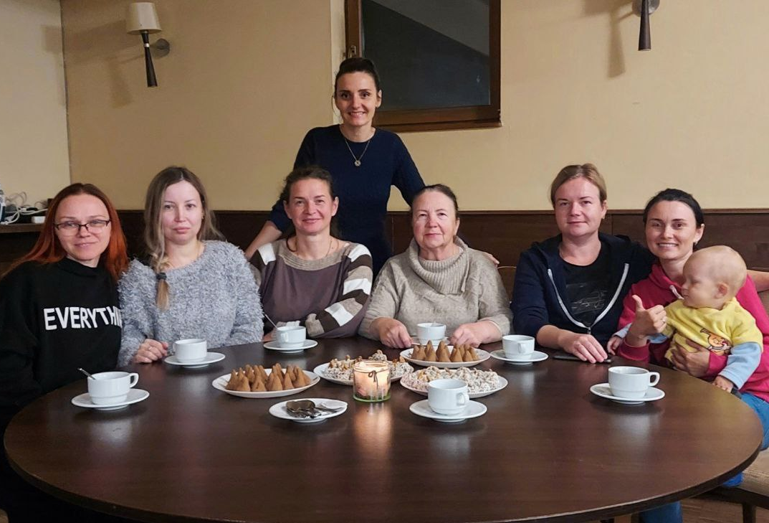
Innovative aspect 1/2
Via cascade training, ECDUR prepared specialists to support Ukrainian children and their families:
  500+ Family Consultants (FC) to provide emergency psychosocial help and facilitate Early Childhood Intervention (ECI) support
  500+ Peer Support Facilitators (PS) to lead support groups for parents
  Regular mentorship support for FCs and PSs and guidance by national coordinators
This approach can be replicated in other emergency contexts, in the field of disabilities and not only
Notes:
Innovative aspect of the project 1/2: training 500 family consultants and 500 peer supporters to provide emergency ECI/ECD support. This approach can be replicated in other emergency contexts, in the field of disabilities and not only

Slide 5
Innovative aspect 2/2
The collective approach in an emergency situation, uniting several countries in the region, allows the identification of mutual challenges, which can be tackled via:
  coordinated actions
  resource pooling
  sharing knowledge and best practices
  building cross–country referral pathways to maximize support from professionals
Notes:
Innovative aspect of the project 2/2: The collective approach in an emergency situation, uniting several countries that allows to acquire a lot of benefirts to achieve the goal of the project

Slide 6
Impact
20 441 beneficiaries reached with ECD/ECI and peer
  support by FCs and PSs
Key challenges and solutions (recommendations) identified to improve national and EU capacity to respond to the needs of young children at risk of or with disabilities, developmental delays or behavioural challenges, including children coming from Ukraine
  national assessments
Political discourse on ECI in an emergency context was launched, putting it on the international agenda together with DI
  international ECI conference and other high-level events
Notes:
Explaining the impact of the project: served over 20000 people with direct support, identified key challenges and recommendations to improve ECI services (in particular to the refugees) in the partner countries and the EU, reached higher political commitment to the matter

Slide 7
Sustainability
The 3-stream approach created a bridge between emergency support and long-term ECI:
  Improved capacity and expertise of ECI/ECD specialists, including those from Ukraine
  Legislative changes on the national level and continued support outside of the project
  Recommendations for the EU as a beacon for future actions
Notes:
This slide explains how the sustainability is reached via Building capacity and expertise of ECI specialists, triggering legislative changes, promoting recommendations for the EU and countries

Slide 8
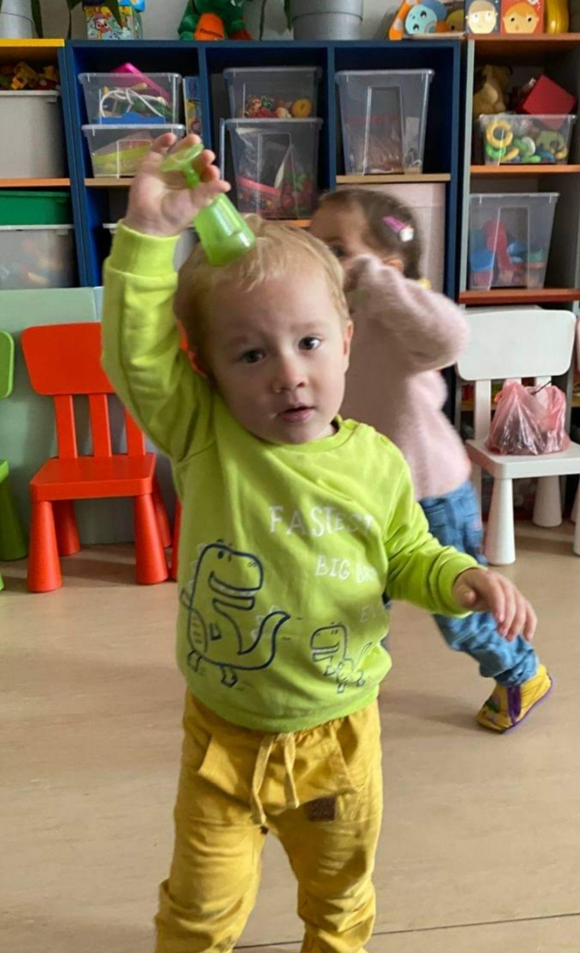
Testimonials
“I am very glad that I joined this project. By helping others, I help myself. It has become a new stage in my life” – a family consultant
“Thanks to this project, we have felt much better, more confident, safe, and calm” – a mother
“Even though we are in a foreign country, we are not alone here. With us are people who always extend a helping hand, advise, and guide us in the right direction” – a mother
“This project is very important, especially for mothers of children with special needs... Thanks to the project, they begin to share their emotions and experiences” – a family consultant
Notes:
Testimonials from the beneficiaries and specialists trained within the scope of the project about its impact on their lives

