Slide 1

Inclusive Education, and ICT
Elif Cansu Gayretli
Değiştiren Adımlar Derneği - Steps that Change
Turkey
Entrepreneurship and leadership development for young people with disabilities
22 Feb 2024, Thursday 14.40 -16.00
Notes:
Inclusive Education, and ICT; Elif Cansu Gayretli; Değiştiren Adımlar Derneği - Steps that Change, Turkey, Entreprenurship and leadership development for young people with disabilities
#ZeroCon24
22 Feb 2024, Thursday 14.40 -16.00

Slide 2
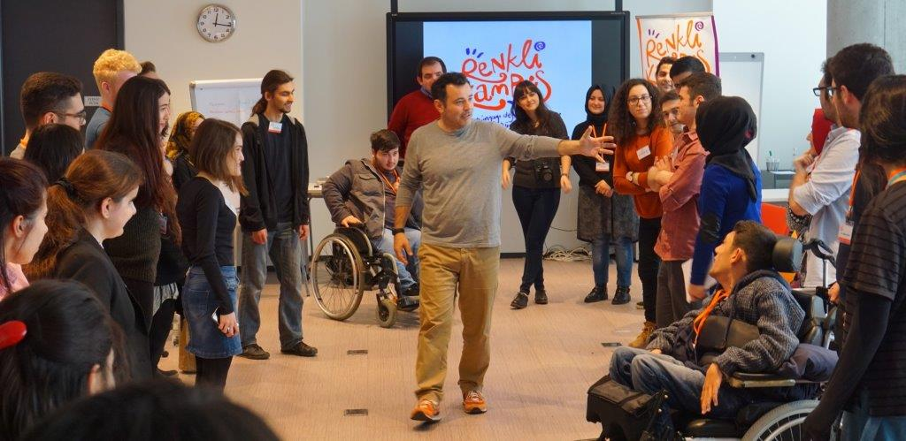
Değiştiren Adımlar Derneği,
Steps that Change
Istanbul based NGO
Diversity and inclusion to engage all parties ie: gender, disability, sexual orientation etc
Empower today’s youth to ensure a better future
Notes:
Presenting the general information about our NGO and our primary goal
Photo: Around 18 university students are together with a facilitator in the middle which conducts a workshop. There are people with and without disabilities. Renkli Kampüs (Campus of Colours) is written on the screen at the background.

Slide 3
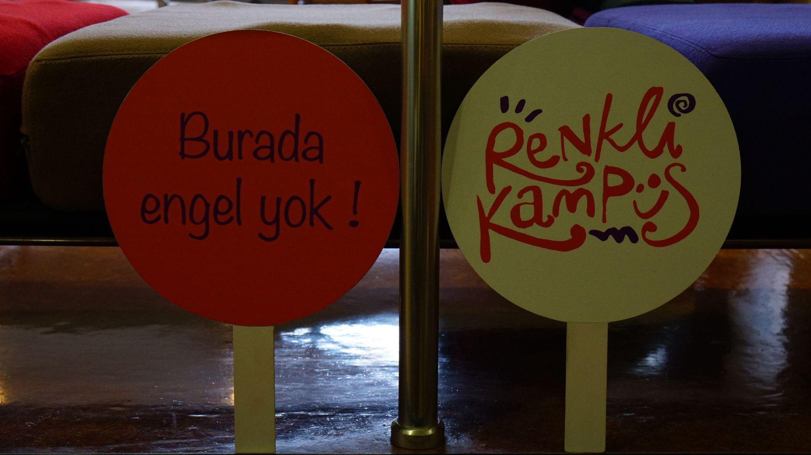
Renkli Kampüs,
Campus of Colours
Campus of Colours, to raise socially responsible leaders and innovators through social awareness
High school and university students with and without disabilities
  Co-working spaces
  Equity of opportunities to access same educational programs
Notes:
Presenting two objectives, method and the partners of the Campus of Colours.
Photo: There are two banners. One is saying ‘Burada engel yok! meaning ‘There are no obstacles here!’. The other one is saying ‘Renkli Kampüs’ the Turkish name of the program.

Slide 4
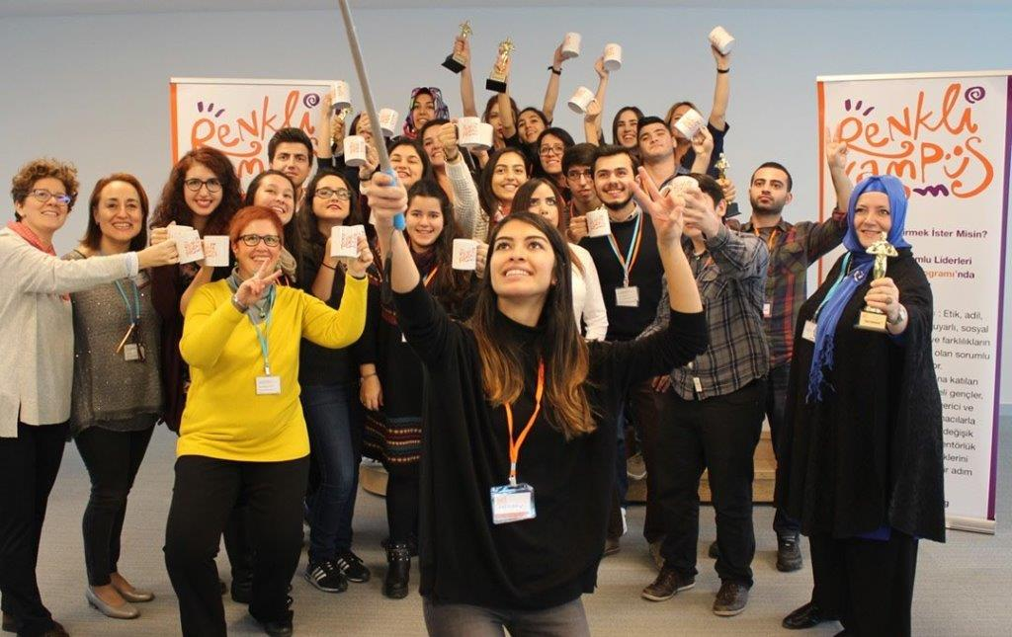
What differentiates us?
Unveil the hidden gems of youth and blend the talent with the community
Peer to peer learning
Co-operation with 30+ NGOs to achieve co-living culture
Build bridges between the stakeholders (public, private sector, NGOs, volunteers etc)
Notes:
Presenting the differentiation points of our project.
Giving detailed explanation of what we are doing and how we differ from other programs conducting in Turkey
Photo: A group of people holding up Campus of Colours mug and smiling for a selfie in the graduation ceremony of second program

Slide 5
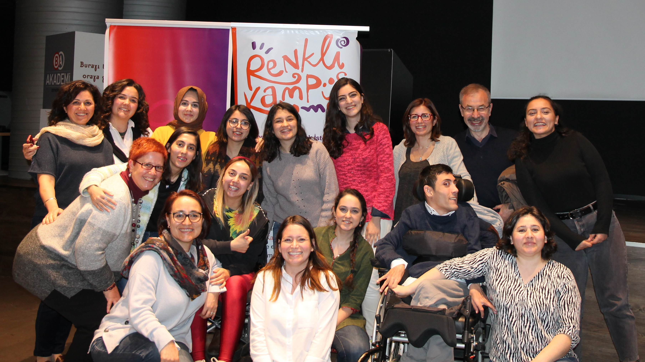
The Butterfly Effect for Youth and Society
Social transformation through self empowerment of Youth
Mutual growth:
  Financially and socially independent youth
  83% of graduates are engaging in civil society activities after the program according to Social Impact Analyis, 2020
One Emproved, All Empowered
Notes:
Presenting our impact in social tranformation through self empowerment of Youth explaining the mutual growth.
Photo: 17 people are posing and smiling in front of Campus of Colours’ banner at the end of a workshop. The group consists of man and woman and also with and without disabilities.

Slide 6
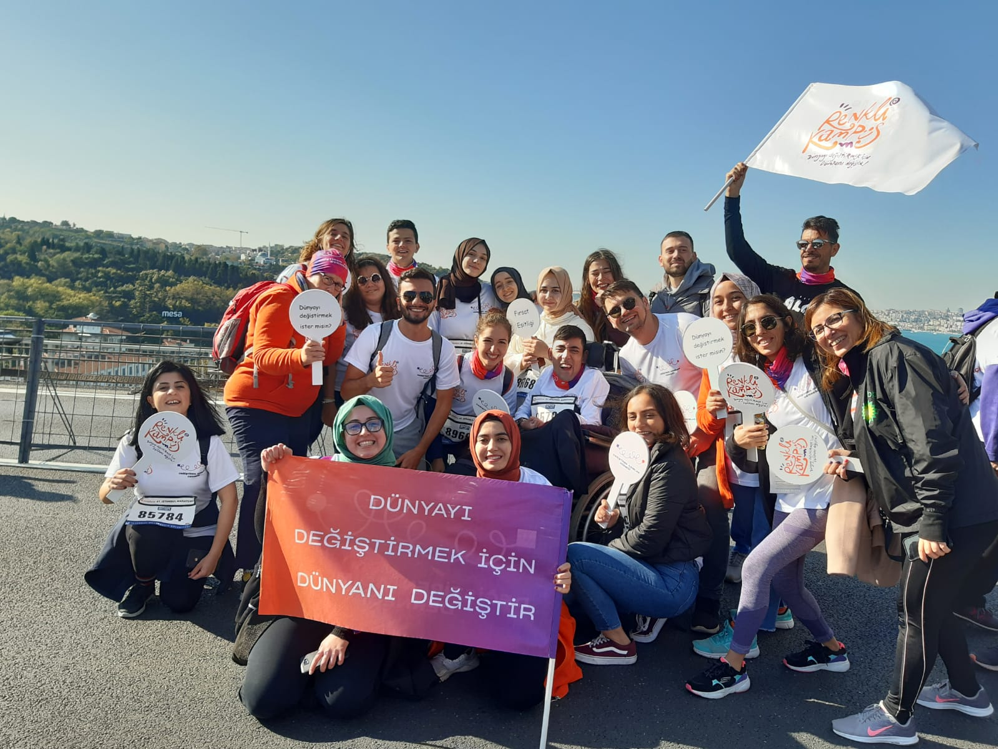
Financials and Sustainability
Donations, sponsors and fundraising events
Inclusion of high school
11 university and 4 high school programs with 400+ graduates
Self Sufficiency with Network and Volunteer web
Notes:
Presenting the financials and the sustainability methods of the Campus of Colours
Photo: Around 20 people are together in their sport clothes on Bosphorus Bridge. Holding banners of Campus of Colours and a sentence that says ‘Change your world in order to change the world.’ in a charity run

Slide 7
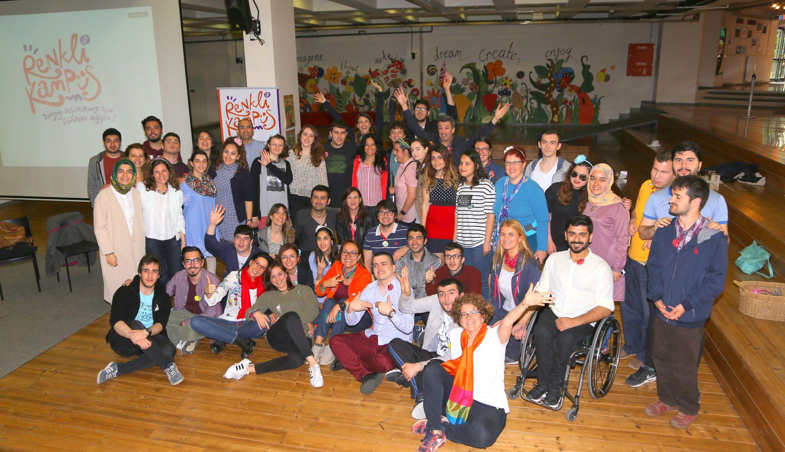
We don't just network, we build bonds
Inspire and be inspired with International Communities
Broaden the impact of Campus of Colours beyond Turkiye
Create new discussion spaces and organize youth camp, ideathon etc
Notes:
Presenting the future plans, next steps and vision of Steps that Change and Colours of Campus
Photo: In the group photo there are around 30 people that are raising their hands and smiling. There is Campus of Colours banner in the background.

Slide 8
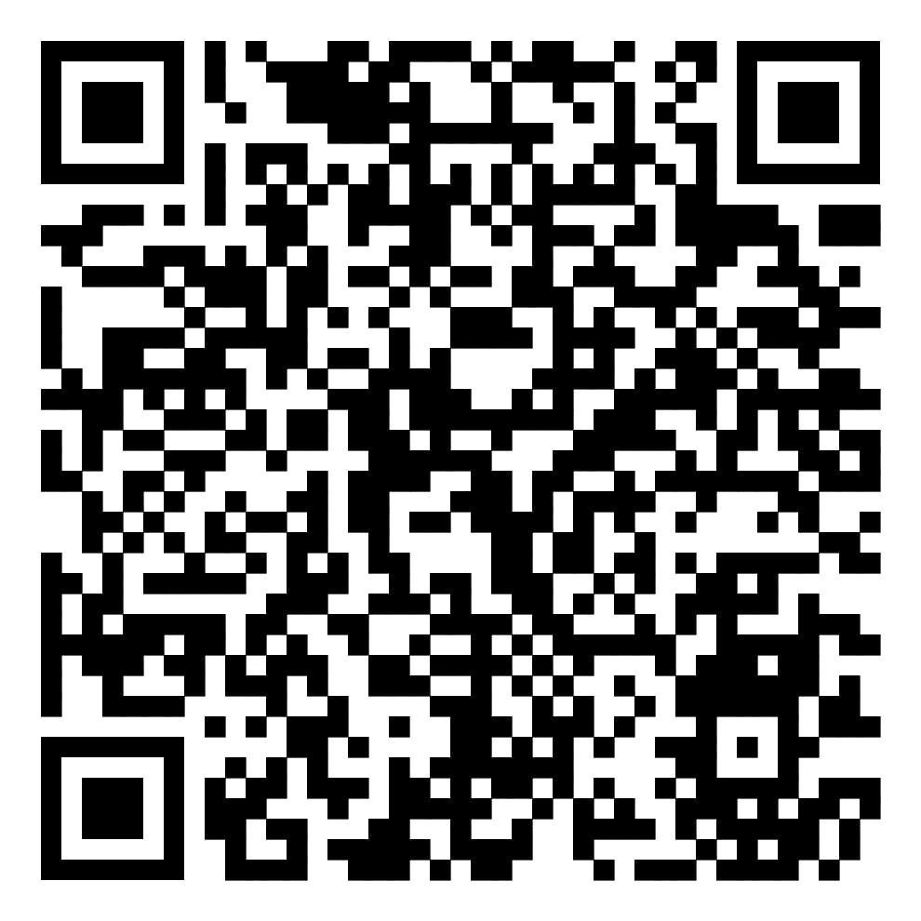
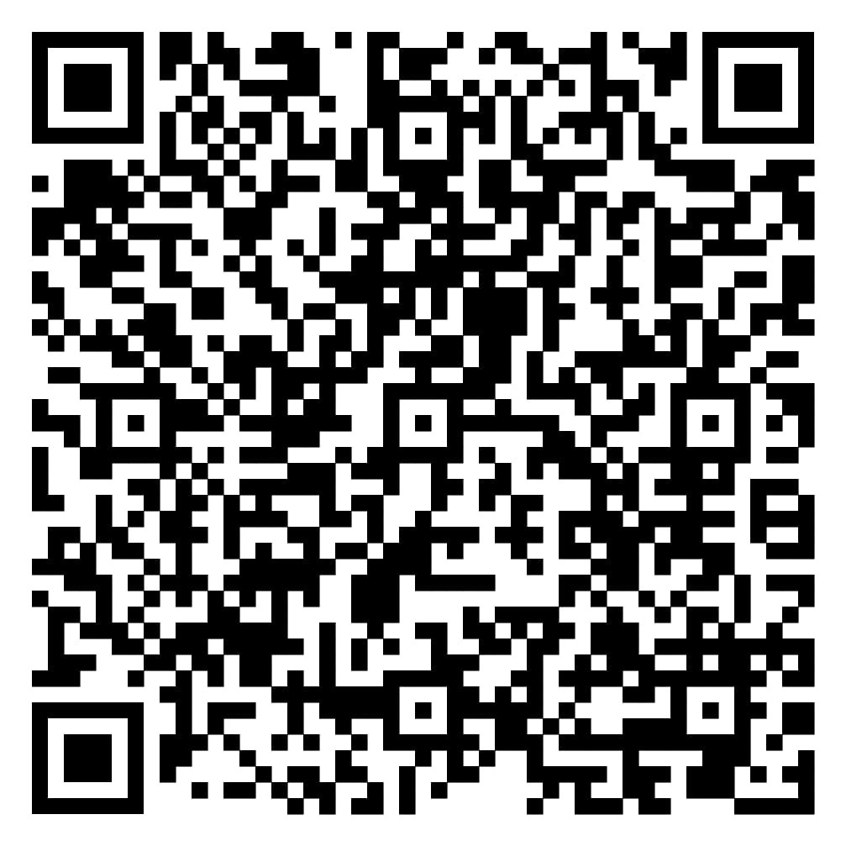
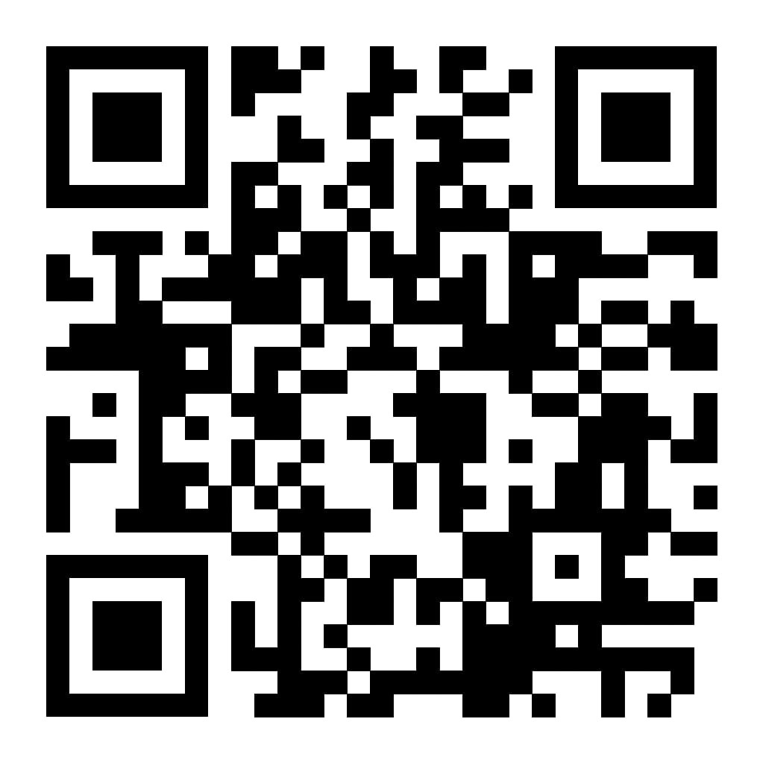
Let’s keep in touch ☺
LinkedIn
Instagram
Website
Notes:
Presenting our Instagram and LinkedIn links

