Slide 1
HACK
Elder Companion

Slide 2
The problem
Aging population
1 in 6 in USA
562 milion worldwide
Cost
OECD 1.8 % of GDP
Lifetime expectancy
Life expectancy at age 65 (in 2021) averaged about 19.5 additional years

Slide 3
The solution
AI companion to aid the elder
Planning and monitoring medical treatment

Slide 4

Benefits
We improve quality of life of elder people
Cost savings & Time savings
Peace of mind for caregivers

Slide 5
Market opportunity
Market size:
TAM : ~1.6 trillion a large, fast-growing market.
SAM : “elder care services” (~US$ 415B).
Primary customers: Elder care homes
Competition:
CeliaAI
Elderwise
Semvox
CareTaker

Slide 6
Business model
B2B
Pay per subscription

Slide 7
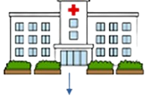



The technical solution
Cloud
Web
Mobile
Tablet
A

Slide 8
Roadmap
09.2025
12.2025
1.2026
12.2026
First MVP
Validation
First pilot trial
The best 3 AI
models.
Romania phase deployment
Go global
A
C
D
B

Slide 9
Team, advisors, motivation
Motivation: A personal commitment to combat the global threat of antibiotic resistance
Daniel Tatar
CEO
Technical Expert
Luca Rednic
CTO
IT expert
Mihetiu Raluca
MD
Medical expert
Varna Liana
CFO
Financials

Slide 10
Ask
100 000 €

Slide 11
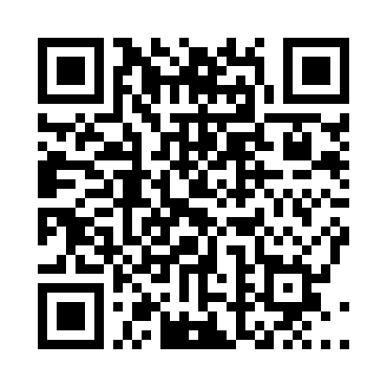
Contact
Florilor 278, ap 43, Floresti
0755293245
Evanovix.com

