Slide 1
We “ Hear” you
Dr. Wajdi Wazzan
Mr. Abdullah Almotiri
King Abdul-Aziz University
Saudi Arabia
Inclusive practices in universities and higher education institutions
Wednesday, 21 February,2024
14:00 – 15:20
Notes:
Dr.Wajdi, Wazzan and Mr. Abdullah, Almotiri from King Abdul-Aziz University in Jeddah. They will present their awarded project called “ we Hear you” for the season inclusive practices in universities and higher education institutions. On Wednesday,21 February , 2024 at 14:00

Slide 2
King Abdulaziz University
Largest Public University in the Kingdom
KAU hosts 30% of total SWD in Higher Edu in the Kingdom
Mission : Community Responsibility : Knowledge Development, Research, Innovation and Entrepreneurship
Notes:
King Abdulaziz University (KAU) is the largest public university in Saudi Arabia (about 80,000 students). An Important part of its mission is to develop the community. The picture show part of KAU huge campus.

Slide 3
Motivation
Deaf Students can’t enroll at KAU
Arabic Language Abilities
Scores in Standardized Tests
Learning levels at public schools
They study parts of the curriculum compared to other students
Notes:
We found that it was difficult for deaf people to get into KAU because of their language abilities. Deaf people have problems in Deaf schools because their curriculum doesn't match that of public schools

Slide 4
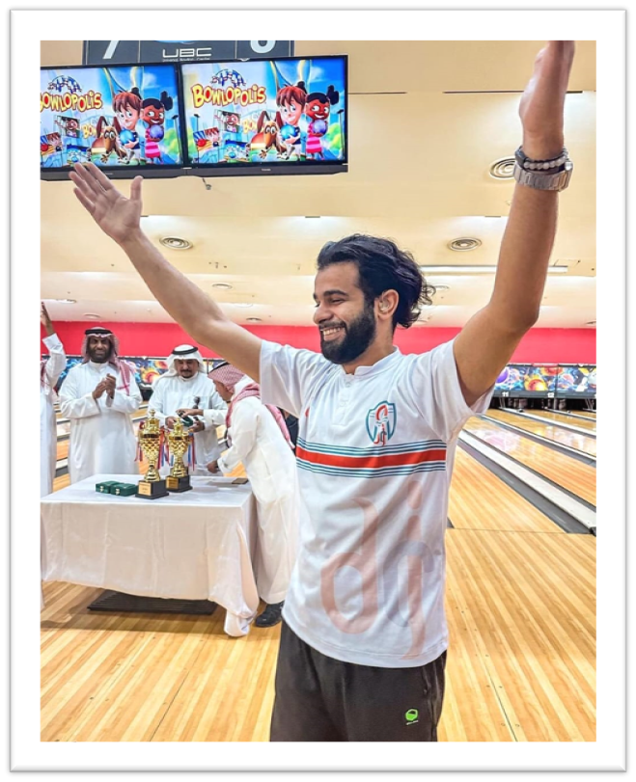
What Can We Do?
KAU is keen to empower and include SWD
We have to elevate Deaf students' Arabic language abilities to a university level in one year.
“We Hear You Program”: The Deaf Preparatory Year
Notes:
What can we do? Three point: Empowering students at KAU, Elevate Deaf’ language skill, launch the project. An Image with a Deaf boy raising his hand to celebrate his achievement.

Slide 5
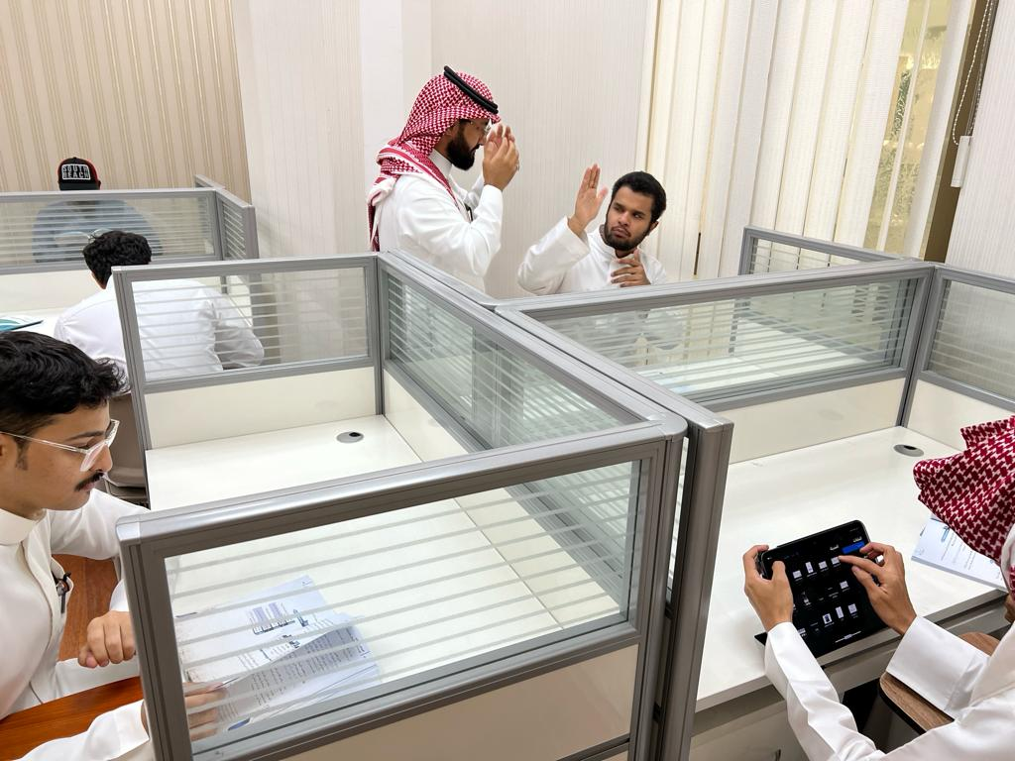
The Solution
An Intensive Arabic Language Year
The curriculum
Assistive technology
Visual aids
Sign language library
Mentorship and guidance
Notes:
Our project aims to empower deaf students by equipping them with the necessary skills to excel in literature and prepare for university. We integrate assistive technology, including visual aids and sign language libraries. The image for Deaf students focusing in their class assignment.

Slide 6
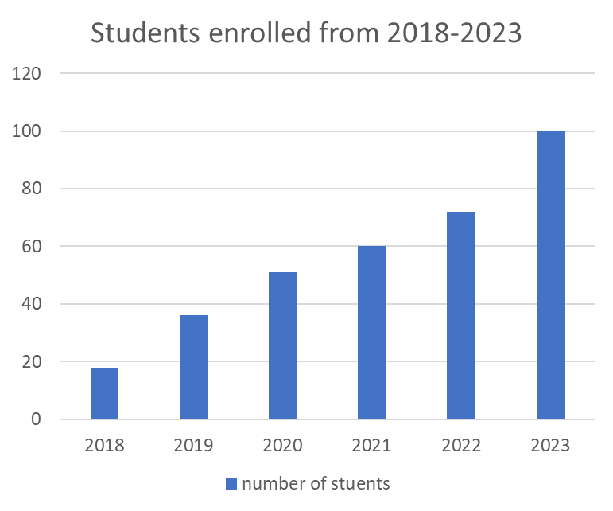
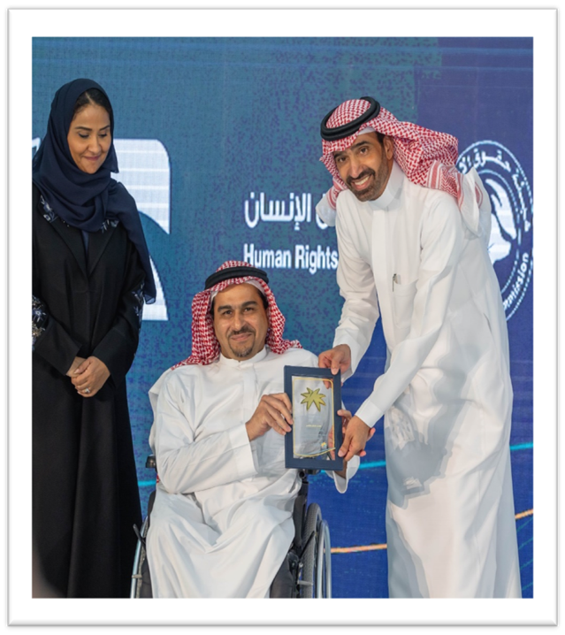
The accomplishments
Academic achievement
Higher education enrollment
Two study majors
Digital Media
Fashion Design
More are coming!
Awards
Notes:
Our project has achieved remarkable success in accepting Deaf students into higher educational institutions. Deaf students. Many of our students have gained admission to college, and the number of admissions is increasing. The project has also received recognition and awards, such as the "Jeddah Awards.“ image 1: a chart showing students enrolled rate from 2018-2023. Image 2 “ Dr. Wazzan received award from gov. clerk.

Slide 7
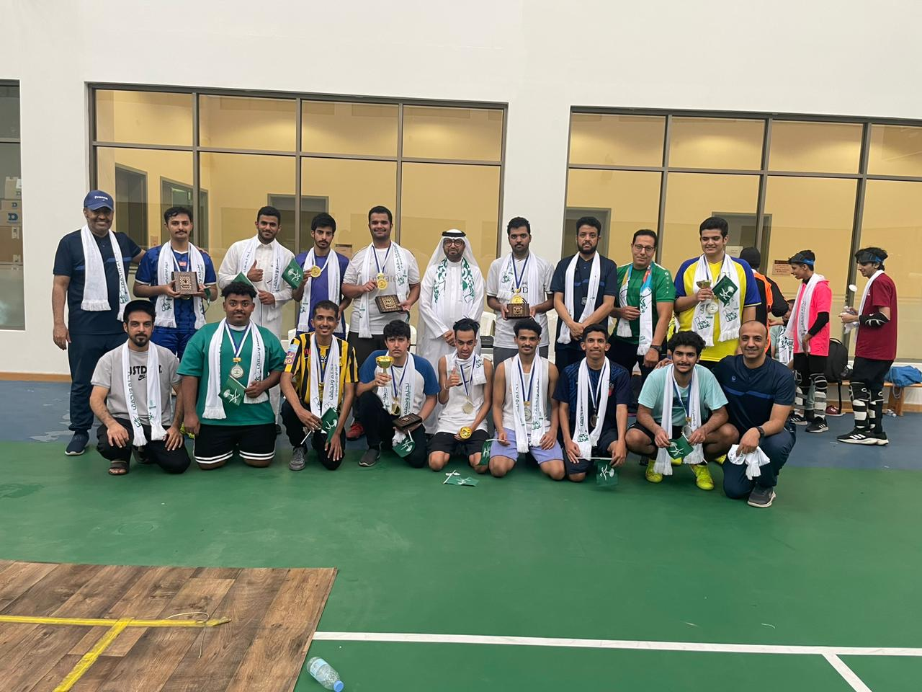
The Impact
Empowering Deaf students
Promoting inclusivity and equal opportunities
Building confidence and self-esteem
Driving social change
Notes:
Our project focuses on improving literacy skills for Deaf students, empowering them to communicate effectively and express their ideas. we ensure equal opportunities for Deaf students in university. we build their confidence, drive societal change, and contribute to a more inclusive society through sign language workshops and awareness training. Image: A group of Deaf students are posing at camera after sport event.

Slide 8
Challenges
Limited awareness and understanding
Deaf culture and sign language: Deaf people face challenges arising from a lack of understanding about their culture and sign language among people in community
Limited access to resources
Qualified of sign language interpreters: the project faced a challenge finding a skilled sign language interpreters. Considering the importance of the interpreter's role and their impact on the project, we were unable to find qualified interpreters. This issue arose due to the lack of academic programs dedicated training and certifying interpreters within kingdom
Notes:
Our project addresses the challenges faced by Deaf students in accessing specialized resources and communication support. Training sign language interpreters and raising awareness among educators, we ensure effective communication and promote inclusivity. This creates inclusive environments and supports the unique communication needs of Deaf students.

Slide 9
Planning our future
Continued program development
Working on providing new areas of study for Deaf students
Expansion of support services
Academic program for sign language interpreters
Collaborating with universities
Exchanging experiences with universities in/outside the kingdom
Notes:
We will update the curriculum based on feedback and adapt to new trends. Additionally, we will expand support services, particularly in the provision of sign language interpreters. We are also seeking collaborations with universities to exchange knowledge and enhance our practices, creating a dynamic learning environment for deaf students.

Slide 10
Thank you.
Notes:
Last slide : a word thank you .

