Slide 1


Lower costs. Higher comfort.
STEPS
- the System of Thermal Energy Packed Storage
PILOT

Slide 2
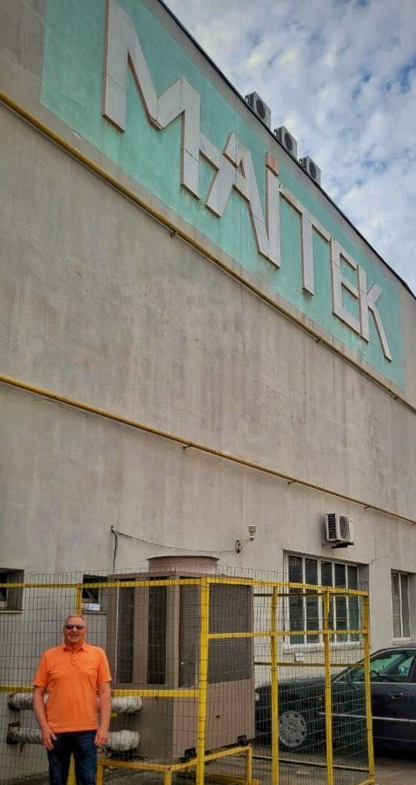
About us
LLC MAITEK PLUS
Established since 2011 in Ukraine. Software and hardware producer. 1,000 objects in Ukraine and in EU were automated. 1,000 square meters of in-house production. Member of the Vinnytsia Automation and Instrument Making Cluster.
MAIN SPECIALIZATION IS:
- automation of technological production, enterprises, multifunctional facilities and business processes;
- energy efficiency and energy supply systems;
- systems for monitoring and managing business and working processes.

Slide 3
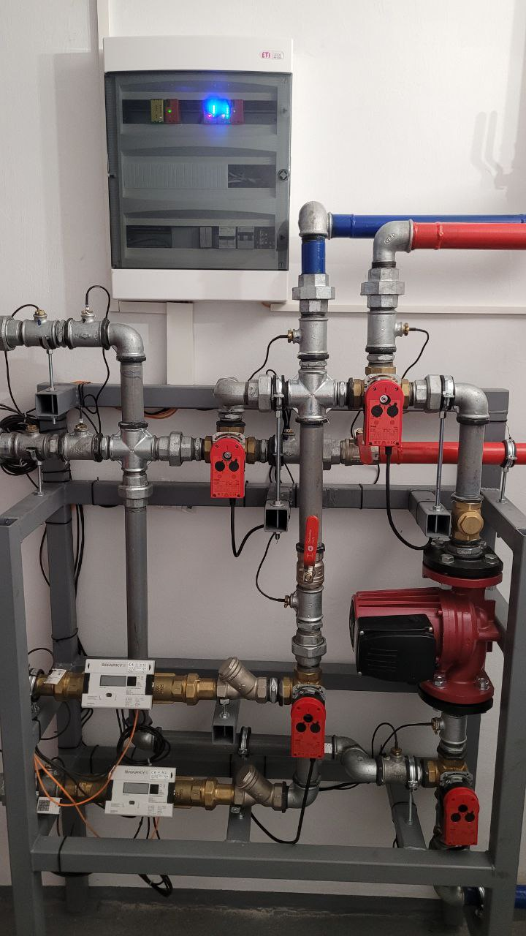


Our Solution
The STEPS is:
Smart algorithms to predict heat demand.
Full integration of a thermal accumulator,
a heat pump, and a solid-fuel boiler in the single system.
Automated work processes with minimal manual intervention.
Intelligent savings are up to 30% on heating costs.

Slide 4
Problems of premises owners that we solve
High heating costs, especially in the face of rising energy prices.
Low efficiency of traditional heating systems.
Difficulties in managing thermal resources due to lack of automation.
Lack of integration with modern IoT solutions.

Slide 5
Three types of generation
Heat pump (air-water) with a capacity of 40 kW. Total power generation: 150-200 kW (depending on the country, permits and certifications)
Capacity of the sectional heat storage at the maximum charge-discharge cycle: 2400 kW/h.
Maximum peak power: 500-600 kW
Free service is for one year
Warranty service is for 5 years, concluding a service contract.
Delivery time is up to six months after order confirmation.
What
our partner
gets?

Slide 6

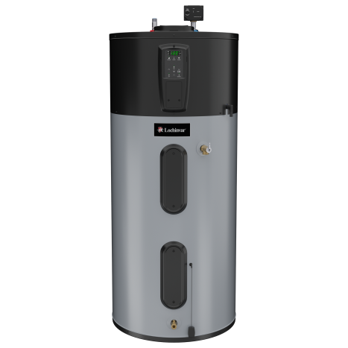

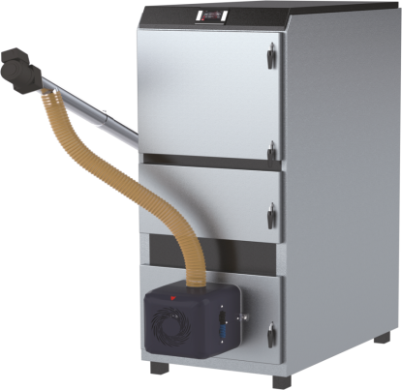
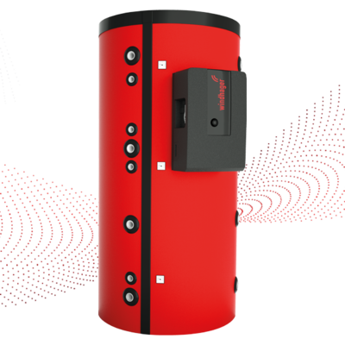
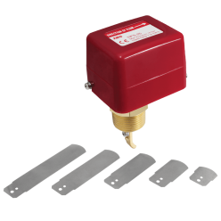
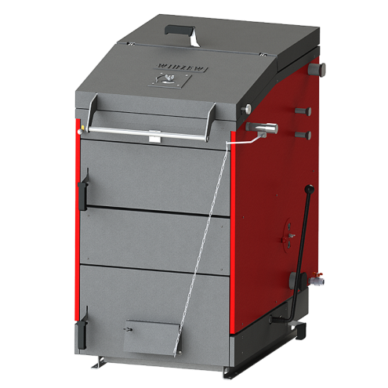

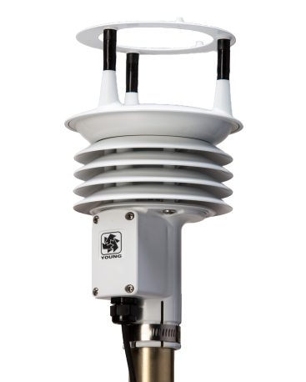
TECHNICAL FUTURES
The STEPS SYSTEM
HP
HGSCS
HP – heat pump
PB – agropellet boiler
WB – firewood boiler
MS – meteo sensor
FS – flow switch
CS – control system
DCHA – double circuit heat accumulator
HGSCS –heat generation and storage control system
PB
FS
DCHA
WB
CS
MS

Slide 7

Economic Benefits
HEATING COSTS SAVINGS ARE UP TO 30% BY THERMAL ACCUMULATOR AND AI-BASED OPTIMIZATION.
FAST INVESTMENT RETURN : achieved within 1-2 years.
LOW MAINTENANCE COSTS: reduced by 20%.
*Results obtained after measurements in our own laboratory and facilities of 1000 m² in Ukraine, 2023

Slide 8

PRICE
from 56,000 to 59,000 € *
*not including the cost of delivery
of components and the
dispatch of specialists for installation
The price depends on the conditions of the project, such as the type of construction: modular, built-in or combined.

Slide 9
Autonomy and fuel diversification
Green transition support
High generation efficiency
Forecasting through Artificial Intelligence.
The STEPS thermal accumulator has a 30 times greater capacity than Tesla's most powerful 82 kW*h accumulator.
The possibility of connecting solar collectors
High peak power
The Accumulator is operating in case of an emergency.
Key advantages

Slide 10



www.kb99.com
Contact us to get a pilot installation calculation!
fundraising.maitek@gmail.com
+380 67 430 18 24

