Slide 1

Your
Strategic
Partner

Slide 2

About Us
Our Journey Starts in 2006 as a sourcing and trading organization, with a straightforward mission. With decades of our dedicated efforts, led us to impressive growth.
Our dedication to maintaining high and consistent quality standards, coupled with dependable and effective service values, has allowed us to carve out a substantial presence in the market.
At present, we function as the sole provider of both B2B and B2C services, presenting a wide array of products. Since its founding, SAAF INTERNATIONAL has quickly expanded its facilities and diversified its product range. t

Slide 3
Our Journey
Founded in 2006 as a sourcing and trading company, began with a clear mission:
“To deliver quality with integrity”.
Through years of focused effort, we’ve achieved sustained growth and built a strong market presence.
Our commitment to high standards, reliable service, and consistency has earned the trust of global partners.
Today, SAAF International proudly operates across both B2B and B2C segments, offering a diverse product portfolio.

Slide 4
About Us
To become strategic partners of our clients for their resource management to increase efficiency and profits. We are a team of experts in all fields in which we are offering services.
Our efficient and experienced staff renders quality services to our clients, we have worthy relations at national & international level industries to find right source at right time for our customers business solutions.

Slide 5

Our Vision & Mission
Our Vision
To become the best strategic business partner of our clients and stake holders around the Globe for mutual business benefits.
Our Mission
Through our highly professional & expert team to provide cost-effective, intelligent solutions in a timely manner to earn mutual business benefit for our valued clients & international partners.

Slide 6
We are dealing in:
Socks
Towels
Knit wear Garments
Home Textiles

Slide 7

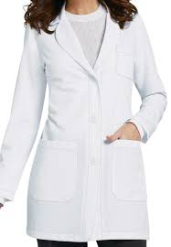
Lab coats, Patient gowns, Operation Theater Dresses

Slide 8

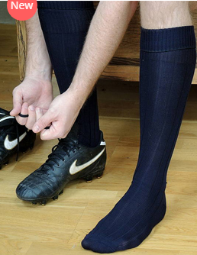

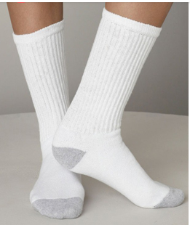
Sports & Casual Socks

Slide 9

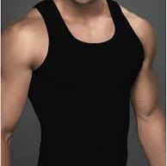
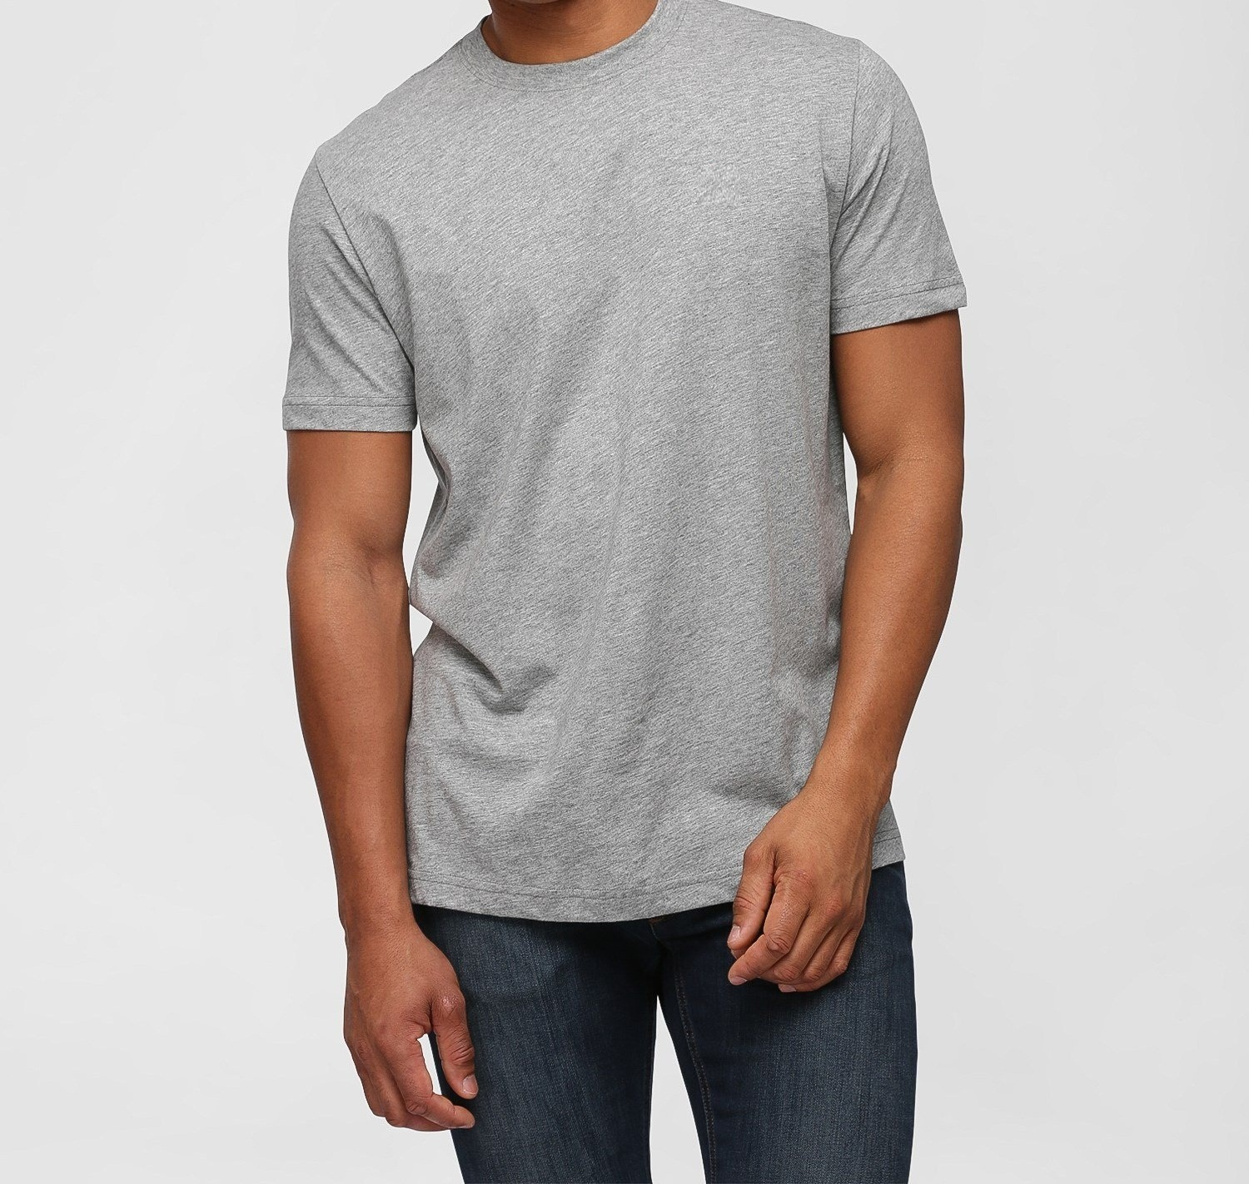
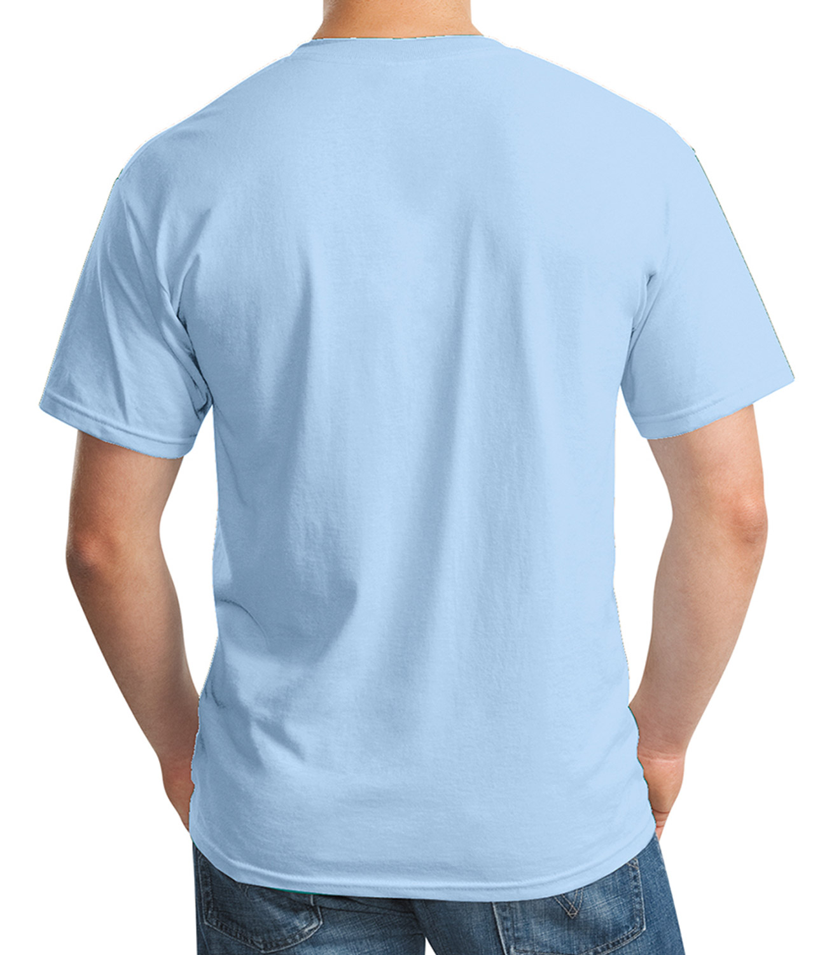
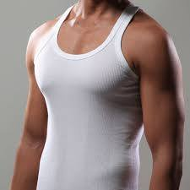
Knit Wears

Slide 10
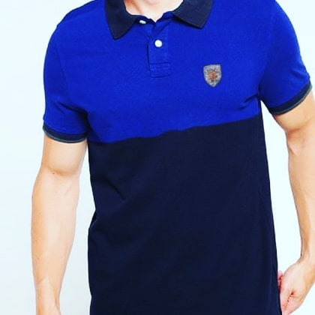
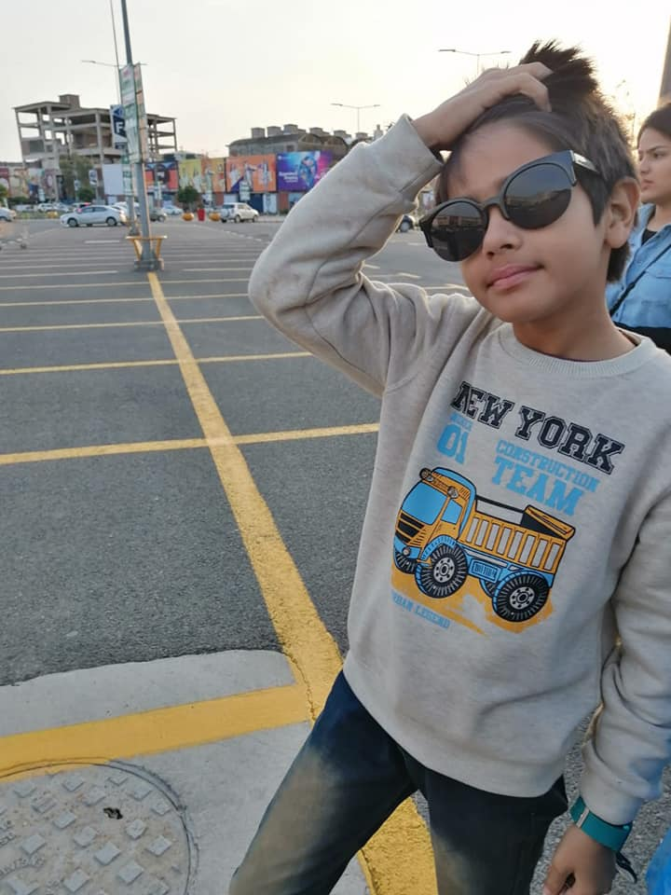
Knit Wears

Slide 11


Towels

Slide 12


Bed linens

Slide 13


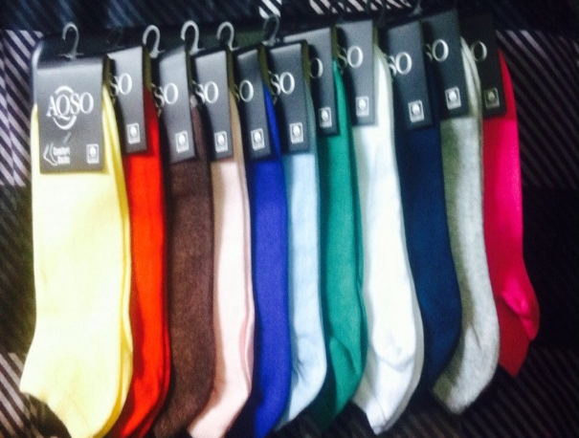



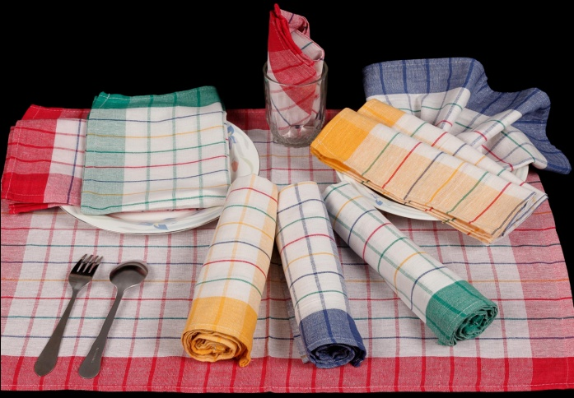

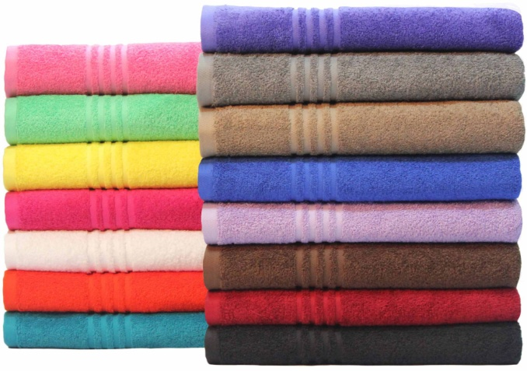


Textiles

Slide 14
Contact us
Ms. Sobia Aqeel: sobia@saafinter.com
    saafinter@hotmail.com
Address:
SAAF INTERNATIONAL
P- 40- St.2. MAKKAH COMMERCIAL,
208 CHAK ROAD.
FAISALABAD (Postal Code: 38860)
PAKISTAN
www.saafinter.com Contact No.
        Cell no: +92 322 66 44 105 + 92 321 66 44105

