Slide 1


Human Centric Sustainability: Empowering Leaders for Sustainable Change
Bringing the human element back to sustainability and change management
At Authentic-Being - Human Centric Sustainability, we provide tailored consulting and coaching services that place people at the heart of sustainable change. Our approach recognizes that true sustainability can only be achieved by understanding and addressing the human factors in organizational transformation.
by Christophe Ginguene – Authentic-Being

Slide 2
Our Services
1
Executive Coaching for Sustainable Leadership
2
Human-Centered Change Management
3
Sustainability Strategy Development
4
Human Factors Analysis (using Fresque du Facteur Humain)
5
CSR Project Management with a Human Focus

Slide 3





The Human Centric Sustainability Journey
Align
Assess
Define sustainability goals that complement both business objectives and human needs
2
Evaluate current practices and identify human-centered opportunities
1
Educate
3
Provide tailored workshops focusing on the human side of change
5
Measure
Track progress using human-centric metrics
Implement
4
Develop and execute strategies that prioritize people in the change process
The final step in our process is to Refine: Continuously improve based on human feedback and outcomes.

Slide 4





Key Benefits
Enhanced employee engagement in sustainability initiatives
Improved change adoption rates
Increased innovation capacity through human-centered approaches
Stronger stakeholder relationships
Measurable sustainability impact with a focus on human well-being

Slide 5




Human-Centered Approach
Sustainable Leadership
1
Executive empowerment
Organizational Culture
2
Values and behaviors
Team Engagement
3
Collaborative implementation
Individual Contribution
4
Personal responsibility
Our human-centric methodology recognizes that sustainable change must be integrated at every level of the organization, from individual contributors to executive leadership. By addressing the human factors at each level, we create lasting transformation that aligns with both business objectives and environmental goals.

Slide 6
Sustainability Strategy Development
Assessment Phase
Strategy Creation
Implementation Support
We begin by thoroughly evaluating your current sustainability practices and identifying opportunities where human factors can drive improvement. This includes stakeholder interviews, process analysis, and cultural assessment.
Working collaboratively with your team, we develop a comprehensive sustainability strategy that places people at the center. This ensures higher adoption rates and more effective implementation.
Our team provides ongoing guidance as you roll out your sustainability initiatives, focusing on communication, training, and addressing resistance to change through human-centered approaches.

Slide 7

Human Factors Analysis
Identify Key Stakeholders
Map all individuals and groups affected by sustainability initiatives
Assess Current Perceptions
Understand existing attitudes toward sustainability using Fresque du Facteur Humain
Determine Barriers
Identify human-related obstacles to sustainable change
Develop Targeted Interventions
Create specific strategies to address human factors in the change process

Slide 8
Our Tools for Sustainable Transformation
Conversational Intelligence (C-IQ)
Conscious Facilitation
Enhances trust and creates transformative conversations. C-IQ helps leaders build stronger relationships and navigate complex change effectively.
Creates safe spaces for authentic dialogue and innovation. Our facilitation awakens collective wisdom and drives sustainable solutions.
Adult Development & Values
Inner Development Goals (IDG)
Identifies growth stages and core values. This framework aligns personal development with organizational sustainability goals.
Focuses on skills and qualities for sustainable development. IDG provides a framework for personal transformation that enables collective change.
Fresque du Facteur Humain (FFH)
CSR Diagnosis Tool
Explores human factors in sustainability challenges. This collaborative workshop reveals how behavioral patterns impact environmental outcomes.
Evaluates corporate social responsibility maturity. This assessment identifies strengths and opportunities for authentic sustainability integration.

Slide 9
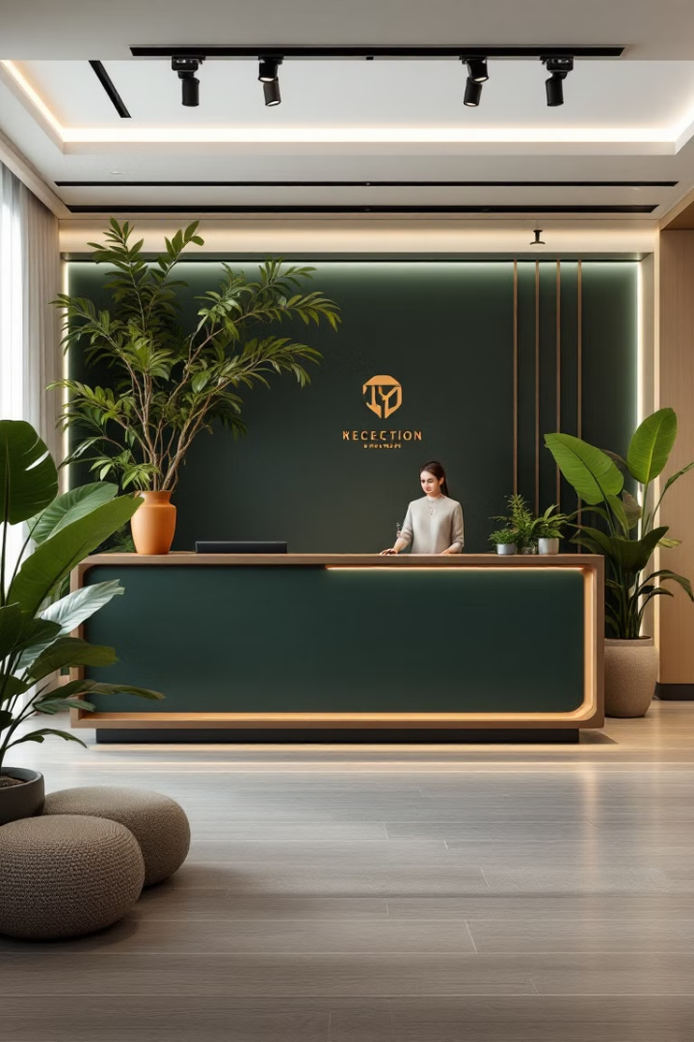
Contact Us
Ready to Transform
Transform your organization with a human-centric approach to sustainability? Contact us for a free consultation.
Get in Touch
Email: christophe.ginguene@authentic-being.pro
Phone: +33 7 80 78 16 41
Website: https://authentic-being.pro/
https://www.humancentricsustainability.com/
Our team is ready to help you integrate human factors into your sustainability initiatives, creating lasting change that benefits both your organization and the planet.

