Slide 1
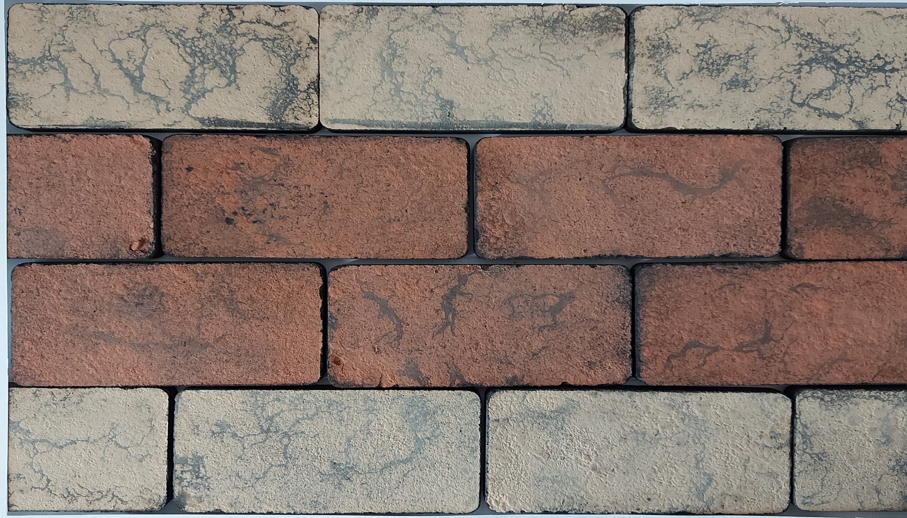


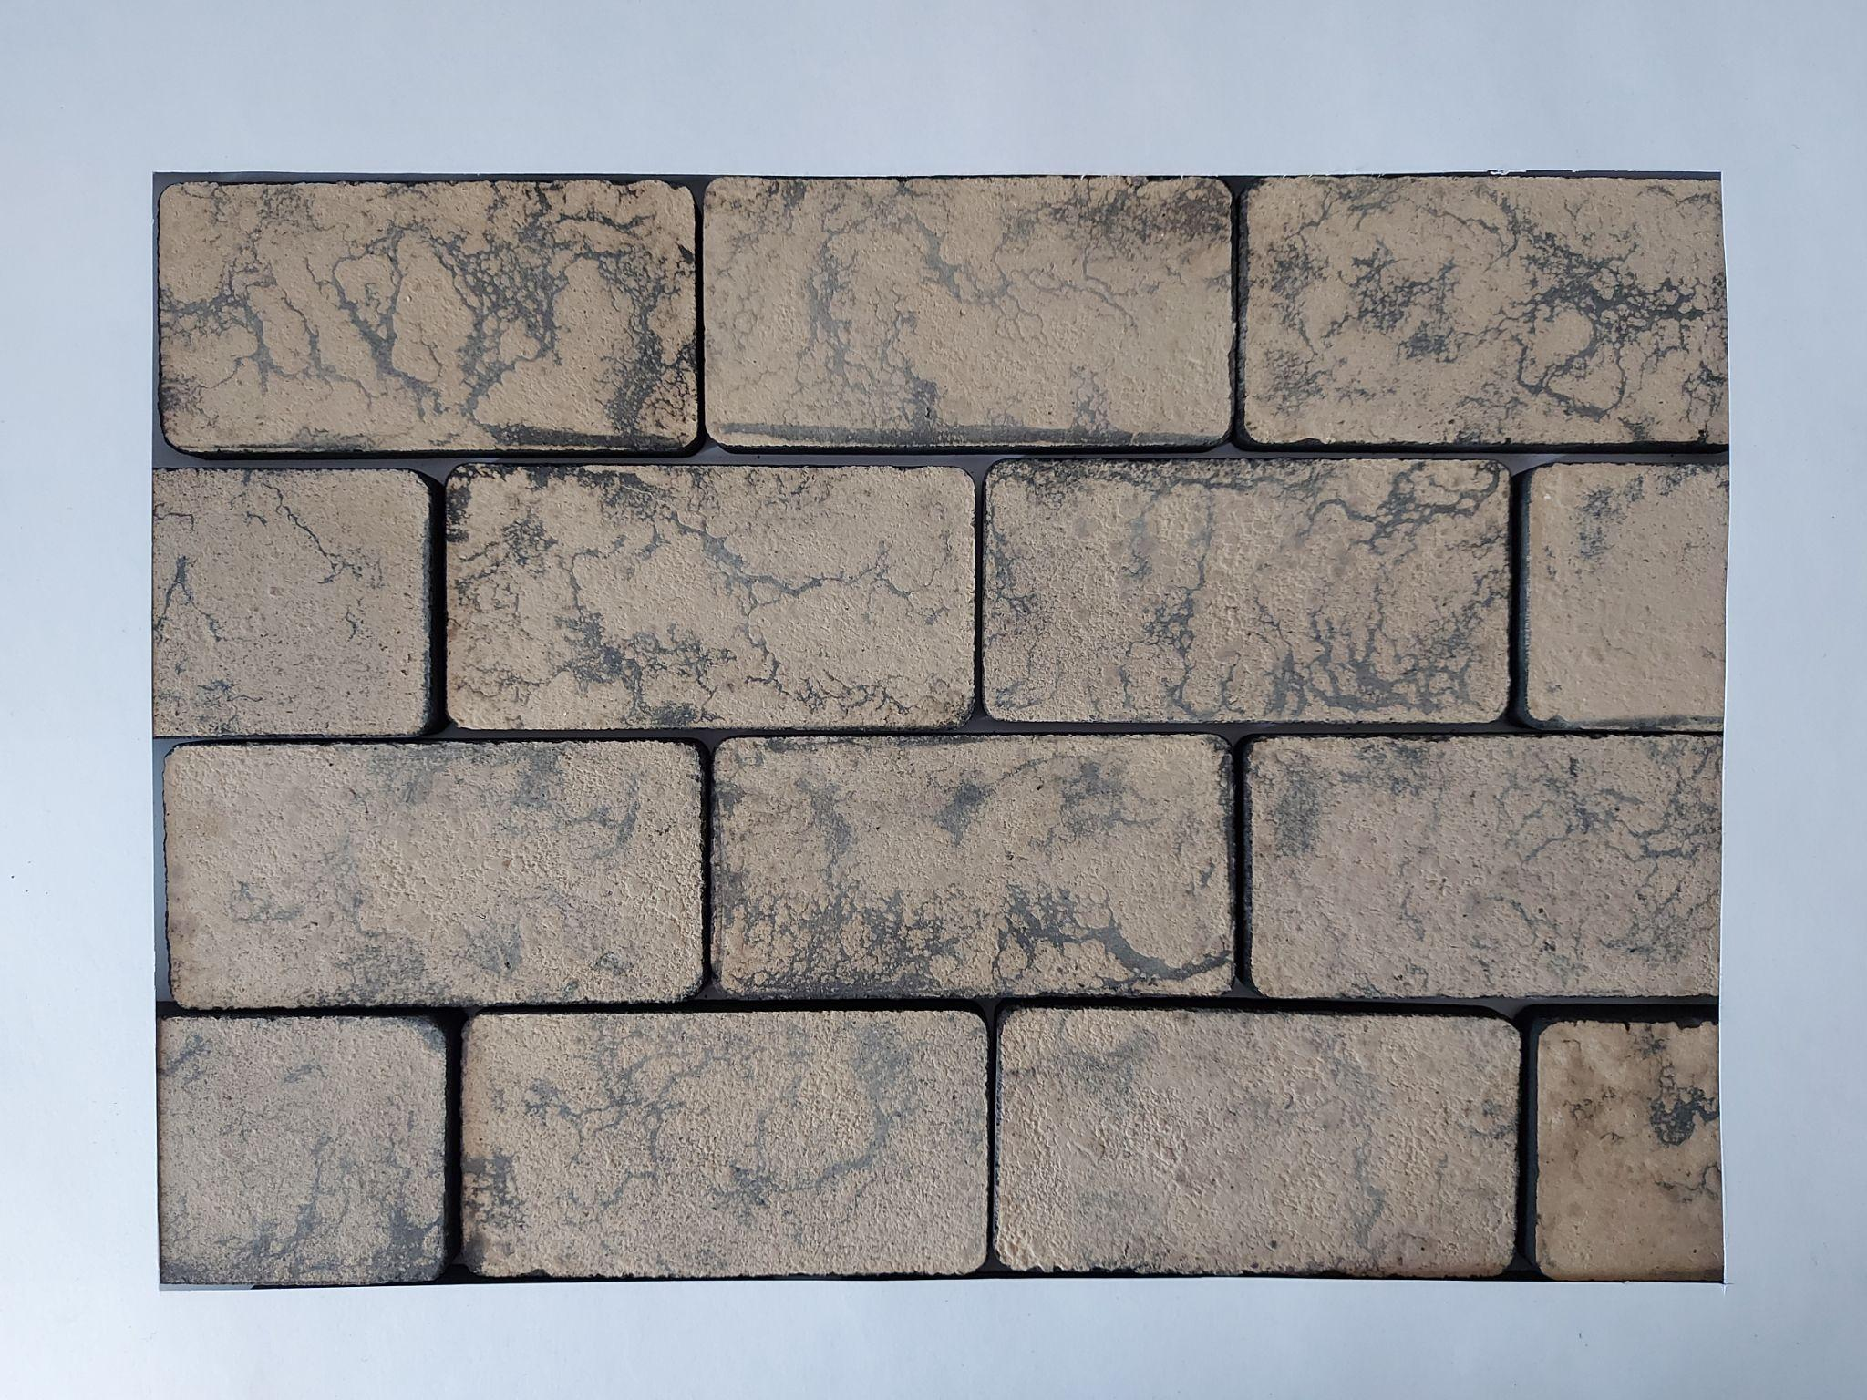
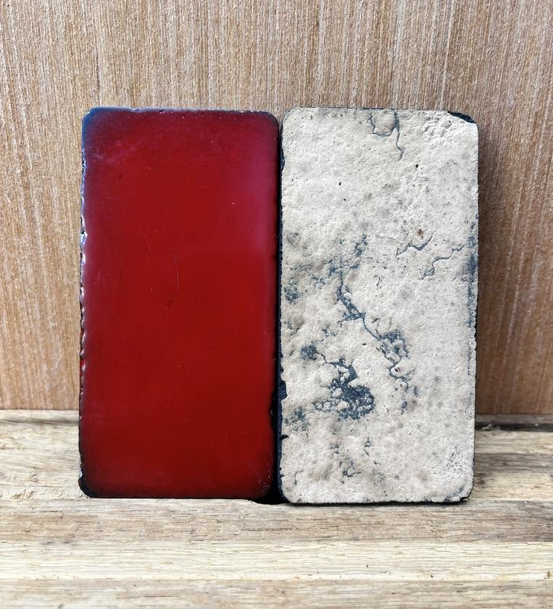

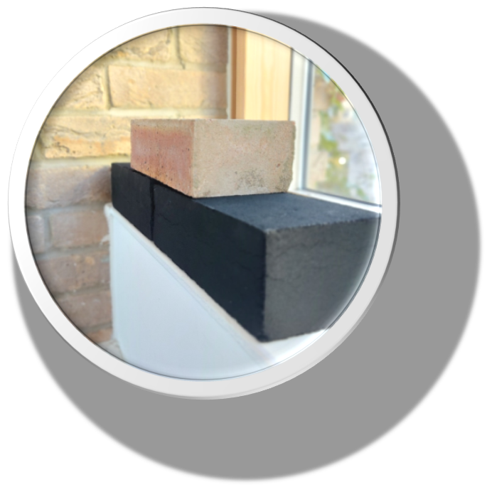
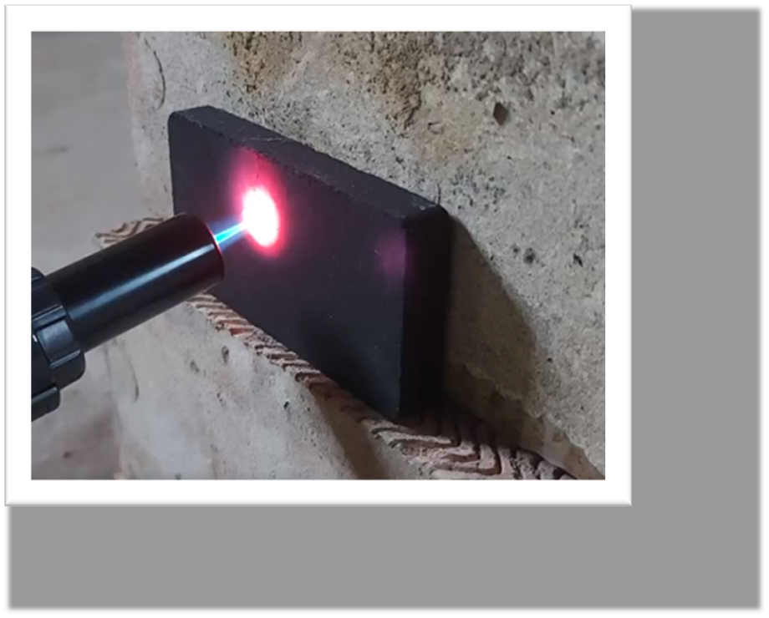
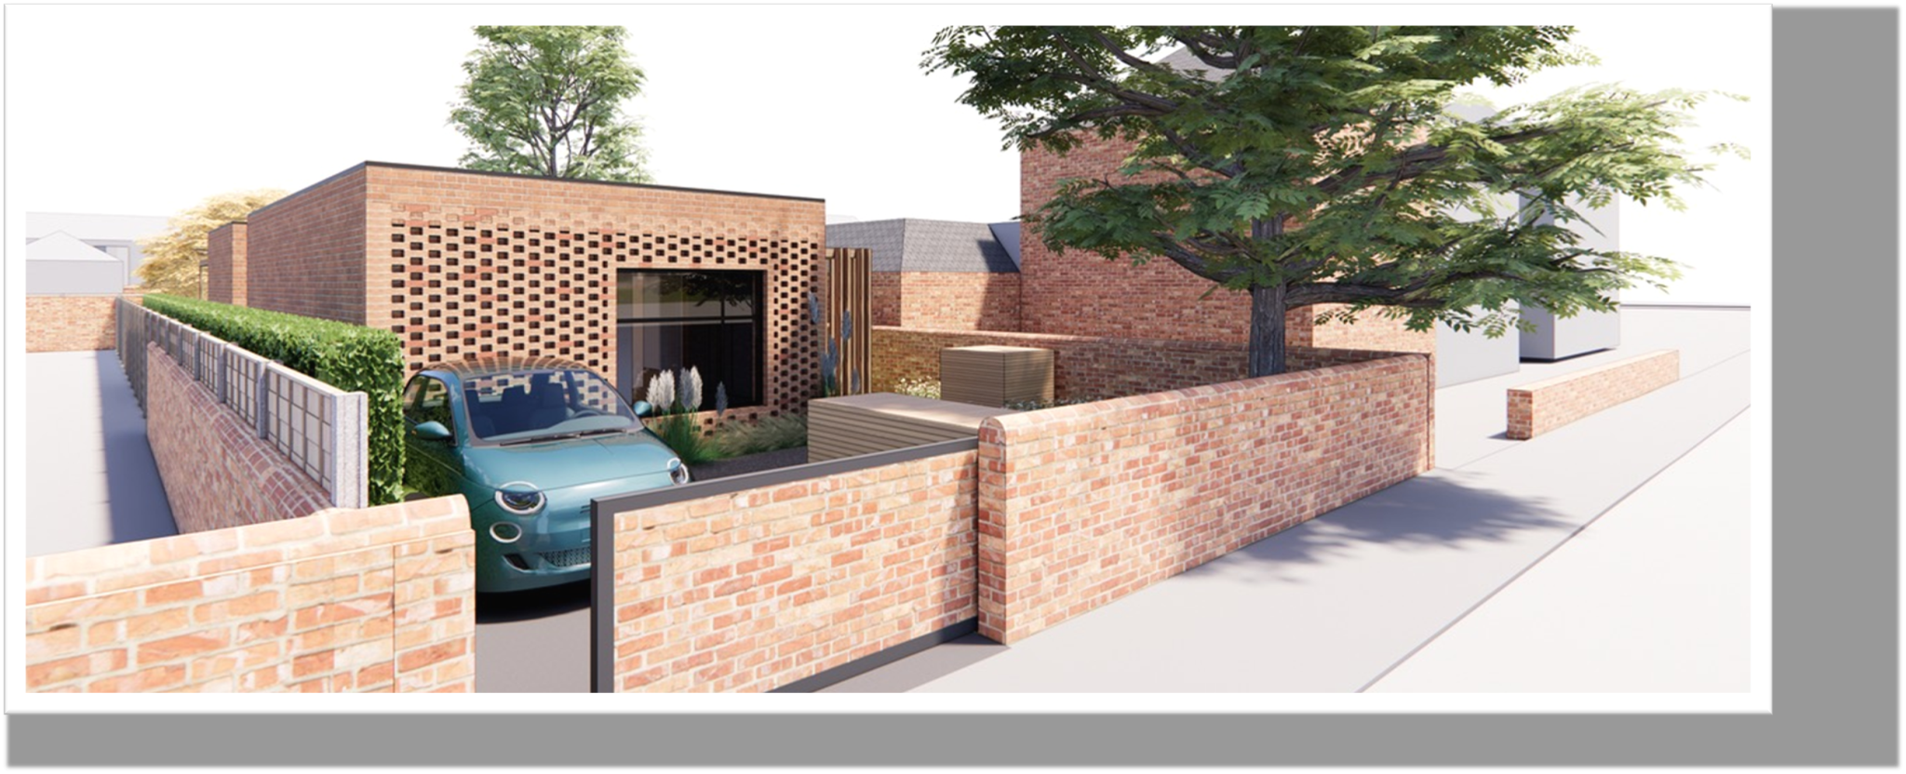
hello@composite-designers.com
www.composite-designers.com
Composite Designers Ltd
Carbon Negative Construction Materials
Custom
Finishes
Circular
Our Brick -2.1 kg CO₂
Flame
Retardant
52% Reduced Embodied Emissions

