Slide 1
Project for waste-free reusable packaging with its own collection system
PATENTED TECHNOLOGY
Dipl.Eng. Milan Michalko - author
Michalt Technology GmbH
Museumstraße 3b/16
A-1070 Wien, Austria
+43 664 458 3801
michalko@michalt.at
www.michalt.at

Slide 2
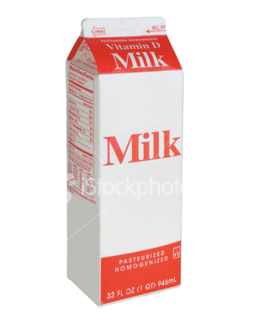
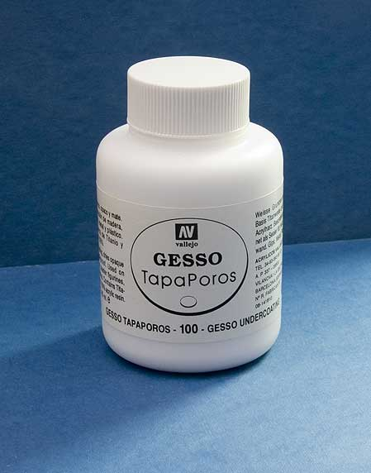
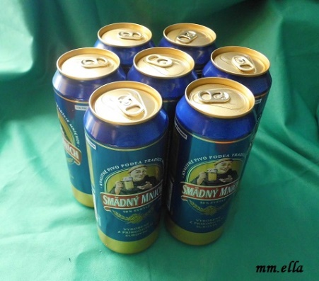

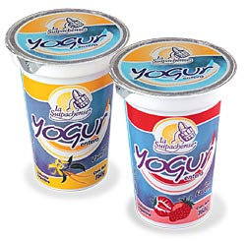
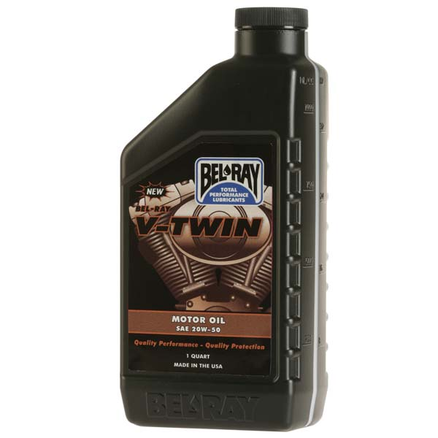
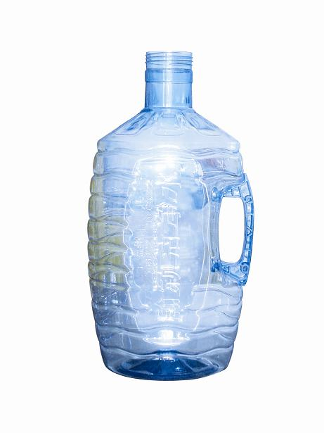
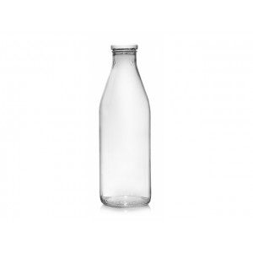
CURRENT PACKAGING

Slide 3
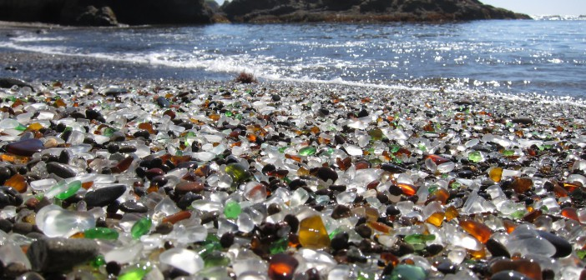
WASTE
/

Slide 4
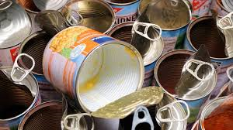
METAL WASTE - TIN PACKAGING
Metal waste recycling requires 1600°CHigh energy costs + a lot of CO2

Slide 5
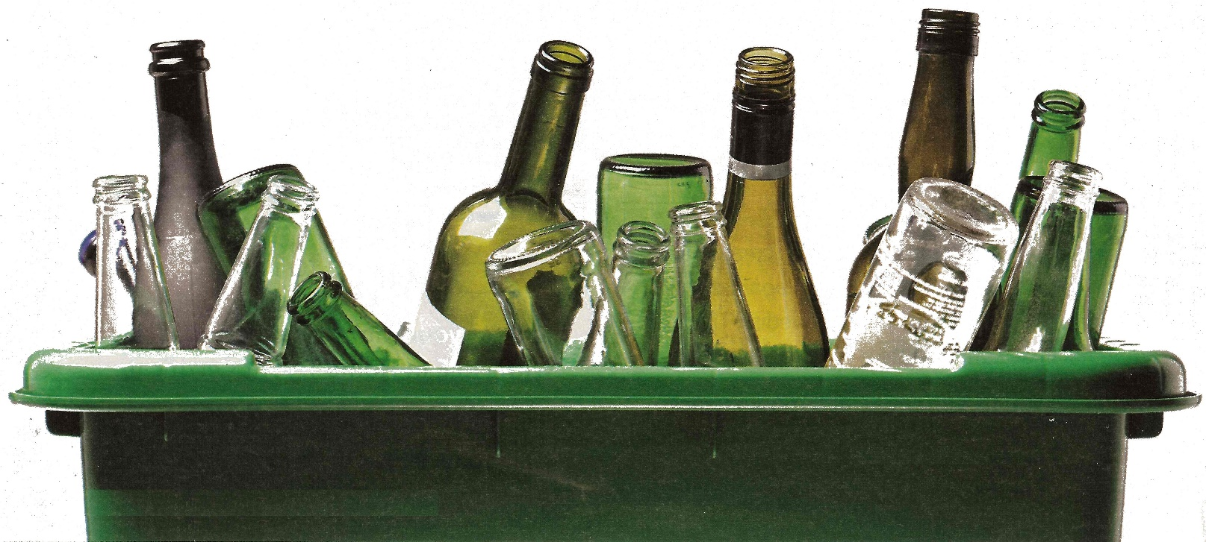

WASTE - GLASS
When recycling glass,
we need 1600°C
High energy costs
High CO2 production

Slide 6
SOLUTION HOW TO REDUCE CO2
PRODUCTION SAVE ENERGY
KEEP THE QUALITY OF THE GOODS

Slide 7

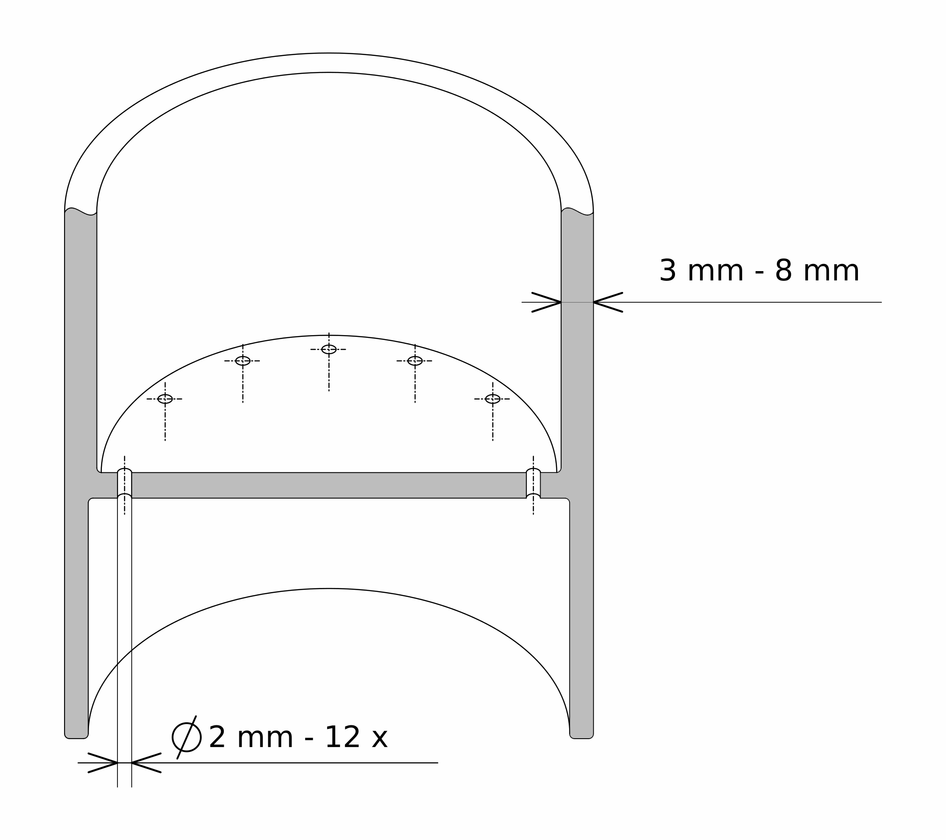
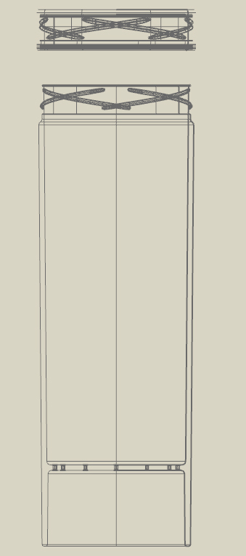
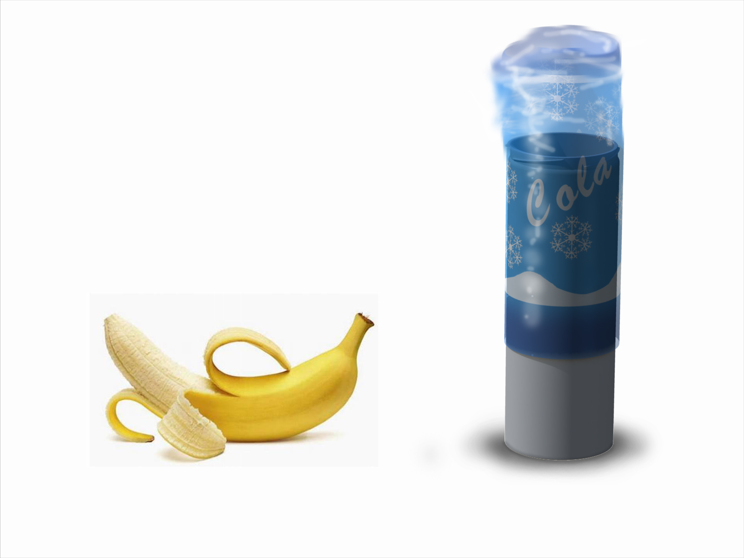
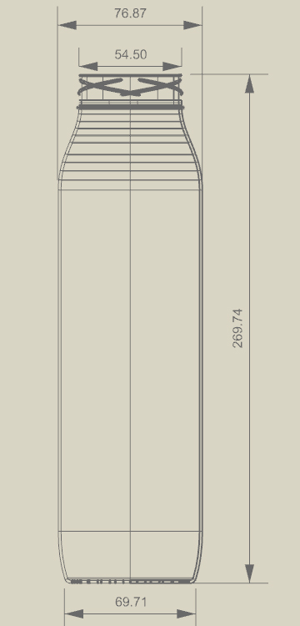
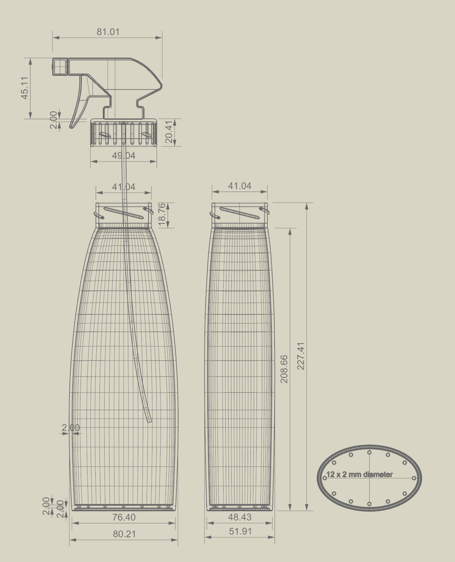
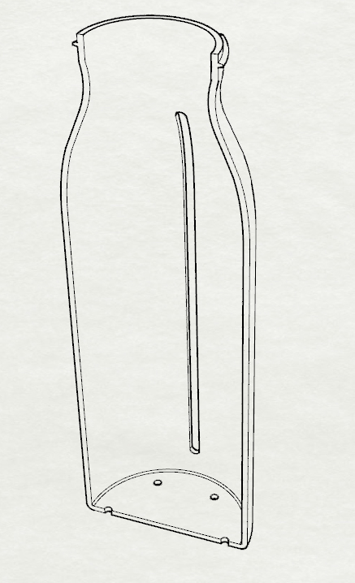
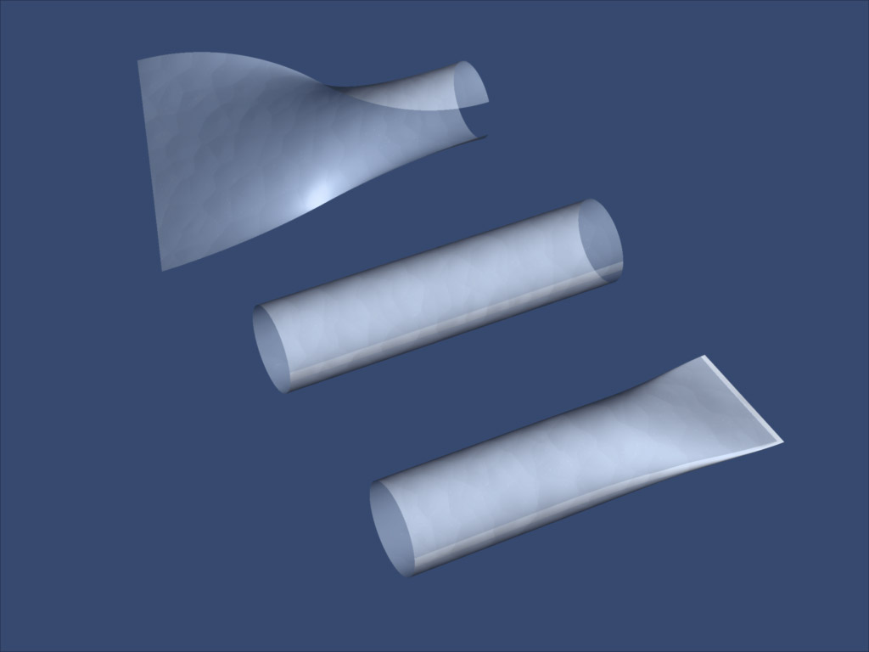
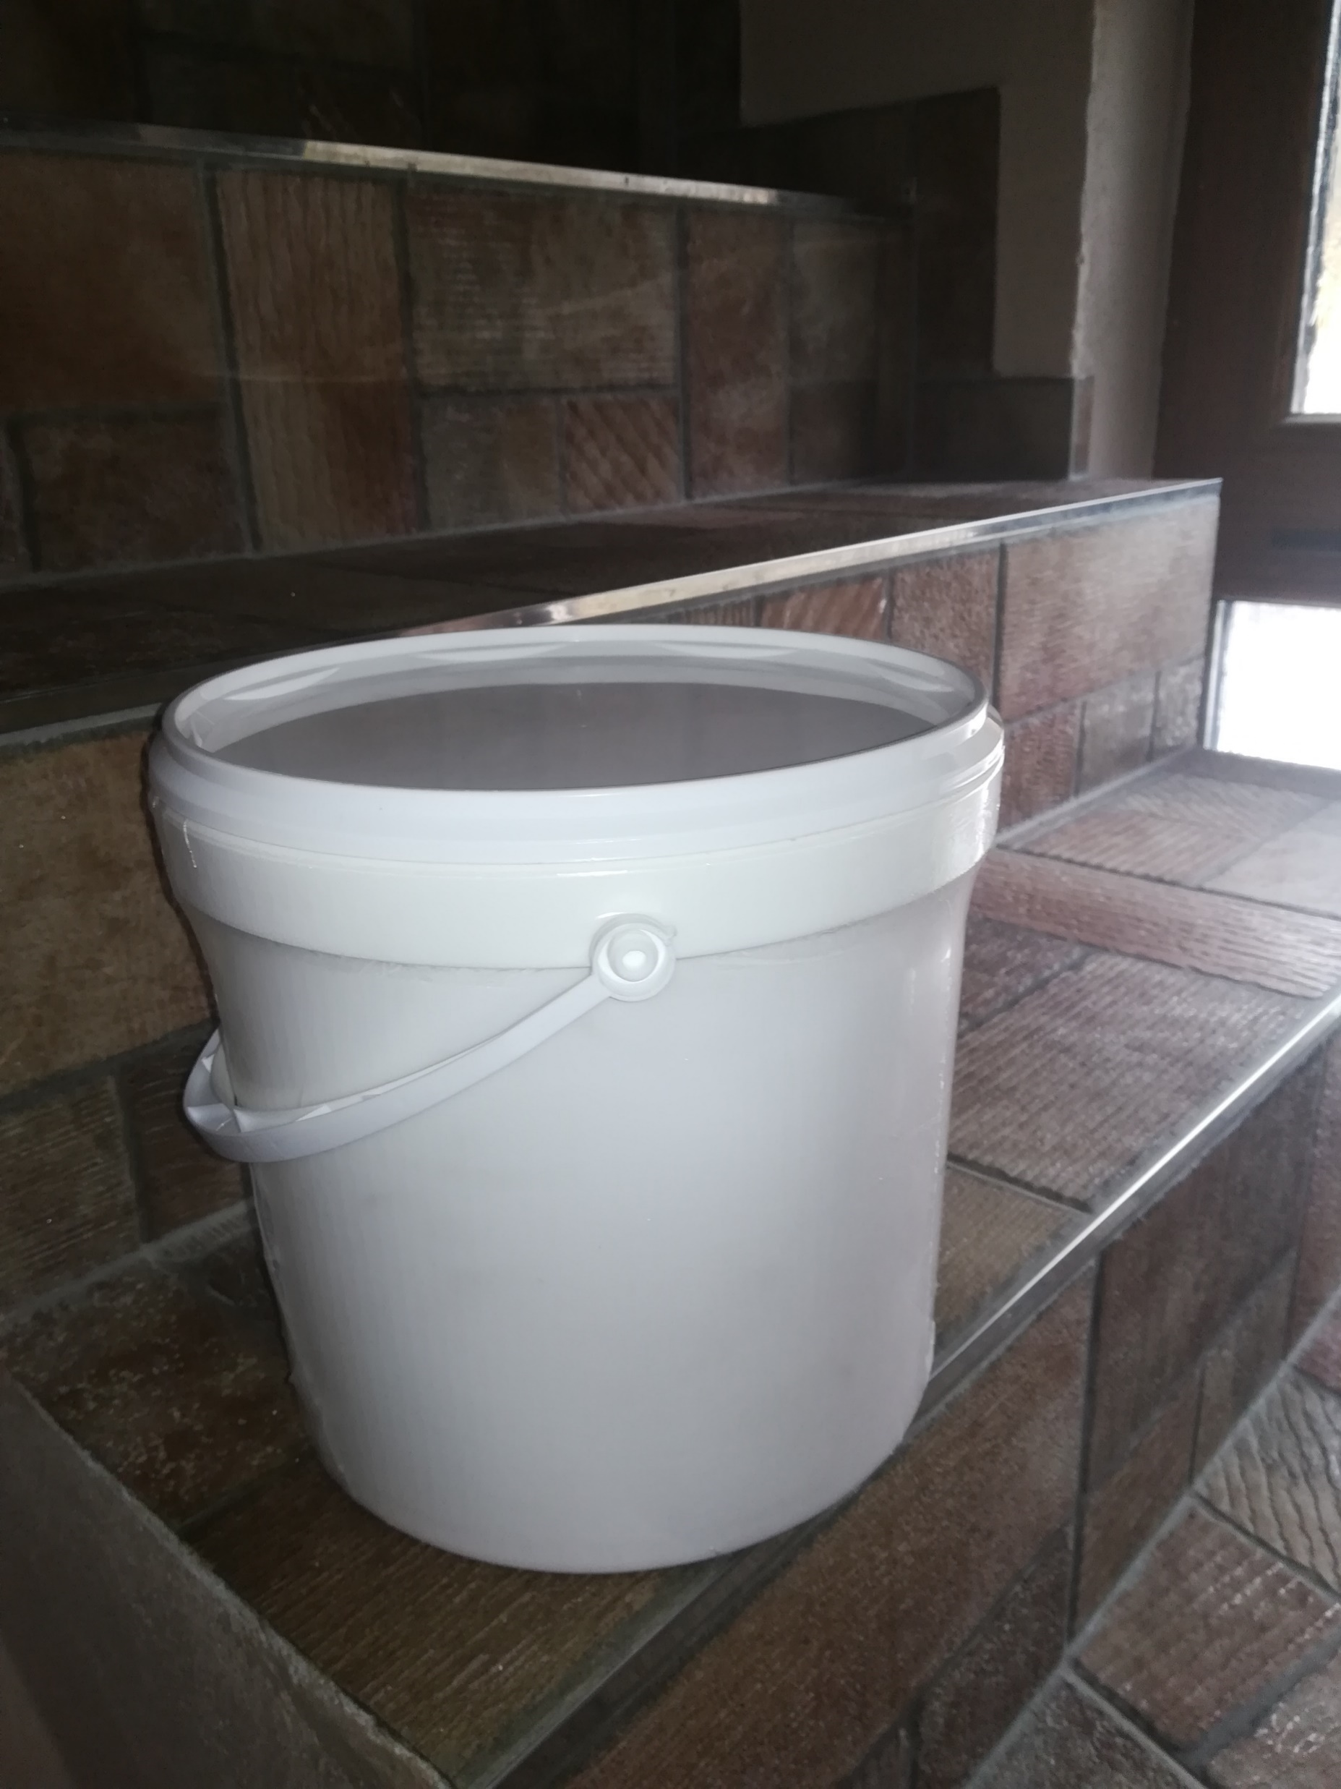
THE SOLUTION OFFERS THE INVENTION OF NEW PATENTED PACKAGING BY AUTHOR DIPL. ENG. MILAN MICHALKO

Slide 8
NEW PACKAGING TECHNOLOGY - MICHALT TECHNOLOGY
-MANUFACTURE OF REUSABLE PLASTIC BODIES - UP TO 260°C
-THE BODY IS REUSABLE FOR SEVERAL YEARS
-RECYCLING THE PLASTIC BODY WILL BE MELT DOWN UP TO 250°C AFTER SEVERAL YEARS
-COVER FOIL ORGANIC - COMPOSTABLE - NO HIGH TEMPERATURE
-FORMATION OF TONE AS MASS FOR FURTHER USE
-PE FOIL - RECYCLING WITHOUT HIGH TEMPERATURES
-ENERGY SAVINGS BY 85%
-CO2 SAVINGS BY 85%
-85% PLASTIC MATERIAL SAVINGS
-85% COST SAVINGS WHEN PURCHASING FOIL WITH REPEATED USE,
-WE NEED NO WATER HYGIENE AND
0 CONTAMINATION IS GUARANTEED THROUGH THE COMPLETE COVERAGE OF THE PLASTIC BODY
0-WASTE

Slide 9
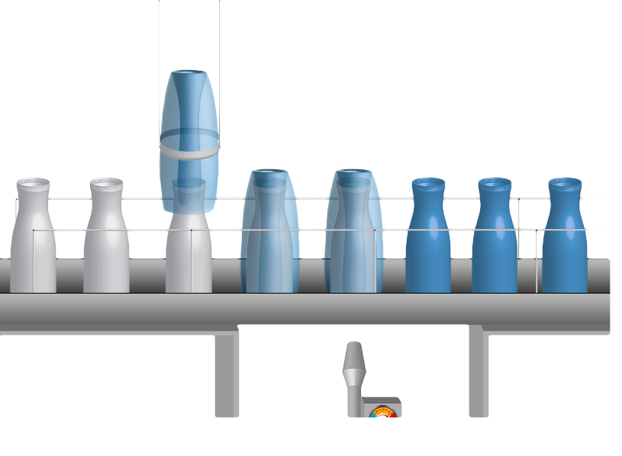
PRINCIPLE - THE MACHINE PACKS THE BODY OUTSIDE AND INSIDE USING THE HEAT, WE SHRINK THE FOIL OUTSIDE
- WE GET A HIGH-QUALITY SURFACE AND THE PACKAGING IS READY TO USE

Slide 10
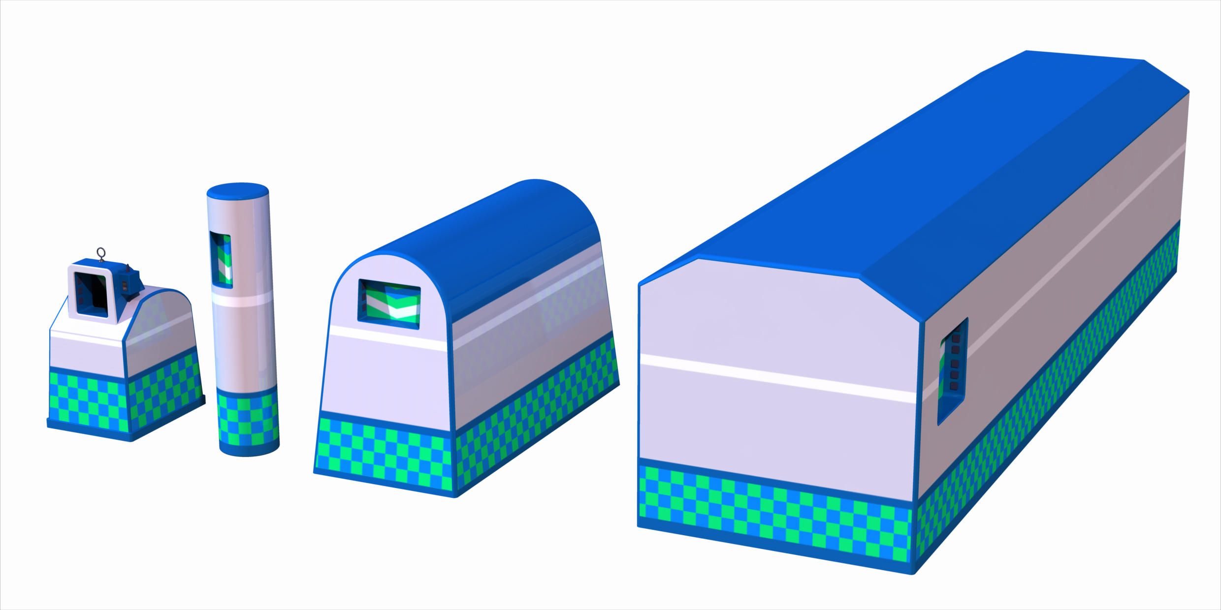
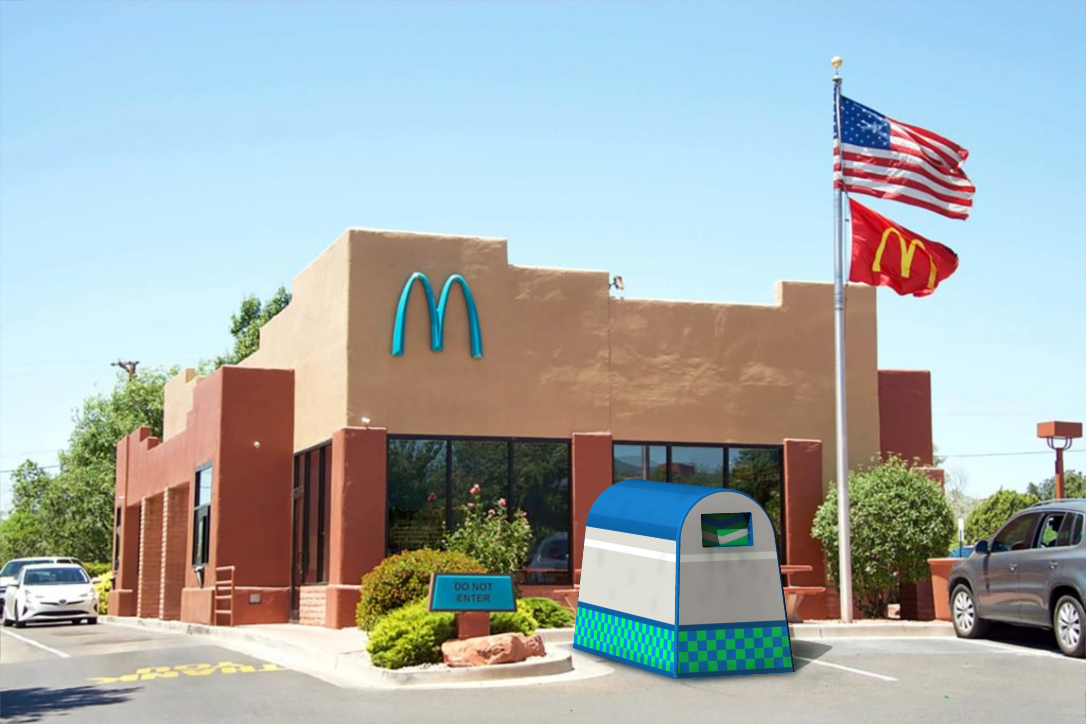
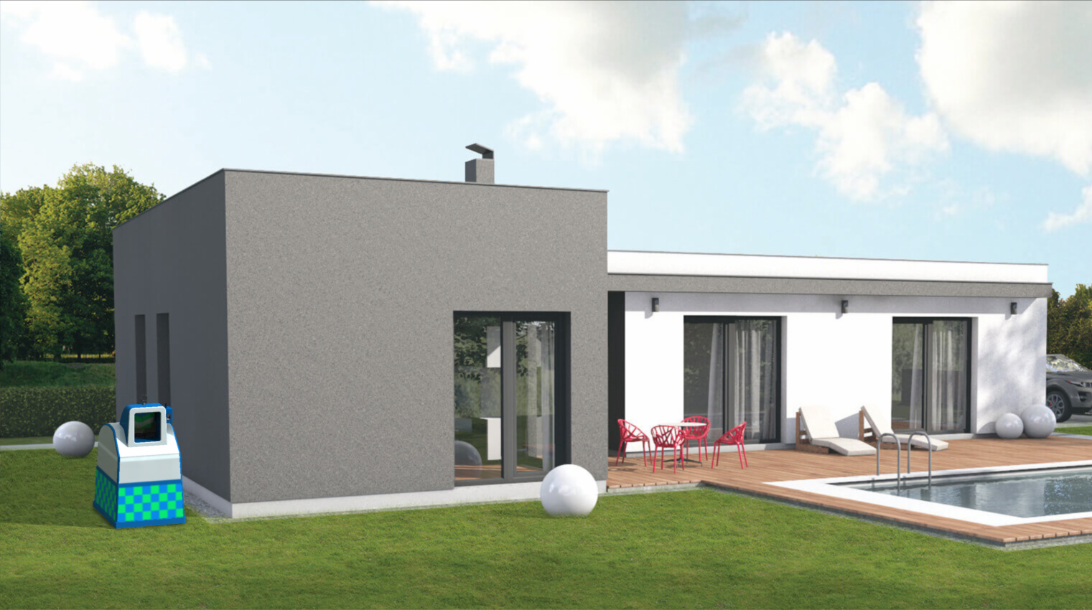
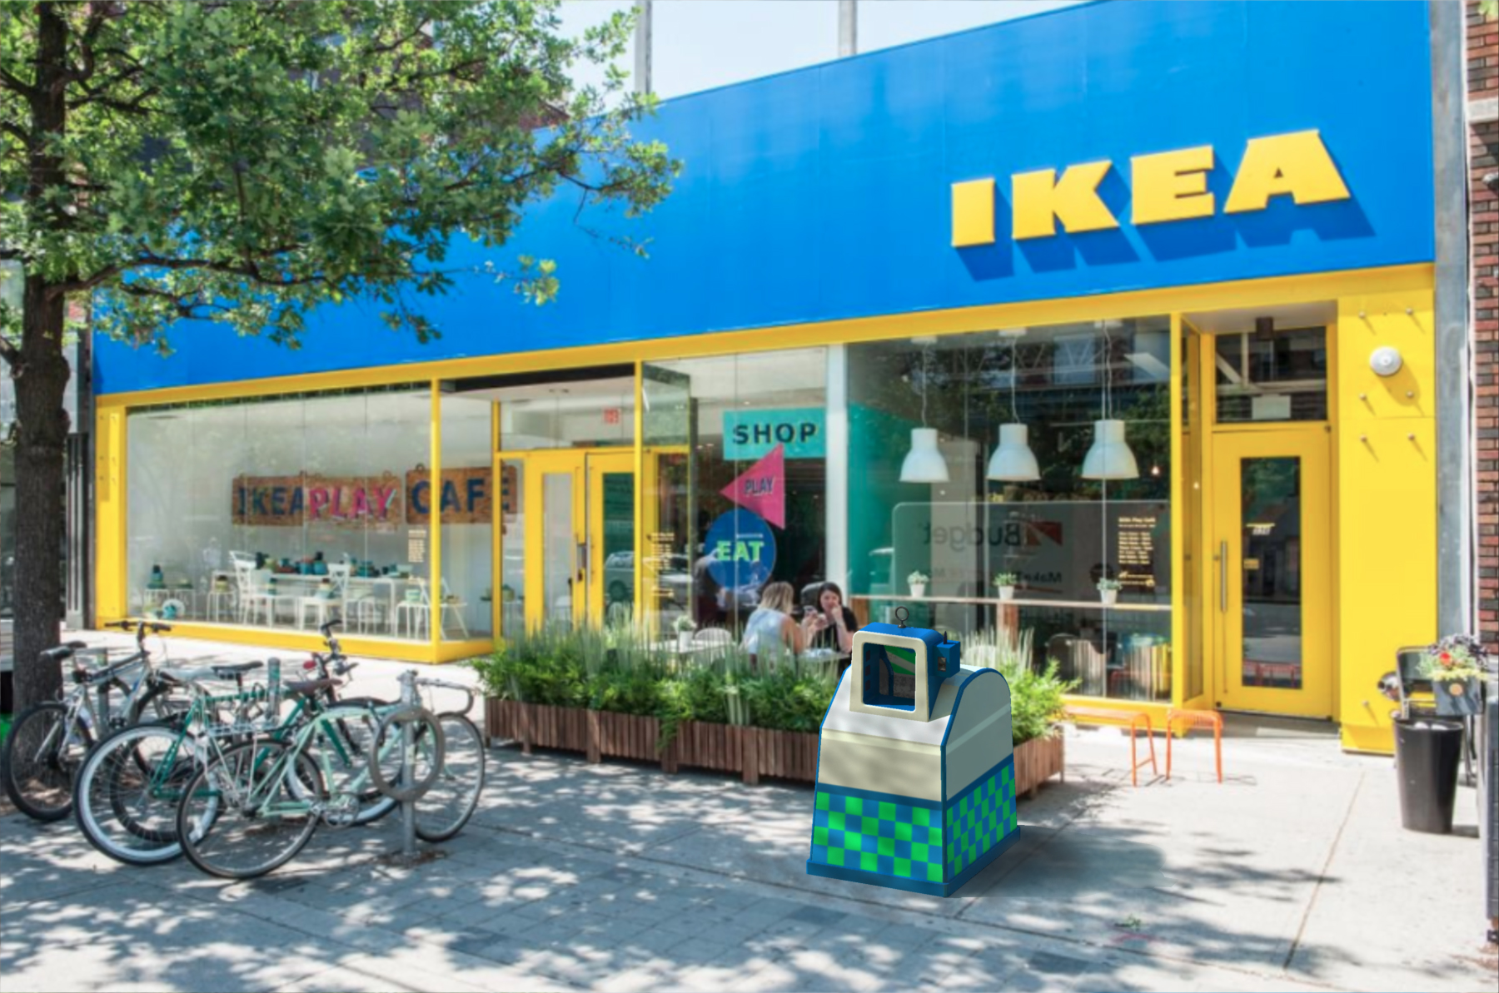
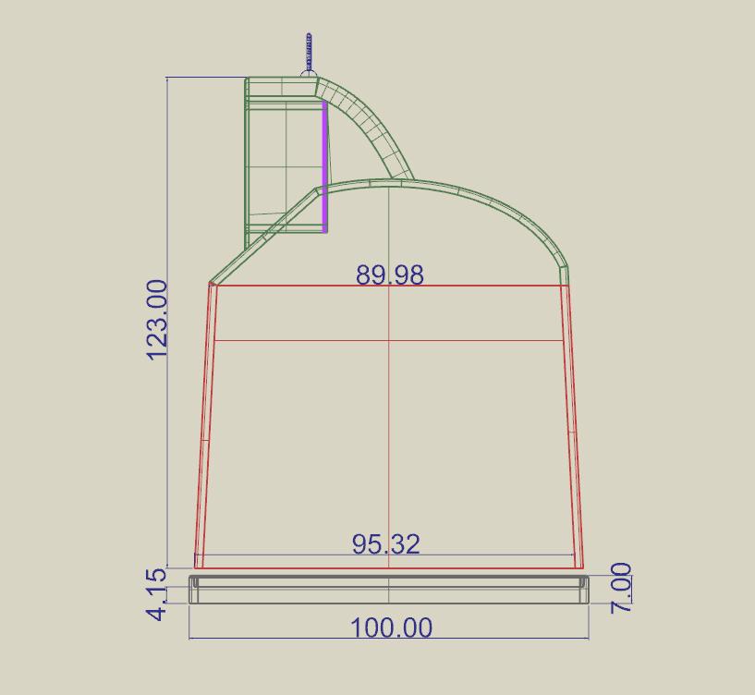
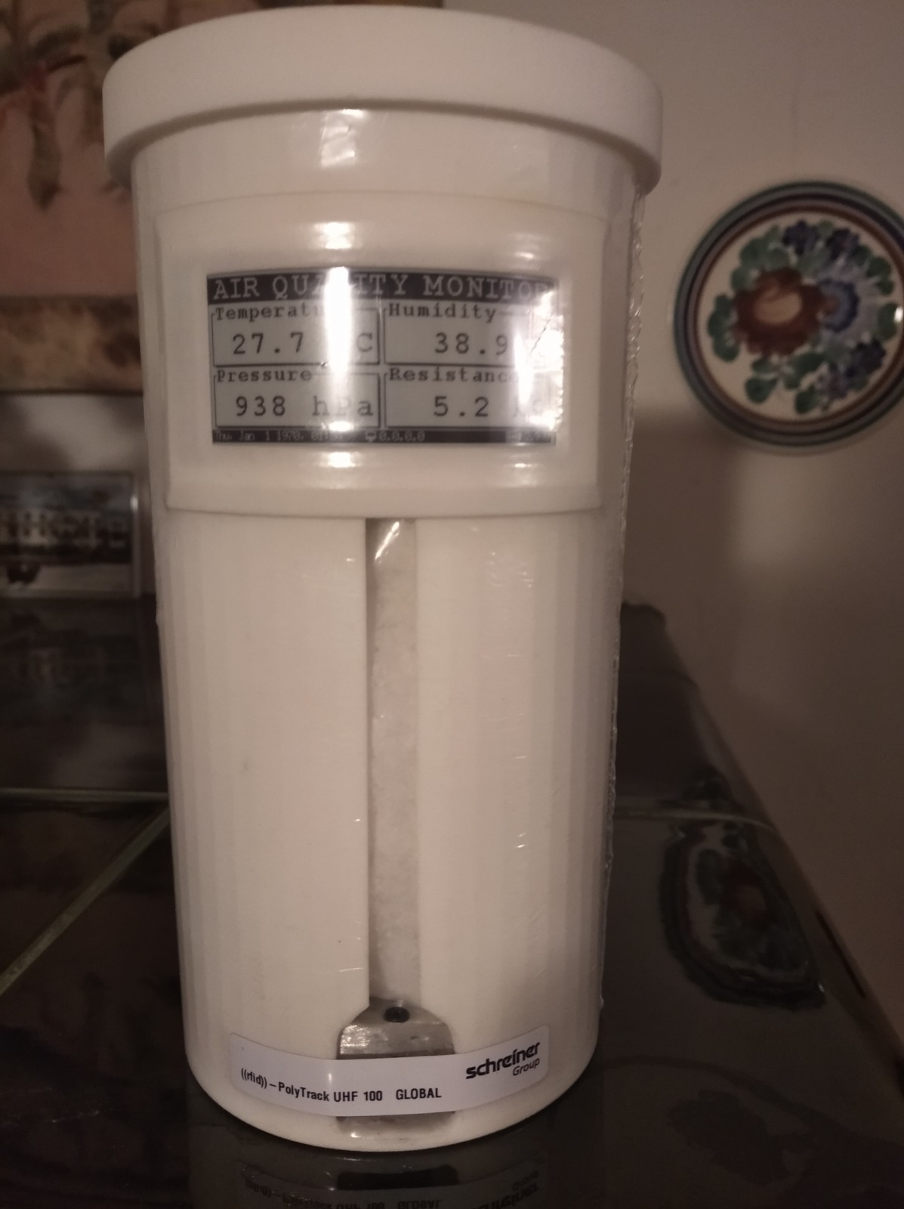
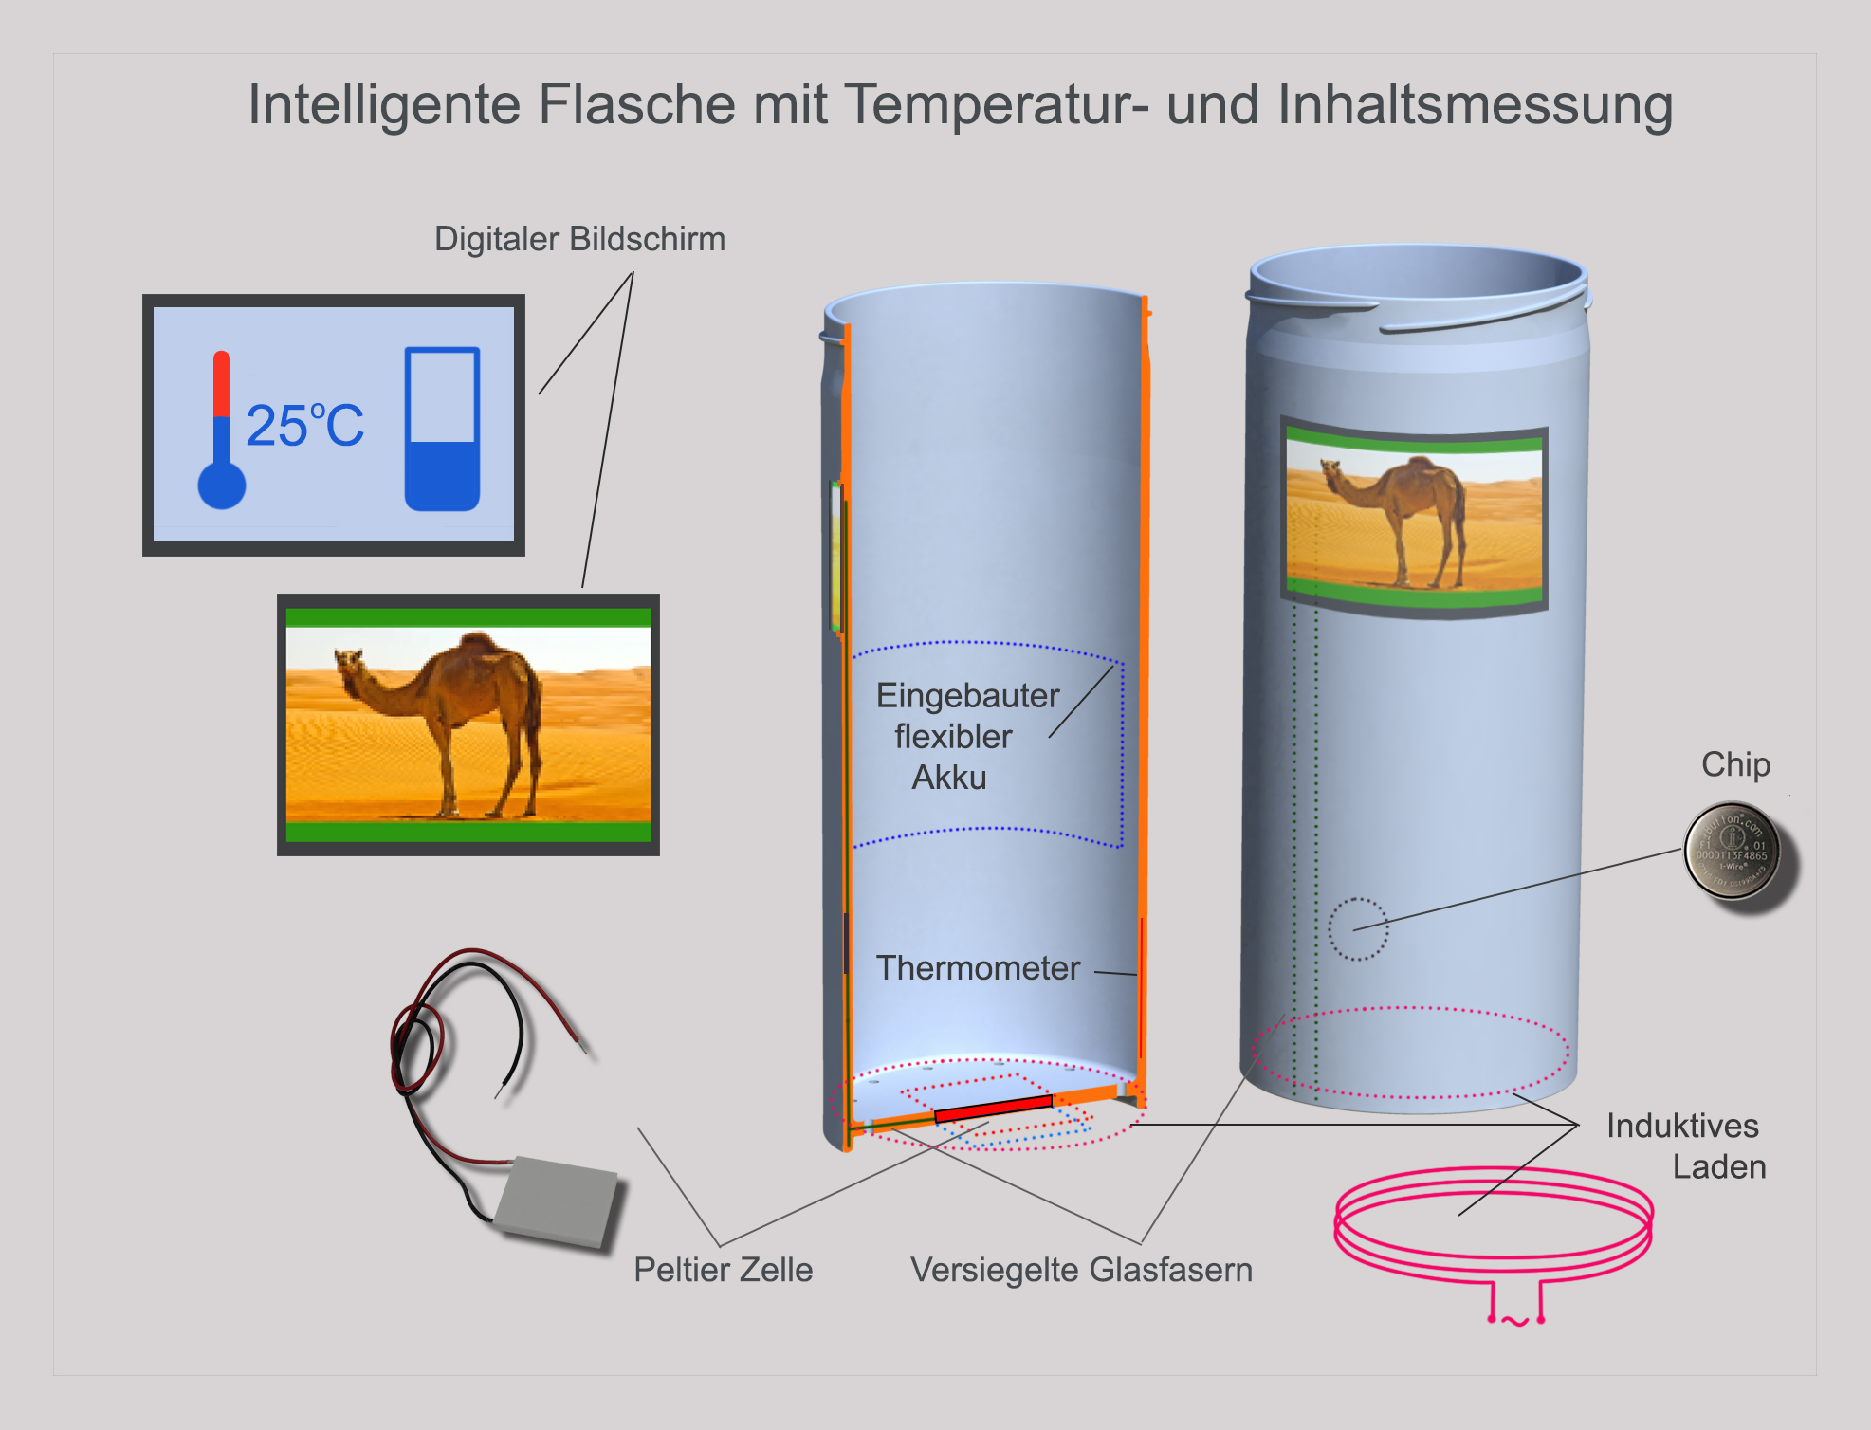
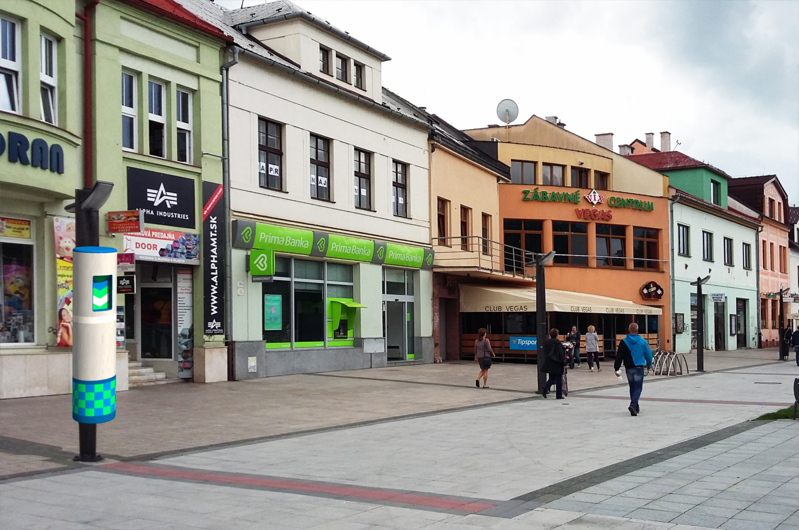
WE OFFER OUR OWN COLLECTION SYSTEM FOR COLLECTING OUR NEW CHIP-EQUIPPED PACKAGING

Slide 11
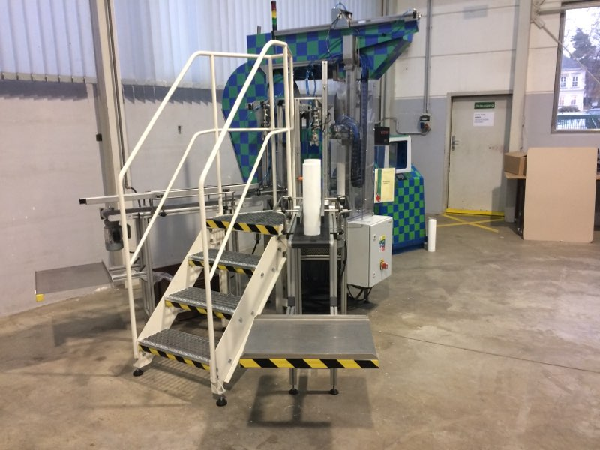
OUR FIRST MACHINE IN THE WORLD - BZ 100 PROTOTYPES CAN PACK AND UNPACK A 2L BODY 3 pieces in 1 min.

Slide 12

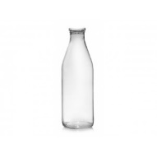
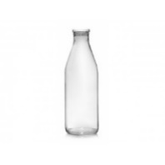
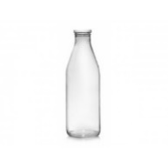
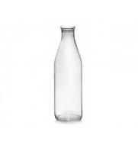



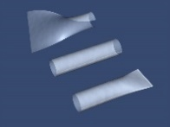
DISPOSABLE PACKAGING
One-way packaging with a volume of 2L= 0.25€
10 pieces = €2.5
NEW PACKAGING
New reusable packaging /CORPUS/ with a volume of 2l = €1.3
1 piece of replacement film for a 2l corpus = €0.014
10 pieces = 0.14€
TOTAL: 1 BODY + 10 PCS EXCHANGEABLE FOIL: €1.44
RECYCLED PE FOIL /POZOFYX/ PURCHASE 1 pc –€ 0.1
TOTAL COST OF NEW PACKAGING FOR 10 REPEATS - €0.44
DIFFERENCE: 10 PIECES -2.5€ ONE-WAY PACKAGING 10 pcs €0.44 - REUSED NEW PACKAGING
GLASS, SHEET METAL - IF REPLACED BY NEW PACKAGING - 85% LESS CO2
COMPARISON

Slide 13
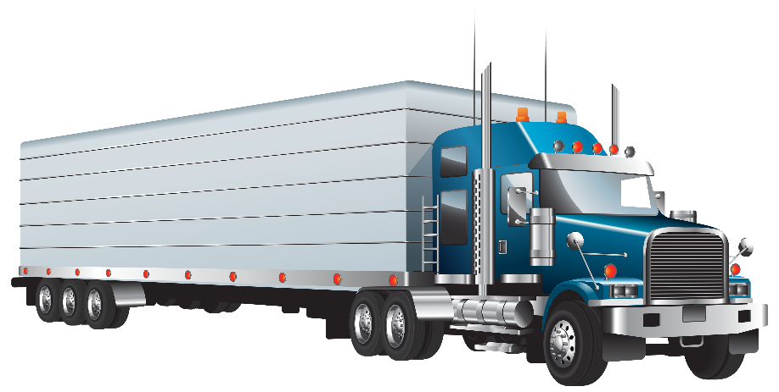
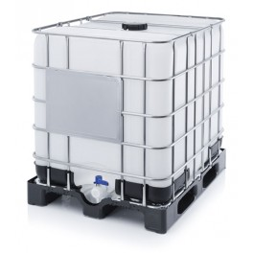
COMPARISON OF VOLUME INDICATORS FOR OLD PACKAGING AND NEW PACKAGING
25,000 pieces of ONE-WAY 2l PLASTIC PACKAGING
Volume approx. 115 m3
25,000 PIECES CHANGEABLE FOIL BAGS
^{Volume approx. 1 m3}

Slide 14
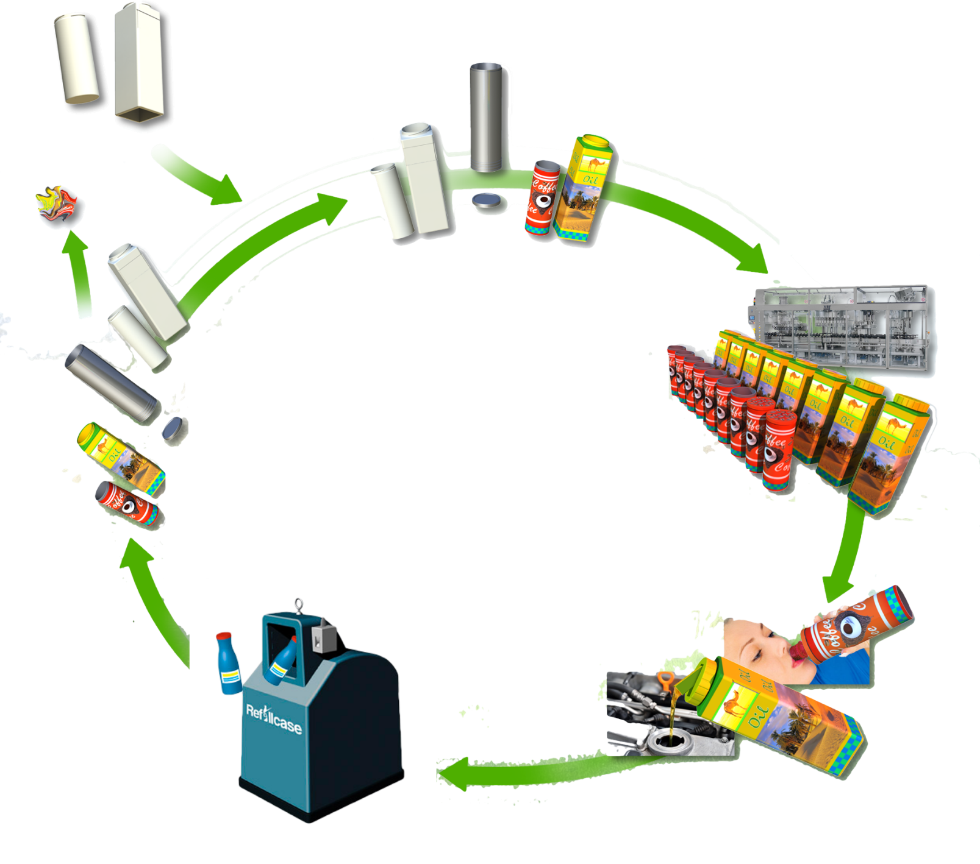
CIRCULATION OF REUSEABLE PACKAGING

Slide 15
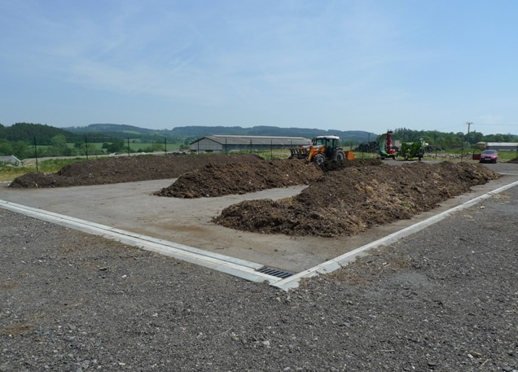
USED ORGANIC FOIL
CONTAMINATED ORGANIC FOOD FOIL ENDS IN INDUSTRIAL COMPOST
Valid standard STN 465735 Industrial composts.
COMPOST IS ENERGY THAT IS RETURNED TO THE SOIL

Slide 16
COMPLEX EFFECTS OF COMPOSTING
-Compost improves soil workability
increases the sorption capacity of lighter soils loosens hardened and heavy soil scan reduce plant diseases and the impact of pests
-Reduces soil acidity and stabilizes pH
-increases water absorption and water capacity
-Reduces water erosion on hills
-Reduces water consumption
-Prevents the soil from drying out-supplies plants with important nutrients for a long time
-Increases the growth of seeds and seedlings
-Regenerates disturbed soils and supports life in the soil

Slide 17
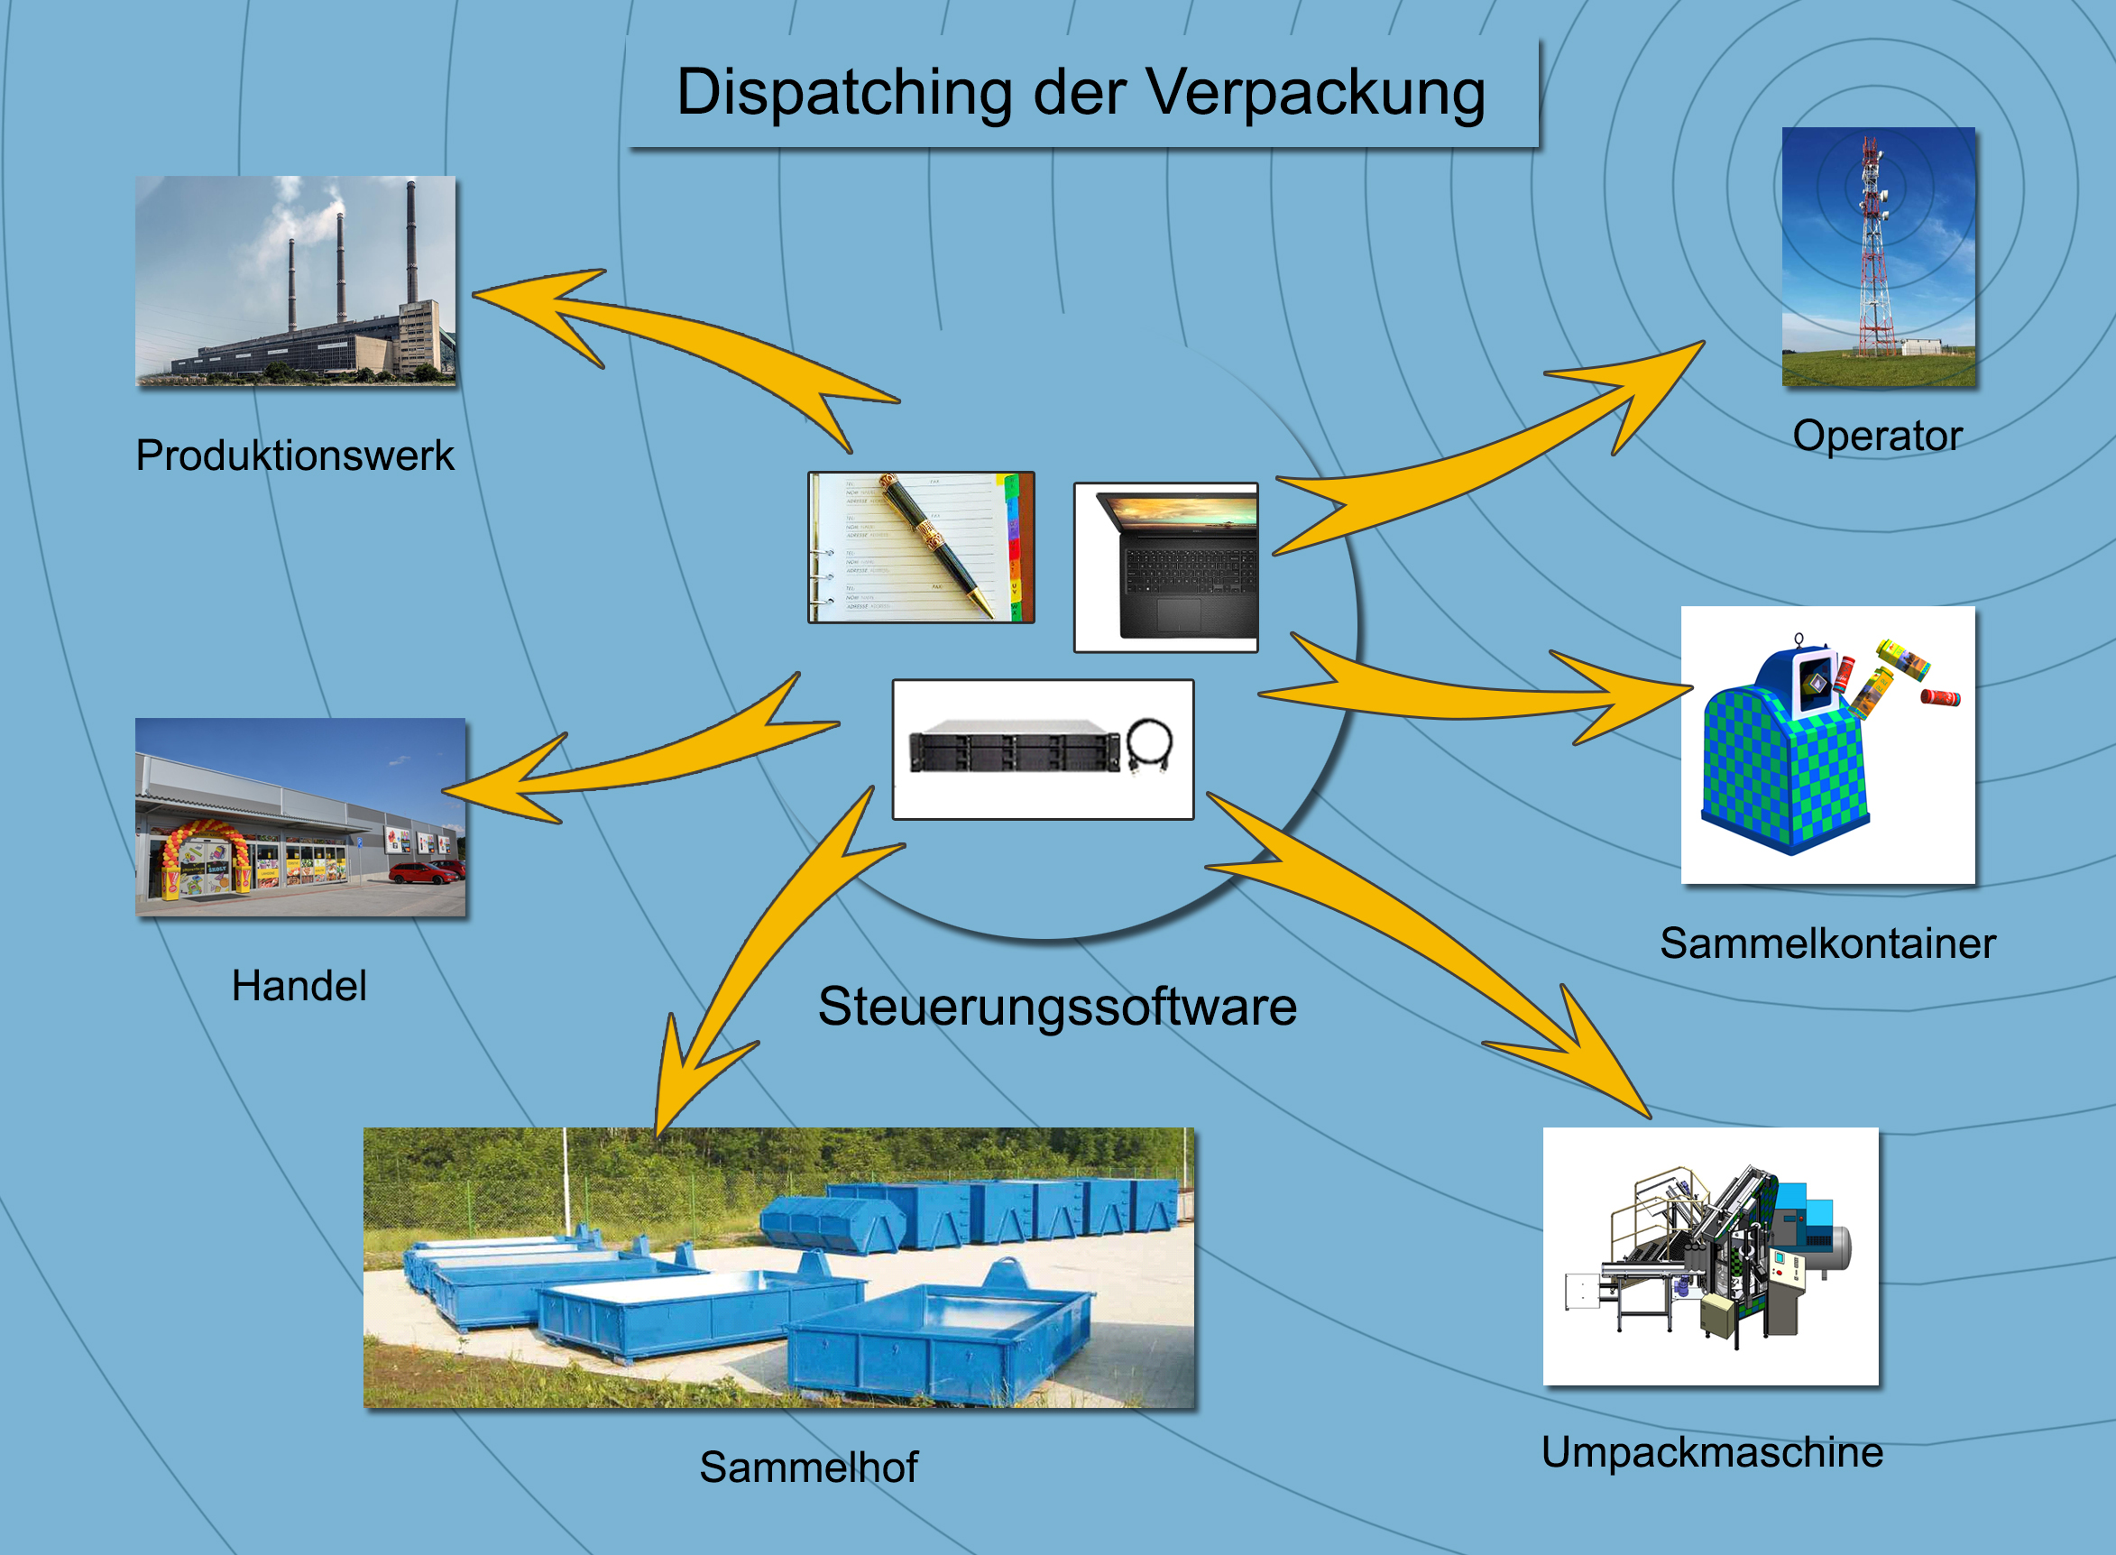
OUR CONTROL SOFTWARE CREATES AN OVERVIEW

Slide 18
THANKS FOR THE ATTENTION

