Slide 1
BIOGIPUZKOA
HEALTH RESEARCH INSTITUTE

Slide 2
What is a Health Research Institute?
Biogipuzkoa Health Research Institute
Fostering Open Science

Slide 3
WHAT IS A HEALTH RESEARCH INSTITUTE?

Slide 4







WHAT IS A HEALTH RESEARCH INSTITUTE?
NATIONAL CONTEXT
OBJECTIVE
To bring basic, clinical and health services research closer together and translate it into translational research of excellence.
University Hospital
Research Centres
Primary Care Area of the NHS
Universities

Slide 5
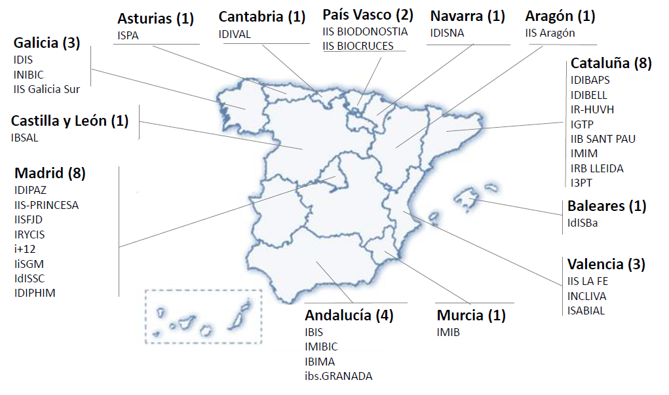
WHAT IS A HEALTH RESEARCH INSTITUTE?
NATIONAL CONTEXT
Source: Carlos III Health Institute (ISCIII)
35
Accredited HRI
380
Centres
+31.000
Researchers

Slide 6

EUSKADI: BASQUE HEALTH ECOSYSTEM
WHAT IS A HEALTH RESEARCH INSTITUTE?

Slide 7
BIOGIPUZKOA HRI

Slide 8





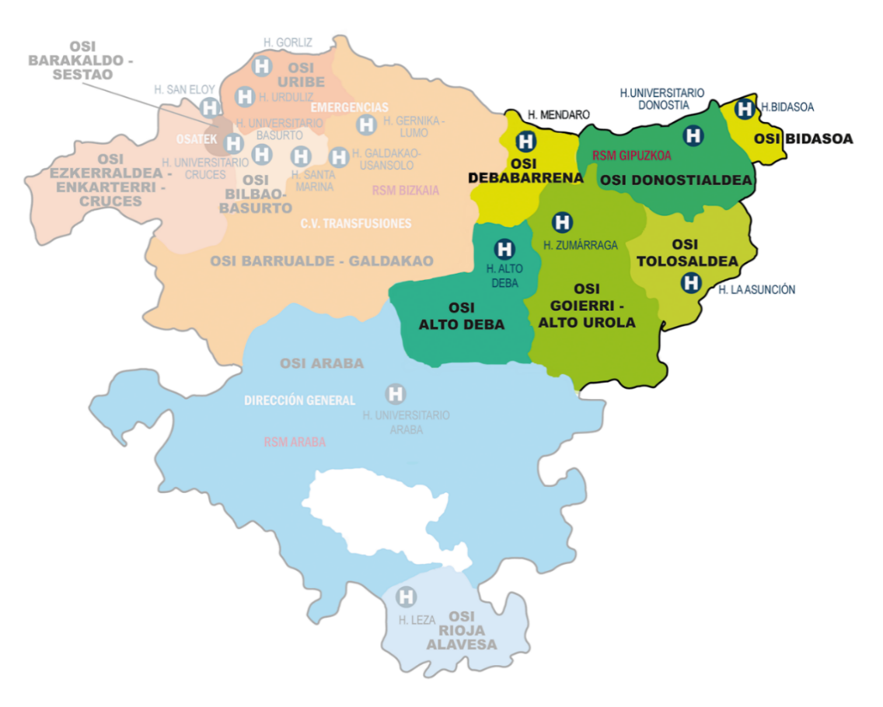
BIOGIPUZKOA HRI
HISTORY
2008
Founded
2011
1st Accreditation
2016 2021
Re-accreditations

Slide 9



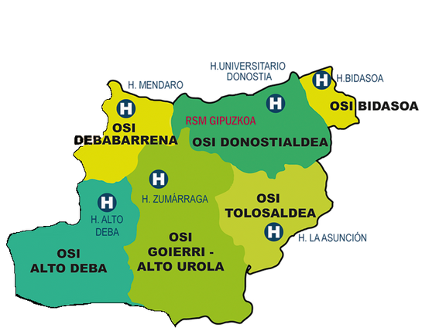


STRUCTURE
BIOGIPUZKOA HRI
Donostia University Hospital
Regional hospitals in Gipuzkoa
Primary Care area in Gipuzkoa
BIOEF
CIDETEC
VICOMTECH
PARKE
MATIA
University of the Basque Country (UPV/EHU)
Additional partners

Slide 10
OBJECTIVE
BIOGIPUZKOA HRI
IDENTIFIED CLINICAL NEEDS
Basic research
Clinical research
Research in Health Services
CITIZENSHIP AND
PATIENTS

Slide 11
BIOGIPUZKOA HRI
BIOGIPUZKOA IN NUMBERS
210
Employees hired
819
Total publications
314
Active clinical studies
501
Researchers on secondment
32
Research groups
9,8M€
Competitive funding
Preliminar numbers IIS Biogipuzkoa 2024

Slide 12
BIOGIPUZKOA HRI
AREAS
7 Research areas
32 Research groups
NEUROSCIENCES
LIVER AND GASTROINTESTINAL DISEASES
INFECTIOUS DISEASES
ONCOLOGY
2 Transversal areas
AGEING
SYSTEMIC DISEASES
EPIDEMIOLOGY AND PUBLIC HEALTH
BIO-ENGINEERING
ADVANCED THERAPIES AND PERSONALISED MEDICINE

Slide 13
AREAS AND GROUPS
2 TRANSVERSAL RESEARCH AREAS
AGEING
Ander Matheu
ADVANCED THERAPIES AND PERSONALISED MEDICINE
Ander Izeta
7 RESEARCH AREAS
NEUROSCIENCES
A. Lopez de Munain
LIVER AND GASTROINTESTINAL DISEASES
Luis Bujanda
INFECTIOUS DISEASES
JM Marimón
ONCOLOGY
Charles Lawrie
SYSTEMIC DISEASES
Irene Díez
EPIDEMIOLOGY AND PUBLIC HEALTH
Jesús Ibarluzea
BIO-ENGINEERING
-
NEURODEGENERATIVE DISEASES
Javier Ruiz Martinez
Myriam Barandiaran
GASTROINTESTINAL DISEASES
Luis Bujanda
SEXUALLY TRANSMITTED INFECTIONS (STI)
Luís Piñeiro
BREAST CANCER
Isabel Álvarez
María M Caffarel
HEART FAILURE WITH HYPERTENSION AND VALVULAR CAUSES
Xabier Arana
PRIMARY CARE
Itziar Vergara
COMPUTATIONAL BIOLOGY AND SYSTEMS BIOMEDICINE
Marcos Araúzo-Bravo
NEUROMUSCULAR DISEASES
A. Lopez de Munain
Amets Sáenz
LIVER DISEASES
Jesús Bañales
RESPIRATORY INFECTION AND ANTIMICROBIAL RESISTANCE
JM Marimón
CELLULAR ONCOLOGY
Ander Matheu
OBSTETRICS AND GYNAECOLOGY
Irene Diez
ENVIRONMENTAL EPIDEMIOLOGY AND CHILD DEVELOPMENT
JM. Ibarluzea
Aitana Lertxundi
BIOENGINEERING IN REGENERATION AND CANCER
Amaia Cipítria
NEUROINMUNOLOGY
David Otaegui
Tamara Castillo
LIVER IMMUNO-ONCOLOGY
Matxus Perugorria
AIDS AND HIV INFECTIONS
Maialen Ibarguren
Paco Carmona
MOLECULAR ONCOLOGY
Charles Lawrie
OTORHINOLARYNGOLOGY AND HEAD AND NECK SURGERY
Xabier Altuna
EPIDEMIOLOGY OF CHRONIC AND COMMUNICABLE DISEASES
Pilar Amiano
MITOCHONDRIA, HEALTH & LONGEVITY
Ian Holt
METABOLISM AND CANCER
Pedro Rodrigues
PAEDIATRICS
Itxaso Martí
E-HEALTH
Iván Macía
32 RESEARCH GROUPS
SENSORIAL NEURODEGENERATION
Cristina Irigoyen
Javier Ruiz Ederra
RESPIRATORY AND PLEURAL PATHOLOGY
Iñaki Salegi
Alberto Garcia Z.
ECONOMIC EVALUATION OF CHRONIC DISEASES
Marisa Merino
TISSUE ENGINEERING
Ander Izeta
MENTAL HEALTH AND PSYCHIATRIC CARE
Andrea Gabilondo
Álvaro Iruin
INNOVATION
-
ICTUS
Patricia de la Riva
Ileana Quiñones
NeuroRNA
Lorea Blázquez
Pablo Iruzubieta

Slide 14
BIOGIPUZKOA HRI
SUPPORT UNITS AND SERVICES
METHODOLOGICAL SUPPORT
ECONOMIC-ADMINISTRATIVE
SCIENTIFIC COORDINATION
INNOVATION
HUMAN RESOURCES
PROJECTS
COMMUNICATION
PROCUREMENT AND PUBLIC CONTRACTING
EVALUATION AND QUALITY
DISSEMINATION AND SCIENTIFIC CULTURE

Slide 15
BIOGIPUZKOA HRI
PLATFORMS
ANIMAL FACILITY
BASQUE BIOBANK
COMPUTATIONAL BIOLOGY
CELL CULTURES
MOLECULAR DIAGNOSTICS
GENOMICS
HISTOLOGY
3D PRINTING
CLINICAL RESEARCH

Slide 16
FOSTERING OPEN SCIENCE

Slide 17



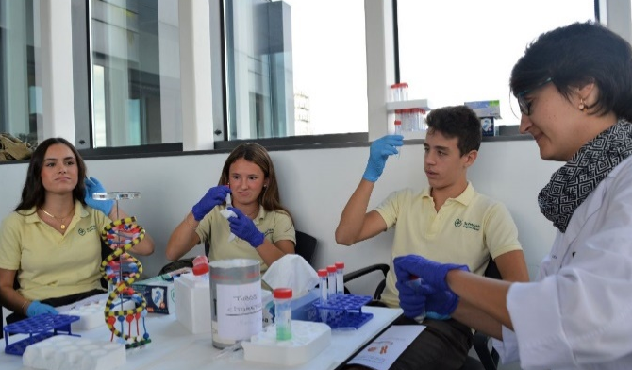
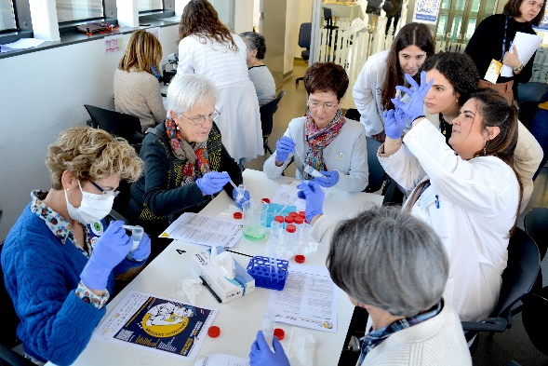
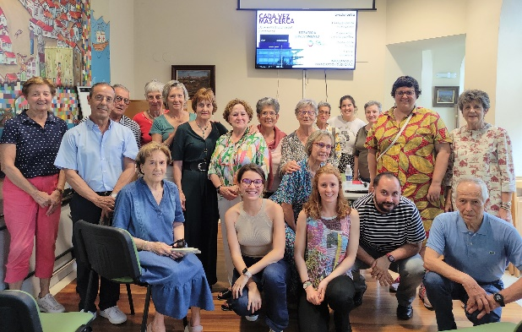
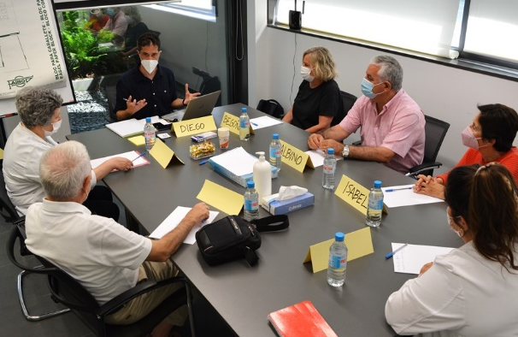


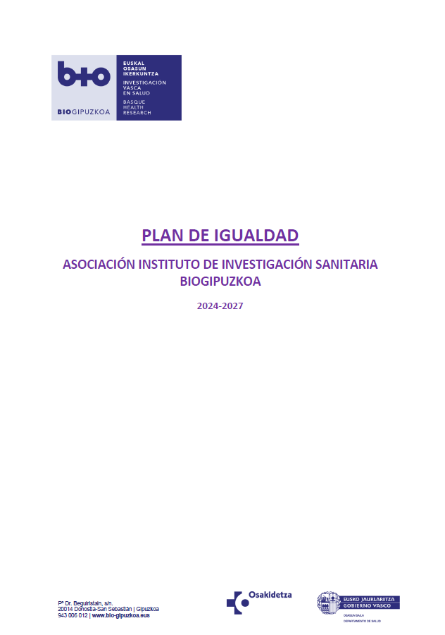
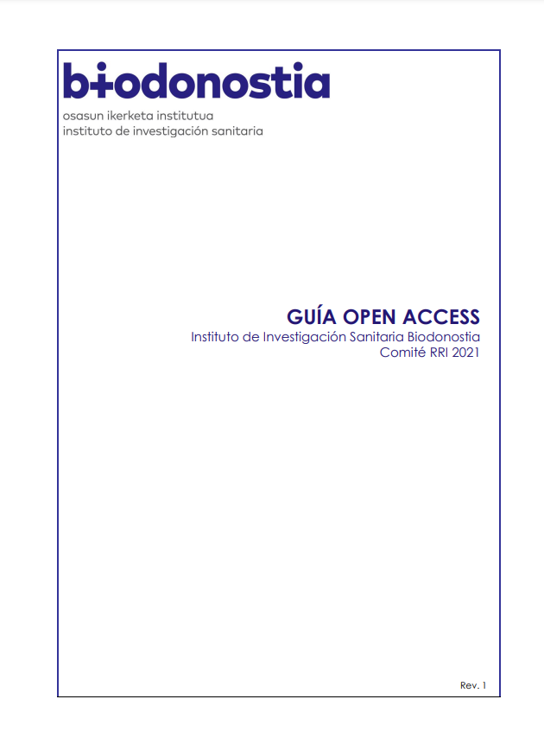
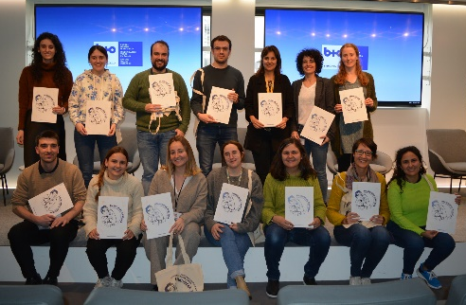




FOSTERING OPEN SCIENCE
SCIENCE EDUCATION
CITIZEN SCIENCE
EQUALITY
OPEN ACCESS

Slide 18
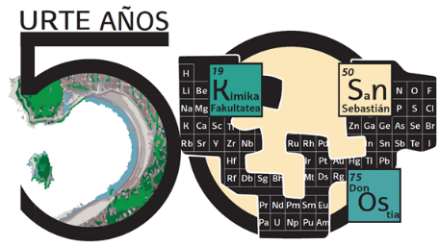


ESKERRIK ASKO
MUCHAS GRACIAS
THANK YOU
www.biodonostia.org
maider.santorcuatolabaien@bio-gipuzkoa.eus

