Slide 1

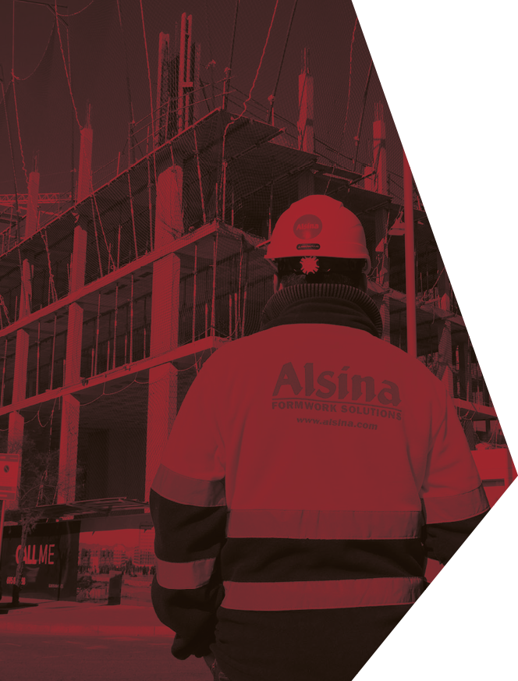


NEXT
Identificación multimodal de artículos

Slide 2

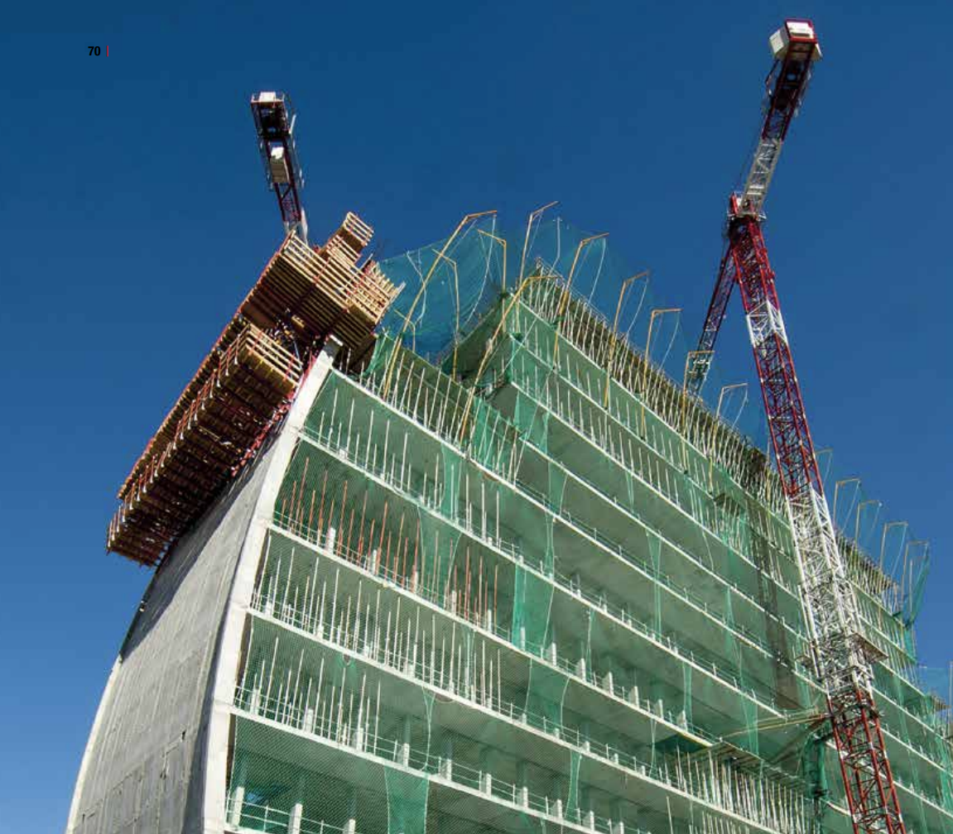
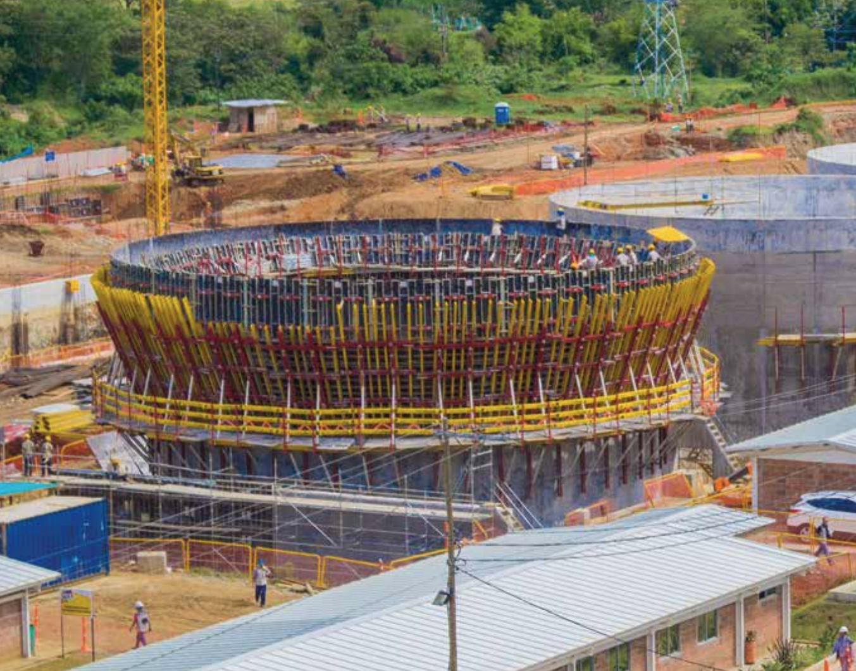
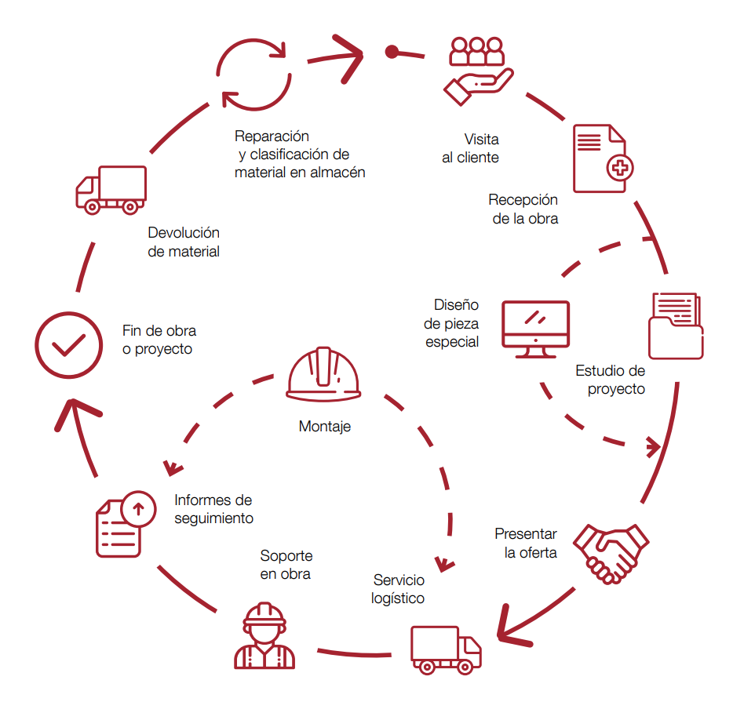
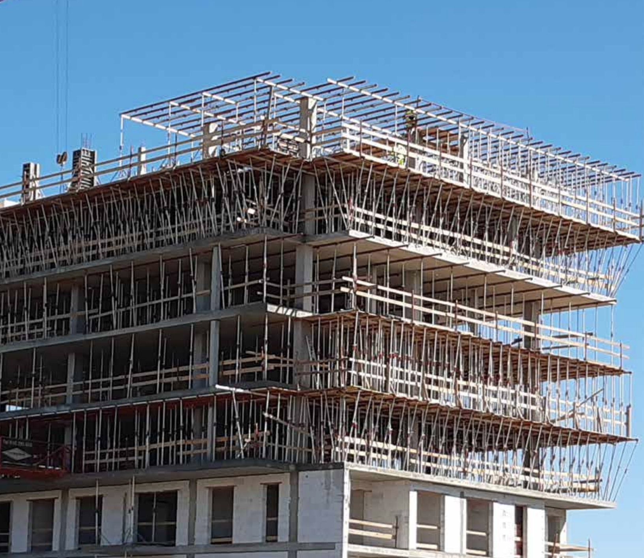
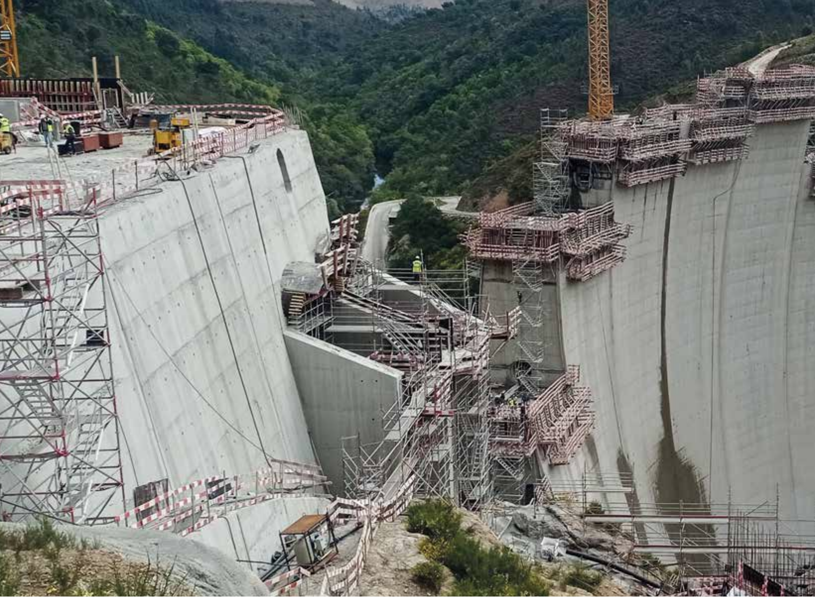
NEXT
MISSION
ALSINA
"To offer Solutions for Concrete Structures that help our Clients to improve efficiency and safety in their projects, through a committed and proximity service in the Global Market, innovating and betting on People as a componentfundamental del negocio”.
www.alsina.com

Slide 3
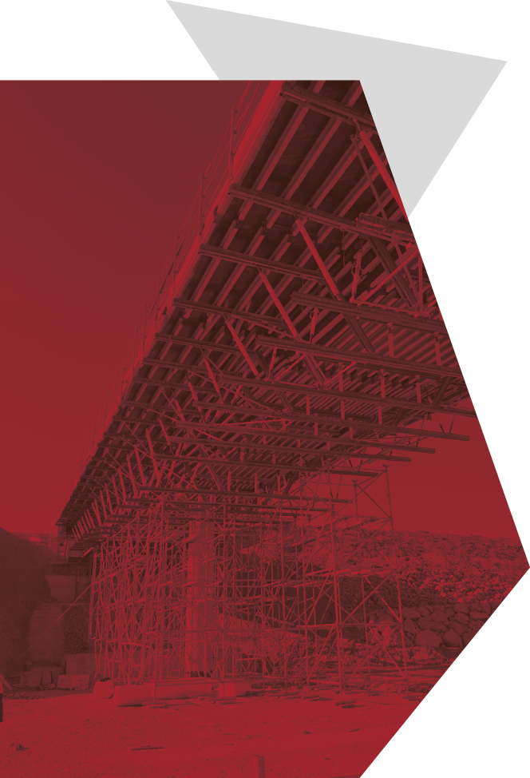
NEXT
Objectives of the challenge
  Identification of items with minimal human intervention by different means.
  Reduction of human error in the entry of relevant information.
  Enrichment of the truthful information of the articles throughout their useful life.
  Deep traceability, repair/status/use history, individualized.
  Detailed durability depending on use and/or repairs, geography, stays in the country.
  Improves efficiency of internal rental processes by actions derived from the information obtained.
  Development of new customer services derived from identification methods.
MULTIMODAL ITEM IDENTIFICATION
OBJECTIVES OF THE CHALLENGE
www.alsina.com

Slide 4

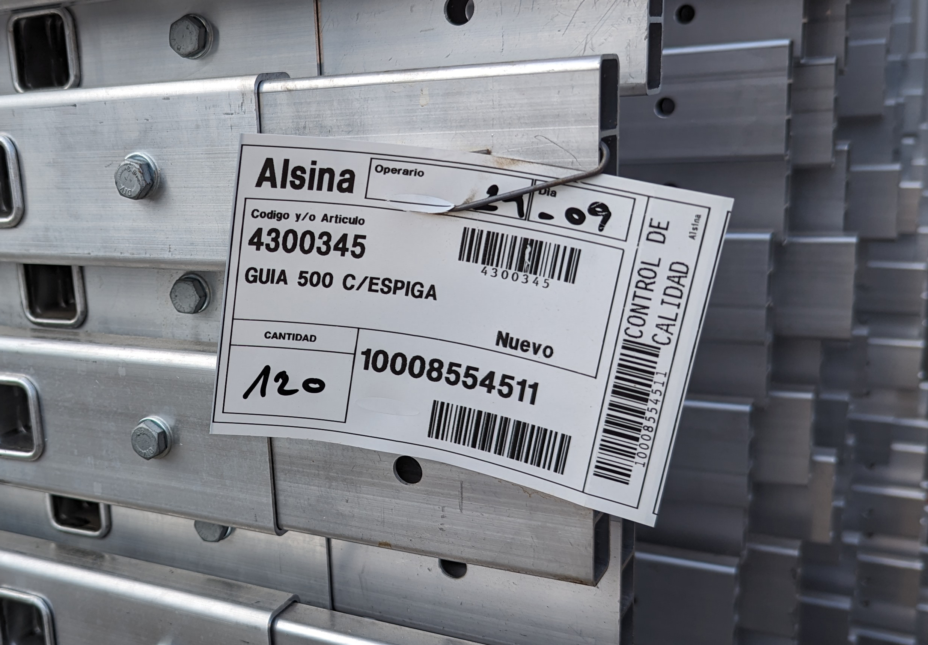
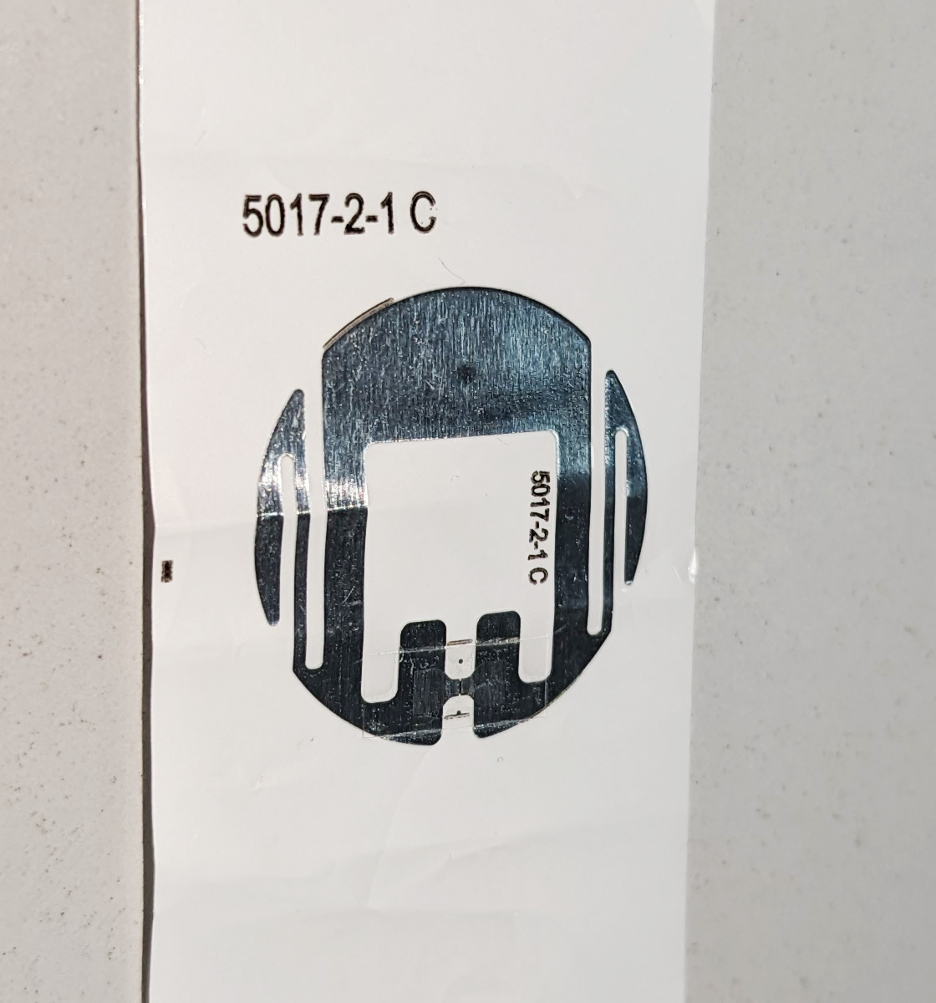
NEXT
Technologies used
and implementation status
  Implemented
  -Barcodes and radio frequencies-stock online Alsina.
  -Assembly Information Qr.
MULTIMODAL ITEM IDENTIFICATION
  Mvp
  -RFID in items - individual count and identification, revisions and expiration.
  -Qr repairs/revisions information.
www.alsina.com

Slide 5

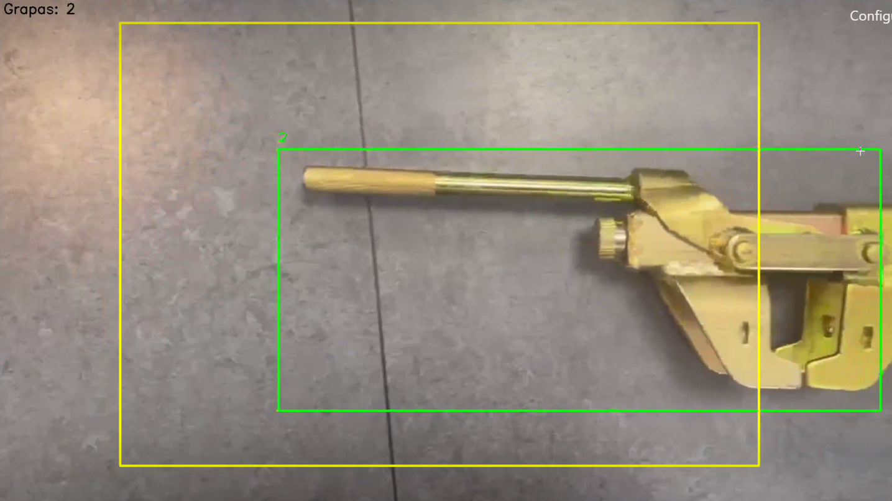
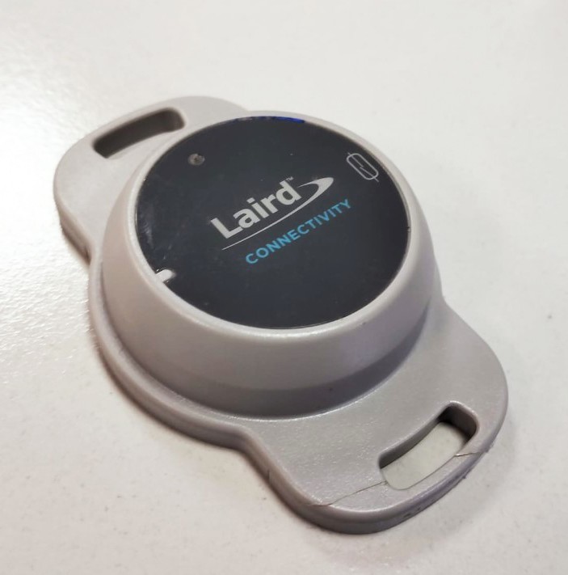
NEXT
Technologies used
and implementation status
  Poc
  -Machine vision - identification and counting of items.
IDENTIFICACION MULTIMODAL DE ARTICULOS
MULTIMODAL ITEM IDENTIFICATION
  Mvp
  -Bluetooth sensors – identification and counting, usage information.
www.alsina.com

Slide 6

NEXT
Technologies used
and implementation status
  Digital product Passport
  -Exploration, Blockchain digital identity
IDENTIFICACION MULTIMODAL DE ARTICULOS
MULTIMODAL ITEM IDENTIFICATION
www.alsina.com

Slide 7

Gracias
www.alsina.com

