Slide 1
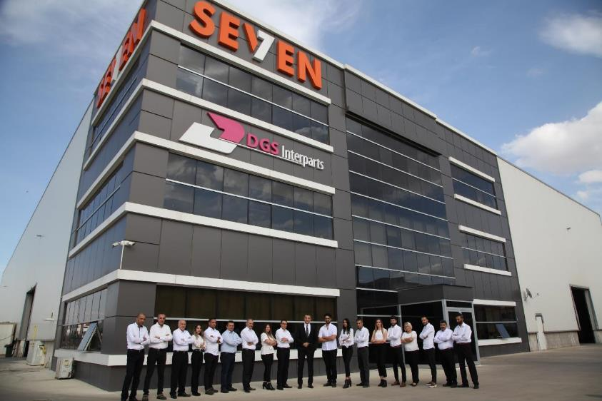
SEVEN

Slide 2
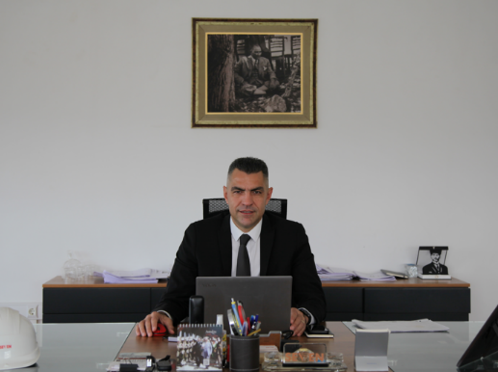
About us
We as Seven Machining Company are established in 2010 in Ostim-Ankara, we started our activities with contract manufacturing in the machining industry. We had maintained our production activities with top-notch standards in the machining industry since our establishment.
With our operations base in Ostim until 2016, We added to our work area to operating in the welding works, and moved our cnc platforms and benches in the machining department over to Sincan Organized Industrial Zone in 2018. Within the first quarter of 2019, we also took another investment decision to integrate machining and welding construction at the same location and purchased our own facilities at the Başkent Organized Industrial Zone.
TRUST is good, CONTROL is better.
Notes:
Seven were established in 2010 in Ostim Ankara as a machining factory. Since then we continue to grew and moved our factory to Sincan – Ankara.
We started to machining industry with a focus towards to Europian Economic Area and aiming the German Quality Standards. Since 2016, we have added welding manufacturing to our work area and we moved our CNC platforms and benches to Başkent Organized Industrial Zone. To integrate machining and Welding construction at the same location.

Slide 3
Our Quality Policy
We endeavors to meet the expectations of our customers in machining and welding construction processes. With our strong and dynamic engineering team, we aim to perform our production-related duties in a meticulous and detail-oriented manner; and we have the machine park to do just that.
Our Health & Safety Policy
Acting with all applicable laws and regulations in order to protect the occupational health and safety of our employees, whom we see as the most valuable resource, to minimize possible occupational accidents and their effects, and to ensure efficiency and quality in work and service production accordingly,
Trying to reach our goal of "zero industrial accident" by eliminating possible risks with the participation of our employees,
We aim to ensure the continuous development of our OHS System and to prioritize the OHS factor in line with this purpose.
Our Environmental Policy
We aim to prioritize a dynamic environmental policy by ensuring the active participation of all employees in our company in training and practices in order to protect the environment and human health in line with the rapidly developing technology and the changing environmental approaches in parallel with this.
Notes:
Our Quality Policy is to meet the expactations of our customers. And we always targeting the German Production Standards.
Our Health and Safety Policy is zero industrial accident by eliminating possible risks with participation of our employees, whom we see as the most valuable resource.
Environmental Policy is protect environment and human health in line with rapidly developing technology.

Slide 6
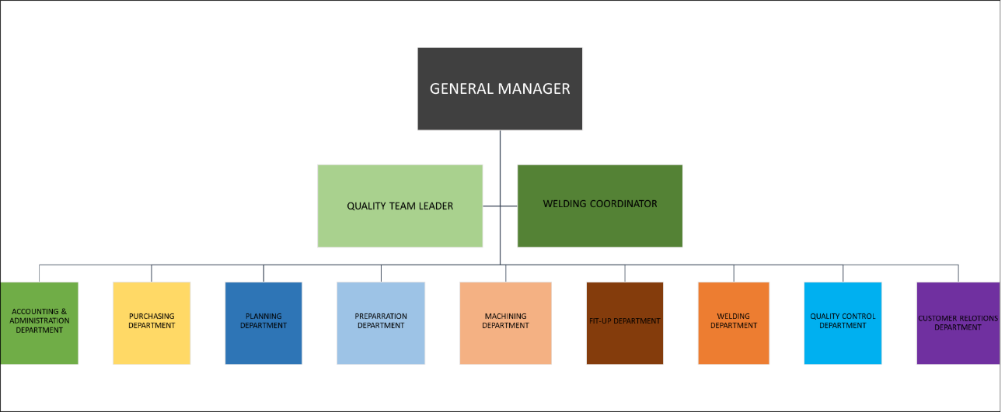
Organısatıon Chart
Number of Employee : 107
Administration : 20
Number of Engineer : 7
Number of Welding Engineer : 2
Notes:
Currently 106 people is working in our company, which 19 of them are in administrative staff and with 2 welding Engineer 7 of them are Engineers.

Slide 7
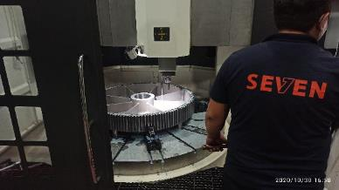
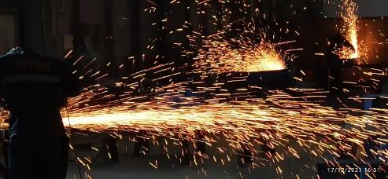
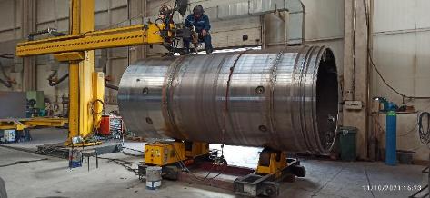
Our Process
Machining
Welding
Painting
Cutting

Slide 8
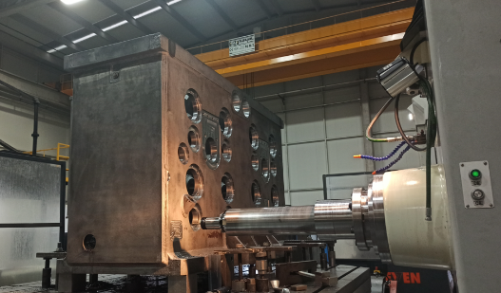
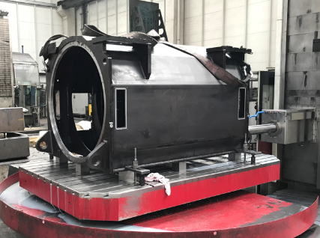
Machınıng
We Perform Safe Machining Procedures
During the machining process, CAD-CAM programs are prepared in accordance with the technical details specified in the project and the technical drawings. Appropriate binding methods and equipment are selected and arranged accordingly. Parts are machined in line with the technical drawings.
After machining, the initial part/batch is assessed by the quality control department to continue mass production as long as quality checks are affirmative. Parts produced are leveled and visually inspected followed by instrumental measurements and checks using such instruments as CMM, Faro, Micrometer, Calipers etc.
Notes:
In machining procedures; CAD-Cam programs are prepared in accordance with tehcnical details specified in technical drawings and Project datas. Machining equipments and methods are selected accordingly. After machining, parts are checks by the quality control department to continue the mass production as long as controls are okay. The quality controls are made with CMM, Faro Arms and Laser Trackers, Micrometer, Calipers etc.

Slide 9
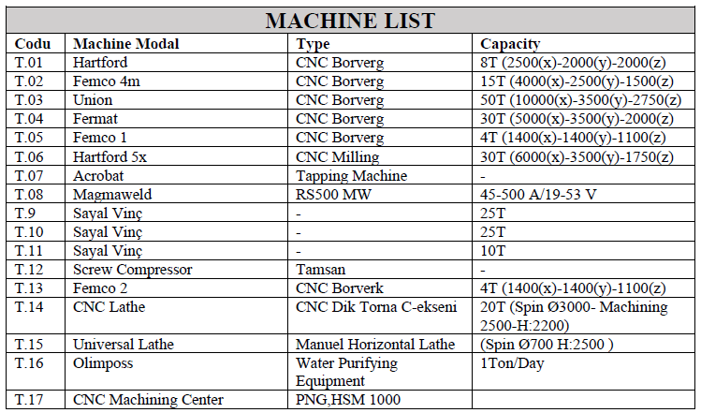
Machıne Lıst

Slide 10
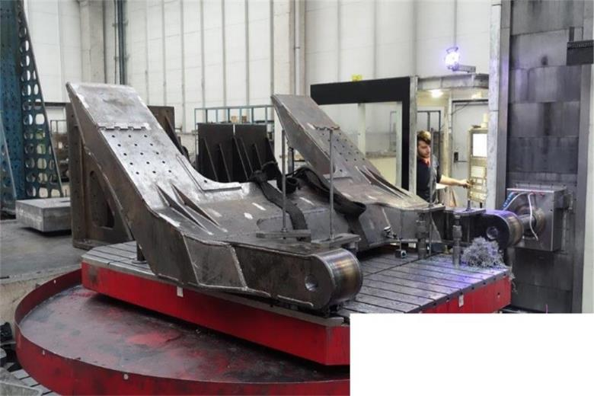
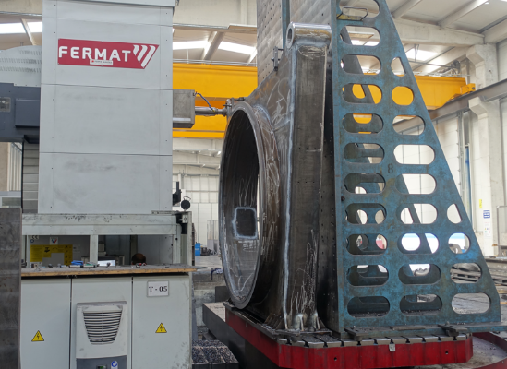
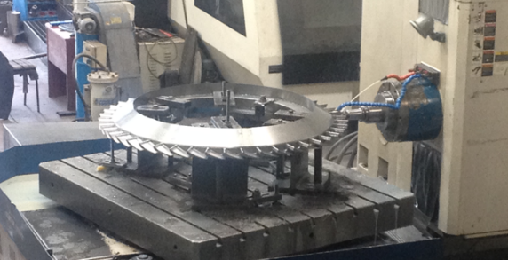

Slide 11
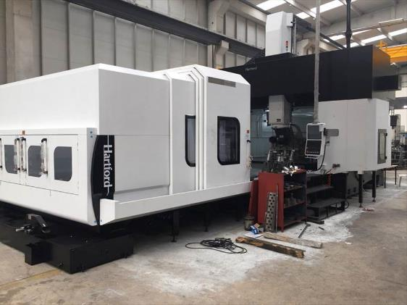
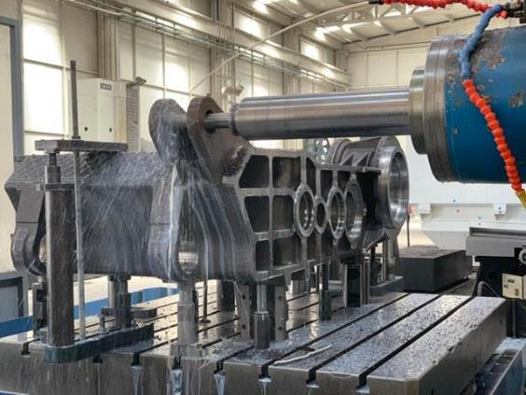
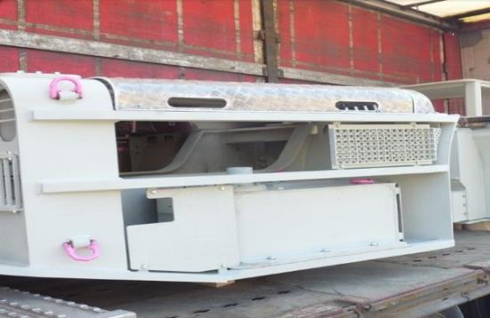

Slide 12
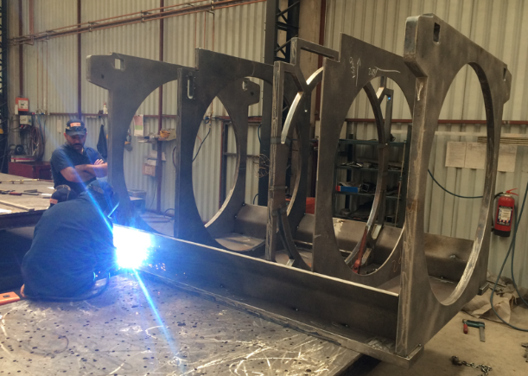
Weldıng
Projects undertaken during bidding phase are assessed for feasibility as per ISO 3834 and EN 1090 standards. Once the order has been approved, technical drawings are studied to determine raw material requirements for procurement. Raw materials received are subjected to entry-level quality checks and transferred to raw material storage area.
Notes:
After the Project approval, technical drawings are studied to determine the materials requirements for production. when the raw materials received, entry level quality checks been done and transfered tho raw material storage area.

Slide 13
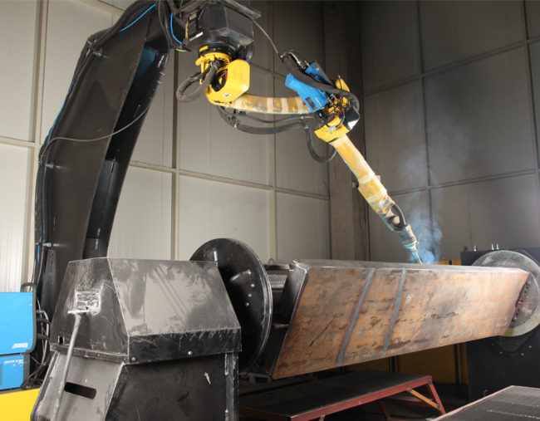
Machine List
Conventional Mig-Mag Welding : 11 machine
Synergic Mig-Mag Welding: 14 machine
Shielded Carbon Electrode Welding : 1 machine
Welding Redressor : 1 machine
Welding Robot : 1 machine
TIG Welding : 1 machine
Winch Capasities : 2*Single leg gantry Crane 5 tonnes
1* 6.3 tonnes winch
1* 10 tonnes winch
1* 16 tonnes winch
Hall : H=8.5m, W=23.5m, L=82m
Belt Saw : h=350mm W=460mm

Slide 14
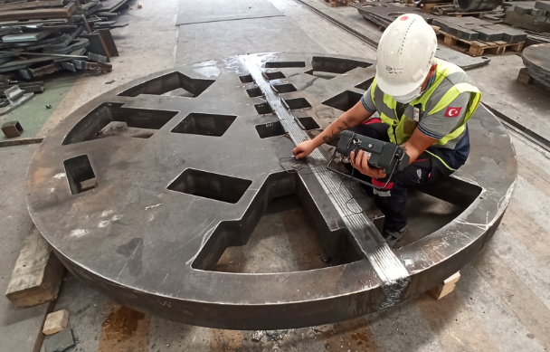
Quality Control personnel perform pre-welding measurement checks. Approved parts are transferred to the welding line for welding processes. The parts are welded by our certified welders in accordance with the welding plans and WPSs for each relevant part. Measurement checks of the parts are performed after welding and adjustments are made as necessary.
Parts the welding processes of which are complete are transferred to the levelling line. The levelling of the parts are performed by our expert staff. Following this process, the NDT tests as requested by the customer are carried out.
Notes:
After the approval of pre-welding quality checks, the parts are transferred to the welding line. Parts are welding by ouy certified welders in accordance with welding plans and WPS’s for each parts. After the welding quality controls are made and necessary adjustments are made.
After the Welding process the parts are transferred to the grading line, which is performed by our expert staff. Following this process NDT tests are performed.

Slide 15
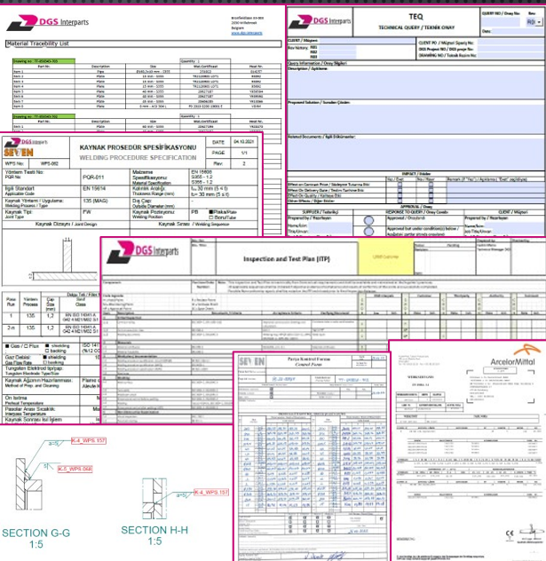
The Qualıty Documentatıon; Manufacturıng Data Book
Index
Third Party Documentation
As build Drawings
Inspection & Test Plan
Material Certificates
  Cross Reference List
  Material Certificates
Dimensional Reports
Welding Inspection Reports (NDT)
Paint Reports
Welding Book
  Welding Matrix / Welding Map
  WPS
  WPQR
  WPQ, Welder Specifications List
  NDT Procedures
  NDT Qualifications List
NC’s and Log
Technical Queries
Release Note

Slide 16
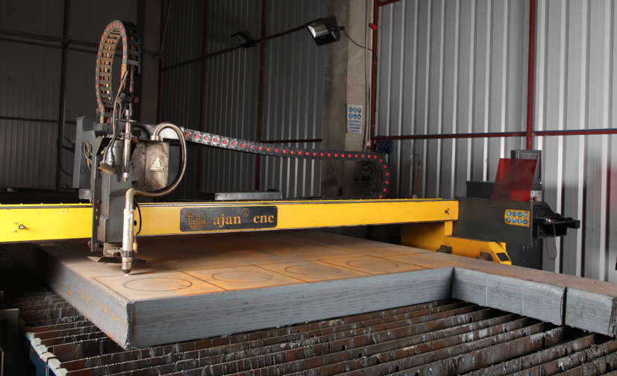
Cuttıng
The materials in the storage area are cut in line with the project's cutting plans and as per the EN ISO 9013 standard. The parts thus cut are leveled as per the EN ISO 8501-3 standard. The parts cut are categorized for pre-machining, for bending and for assembly. After the performance of quality checks of parts, the pre-machining and bending processes of which are complete, the parts are transferred to the assembly area for fit-up as per technical drawings.
We can cut the materials up to 300mm thickness.
Notes:
The raw materials are cut in line with the projects cutting plans and ISO 9013 standard. The cutted parts are categorized for pre-machining, bending and for assembly. After the qulity checks the parts are transferred to the assembly area. We can cut the materials up to 300 mm thickness.

Slide 17
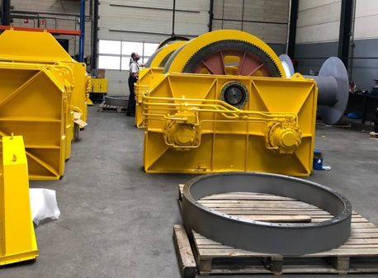
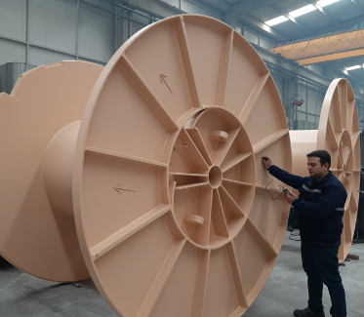
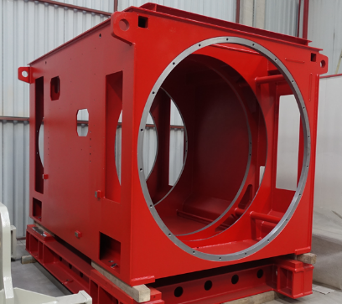
Paıntıng
Part surfaces are prepared for painting by sandblasting as per ISO 8501 quality grade SA2.5. The sandblasted parts are subjected to SALT testing to guarantee adhesiveness on part surface. After surface roughness controls, the primer is applied and the part is transferred to the machining line for further processing, as required. The parts which go through fine machining are painted with the final coat, if any.
Notes:
Parts are prepared for painting by sandblasting. The sandblasted parts are subjected to Salt testing to guarntee adhesiveness on part surface. After the Salt Ctesting the primer is applied and these parts are transferred to the machining process. The parts are painting with final coat after machining.

Slide 18
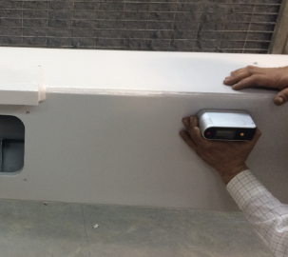
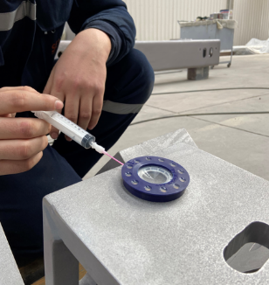
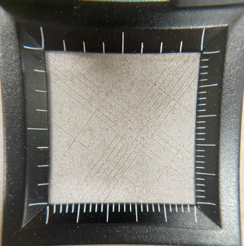
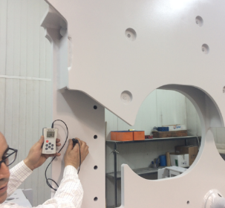
The parts which are painted with the final coat are checked by the quality control department for thickness of paint, adhesion and gloss; and the parts the paint quality of which has been approved are packaged and made ready for shipment.
Notes:
The parts after painted the final coat, checked by the quality control department for thickness of paint, adhesion and gloss. The approved painted parts are packed and made ready for shipment.

Slide 19
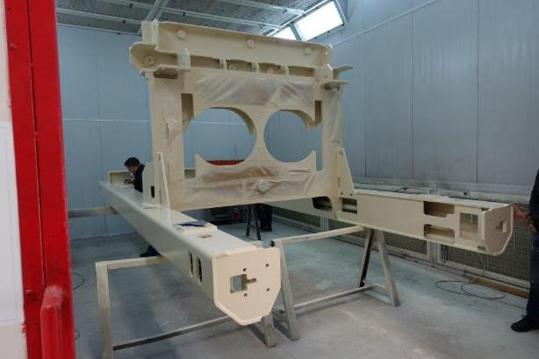
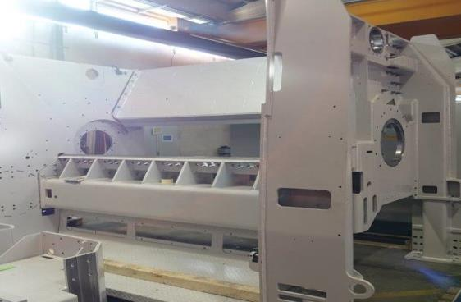
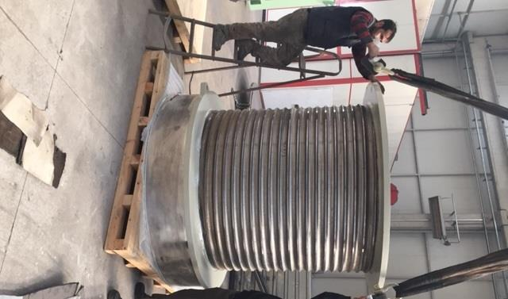
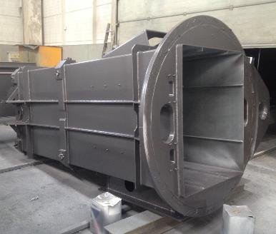
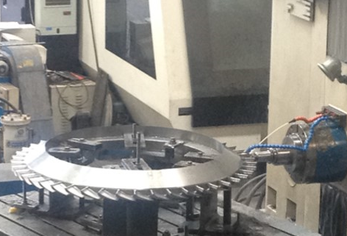
Realızatıons

Slide 20
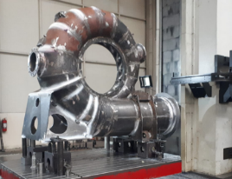
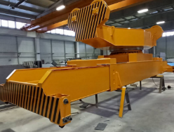
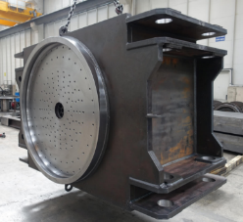
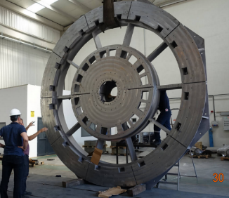
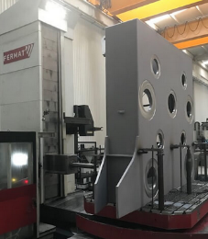
Sectors
Energy
    Heavy Lıftıng and Crane Equıpment
        Machıned Equıpment
            Mınıng
                Offshore

Slide 21
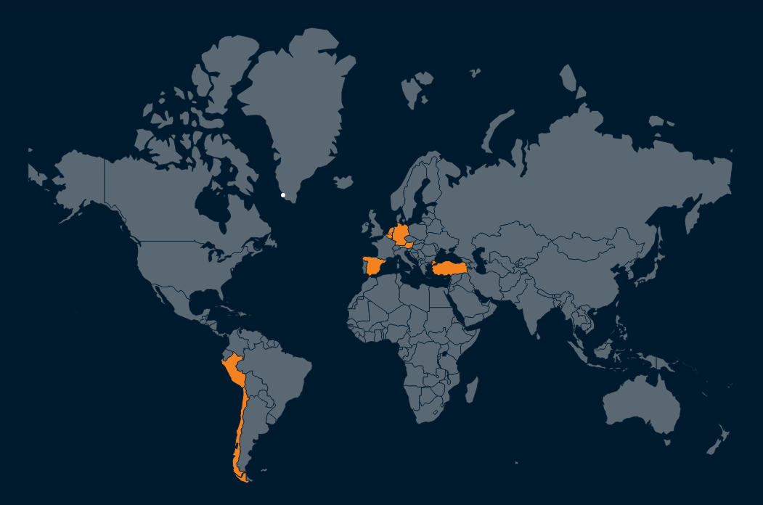
Countrıes We Work Wıth
Thank You….
Web: www.sevenmakina.com
Instagram: https://www.instagram.com/sevenislemeimalat/
LinkedIn: https://www.linkedin.com/in/seven-i%C5%9Fleme-imalat-makina-san-ve-tic-a-%C5%9F-293036232/

