Slide 1
Deaf Education in Chile: moving towards inclusion
Ignacia Sauvalle Ricart
Fundación En Señas del Instituto de la Sordera
Chile
Methods for teaching sign language and fostering signing communities
February 22nd 13:40 to 14:40
Notes:
Title: Deaf Education in Chile: moving towards inclusion
First name, last name of speaker(s): Ignacia Sauvalle Ricart
Name of Organization: Fundación En Señas del Instituto de la Sordera
Name of Country: Chile
Name of Session (as written in Agenda): Methods for teaching sign language and fostering signing communities
#ZeroCon24
Day and Time of Session: February 22nd 13:40 to 14:40

Slide 2
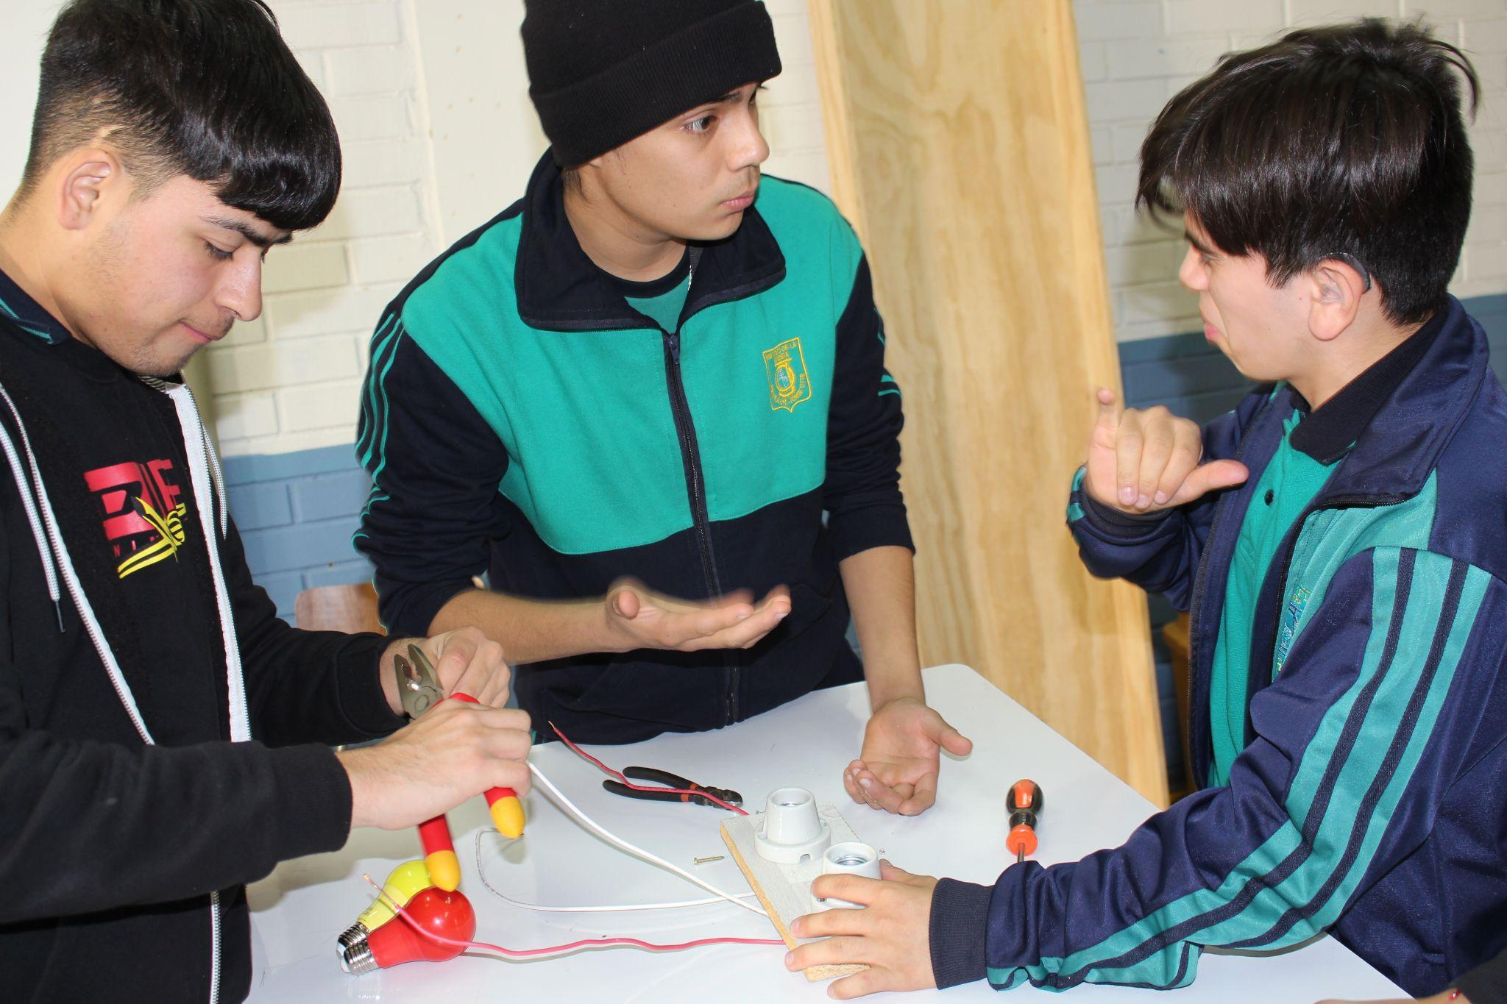
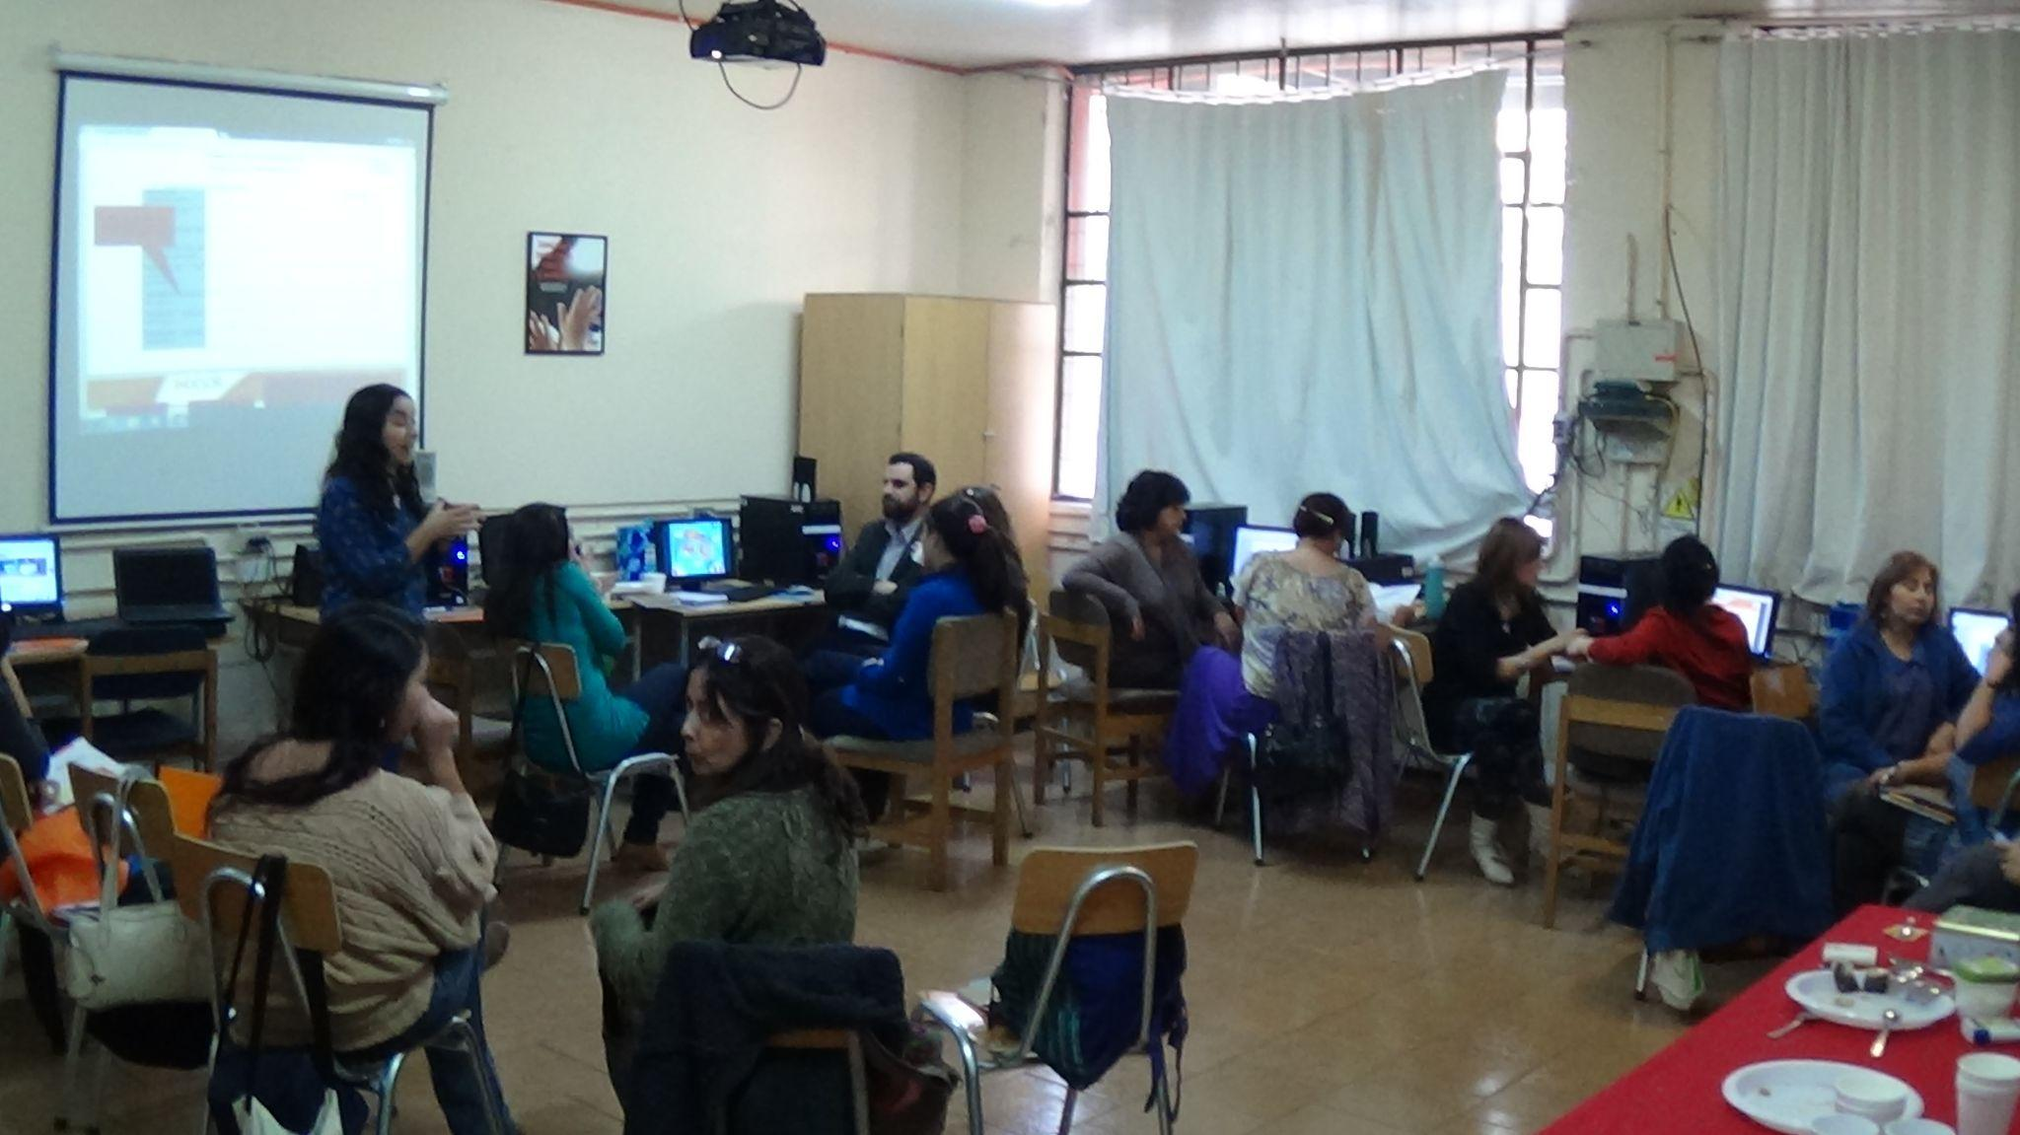
Fundación En Señas
Instituto de la Sordera (Indesor)
Intercultural bilingual school
113 students
Deaf and hearing professionals
+50 schools advised
+300 trained professionals
Notes:
Indesor, founded in 1959, supports the Bilingual Intercultural School for Deaf Students named after Dr. Jorge Otte. In 2018, the organization started the "En Señas" Foundation to help include deaf children in regular schools across the country.

Slide 3
Sharing our deaf education experience
Lead transition to a fairer society for deaf people.
Spread in other schools cultural and linguistic rights approach.
Contribute to effective inclusion in education, social, and occupational activities.
Foster equitable participation in diverse aspects of life.
Notes:
The essence of our project : help building a more inclusive society for deaf and hard of hearing people. We focus on cultural and language rights. Our goal is to actively include and involve deaf and hard of hearing people, in education, social activities, and work.

Slide 4
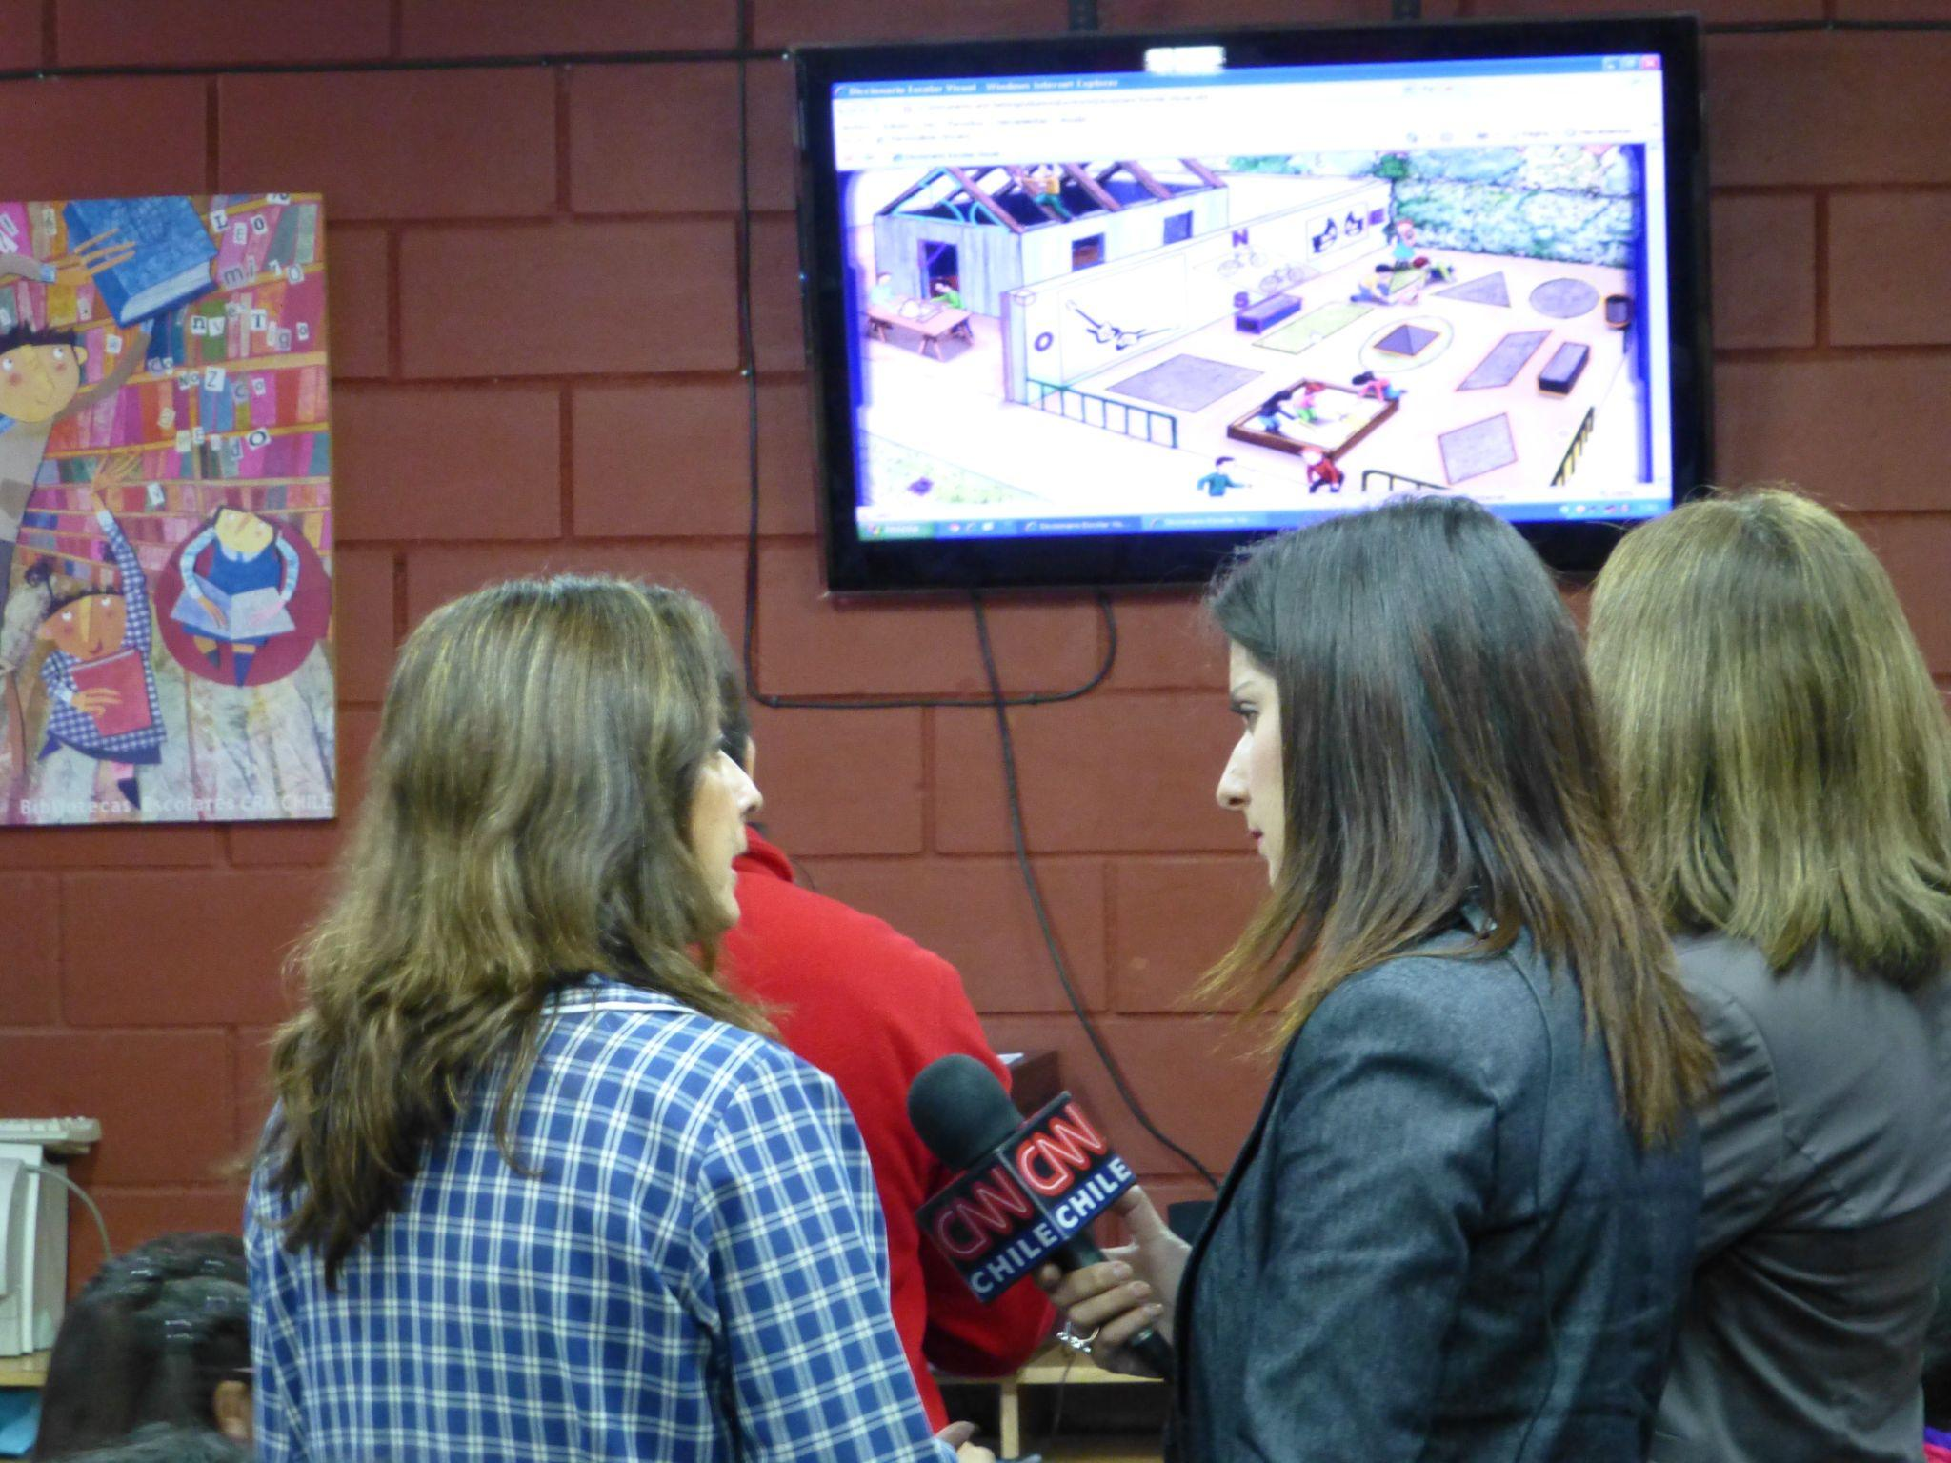
Innovating in the education of deaf students
Sharing innovative strategies for the inclusion of deaf students in mainstream institutions.
Developing Digital Educational Resources.
Promoting Deaf Culture and sign language.
Notes:
How are we innovating? We are now well-known across the country. We're recognized for introducing a special way of teaching that includes both languages and cultures. We also create new ideas to include deaf students in regular schools. We make digital learning tools and spread awareness about deaf culture and sign language.

Slide 5
Creating an impact on students, families, mainstream schools… and our society
+100 children free intercultural bilingual education each year.
+300 trained professionals
+1.000 people had studied Chilean Sign Language with us
+500 hearing children learning Chilean Sign Language in mainstream schools
Notes:
Sample Slide: presenting three points on our project and the relationship to this year’s theme of the Zero Project Conference. Point 1; Point 2; Point 3 connect together in this way.

Slide 6
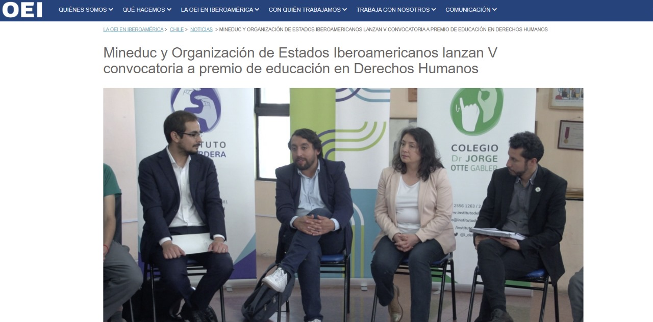
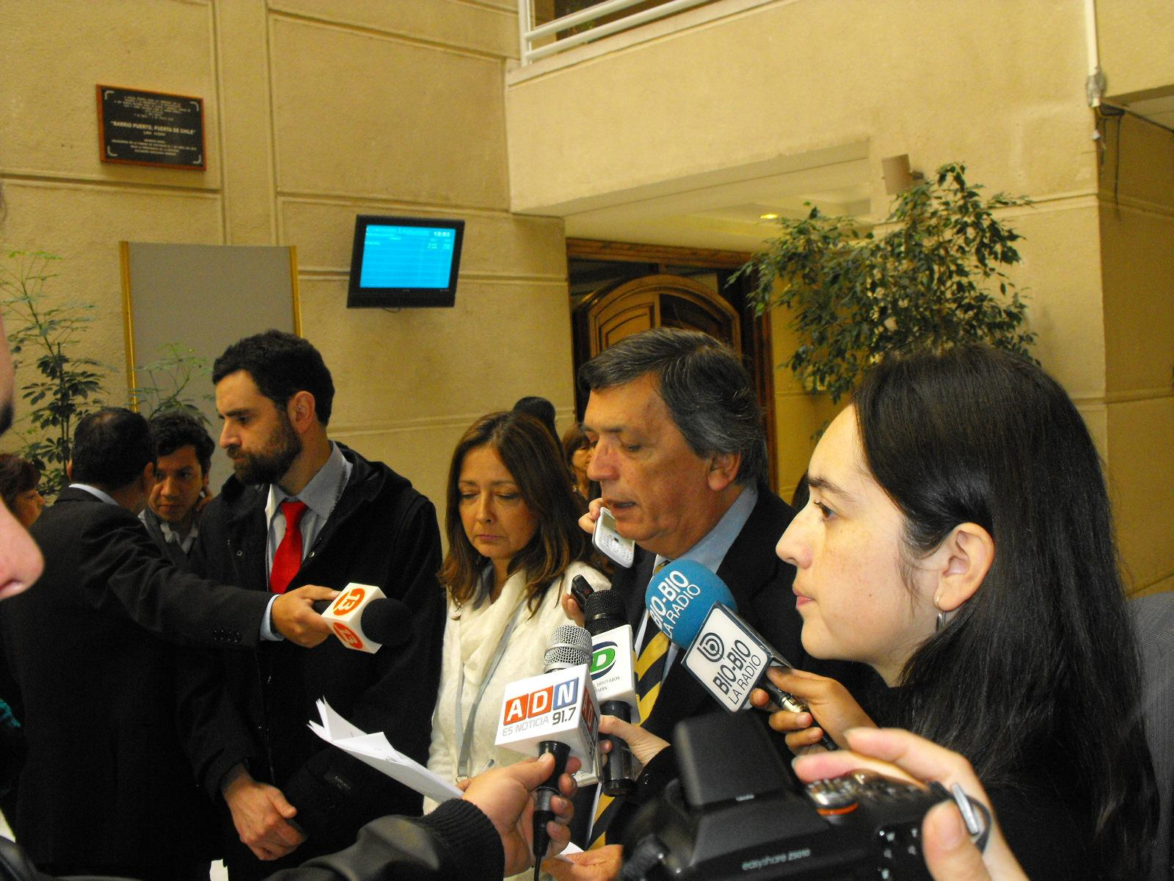
Our achievements
+20 projects with public and private funds.
We serve as recurring consultants for governmental organizations.
2010 Network of Leading Schools (Fundación Chile)
2017 Sustainable Initiatives Award in Quality Inclusive Education (HUB Sustentabilidad)
2022 Ibero-American Prize for Education in Human Rights (Organization of Ibero-American States and Fundación SM)
2023 Member organization of World Federation of the Deaf.
Notes:
We've completed more than 20 projects supported by public and private funds. Our focus is on the deaf community, especially kids and teenagers. We regularly help government organizations like the Ministry of Education and the National Disability Service, giving advice on issues related to educating deaf students.
In 2010, Fundación Chile recognized us for solving educational challenges with creative teaching ideas in challenging situations. In 2017, HUB Sustentabilidad gave us an award for our sustainable initiatives in providing quality inclusive education. In 2022, the Organization of Ibero-American States and Fundación SM honored us with the Ibero-American Prize for Education in Human Rights. This was for supporting the right of deaf children to be educated in their own language. In 2023, the World Federation of the Deaf accepted us as a member organization.

Slide 7
Our challenges
Reach more schools in Chile and other regional countries sustainably
Finance our operation and endure over time
Contribute to the effective inclusion and participation of deaf children and adolescents, across schools in the country, Latin America and the Caribbean
We aim to achieve this through systematic process of expansion, replication, and collaboration
Notes:
Challenges: We want to help more schools in Chile and nearby countries in a way that lasts, so we can keep running our programs and making things better for deaf people. Our main aim is to make sure deaf people, especially kids and teens, are included and can take part in everything. We plan to do this by using a new and creative way of teaching in schools across our country, Latin America, and the Caribbean. We want to grow and help more people by working together with others and using the same good methods everywhere

Slide 8
Our next steps
Short-term: Scaling our project at the national level, and to countries in the region we have previously collaborated with.
Medium-term: Focus on financing, scaling (national and international coverage), partnership building, intersectoral collaboration, public advocacy, and data collection.
Long-term: Maintain and strengthen partnerships, further collaboration, and influence public policies for sustained impact.
Notes:
Next steps…

Slide 9
Thank you for your attention
our contact information:
isauvalle@institutodelasordera.cl
@i_delasordera
@iensenas
Notes:
Sample Slide: presenting three points on our project and the relationship to this year’s theme of the Zero Project Conference. Point 1; Point 2; Point 3 connect together in this way.

