Slide 1
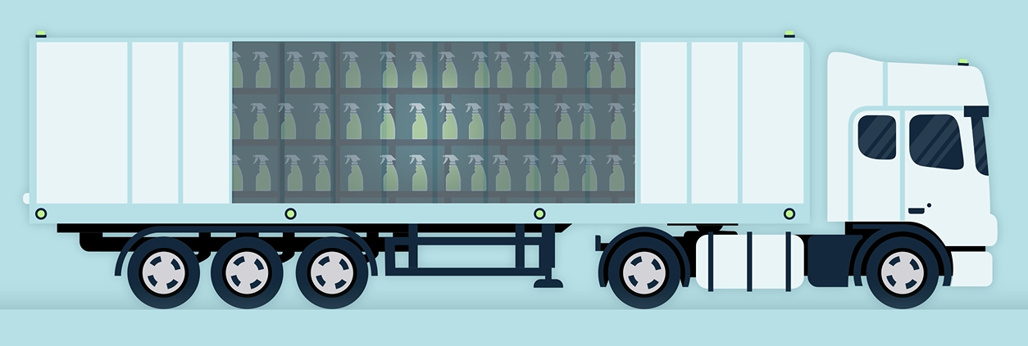

-We believe the future is not about transporting water in packaging, but about transporting knowledge, concentrates and data through circular infrastructure.

Slide 2
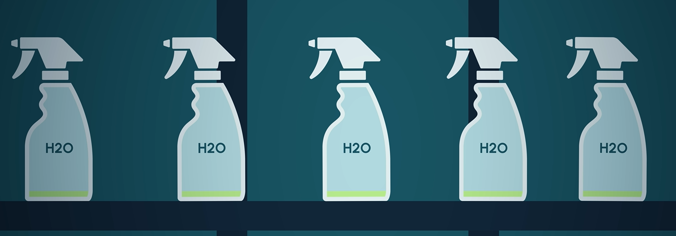
-The biggest packaging problem isn't packaging.
99% Water
1% Chemistry
- It's the way we distribute liquid products.

Slide 3
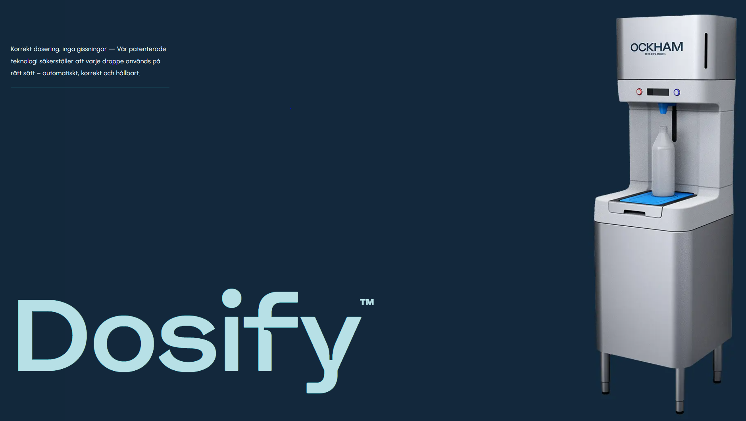
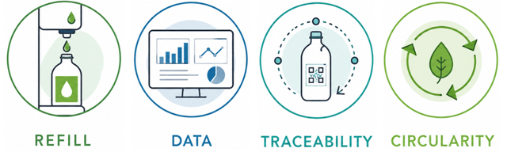
Our patented, universally compatible platform combines all four in one automated system.

