Slide 1
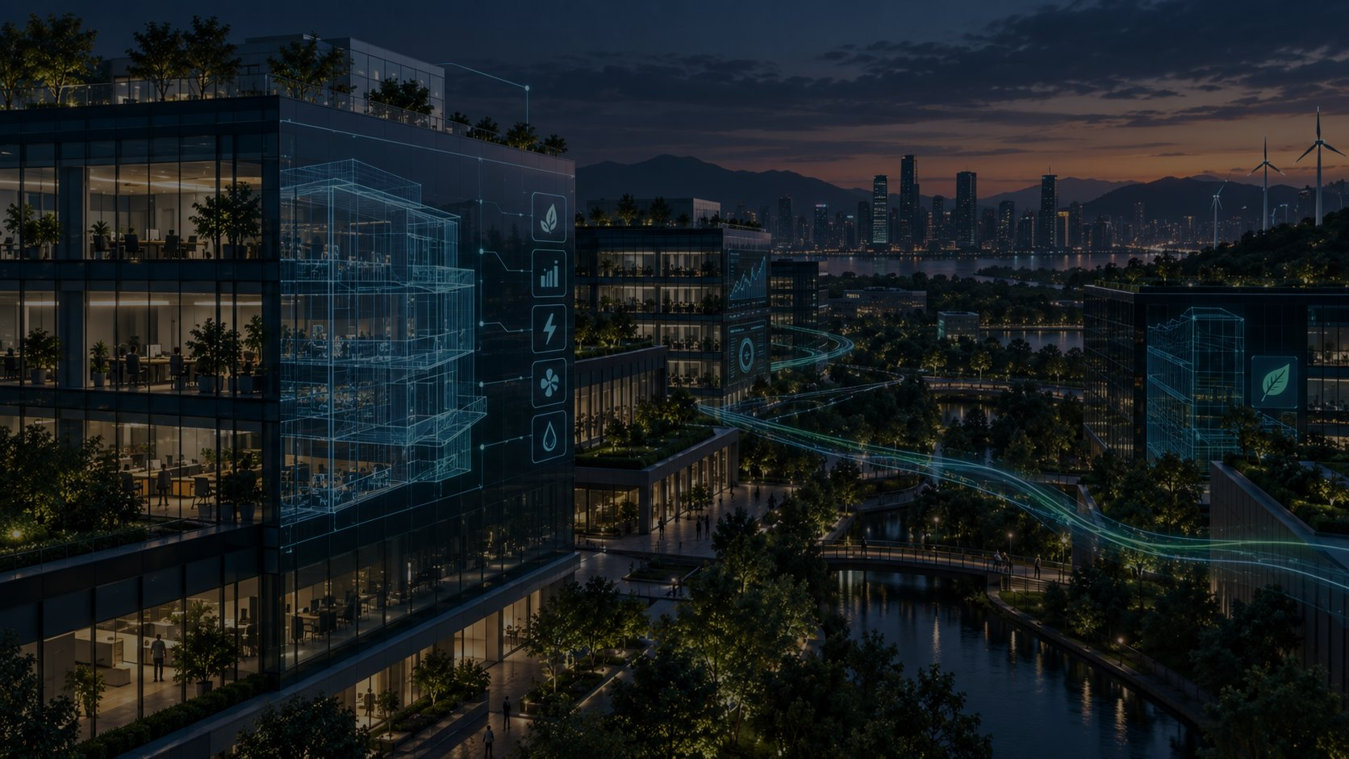

SMART CITY EXPO 2026 • OPEN INNOVATION CHALLENGE
Smart Building & Energy
AI-powered energy optimization, building digital twin and decision-support platform for smarter, lower-carbon buildings and districts.
Challenge / PoC Deck

Slide 2
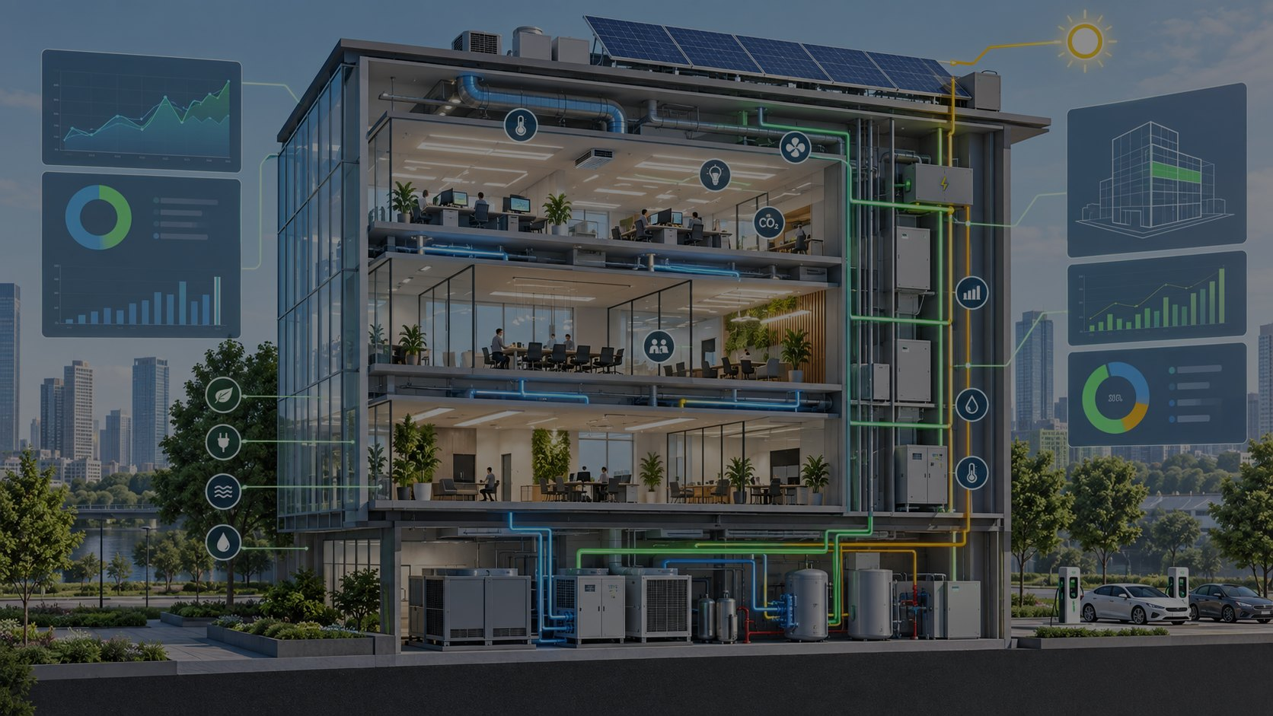
Why Smart Building & Energy?
Smart Building & Energy
A city-scale digital twin is ambitious but complex. Smart Building & Energy converts our existing research base into a focused product: energy consumption, HVAC analytics, optimization, a building digital twin and decision support.
Smart Building & Energy • Challenge Deck • 2

Slide 3
Alignment with the Challenge
• Solution providers in AI, GovTech, digital tools and data analytics
• B2B and B2G meetings with public and private challenge owners
• A clear route from the right solution partner to an accelerated pilot
• A focused, feasible PoC rather than a fully developed platform
Our Response
Energy Efficiency
Energy Optimization
Integrated Management
Smart Building
Predictive Analytics
Decision Support
Source: Smart City Expo 2026 Open Innovation Challenge
Smart Building & Energy • Challenge Deck • 3

Slide 4
Turning Research into a Product
A research base of 691 sources supports four product components
OPP-001
AI Urban Energy Optimizer
Energy Intelligence Engine
CORE
OPP-003
Building-to-City Digital Twin
Building Digital Twin
CORE
OPP-002
AI Building Retrofit Advisor
Retrofit Decision Support
V1.1
OPP-004
Positive Energy District AI
Campus / District Scaling
V2
Strategy: convert the highest-value research themes into a challenge-ready PoC architecture.
Smart Building & Energy • Challenge Deck • 4

Slide 5
Product Scope
Smart Building & Energy is the core use case. AI supports decisions, while the digital twin provides visualization and scenario analysis.
01
Energy Monitoring
02
AI Forecasting
Track consumption, cost, CO₂, peak demand and kWh/m²
Forecast energy use and peak load for 24 hours and 7 days
03
Anomaly Detection
04
Optimization
Detect abnormal energy and HVAC behavior
Recommend setpoints, schedules, load shifting and savings measures
05
Building Digital Twin
06
AI Energy Copilot
Show energy status and alarms by floor and zone
Explain calculated results and support operating decisions
Smart Building & Energy • Challenge Deck • 5

Slide 6
Demo Story
A concrete energy-saving scenario that can be understood in 2–3 minutes
1
2
3
4
5
6
Portfolio
Alert
Cause
Forecast
Action
Impact
Monitor three buildings
Building A shows an 18% anomaly
HVAC runtime exceeds its baseline
Tomorrow’s peak demand is forecast to rise 11%
Recommend a new setpoint and start time
Calculate energy, cost and CO₂ savings
The demo shows an AI-assisted energy decision platform that recommends measurable actions, not merely a dashboard.
Smart Building & Energy • Challenge Deck • 6

Slide 7
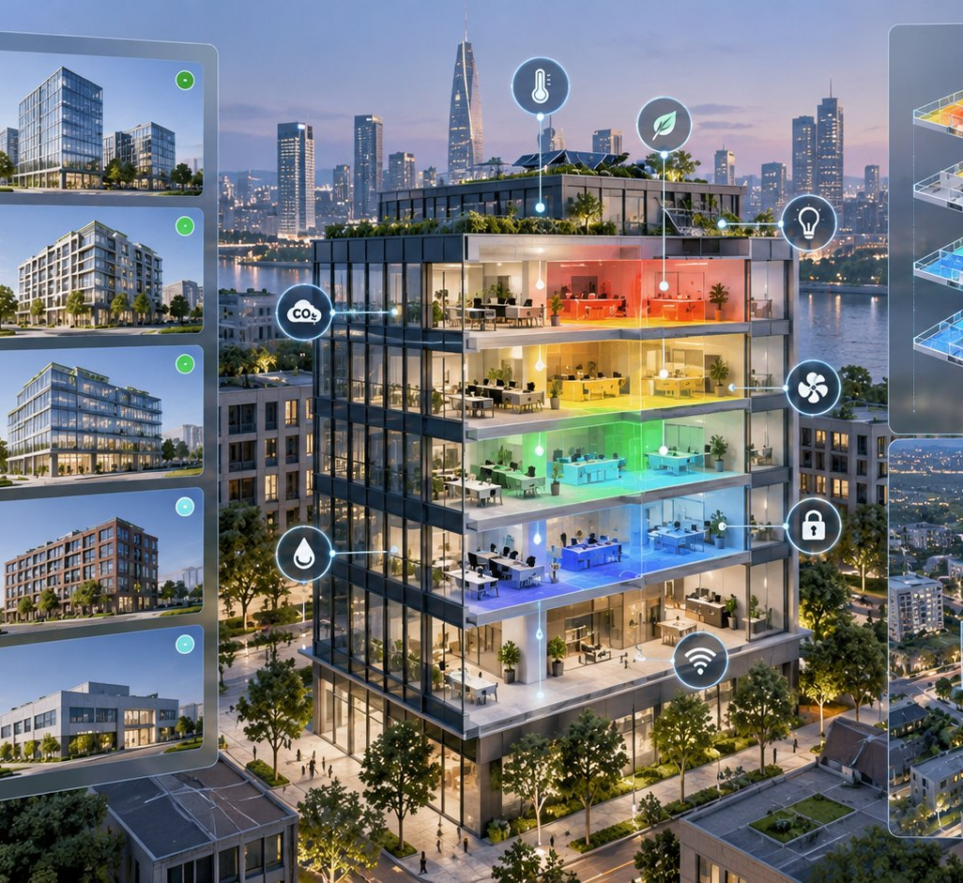
PoC Data Model
Engineering-realistic synthetic data enables the demonstration before live customer data is available
City
Top-level model designed for campus and district scaling
Site
Building portfolio and operating context
Building
Energy, cost, carbon and alarm data
Floor / Zone
HVAC, occupancy, indoor air quality and comfort detail
Meter / Sensor
Time-series data and measurement reliability
Demo building: 12,500 m² office, four floors, HVAC, lighting and equipment loads, PV generation, outdoor temperature, occupancy and controlled anomalies.
Smart Building & Energy • Challenge Deck • 7

Slide 8
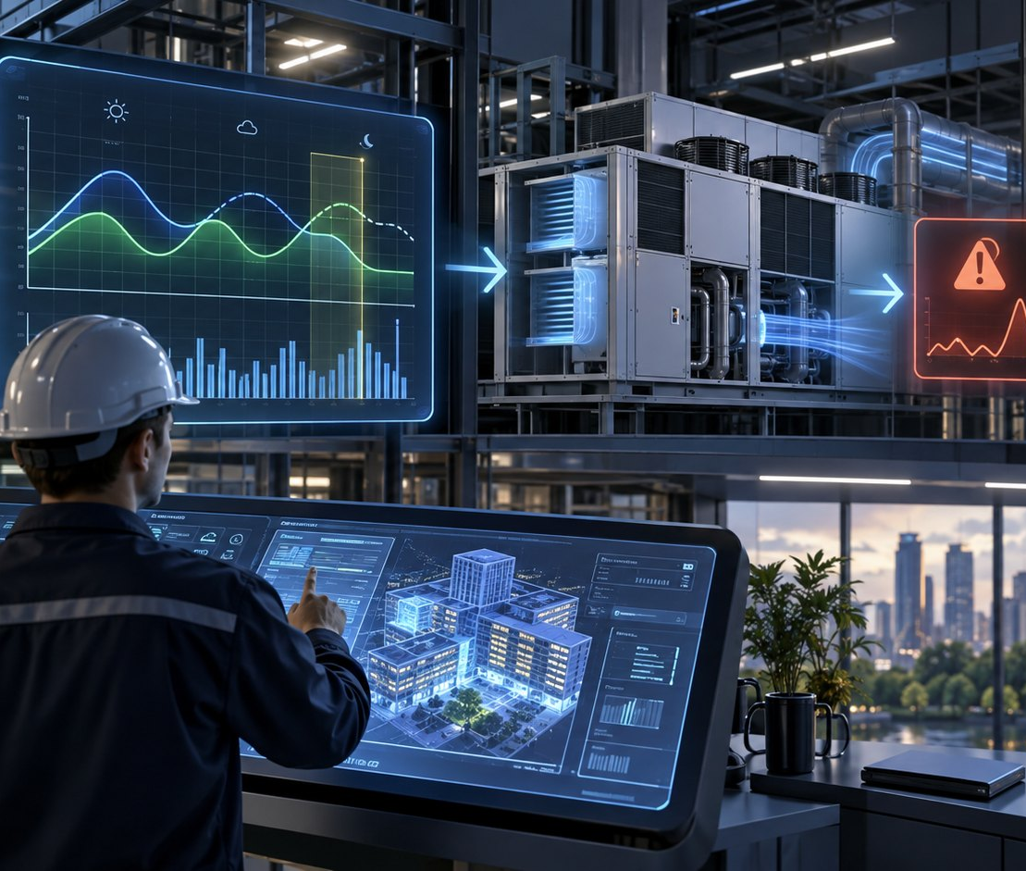
Deterministic Engine + AI
A trusted calculation engine generates the results. AI explains, compares and recommends actions.
CLEAR RESPONSIBILITIES
A
Deterministic Energy Engine
Calculates kWh, kWh/m², peak demand, cost, CO₂ and baselines
B
ML / Analytics Engine
Produces forecasts, anomaly and pattern detection, and confidence scores
C
AI Energy Copilot
Explains calculated results, recommends actions and shows supporting evidence
Core principle: AI does not invent calculations. It translates validated analytical results into clear guidance.
Smart Building & Energy • Challenge Deck • 8

Slide 9
Challenge MVP Screens
The broader product vision remains intact while the application demonstrates the critical workflow
01
Executive Dashboard
02
Building Energy View
03
AI Forecast
04
Anomaly Detection
05
Optimization Recommendation
06
Building Digital Twin
07
Scenario Lab
08
AI Energy Copilot
V1 scope: dashboard, forecast, anomaly detection, recommendation and scenario analysis. Retrofit support and district scaling follow in the next phase.
Smart Building & Energy • Challenge Deck • 9

Slide 10
Application Positioning
One product with emphasis tailored to each challenge
Primary angle
Smart Building & Energy
Energy monitoring, forecasting, anomaly detection and optimization
Technology angle
AI + Building Digital Twin
Digital twin as visualization and scenario layer
Business angle
Pilot-ready decision support
Municipality, campus, hospital, university or business park pilots
Expansion angle
Building to Campus to District
Positive Energy District and Smart City roadmap
Challenge pitch: AI-Powered Smart Building & Energy Intelligence Platform
Smart Building & Energy • Challenge Deck • 10

Slide 11
Development Roadmap
Progress from the challenge demo to a pilot-ready product
Stage 0
Stage 1
Stage 2
Product Architecture
Knowledge Mapping
Demo Data + Engine
Scope, data model, calculation ownership, demo story
Map the research corpus to product functions, models, formulas and retrieval sources
Synthetic data, KPIs, baselines, forecasting and anomaly detection
Stage 3
Stage 4
Stage 5
Premium MVP UI
Challenge Package
Pilot Readiness
Dashboard, twin, scenario lab, copilot
B2Match profile, pitch, demo video and one-page brief
Live building data adapter and reporting
Smart Building & Energy • Challenge Deck • 11

Slide 12
Smart Building & Energy
Our research base is becoming a Smart Building & Energy Challenge PoC.
Next deliverable: B2Match profile + 200-word solution pitch + 8-screen demo scope
Barcelona • SCEWC26 • Open Innovation Challenge

Slide 13
DRIVE SOURCE ANALYSIS
Key Findings from the Research Base
The Smart Building & Energy direction is supported by the technical research corpus.
Energy is the core problem
Building is the right starting point
Smart-city research consistently links energy management with IoT, smart metering, forecasting and integrated infrastructure.
A building provides a measurable and demonstrable starting point with clear energy-saving KPIs before scaling to a city.
Integration beats isolated devices
AI must be actionable
Smart-building systems create value when heating, cooling, lighting, renewables and sensor data work together.
AI should support forecasting, anomaly detection, root-cause analysis and practical energy actions.
Scale path is clear
The path from building to campus, district and city aligns with the research focus on integrated systems and data.

Slide 14
KNOWLEDGE-TO-PRODUCT MAP
Research Evidence Mapped to Product Modules
The evidence base shows which sources support each product component.
Source
Technical Theme
Product Component
Energy & Sustainable Development in Smart Cities
Energy management • IoT • smart metering • forecasting
Energy Engine + Forecasting
Smart Power for Smart Home
Load disaggregation • peak demand • PV/storage • simulation
Load Intelligence + What-if
CEDIA Smart Home Infrastructure
Heating/cooling/lighting • renewables • occupancy/temp/air quality
Smart Building Data Model
Smart Cities and Smart Homes
Sensing → communicating → processing → applying
Product architecture
Schneider Urban Efficiency
Step-by-step system integration • measurable savings
Scaling & pilot strategy
EC / McKinsey Digital Transformation
AI • data platforms • trustworthy AI • climate digital solutions
EU challenge positioning
Product decision: The digital twin remains the visualization and scenario layer.
Energy intelligence and peak-load optimization form the core product.

Slide 15
MVP REFINEMENT
Refined Challenge MVP
Research analysis shifted the priority from a digital-twin showcase to measurable energy-intelligence value.
P0 — Core Workflow
P1 — Vision in the Pitch, Second Product Phase
•
PV / Battery Optimization
Energy Dashboard
Smart Meter / Sensor Data
HVAC & Load Breakdown
•
Building Digital Twin
Energy Forecast
Peak Demand Prediction
Anomaly Detection
•
Retrofit Advisor
AI Optimization Recommendation
What-if Scenario Engine
AI Energy Copilot
Roadmap — Controlled Expansion to Smart City Scale
•
Campus Energy Management
•
Positive Energy District
•
City Integration
Positioning: An AI-powered energy intelligence platform that starts with one building and scales to campuses and districts.

Slide 16
PITCH INTEGRATION
Research Summary
Smart Building & Energy Intelligence Platform
The research base strongly supports this direction. Energy management is a core smart-city challenge, and smart buildings depend on integrated heating, cooling, lighting, renewable generation and sensor data. Effective transformation begins with measurable improvements at building level before expanding to campus, district and city scale. The Challenge PoC therefore focuses on energy monitoring, forecasting, peak-demand prediction, load breakdown, anomaly detection, optimization recommendations and what-if scenarios. The digital twin provides visualization and scenario analysis, while AI explains deterministic calculations and recommends practical energy actions.
Core message: We turn building energy data into trustworthy, explainable and actionable decisions.
Energy
AI
IoT
HVAC
Peak Load
What-if
Digital Twin

