Slide 1
APP MORADA
Yereli Rolander
Adriana García (s)
Centro Interdisciplinario de Derechos, Infancia y Parentalidad A.C
México
Leveraging social media, gaming, radio, and YouTube for education, networking, and employment
February 22nd, 2024. Time: 9:00 -11:00
Notes:
Please add your notes here.
Morada APP: Inclusive technological tool for the prevention and attention to violence against women; Yereli Rolander, Adriana García; Centro Interdisciplinario de Derechos, Infancia y Parentalidad A.C, México, Name of Session (as written in Agenda)
#ZeroCon24
Day and Time of Session

Slide 2
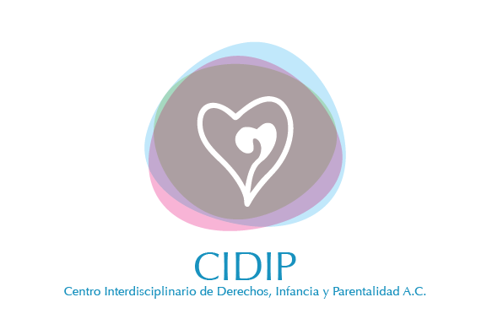
Centro Interdisciplinario de Derechos, Infancia y Parentalidad A.C.
We are an organization that was founded in 2017.
We promote respect, guarantee and exercise of the human rights of girls, adolescents and women from an intersectional approach.
We promote the participation and leadership in all processes and actions.
We are the only organization in Mexico that has a gender, disability and violence program.
Notes:
Presenting four points regarding the work of our organization. Image: CIDIP A.C. logo.

Slide 3
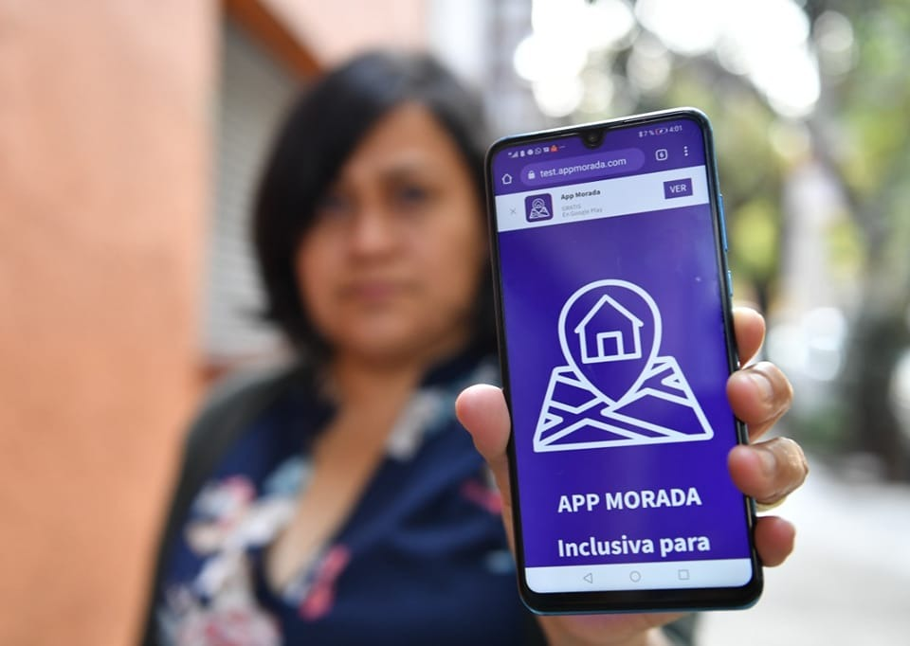
MORADA APP
It is a free inclusive App for the prevention and attention of violence against women. The application is designed in accessible formats, has web accessibility and is aimed especially for women with diverse disabilities.
Notes:
Presenting the object of the morada application. Image of the Morada app.

Slide 4
BACKGROUNDAPP MORADA
The Morada App was created in the midst of a pandemic when rates of gender-based violence in Mexico were at an all-time high.
It was developed in response to the project on obstetric violence against women with disabilities conducted in 2019 in which 100% of the participants reported having suffered violence at some point in their lives.
The first survey on violence against women with disabilities in Mexico was conducted to develop the App according to the needs of women with disabilities.
Notes:
Presenting the background of the Morada APP, highlighting its design and implementation in the pandemic, as well as its response to the rates of violence against women with disabilities.

Slide 5
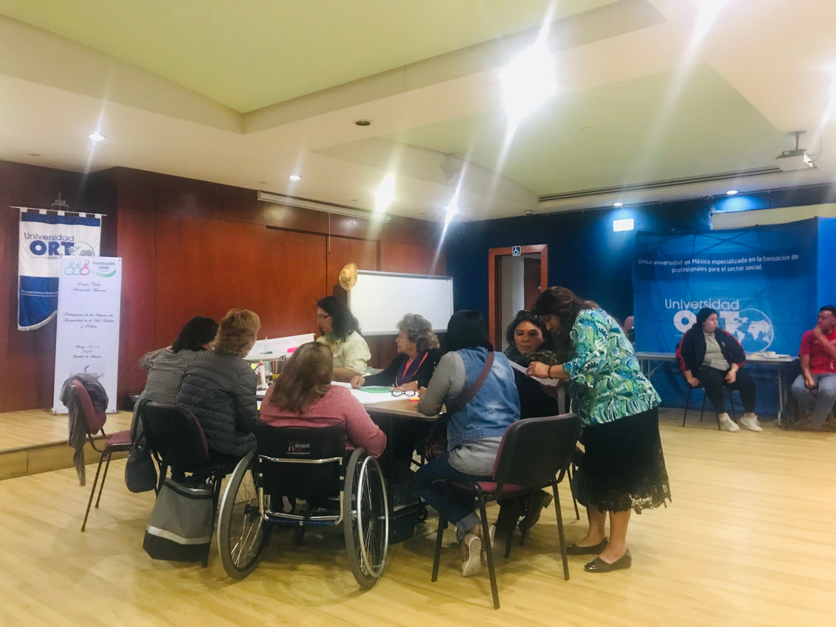
Problems Targeted
According to surveys, 72.6% of women with disabilities in Mexico experience violence, but are invisible to laws, public policies, and government budgets, 98 per cent do not report it to authorities.
Notes:
The target problem is presented: the violence experienced by 72.6% of women with disabilities in Mexico. Image of a pilot group of women with disabilities.

Slide 6
Solution and innovation
Morada App was developed in 2020 with the active participation of women with different disabilities and evaluated by the women themselves in pilot groups.
It is fully accessible and complies with the Web Content Accessibility Guidelines 2.1 Level AA standard.
It has a screen reader, pictograms, easy readability, all content is in videos in Mexican Sign Language and offers targeted support for women with and without disabilities who are victims of gender-based violence.
A 24/7 video call-hotline is available and supported by Mexican Sign Language, providing women with emergency numbers or directing them to the right institutions that offer help in cases of violence.
Notes:
Solution and innovation are presented: Technological tool for the prevention and attention of violence against women with disabilities that complies with the Web Content Accessibility Guidelines 2.1 Level AA standard.

Slide 7
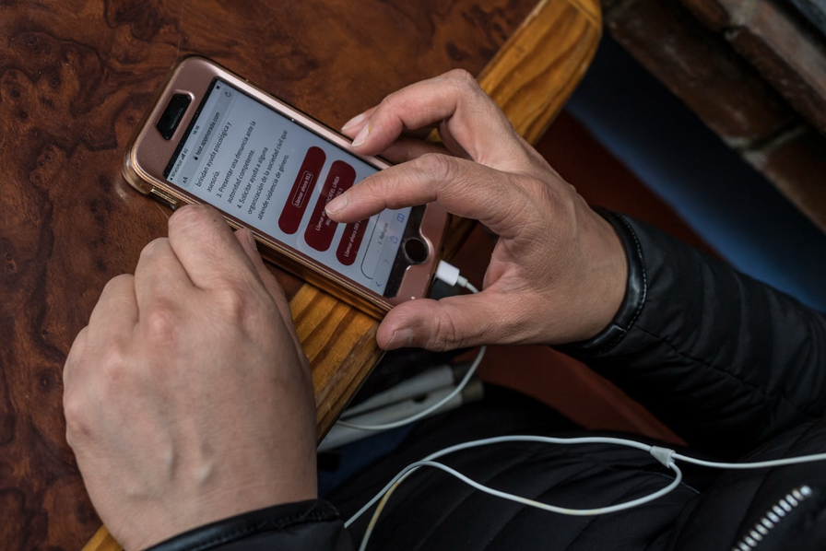
FUNCTIONS
Web accessibility Information on modalities and types of violence.
What to do in case of violence?
Emergency calls LSM (video call in Mexican Sign Language) Relay Service
Accessible violence quiz
Accessible National Survey on Partnership Violence against women with disabilities.
Notes:
The functions of the Morada APP are presented. Image of a disabled user of the Morada app.

Slide 8
IMPACT
The Morada APP has been consulted monthly by an average of 700 women.
Alliances were created with the most important association of interpreters and translators of Mexican sign language and with feminist organizations.
An assistance route was created with the with the Women of Mexico City Secretary to provide timely assistance to women with disabilities.
In 2020, 152 public servants were trained to promote an inclusive culture in the care of women with disabilities who experience gender-based violence.
They were made through the App Survey of Violence against Women with Disabilities in Mexico City 2020 and the National Survey on Violence against Women with Disabilities in the couple 2022.
In 2020, 152 public officials were trained; in 2021 three workshops were held, with a total of 164 participants; and by 2023 the Morada App Movement had 32 speakers across Mexico.
Notes:
The impact of the Morada APP is presented: In 2020, 152 public officials were trained; in 2021 three workshops were held, with a total of 164 participants; and by 2023 the Morada App Movement had 32 speakers across Mexico.

Slide 9
Financing, sustainability, challenges
App Morada is financed by public funds and member contributions. The development of App Morada in 2020 was financially supported by the with the Women of Mexico City Secretary, and the 2021 update by the Institute for People with Disabilities in Mexico City.
Funding from the United Nations Trust Fund to Eliminate Violence against Women is available to implement the Morada App in two more Mexican states. The challenges are enormous since it is necessary to have more funding to achieve a nationwide mapping and implement the application in each entity according to the system of violence.
Notes:
Presenting financing, sustainability, challenges

Slide 10
Project's next steps
The Response Mechanism in Mexico for the attention of violence against women with disabilities will be implemented on 2024- 2026.
The mechanism will improve, update and expand the coverage of the Morada App in two more Mexican states, Nuevo León and Querétaro, in addition to training for public servants of the state systems of violence.
The implementation of a toolbox on gender and disability.
The creation of a standardized protocol for the attention of women with disabilities who are victims of violence, and the strengthening of the Sorydisca network.
Notes:
Presenting Project's next steps: the Response Mechanism for the attention of violence against women with disabilities in Mexico .

