Slide 1
Reporting Disability Inclusion within ESG Frameworks
Anna Herzog
myAbility Social Enterprise
Austria
ESG, Circular Economy and DisAbility Inclusion
05.03.2025 17:00
Notes:
Please add your notes here.
Title; First name, last name of speaker(s); Name of Organization, Name of Country, Name of Session (as written in Agenda)
#ZeroCon24
Day and Time of Session

Slide 2

Anna Herzog (she/her)
Solutions Lead at
myAbility Social Enterprise
anna.herzog@myAbility.org
Notes:
Sample Slide: presenting three points on our project and the relationship to this year’s theme of the Zero Project Conference. Point 1; Point 2; Point 3 connect together in this way.

Slide 3
Benefits of Measuring and Reporting
Disability Inclusion within ESG Frameworks
KPIs will highlight the importance of disability inclusion within social sustainability & ESG.
Standardized external reporting ensures quality of information, transparency, comparability and credibility.
Standardized internal reporting supports strategy monitoring and increases efficiency of measures.

Slide 4










Disability Inclusion KPIs for ESG Reporting: our holistic approach
Representation
Accessibility
Awareness & Competence
HR & Recruiting
Network

Slide 5

Best Practice: Representation
Specify representation of people with disabilities at management level.
Ensure regular and transparent reporting of representation KPIs for (hiring) managers.

Slide 6
Best Practice: Accessibility
Include offers on flexible workplaces as well as flexible working hours.
Specify the accessibility of process for workplace adjustments and how this offer is communicated.

Slide 7
Best Practice: Awareness & Competence
Include target group of trainings and whether they are voluntary or compulsory.
Conduct Impact Analysis of training measures to make changes in the perception and thinking of the participants visible.

Slide 8
Best Practice: HR & Recruiting
Specify ways of contact for accommodation needs during the recruiting process.
List measures to increase (digital) accessibility along the recruiting process.

Slide 9
Best Practice: Network
Include resources for employee network / ERG (e.g. sponsorship, % of working time).
Specify mission and scope of action for employee network / ERG.

Slide 10
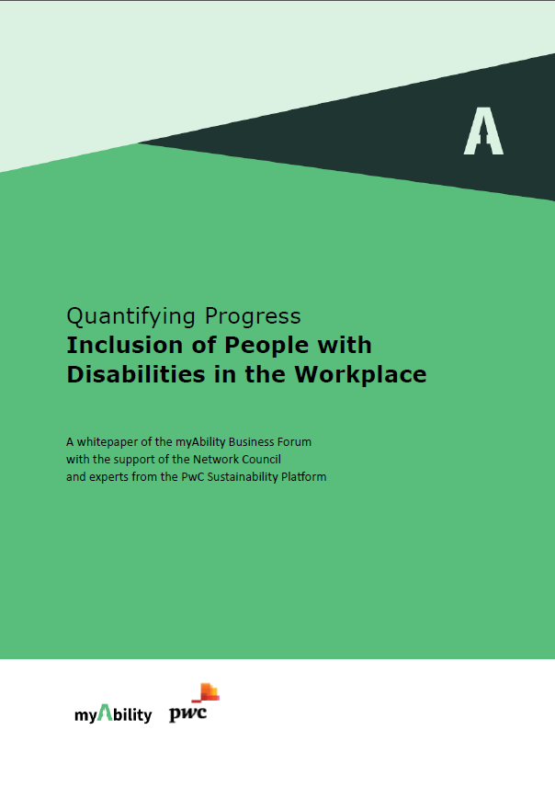
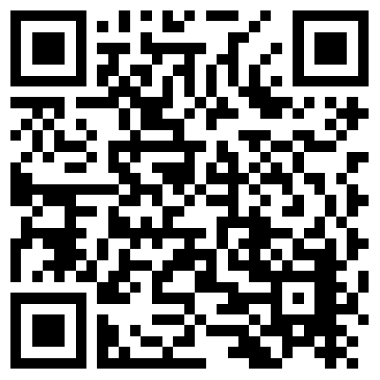
Find more details in our whitepaper!
Whitepaper „Quantifying Progress: Inclusion of People with Disabilities in the Workplace“
Download now!
https://www.myability.org/en/knowledge/whitepaper-esg-reporting-inclusion

