Slide 1
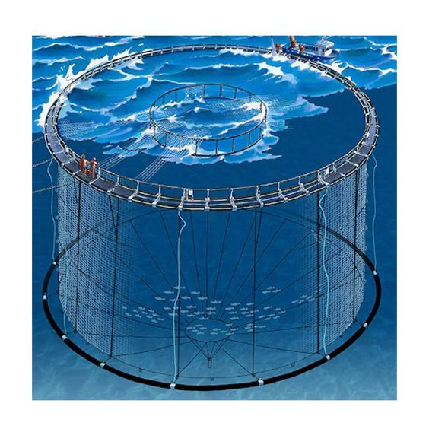
Automating Aquaculture: HDPE Fish Cages with AI
Introducing Constantnople, a groundbreaking startup developing an innovative AI-powered HDPE fish cage system to transform aquaculture. We are addressing the rising demand for sustainable seafood production by offering a data-driven solution that optimizes fish health, maximizes yield, and minimizes environmental impact.
BB
by Boniface Wainaina

Slide 2
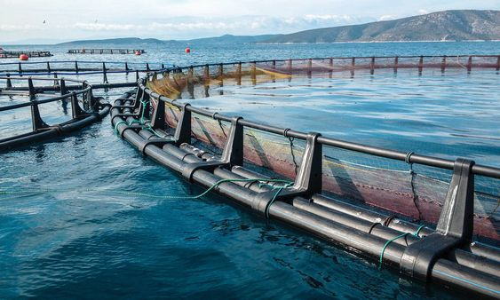
Company Overview: Constantnople
Our mission is to empower fish farmers with the latest technology to enhance their operations. We leverage cutting-edge AI and IoT to monitor fish health, optimize feeding strategies, and predict potential challenges proactively. Our system provides real-time insights and alerts, enabling farmers to make data-informed decisions for greater efficiency and sustainability.
Sustainable Aquaculture
Our AI-powered fish cage system fosters sustainable aquaculture practices by reducing waste, minimizing environmental impact, and ensuring optimal fish health.
Enhanced Productivity
Our system optimizes feeding and water quality, resulting in faster fish growth, improved yield, and increased profitability for fish farmers.
Data-Driven Insights
Real-time data collection and analysis provide valuable insights for proactive management, disease prevention, and optimization of fish farming operations.

Slide 3
Product & Services: AI-Powered HDPE Fish Cage System
Our flagship product is an AI-powered fish cage system that integrates advanced sensors, underwater cameras, and a cloud-based platform. It provides comprehensive monitoring and management capabilities, empowering fish farmers to optimize every aspect of their operations.
Hardware
Software
AI & Machine Learning
Our system consists of robust, durable fish cages equipped with sensors for real-time data collection, including water quality parameters (temperature, salinity, dissolved oxygen), fish health indicators, and environmental conditions.
The cloud-based software platform seamlessly integrates with the hardware, providing a user-friendly interface for data visualization, analysis, and management. Farmers can access real-time data, receive alerts, and make informed decisions.
Our AI algorithms analyze the collected data to identify trends, predict potential challenges, optimize feeding strategies, and provide actionable insights for improved efficiency and sustainability.

Slide 4
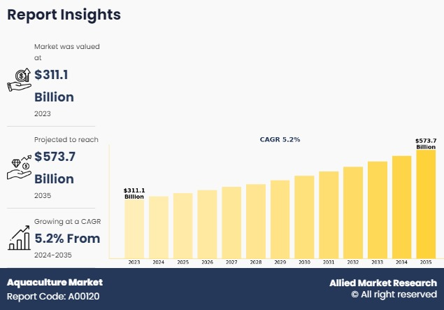
Market Opportunity: Global Aquaculture Market
The global aquaculture market is experiencing rapid growth, driven by increasing demand for seafood, concerns about overfishing, and the need for sustainable food sources.
TAM
The total addressable market represents the potential market size for our product, encompassing all aquaculture operations globally.
SAM
The serviceable addressable market focuses on the specific segment of aquaculture operations that are amenable to our AI-powered fish cage system, considering factors like farm size, location, and technology adoption.
SOM
The serviceable obtainable market represents the specific portion of the SAM that we can realistically capture within a defined timeframe, taking into account competitive landscape, market penetration strategies, and available resources.

Slide 5
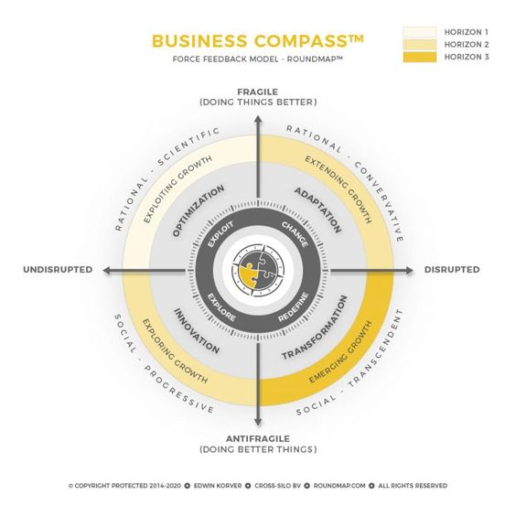
Business Model: Revenue Generation
Our revenue model is based on a combination of subscription fees and hardware sales. We offer flexible subscription plans tailored to different farm sizes and needs, providing ongoing access to our software platform, AI insights, and customer support.
1
Subscription Fees
Monthly or annual subscription fees for access to the software platform, AI analytics, and customer support.
2
Hardware Sales
Sale of the AI-powered fish cage system, including sensors and other equipment, to individual fish farmers.
3
Data Analytics Services
Offer customized data analysis services to fish farmers, providing in-depth insights and recommendations for improved efficiency and sustainability.

Slide 6
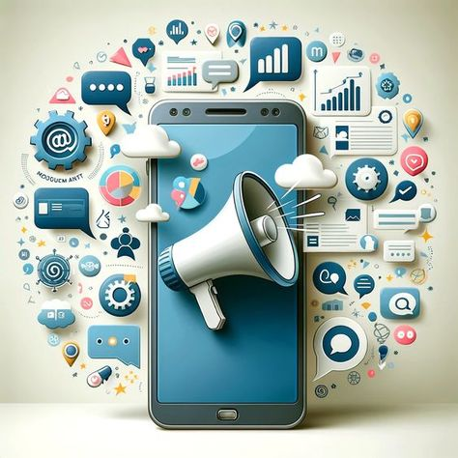
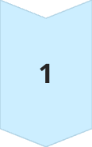
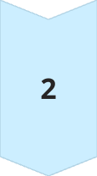
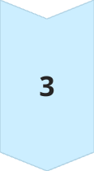
Competitive Landscape: Key Players & Advantages
We have identified several key competitors in the aquaculture technology space, including companies offering traditional monitoring systems, software-only solutions, and other AI-powered systems.
Traditional Monitoring Systems
Offer basic sensor data collection and limited analysis capabilities, lacking AI-powered insights and automation features.
Software-Only Solutions
Provide software-based analytics and management tools but require integration with existing hardware infrastructure, potentially limiting scalability and compatibility.
Constantnople: AI-Powered Fish Cage System
Offers an integrated hardware and software solution with advanced AI capabilities, providing comprehensive monitoring, analysis, and automation features for optimal efficiency and sustainability.

Slide 7
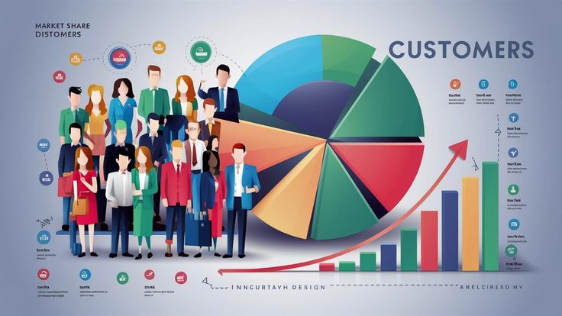
Go-to-Market Strategy: Customer Acquisition & Scaling
Our go-to-market strategy focuses on targeted customer acquisition, leveraging a multi-channel approach to reach potential fish farmers and showcase the value of our AI-powered fish cage system.
1
Target Market
We are targeting commercial fish farmers, aquaculture companies, and research institutions seeking to improve efficiency, sustainability, and profitability.
2
Marketing & Outreach
We will utilize digital marketing, industry events, and partnerships to raise awareness, generate leads, and build relationships with potential customers.
3
Sales & Distribution
We will establish a direct sales team and partner with aquaculture equipment distributors to expand reach and secure sales.
4
Scaling & Growth
We will focus on continuous product development, expansion into new markets, and strategic partnerships to achieve sustainable growth and
market leadership.

Slide 8
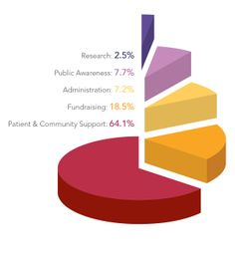
Ask Amount: Funding for Growth & Expansion
We are seeking 10M KES to accelerate the development and deployment of our AI-powered fish cage system, expand our market reach, and solidify our position as a leader in sustainable aquaculture technology.
Product Development
Marketing & Sales
Team Expansion
Research & Development
Fund further development of the AI-powered fish cage system, including advanced sensor integration, enhanced AI algorithms, and user interface improvements.
Invest in targeted marketing campaigns, industry event participation, and sales team expansion to accelerate customer acquisition and market penetration.
Hire additional engineers, data scientists, and marketing professionals to support product development, research, and business operations.
Fund ongoing research and development efforts to explore new AI applications for aquaculture, improve system performance, and enhance sustainability features.

Slide 9
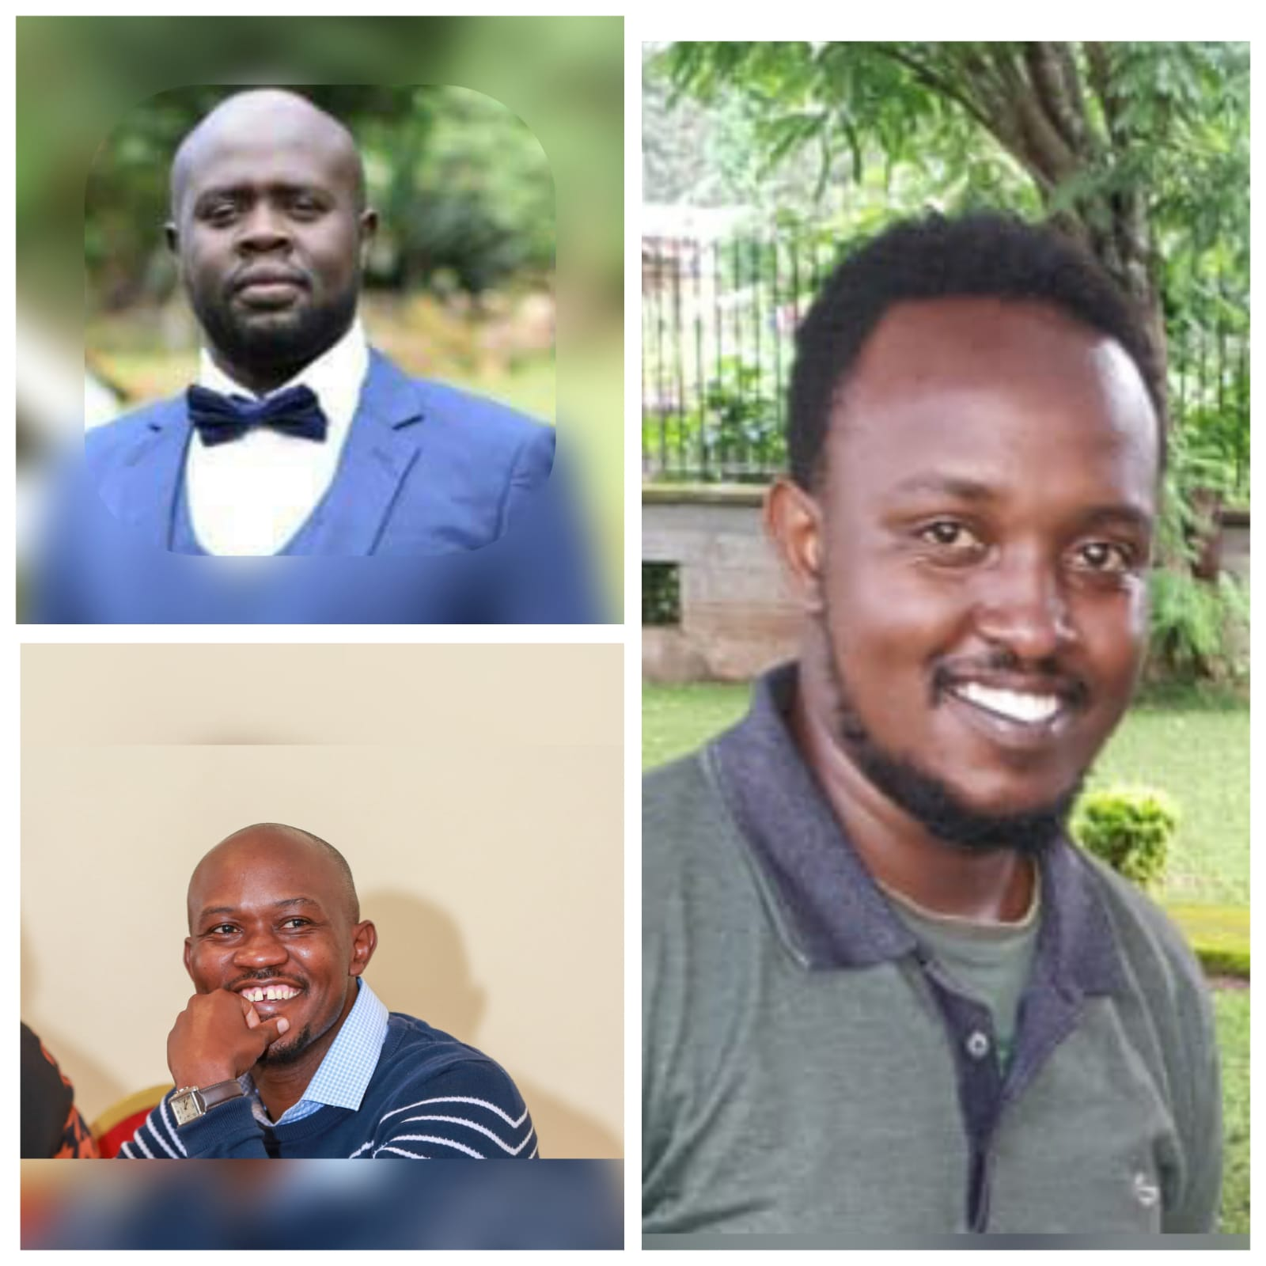
Our Team: Passionate Leaders & Experts
Our team is comprised of experienced professionals with a passion for aquaculture and a deep understanding of AI and IoT technologies. We are driven to create a sustainable future for seafood production and empower fish farmers with the tools to succeed.
Boniface Wainaina
Founder 1
Expertise in Accounting and software development.
Titus Kipkorir
Founder 2
Expertise Chemical Engineering and Water Engineering.
Dennis Ngura
Founder 3
Expertise in Purchasing and Supplies Management and Accounting

Slide 10
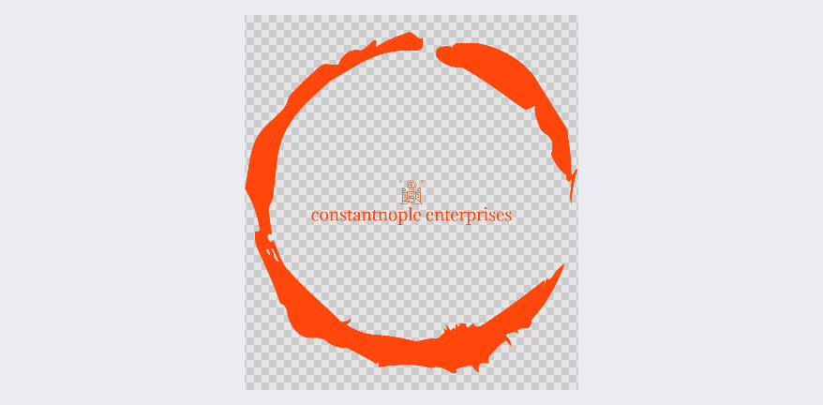
Thank You: Contact Information
P.O BOX 715-200 Nairobi, Kenya
Mobile: 0728483950/0106388597
Email: constantnenterprise@gmail.com

