Slide 1
First pancake
Tim van Wijk
Pirmas blynas
Small organizations as inclusion champions
March 5th 14:00
Notes:
Tim van Wijk; Pirmas blynas; Lithuania; Small organizations as inclusion champions; #ZeroCon25 March 5, 14:00

Slide 2
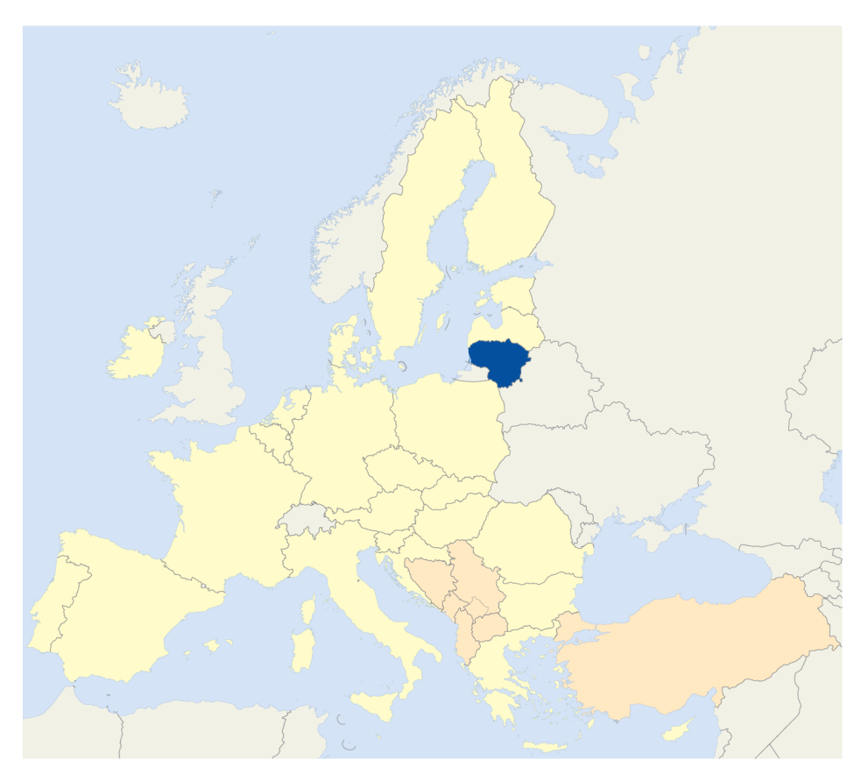

Lithuania
Notes:
Lithuania is in the center of Europe

Slide 3
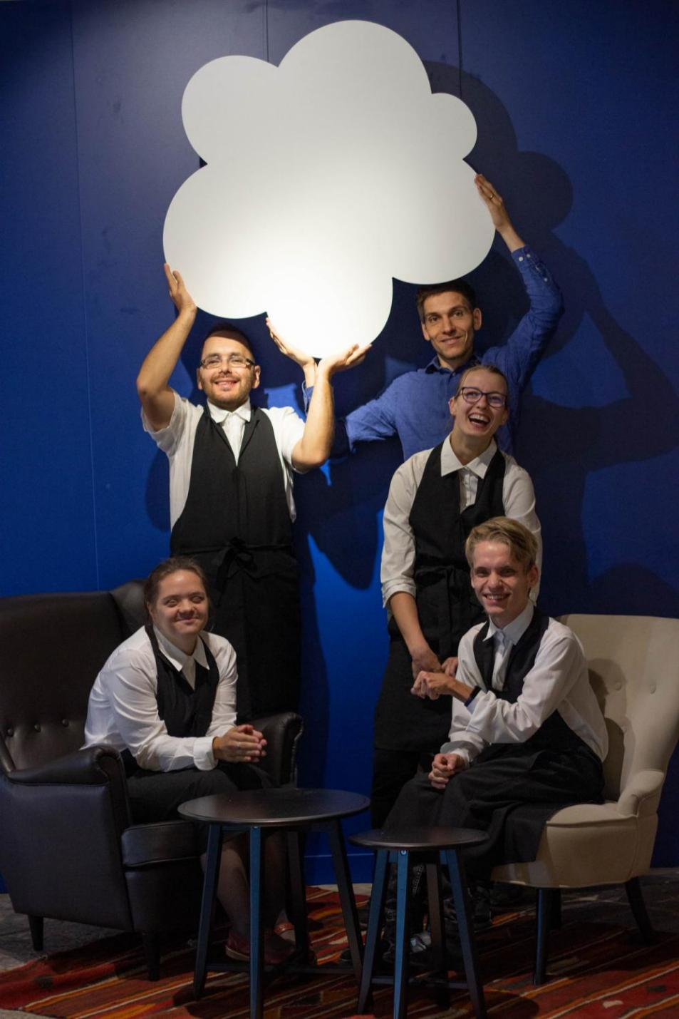
2018 we opened our doors The first such restaurant in the Baltic states
Pancakes on the menu 70% of our employees have a disability When we opened we did not receive any subsidies
Social restaurant Pirmas Blynas
Notes:
in 2018 we opened the doors of our social restaurant The first such restaurant in The Baltic states We have pancakes on the menu 70% of our employees have a disability When we opened we did not receive any subsidies

Slide 4
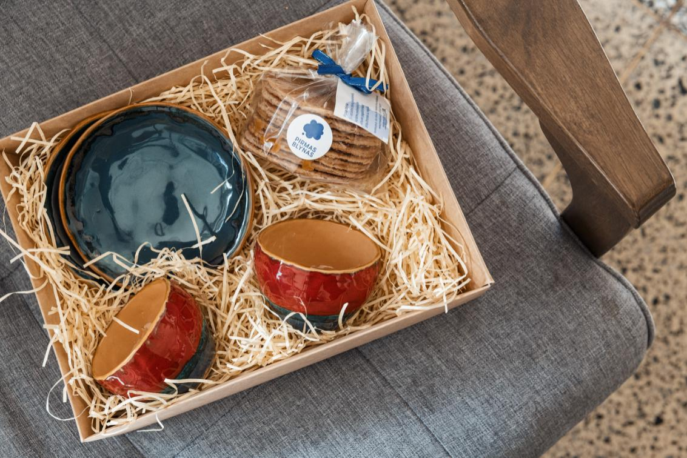
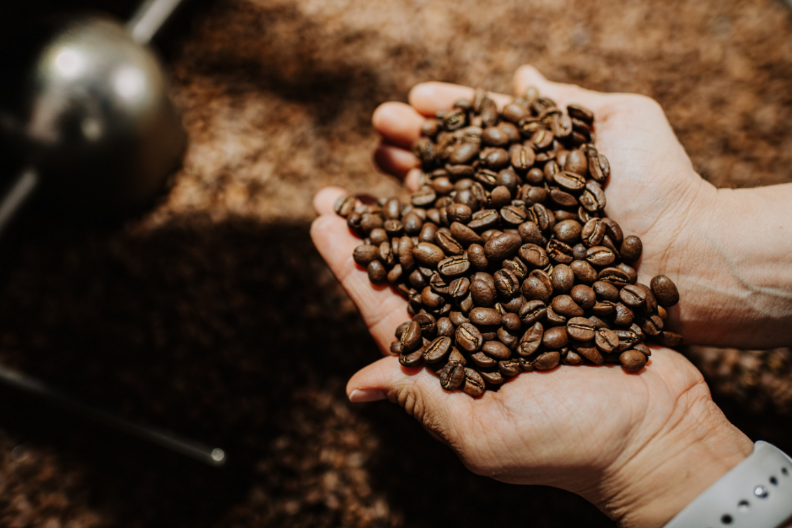
Christmas presents
- Good for business - Good for our social goal - Extra skills training
Notes:
Christmas presents They are good for business Good for our social goal Good for extra skills training of our employees

Slide 5
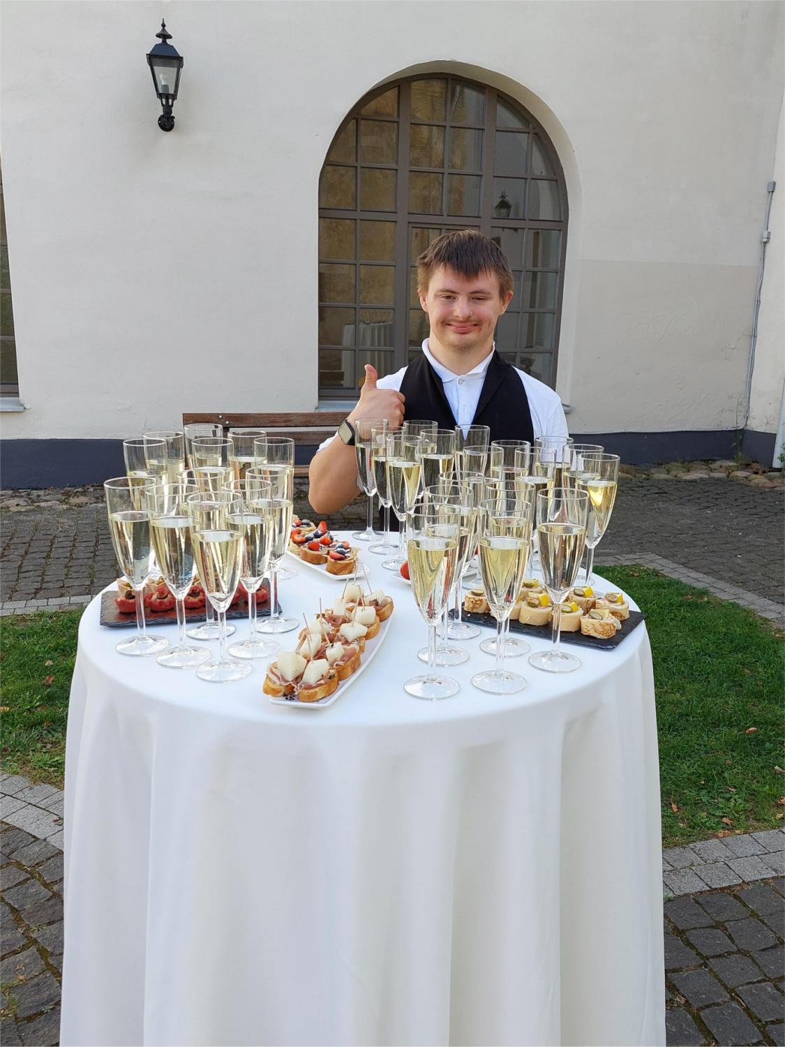
Other activities
Cooperation with other social organizations
Lessons about Down syndrome for school children Champagne tables after weddings Lunches on location Group celebrations
Notes:
Cooperation with other social organizations Lessons about Down sindrome for school classes Champagne tables after weddings Lunches on location Group celebrations

Slide 6
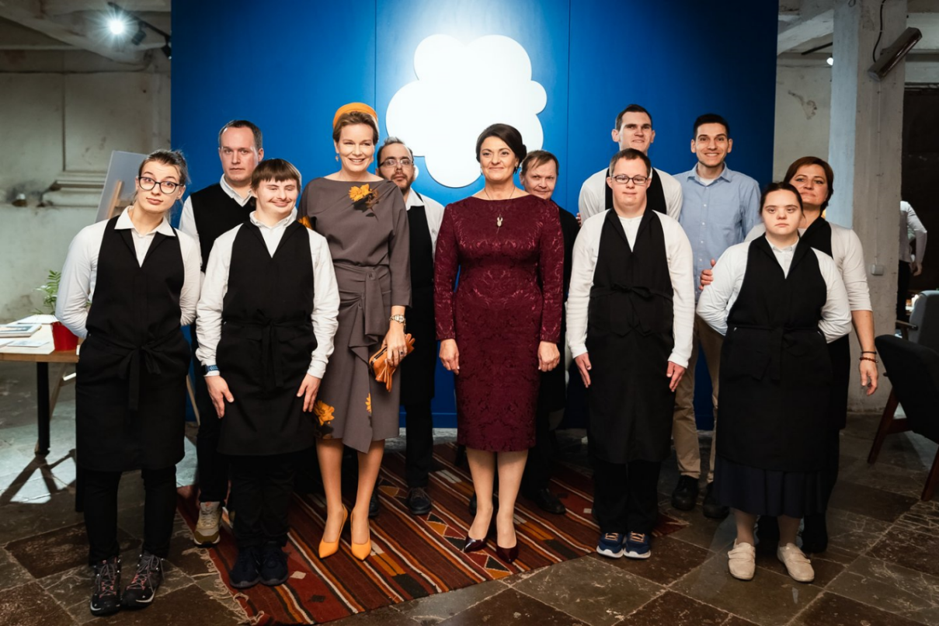
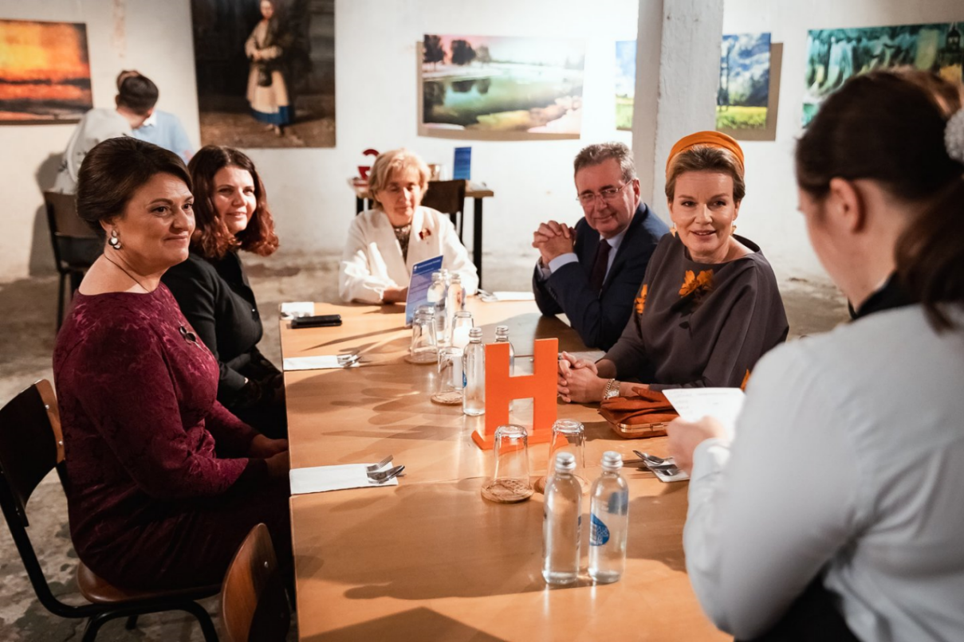
Achievements
Self-sustainable
We train 15 interns
Awards
Notes:
Achievements We became a sustainable social restaurant We now also train 15 inters in working skills We received multiple award for our activities, from the city, from the country and now also international

Slide 7
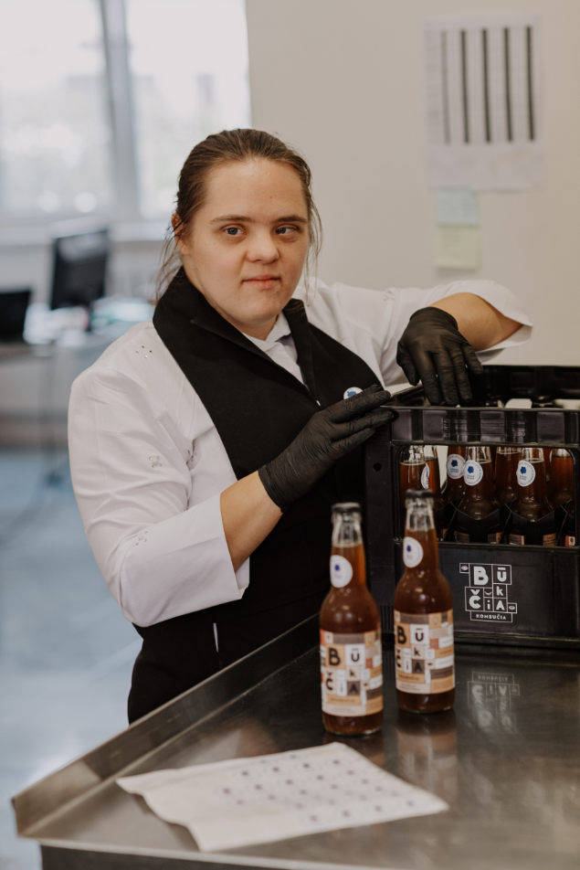
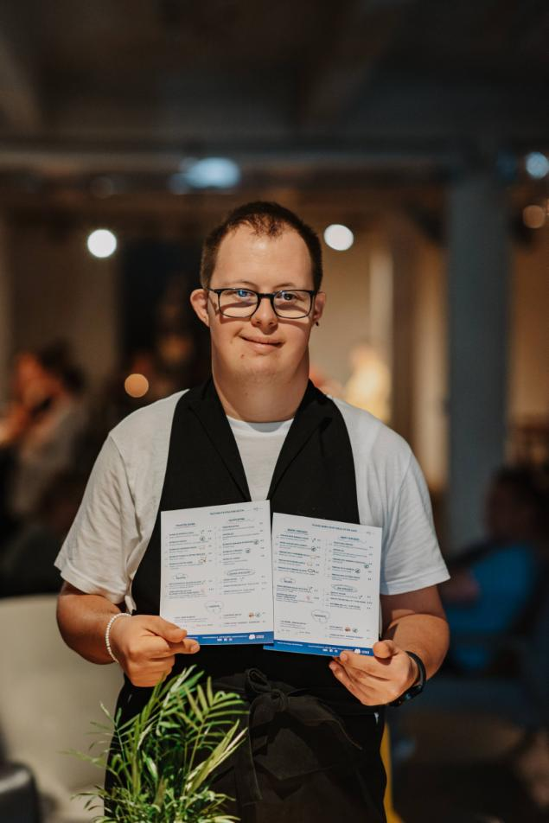
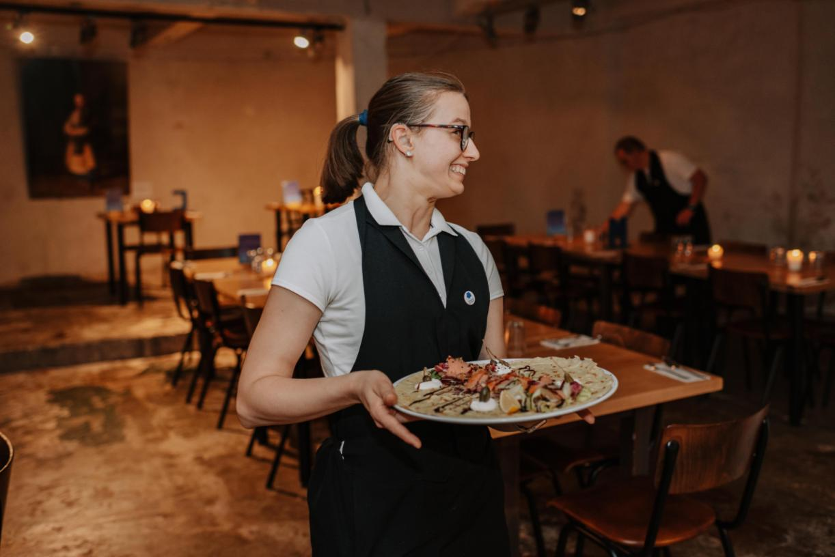
Our employees
Notes:
We are very proud of the awards, but most proud we are of our employees. They overcame so much to reach what they have reached now.

