Slide 1

PRESENTER FULL NAME: Cosmin H. Nadaban
ORGANIZATION: Future Energy Motors
WORKSHOP NAME: Smart Mobility / Smart and Renewable Energy
E-MAIL: cosmin.nadaban@a3plus.energy

Slide 2

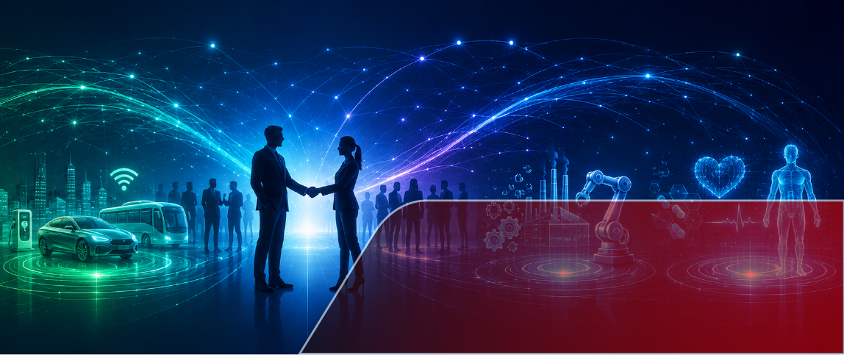
⋅ A Romanian deep-tech green hardware startup specializing in the design, modeling, and validation of next-generation electric motor and generator architectures
Description of the Organisation
⋅ Incubated by FasterCapital to accelerate global market deployment, cross-border European research cooperation, and engineering validation paths.
⋅ Headquartered in Arad, Romania, strategically positioning Eastern European engineering innovation to support the much-needed EU Net-Zero transit goals.

Slide 3


Your Teams’
Expertise
⋅ Conceptual design and multi-body physics modeling utilizing MSC ADAMS software.
⋅ Basic simulation tracking for rotational stability, safety, and core mechanical behavior.
⋅Architecture configurations for zero-emission motors and powertrain propulsion setups.
⋅ Dual-capability mapping to integrate onboard battery charging with grid energy generation.

Slide 4




Your Research Fields
Clean Power Generation, High-Torque Propulsion & Powertrain Systems
Potential-to-Kinetic Energy Conversion, Motor & Generator Co-Design
TRL 3-4 Analytical Prototyping & Physics Simulation Validation
Onboard Battery Charging, Centralized Networks & Decentralized Power Stations

Slide 5
Your On-going Projects
None / Seeking First Horizon Europe Cooperation

Slide 6
Calls: Cluster 4 (DATA-09, MAT-32) & Cluster 5 (Energy & Mobility Partnerships)
Project Idea
Project Idea: Transitioning a Potential-to-Kinetic Motor/Generator from MSC ADAMS Simulation (TRL 3) to a Lab-Validated Physical MVP (TRL 4).
Deadline Dates:
Objectives:
• Build a physical Minimum Viable Product (MVP) to validate potential-energy propulsion and mechanical torque efficiency in a clean lab environment.
• Demonstrate multi-capability features: acting as an autonomous motor, onboard vehicle battery charger, and power station generator module.
Expected Results:
• Sustainable Energy: Ultra-efficient power generation for Data Centers, Wave/Tidal systems, and Industrial Waste-Heat conversion loops.
• Clean Mobility: Fuel-free charging and high-torque propulsion adaptable for Heavy Duty Vehicles, Aviation, Ships, and Next-Gen Battery architectures.

Slide 7
Consortium – required partners
No | Expertise | Type | Country | Role in the project
01 | EU Proposal Management & Admin | University / Research Center | Any EU Member State | Consortium Coordinator; handles administrative, legal, and financial reporting.
02
03 | Industrial Power & Data Center Grid Integration | Large Enterprise / Utility Provider | Any EU Member State | End-user partner defining specifications for decentralized and centralized power stations.
04
Hardware Engineering &
Lab Testing
R&D Institute /
Academic Lab
Any EU Member State
Technical partner to build and validate the physical TRL 4 MVP in a laboratory.
Automotive Powertrains & Clean Mobility
Industrial OEM / Tier-1 Supplier
Any EU Member State
End-user partner testing potential-to-kinetic propulsion modules in heavy vehicles or marine transport.

Slide 8
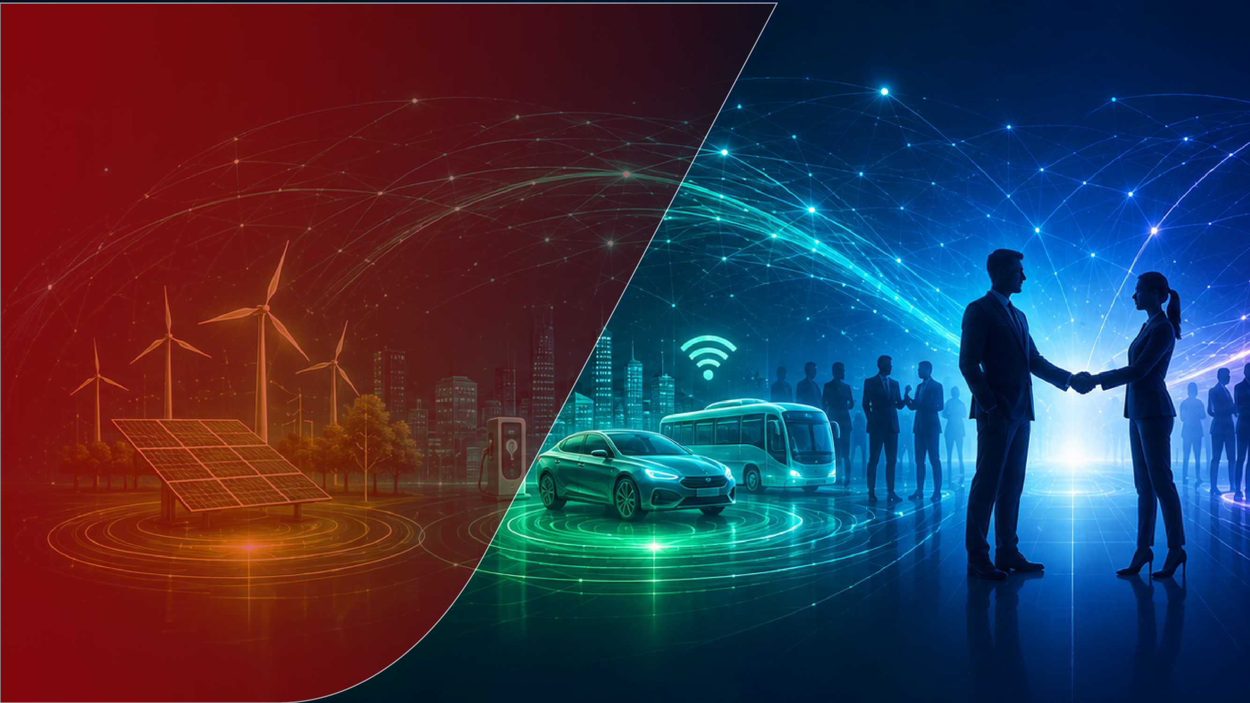
PRESENTER CONTACT
DETAILS:
Company: Future Energy Motors
Name: Cosmin H. Nadaban
Role: Founder & Technology Lead
Email: cosmin.nadaban@a3plus.energy
Web: https://www.a3plus.energy/
LinkedIn: https://www.linkedin.com/in/-cosmin-%E2%98%BC-nadaban-/
COUNTRY: Romania

