Slide 1

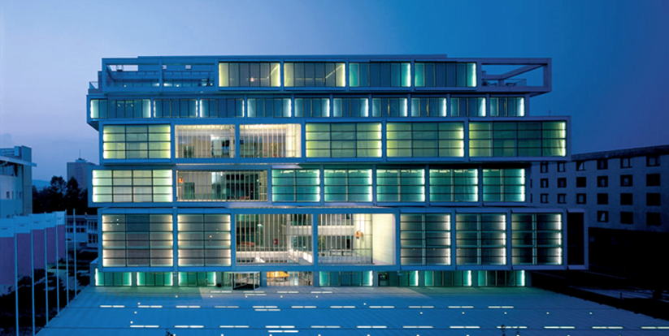








Chamber of Commerce and Industry of Slovenia (CCIS)
About CCIS
Slovenia's most influential and largest business association
Non-profit, non-governmental, independent business organisation representing the interest of its members
Member of the Economic and Social Council in Slovenia
Representative Chamber of Commerce
Social partner organization and signatory party of more than 20 branch-level collective agreements
Notes:
Main Activities
Lobbying for a business-friendly environment
Boosting the internationalisation of companies
Promoting trade
Encouraging development and innovation
Informing and educating
Promoting the best
Connecting businesses
Structure of CCIS
Members are organised within:
25 branch associations/chambers representing specific sectors of the Slovenian economy,
13 regional chambers representing regional interests.

Slide 2
Our (CCIS) specific competence
Several cross-border projects with Austria and Italy - circular economy, SME competitiveness and improved cooperation between SMEs and R&D institutions
Enterprise Europe Network (EEN) for technology and business services since 2008 (partner) and Slovenian EEN consortium (lead partner) since 2022
Section Start-up and scale-up companies at CCIS
SPOT project (Lead partner of the consortium for the Central Slovenia region)
Corpostart project (partner) - brought start-ups together with large companies to create new opportunities for start-ups
Trained staff advising both scale-ups and start-ups looking for new business opportunities, entering new markets and integrating into new value chains
Website: Chamber of Commerce and Industry of Slovenia (gzs.si)
Contacts: Petra Arzenšek (Petra.Arzensek@gzs.si), Andrej Brvar (Andrej.Brvar@gzs.si), Anja Gorše (Anja.Gorse@gzs.si)
Notes:
GZS has many years of experience with international projects. The project office supports the implementation of projects in the departments, sector associations and regional chambers of IHK. In the past three years, GZS has participated as a partner in several cross-border projects with Austria and Italy in the field of circular economy, SME competitiveness and improved cooperation between SMEs and R&D institutions. GZS has been a partner of the Enterprise Europe Network (EEN) for technology and business services since 2008 and lead partner of the Slovenian EEN consortium since 2022. With the SPOT project, GZS is lead partner of the consortium for the Central Slovenia region. Both projects have trained staff advising both scale-ups and start-ups looking for new business opportunities, entering new markets and integrating into new value chains. GZS was a partner in the Corpostart project, where we brought start-ups together with large companies to create new opportunities for startups. At the same time, we strengthen entrepreneurial skills in the PODVIG and POGUM projects and promote flexible transitions between education and the environment in high schools and primary schools.
The section Start-up and scale-up companies is an independent professional association of companies, independent entrepreneurs, natural persons, investors and actors of the supporting environment, which operate in the field of the Slovenian, European and global market and are primarily united by the need for connection, cooperation, exchange of knowledge and skills , support, as well as the creation of a strong, attractive Slovenian startup and scaleup ecosystem for investors and strategic partners. They support all start-ups and scale-ups regardless of the age of the founders/owners and the main activity of the company. It was formed in December 2022.

