Slide 1


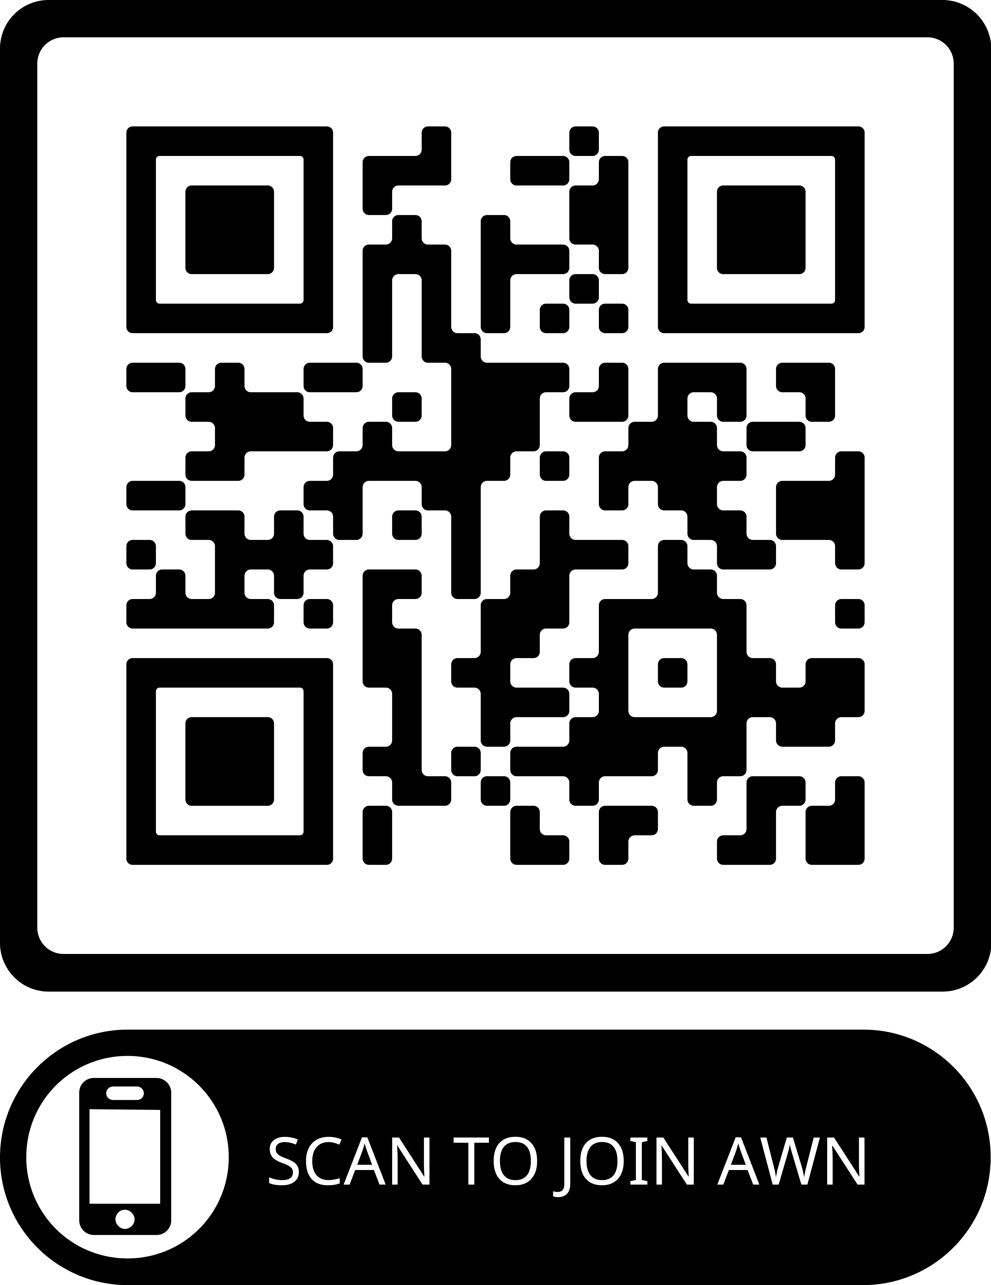

Slide 2

Mission
Vision
Create a platform that empowers and supports women across the automotive aftermarket industry by providing networking opportunities, professional development resources and a supportive community.
Our vision at AWN is to be the advocate for the advancement of women in the automotive aftermarket industry.
We envision a future where women are empowered, celebrated and represented at every level of the automotive aftermarket sector.

Slide 3

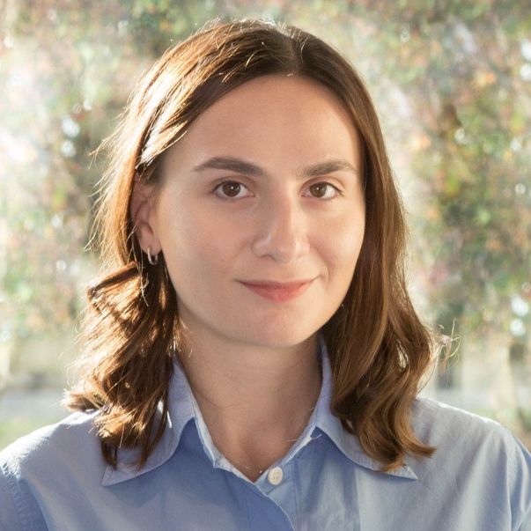
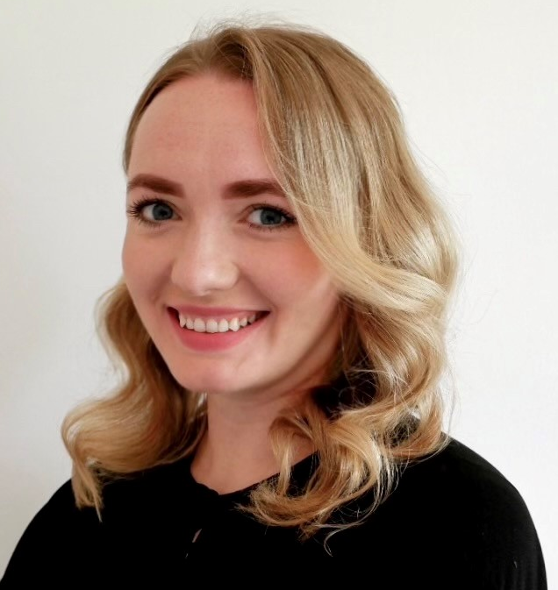
MEET THE TEAM
7 years in Automotive Aftermarket
4 years of active participation in the industry
Extensive experience in Sales and Marketing
Millennials with diverse international background
Mariam Lochoshvili
Project manager
Natalia Kushch
Project manager
Notes:
Networking Events: Host regular networking events such as meet-and-greets, mixers, or social gatherings where members can connect with each other, share experiences, and build professional relationships.
Educational Workshops: Organize workshops, seminars, or webinars on topics relevant to the automotive aftermarket industry, such as technical skills training, career development, leadership, entrepreneurship, or industry trends.
3. Recognition and Awards Programs: Establish recognition and awards programs to celebrate the achievements, contributions, and leadership of women in the automotive aftermarket, inspiring others and fostering a culture of excellence.

Slide 4


Why Join AWN?
Feeling like outnumbered during automotive networking events?
Are you eager to connect with other women in the automotive aftermarket who understand the ins and outs of our industry?
Are you looking for a community where you can help each other grow?
Want to stay ahead of the curve in the fast-paced world of automotive?
JOIN AWN TODAY!

Slide 5



What We Do:
Networking
Events
Educational Workshops
Support & Recognition Programs
Together, we aim to drive positive change, inspire innovation, and shape the future of the automotive industry for generations to come.
Notes:
Networking Events: Host regular networking events such as meet-and-greets, mixers, or social gatherings where members can connect with each other, share experiences, and build professional relationships.
Educational Workshops: Organize workshops, seminars, or webinars on topics relevant to the automotive aftermarket industry, such as technical skills training, career development, leadership, entrepreneurship, or industry trends.
3. Recognition and Awards Programs: Establish recognition and awards programs to celebrate the achievements, contributions, and leadership of women in the automotive aftermarket, inspiring others and fostering a culture of excellence.

Slide 6


How to get involved
Let's Chat

