Slide 1
Aspiration for equitable schools with high quality – compensatory actions and accountability framework
Elisabeth Högberg
The Swedish Agency for Special Needs Education and Schools
Sweden
Zero Project Policymaker Forum: Good policies from Europe on Inclusive Education
Wednesday 15.00-16.30

Slide 2
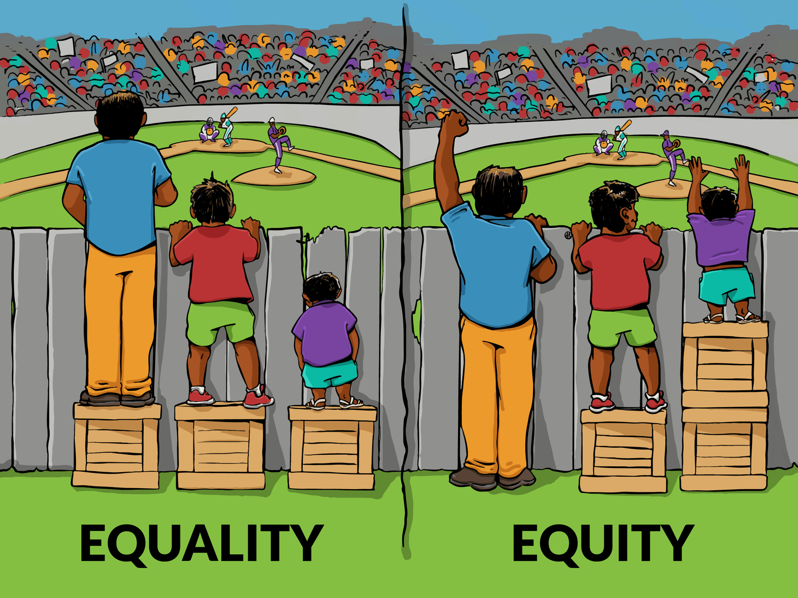
Equitable education – Inclusive education
The Education Act 2010:800 and The Curricula LGR 22
Public Investigation 2021
SOU 2021:11 Better opportunities for students to meet the knowledge requirements, active support and student health work and strengthened education for students with intellectual disabilities
How we work to innovate and support concepts of equity and quality
Det här fotot av Okänd författare licensieras enligt CC BY

Slide 3
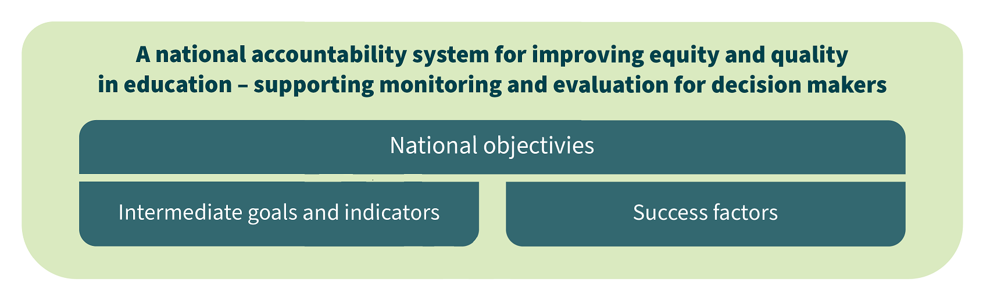
National Objectives
Intermediate Goals and Indicators
Success factors

Slide 4

Success factors for equitable high quality school development
Culture of thrust
Healthy learning environment
Compensatory measures
Competent leadership
Professional development
Monitoring and evaluation
Clear roles and responsibilities

Slide 5
Compensatory measures
Collect
Participation
What works? What doesn´t work?
Summarize
Analyse
Identify needs
Design the support
Summarize assessment
Decision of support, Action Plan
Provide support
Evaluate

Slide 6
In-school specialist provision
Working methods
Collaboration and develope-ment
Prevention, Health and Learning
Amendments in the Educational Act 2023
Working methods for prevention, intervention and compensation
Collaboration and developement
Preventive, Health and Learning

Slide 7




New swedish policy briefs based on collaboration with European Agency
We have made a policy brief how to develop our Speciallist Provision from collaboration with European Agency CROSP
We have made a policy brief on an IDE project about recommendations how digital support and inclusive education is interrelated. IDE

