Slide 1

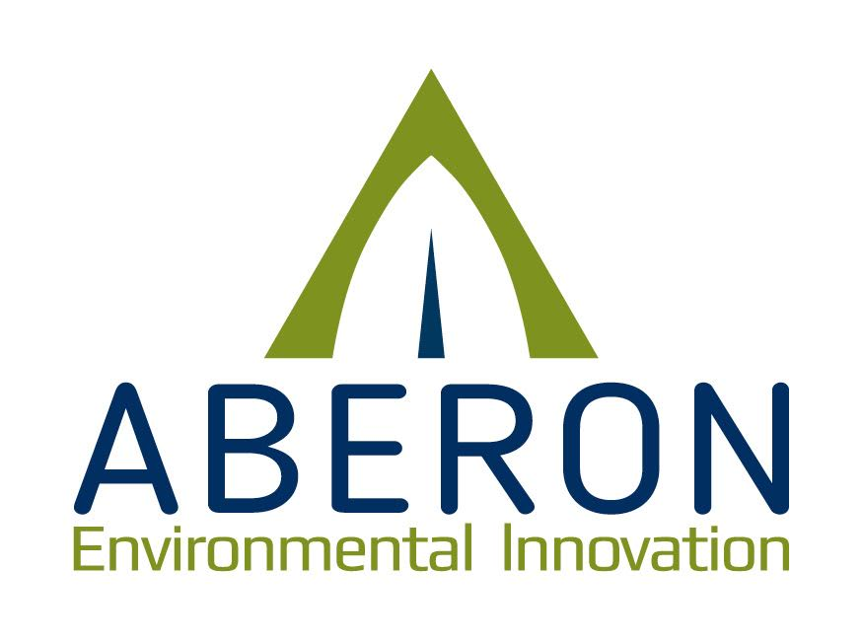
Resilient Clean Energy Microgrid Solutions (RCEMS)
Partnerships for Horizon Europe: ideas for Smart Communities projects - 7th edition
Accelerate the integration of PV systems in vulnerable communities
7 May 2025

Slide 2

Table of contents
01
02
03
04
05
06
About Aberon
Project concept
Methodology
Work packages
Partners & Pilots
Budget

Slide 3

About ABERON
The company
Portfolio
.
ABERON OOD. is a Sofia, Bulgaria based private consultancy, offering technical assistance, research, project management, education and training.
ABERON provides engineering, consulting, R&D, outsourcing, capacity building, and state-of-the-art technology services and products.
ABERON is experienced in working with both the public and private sector to design, develop, implement, and manage projects and have a large network of partners both in the country and in Europe.
ABERON partners in consortia under Horizon, LIFE, INTERREG, COST Action, and the EEA Grants.
Energy: Green transition, Renewable energy (including heating and cooling), Energy efficiency, Smart grids, Energy poverty, Energy communities' business modelling.
Environment: climatology, water & wastewater, marine and aquaculture, ecosystems services & nature, Agriculture: climate change adaptation, sustainable agriculture, LCA, precision agriculture, GIS in agriculture, agricultural waste management, natural resource management, farm monitoring and management systems;
IT: developing software applications for monitoring and managing processes, big data analysis, IoT, EWS, DSS, and software evaluation, implementation & training.

Slide 4

Project concept
The RCMES is dedicated to overcoming the social, cultural, regulatory and economic barriers impeding the widespread adoption of photovoltaic (PV) technologies.
Through interdisciplinary research, innovation, and targeted pilot programs across diverse cultural, urban, and environmental contexts, we aim to identify challenges, unlock opportunities, and accelerate the integration of PV systems into vulnerable communities.
By developing community-based PV microgrid solutions, we aspire to meet energy needs, foster local resilience, strengthen social cohesion, and empower communities to thrive, even through crisis.
The concept focuses on developing sustainable energy systems in urban communities that need support while emphasizing community involvement in the design process.
The project pr aims to create innovative solutions that blend technology, culture, and governance, crafting resilient systems that align with the community’s needs and aspirations.
Ultimately, it seeks to empower citizens to engage in the clean energy transition.
Notes:
The project's use of design methods ensures that renewable energy solutions are functional and culturally and socially integrated, fostering a sense of ownership and acceptance within the community. By employing human-centered and participatory design approaches, the project aligns technological systems with each community's unique needs, aesthetics, and values, maximizing adoption and long-term impact.

Slide 5
Problem solving
Addressing different challenges:
Energy poverty and high risk from climate change
Low adoption rates of PV systems
Varying level of awareness
Low trust in new technologies
Conservative social norms
Complex legal framework
Insufficient attention to heritage and urban typology
Notes:
While advancements in photovoltaic (PV) and energy storage technologies have improved efficiency and reduced costs, their full societal potential has yet to be realized. PV systems have evolved from revolutionary ideas to innovative but specialized applications and, ultimately, to commercially viable infrastructure components. However, the adoption rates of these systems remain relatively low . This slow pace of adoption is not only due to economic or technical factors but also to more profound cultural, social, and community-based challenges. These challenges include varying levels of awareness, low trust in new technologies, low trust in Gov./Muni., conservative social norms, insufficient attention to heritage and urban typology, and a lack of meaningful community engagement in the adoption process .

Slide 6
Objectives
The proposal seeks to:
1. Identify and analyze the cultural, social, regulatory, economic, and urban factors that hinder PV adoption;
2. Focus on community engagement, community trust in authorities, trust in renewable technologies, and the adaptability of PV microgrids to local cultural and urban contexts;
3. Explore innovative, community-based microgrid solutions that enhance energy resilience, flexibility, and sustainability by leveraging participatory design methods and integrating local cultural values, social practices, and heritage considerations;
4. Develop a comprehensive, strategic toolkit tailored to cultural, social, and urban contexts to facilitate the effective and equitable integration of PV systems.

Slide 7
03
Methodology
Triple-helix for innovation: establish a triangle of expertise - technology, culture, and governance - to support 3-5 municipalities in Europe. These municipalities will establish pilot microgrid sites, engage the community, construct a microgrid, and implement social impact initiatives.
Aim: reduce energy poverty, enhance disaster preparedness, and create resilient energy systems by integrating community resources to reduce dependence on fossil fuels.
Focus on improving solar power, energy storage, electric mobility, and secure, decentralized networks.
Using human-centered design, we will engage communities to ensure lasting social benefits, economic viability and foster regional cooperation.
Selecting 3-4 pilot sites with:
  1. Technical analysis and planning for the PV microgrid.
  2. Locally adapted interdisciplinary design guidelines (such as, product and interface design) for the microgrid.
Notes:
The pilots will address key research questions, including:
1.What participatory models are most effective for engaging communities in the design, adoption, and management of energy systems?
2.What governance models need to be developed in order to ensure the sustainability of the pilots?
3.How can PV systems be tailored to meet the unique needs of each community while maintaining adherence to universal technological standards?
4.What barriers—technological, cultural, regulatory or urban—exist, and how can they be effectively mitigated?
These pilots will not only test innovative solutions but will also serve as learning platforms to refine tools, frameworks, and methodologies for broader application.

Slide 8
Work packages
04
WP1 Integration of PV systems in vulnerable communities
WP2 PV Technology and Smart System Integration
WP3 Integration of pilot sites
Focuses on determining the technical and methodological specifications needed to define the entire project regarding developing innovative design paradigms that harmonize with the local urban landscape, available technologies, micro grid requirements and stakeholder engagement.
Addresses the design aspects of integrating PV Systems in Urban Communities
Develop a practical, design-based implementation toolbox adaptable and scalable to diverse urban, cultural, and social contexts, providing tools, templates, and guidelines for end-user engagement in implementing communal PV microgrids. The toolbox will be finalized with clear recommendations and adaptable frameworks for future replication.
Focuses on the technological aspects of installing PV systems in the urban environment where vulnerable communities are located as part of a microgrid.
This involves analysing the 4 related phases of microgrid installation i.e. energy production, storage, distribution and consumption.

Slide 9
Work packages - 2
WP4 Stakeholder engagement
WP5 Intergation of pilots
Develop methodology for stakeholder engagement and inclusive management mechanisms of a shared infrastructure resource required for the implementation of PV-micro-grid adoption.
It will focus on socio-economic aspects, cultural aspects, gender equality and increasing trust.
The pilots will be operating in 3-5 different cities, each with unique features that need consideration such as heritage, transportation systems, community structure, tourism aspects and more.
Each pilot site will be carefully chosen to showcase different challenges in PV adoption and deployment where the microgrids will demonstrate different patterns.
WP6 Communication & Dissemination
WP7 Project management
Focus on the dissemination and exploitation of the results of RCEMS. A business model will be developed to facilitate exploitation and a full business plan will be prepared.
This WP will be responsible for the day-to-day management of the project, following the timeline, high quality starboard of research, documentation and reports, and handle the communication with the EU.

Slide 10

Partners & Pilots
Project Coordinator
Beneficiary 1
Beneficiary 2
High technical expertise in microgrids, RES technologies, Smart grid infrastructure, Cybersecurity
Urban design, Architecture, Cultural &Historical heritage RES technologies, Smart cities, E-mobility
Social science and humanities, Energy poverty, Renewable Energy Communities, Citizen Energy Communities
Pilot 1
Pilot 2
Pilot 3
Urban (peri-urban) area with public and private buildings, charging station(s), condominiums
Peri urban area with cultural (historical) site, tourist infrastructure public buildings, town houses
Academia campus, transport infrastructure, town houses, commercial areas

Slide 11

Budget
3-4 000 000 EUR

Slide 12

Potential Cluster 5 calls
HORIZON-CL5-2025-06-D1-06
HORIZON-CL5-2026-02-D4-02
HORIZON-CL5-2026-02-D3-20

Slide 13

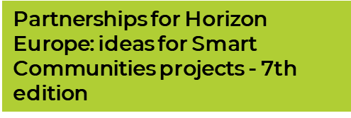

Cveta Dimitrova
cveta.dimitrova@aberon.bg
www.Aberon.bg

