Slide 1
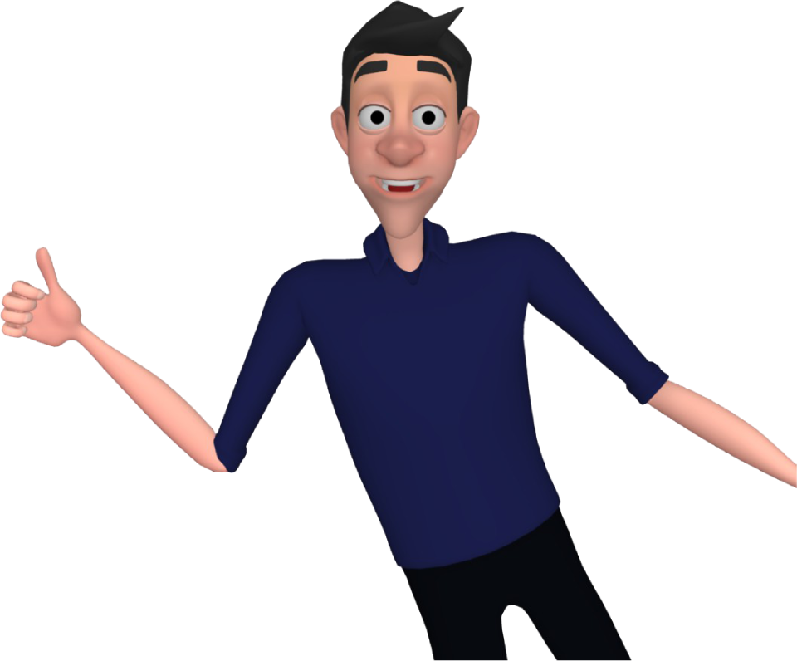
VLibras
Prof. Dr. Tiago Maritan
Prof. Dr. Guido Lemos
Prof. Dr. Rostand Costa
Federal University of Paraíba
Brazil
Innovative tech solutions enhancing sign language communication
21 February 2024 | 12:00 - 13:00
Notes:
Please add your notes here.
Title; First name, last name of speaker(s); Name of Organization, Name of Country, Name of Session (as written in Agenda)
#ZeroCon24
Day and Time of Session

Slide 2
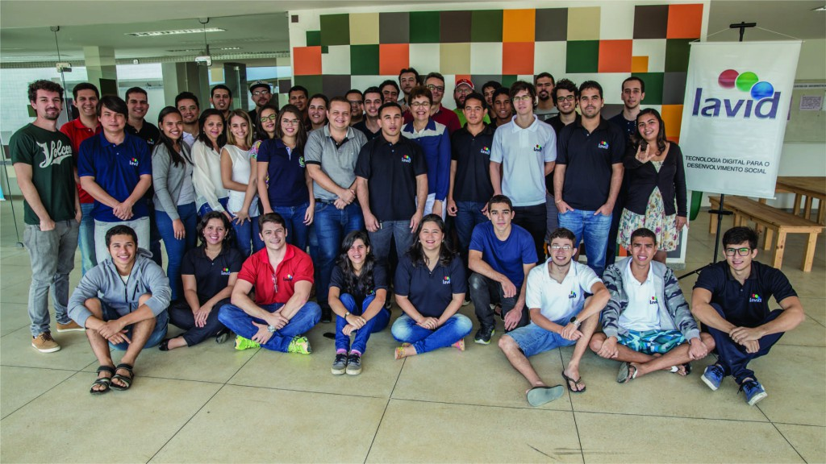
About Us
Digital Video Applications Lab - LAVID
Research Lab at Federal University of Paraiba (UFPB) - Brazil
Comprising 12 professors and 130 researchers/students in diverse fields such as Computer Science, Linguistics, Communication, Design, Education, etc.
Holds 11 patents and has incubated 10 start-ups with clients spanning Taiwan, China, Argentina, Chile, USA, Portugal and Madrid
Notes:
Sample Slide: presenting three points on our project and the relationship to this year’s theme of the Zero Project Conference. Point 1; Point 2; Point 3 connect together in this way.

Slide 3
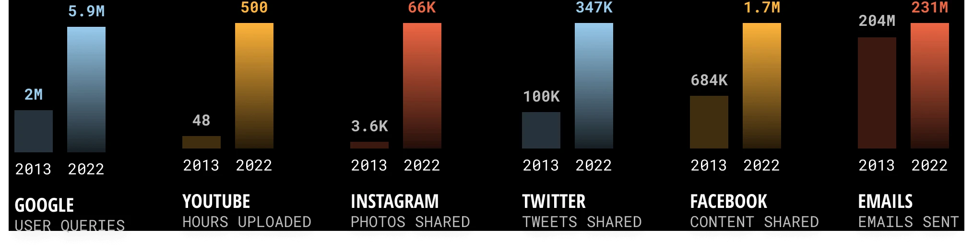
Motivation
Amount of information in the digital world is overwhelming!
How can we make all this information accessible to Deaf people?
  Human interpretation can only cover a small part of this content
Information per minute on some digital platforms!
Font: domo.com
Notes:
Sample Slide: presenting three points on our project and the relationship to this year’s theme of the Zero Project Conference. Point 1; Point 2; Point 3 connect together in this way.

Slide 4
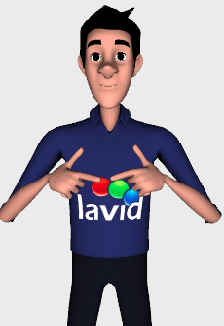


VLibras
Machine Translates Tool from Portuguese to Brazilian Sign Language
  An Open-source and free AI Tool
  Works as an additional layer of accessibility for Deaf individuals in ICTs
Notes:
Sample Slide: presenting three points on our project and the relationship to this year’s theme of the Zero Project Conference. Point 1; Point 2; Point 3 connect together in this way.

Slide 5
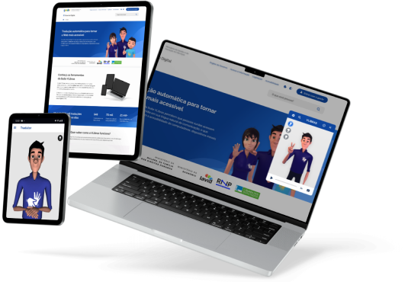
VLibras Suite
VLibras provides tools for websites, smartphones, VoD, TV and Cinema in the Brazilian context
Additionally:
Over 100k sentences for AI training
Over 22k signs - animated in 3D
Research started in 2009;
The products were launched in 2016 by the Brazilian Federal Government;
Notes:
Sample Slide: presenting three points on our project and the relationship to this year’s theme of the Zero Project Conference. Point 1; Point 2; Point 3 connect together in this way.

Slide 6
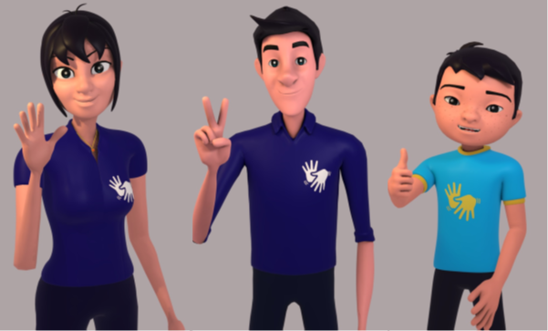
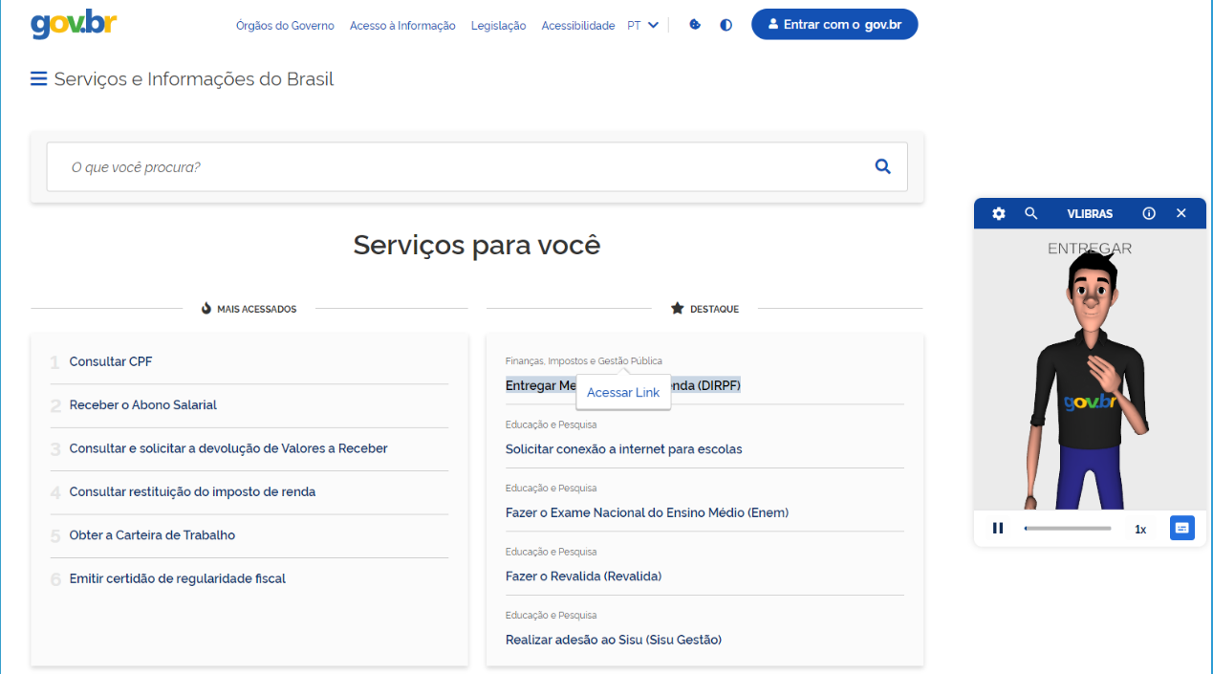
Use of VLibras
+ 30M of downloads daily;
(+1 billion of downloads monthly);
+ 3M of translations monthly
(+ 150M translations over time);
Installed on over 120K websites, including:
  Brazilian Federal Government
  Chamber of Deputies
  Federal Senate
  Superior Justice Tribunal
  Numerous websites of public institutions
  Numerous commercial websites
Notes:
Sample Slide: presenting three points on our project and the relationship to this year’s theme of the Zero Project Conference. Point 1; Point 2; Point 3 connect together in this way.

Slide 7
Our Plan for Scaling: The OpenSigns Concept
Machine Translation into other Sign Languages
  Reuse VLibras components to speedup the development
  Required funding and involvement of sign language experts
    Creation of a sign vocabulary and database in the target sign language
We need to develop sustainable strategies for the evolution and infrastructure financing of VLibras
  VLibras is funded by the Brazilian Federal Government and is subject to the risk of funding interruption when government change.
We are open to partnerships and collaborations
Notes:
Sample Slide: presenting three points on our project and the relationship to this year’s theme of the Zero Project Conference. Point 1; Point 2; Point 3 connect together in this way.

Slide 8
Acknowledgements
A special thanks to the Brazilian Federal Government (gov.br) for financing VLibras since 2014, enabling us to achieve these results.
I also extend my congratulations and express special thanks to the two VLibras enthusiasts present here::
Prof. Dr. Guido Lemos, founder of LAVID and pioneer of VLibras, and
Cesar Bonfim, VLibras representative in the Brazilian Federal Government
Notes:
Sample Slide: presenting three points on our project and the relationship to this year’s theme of the Zero Project Conference. Point 1; Point 2; Point 3 connect together in this way.

Slide 9
My Contacts
VLibras Contacts
LinkedIn: www.linkedin.com/in/tiago-maritan
E-mail: tiagomaritan@lavid.ufpb.br
Instagram: @vlibrasoficial
Facebook: facebook.com/vlibras
Website: vlibras.gov.br
Notes:
Sample Slide: presenting three points on our project and the relationship to this year’s theme of the Zero Project Conference. Point 1; Point 2; Point 3 connect together in this way.

