Slide 1
Diverse Minds, New Insights: (Student) Researchers with Disabilities
Kristie Patten, PhD, OT/L, FAOTA
New York University, United States
Diverse Minds, New Insights: Researchers with disabilities
Wednesday, March 5th, 2025
15:00 PM CET – 16:00 PM CET
Notes:
Please add your notes here.
Title; First name, last name of speaker(s); Name of Organization, Name of Country, Name of Session (as written in Agenda)
#ZeroCon24
Day and Time of Session

Slide 2


Nest Support Project
NYU
Nest
Metro Center
Notes:
Sample Slide: presenting three points on our project and the relationship to this year’s theme of the Zero Project Conference. Point 1; Point 2; Point 3 connect together in this way.

Slide 3
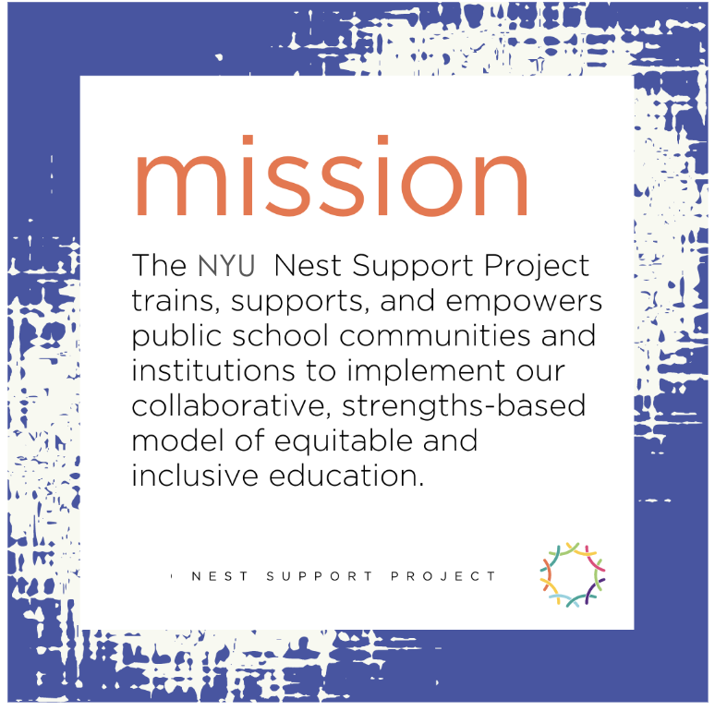
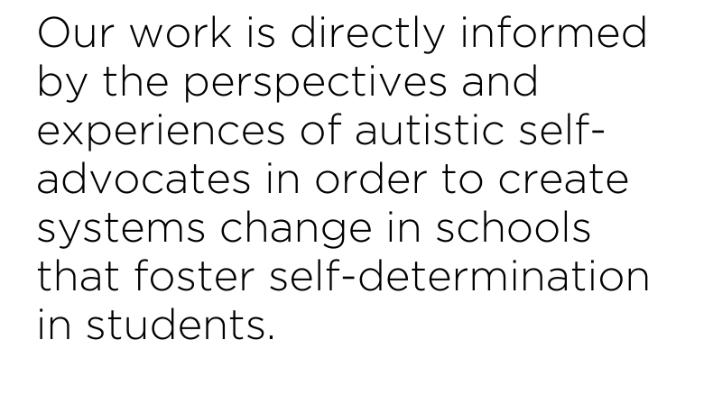
Mission of the NYU Nest
Notes:
Sample Slide: presenting three points on our project and the relationship to this year’s theme of the Zero Project Conference. Point 1; Point 2; Point 3 connect together in this way.

Slide 4
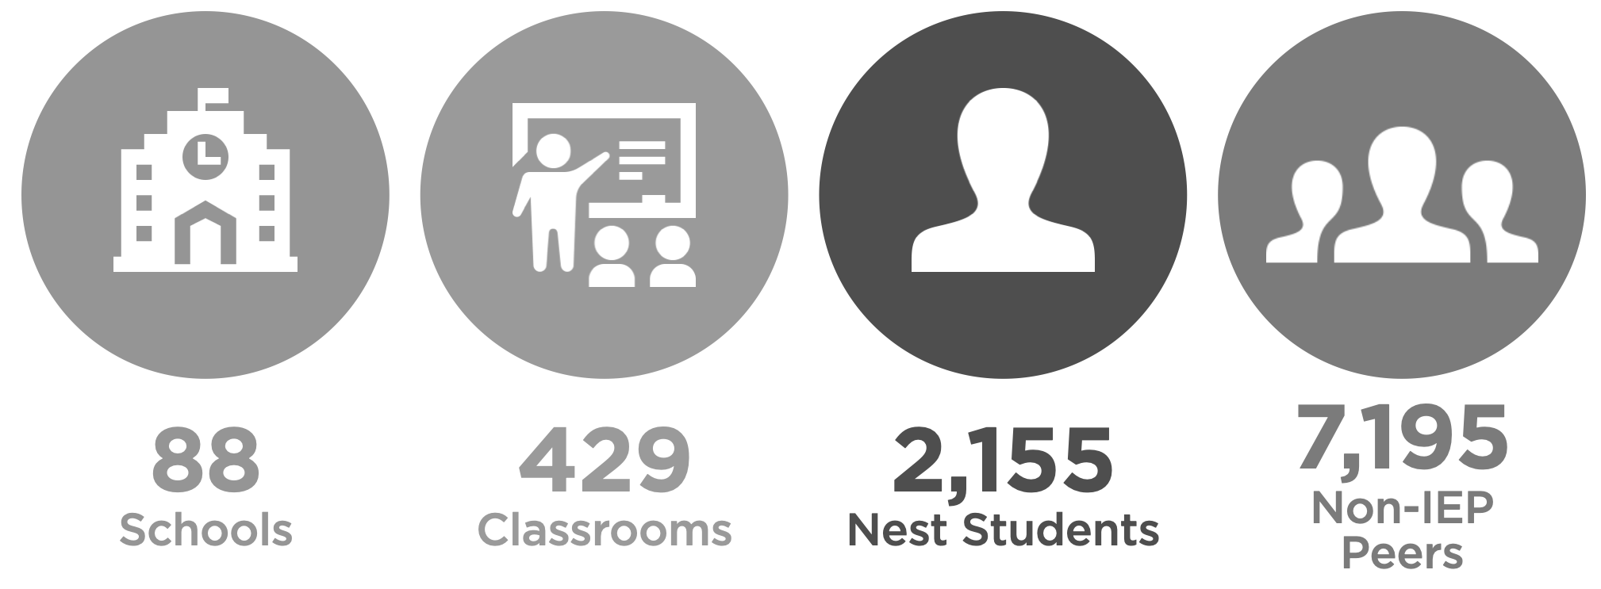
Nest by the Numbers 2024-25
Notes:
Sample Slide: presenting three points on our project and the relationship to this year’s theme of the Zero Project Conference. Point 1; Point 2; Point 3 connect together in this way.

Slide 5


Making Mentors
Title: Making Mentors: Empowering Autistic High School & College Students in STEM (NSF Award # 2241350)
Institutions: Education Development Center (EDC), New York University (NYU), City University of New York Staten Island (CUNY/SI)
Design: Co-designing mentorship with autistic high schoolers and STEAM undergraduates and graduate students in NYC
Duration: 3-year project
IDEAS: Inventing, Designing and Engineering on the Autism Spectrum (NSF Award # 1614436)
Developing Abilities and Knowledge for Careers in Design and Engineering for Students on the Autism Spectrum by Scaling Up Making Experiences (NSF Award # 1850289)
Notes:
Sample Slide: presenting three points on our project and the relationship to this year’s theme of the Zero Project Conference. Point 1; Point 2; Point 3 connect together in this way.

Slide 6
Rationale & Research Foundation
Increasing Need: More autistic students are entering college.
Transition Challenges: Autistic students face difficulties with self-advocacy, peer relationships, and confidence despite strong academics.
Mentorship Benefits: Research shows autistic students connect better with autistic mentors, leading to improved transitions.
Participatory Approach: The program is co-designed with autistic students to ensure it is effective, relevant, and empowering.
Notes:
Sample Slide: presenting three points on our project and the relationship to this year’s theme of the Zero Project Conference. Point 1; Point 2; Point 3 connect together in this way.

Slide 7
Yearly Breakdown
Year 1:
Mentees: 10 NYCPS high school students
Mentors: 5 NYU STEM students, 5 CUNY STEM students
Year 2:
Mentees: 20 NYCPS high school students
Mentors: 10 NYU STEM students, 10 CUNY STEM students
Year 3:
Expansion: 20 NYCPS students and 20 students (NYU/CUNY)
Notes:
Sample Slide: presenting three points on our project and the relationship to this year’s theme of the Zero Project Conference. Point 1; Point 2; Point 3 connect together in this way.

Slide 8
Program Goals & Purpose
Mentorship Model: Support the transition from high school STEM interests to college majors and careers.
Maker Programs: Mentors work on shared STEM projects with mentees.
Guidance: Provide tailored advice on college applications, coursework, and extracurricular activities.
Self-Advocacy: Equip students with self-advocacy skills.
Toolkit Creation: Co-develop a digital toolkit to replicate the program.
Notes:
Sample Slide: presenting three points on our project and the relationship to this year’s theme of the Zero Project Conference. Point 1; Point 2; Point 3 connect together in this way.

Slide 9
Key Program Components
Near-Peer Mentoring: Autistic college students mentor high schoolers in STEM fields
Project-Based Engagement: Mentors guide mentees through maker projects, connecting them STEM fields.
College & Industry Exposure: Organize school visits, and meet faculty.
Mentor Development: Mentors develop leadership, research, presentation and community-building skills.
Digital Resources: Co-create websites, and guides for future programs.
Notes:
Sample Slide: presenting three points on our project and the relationship to this year’s theme of the Zero Project Conference. Point 1; Point 2; Point 3 connect together in this way.

Slide 10
Presentations/Conferences
1. Perspectives from an Autistic-to-Autistic Mentorship Program: A Journey of Shared Experiences🗓️October 18, 2023 |🏛️College Autism Summit, Nashville,TN
2. "What Double Empathy Problem?" Exploring Self-Advocacy in an Interest-Based Autistic-to-Autistic Peer Mentorship Program🗓️2024 |🏛️American Occupational Therapy Foundation (AOTF)
3. Facilitation of Self-Advocacy in an Autistic-to-Autistic Peer Mentorship Program: A Pilot Study of Stakeholder Perspectives🗓️2024 |🏛️International Society for Autism Research (INSAR)
4. Autistic Peer Mentorship: Unveiling Transformative Potential, Fostering Mental Health Resilience in the Autistic Community🗓️2024 |🏛️OT Summit 2024
5. Making a Mentorship Program Where Autistic College Students Mentor Autistic High School Students Increasingly Participatory (Poster Presentation)🗓️2025 |🏛️ International Society for Autism Research (INSAR)
Notes:
Sample Slide: presenting three points on our project and the relationship to this year’s theme of the Zero Project Conference. Point 1; Point 2; Point 3 connect together in this way.

