Slide 1
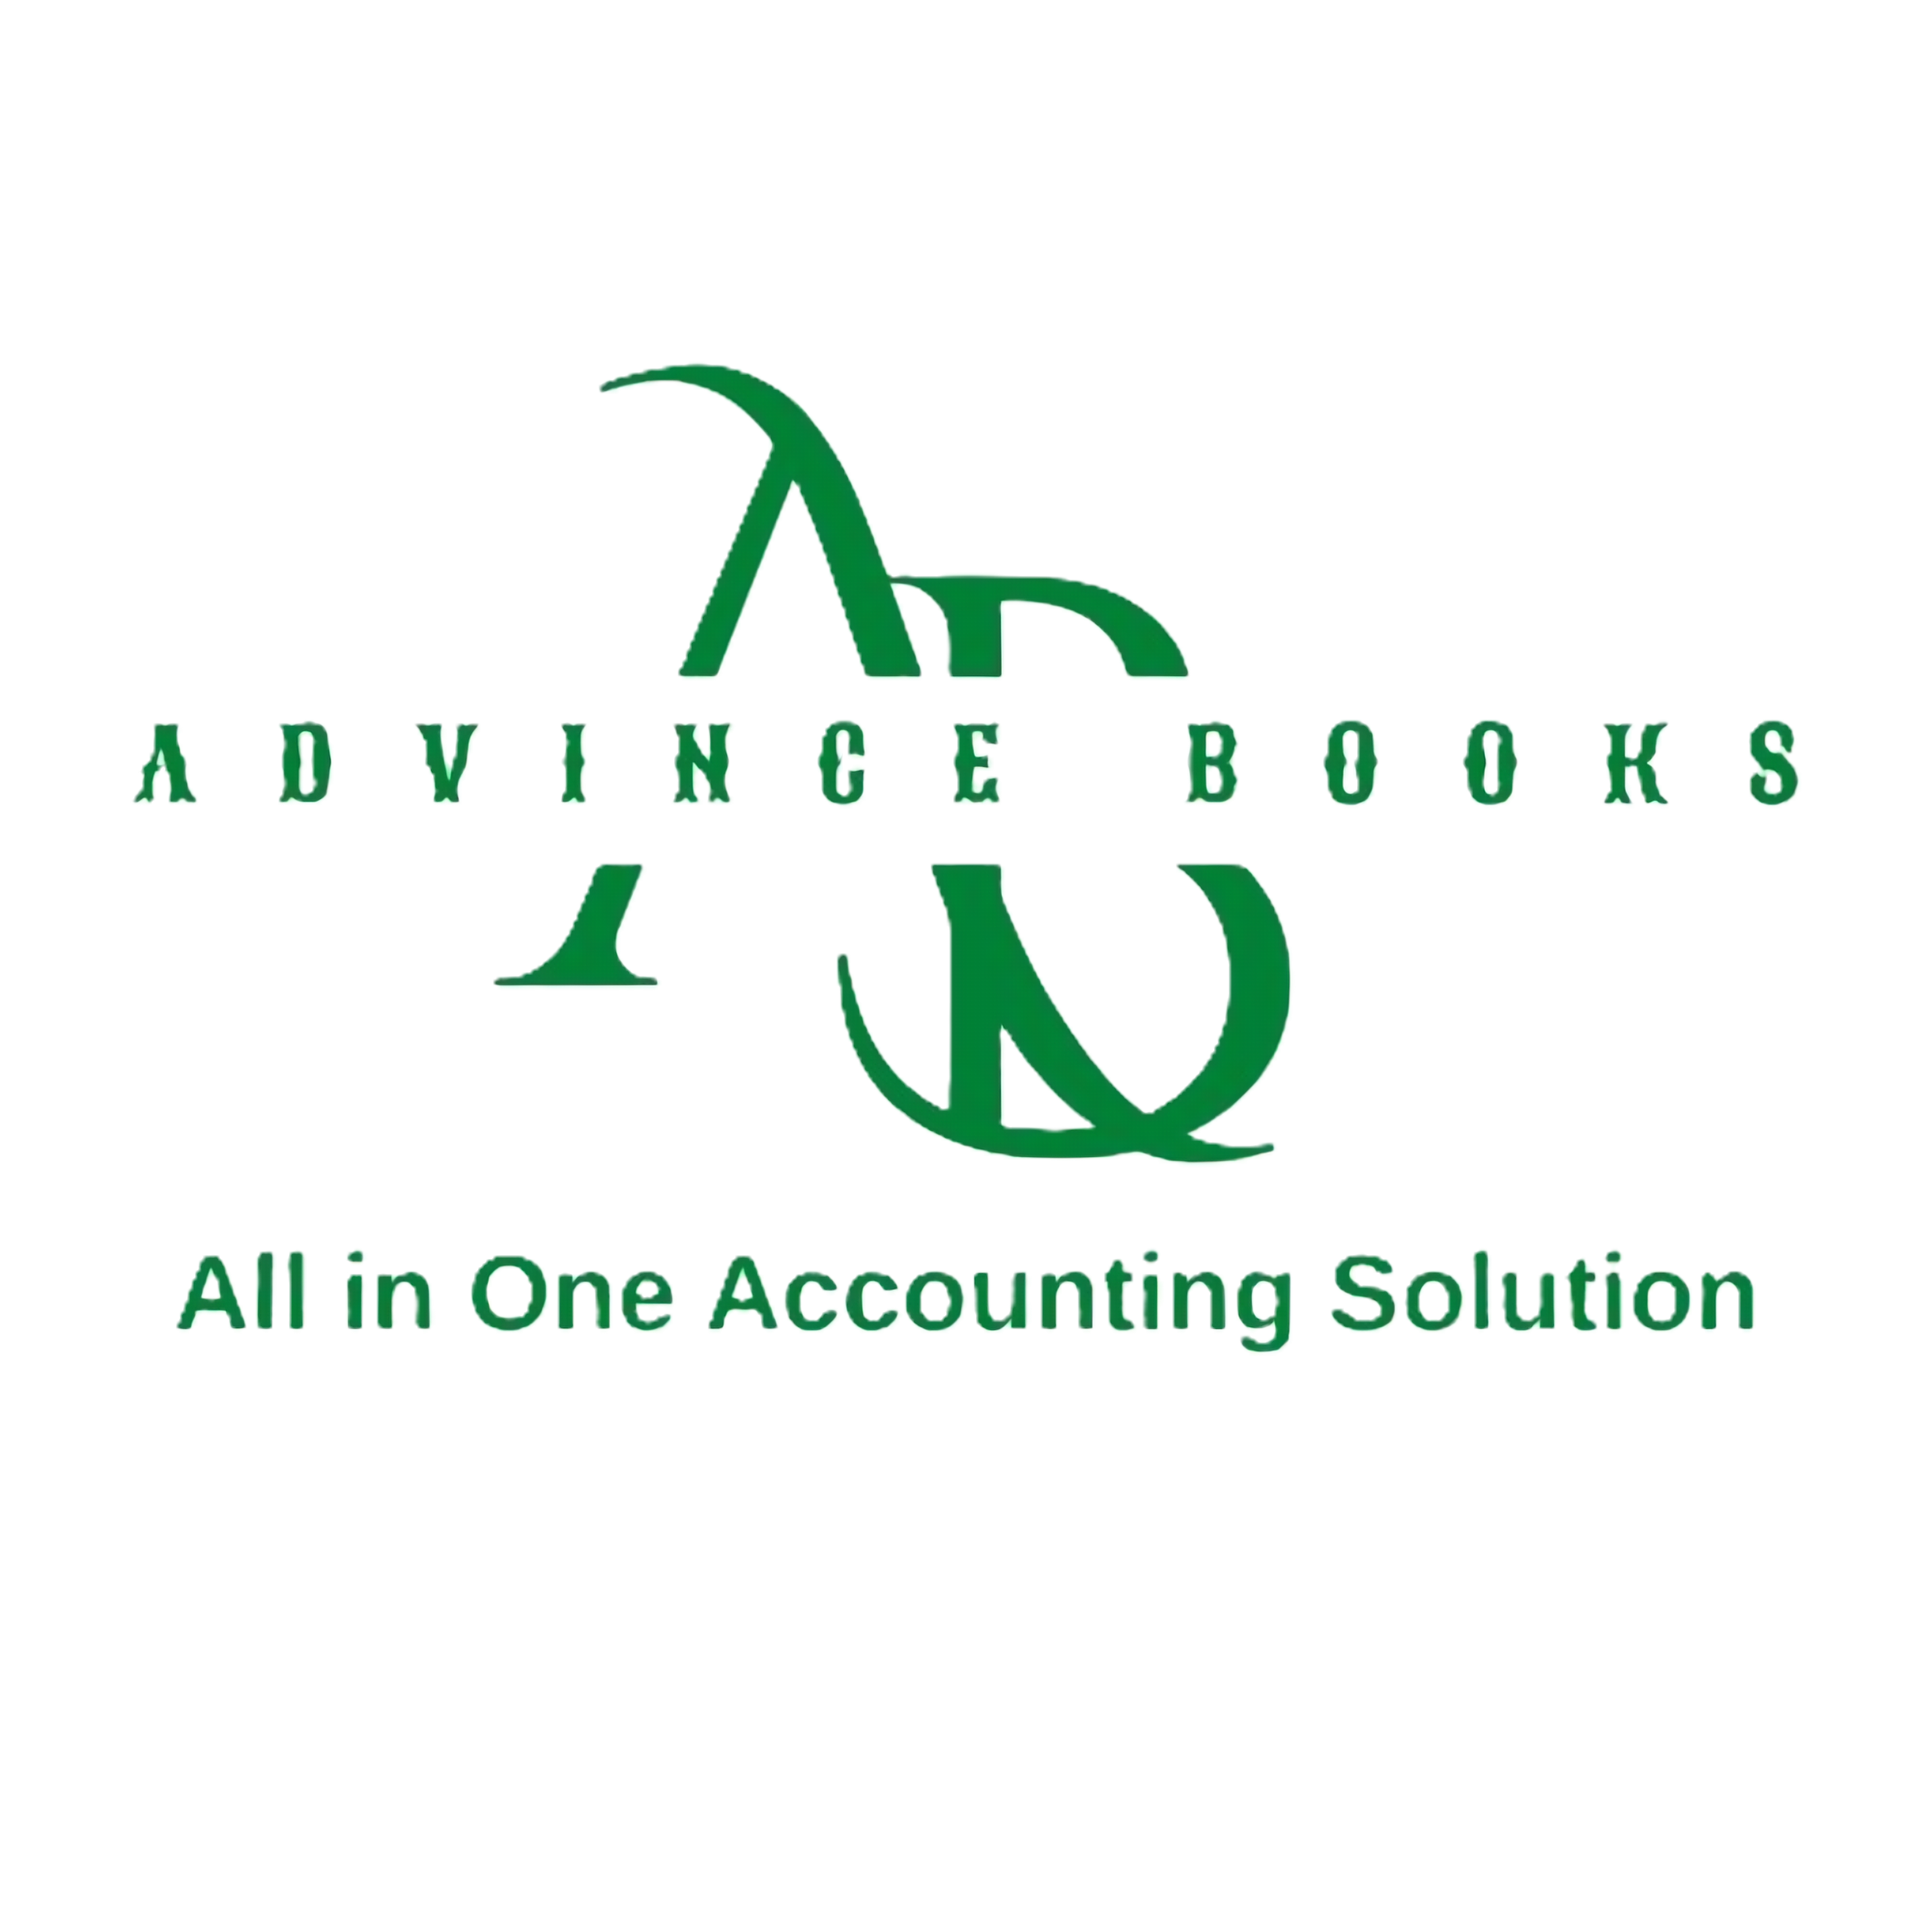

ADVINCE BOOKS
Cross-border accounting software + CA/CPA services, in one platform.
Ashutosh Kar · Founder & CEO · CA (India) · CPA (USA) · advincebooks.com

Slide 2


One platform. Software + practitioners.
Advince Books pairs a proprietary SaaS accounting platform with hands-on CA/CPA delivery
The accounting stack for cross-border founders
Advince Books is not another bookkeeping tool. It is a multi-entity platform designed around how cross-border businesses actually operate with qualified CAs and CPAs behind every workflow.
Software handles the system of record. Our practitioners handle judgement — filings, structuring, tax positions inside the same platform.
SaaS Platform — Advince Books
Multi-entity ledgers, AI Financial Health Score, financial modelling and investor-ready reporting in one login.
+
Professional Services — Advince CPA & Advince LLP
US and India compliance, GST, business setup, international taxation and advisory — delivered by the team that built the software.
3

Slide 3



The product
Four modules founders otherwise buy from four different vendors
AI Financial Health Score
Multi-Entity Management
A real-time, AI-driven score of business financial health — cash, compliance, ratios — so founders see problems before their investors do.
India entity, US entity, German subsidiary — consolidated dashboards and entity-level books in a single login.
Financial Modelling
Pitch Deck Module
Projections, scenarios and valuation-ready models built on live accounting data, not stale spreadsheets.
Investor-ready financial slides generated straight from the books — numbers that always match diligence.
4

Slide 4
A large market, growing fastest in our corridors
TAM · ~$20B+
Global accounting software
$12.4B
projected cloud accounting market by 2033 — more than doubling from 2025
SAM · ~$5.6B
Cloud accounting for SMEs (2025)
~9% CAGR
India (~8.9%) and Germany (~9.2%) are among the fastest-growing accounting software markets, 2025–35
SOM
$5–50M
3-yr beachhead
61%
of cloud accounting users are SMEs — exactly the segment we serve
SOM framed bottom-up: reachable cross-border entities × conversion × blended ACV (software + services).
5

Slide 5
Business model
Two reinforcing revenue streams with one acquisition cost
The flywheel
Software clients convert to services. Services clients adopt the software. Blended ACV grows while acquisition cost stays flat.
SaaS Subscriptions
Professional Services
Recurring · high margin
High-trust · high ACV
Tiered plans by entities & users
Annual contracts, predictable ARR
AI features drive plan upgrades
Compliance, tax & advisory retainers
Business setup & structuring mandates
Delivered by in-house CAs / CPAs
One client, two revenue lines
Pricing: subscription plans plus custom all-in-one plans combining software and services.
6

Slide 6
Why we win
Point solutions digitise a task. We own the cross-border finance function.
 | Advince Books | Inkle | Commenda | Generic tools (QuickBooks / Zoho)
Built & run by CAs / CPAs | ● | — | — | —
Software + in-house services | ● | ◐ | ◐ | —
India–US and India–Germany corridors | ● | ◐ | ◐ | —
Multi-entity consolidation | ● | ◐ | — | ◐
Founder tools (modelling, pitch deck, health score) | ● | — | — | —
● Full ◐ Partial — Not offered
7

Slide 7



Go-to-market
Corridor by corridor — deep in each before expanding to the next
LIVE
ACTIVE
NEXT
India–US
India–Germany
Australia & New Zealand
Core corridor: Advince CPA + Advince LLP serving startups & MSMEs with US–India structures. Newsletter: The India–US Ledger.
GIIC network, Asia Berlin and German-Indian summits; TaxBridge dual-country tax estimator as the demo wedge for NRIs and founders.
Staged, cost-minimised market entry currently in evaluation with a venture-studio partner.
Acquisition channels
LinkedIn content engine across all three Advince entities
Ecosystem events & delegations (GIIC, India Gateway 2026)
Founder consulting funnel via Topmate & newsletter
8

Slide 8

Founder & team
The Advince group
Ashutosh Kar
Advince Books
Founder & CEO
Proprietary SaaS accounting platform
Chartered Accountant (India) · CPA (USA) · Corporate Lawyer
Cross-border practitioner across India–US and India–Germany structures
Active in the German Indian Innovation Corridor (GIIC) network
Advince CPA
US-focused professional services
Advince LLP (India)
India compliance & advisory
11

