Slide 1




Deliverable 3
Team [your Team‘s name]
Make sure your Team’s Deliverable is uploaded HERE before the deadline!
Deadline: October 29th, 2025 (10:00 AM)

Slide 2

Project description
Step 1 Value Proposition
What is the problem you are solving?
What is your solution and what is you key differentiator (USP)?
Step 2 Product / Innovation
Determine your goals
What is your key innovation? Can you protect it? Do you have IP (copyrights, patents, etc.)?
Tell us about your current TRL and tech scalability

Slide 3
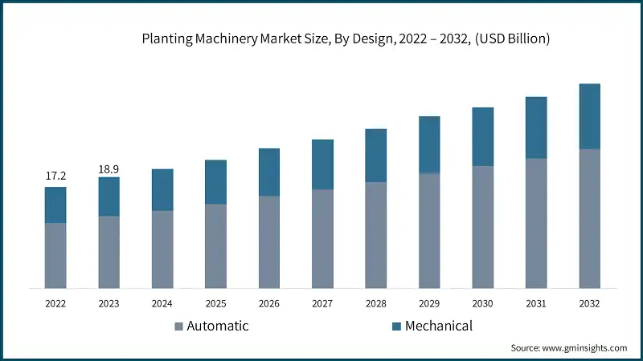

Step 3 Competition
What is the competitive landscape for your product / solution?
Step 4 Market size
How big Is the market (also addressable market)?
Step 5 Business model
What is your envisioned business model (how do you expect to generate revenue/profit)?
Step 6 Go to Market
Who are your targeted / potential customers? Give specific examples (companies etc.) if possible
Roadmap to access target customer-

Slide 4

Step 7 Market Validation & Traction so far
What are your key achievements so far?
Do you have any indicators of product-market-fit (f.e. Prizes, MOUs, pilots, increase in TRL, feedback from customers etc)?
Step 8 Team
Competencies in the team and complementarity
Plans to grow the team (if relevant)
Step 9 Prize Impact
Share the idea on how prize will can be catalytic for development of the idea and successful exploitation of the market opportunity

Slide 5
Criteria | Explanation
1.Problem solution fit | The proposed solution is distinctive, innovative and can effectively tackle a well-defined/identified problem.
2.Business model | The business model articulates a clear route to market, is scalable and realistic.
3.Prize impact | The prize will be catalytic for development of the idea and successful exploitation of the market opportunity.
4.Team and TeamUp journey | The team has the necessary skills, expertise and experiences to exploit the identified market opportunity. The team developed successfully during the programme. They are fully aware of their strengths, weaknesses and roles.
5.Impact on the food system | The innovation has big potential to improve Europe’s food system and deliver social, environmental and economic impact.

Slide 6

Make sure your Team’s Deliverable is uploaded HERE before the deadline!

